Slide 1
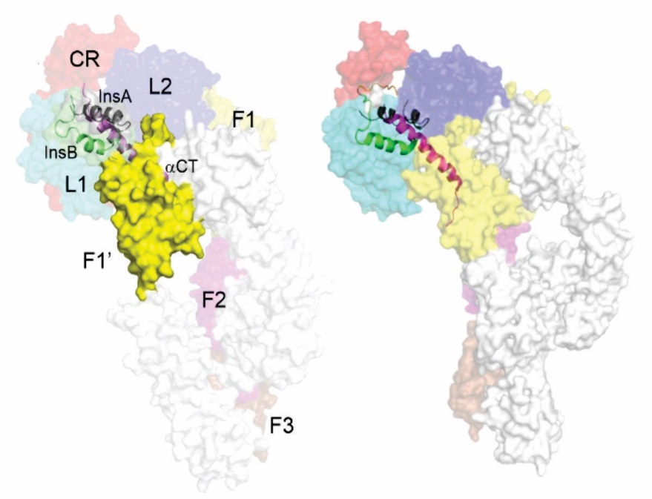
Multiscale Computational Protocol for Atomistic Understanding and Modulation of Insulin Binding to Insulin Receptor
Yevgen Yurenko
Institute of Organic Chemistry and Biochemistry, Czech Academy of Sciences
(Prof. Pavel Hobza Group)
ENBIK conference, June 2022
European Regional Development Fund (OP RDE), Project: "Chemical biology for drugging undruggable targets
(ChemBioDrug; CZ.02.1.01/0.0/0.0/16_019/0000729)", by the Ministry of Education, Youth and Sports of the Czech Republic

Slide 2
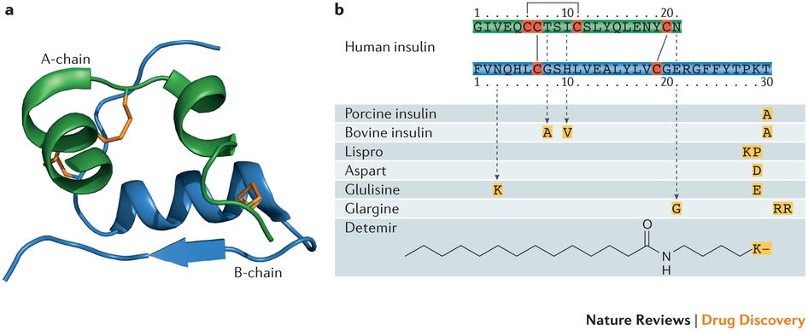
Motivation
Treatment of diabetes → insulin analogs.
Design via understanding of insulin-IR binding mechanisms, and energetics;

Slide 3
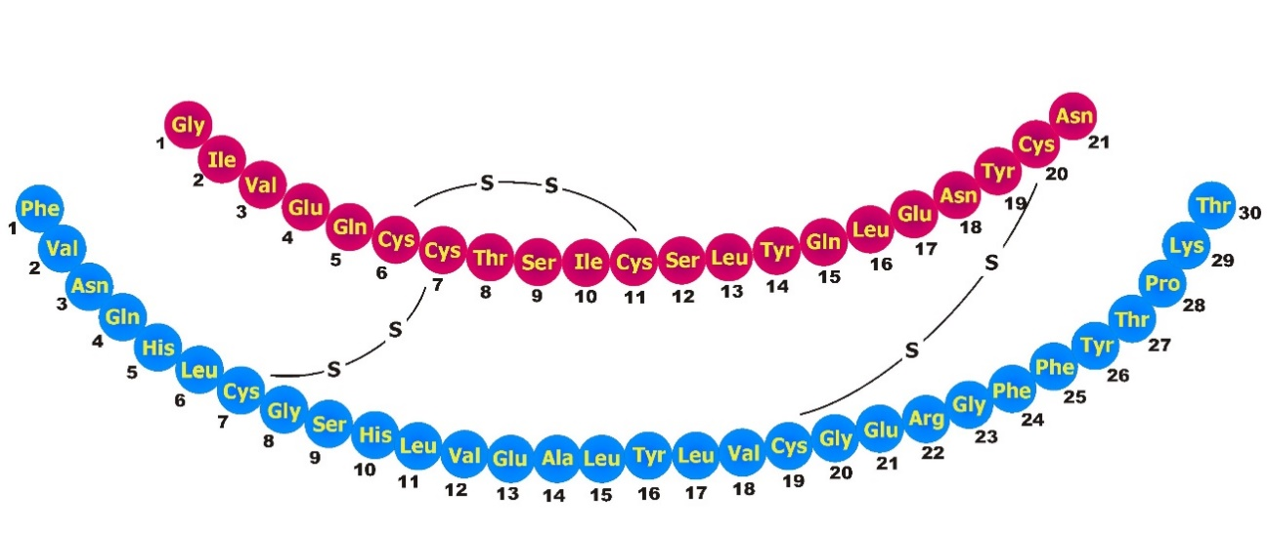
Background
Insulin is a key protein hormone regulating human metabolism;
It is a globular peptide (51 residues) composed of two chains - A (21 residues) and B (30 residues)
Insulin binds to insulin receptor (IR) → metabolic growth and signalling

Slide 4
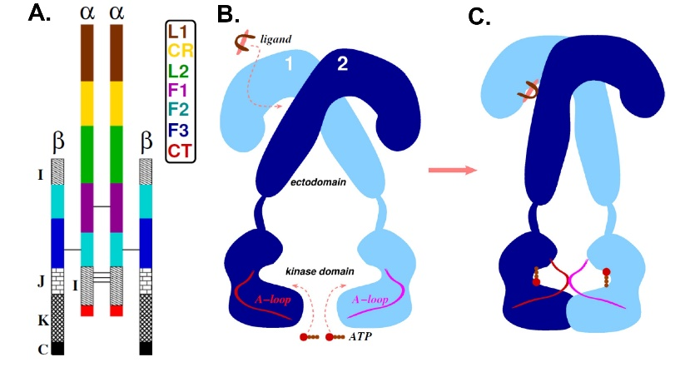
Schematic representation of IR and its domains

Slide 5
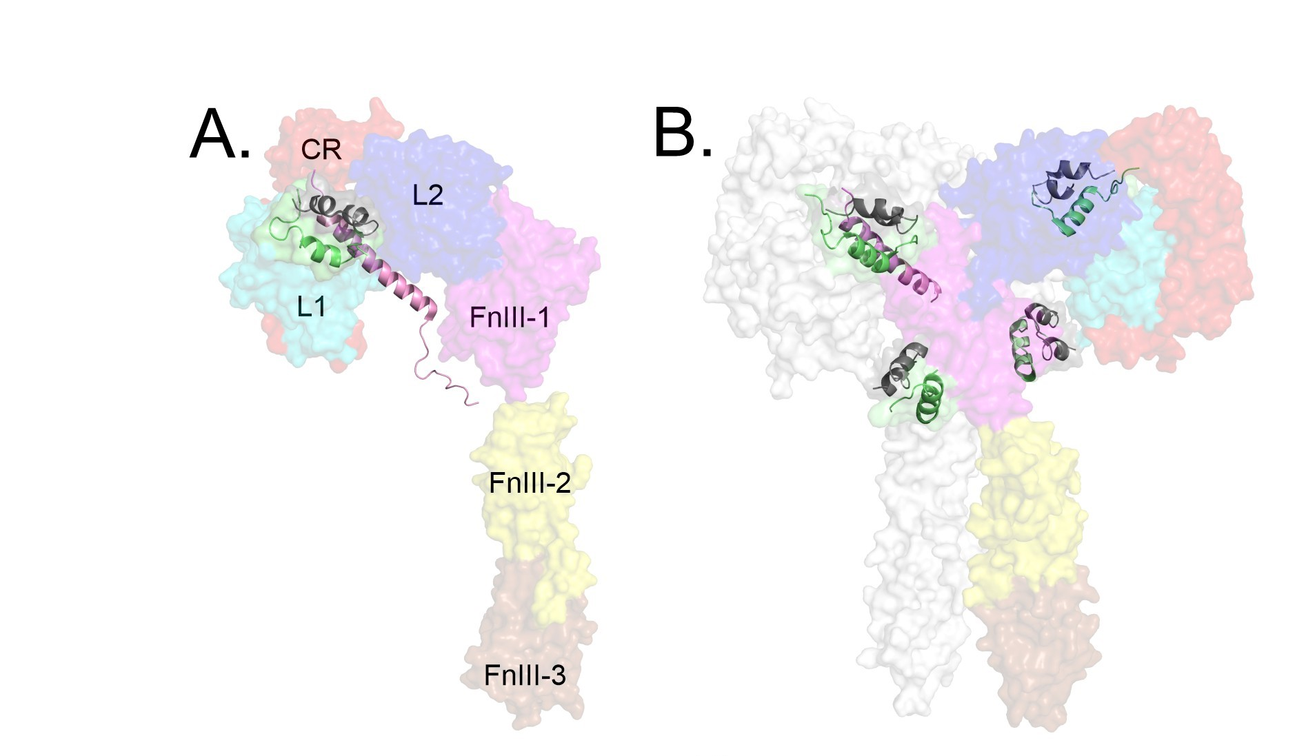
Insulin-IR complexes
Scapin et al., Nature, 2018, 556, 122 Uchikawa et al., 2019, doi: 10.7554/eLife.48630

Slide 6
Aims
Develop hierarchical computational protocol applicable insulin-IR system;
Detect the major non-covalent forces at the insulin-IR interface;
Determine the interaction “hotspots” within the insulin and IR;
Evaluate the performance of various computational approaches (MM, SQM, DFT-D3) in describing large flexible protein-protein systems

Slide 7
Computational methods
Molecular mechanics/dynamics (MM/MD)
Quantum mechanics (QM)
Virtual glycine scan (VGS)

Slide 8
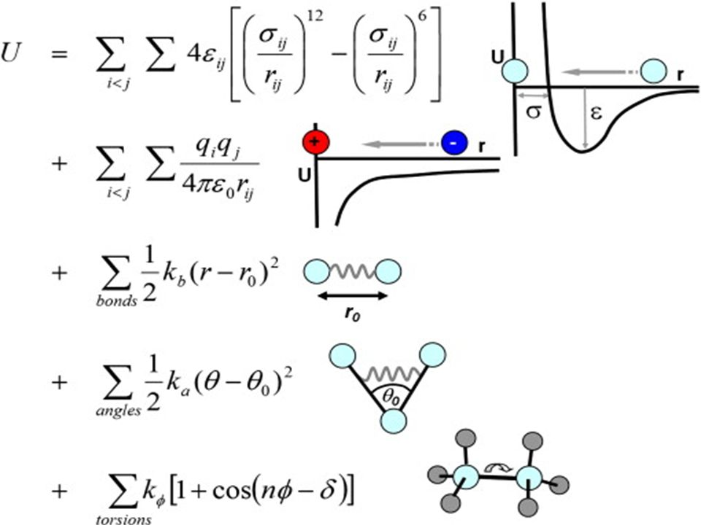
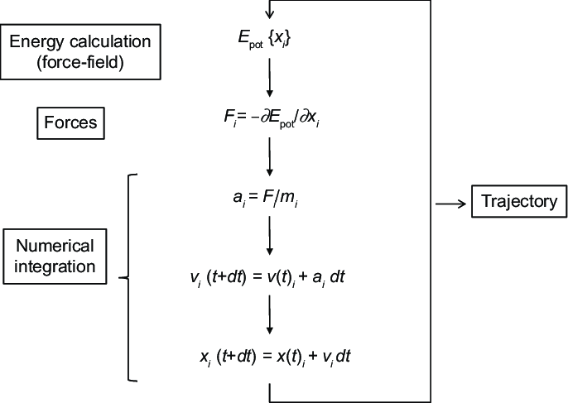
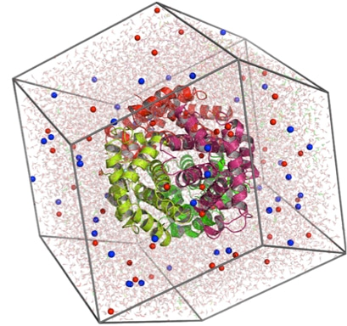
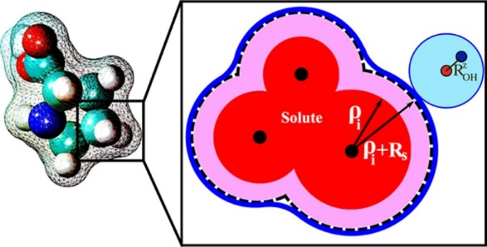
Molecular mechanics (MM) and molecular dynamics (MD)
Explicit solvation
Generalized Born model

Slide 9
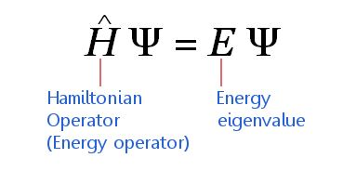
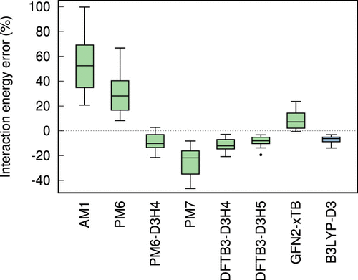
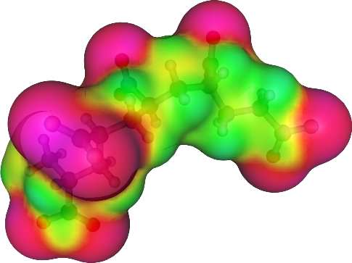
Quantum mechanical (QM) methods
Semi-empirical (SQM) PM6-D3H4
DFT-D3
D3 – correction for dispersion, H4 – for H-bonding
COSMO solvation
J. Chem. Inf. Model. 2020, 60, 3, 1453
Non-covalent interaction Atlas http://www.nciatlas.org/

Slide 10
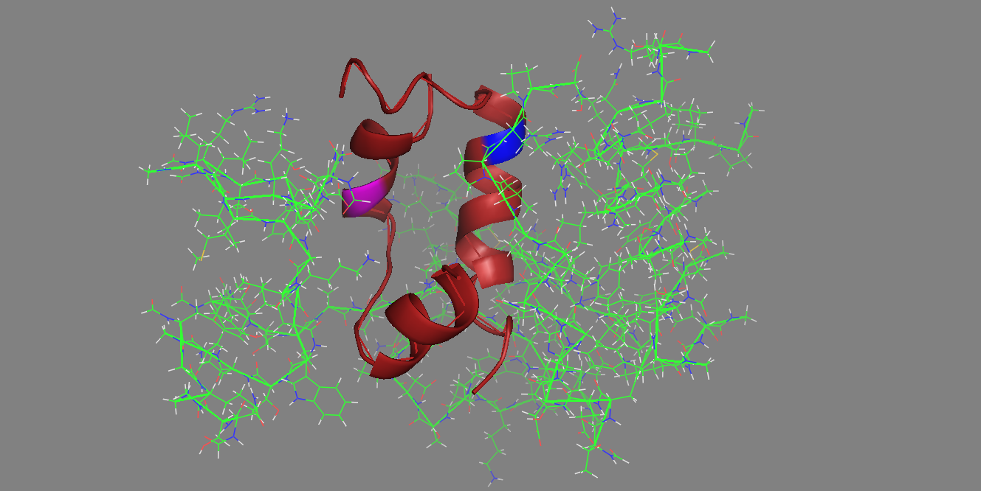
Virtual Glycine Scan (VGS)
Simple but powerful approach that allows to track the contribution of
each residue (from Ins or IR side) to the binding free energy;
Contribution of individual side chains to interaction
ΔΔG_{int} = -[ΔG_{int} (WT) – ΔG_{int} (Gly)]
Automated procedure for identification of interaction hotspots
Pecina et al., J. Phys. Chem. B (2013) 117, 16096
GLU→GLY
Honda et al., Eur. J. Org. Chem. (2018), 37, 5203

Slide 11
Results

Slide 12
Advanced hierarchical computational protocol
Remodeling of experimental 3D structures, adding missing loops
Enhanced sampling MD simulations
Snapshot selection, fragmentation, geometry optimization
Virtual glycine scan (VGS)
Verification of computational protocol: comparing to experimental data

Slide 13
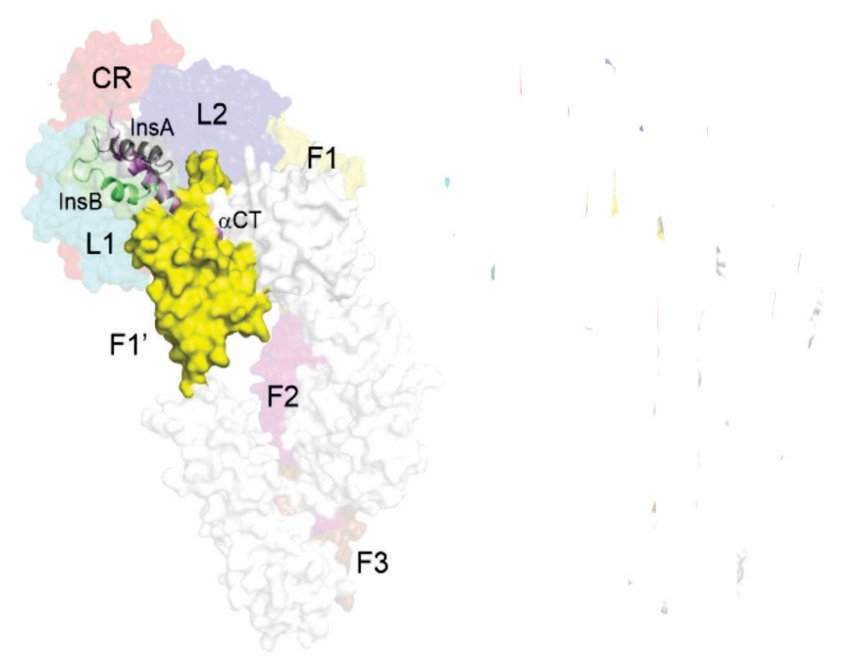
Molecular dynamics and H-bonding analysis
Location at Insulin//IR interface | Insulin residue | IR residue | H-bond type | Evidence in PDB structure (ID: 6HN5) | Evidence in remodeled and minimized structure | Evidence in virtual glycine scan | MD occupancies, %
 |  |  |  |  |  |  | Trajectories
 |  |  |  |  |  |  | traj-1 | traj-2 | traj-3
Well-established hydrogen bonds
A chain helix 1 // αCT’ | VAL A3 | ASN 711 | NH…O | yes | yes | yes | 19.5 | 15.5 | 25.3
A chain helix 2 // αCT’ | ASN A18 | ARG 717 | OH…N | yes | yes | no | 75.3 | 79.9 | 76.5
B chain α helix // L1/FnIII-1’ loop | SER B9 | ARG 65 | OH…N | yes | yes | yes | 70.0 | 66.1 | 62.3
 | GLU B13 | ARG 65 | OH…N | yes | no | yes | 53.7 | 58.1 | 80.1
B chain C-terminus // L1/CR | GLU B21 | LYS 40 | OH…N | yes | yes | yes | 50.1 | 14.1 | no
 | PHE B24 | ASN 15 | NH…O | yes | yes | yes | 70.5 | 73.3 | 66.8
Binding site includes L1, CR, L2, FnIII-1’, cross-linking between Sites 1a and 1b

Slide 14
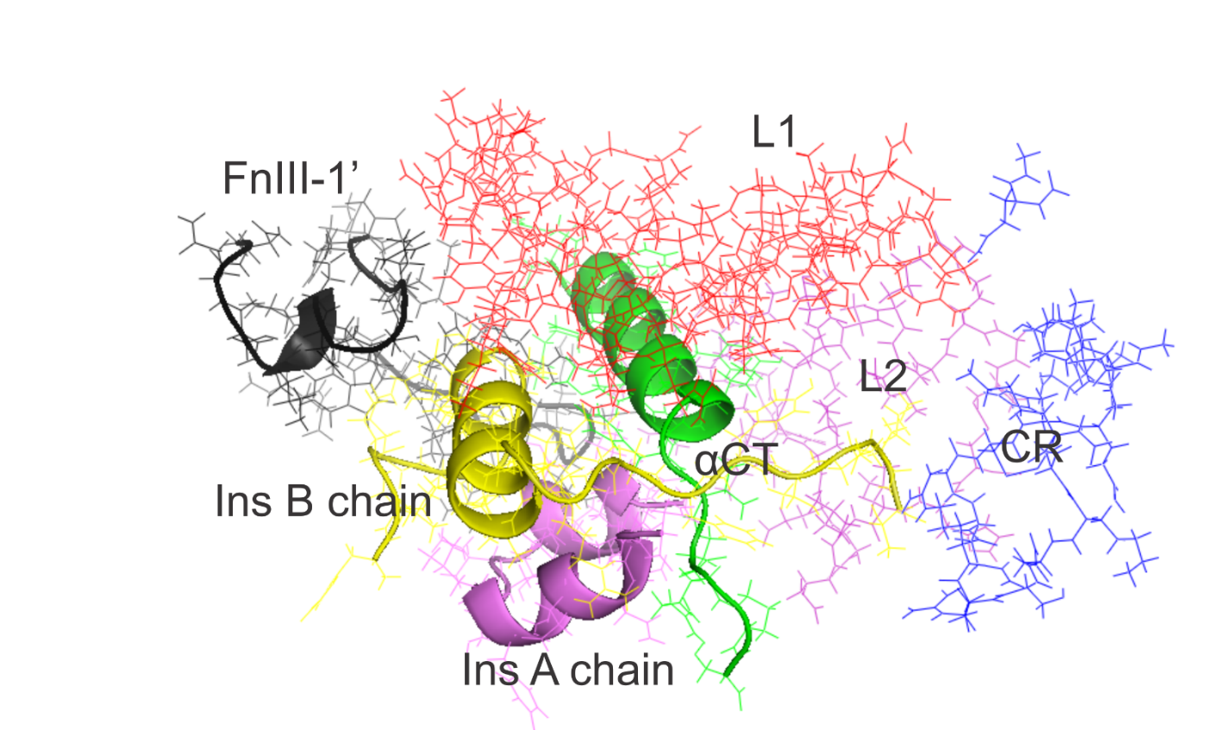
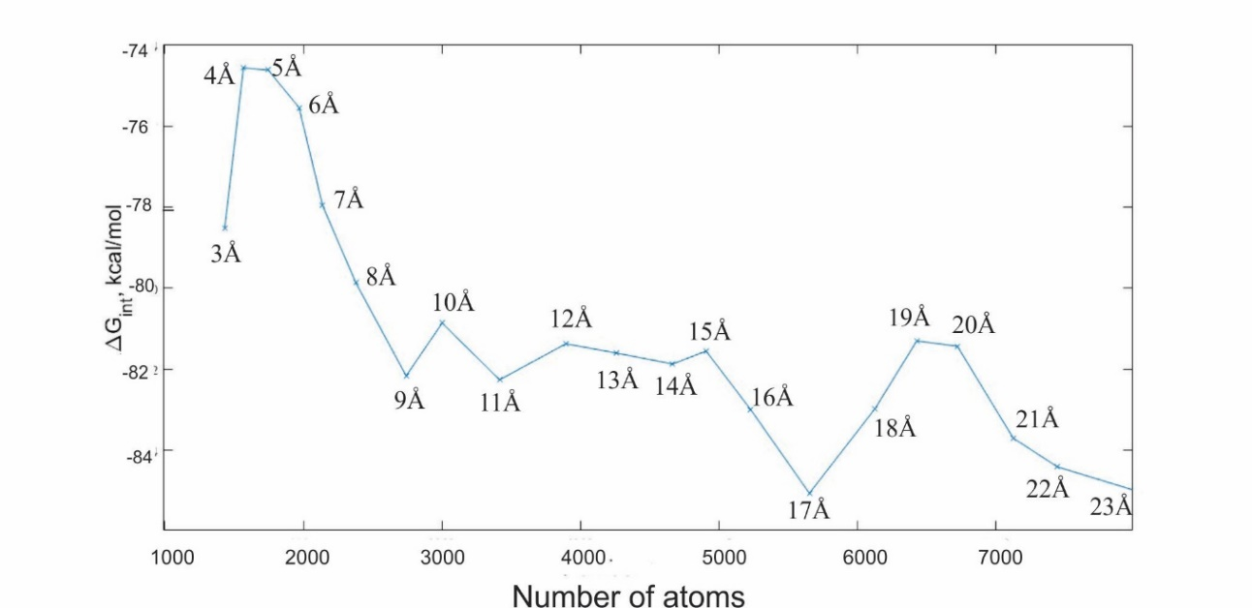
Fragmentation, snapshot selection
Ins/IR interaction energy and system size vs. fragmentation distance
11Å-fragmented model

Slide 15
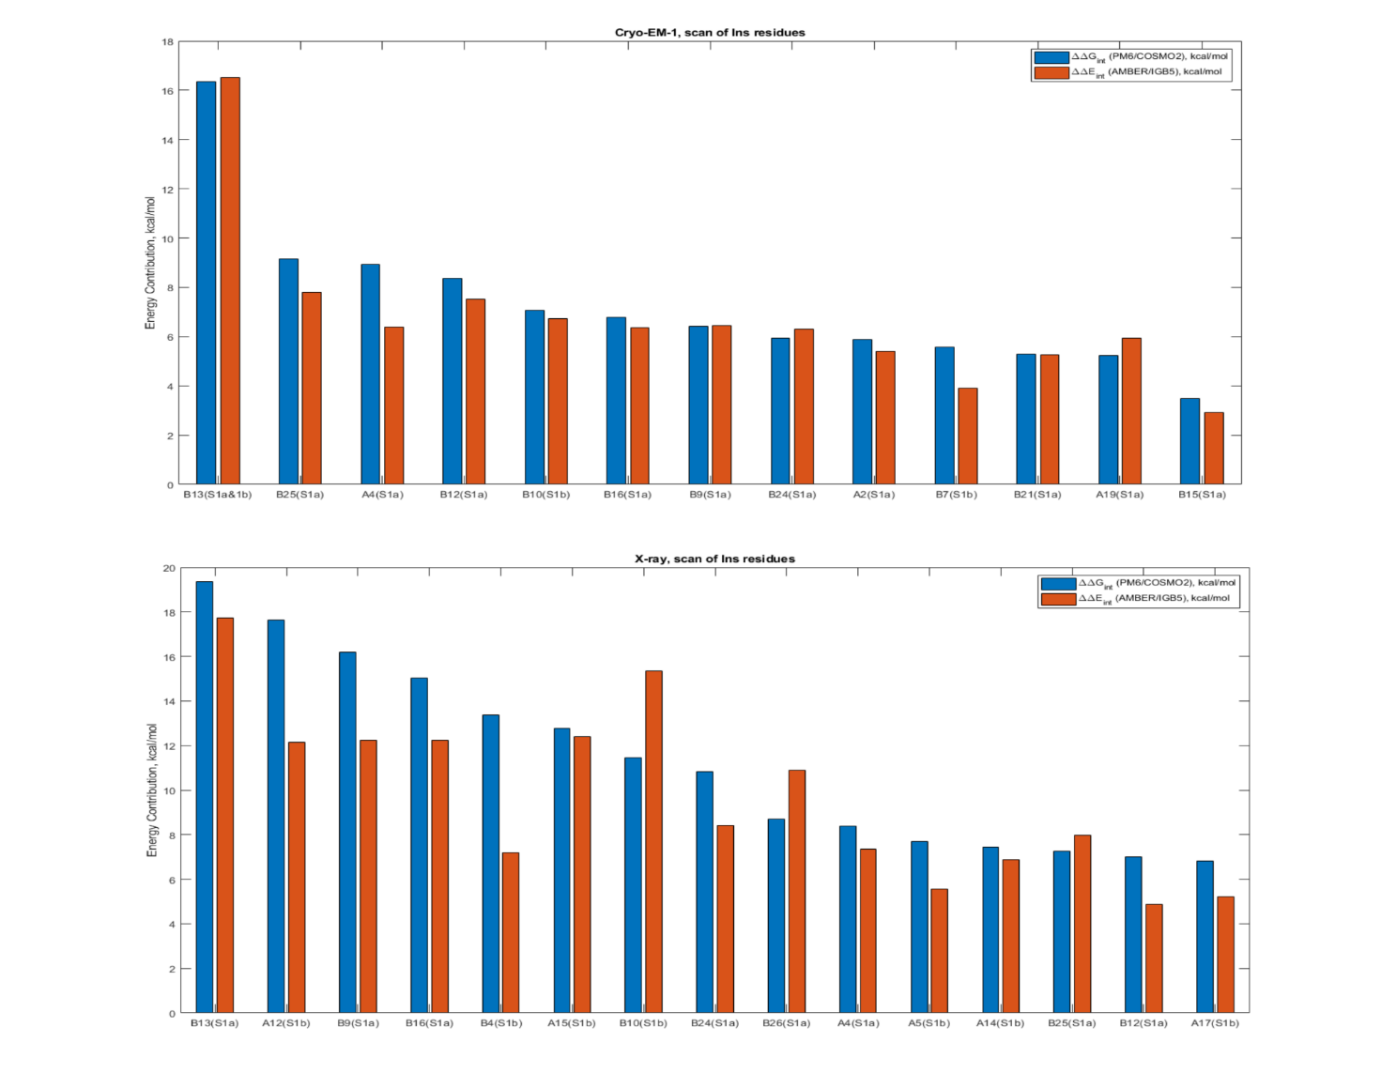
VGS: interaction “hotspots” and their energy contributions

Slide 16
VGS: computational vs. experimental data
Site | Residue | Residue location within the A or B chain | Evidence in experimental structures | Soluble receptor affinity of the Ala mutant (%Hi) | Cell receptor affinity of the Ala mutant (%Hi)
1a | Ile A2 | N-terminal α-helix | Yes | - | 0.6
 | Glu A4 | N-terminal α-helix | Yes | 139 | 142
 | Tyr A19 | С-terminal segment | Yes | 0 | <0.1
 | Val B12 | Central α-helix | Yes | - | 1
 | Tyr B16 | Central α-helix | Yes | 69 | 34
 | Phe B24 | C-terminal β-strand | Yes | - | 5
 | Phe B25 | C-terminal β-strand | Yes | - | 10
1b | Cys B7 | type II β-turn | Yes | - | -
 | Glu B13 | Central α-helix | Yes | 12 | 10

Slide 17
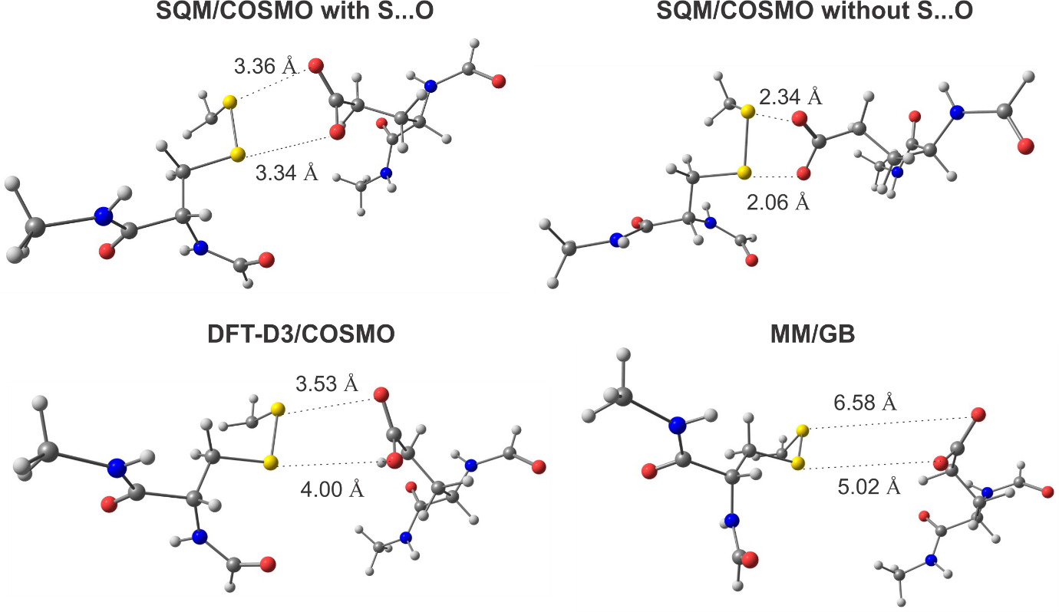
Importance of corrections for S…O close contacts

Slide 18
Interaction energy for various types of non-covalent interactions in DFT-D3 optimized dimers
Ins or IR residue | Interaction partner residue | Interaction
 |  |  | DFT-D3 | PM6-D3H4 /COSMO | AMBER/IGB5
Glu A4 | Asn 920 (αCT) | NH…O | -20.0 | -21.0 | -15.2
His B10 | Ser 827 (FnIII-1’) | NH…O | -11.7 | -10.0 | -8.5
Glu B13 | Arg 65 (L1) | NH…O, salt bridge | -98.3 | -92.8 | -83.9
Glu B13 | Arg 826 (FnIII-1’) | electrostatic and NH…O, salt bridge | -102.9 | -101.5 | -92.5
Glu B13 | Ser 827 (FnIII-1’) | OH…O | -22.5 | -21.8 | -23.0
Leu B15 | Phe 923 (FnIII-1’) | CH…π | -2.9 | -2.8 | -2.5
Tyr B16 | Phe 39 (L1) | Stacking | -6.8 | -6.1 | -5.8
Phe B24 | Asn 15 (L1) | NH…O | -8.2 | -7.9 | -6.0
Phe B25 | Arg 14 (L1) | NH…O, electrostatic | -23.6 | -24.1 | -18.7
Glu 287 (CR) | Cys 333 (L2) | S…O, electrostatic | -2.0 | -1.4 | +5.0
Gly 463 (L2) | Cys 468 (L2) | S…O | -12.6 | -13.8 | -13.4
MM failure

Slide 19
Conclusions and outlook
The proposed advanced state-of-the-art hierarchical computational protocol is efficient for reliable mapping of “hotspot” residues at the Ins/ IR interface
The computational protocol and the VGS scan procedure can be used for performing the modifications that lead to specific insulin and IR mimetics with desired properties
The protocol for in silico design of efficient insulin analogues with higher potency
We expect it is general enough and applicable to other protein-protein systems.

Slide 20
Acknowledgments
Martin Lepšík
Pavel Hobza
Michaela Černeková
Anja Muzdalo
Adam Pecina
Jan Řezáč
Jindřich Fanfrlík
Jiří Jiráček
Lenka Žáková
Thank you for your attention!

