Slide 1
Comparative-based RNA tertiary structure prediction
Hoksza David, Galvánek Rastislav
Department of Software Engineering
Faculty of Mathematics and Physics
Charles University

Slide 2
Structure prediction approaches
De novo prediction
  Simulation of the biophysical process
  Possibly using coarse-grained models or fragments
Comparative modeling
  Sequence-structure correlation
  Suitable for large structures
Notes:
Stacking interactions determine helical structures, and are responsible for coaxial stacking of helices not con- nected linearly. Finally, the folding and dynamics of many structured RNA molecules depends on the presence of ions. Therefore, comparative modeling of RNA 3D structures shares some challenges with protein modeling, but also presents its unique ones
ab initio modeling based on biophysical rules, which simulates the folding process in search of the conformation with the minimal free energy. The main problems with this method are the extreme ruggedness of the energy landscape (multiple local minima), the complexity of the function with which to calculate the free energy of the system (high cost of evaluating each conformation), imperfections of the energy function (the calculated energy does not necessarily correspond to the real energy) and the need for huge computational power to sample the con- formational space (due to a large number of degrees of freedom it is not feasible to check all possible conform- ations). To increase the efficiency of computations, full atom models are sometimes replaced by coarse-grained models, which treat groups of atoms as single interaction centers, so that smaller number of interactions must be evaluated

Slide 3
Existing approaches
Method | Principle | Note
iFoldRNA | Corse-grained de novo
FARFAR | Knowledge-based de novo (Rosetta framework)
MC-Fold/MC-Sym Pipeline | Secondary structure-based de novo
RNAComposer | 3D structure elements (secondary structure-based) dictionary de novo | <= 500 nt
ModeRNA | Fragment-based comparative modeling
Notes:
http://rnacomposer.ibch.poznan.pl/Home/Help
coarse-grained models, which treat groups of atoms as single interaction centers, so that smaller number of interactions must be evaluated

Slide 4
Outline of the algorithm
Input: sequences of target, sequence and structure of template
Output: structure of target
Sequence alignment and identification of regions with high sequence similarity
Copy parts of structure corresponding to similar regions
Predict low dissimilar parts de novo
Combine the predicted substructures

Slide 5
Similar regions identification
Sequence alignment using EMBOSS Needle
Sliding window technique → sequence identity percentage
Use template substructures corresponding to conserved regions as prediction
Notes:
SlidingWindow(alignment, windowLength=10, minimalLimit=5)
ProcessGaps(alignment, cutoff=0.5*length(gap))
ProcessLongUnconservedParts(conservedParts, ncAvarageLength, minLengthGapLimit=5)

Slide 6
Dissimilar regions de novo prediction
TEMPLATE
TARGET
FARFAR
  De novo prediction tool allowing to use constraints
Gap treatment
Short vs long regions
  Edge residues → unconserved
  Residues in ball → constraint
Parallelization
  Sequence split to equal-length parts
  Long dissimilar regions predicted independently
AG-G-GA
AGGGGGA
AGGGA
A--GA
Notes:
ProcessLongUnconservedParts(conservedParts, ncAvarageLength, minLengthGapLimit=5)
Podµa testov publikovaných autormi algoritmu (Das a kol., 2010) toti¾ platí, ¾e pri predikcii ¹trnástich ¹truktúr dlhých 6 a¾ 13 nukleotidov je priemer RMSD do 2 A, ale pri predikovaní jedenástich ¹truktúr dlhých 13 - 23 nukleotidov je priemer RMSD 6.5 A.

Slide 7
Connecting predicted substructures
Join of copied (similar) and predicted (dissimilar) parts
Removal of duplicate residues

Slide 8





Technical solution
(Bio)Python
Emboss Needle
FARFAR libraries
Metacentrum
Pymol

Slide 9
Preliminary experimental results
PDB structures split into categories based on length
Evaluation
  RMSD superposition → score
  Impact of
    Similarity
    Gap count
    Sequence size
# nucleotides | # structures
1-50 | 1664
51 - 100 | 259
101 - 500 | 128
501 – 1000 | 3
1001 – 2000 | 13
2001 - | 14

Slide 10
51 - 100
101 - 500

Slide 11
Results 51 - 100
RMSD 35.58
Similarity (%) | Gaps (%) | Avg RMSD | Stddev RMSD
30 – 45 | 30 – 45 | 32.05 | 6.09
45 – 60 | 30 – 45 | 32.3 | 4.78
60 – 75 | 0 – 15 | 11.88 | 7.81
60 – 75 | 15 – 30 | 9.63 | 2.33
60 – 75 | 30 – 45 | 8.8 | 7.2
75 – 90 | 0 – 15 | 6.02 | 4.37
75 – 90 | 15 – 30 | 6.93 | 4.45
RMSD 5.34
RMSD 12.03
RMSD 1.68

Slide 12
Large RNAs
Target | Length | Similarity (%) | Gap (%) | RMSD
3DG0 | 2904 | 68 | 15.3 | 13.62
4JI1 | 1522 | 71.6 | 14.1 | 14.5
4V6W | 1995 | 68.3 | 19.9 | 32.7
3J2G | 1533 | 99.4 | 0.6 | 9.6
4JI1 (1522 nt)
Notes:
4ji - 30S ribosomal subunit from Thermus thermophiles (Druh gramnegativních, aerobních, tyčinkovité bakterie nalezené v horkých pramenech v neutrální až alkalické pH, stejně jako v teplovodních topení.)

Slide 13
Comparison to FARFAR
EXPERIMENT
COMPARATIVE
FARFAR
2QUW(57 nt)
RMSD 4.95
RMSD 21.59
4QK8 (122 nt)
RMSD 6.48
RMSD 28.43
Notes:
V¹imneme si, ¾e okrem toho, ¾e RMSD je v prípade FARFAR niekoµkonásobne väè¹ia, FARFARom predikované ¹truktúry sa nepodobajú na tie experimentálne získané, zatiaµ èo na¹im algoritmom predikované ¹truktúry áno,
4qk8 - 61.9%

Slide 14
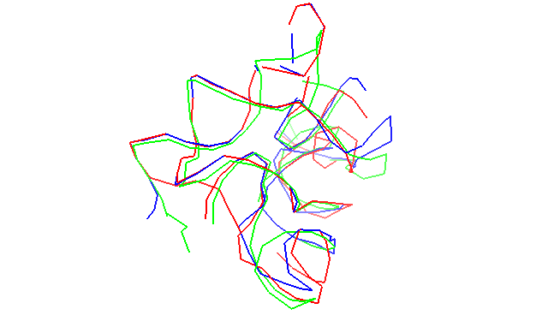
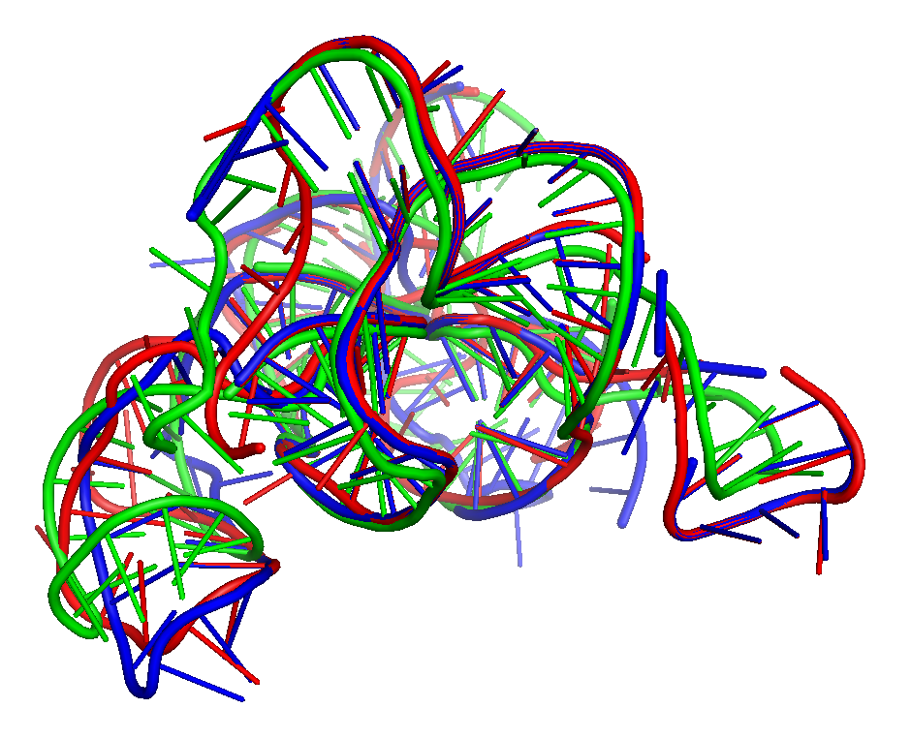
Comparison to ModeRNA
EXPERIMENT
COMPARATIVE
MODERNA
2QUW(57 nt)
RMSD 5.18
RMSD 5.89
4QK8 (122 nt)
RMSD 6.48
RMSD 9.3

Slide 15
Future work
Detail analysis of incorrectly predicted regions
Possible inclusion of secondary structure
Software tool
Large-scale evaluation

Slide 16

Questions?

