Slide 1
Large-scale exploration of chemogenomic space via QSAR modelling
Ctibor Škuta, Daniel Svozil
ENBIK2016

Slide 2
What is chemogenomic space?
chemogenomic space (CGS) is a potential 2D space that encompasses the interactions of all possible ligand-target complexes
represented by the chemogenomic matrix (CGM)
the vast number of all relevant ligands and the number of all druggable targets (not specifically human targets) cause the matrix to be extremely sparse
bioprint
 | Target₁ | Target₂ | Target₃ | Target_{n}
Ligand₁ | - | 3.2 | - | -
Ligand₂ | 5.6 | - | 8.6 | -
Ligand₃ | - | - | 5.9 | -
Ligand_{m} | - | - | - | 6.7
chemoprint
(affinity
fingerprint)
Chemogenomic matrix
ENBIK2016

Slide 3
What is it good for?
the profiles contained in the chemogenomic matrix proved to be extremely useful for ligand/target description
this type of descriptor bridges the gap between purely structure-based (target-based) and ligand-based approaches for ligand/target description
scaffold hopping, drug repurposing, adverse and side efects clarification
Kauvar, L.M., et al., Predicting Ligand-Binding to Proteins by Affinity Fingerprinting. Chemistry & Biology, 1995. 2(2): p. 107-118.
ENBIK2016

Slide 4
Our goal
Propose a method for the prediction of reliable chemogenomic space on a large scale
Build workflow for the automatic QSAR modeling and chemogenomic space prediction
Asses the validity of resulting chemogenomic space through the utilization of predicted affinity fingerprints
ENBIK2016

Slide 5
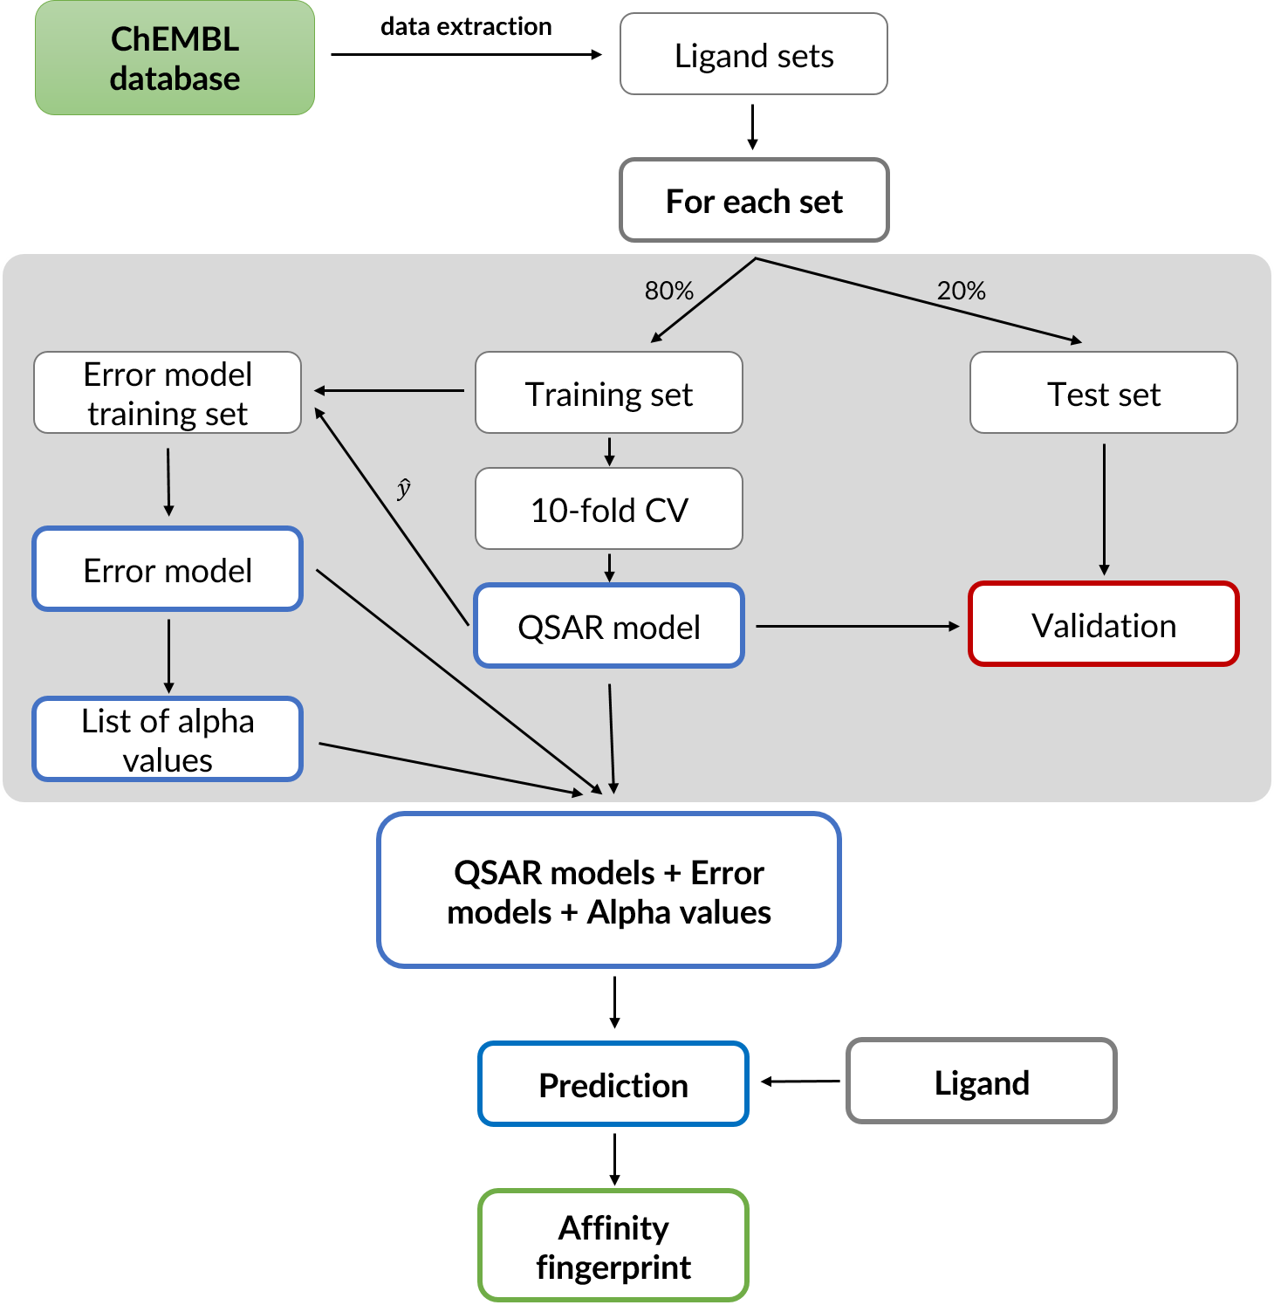
Our workflow
Data
QSAR modelling
Error modelling (conformal prediction)
CGS prediction
Affinity fingerprinting
ENBIK2016

Slide 6
Workflow
Data
QSAR modelling
Error modelling (conformal prediction)
CGS prediction
Affinity fingerprinting
ENBIK2016

Slide 7
Data extraction
Data source: ChEMBL database
  (i) human targets; (ii) activity type: EC50, IC50, Ki or Kd; (iii) activity relationship as “=”; (iv) confidence score equal to 7 or 9 (i.e., an assay where ligand binds directly to a single target protein or to a subunit in a target complex)
separate sets for different target and activity type combinations
at least 50 ligands per each set
Result: 1360 ligand sets (980 distinct) with an average size of 267 ligands per set (pIC50: 786, pKi: 365, pEC50: 173, pKd: 36)
ENBIK2016

Slide 8
Our workflow
Data
QSAR modelling
Error modelling (conformal prediction)
CGS prediction
Affinity fingerprinting
ENBIK2016

Slide 9
QSAR modelling
Random forest algorithm (100 trees, random seed)
ECFP6 fingerprints (1024 bits)
QSAR modelling
  80 : 20 ratio for training : test set
  10-fold cross-validation
  acceptance criteria: q² ≥ 0.5 and R² ≥ 0.6
    q² - cross-validated coefficient of determination (internal validation)
    R² - coefficient of determination (external validation)
ENBIK2016

Slide 10
QSAR modelling results
440 models from initial 1360 met the performance criteria and were selected for further use
376 distinct targets
  pIC50: 256, pKi: 137, pEC50: 37, pKd: 10
  median(q²) = 0.653
  median(r²) = 0.72
  the median of ligands in a set: 212
ENBIK2016

Slide 11
Our workflow
Data
QSAR modelling
Error modelling (conformal prediction)
CGS prediction
Affinity fingerprinting
ENBIK2016

Slide 12
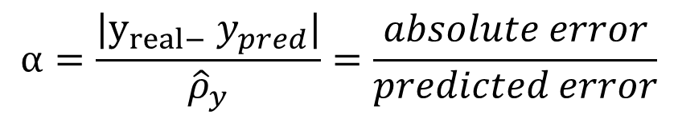
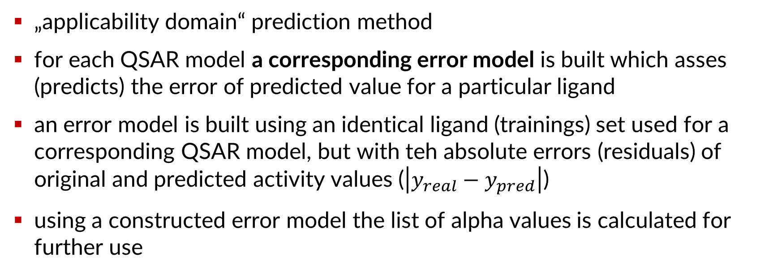
Conformal prediction method
„applicability domain“ prediction method
for each QSAR model a corresponding error model is built which asses (predicts) the error of predicted value for a particular ligand
an error model is built using an identical ligand (trainings) set used for a corresponding QSAR model, but with teh absolute errors (residuals) of original and predicted activity values ($\left|y_{real}−y_{pred}\right|$)
using a constructed error model the list of alpha values is calculated for further use
$$α=\frac{|y_{real−} y_{pred}|}{{\hat{ρ}}_{y}}=\frac{absolute error}{predicted error}$$
ENBIK2016

Slide 13
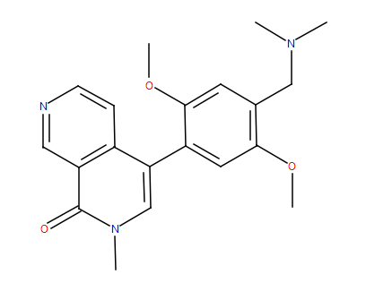
Conformal prediction
α
0.5
0.7
0.2
0.9
2
3.2
1.4
α
0.2
0.5
0.7
0.9
1.4
2
3.2
0%
QSAR model
training set
Error model
Alpha values
absolute errors
sort
for each prediction we set a tolerated error level (ε, confidence (C) = 1 - ε) which determines an alpha value used for tha calculation of a predicted activity value confidence interval
~90%
100%
e.g., when ε = 10%
then C = 90% and α = 2
QSAR model
Activity
Activity ± error*α
Error model
Error
ENBIK2016

Slide 14
Our workflow
Data
QSAR modelling
Error modelling (conformal prediction)
CGS prediction
Affinity fingerprinting
ENBIK2016

Slide 15
CGS prediction
440 QSAR model + 440 error models
confidence level (C), maximum confidence interval (CI_{max})
QSAR model₁
QSAR model₂
QSAR model₃
QSAR model₄
QSAR model₅
QSAR model₆
QSAR model₇
QSAR model₄₄₀
 | Target₁ | Target₂ | Target₃ | Target₄ | Target₅ | Target₆ | Target₇ | … | Target₄₄₀
Ligand₁
Ligand₂
Ligand₃
Ligand₅
Ligand₆
Ligand_{n}
ENBIK2016

Slide 16
CGS prediction
440 QSAR model + 440 error models
confidence level (C), maximum confidence interval (CI_{max})
QSAR model₁
QSAR model₂
QSAR model₃
QSAR model₄
QSAR model₅
QSAR model₆
QSAR model₇
QSAR model₄₄₀
 | Target₁ | Target₂ | Target₃ | Target₄ | Target₅ | Target₆ | Target₇ | … | Target₄₄₀
Ligand₁ | - | 5.5 | 3.7 | - | 8.4 | - | 9.9 |  | -
Ligand₂ | - | - | 4 | 6 | 4.5 | - | 9.7 | - | 3.7
Ligand₃ | 8.4 | - | 4.7 | - | 8.6 | - | 5.5 | 5 | 4
Ligand₅ | 4.5 | 6.4 | - | 4.5 | 4.2 | - | 6.7 | - | 4.7
Ligand₆ | 8.6 | 7.5 | 5.5 | 8.6 | 5.5 | - | 3.4 | 3.7 | -
Ligand_{n} | 4.2 | 5.5 | 6.7 | 4.2 | 6.7 | - | - | 4 | 8
ENBIK2016

Slide 17
Our workflow
Data
QSAR modelling
Error modelling (conformal prediction)
CGS prediction
Affinity fingerprinting
ENBIK2016

Slide 18
CGS validation
the qualities of selected QSAR models do not guarantee that the part of CGS created from their predicted values is valid (that it actually makes sense…)
to validate the CGS we took affinity fingerprints (AFFPs) represented by the rows of CGM and put them to a test in a series of classification tasks and compared them with commonly used structural fingerprints (ECFP4, MACCS)
ENBIK2016

Slide 19
AFFPs
  consist of 440 predicted values contained in the CGM row
  according to the conformal prediction settings some of the values might not be accepted (missing)
    affp_real – predicted values where missing values are replaced for 0
    affp_gt_X (binary) - activity cut-off (X) was used to set a corresponding bit to 1 if a predicted value exceeded this cut-off, otherwise, a bit was set to 0
    affp (binary) - each predicted affinity value was considered as 1, while each missing value was considered as 0
ENBIK2016

Slide 20
Classification testing
  Benchmarking platform developed by Landrum and Riniker [1]
  enables a standardized comparison of 2D fingerprints performance
  Two types of data sets for testing:
    1. Diverse sets of active ligands (MUV, DUD, ChEMBL)
    2. Related active ligands sharing one or two common scaffolds (ChEMBL)
  Performance metrics: AUC, EF5
  Similarity metric: Rogot-Goldberg
  Since the results for both sets are more or less similar you will see results only for the first set
1. Riniker S, Landrum GA: Open-source platform to benchmark fingerprints for ligand-based virtual screening. Journal of cheminformatics 2013, 5(1):26.
ENBIK2016

Slide 21
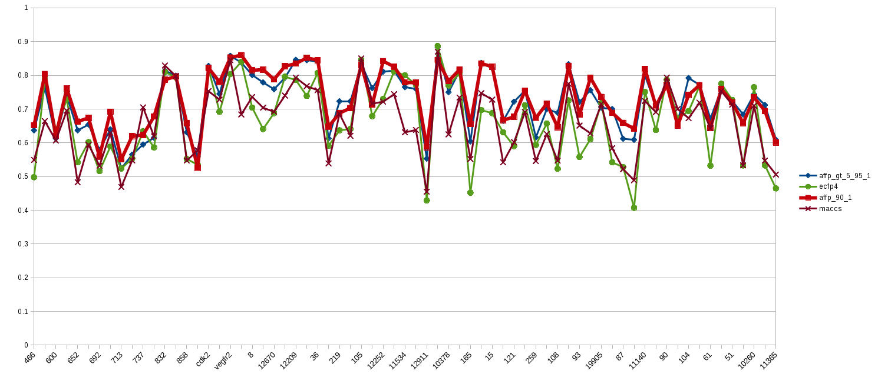
Classification results (AUC: ECFP4 X MACCS X AFFP_90_1 X AFFP_GT_5_95_1)
ENBIK2016

Slide 22
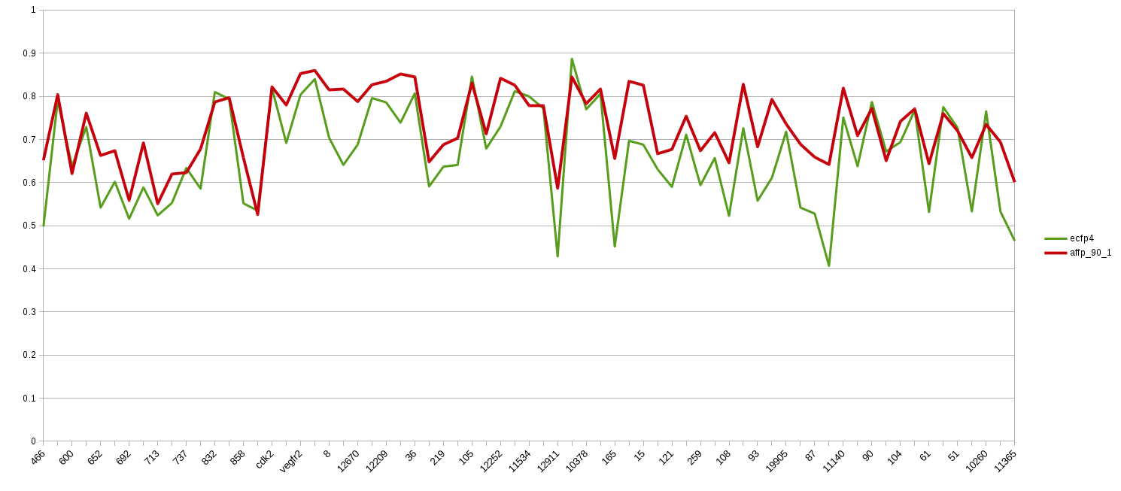
Classification results (AUC: ECFP4 X AFFP_90_1)
ENBIK2016

Slide 23
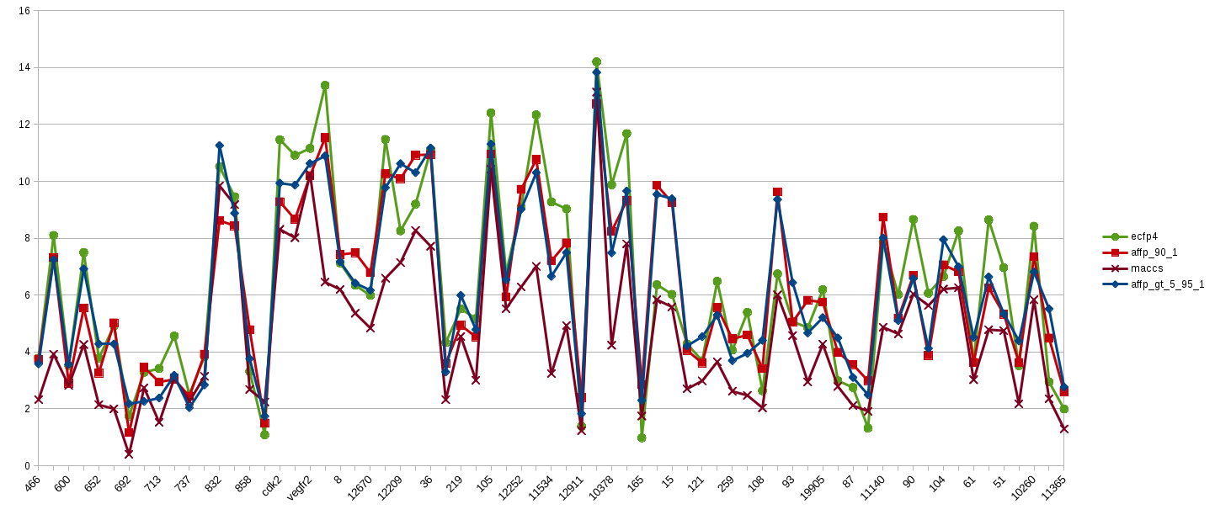
Classification results (EF5: ECFP4 X MACCS X AFFP_90_1 X AFFP_GT_5_95_1)
ENBIK2016

Slide 24
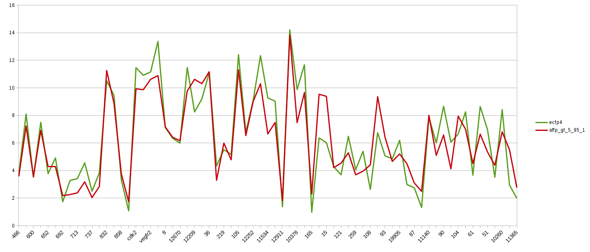
Classification results (EF5: ECFP4 X AFFP_GT_5_95_1)
ENBIK2016

Slide 25
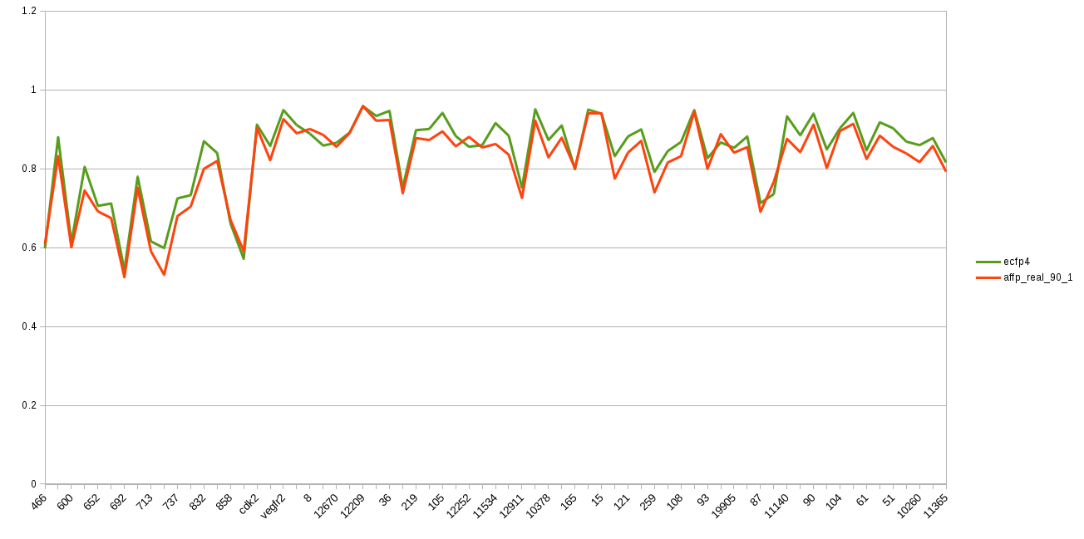
Classification results (RF, AUC: ECFP4 X AFFP_REAL_90_1)
ENBIK2016

Slide 26
Future goals
  the optimalization of criteria for real valued AFFPs models (values) selection and the imputation of missing values
  the detailed investigation of similar structure motifs based on AFFPs and comparison with commonly used FPs
  thorough testing of real and binary AFFPs in regression tasks
ENBIK2016

Slide 27




Acknowledgements
  Igor Tetko (Institute of Structural Biology, Helmholtz Zentrum München)
  Gerard van Westen (Leiden Academic Centre for Drug Research)
  Isidro C. Cortes (Harvard Medical School)
  Daniel Svozil (LICH, UCT Prague)

