Slide 1
Molecular Transport in the view of Structural Bioinformatics & Chemoinformatics
Karel Berka
Department of Physical Chemistry, Regional Centre of Advanced Technologies and Materials, Faculty of Science, Palacký University Olomouc, Czech Republic

Slide 2
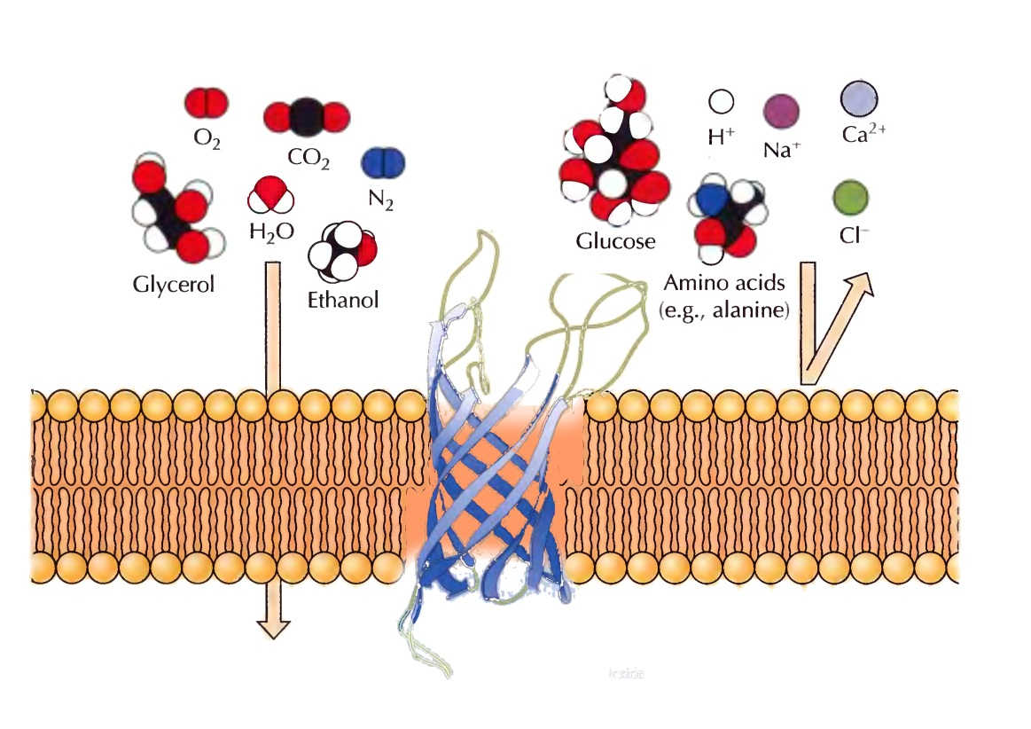
Molecular Transport on Membranes
Majority of drugs has target on membrane
Permeation
Passive transport
Protein-assisted passive transport
Active Transport
Accumulation
Metabolism
Activity
Toxicity
Barrier
Ions + polar compounds – impermeable => transporters
Most drugs – passive permeation X transporters?
Di Meo F, et al Pharmacol. Res., 111, 471–486, 2016.

Slide 3
MOLMEDB.UPOL.CZ
Database of interactions of compounds with membranes

Slide 4
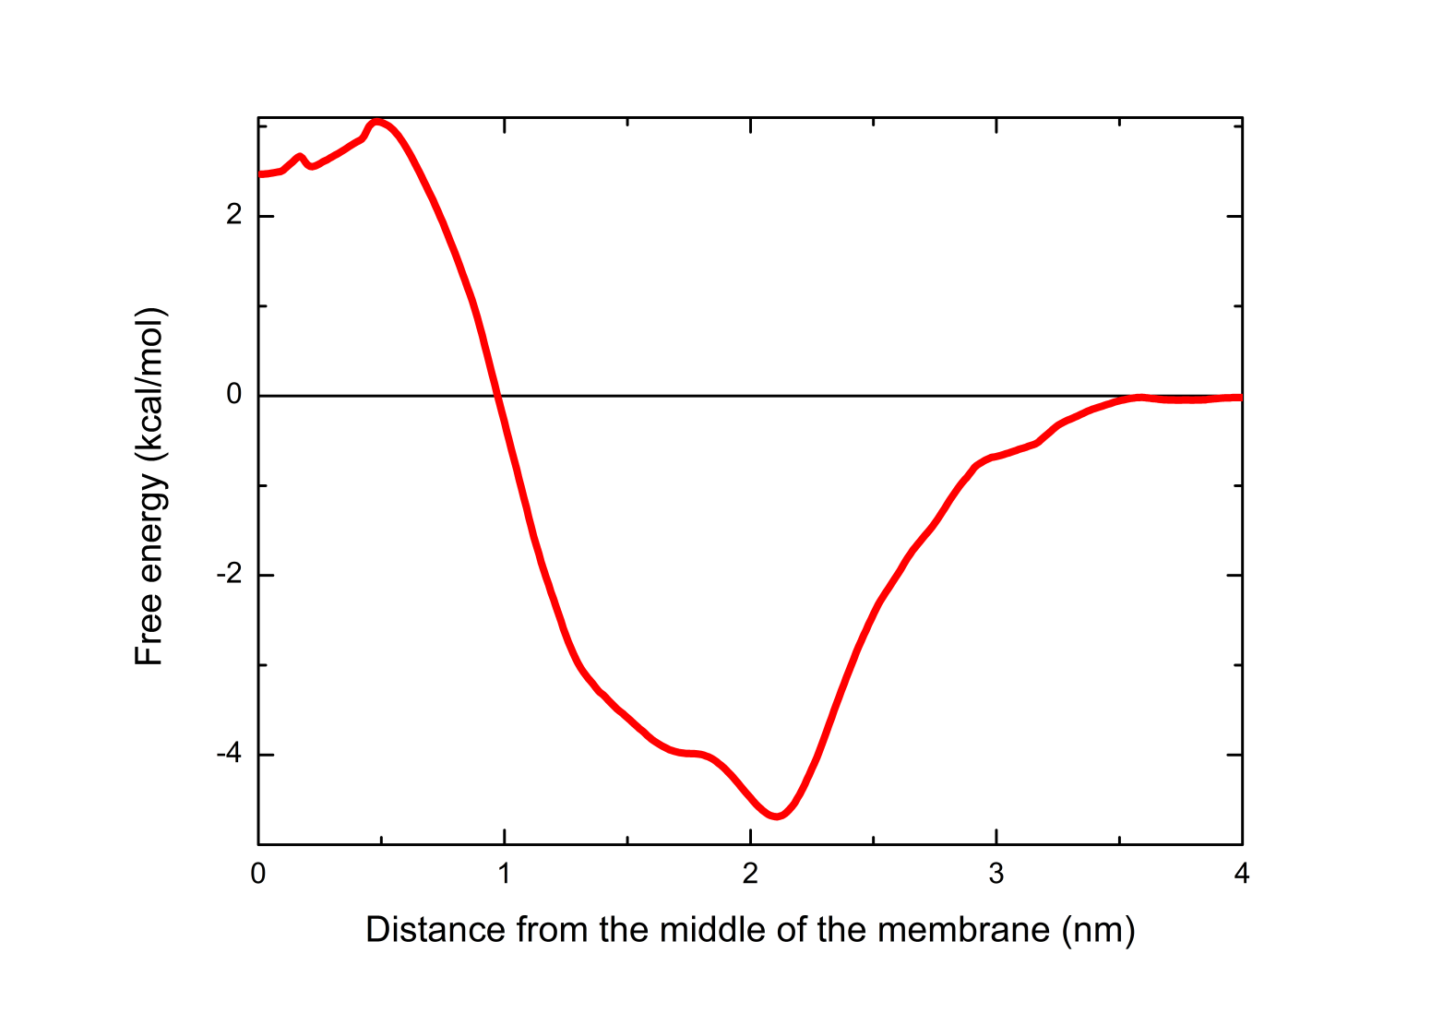
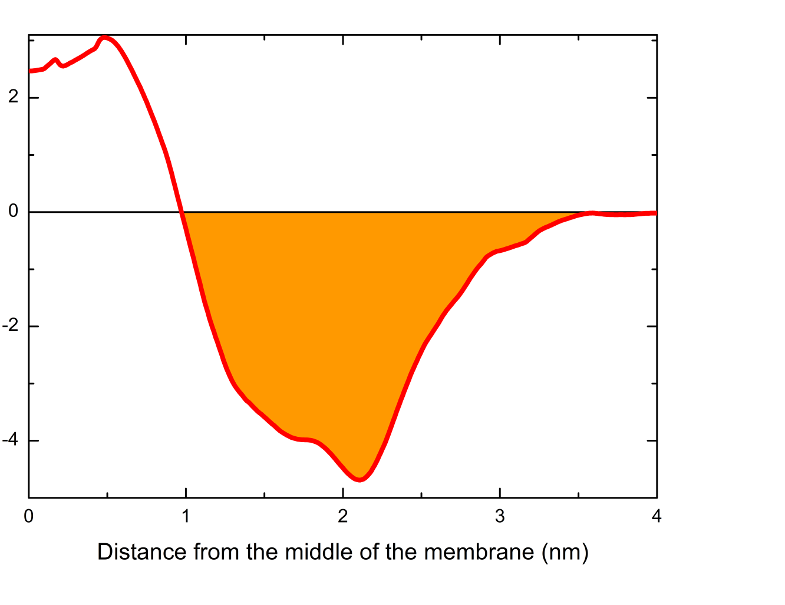
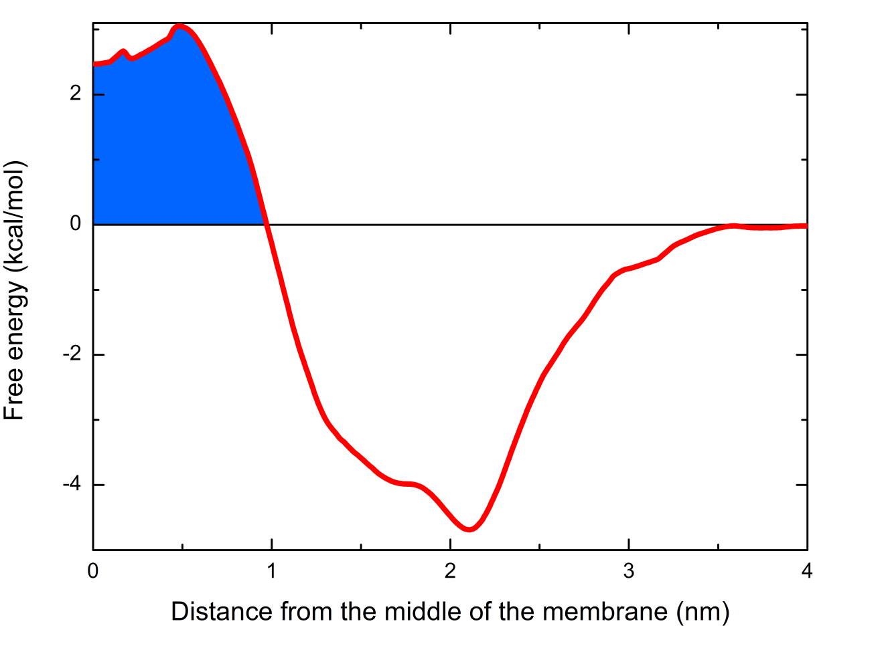
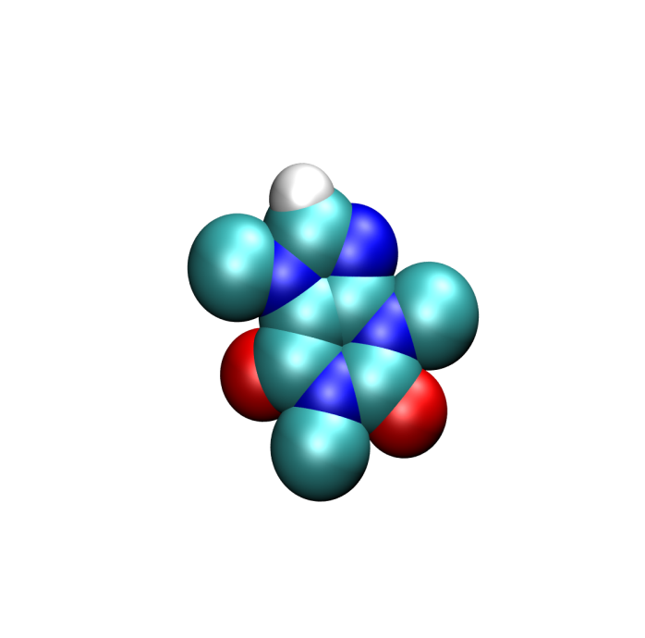
Behavior of drug on membrane
Permeability – P = 1/R
Free energy – ΔG(z)
Diffusion – D(z)
Partitioning - K
Free energy – ΔG(z)
$$K=2\int_{0}^{z}{e^{−\frac{∆G(z`)}{RT}}dz`}$$
$$P=\frac{1}{R}$$
$$R=\int_{outside}^{z}{R\left(z`\right)dz`=}\int_{outside}^{z}{\frac{e^{+\frac{∆G(z`)}{RT}}}{D(z`)}dz`}$$
$$R=\int_{outside}^{z}{R\left(z`\right)dz`=}\int_{outside}^{z}{\frac{e^{+\frac{∆G(z`)}{RT}}}{D(z`)}dz`}$$
Free energy (kcal/mol)
Free energy (kcal/mol)
$$K=2\int_{0}^{z}{e^{−\frac{∆G(z`)}{RT}}dz`}$$
Marrink, S. J.; Berendsen, H. J. C. J. Phys. Chem. 1996, 100, 16729–16738.

Slide 5
MolMeDB
Database of interactions between molecules and membranes
Free energy profiles
Affinity
Position
Partitioning constant
Penetration barriers
Alpha version at https://molmedb.upol.cz

Slide 6
MolMeDB - comparator
Can be used for comparison of membrane behavior of similar compounds:
Better penetrator
Experimental Dye leakage from liposome
Free energy [kcal/mol]
Distance [nm]

Slide 7
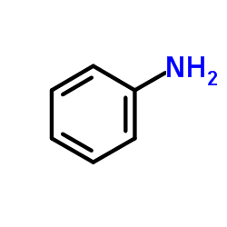
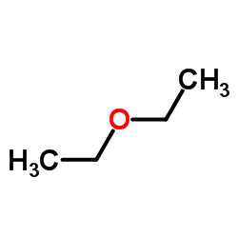
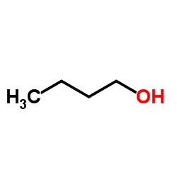
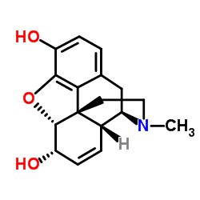
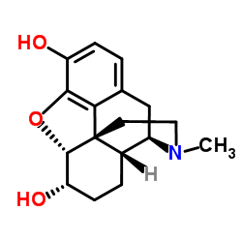
Permeability of Similar Compounds
aniline
logKow ≈ 0.9
COSMOmic – SC mix (CRN:Chol:FFA 1:1:1)
Skin permeabilities
diethylether
n-butanol
-7.81
Highest barrier in the centre -> lowest permeabilities
-8.38
morphine
-6.00
dG [kcal/mol]
dihydromorphine
-5.21
Affinity
-5.36
Exp logKp [cm/s]
Lowest barriers -> higher permeability

Slide 8
MEMBRANE proteins and DRUGS

Slide 9
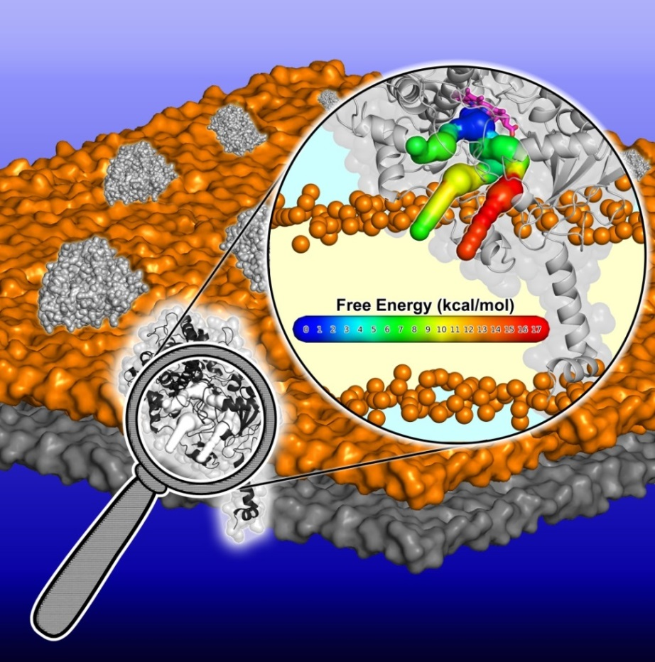
Porous Pathways in Proteins
Channels/Tunnels
Connect active site with exterior
Pores
Running through the structure
Paloncýová M, Navrátilová V, Berka K, Laio A, Otyepka M: Role of Enzyme Flexibility in Ligand Access and Egress to Active Site – Bias-Exchange Metadynamics Study of 1,3,7-Trimethyluric Acid in Cytochrome P450 3A4 J. Chem. Theory Comput., 12(4), 2101–2109, 2016.

Slide 10
CYP.UPOL.CZ
Cytochromes P450 on membranes

Slide 11
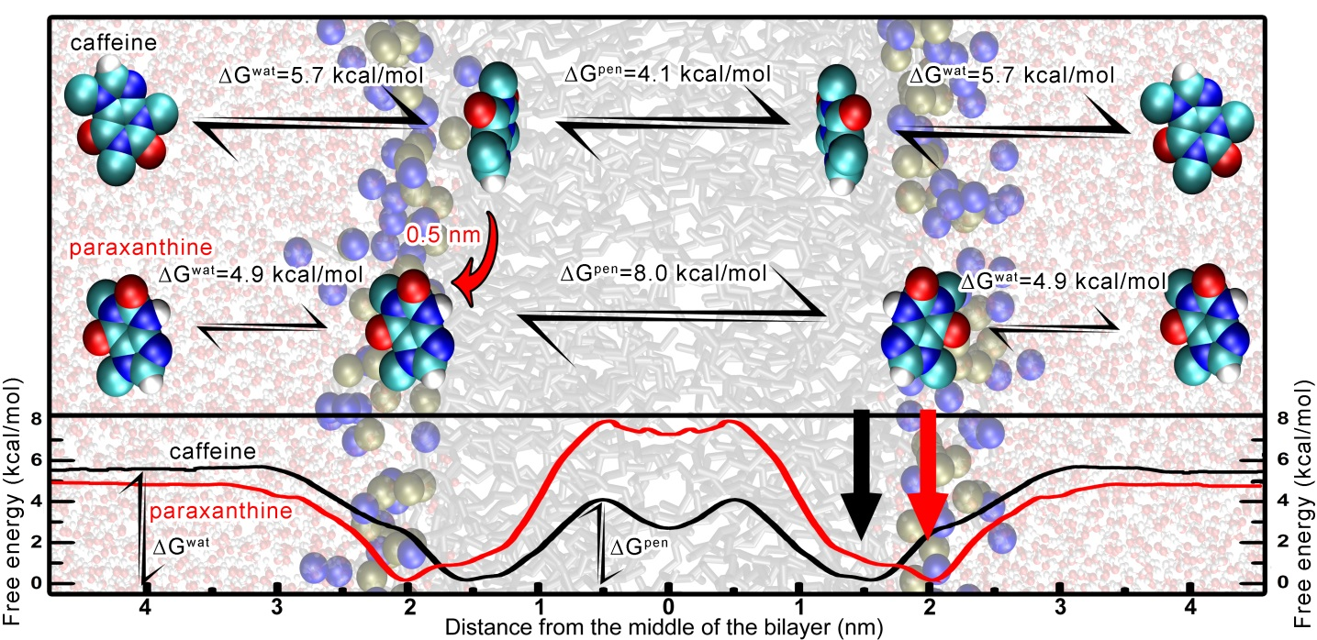
Drugs with Cytochromes P450
Drugs – mostly aromates
Deeper in the membrane
Higher lipids afinity
Metabolites
Easier membrane escape
Drugs – Access tunnel
Metabolites – Eggress tunnel
Paloncýová M, Berka K, Otyepka M: J. Phys. Chem. B 2013, 117, 2403–10.
Berka K, Paloncyova M, Anzenbacher P, Otyepka* M: J. Phys. Chem. B, 2013, 117(39), 11556-11564. Berka K, Hendrychová T, Anzenbacher P, Otyepka M: J. Phys. Chem. A 2011, 115, 11248–11255.
Notes:
U tohoto i příštího slidu bys mohl zvýraznit v publikacích spíše sebe

Slide 12
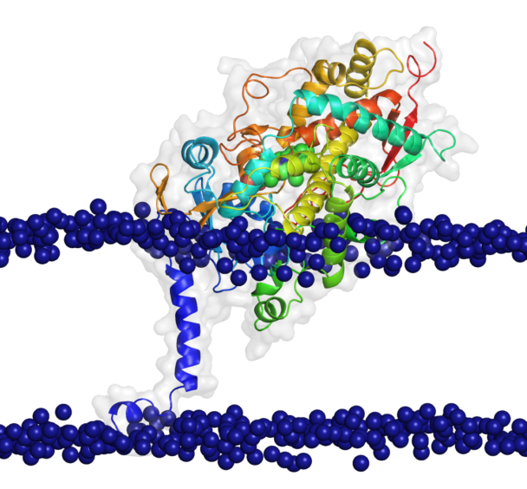
CYP on Membrane Database
structures of membrane anchored CYPs attached to the membranes showed in LiteMol¹
Visualization of similarities and differences of membrane position of CYP on membrane
CYP3A4 on DOPC membrane
https://cyp.upol.cz
1. Sehnal D, et al Nature Methods, 14, 1121–1122, 2017.
2. Šrejber M et al J Inorg Biochem, 183, 117-136, 2018.

Slide 13
ncbr.muni.cz/ChannelsDB
Database of channels, tunnels and pores

Slide 14
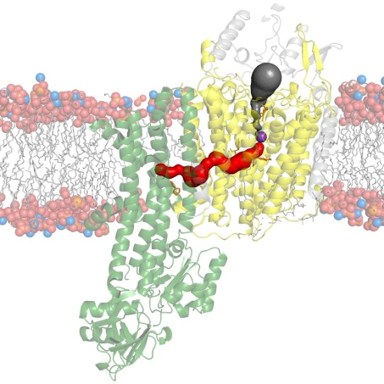
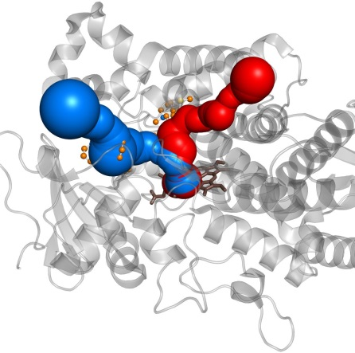
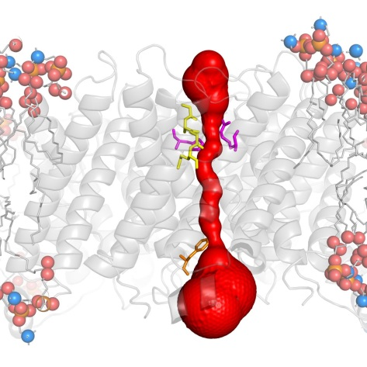
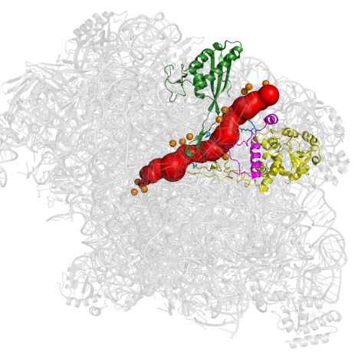
ChannelsDB
Channel annotations for PDB
Reviewed from literature
Tunnels from Catalytic Site Atlas
Tunnels from enzyme cofactors (e.g. HEM or FAD)
Transmembrane pores
Calculated with MOLE^{1,2}
KdpFABC complex pore (5mrw)
Cytochrome P450 2D6 tunnel (3tbg)
http://ncbr.muni.cz/ChannelsDB
Aquaporin (1ymg)
Ribosomal exit tunnel (1jj2)
1. Berka K et al, Nuc. Acids Res., 40(W1), W222-W227, 2012
2. Sehnal D et al., J. Cheminform, 5(1), 39, 2013
3. Pravda L et al. Nuc. Acids Res. 46(D1), D399–D405, 2018. doi: 10.1093/nar/gkx868

Slide 15
ChannelsDB
http://mole.upol.cz
Pravda L et al. Nuc. Acids Res. 46(D1), D399–D405, 2018. doi: 10.1093/nar/gkx868

Slide 16
MOLE.upol.cz
MOLEonline update for detection and analysis of channels, tunnels and transmembrane pores

Slide 17
MOLEonline
Detection and analysis of channels, tunnels and pores
Pravda L, et al Nuc. Acids Res., ASAP, 2018, doi:10.1093/nar/gky309

Slide 18
MOLEonline
Update of MOLEonline¹
+ Refurbishment of code LiteMol and mmCIF
+ 2-ways integration of ChannelsDB
+ Transmembrane pores mode
(OPM database or MEMBED)
+ new properties along channel
logD, logS, freeRadius, …
1. Berka K et al, Nuc. Acids Res., 40(W1), W222-W227, 2012
2. Pravda L, et al Nuc. Acids Res., ASAP, 2018, doi:10.1093/nar/gky309
TRPML1 porin (PDBIDs: 5wj5, 5wj9)
https://mole.upol.cz

Slide 19
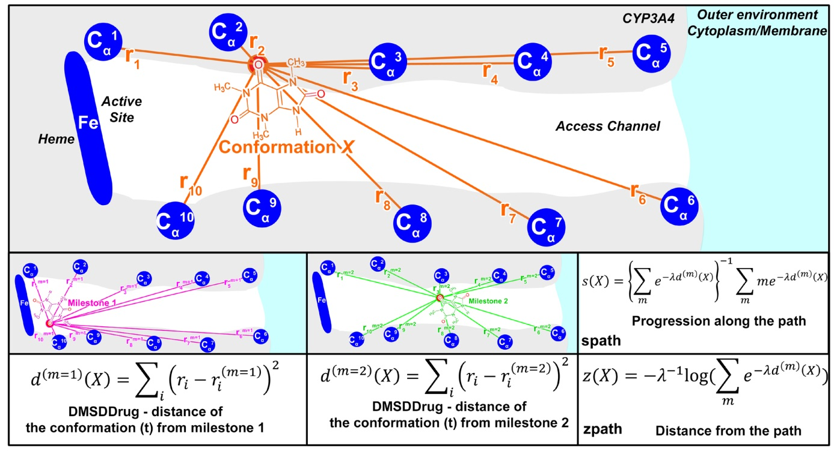
Ligand Access and Egress to Active Site
BE-META simulation
Along channels identified from MOLE
with newly defined CV – DMSDDrug – distance of drug from milestones
1,3,7-Trimethyluric Acid egress from Cytochrome P450 3A4
=> identification of egress channel
Paloncýová M, Navrátilová V, Berka K, Laio A, Otyepka M: Role of Enzyme Flexibility in Ligand Access and Egress to Active Site – Bias-Exchange Metadynamics Study of 1,3,7-Trimethyluric Acid in Cytochrome P450 3A4 J. Chem. Theory Comput., 12(4), 2101–2109, 2016.

Slide 20
Summary
MolMeDB
Interactions of small molecules with membranes
CYP on membranes DB
Membrane structures of cytochromes P450
ChannelsDB
Channels within whole PDB database
MOLEonline
Update on channel analysis

Slide 21
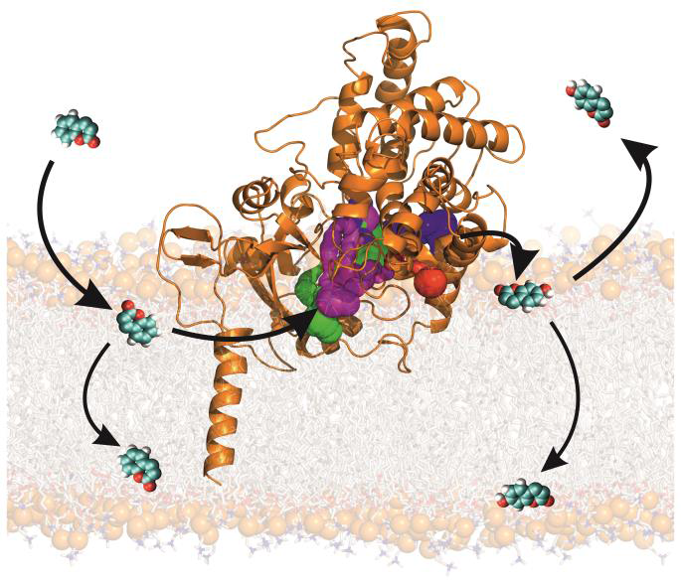
Conclusions
Molecular transport enlighten pharmacokinetic aspects of drug in cell
Accumulation
Metabolism
Partitioning
Penetration

Slide 22
Acknowledgement
Michal Otyepka
Markéta Paloncýová
Veronika Navrátilová
Martin Šrejber
Petr Voňka
Jaroslav Koča
Radka Svobodová-Vařeková
David Sehnal
Lukáš Pravda
Adam Midlík
Notes:
Joanna + Sam

Slide 23
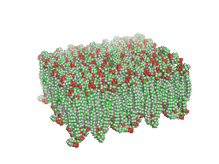
Thank you for your attention
Questions, please?

Slide 24
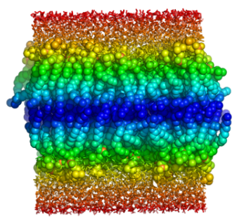
Free Energy Profile Calculation Methods
Molecular dynamics simulations – force fields
Z-constraint
WHAM
Metadynamics
Add a biasing potential
$$∆G\left(z\right)=−V(z)$$
COSMOmic
Semicontinuous approach
RI-DFT B-P/TZVPD + COSMO-RS
Paloncýová, M.; Berka, K.; Otyepka, M. Convergence of Free Energy Profile of Coumarin in Lipid Bilayer. J. Chem. Theory Comput. 2012, 8, 1200–1211.

