Slide 1
Vysočina, Bystřice nad Pernštejnem
11-13 June 2018
Advances in interpretation of QSAR models
Pavel Polishchuk
Institute of Molecular and Translational Medicine
Faculty of Medicine and Dentistry
Palacky University
pavlo.polishchuk@upol.cz

Slide 2
QSAR model learning
Learning
D₁ | D₂ | D₃ | … | D_{N}
1 | 0 | 9 | … | 1
4 | 0 | 1 | … | 1
0 | 2 | 3 | … | 3
… | … | … | … | …
4 | 0 | 0 | … | 1
Model
Output
Model
Output
OC[C@H]1OC(O)[C@H](O)
[C@@H](O)[C@@H]1O
Interpretation is the retrieval of useful knowledge from computational models.

Slide 3
Interpretation of QSAR models
Why interpretation is important?
Found active/inactive patterns which can be used for optimization of compound properties
Retrieve trends of structure-activity relationships which can be used for knowledge-base model validation
Regulatory purposes

Slide 4
Interpretation of QSAR models
Principles and issues
Model should be predictive
Interpretation is valid within the applicability domain of the model
Interpretation results are data set dependent

Slide 5
Interpretation of QSAR models
plant growth inhibition activity of phenoxyacetic acids
1/C = 4.08π – 2.14π² + 2.78σ + 3.38
Hansch equation
rate of penetration of membranes in the plant cell
electronic factors
π = logP_{X} – logP_{H}
σ - Hammet constant
Free-Wilson models
Inhibition activity of compounds against Staphylococcus aureus
R is H or CH₃; X is Br, Cl, NO₂ and Y is NO₂, NH₂, NHC(=O)CH₃
Act = 75R_{H} – 112R_{CH3} + 84X_{Cl} – 16X_{Br} – 26X_{NO2} + 123Y_{NH2} + 18Y_{NHC(=O)CH3} – 218Y_{NO2}

Slide 6
Interpretation paradigm
Learning
D₁ | D₂ | D₃ | … | D_{N}
1 | 0 | 9 | … | 1
4 | 0 | 1 | … | 1
0 | 2 | 3 | … | 3
… | … | … | … | …
4 | 0 | 0 | … | 1
Model
Output
Descriptor
contributions
(optional)
Interpretation
“model → descriptor → (structure)” paradigm

Slide 7
Model interpretability
interpretability of model
interpretability of machine learning method
interpretability of descriptor
Popular misbelief
interpretation of descriptor contributions
structural interpretation
MLR
DT
PLS
Model interpretability
kNN
RF
SVM
NN
ensembles
Model complexity

Slide 8
Interpretability of machine learning methods
Linear models
Linear regression
PLS
Non-linear models
Decision tree
Random Forest
Neural nets
SVM
regression coefficients,
X-scores, variable importance
Rule-based, variable importance

Slide 9
Machine learning-independent interpretation approaches
Sensitivity analysis
Variable importance
Partial derivatives

Slide 10
Partial derivatives
forward difference
backward difference
central difference
-2
C-C-N -3
C-C-O +6
0
-2
+2
+1
+4
+4

Slide 11
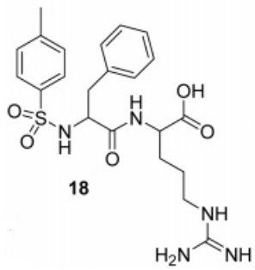
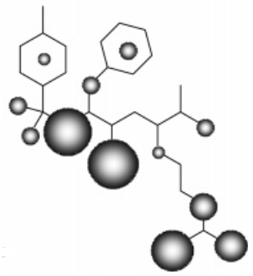
Partial derivatives: Thrombin inhibitors example
Thrombin inhibitors
3-point pharmacophore fingerprints
R_{i} = f(x(x_{i}=1)) - f(x(x_{i}=0))
Gly216
Asp189
Franke, L.; Byvatov, E.; Werz, O.; Steinhilber, D.; Schneider, P.; Schneider, G. Extraction and Visualization of Potential Pharmacophore Points Using Support Vector Machines: Application to Ligand-Based Virtual Screening for COX-2 Inhibitors. Journal of Medicinal Chemistry 2005, 48, 6997-7004

Slide 12
Interpretation paradigms
Learning
D₁ | D₂ | D₃ | … | D_{N}
1 | 0 | 9 | … | 1
4 | 0 | 1 | … | 1
0 | 2 | 3 | … | 3
… | … | … | … | …
4 | 0 | 0 | … | 1
Model
Output
Descriptor
contributions
(optional)
Interpretation
“model → descriptor → (structure)” paradigm
“model → structure” paradigm

Slide 13
“Model → structure” paradigm
–
=
A
B
C
Activity_{pred}(A) | Activity_{pred}(B) | Contribution(C)
f(A) = x | f(B) = y | W(C) = x – y
Polishchuk, P. G.; Kuz'min, V. E.; Artemenko, A. G.; Muratov, E. N. Universal Approach for Structural Interpretation of QSAR/QSPR Models. Molecular Informatics 2013, 32, 843-853

Slide 14
“Model → structure” interpretation approaches
1. Similarity maps
Riniker, S.; Landrum, G. Similarity maps - a visualization strategy for molecular fingerprints and machine-learning methods. Journal of Cheminformatics 2013, 5, 43
2. Universal structural interpretation
Polishchuk, P. G.; Kuz'min, V. E.; Artemenko, A. G.; Muratov, E. N. Universal Approach for Structural Interpretation of QSAR/QSPR Models. Molecular Informatics 2013, 32, 843-853
3. Computational matched molecular pairs
Sushko, Y.; Novotarskyi, S.; Korner, R.; Vogt, J.; Abdelaziz, A.; Tetko, I. Prediction-driven matched molecular pairs to interpret QSARs and aid the molecular optimization process. Journal of Cheminformatics 2014, 6, 48

Slide 15
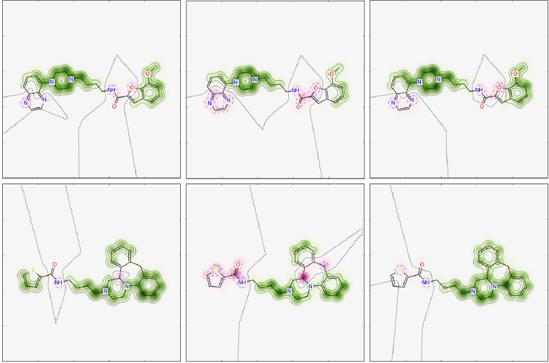
Similarity maps
RF model of D3 inhibitors based on fingerprints
Morgan2
CountMorgan2
FeatMorgan2
Riniker, S.; Landrum, G. Similarity maps - a visualization strategy for molecular fingerprints and machine-learning methods. Journal of Cheminformatics 2013, 5, 43

Slide 16
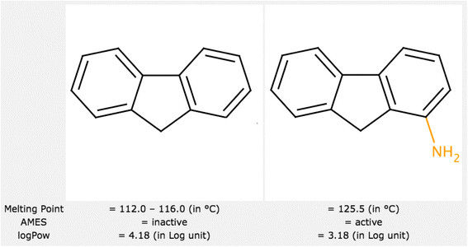
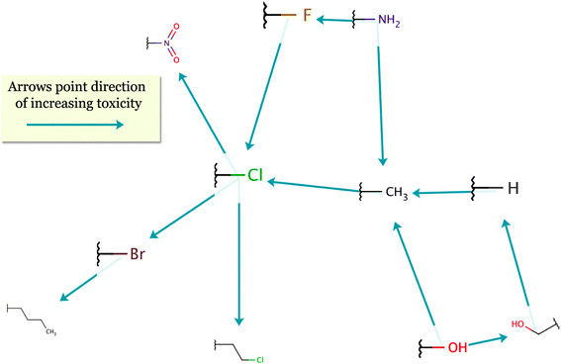
Prediction-driven MMP
MMP Example
f(A-B) - f(A-C) = W(B→C)
Aquatic toxicity
Sushko, Y., Novotarskyi, S., Korner, R., Vogt, J., Abdelaziz, A., Tetko, I. Journal of Cheminformatics, 2014, 6(1): p. 48.

Slide 17
Universal structural interpretation: Ames mutagenicity

Slide 18
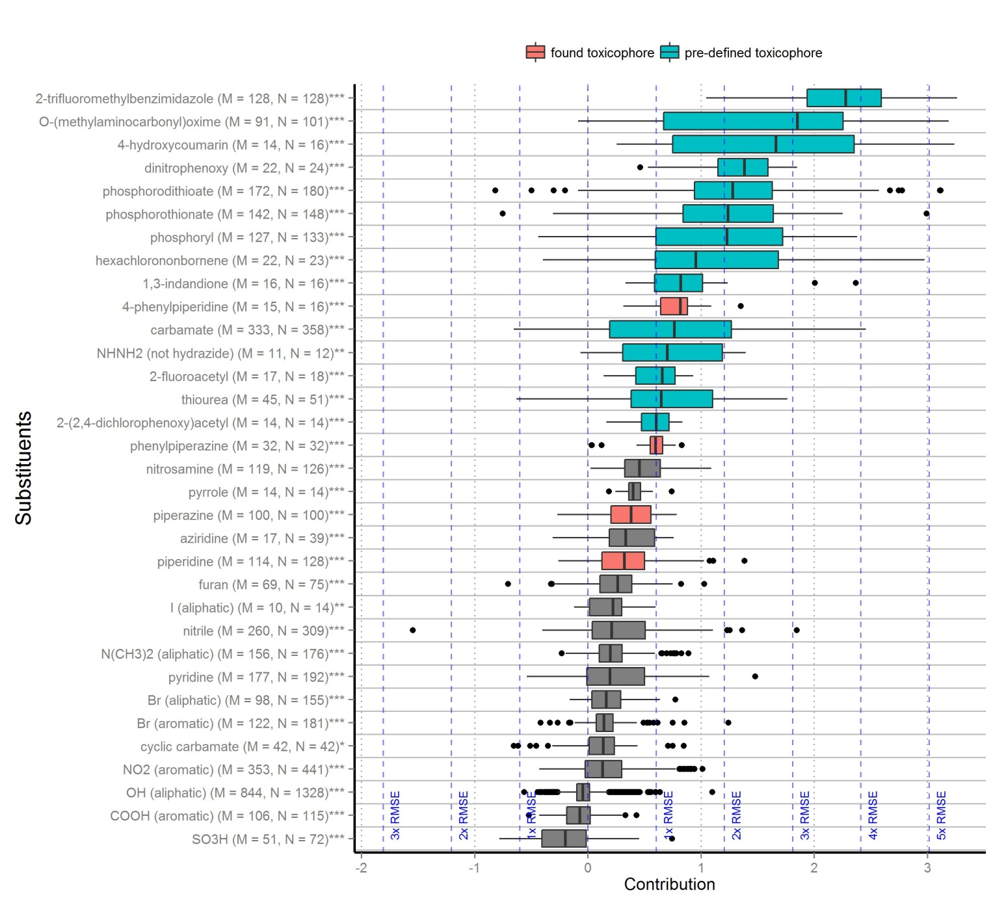
Universal structural interpretation
Acute oral toxicity on rats
?
?
Polishchuk P, Tinkov O, Khristova T, Ognichenko L, Kosinskaya A, Varnek A, Kuz’min V. Journal of Chemical Information and Modeling 2016, 56, 1455-1469.

Slide 19
Context dependence of structural interpretation

Slide 20
Context dependence of structural interpretation
unpublished results

Slide 21
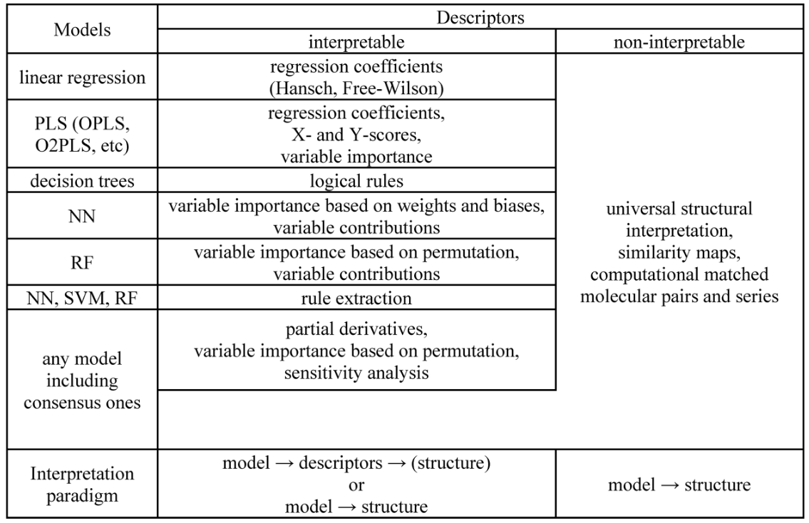
Applicability of interpretation approaches
Polishchuk, P. Journal of Chemical Information and Modeling, 2017, 57(11), 2618-2639.

Slide 22
Conclusion
Paradigm I
model → descriptor contributions → structure
Paradigm II
Model
model → structure
Model
All models are interpretable
Interpretation results of valid predictive models should converge independent of:
interpretation approach
descriptors
machine learning method

Slide 23
Perspectives
New paradigm will be valuable for interpretation of deep neural nets implicitly generating feature representation, e.g. autoencoders, recurrent neural nets, etc.
Development of convenient automatic workflows for model interpretation
Development of de novo and adaptive design systems

Slide 24
Thank you for your attention

