Slide 1
PDBe-KB: a new community-driven knowledge base resource at EMBL-EBI for structure related functional annotations
Lukáš Pravda
www.pdbe.org

Slide 2
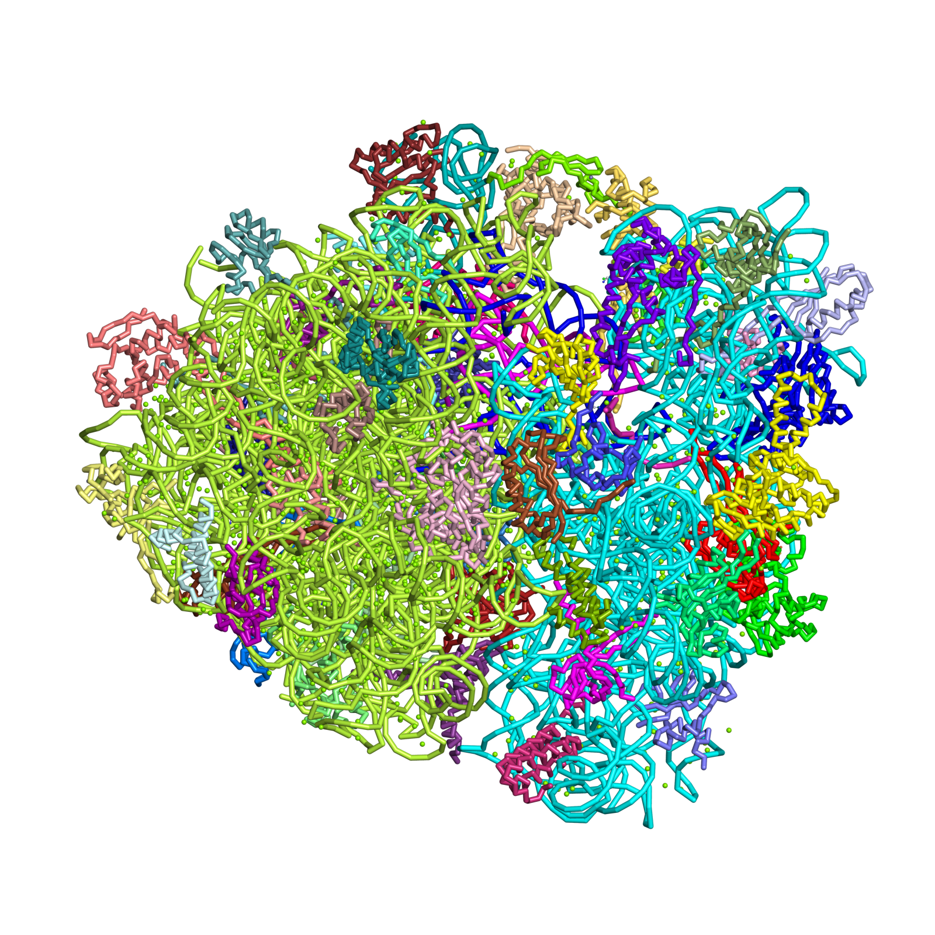
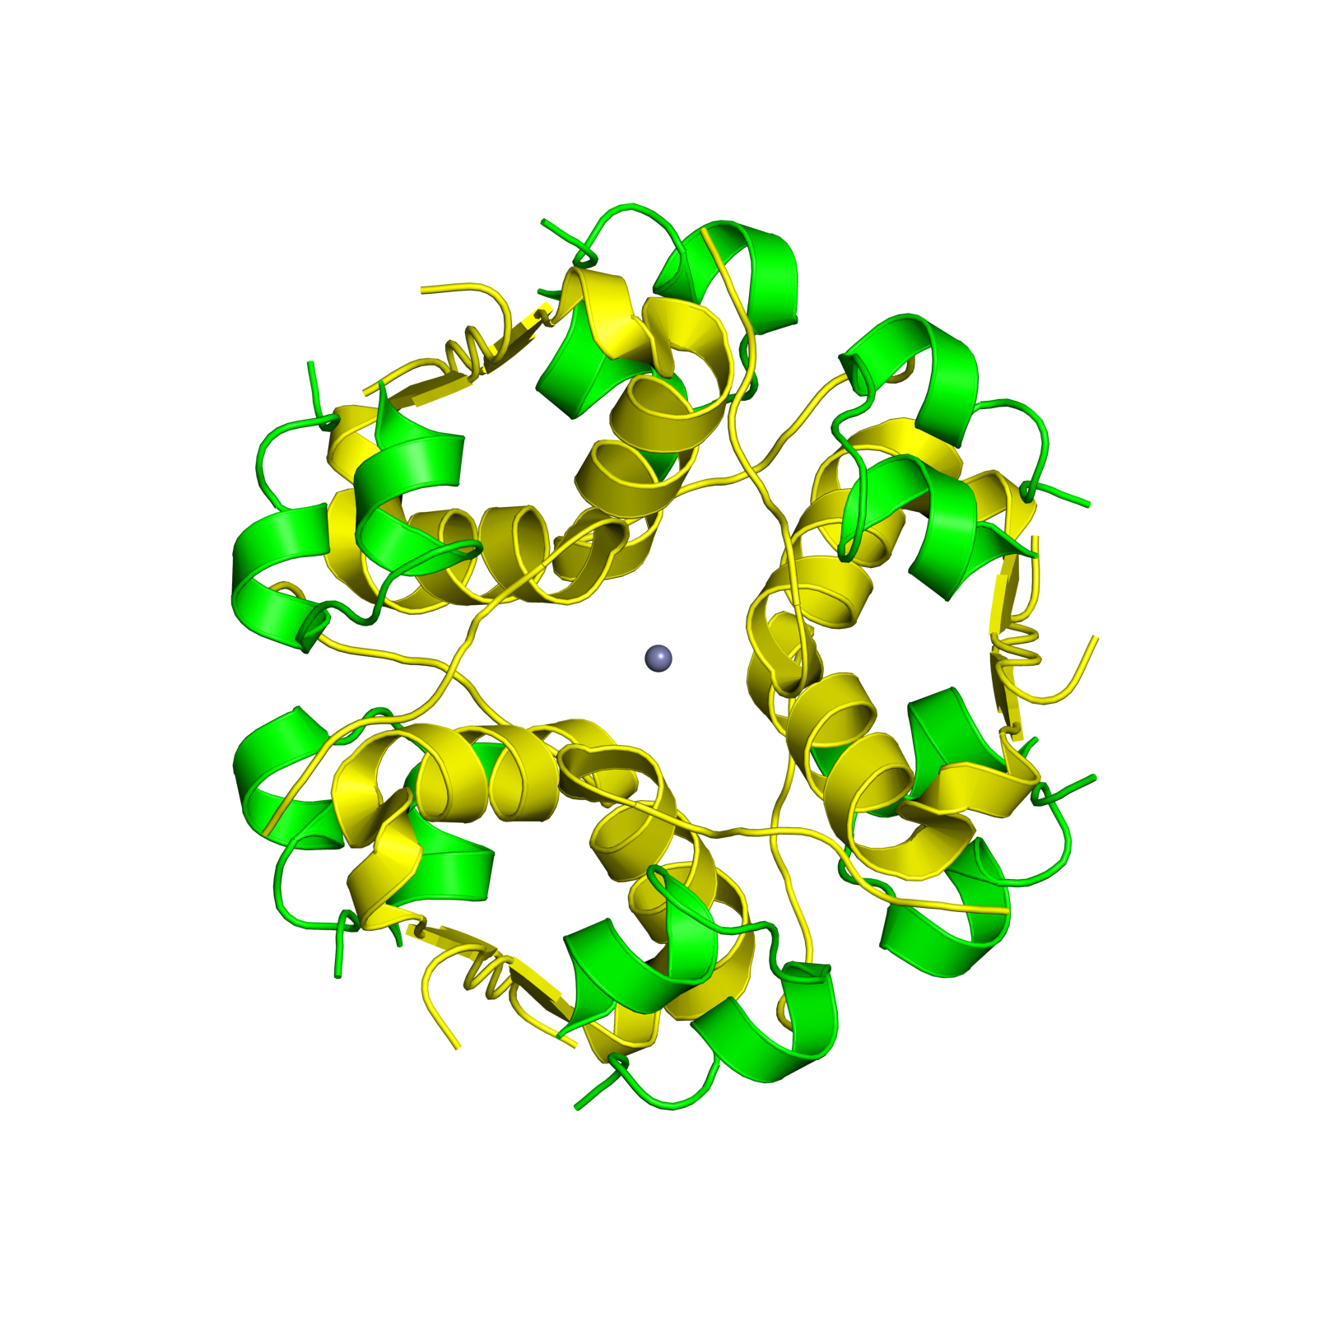
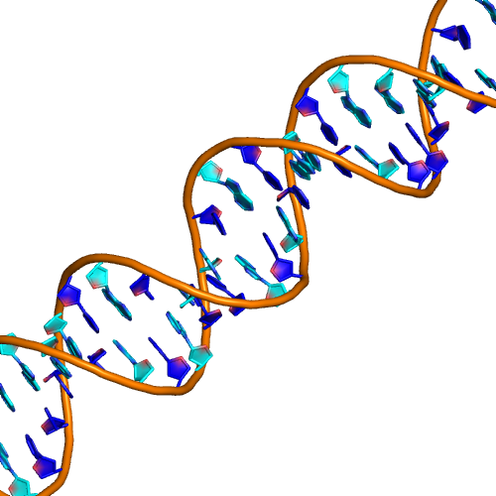
What is the Protein Data Bank (PDB)?
An archive of experimentally determined
3-dimensional structures of biological macromolecules
Protein, nucleic acids, sugars

Slide 3
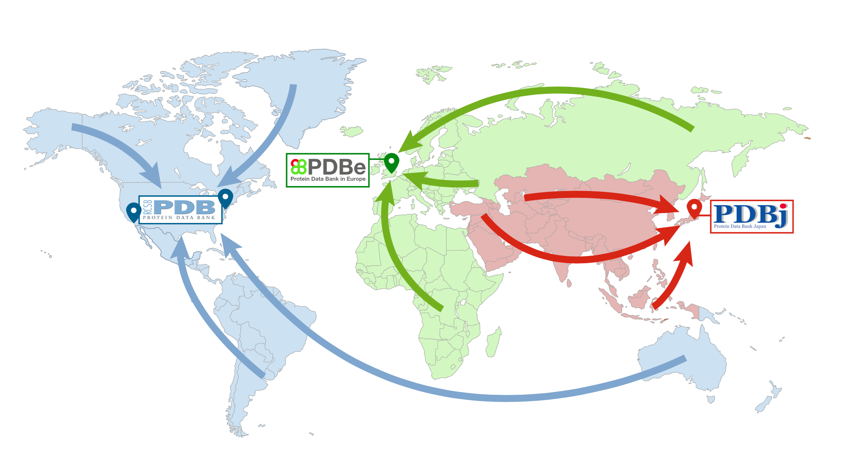
‘The PDB’
FTP Archive

Slide 4
Motivation
“Coordinates by themselves just specify shape and are not necessarily of intrinsic biological value, unless they can be related to other information” Integrative database analysis in structural genomics, Mark Gerstein, Nature Structural Biology 7, 960 , 2000
ATOM 1 N GLN A 39 24.690 -27.754 24.275 1.00 60.76 N
ATOM 2 CA GLN A 39 23.581 -26.768 24.416 1.00 60.98 C
ATOM 3 C GLN A 39 23.990 -25.379 23.905 1.00 59.98 C
ATOM 4 O GLN A 39 25.070 -25.209 23.330 1.00 60.25 O
ATOM 5 CB GLN A 39 23.136 -26.685 25.878 1.00 60.69 C
ATOM 6 N VAL A 40 23.115 -24.395 24.122 1.00 59.58 N
ATOM 7 CA VAL A 40 23.342 -23.010 23.690 1.00 57.26 C
ATOM 8 C VAL A 40 24.000 -22.152 24.778 1.00 56.00 C
ATOM 9 O VAL A 40 23.992 -20.920 24.692 1.00 55.53 O
ATOM 10 CB VAL A 40 22.015 -22.337 23.275 1.00 57.32 C
Notes:
Commonly PDB has just 3D coordinates… Glutamine, Valine so without any value added information this piece of information will be of little use.

Slide 5
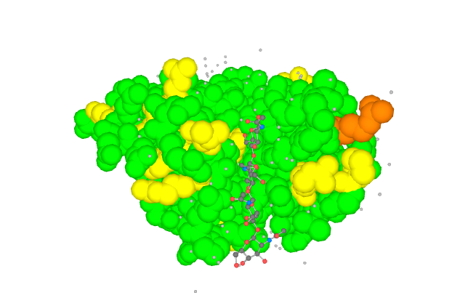
Domain Mapping Validation Functional sites
Enzyme reactions Sequence
SIFTS Annotation
PDB
Annotation
Mutation X disrupts
enzyme function, which causes Y disease
Molecular data
Information
Knowledge
Notes:
We have a number of different resources which contain information about … so eventually what we would like to tell about a given structure is… some of this information is present in the PDB with resources such as SIFTS.

Slide 6
PDBe Knowledge Base (PDBe-KB)
PDBe-KB
SIFTS
FunPDBe
A new EMBl-EBI resource for functional annotations of macromolecular structure data
Common infrastructure, API and visualization components
Bring together functional annotation efforts into a single resource (PDBe-KB)
FunPDBe, SIFTS, internal projects on enzyme, Rfam, cofactor and annotation of complexes.
Better exposure and acknowledgement of the community driven nature and contributions by partner resources
and more...

Slide 7
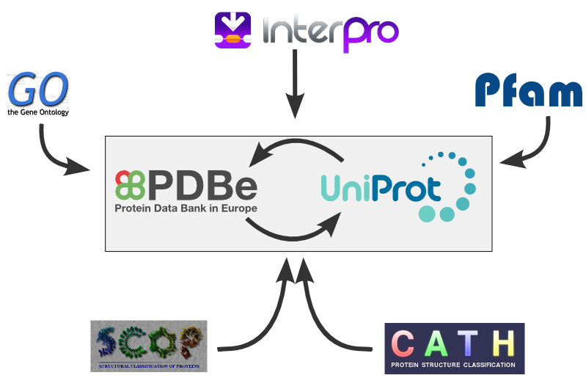
SIFTS

Slide 8
PDBe – Knowledge Base
FunPDBe
www.funpdbe.org

Slide 9
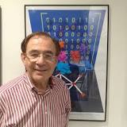
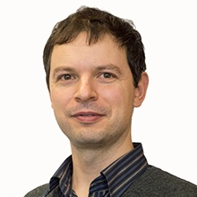
FunPDBe: a PDBe-KB project
Assemble predictions/manual annotations from collaborating groups
Develop standards for representing functional annotation data
Implement an integrated resource for data delivery
Standard REST API and data delivery mechanism
Data visualisation components
Dissemination and training
Training workflows

Slide 10
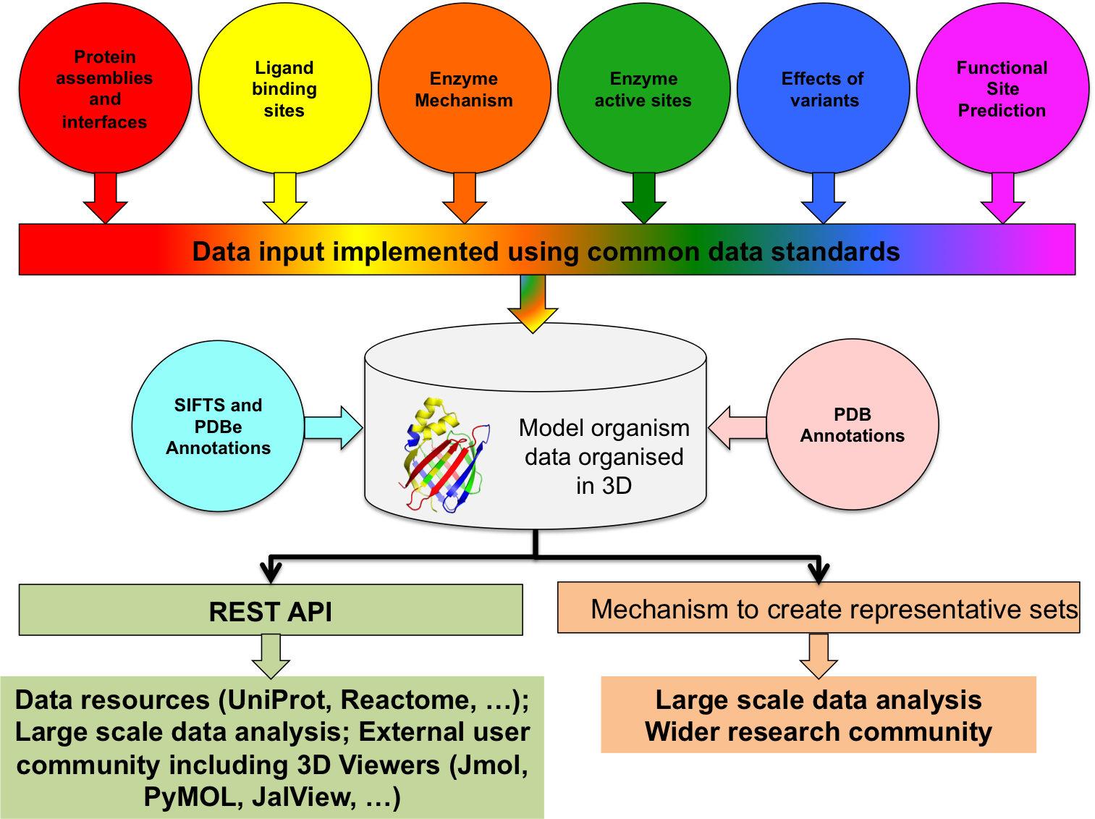
Types of data committed by partners

Slide 11
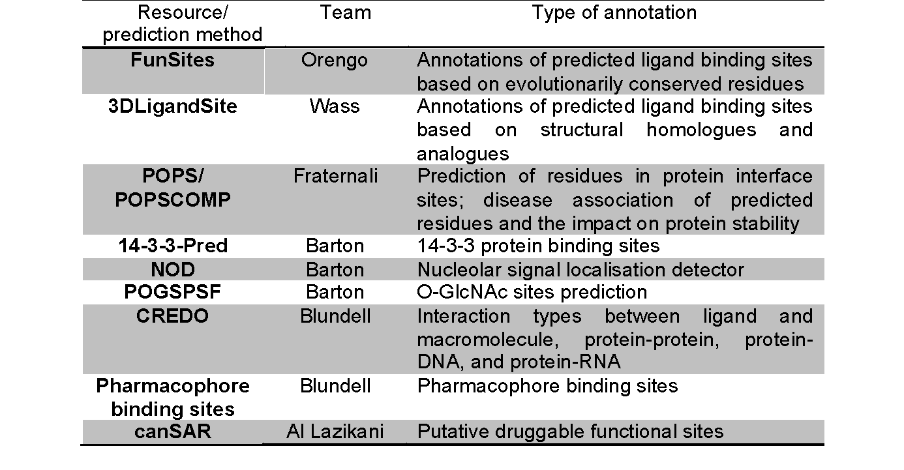
Resources on board
… and counting

Slide 12
High-level overview of the FunPDBe workflow
“Data IN”
“Data OUT”

Slide 13
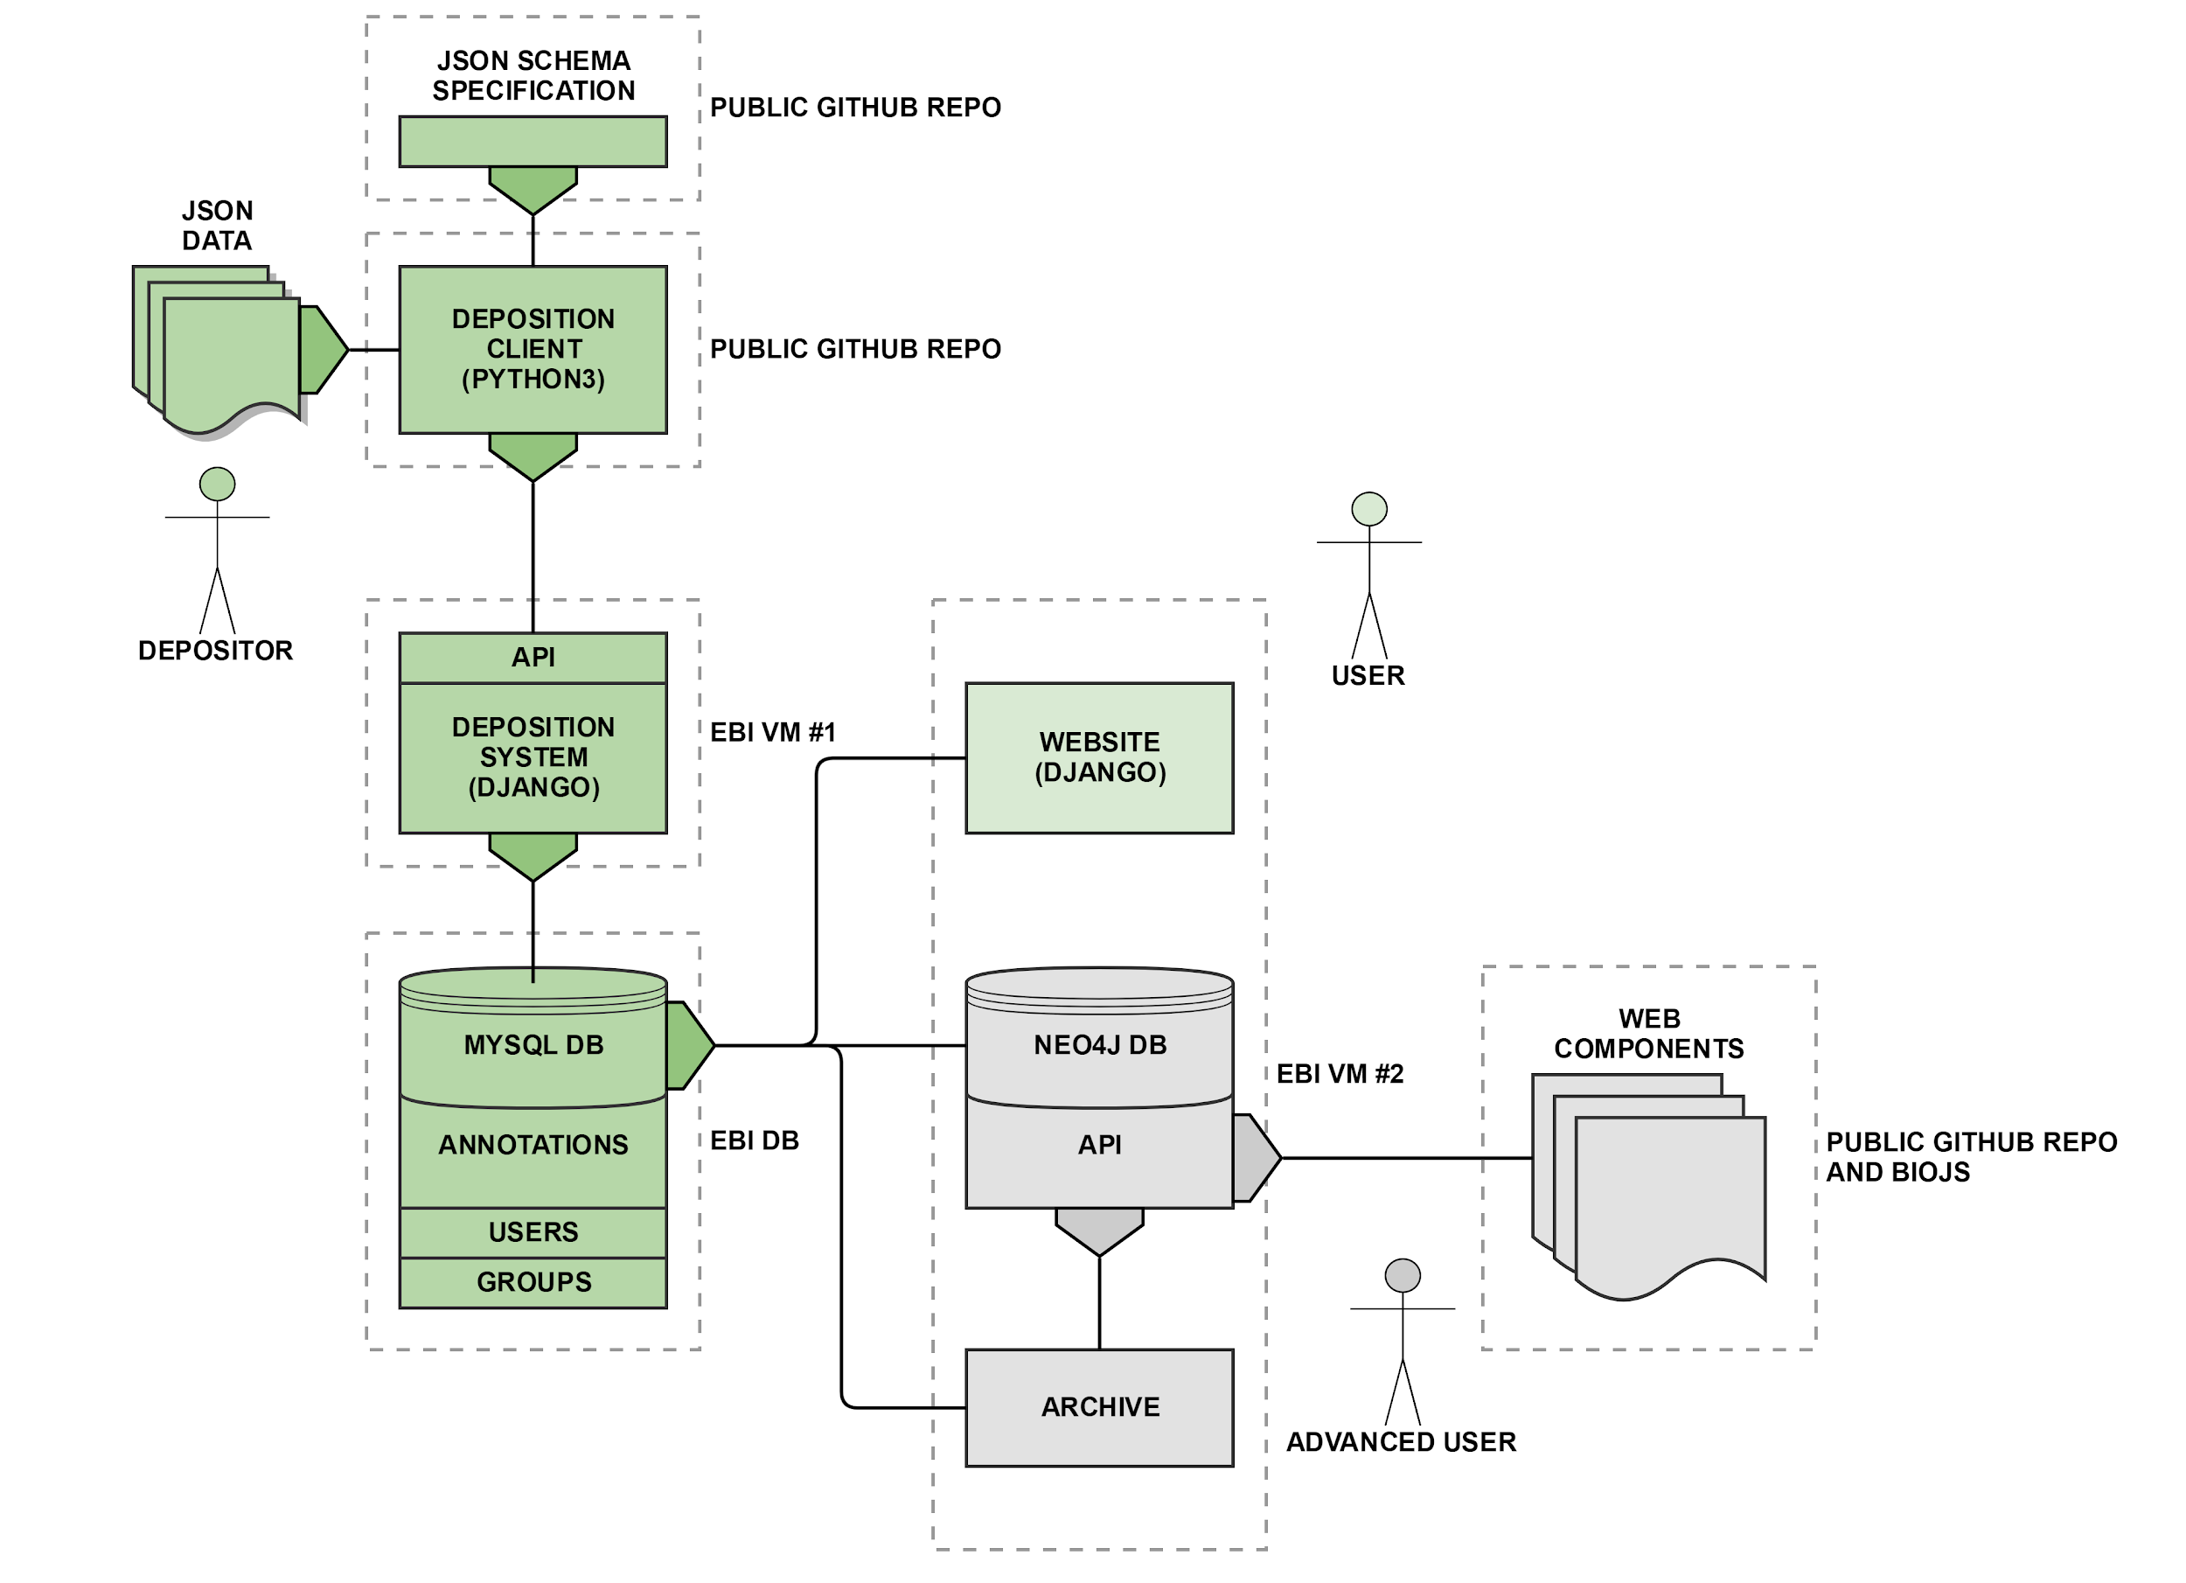
Detailed workflow

Slide 14
Deposition
The deposition format is specified as JSON schema.
Python client to push data is available.
Communicates over RESTful API (GET/POST/DELETE/PUT). POST/PUT/DELETE is limited to resources the depositor has access to (admin granted permission, not automatic). The API soon to be released.
https://github.com/funpdbe-consortium

Slide 15
FunPDBe (Agreed guidelines)
PDBe will
Maintain the infrastructure
Update the annotations from member data resources
Have regular release of annotation data
Develop necessary API calls
Work with member data resources to develop and distribute web components for data visualisation.

Slide 16
FunPDBe (Agreed guidelines)
Member data resource will
Follow established standards for providing annotations - in absence of a standard work with FunPDBe members to develop standards
Produce at least one release per year
Must be seen to be evolving, either adding new entries or expanding existing annotations
Send representative to an annual workshop, at their own cost.

Slide 17
Conclusion
There is a vast and diverse universe of protein functional annotations, which is difficult to explore on its own.
PDBe-KB is a new community-driven resource to bind diverse resources providing functional annotation of protein structures, to promote interoperability and comparative analyses.
PDBe to provide infrastructure, update annotations, develop API calls and release data regularly.

Slide 18
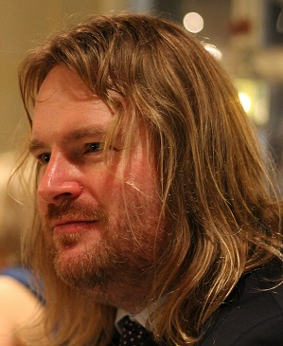
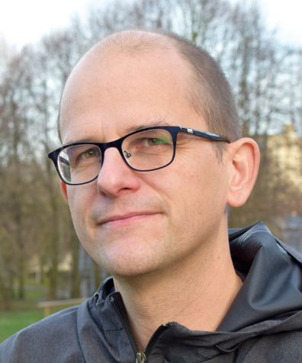
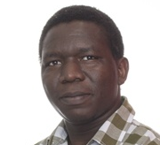
Acknowledgements
Sameer Velankar (lead PI)
Christine Orengo (WP1 PI)
Janet Thornton (WP2 PI)
Mike Sternberg (WP3 PI)
NoD, 14-3-3-Pred:
Geoff Barton
Stuart MacGowan
CREDO:
Tom Blundell
Marcin Skwark
canSAR:
Bissan al-Lazikani
Patricio DiMicco
FunPDBe infrastructure:
Mihály Váradi
Stephen Anyango
Aleks Gutmanas
FunSites:
Ian Sillitoe
Sayoni Das
3DLigandSite:
Mark Wass
Henry Martell
Dynamine:
Wim Vranken
POPSCOMP:
Franca Fraternali
Andrew Leach
Chris Radoux
Radka Svobodova Varekova
Alfonso Valencia Manuela Helmer-Citterich MS Madhusudhan Debasisa Mohanty

