Slide 1
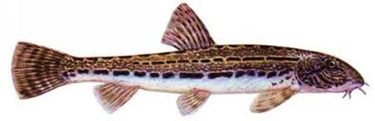
Assembling diploid genome of Cobitis taenia using Illumina short reads
June 13 2018
Martin Mokrejš

Slide 2
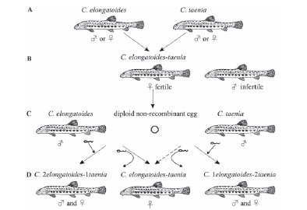
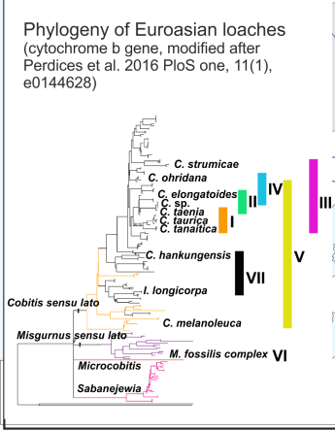
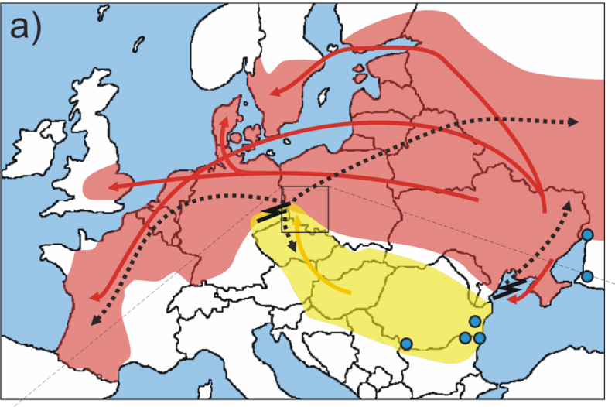
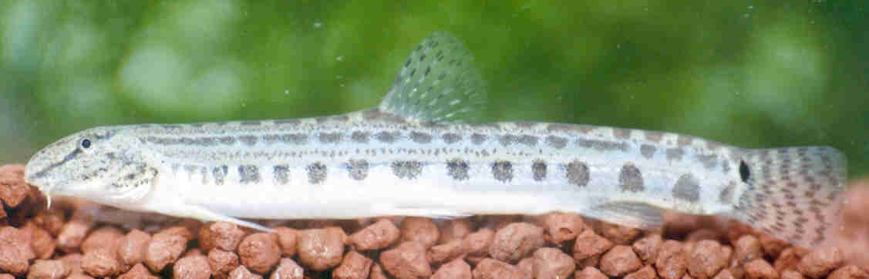
European loaches – suitable model case
Hybridisation among Cobitis species is known to produce clonal lineages;
Gynogenetic reproduction of hybrids
Hybrids exist in following forms:
ET, EET, ETT, EN, EEN, ENN,ETN, EP, EEP
Polyphyletic and dynamic origin of clones
Cobitis elongatoides E
Cobitis taenia T
Cobitis tanaitica N
Cobitis pontica P
Janko et al. 2006 Mol. Ecol.; Choleva et al. 2012 Evolution

Slide 3
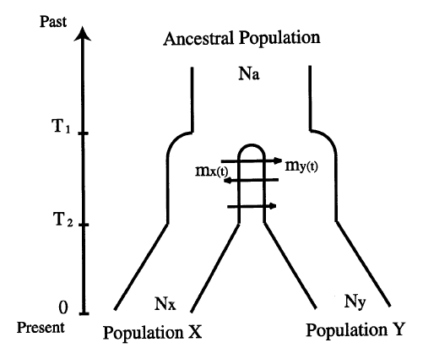
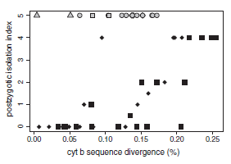

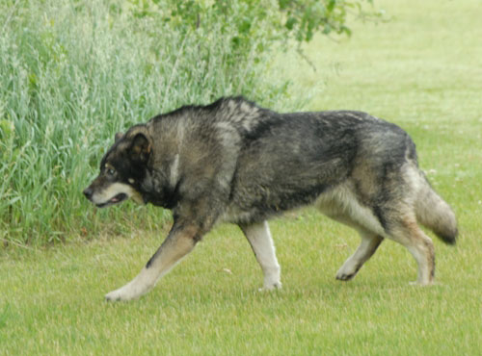
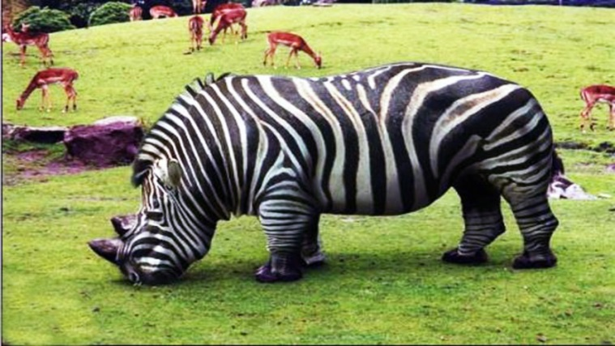
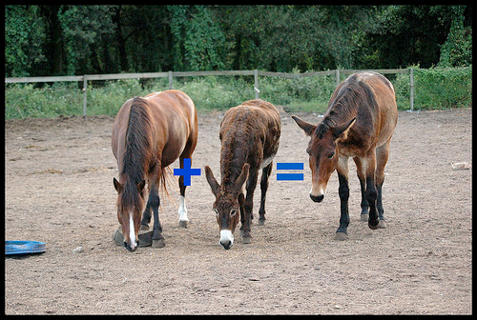

Asexual reproduction and polyploidy arises as a by-product of hybridization/speciation continuum
Russell 2003 Ann.Zool.Fenn.

Slide 4
Expected genome size? 1.3Gbp

Slide 5
Existing RNA and DNA sequences in public databases
RNA
Cyprinus_carpio/GCF_000951615.1_common_carp_genome_rna.fna 75414
Cyprinus_carpio/GCF_000951615.1_common_carp_genome_rna_from_genomic.fna
77 014
Cobitinae/txid278169__nucest.fna 22 186
DNA
Cyprinus_carpio/GCF_000951615.1_common_carp_genome_genomic.fna
9 378
Cobitinae/txid278169__nuccore.fna 19 490

Slide 6
mtDNA genomes (16 541 bp)
Cobitis elongatoides mitochondrion
Cobitis biwae mitochondrion
Cobitis choii mitochondrion
Cobitis granoei mitochondrion
Cobitis lutheri mitochondrial DNA
Cobitis matsubarai voucher mitochondrion
Cobitis minamorii minamorii mitochondrial DNA,
Cobitis minamorii tokaiensis mitochondrial DNA
Cobitis sinensis mitochondrion
Cobitis striata mitochondrion
Cobitis striata striata mitochondrial DNA
Cobitis takatsuensis mitochondrion
Sarcocheilichthys variegatus microoculus mitochondrion

Slide 7
Sequence datasets of the Cobitis (fish) genome
Illumina 2x250nt reads paired-end, inserts ~600bp
Illumina 2x250nt reads mate-pair:
5kbp
8kbp
5kbp

Slide 8
Quality control steps
raw vs. trimmed FASTQ files can inspected
FASTQC/MultiQC
trimmomatic
KAT
assembled unitigs/contigs/scaffolds can be inspected
ntCard/jellyfish
GenomeScope
KAT

Slide 9
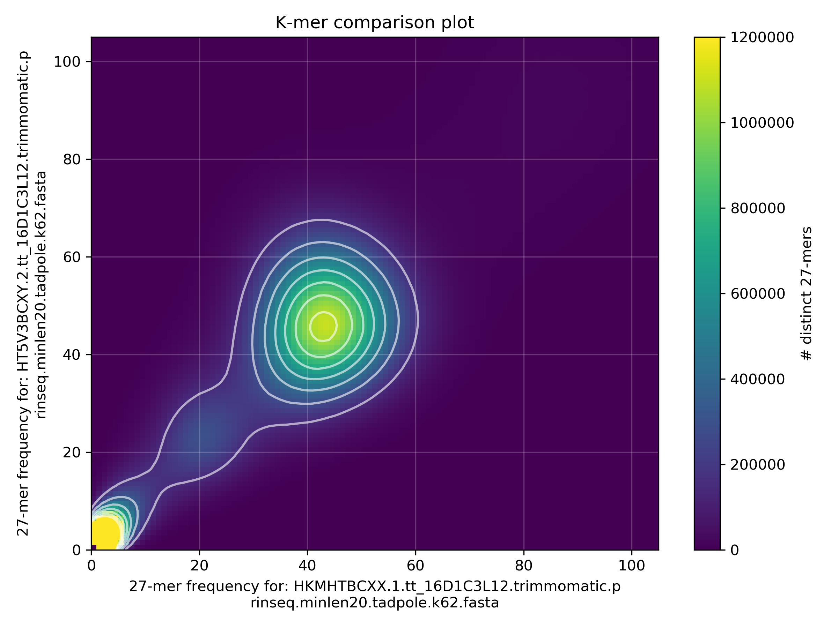
Basic quality-control checks, PE2016 vs. PE2017 libraries,
kmer freq. vs. kmer freq.

Slide 10
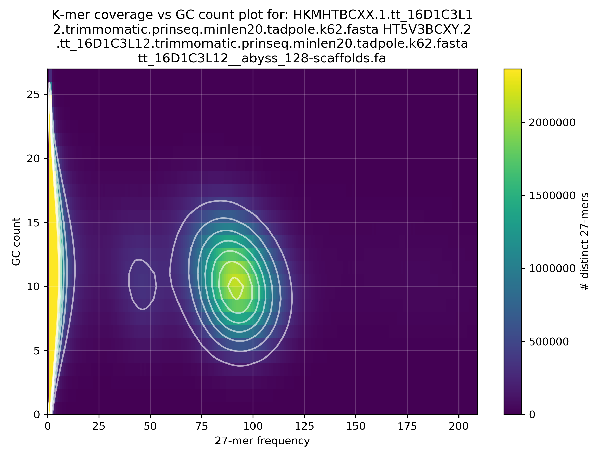
Basic quality-control checks, PE2016 vs. PE2017 libraries,
kmer freq. vs. GC-content

Slide 11
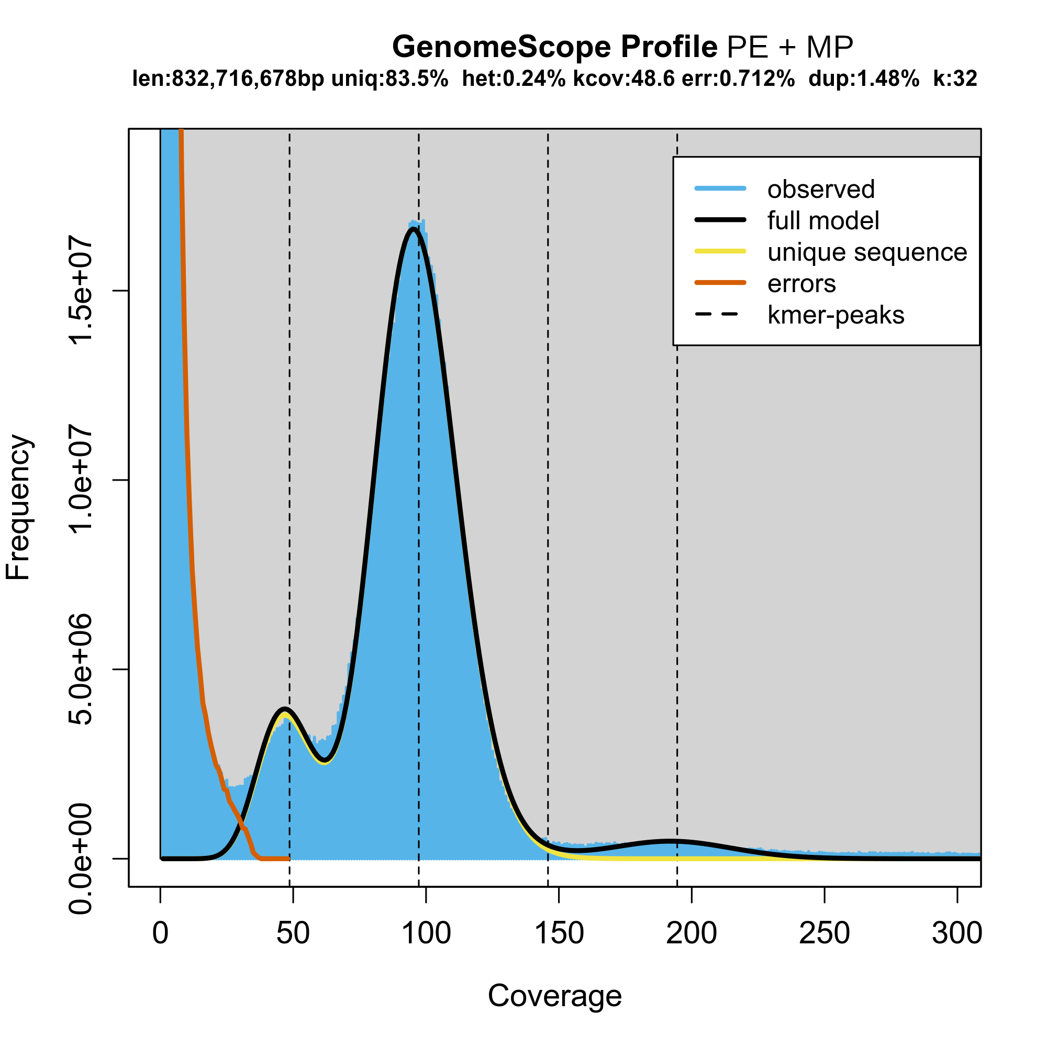
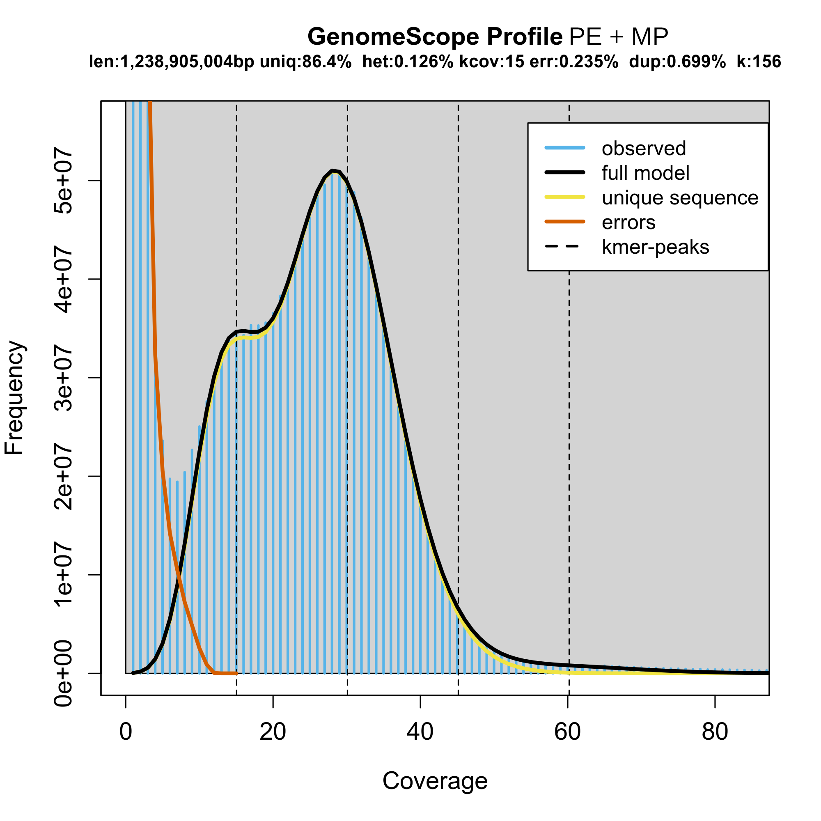
K-mer frequency analysis of cleaned reads reveals diploid and haploid portions of the genome

Slide 12

Computational resources spent so far
32 TB working dataset (FASTQ, BAM, VCF)
731 GB working 454 cDNA datasets
723 856 CPU hours burned under OPEN-9-41 project
Future work under OPEN-13-42 with 448 000 core-hours available from 2018-05-25 to 2019-02-20.
www.it4i.cz
Technical University of Ostrava

Slide 13
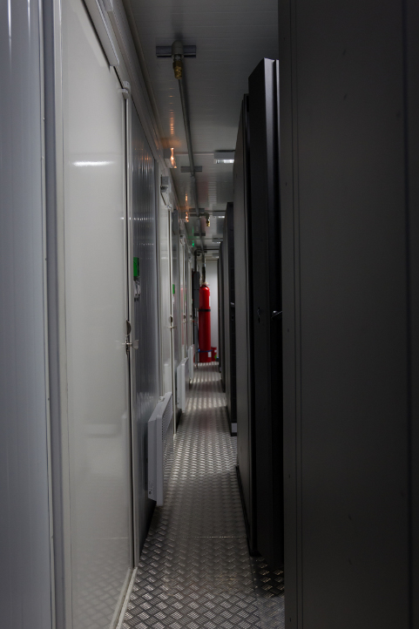
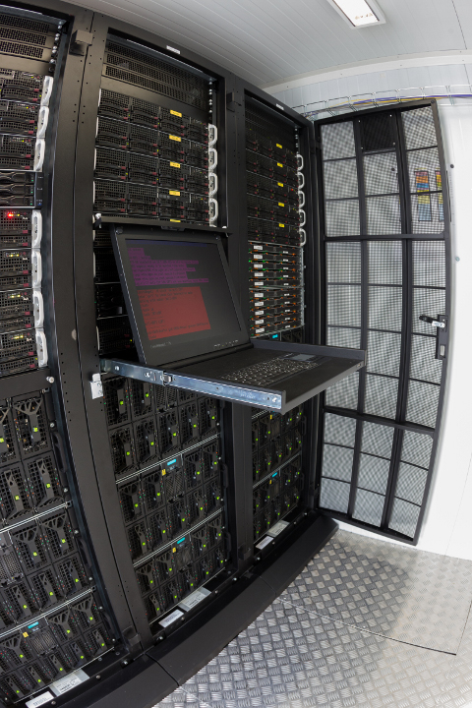
Anselm in numbers
209 compute nodes
3344 Intel Sandy bridge cores
15136 GB RAM (64, 96, 512)
24 nVidia Tesla K20
4 Intel Xeon Phi (240 cores)
Rpeak 94TFlop/s (94*10^12 flops per sec)
Rmax 73TFlop/s (LINPACK)

Slide 14
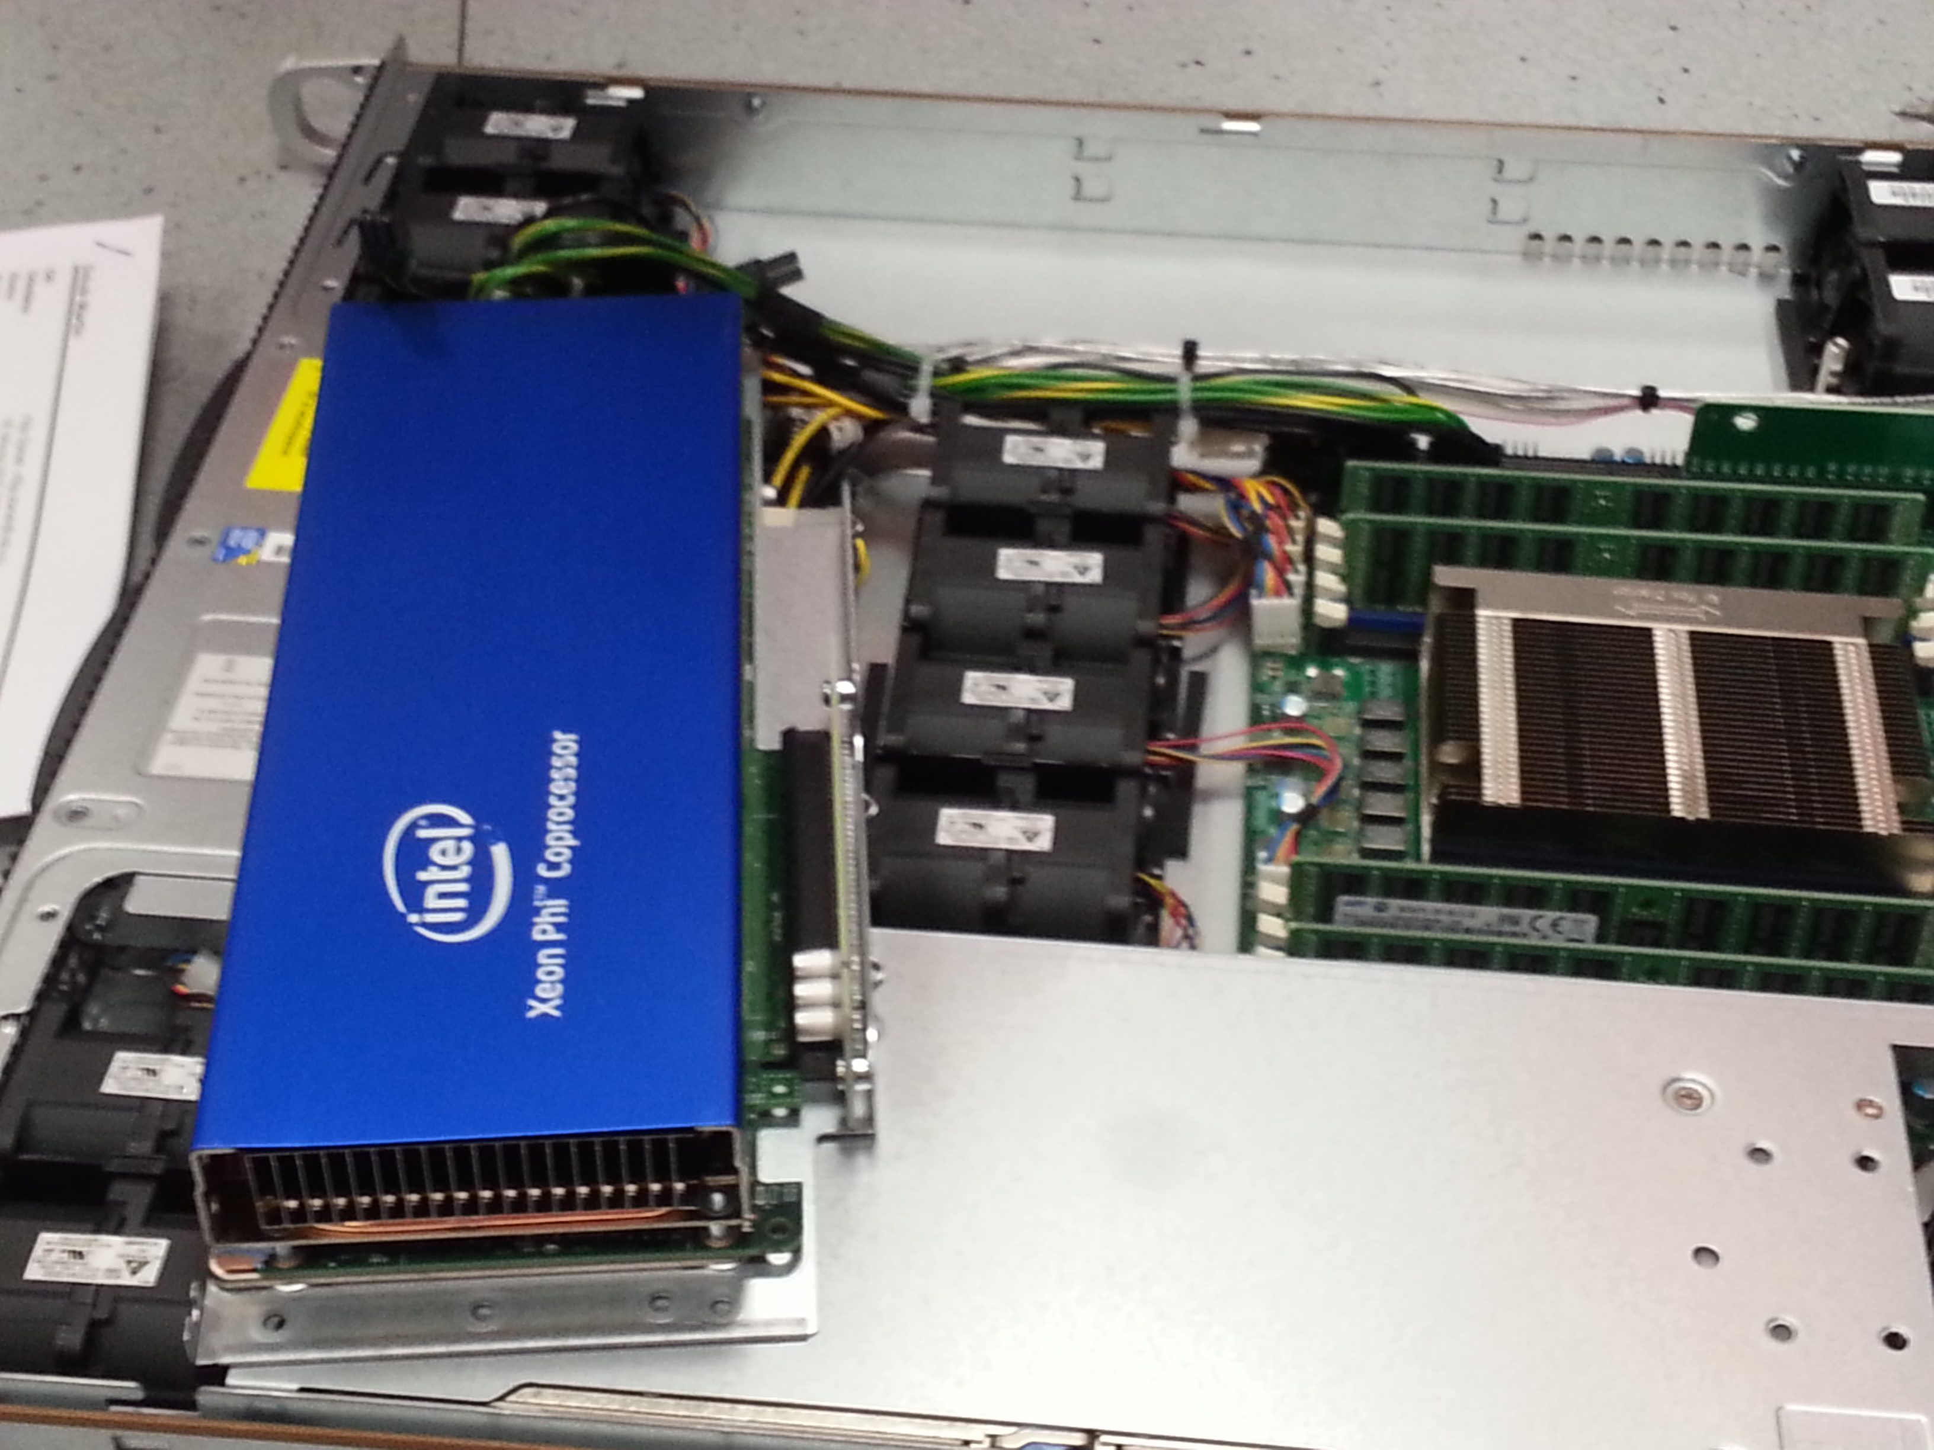
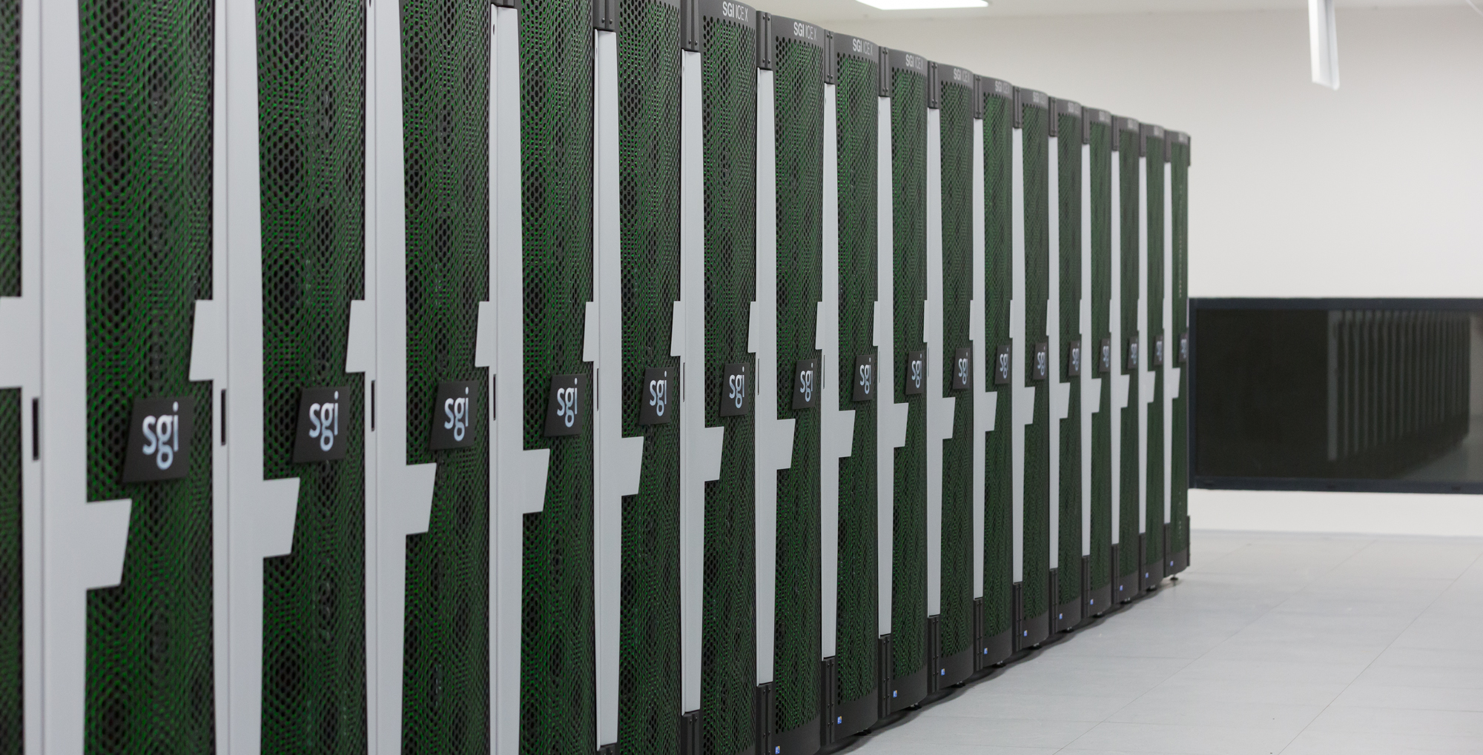
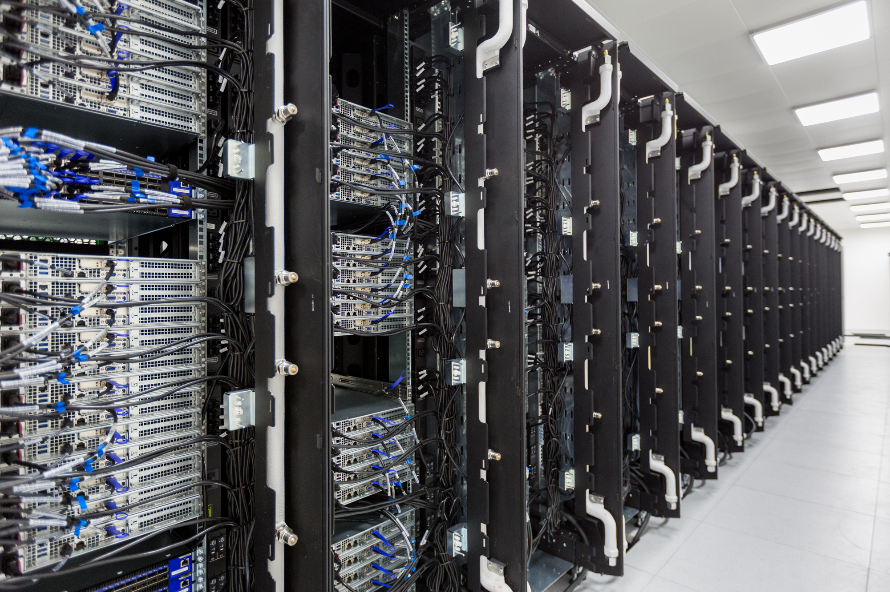
Salomon in numbers
1008 compute nodes
24192 Intel Haswell cores
129024 GB RAM (128)
864 Intel Xeon Phi 7120P (52704 cores)
Rpeak 2PFlop/s (2*10^15 flops per sec)
Rmax 1.5Flop/s (LINPACK)

Slide 15
Cleanup of Roche/454 normalized cDNA transcriptomes
Jobs running since Feb 9 using 2-4 CPU threads for each dataset:
dataset A-side B-side
GYAB93P01 88.9% 85.2%
HRTMUOC01 79.2% 75.6% (4 barcodes, 2 of them are unexpected, known RL12(lu16)+RL09(co09)), v datasetu jsou rozhodne
navic RLMID7 (19678x) a RLMID8 (20792x); pro srovnani RLMID9 (161696x), RLMID12 (77666x)
HULCKIV01 100% 95.5%
Completed as of 13. 6. 2018:
GPYRH5H01 100% 100%
GPYRH5H02 100% 100%
G736HC301 100% 100%
IFMUJ8102 100% 100%
IGASIBU01 100% 100%
HRTMUOC02 100% 100% (4 barcodes, 2 of them are unexpected, known RL10(co10)+RL11(co11)), v datasetu jsou rozhodne
navic RLMID5 (29594x) a RLMID6 (25724x); pro srovnani RLMID10 (318638x), RLMID11 (41880x)
IFMUJ8101 100% 100%
G3UKN3Q01 100% 100% 1.2% unmatched, 25.6% match to carp/Cobitinae, 706584
G3UKN3Q02 100% 100%
G736HC302 100% 100%
GS60IET01 100% 100%

Slide 16
The transcriptomic data were already be used for:
design of TargetedEnrichment probes for sequencing of a population of individuals
mapping of reads and prediction of informative SNPs
Transcriptomic data will be used for:
prediction of actively transcribed genes
further scaffolding/ordering of genomic contigs (abyss)

Slide 17
Genome assemblies
SOAPdenovo
SPAdes-3.11.1
abyss-2.0.2 and 2.1.0

Slide 18
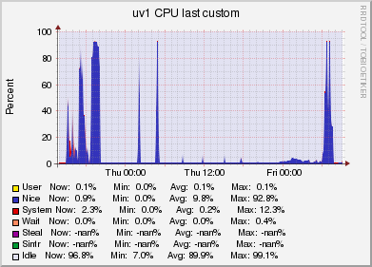
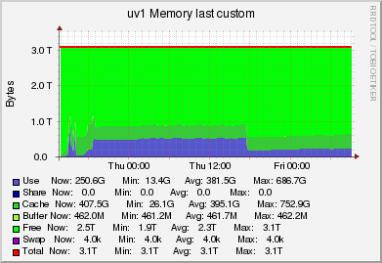
SPAdes 3.11.1 assembly attempts
no good results nor performance, placing input data + $tmpdir into /dev/shm is a must
had to use --read-buffer-size and --tmp-dir options
badly scaling, k-mer splitting/counting is single-threaded
no expected remaining computations time is printed
scaffolding crashed
error-correction using builtin hammer tools uses k=21 (suboptimal)
can perform several incremental assemblies but after the last k-mer size moves to gap closing (without outputting intermediate files)

Slide 19
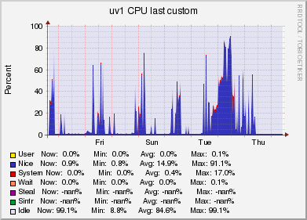
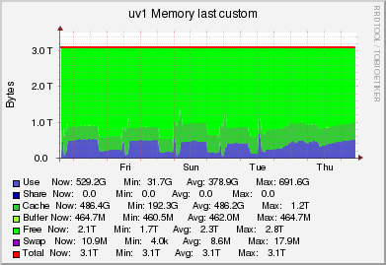
SPAdes: Series of several incremental assemblies with increasing k-mer sizes

Slide 20
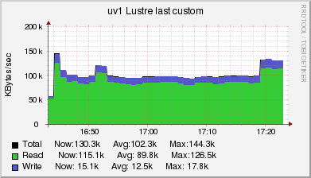
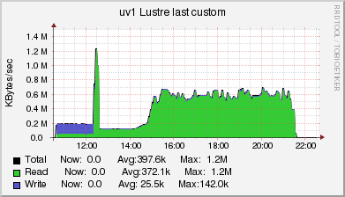
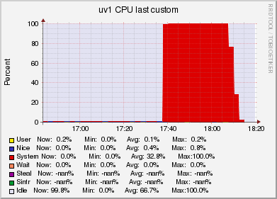
SPAdes: reading/writing of output files is slow (1 MBps vs. 0.6 – 1.2 GBps)
SPAdes supposedly writes out data in too small chunks (should be 1MB or even 10MB in size)
too many of too small chunks kill the LustreFS filesystem servers and cause data loss

Slide 21
Genome assemblies
abyss-2.0.2
  ECC correction using tadpole.sh, k=63
  k-mer sizes 64, 96, 128, 144, 160, 192
  tuning of N value did not improve contiguity (weird)
    abyss_k128_ecc_N10/tt_16D1C3L12__abyss_128-scaffolds.fa
    abyss_k128_ecc_N10/tt_16D1C3L12__abyss_128-contigs.fa
n n:500 L50 min N80 N50 N20 E-size max sum name
3282088 479704 87706 500 1203 2936 6202 4112 57779 921.7e6 tt_16D1C3L12__abyss_128-unitigs.fa
2524714 320183 47968 500 2439 5684 11904 7801 84004 972.2e6 tt_16D1C3L12__abyss_128-contigs.fa
2383939 195685 4463 500 7332 48678 144350 83684 910150 968.8e6 tt_16D1C3L12__abyss_128-scaffolds.fa

Slide 22
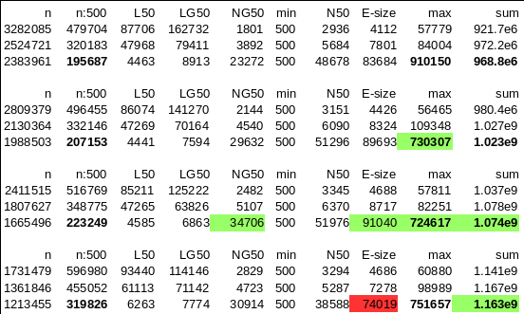
Several very good assemblies were prepared by abyss-2.0.2 using error-corrected reads
N50 is the length of the contig, and L50 is the number of the contigs whose size is N50 or larger. Yes it's weird, but that's the way it is.
See https://en.wikipedia.org/wiki/N50,_L50,_and_related_statistics
and http://quast.bioinf.spbau.ru/manual.html#sec3.1.1

Slide 23

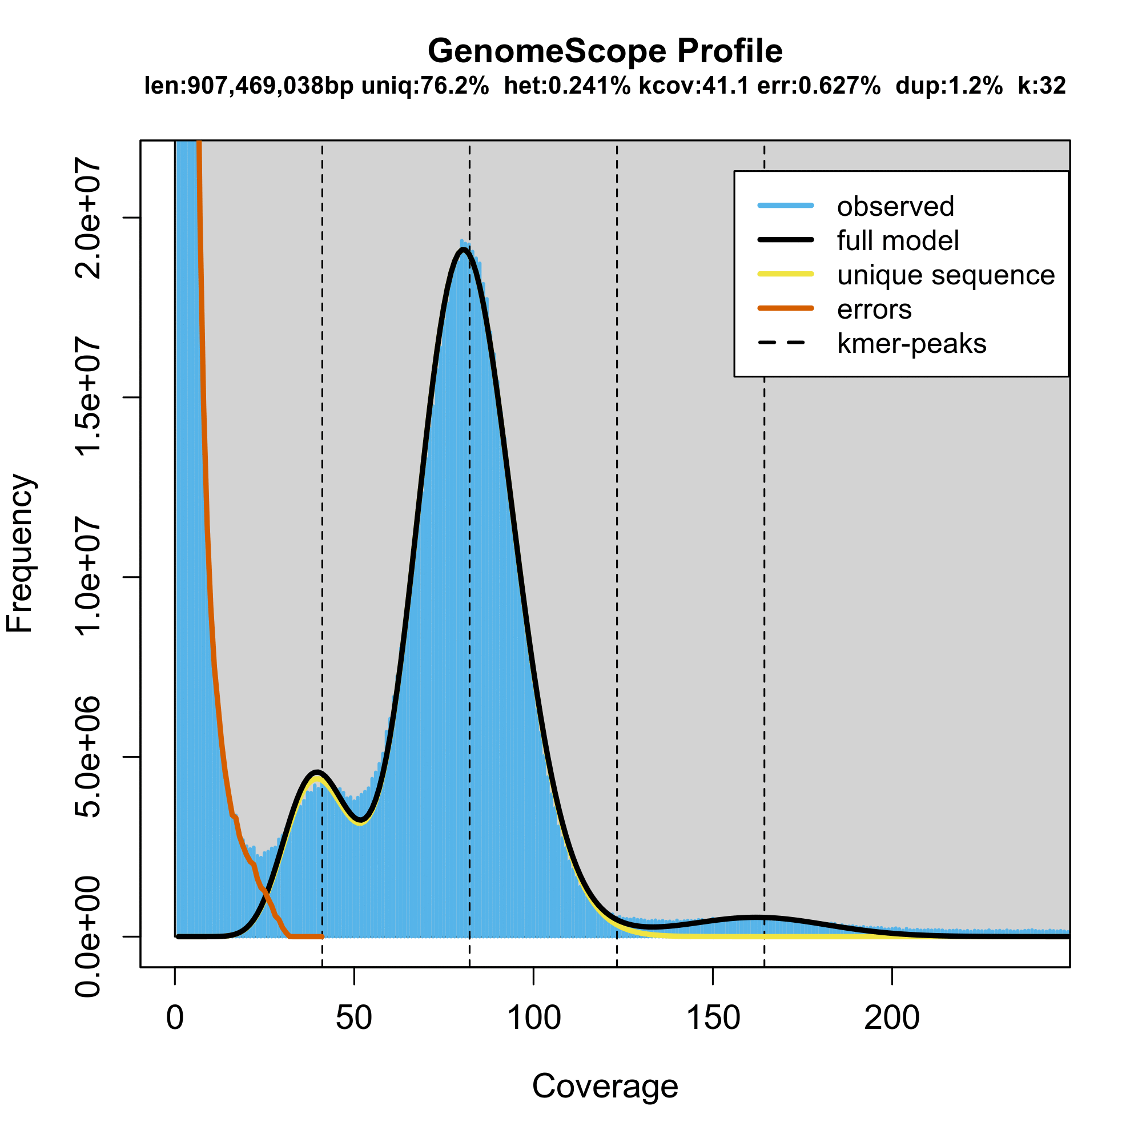
Animated GIFs with distribution of k-mer-based coverages and genome size estimations from them
Paired-end and mate-pair data considered
Paired-end data only considered

Slide 24
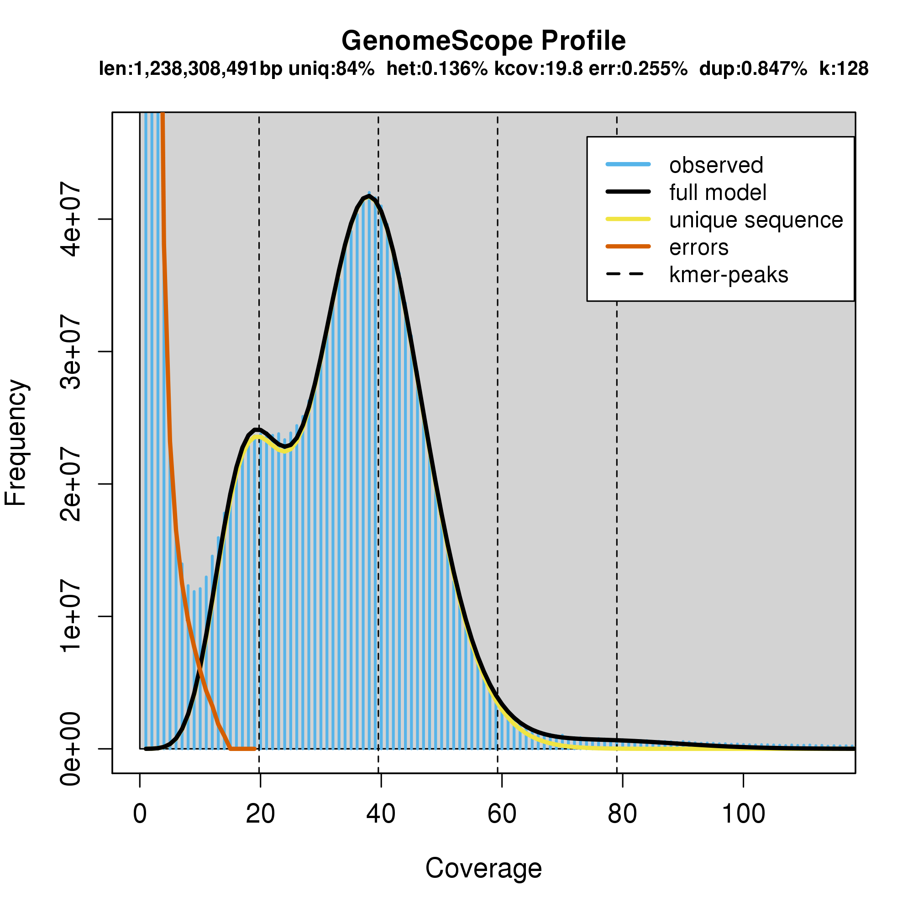
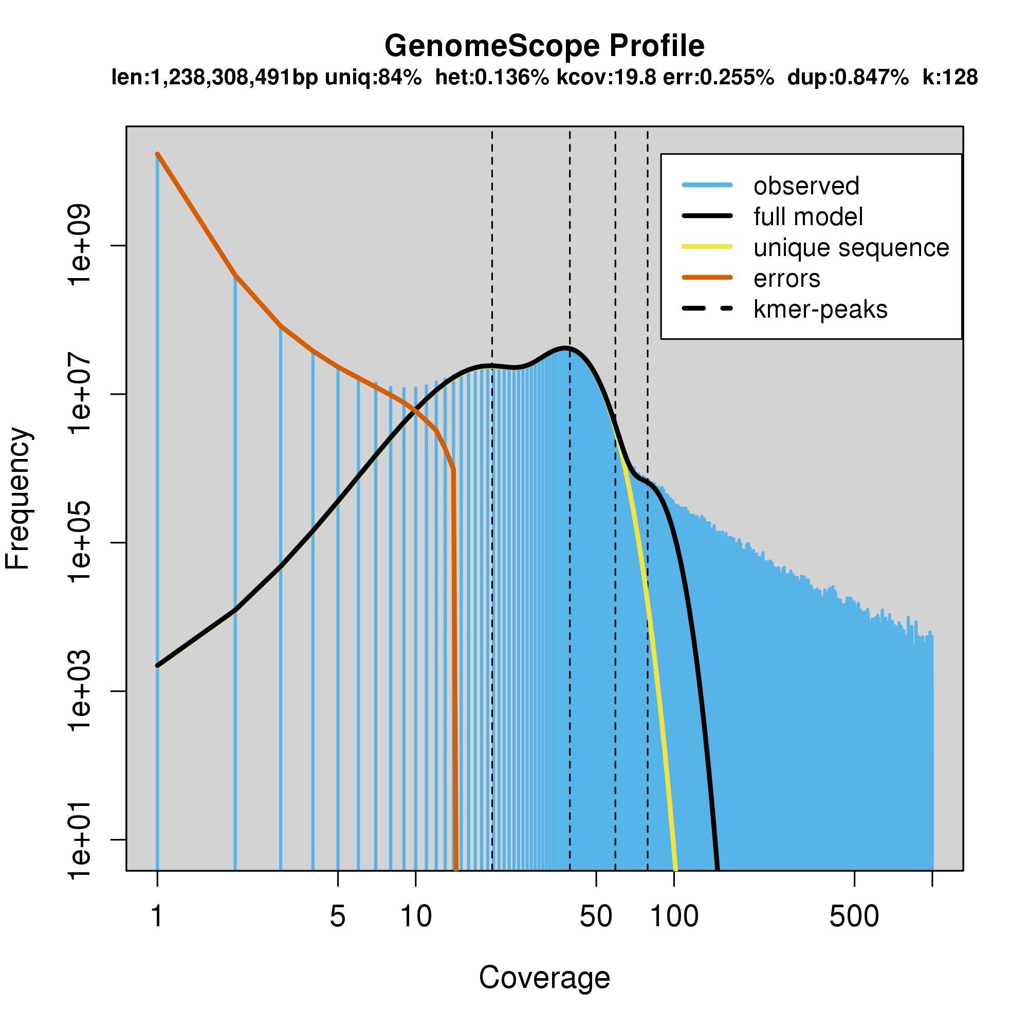

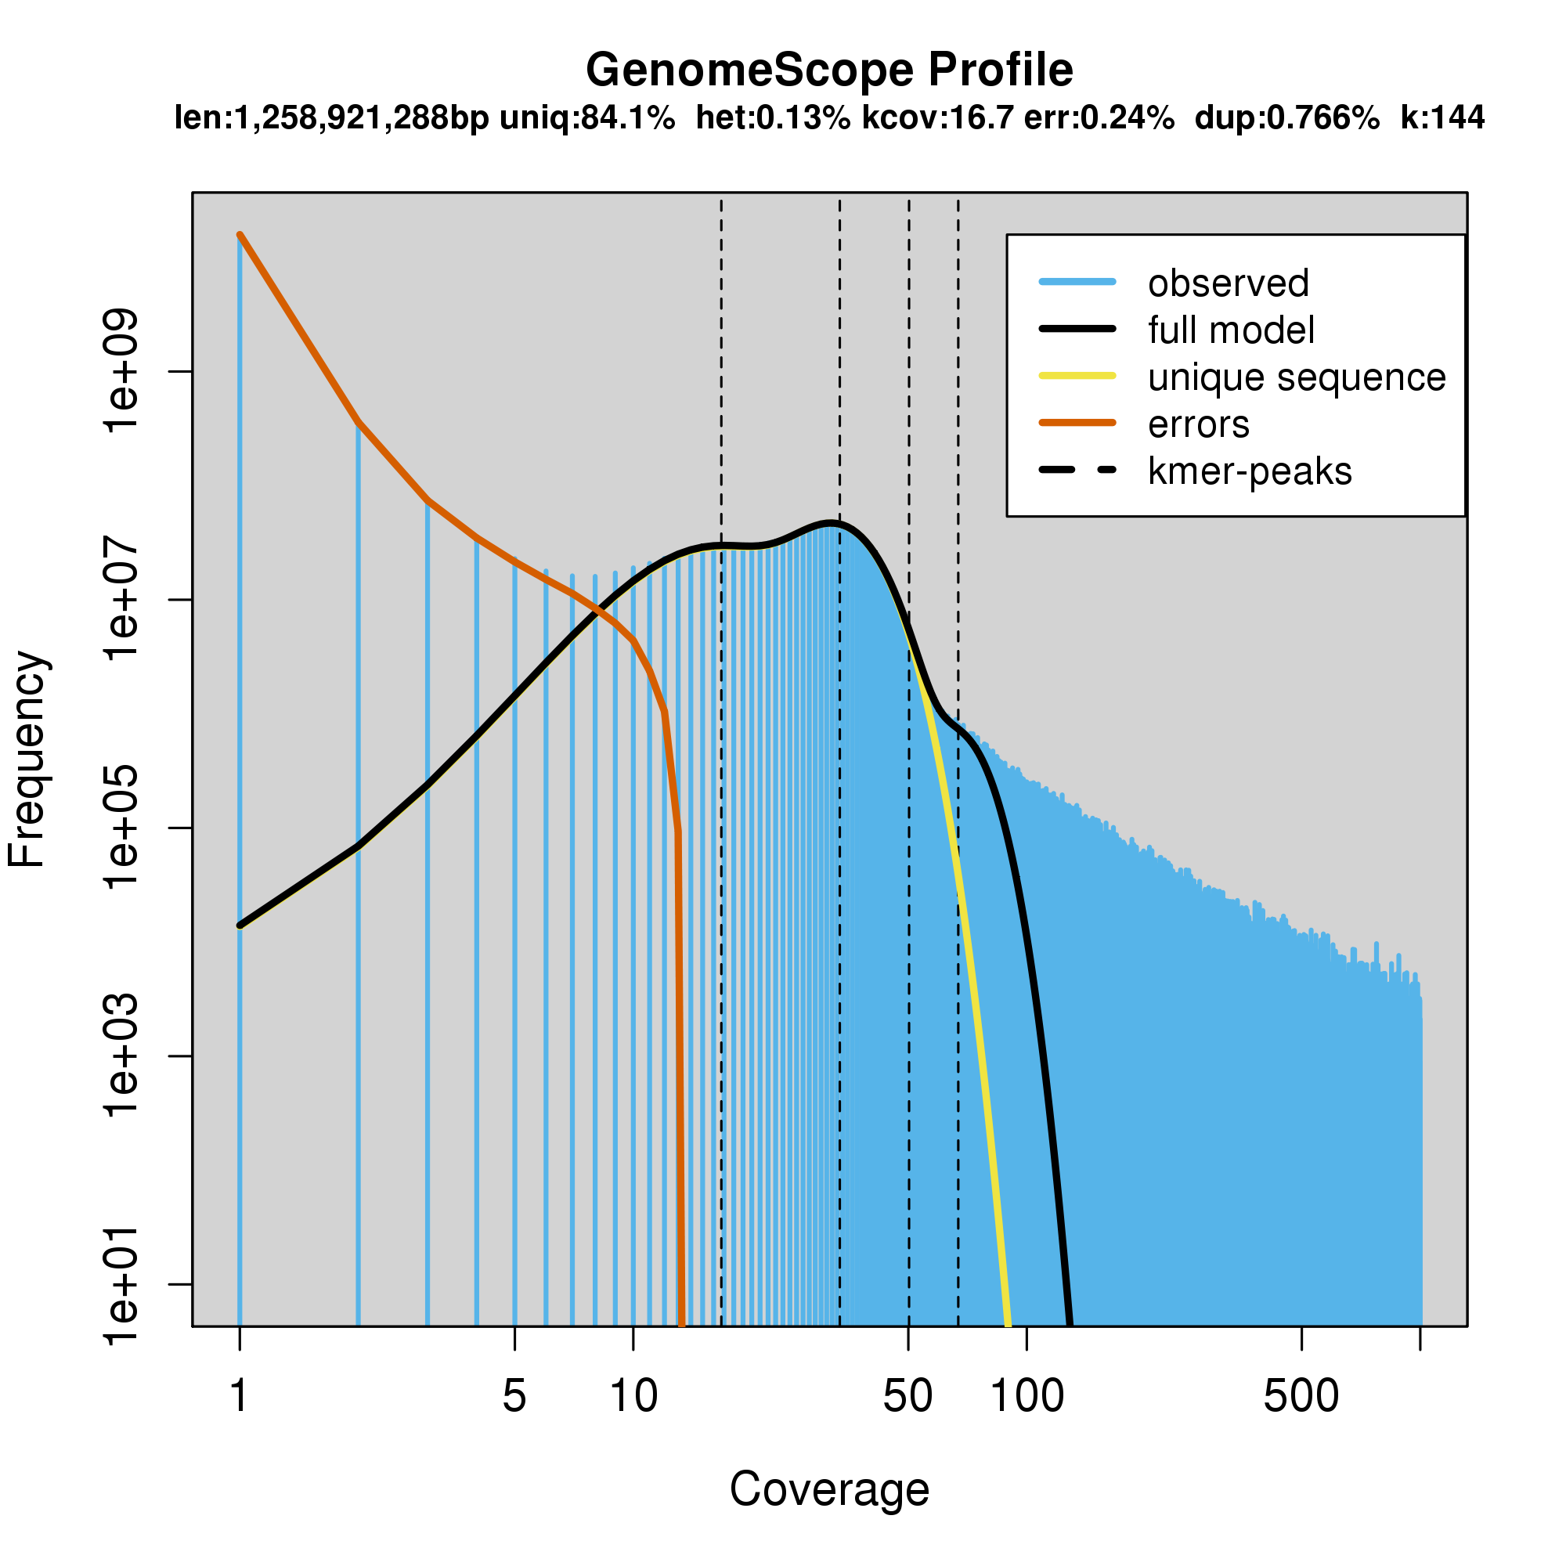
tt_16D1C3L12__PE-only__ntCard_k128.histo http://qb.cshl.edu/genomescope/analysis.php?code=HBnsyGEI1MNQDu1sB3fW
GenomeScope version 1.0
k = 128
property min max
Heterozygosity 0.135367% 0.136532%
Genome Haploid Length 1,236,859,142 bp 1,238,308,491 bp
Genome Repeat Length 197,837,241 bp 198,069,067 bp
Genome Unique Length 1,039,021,900 bp 1,040,239,424 bp
Model Fit 96.0452% 98.0828%
Read Error Rate 0.255411% 0.255411%
tt_16D1C3L12__PE-only__ntCard_k144.histo http://qb.cshl.edu/genomescope/analysis.php?code=2ZkJ2eyTW83ZdmDl98mk
GenomeScope version 1.0
k = 144
property min max
Heterozygosity 0.129235% 0.13013%
Genome Haploid Length 1,257,611,366 bp 1,258,921,288 bp
Genome Repeat Length 200,553,631 bp 200,762,527 bp
Genome Unique Length 1,057,057,735 bp 1,058,158,761 bp
Model Fit 96.5393% 98.5629%
Read Error Rate 0.239662% 0.239662%

Slide 25
tt_16D1C3L12__PE-only__ntCard_k156.histo http://qb.cshl.edu/genomescope/analysis.php?code=2ZkJ2eyTW83ZdmDl98mk
GenomeScope version 1.0
k = 156
property min max
Heterozygosity 0.127693% 0.128482%
Genome Haploid Length 1,267,403,131 bp 1,268,723,749 bp
Genome Repeat Length 201,426,908 bp 201,636,793 bp
Genome Unique Length 1,065,976,223 bp 1,067,086,957 bp
Model Fit 96.8822% 98.8092%
Read Error Rate 0.230913% 0.230913%

Slide 26
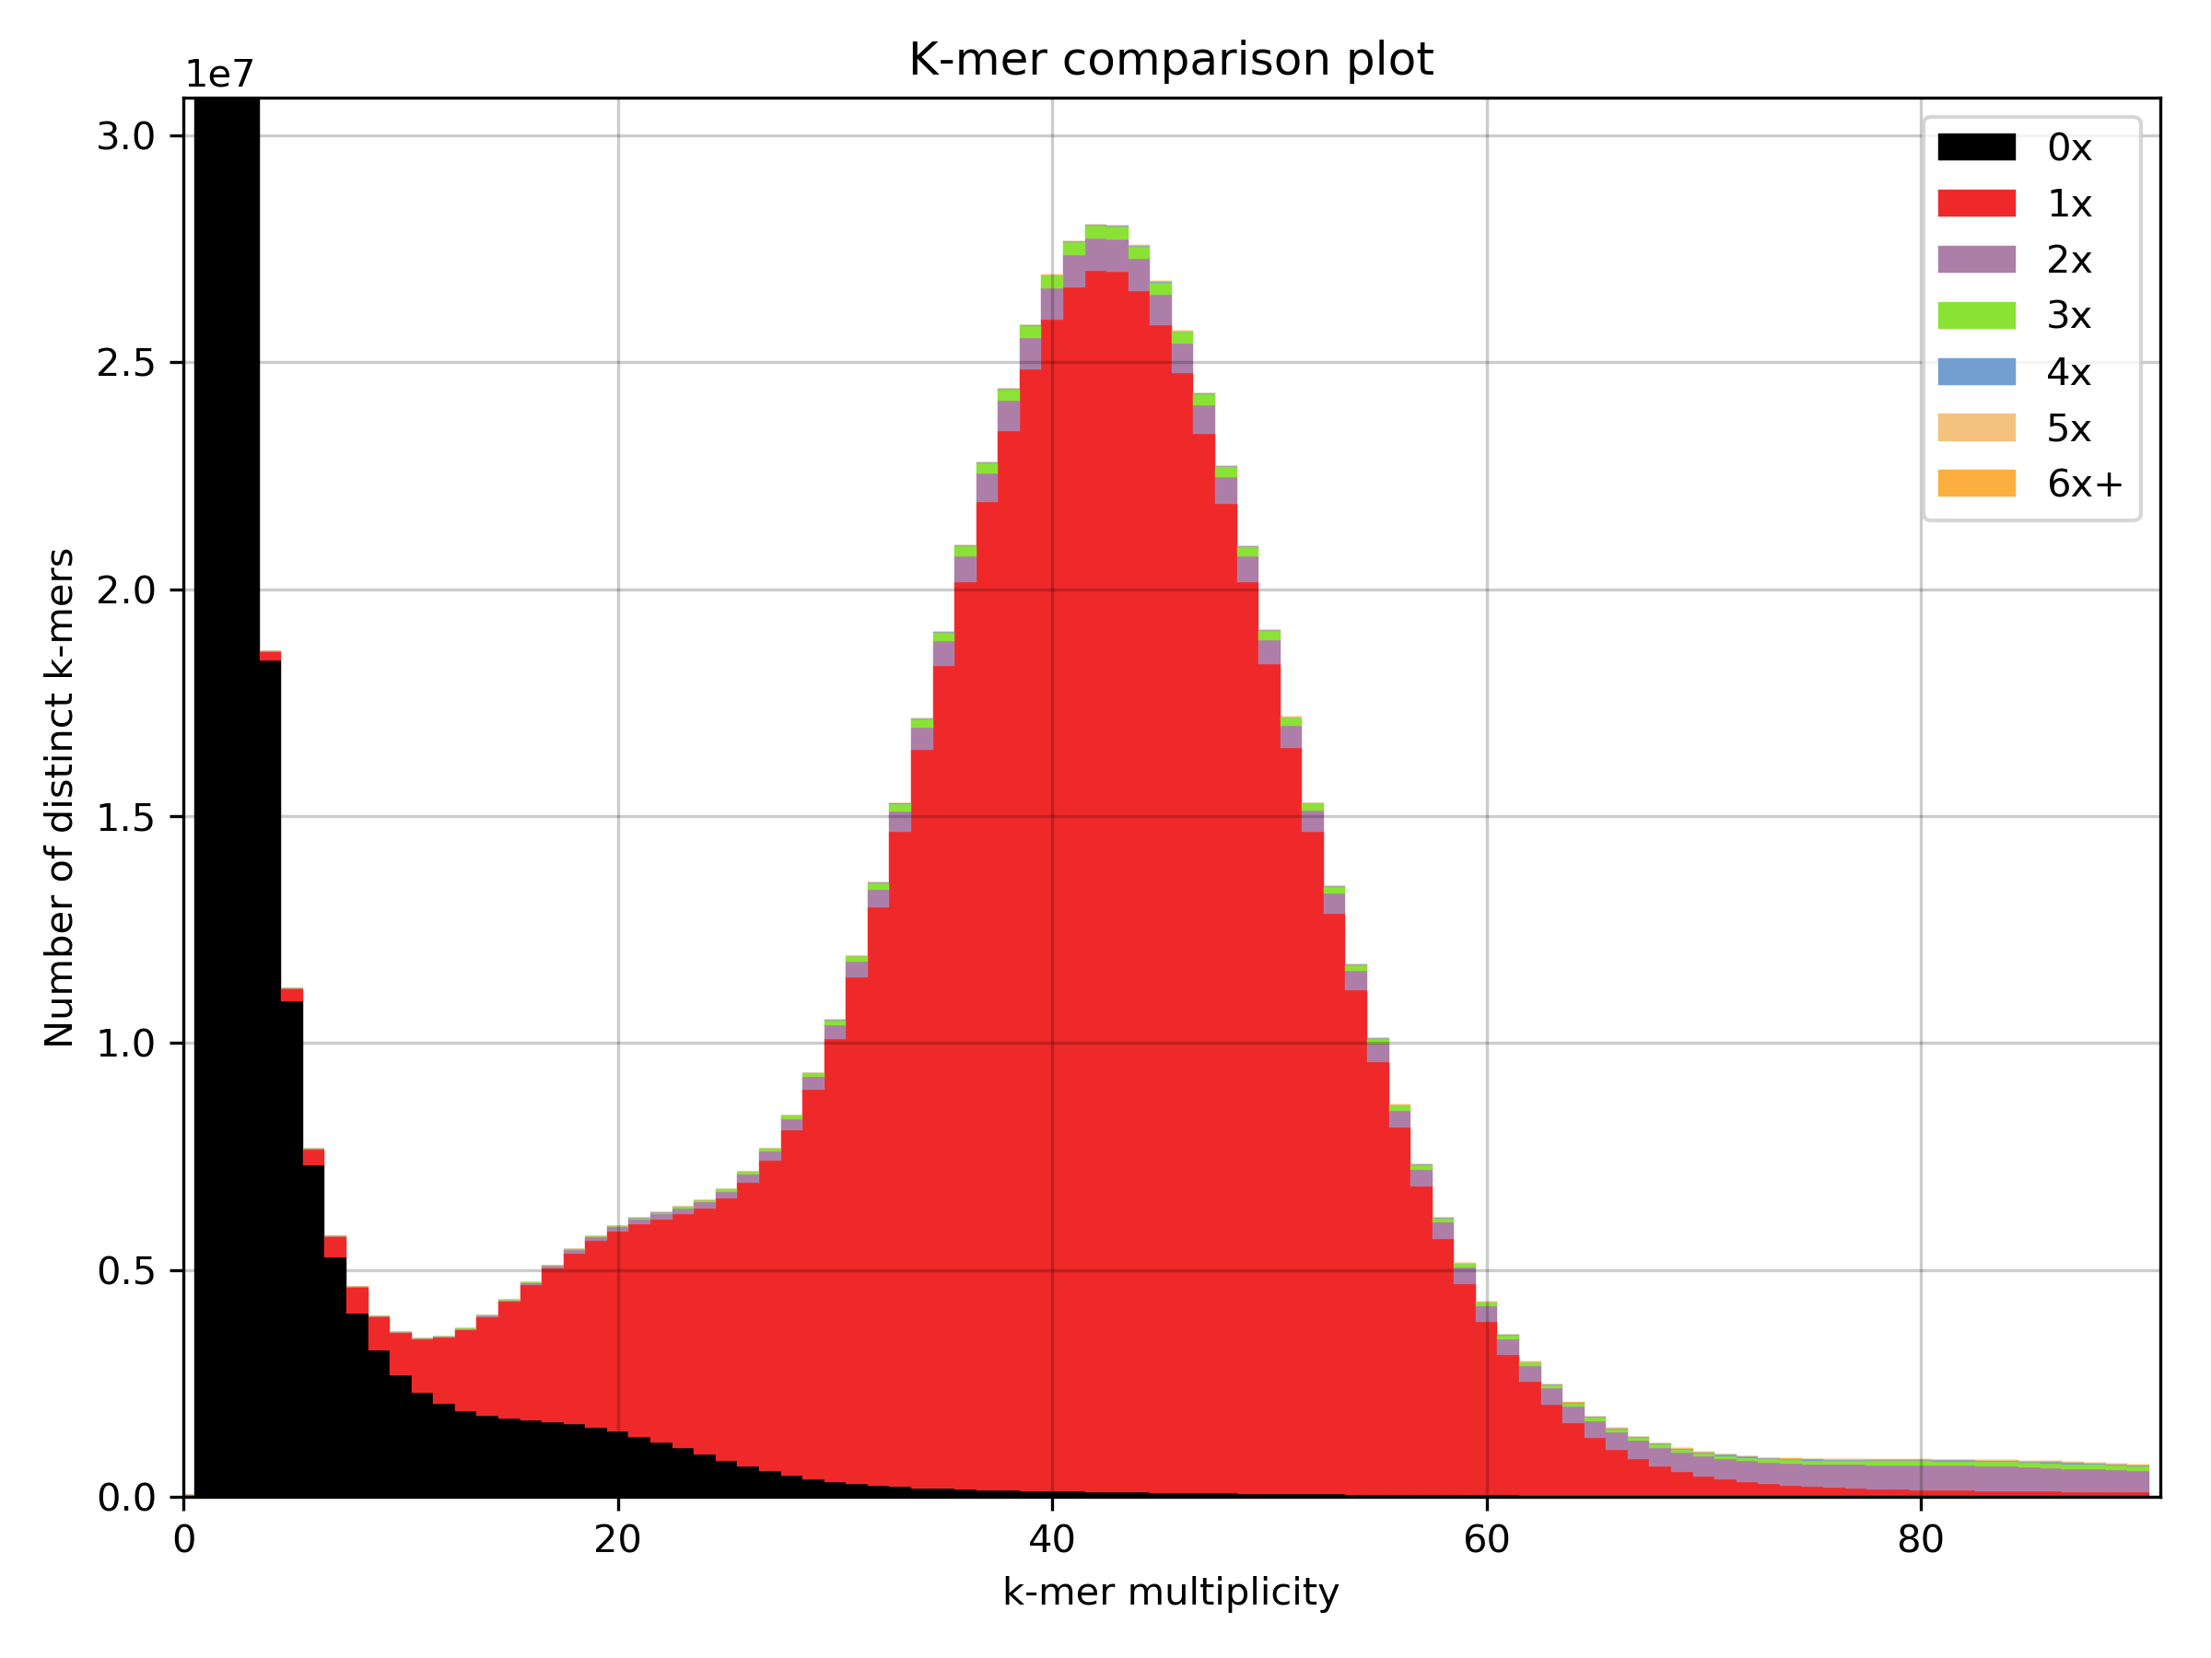
Basic quality-control checks, PE2016 vs. abyss-k160 assembly
Is the genome assembly at k=160 inflated?

Slide 27
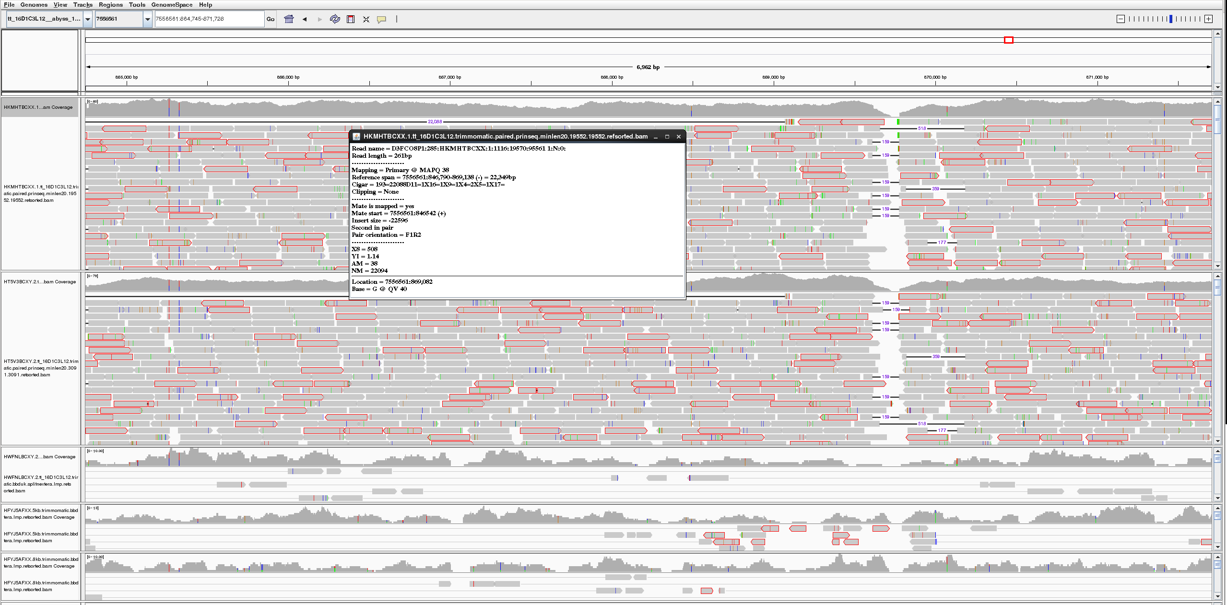
Gaps in the abyss_k128_ecc_N10 assembly and lots of read pairs with wrong insert-size (BBmap).

Slide 28
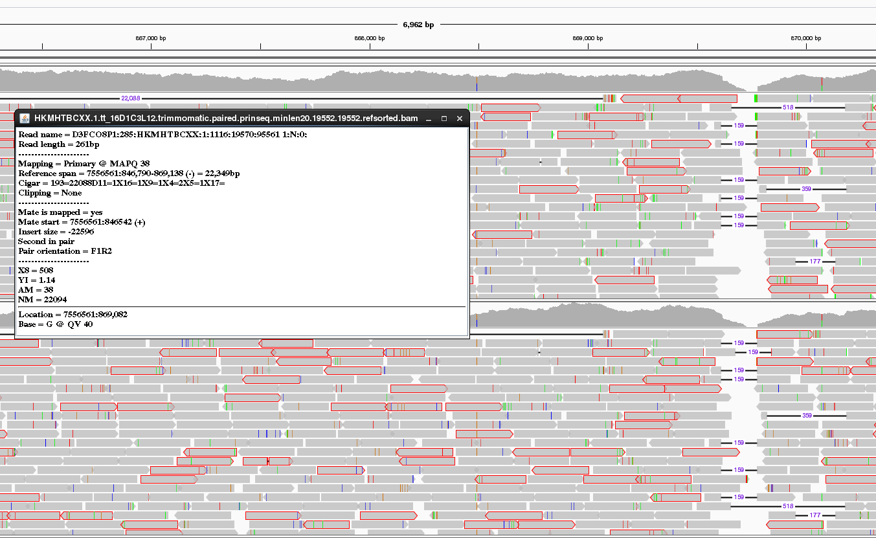

Slide 29
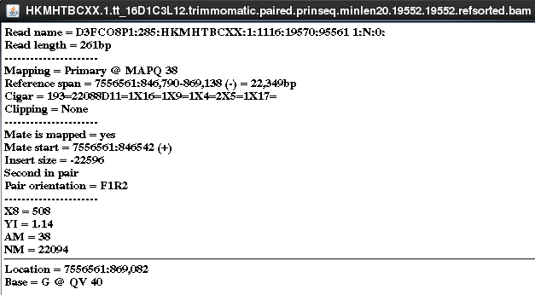
The insert-size -22596 bp of this paired-end read does not “make sense”
BBmap with 96% identity requirement

Slide 30
Gap closing + Misassembly correction + SNP/InDel fixes
abyss-sealer
  with default settings closed 10.8873% gaps, 106hrs wallclock at 104CPUs, used 3TB RAM, finished
  with ‘-B nolimits’ is too slow, mostly single-threaded, cancelled
pilon-1.22
  naive settings to correct issues and errors require an amazing lot of resources, cancelled
Job ID Username Queue Jobname SessID NDS TSK Memory Time S Time
--------------- -------- -------- ---------- ------ --- --- ------ ----- - -----
8011705.isrv5 mmokrejs qfat pilon 61528 1 8 3099gb 1200: R 201:30

Slide 31
Gap closing + Misassembly correction + SNP/InDel fixes (pilon-1.22, cancelled later on)
just 4 fully closed gaps out of 32 266 attempted so ar
  Confirmed 693 of 693 bases (100.00%)
  Confirmed 891 of 891 bases (100.00%)
  Confirmed 493 of 493 bases (100.00%)
  Confirmed 412 of 412 bases (100.00%)

Slide 32
Gap closing + Misassembly correction + SNP/InDel fixes (pilon-1.22)
20000
Relative portions of all existing gaps (both closed or not)
32 266 gaps of 195 685 processed so far
15000
Mostly no gap was closed and in few cases only ~90% were closed of a particular gap
Absolute count
10000
5000
0
0
20
40
60
80
100
Relative sizes of all gaps

Slide 33
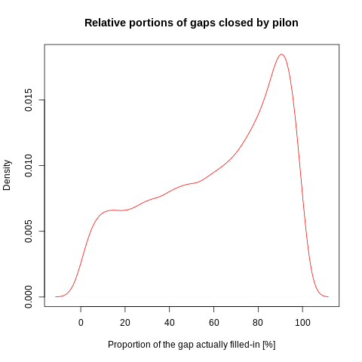
Gap closing + Misassembly correction + SNP/InDel fixes (pilon-1.22)
150
Relative portions of gaps actually closed by pilon
32 266 gaps of 195 685 processed so far
100
Absolute count
50
0
0
20
40
60
80
100
Relative size of the gap

Slide 34
Gap closing + Misassembly correction + SNP/InDel fixes (pilon-1.22)
32 266 gaps of 195 685 processed so far

Slide 35
Gap closing + Misassembly correction + SNP/InDel fixes (pilon-1.22)
35000
30000
Absolute sizes of all scaffold gaps, resp. of actually filled gaps
32 266 gaps of 195 685 processed so far
25000
20000
Absolute count
15000
10000
5000
0
500
1500
3500
7500
16000
34000
72000
160000
Gaps sizes in scaffolds [all (red), those acted upon (blue)]

Slide 36
Genomes contain loci with too similar sequences
Read mapping/aligning tools have multiple candidate loci where to place an NGS read
either use the one with the highest score
use as a a primary match and other as a secondary match
SNP callers work only with the primary matches and ignore the secondary matches
I investigated with what sequence identity BBmap aligns the reads
bwa mem does not record what sequence identity the alignment has

Slide 37
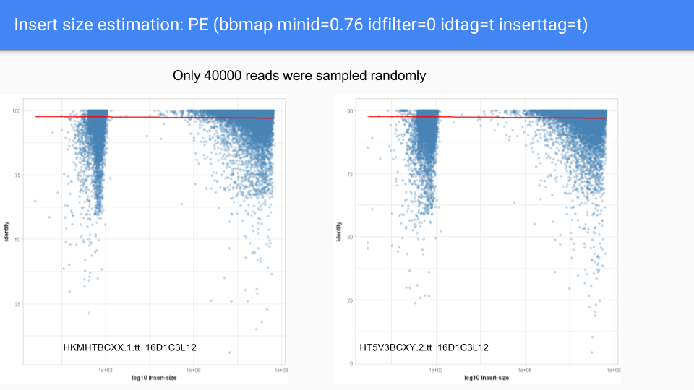
BBmap tuning

Slide 38
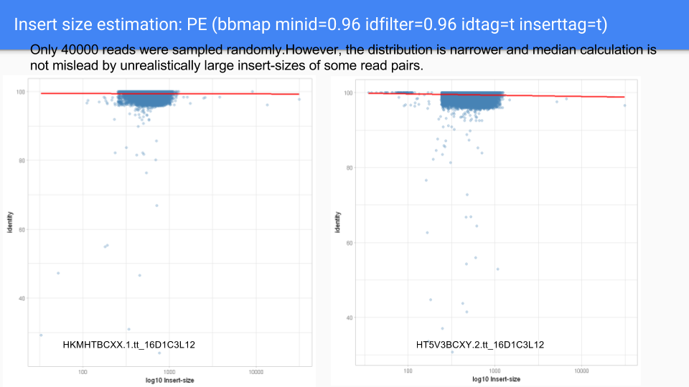
BBmap tuning

Slide 39
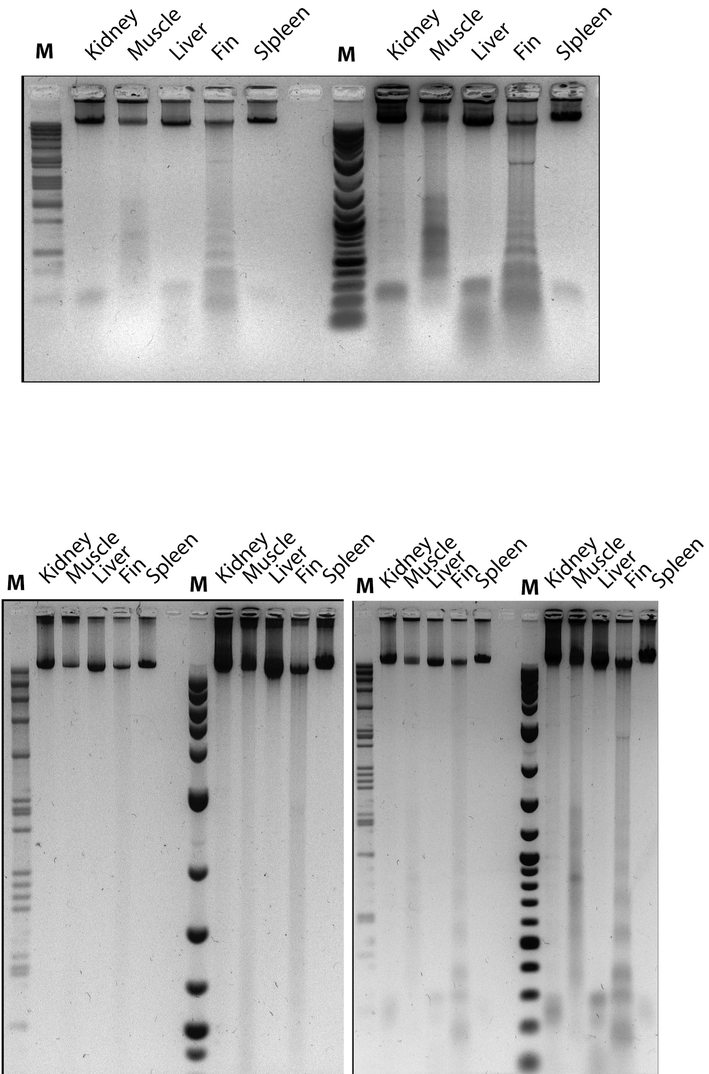
Oxford Nanopore datasets
2017:
1D-reads, RapidSequencing kit
3kbp avg. reads
2018:
Cobitis taenia, spleen
1D-reads, RapidSequencing kit
7 runs, 0.7Gbp per run
~ 60 000 reads >=10 kbp
proovread
albacore
future: chiron

Slide 40
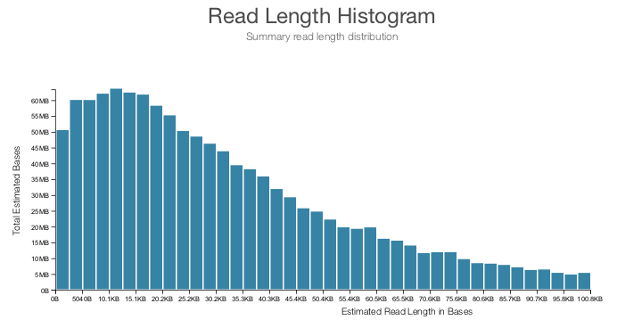
2018: Oxford Nanopore sequencing for 1 day 21 hrs (SEKA1)

Slide 41
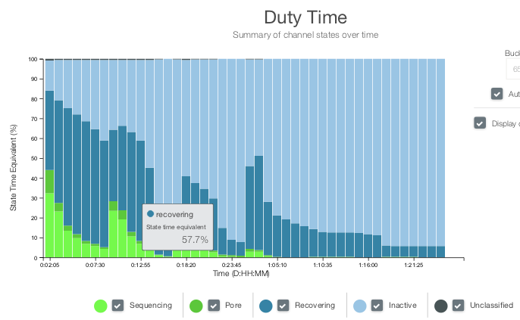
2018: Oxford Nanopore sequencing for 1 day 21 hrs (SEKA1)

Slide 42
We still have cDNA reads not matching abyss-k160 assembly but matching common carp genome or DNA/EST of Cobitinae
G3UKN3Q01 1.2% unmatched, 25.6% match to carp/Cobitinae
Pending calculations (blastn with E⁻¹⁹)
GPYRH5H01
HULCKIV01
GS60IET01
GYAB93P01
HRTMUOC01
G736HC302
G736HC301
G3UKN3Q01
G3UKN3Q02
IGASIBU01
IFMUJ8102
IFMUJ8101
HRTMUOC02
GPYRH5H02

Slide 43
Karel Janko (UŽFG AV ČR)
Jan Kočí (OSU)
Jan Roslein (OSU)
Oldřich Bartoš /UŽFG AV ČR)
Jan Pačes (UMG AV ČR)
Petr Pajer
Vladimír Beneš (EMBL)
Dinko Pavlinič (EMBL)
Thank you!

Slide 45
Several very good assemblies were prepared by abyss-2.0.2 using uncorrected reads
$ abyss-fac -G 1267403131 tt_16D1C3L12__abyss_64-?.fa
n n:500 L50 LG50 NG50 min N80 N50 N20 E-size max sum name
17.02e6 400495 97124 400495 500 500 929 1797 3307 2389 40026 576.5e6 tt_16D1C3L12__abyss_64-1.fa
9269779 400495 97124 400495 500 500 929 1797 3307 2389 40026 576.5e6 tt_16D1C3L12__abyss_64-2.fa
8970038 386281 91280 386281 500 500 1008 1971 3663 2649 48544 597e6 tt_16D1C3L12__abyss_64-3.fa
3036 0 0 0 0 0 0 0 0 0 0 0 tt_16D1C3L12__abyss_64-4.fa
5148 0 0 0 0 0 0 0 0 0 0 0 tt_16D1C3L12__abyss_64-5.fa
8178432 310669 63719 310669 500 500 1495 2882 5772 4006 59732 633.7e6 tt_16D1C3L12__abyss_64-6.fa
150 23 9 23 519 519 675 918 1344 1079 2400 20808 tt_16D1C3L12__abyss_64-7.fa
8066430 203300 7924 203300 500 500 1783 15776 59085 34309 290392 632.8e6 tt_16D1C3L12__abyss_64-8.fa
$ abyss-fac -G 1267403131 tt_16D1C3L12__abyss_80-?.fa
n n:500 L50 LG50 NG50 min N80 N50 N20 E-size max sum name
13.12e6 446607 100548 356890 643 500 968 2003 3865 2719 40026 684.4e6 tt_16D1C3L12__abyss_80-1.fa
7098314 446607 100548 356890 643 500 968 2003 3865 2719 40026 684.4e6 tt_16D1C3L12__abyss_80-2.fa
6781726 423529 92333 302719 757 500 1071 2247 4374 3073 48480 707.5e6 tt_16D1C3L12__abyss_80-3.fa
4693 0 0 0 0 0 0 0 0 0 0 0 tt_16D1C3L12__abyss_80-4.fa
6110 0 0 0 0 0 0 0 0 0 0 0 tt_16D1C3L12__abyss_80-5.fa
5820652 308849 55950 157302 1610 500 1887 3813 7894 5337 59232 755e6 tt_16D1C3L12__abyss_80-6.fa
308 99 34 99 501 501 707 977 1455 1144 2825 94745 tt_16D1C3L12__abyss_80-7.fa
5696462 191129 5702 43046 1934 500 2941 28235 91696 52410 565062 753.4e6 tt_16D1C3L12__abyss_80-8.fa
$ abyss-fac -G 1267403131 tt_16D1C3L12__abyss_96-?.fa
n n:500 L50 LG50 NG50 min N80 N50 N20 E-size max sum name
10.67e6 480137 100288 266417 964 500 1006 2224 4498 3088 40026 779.6e6 tt_16D1C3L12__abyss_96-1.fa
5767063 480137 100288 266417 964 500 1006 2224 4498 3088 40026 779.6e6 tt_16D1C3L12__abyss_96-2.fa
5440940 445527 89508 221230 1188 500 1142 2565 5220 3560 57744 802.7e6 tt_16D1C3L12__abyss_96-3.fa
6539 0 0 0 0 0 0 0 0 0 0 0 tt_16D1C3L12__abyss_96-4.fa
6512 0 0 0 0 0 0 0 0 0 0 0 tt_16D1C3L12__abyss_96-5.fa
4474821 304908 49734 107774 2642 500 2204 4824 10075 6702 61751 854.7e6 tt_16D1C3L12__abyss_96-6.fa
515 208 68 208 501 501 722 1144 1782 1295 3032 218062 tt_16D1C3L12__abyss_96-7.fa
4344599 184154 4671 14726 10390 500 5460 40717 121439 70922 851373 852.6e6 tt_16D1C3L12__abyss_96-8.fa
$ abyss-fac -G 1267403131 tt_16D1C3L12__abyss_112-?.fa
n n:500 L50 LG50 NG50 min N80 N50 N20 E-size max sum name
8861505 509781 99296 212832 1294 500 1031 2434 5108 3438 45517 864.1e6 tt_16D1C3L12__abyss_112-1.fa
4792535 509781 99296 212832 1294 500 1031 2434 5108 3438 45517 864.1e6 tt_16D1C3L12__abyss_112-2.fa
4462563 461389 85975 173733 1635 500 1207 2887 6078 4039 49970 884.7e6 tt_16D1C3L12__abyss_112-3.fa
8534 0 0 0 0 0 0 0 0 0 0 0 tt_16D1C3L12__abyss_112-4.fa
6145 0 0 0 0 0 0 0 0 0 0 0 tt_16D1C3L12__abyss_112-5.fa
3561326 305368 45960 82288 3652 500 2455 5703 11978 7851 79396 936.6e6 tt_16D1C3L12__abyss_112-6.fa
663 311 99 311 500 500 798 1193 1927 1362 3365 340199 tt_16D1C3L12__abyss_112-7.fa
3427972 184013 4178 9292 21190 500 7950 50996 146429 85078 664640 934.1e6 tt_16D1C3L12__abyss_112-8.fa
$ abyss-fac -G 1267403131 tt_16D1C3L12__abyss_128-?.fa
n n:500 L50 LG50 NG50 min N80 N50 N20 E-size max sum name
7603647 540270 98987 178531 1617 500 1042 2609 5644 3732 45325 940.8e6 tt_16D1C3L12__abyss_128-1.fa
4164814 540270 98987 178531 1617 500 1042 2609 5644 3732 45325 940.8e6 tt_16D1C3L12__abyss_128-2.fa
3835048 475698 83169 143642 2074 500 1260 3192 6791 4462 56412 956e6 tt_16D1C3L12__abyss_128-3.fa
11372 0 0 0 0 0 0 0 0 0 0 0 tt_16D1C3L12__abyss_128-4.fa
5300 0 0 0 0 0 0 0 0 0 0 0 tt_16D1C3L12__abyss_128-5.fa
3011140 310186 43902 67976 4608 500 2643 6415 13450 8757 104425 1.006e9 tt_16D1C3L12__abyss_128-6.fa
772 429 133 429 500 500 786 1261 2004 1414 3662 482664 tt_16D1C3L12__abyss_128-7.fa
2876731 189115 4029 7223 30658 500 9361 56647 164847 94949 793681 1.003e9 tt_16D1C3L12__abyss_128-8.fa

Slide 46
Original data calculated at GenomeScope
tt_16D1C3L12__PE-only__ntCard_k32.histo
http://genomescope.org/analysis.php?code=85k6B5aH7tu2vRt7JNMp
tt_16D1C3L12__PE-only__ntCard_k64.histo
http://genomescope.org/analysis.php?code=BfNXYUjshZ8zWFk8JUf2
tt_16D1C3L12__PE-only__ntCard_k96.histo
http://genomescope.org/analysis.php?code=pJuy0fKxb5nXns6ynp4M
tt_16D1C3L12__PE-only__ntCard_k112.histo
http://genomescope.org/analysis.php?code=uIKzl6JvNnoeMPnRQlU6
tt_16D1C3L12__PE-only__ntCard_k128.histo
http://genomescope.org/analysis.php?code=HBnsyGEI1MNQDu1sB3fW
tt_16D1C3L12__PE-only__ntCard_k144.histo
http://genomescope.org/analysis.php?code=2ZkJ2eyTW83ZdmDl98mk
tt_16D1C3L12__PE-only__ntCard_k156.histo
http://genomescope.org/analysis.php?code=jXyExLoKD4kb5whTfgnO

Slide 47
Original data calculated at GenomeScope
tt_16D1C3L12__PE_MP__ntCard_k32.histo
http://genomescope.org/analysis.php?code=3QqcfvLBKRwDtwi7S2X0
tt_16D1C3L12__PE_MP__ntCard_k64.histo
http://genomescope.org/analysis.php?code=ZFFBghIODiCvk3YTWauj
tt_16D1C3L12__PE_MP__ntCard_k96.histo
http://genomescope.org/analysis.php?code=zzWhjhQLbPrsr71ineYM
tt_16D1C3L12__PE_MP__ntCard_k112.histo
http://genomescope.org/analysis.php?code=L6DbOeQhq3dftKa7iMYK
tt_16D1C3L12__PE_MP__ntCard_k128.histo
http://genomescope.org/analysis.php?code=DS3L6FbjjuFsplV2hjdH
tt_16D1C3L12__PE_MP__ntCard_k144.histo
http://genomescope.org/analysis.php?code=C8RNj53qEnrgcYePakEM
tt_16D1C3L12__PE_MP__ntCard_k156.histo
http://genomescope.org/analysis.php?code=GuewGa4LH8oChATh8ICW

