Slide 1
Kriti Bhagat
kriti@mail.muni.cz
RBP Bioinformatics
Panagiotis Alexiou Group
“Prediction of RNA G-quadruplexes Using Interpretable Neural Networks.”
CEITEC
at Masaryk University
Notes:
Hello and welcome
My name is xxx and I am xxx of CEITEC.
It is my great pleasure to welcome you today and to introduce CEITEC – Central European Institute of Technology.
The story of CEITEC is much like science itself – exciting and in some ways unpredictable. So let me share with you some key moments of CEITEC’s history, its key achievements of the present and the outlook for its future.
1

Slide 2
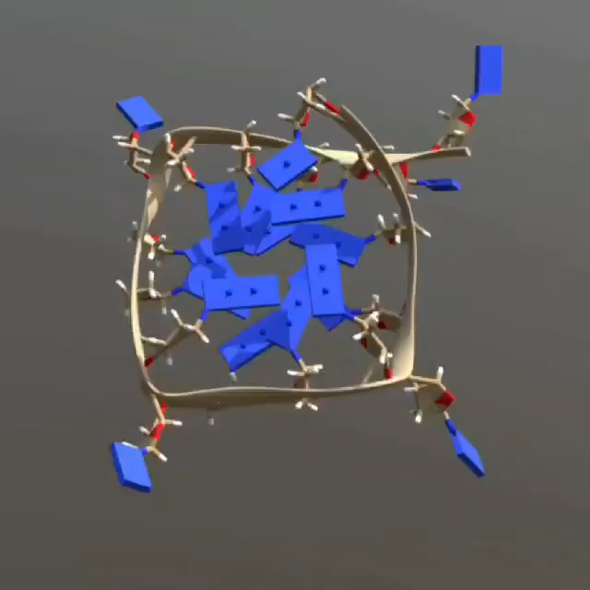
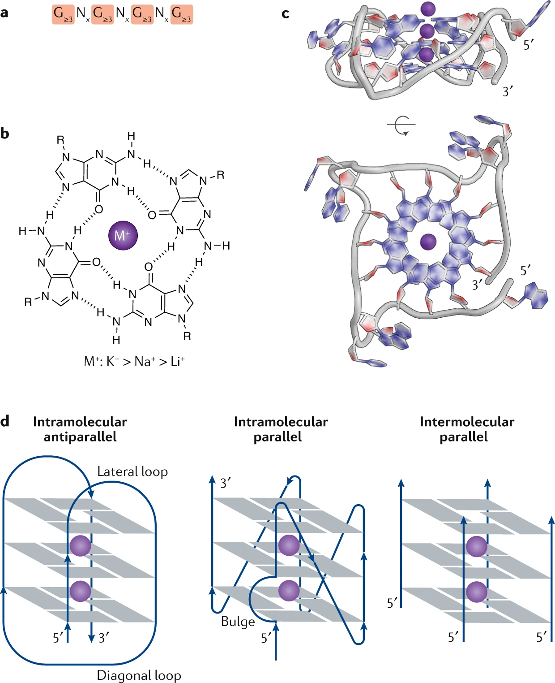
G-quadruplex’s
RNA G4’s have a parallel topology.
Structure and topologies of G-quadruplexes
CEITEC at Masaryk University
2
Notes:
2

Slide 3
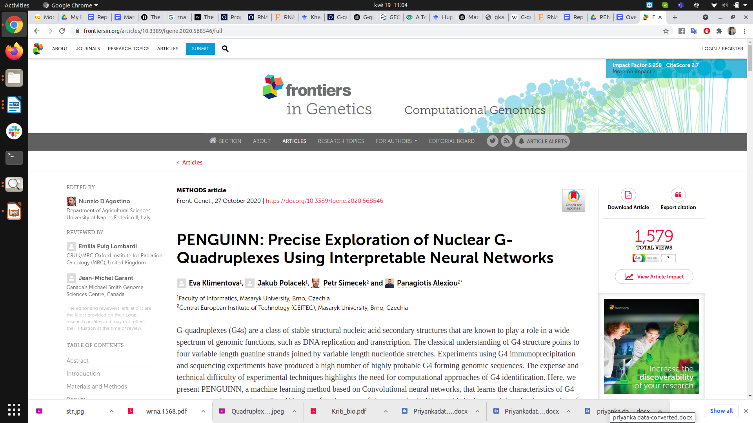
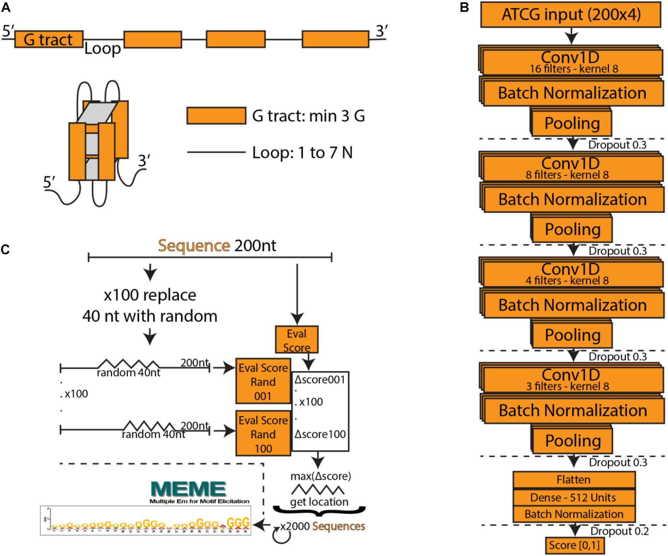
RNA Sequence
Performance
CEITEC at Masaryk University 3
https://doi.org/10.3389/fgene.2020.568546l

Slide 4
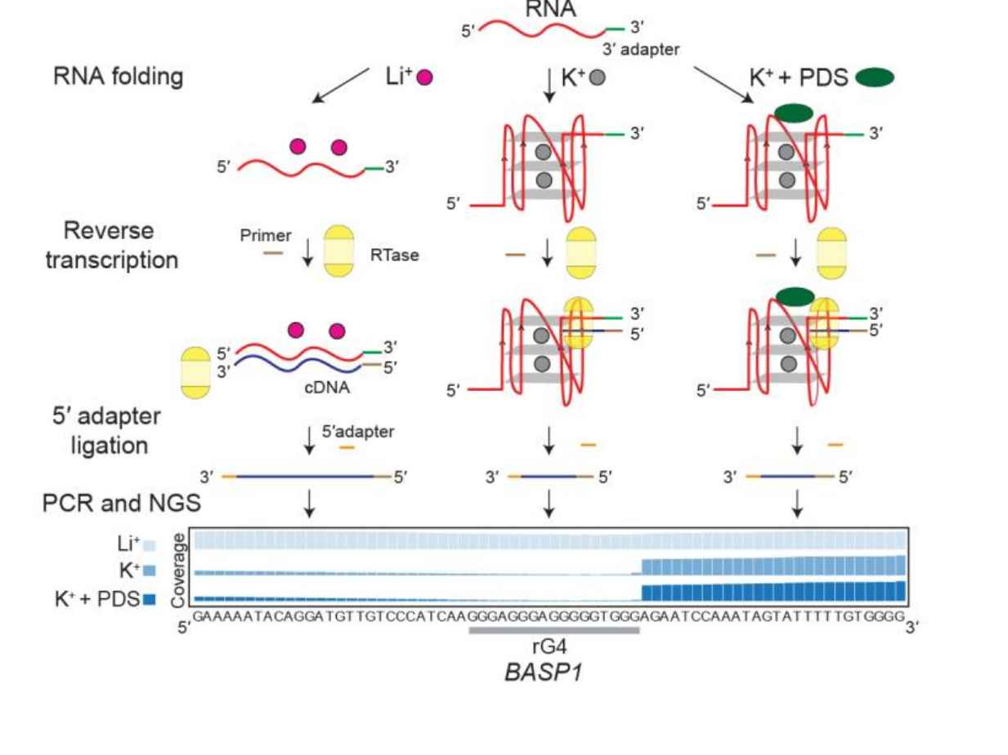
Datasets
Training data :
K+PDS :11 K positives + 11 K negatives
K : 3 K positives + 3 K negatives
Evaluation ratio’s : 1:1,1:10 and 1:100
Figure: rG4s Reverse exploites transcriptase stalling (RTS) in the presence of K+ , KPDS
CEITEC at Masaryk University 4

Slide 5
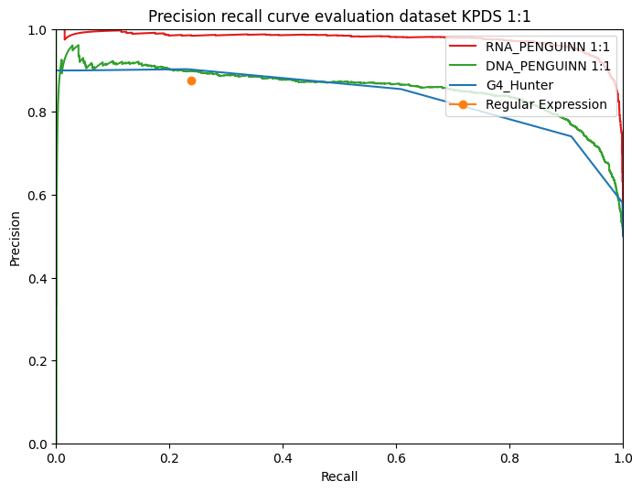
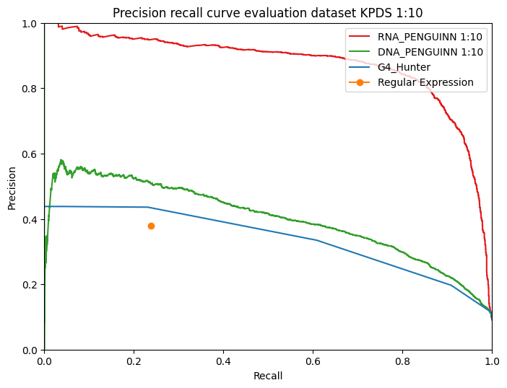
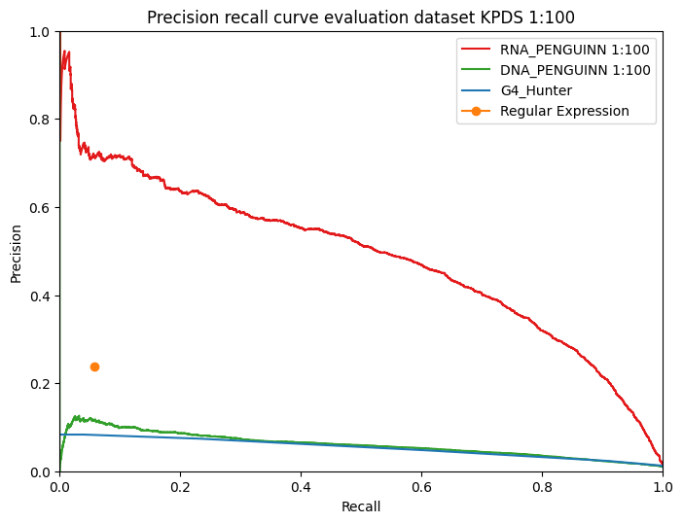
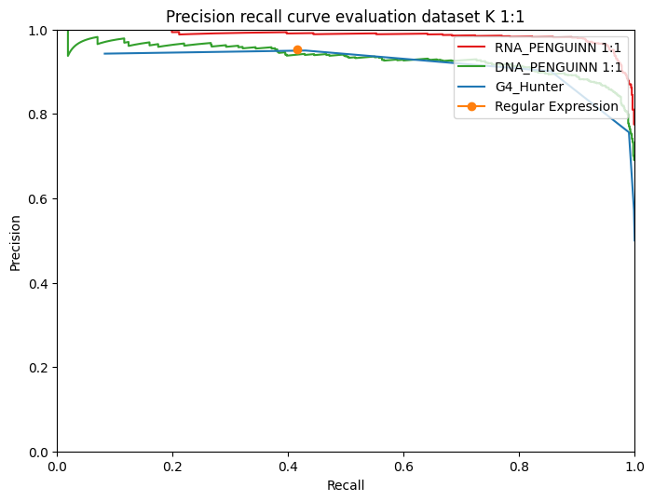
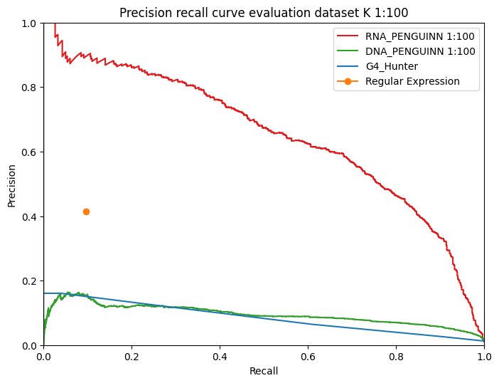
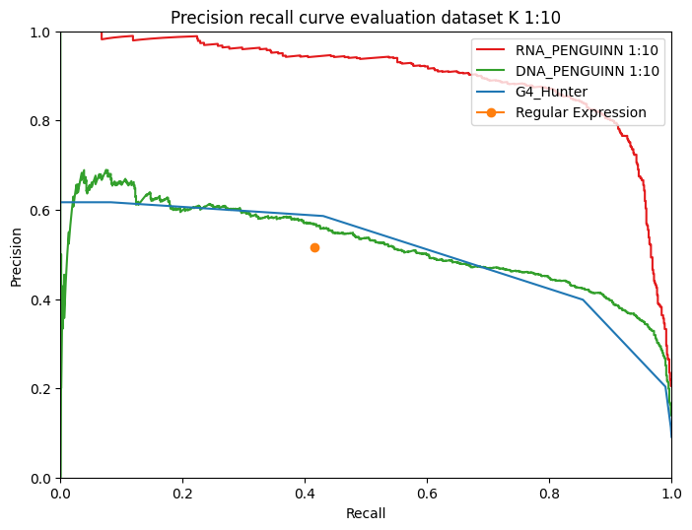
Comparison: State of art
auPRC RNA- 0.975
auPRC DNA-0.856
auPRC RNA- 0.486
auPRC DNA-0.599
auPRC RNA-0.873
auPRC DNA-0.339
auPRC RNA-0.650
auPRC DNA-0.094
auPRC RNA-0.986
auPRC DNA-0.932
auPRC RNA-0.885
auPRC DNA-0.520
CEITEC at Masaryk University 5

Slide 6
Summary
RNA model outperforms other state-of-the-art in classifying the G4s.
Higher precision/sensitivity even at highly imbalanced datasets.
Regular expression subsides with more imbalanced dataset.
CEITEC at Masaryk University 6

Slide 7


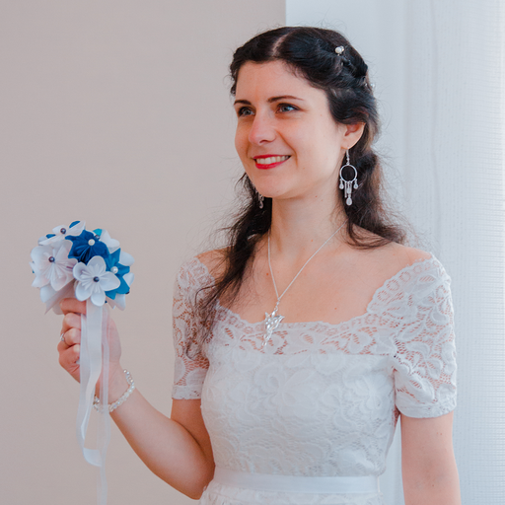




Acknowledgment
7
Panagiotis Alexiou, Ph.D.
Kriti Bhagat,M.tech
Iektra-Chara Giassa, Ph.D.
https://ml-bioinfo-ceitec.github.io/PENGUINN-RNA/

Slide 8
CEITEC
@CEITEC_Brno
Thank you
www.ceitec.eu
Notes:
8

