Slide 1
SeqUIa: a software platform for GUI based next-generation sequencing data analysis
Vojtěch Bystrý

Slide 2
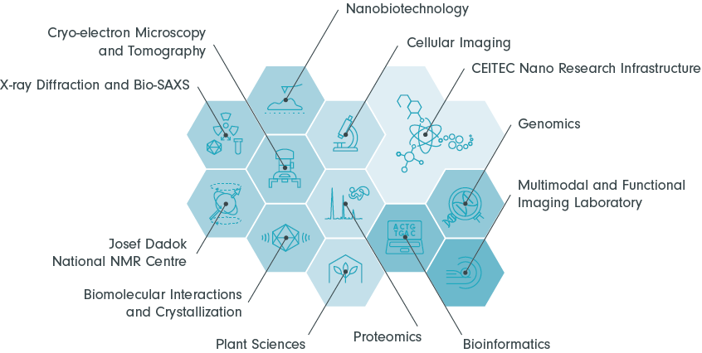
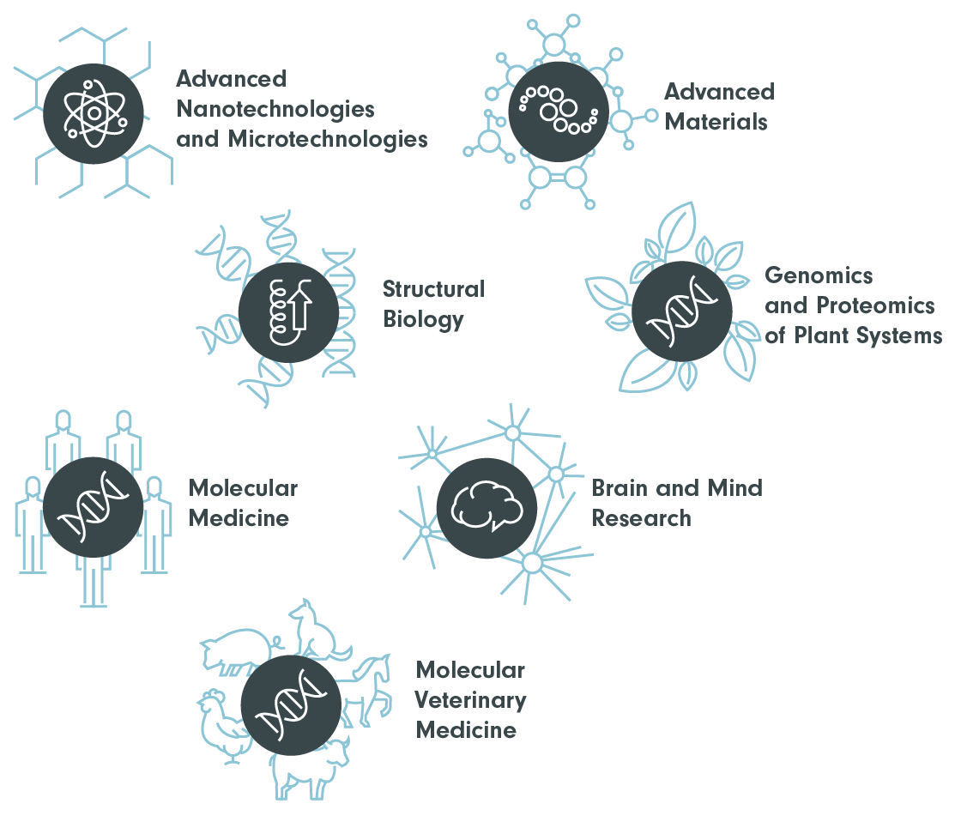
CEITEC Bioinformatics Core Facility
CEITEC research areas
Notes:
This talk is about tool but Let me tell you a short story.
Ad hoc bioinformatics.

Slide 3
CEITEC Bioinformatics Core Facility
CEITEC research areas
Notes:
From 2018

Slide 4
Bioinformatics CF mission
GCF
Bioinformatics education
Primary NGS analysis
Secondary standard NGS analysis
Custom (project specific) analysis
Notes:
Advised from Vladimir Benes EMBL

Slide 5

Bioinformatics CF mission
GCF
AUTOMATE
Bioinformatics education
Primary NGS analysis
Secondary standard NGS analysis
Custom (project specific) analysis

Slide 6

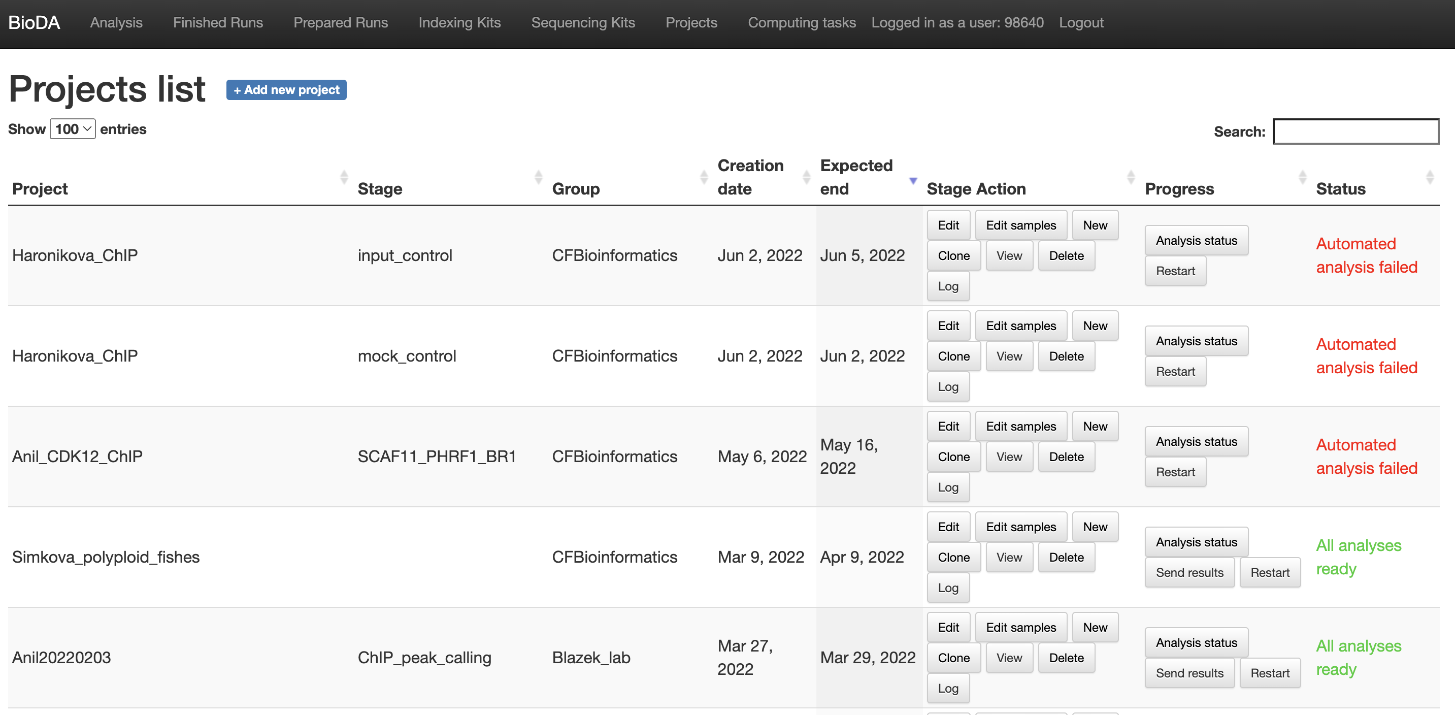

BioDA system
+ set-up Galaxy server
Develop our in-house system BioDA

Slide 7
BioDA system
+ set-up Galaxy server
Develop our in-house system BioDA
Developed in ~1 year and was used for ~3 years
Limitations
  Front-end
    slow, bad user experience
  Not flexible
    constant tweaks to add new functionality and analysis

Slide 8
BioDA system
+ set-up Galaxy server
Develop our in-house system BioDA
Experience + Know-how
+ New ideas
Developed in ~1 year and was used for ~3 years
Limitations
  Front-end
    slow, bad user experience
  Not flexible
    constant tweaks to add new functionality and analysis
Aim to do it right
Grant application

Slide 9



TAČR and a new collaboration
Supported by TAČR - TJ04000141
Notes:
So what is sequia except a misspelled tree

Slide 10

TAČR and a new collaboration
Supported by TAČR - TJ04000141
Notes:
So what is sequia except a misspelled tree

Slide 11
Sequencing User Interface analytics
…your solution for genomic sequencing analysis
Software platform for GUI based next generation sequencing data analysis
Notes:
What is sequia

Slide 12



Information system for NGS analysis
Chemistry registration
Barcode enabled
Sequencing
Support direct data access
Data analysis
Results visualization
Automated!
Reproducible
integrate all patient's data
Lab technician
Bioinformatician
Clinical geneticist/
molecular biologist

Slide 13
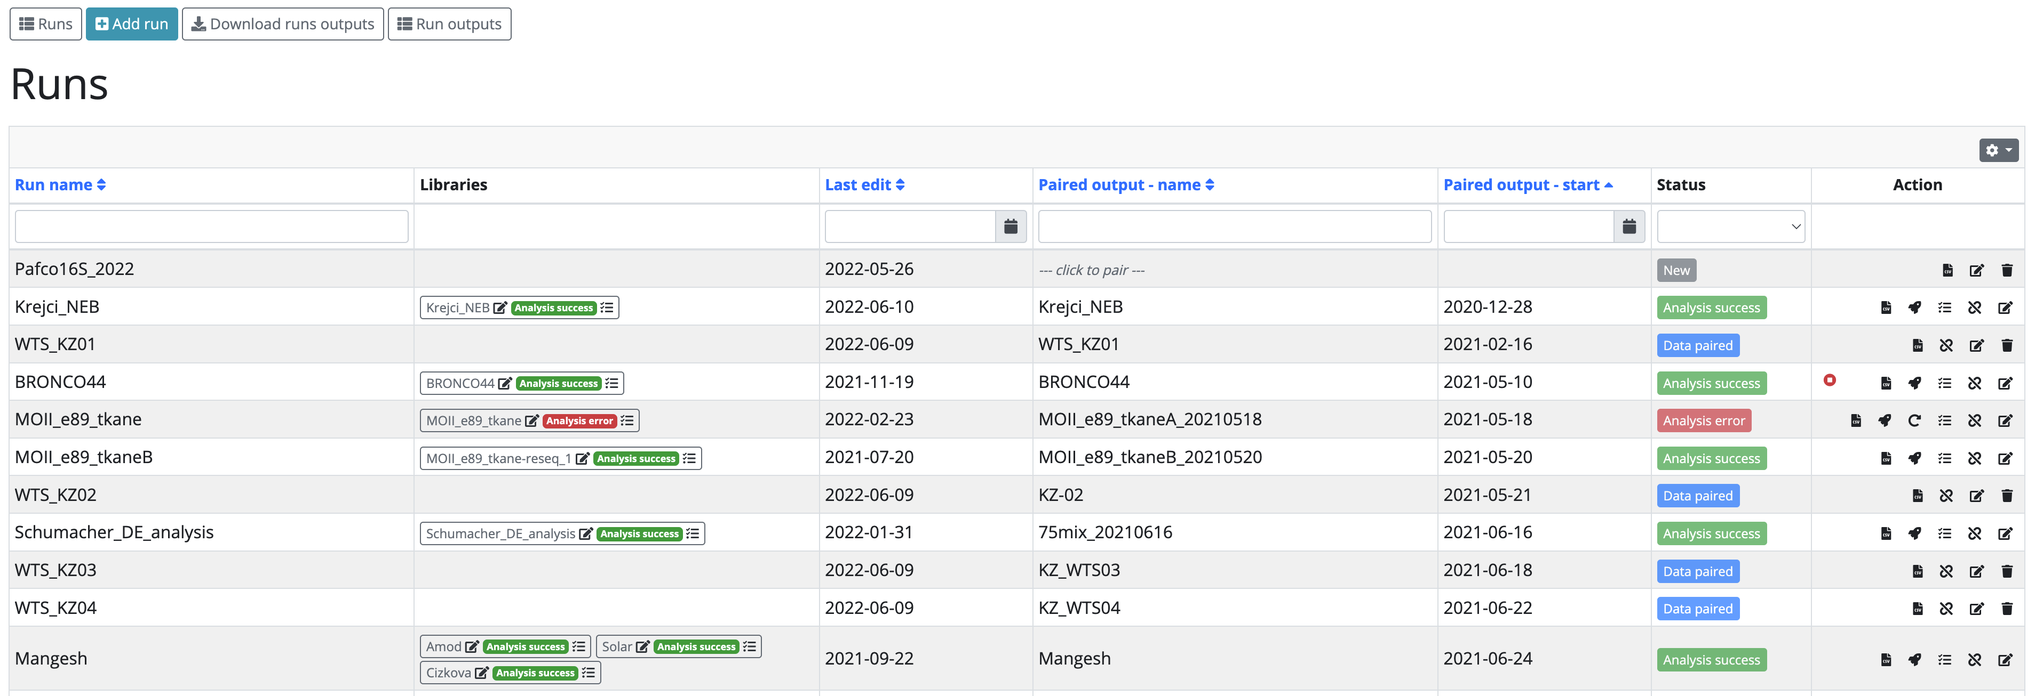

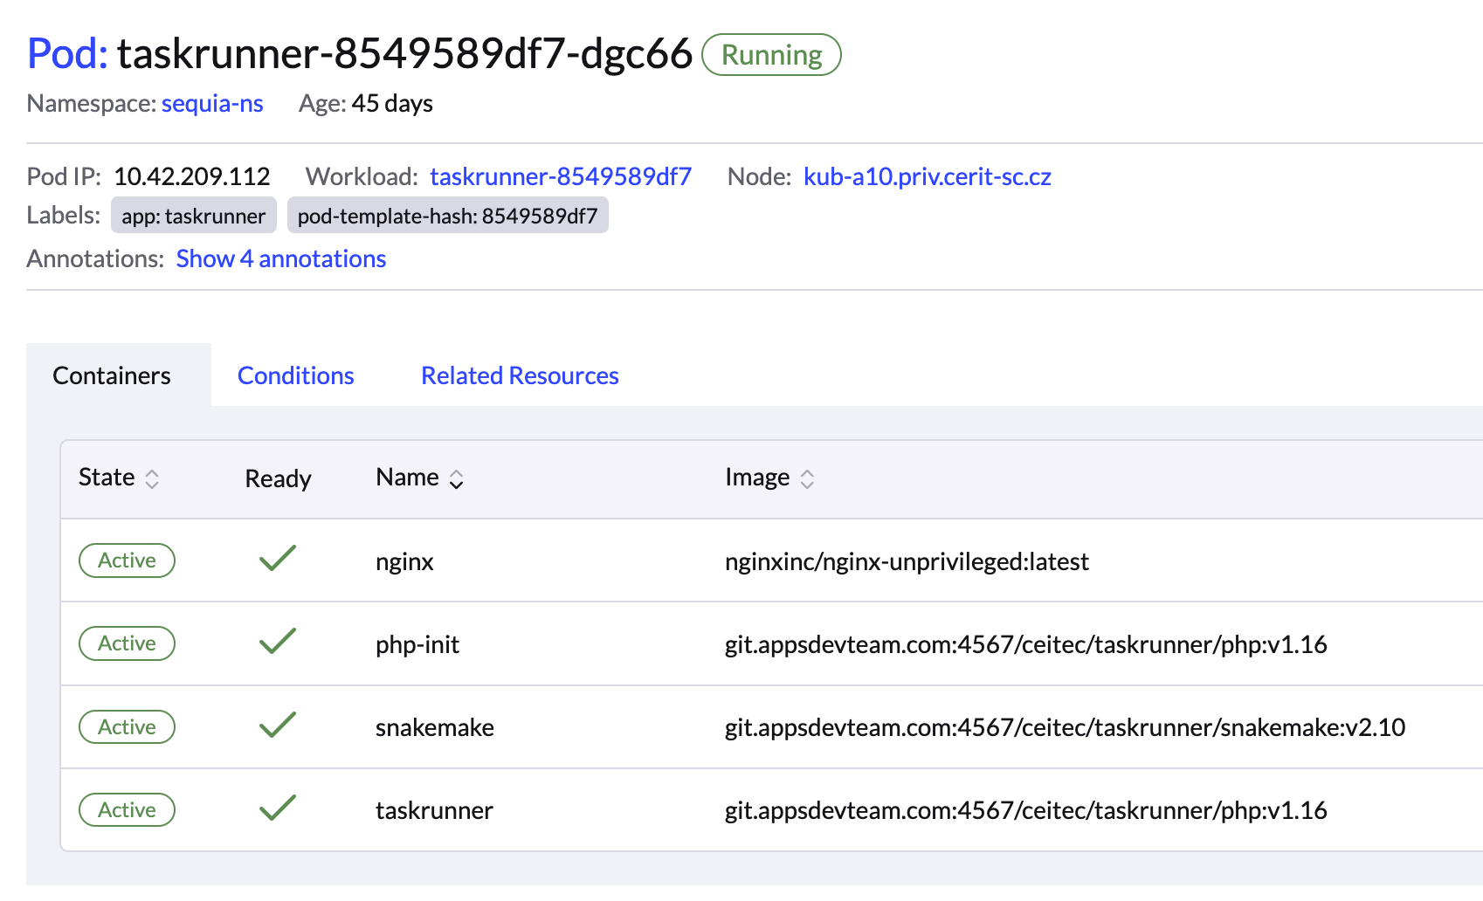
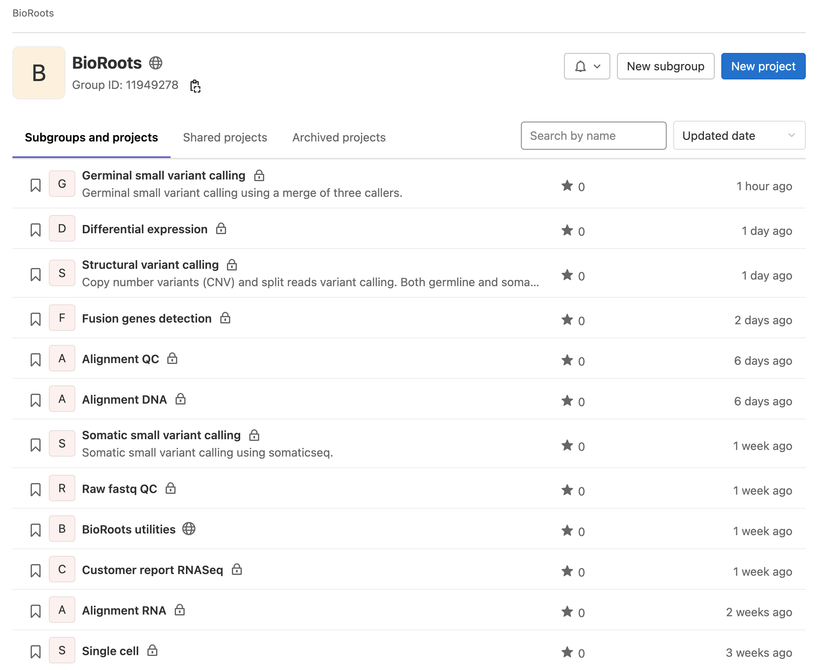
Architecture
TaskRUNner
BioRoots

Slide 14
Main advantage
Full fledge NGS-LIS with automatic bioinformatics processing
TaskRUNner
Generic workflow plug-in system
BioRoots

Slide 15
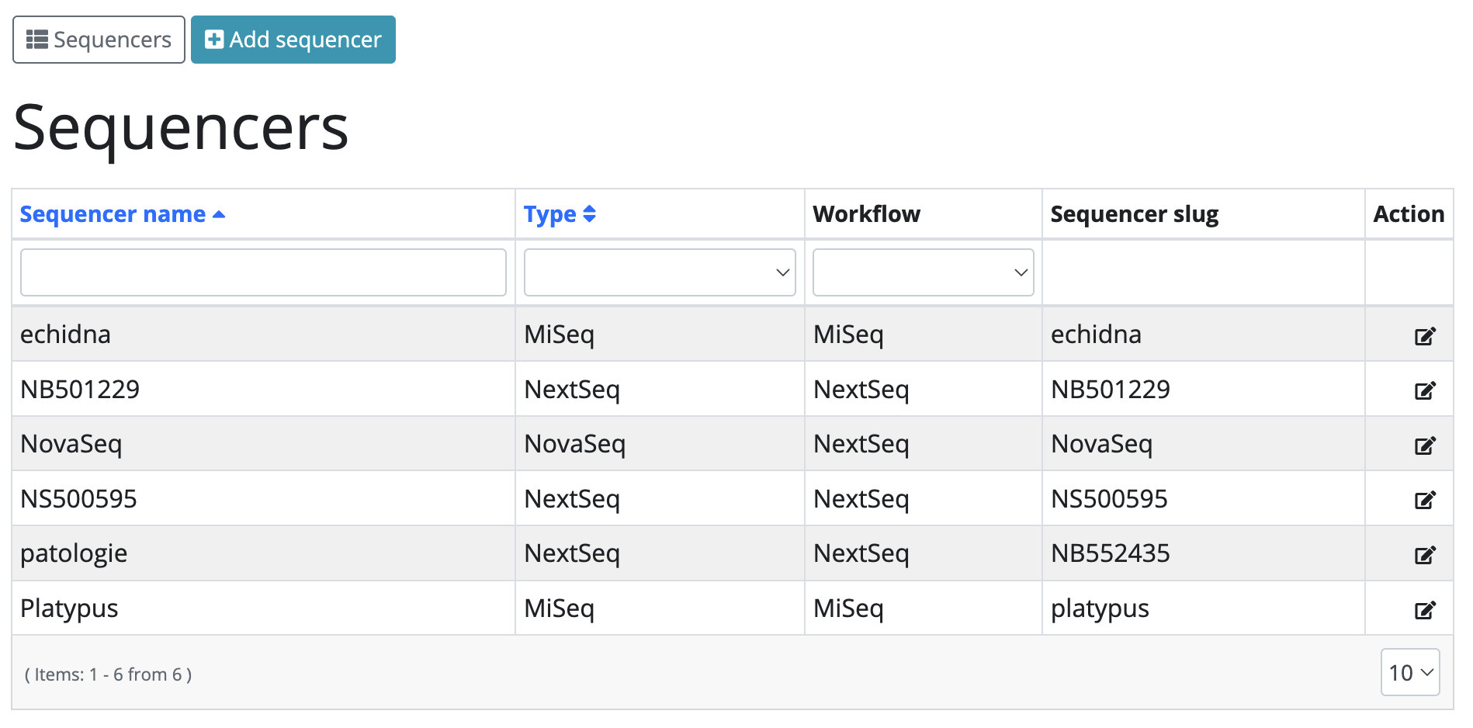
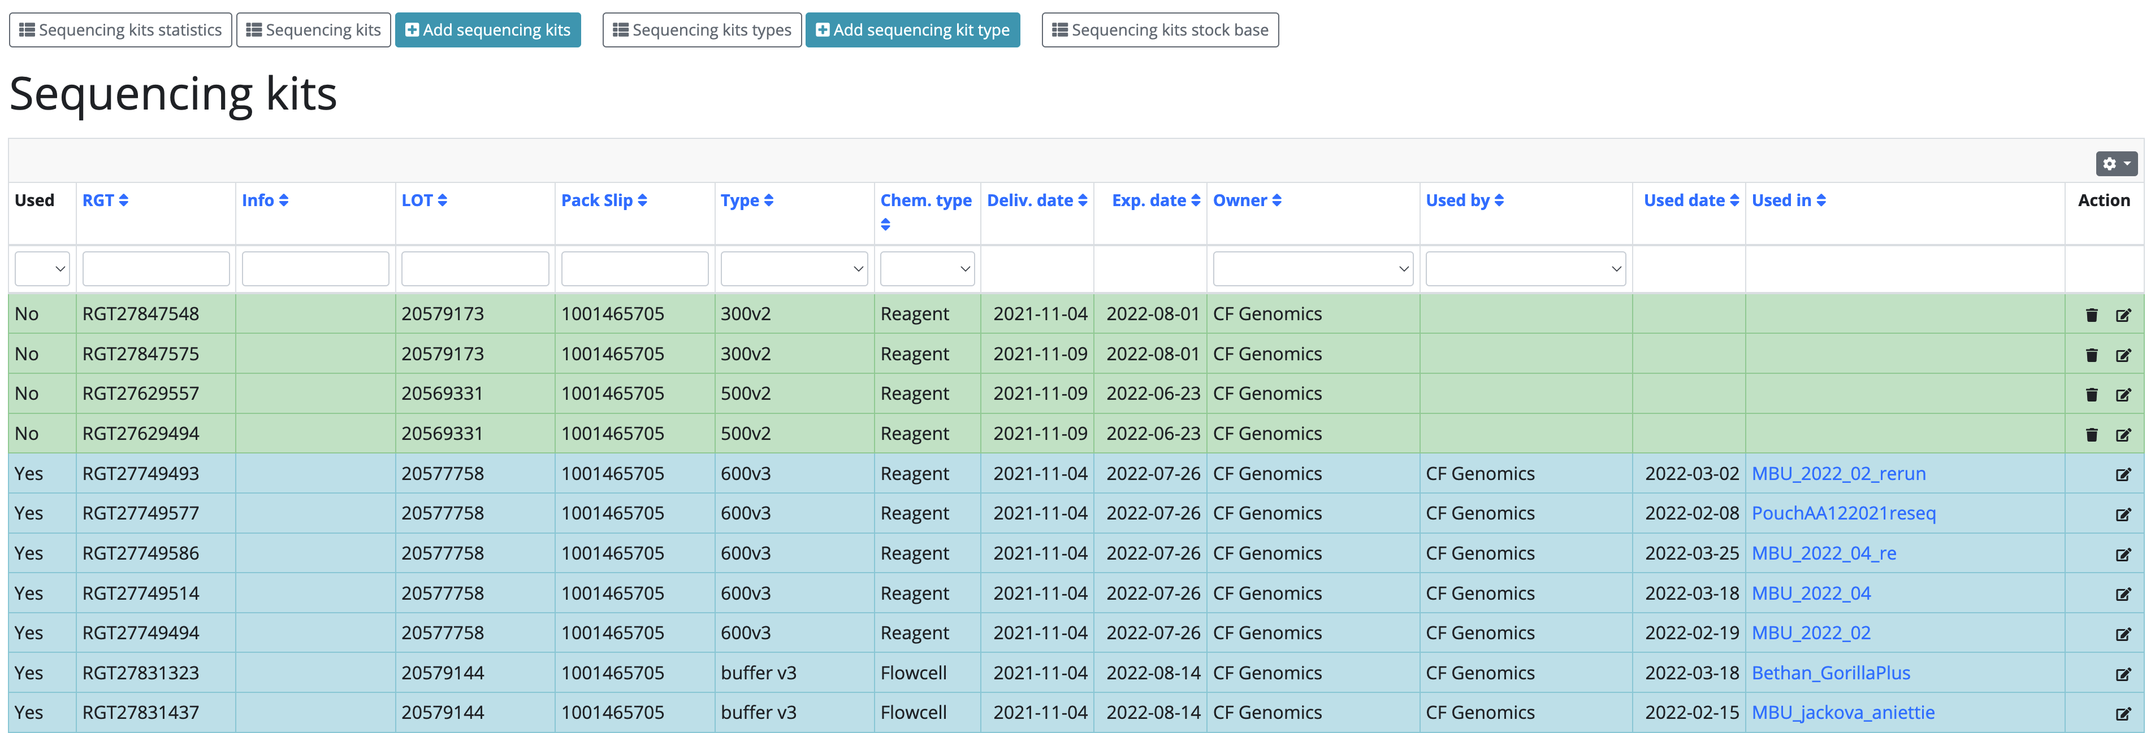
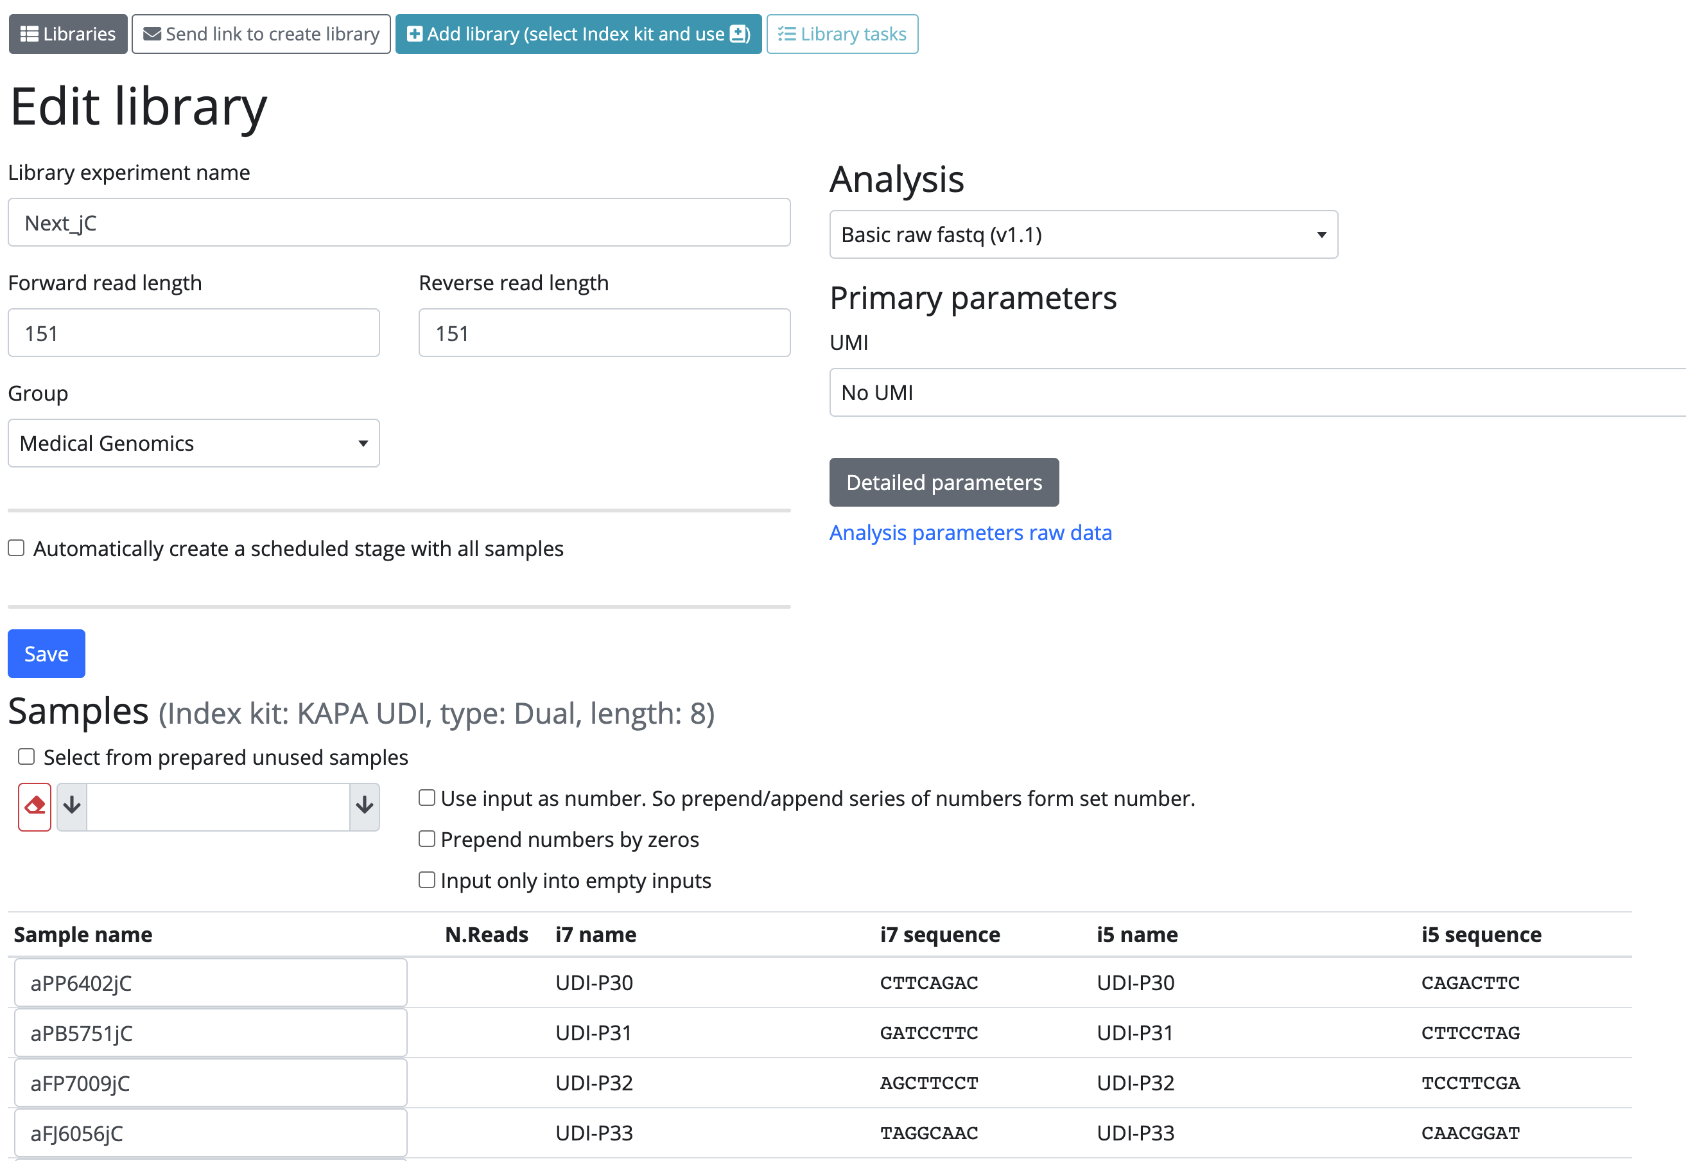
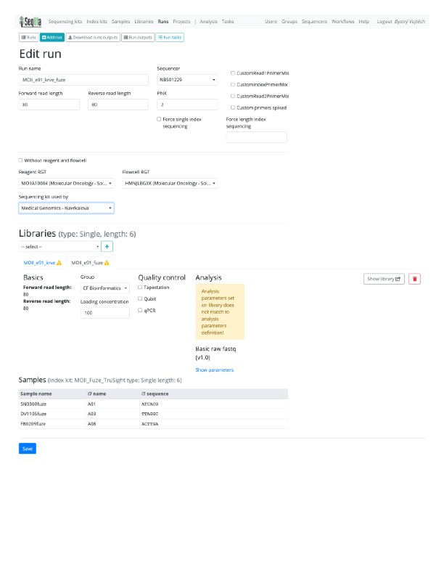
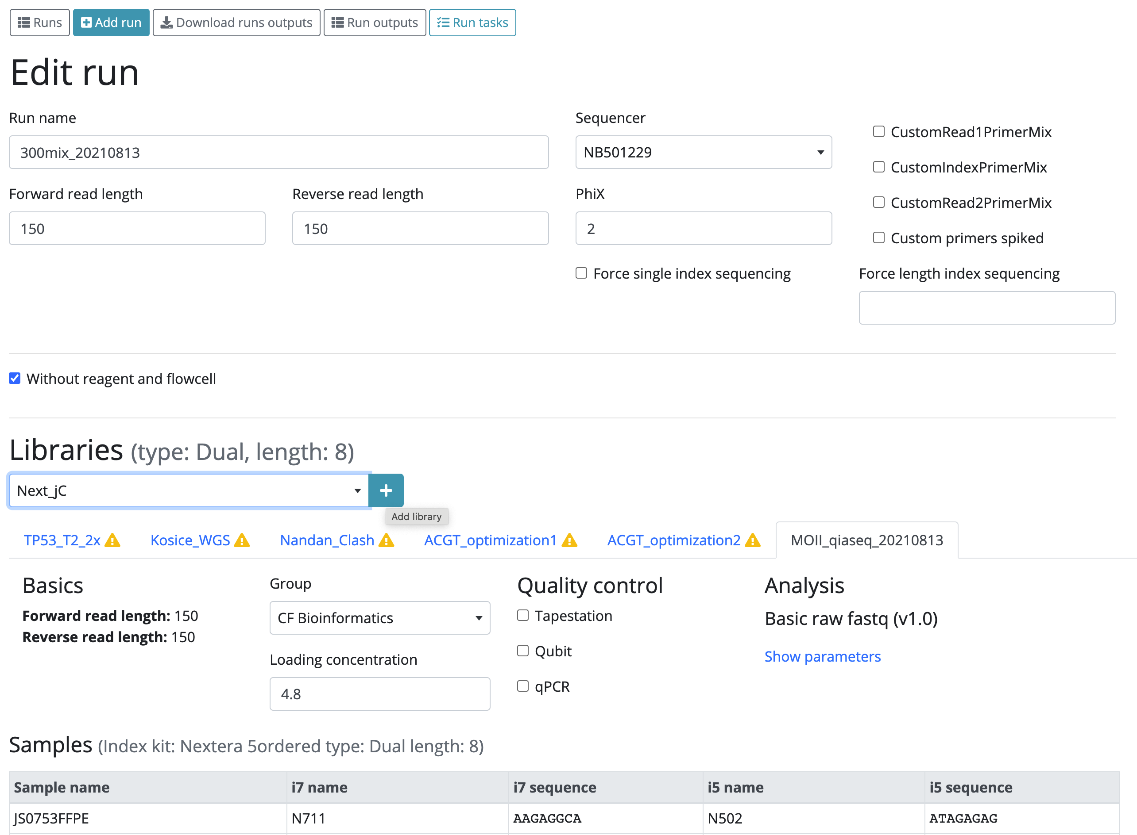
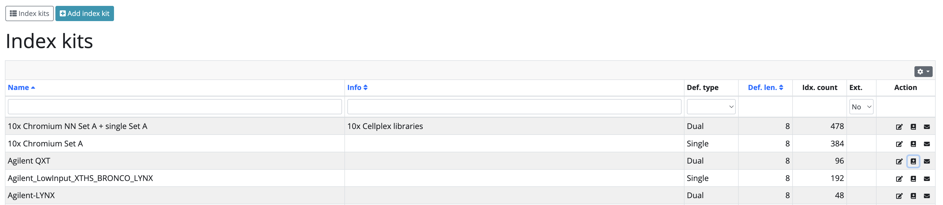
Full fledge NGS-LIS

Slide 16
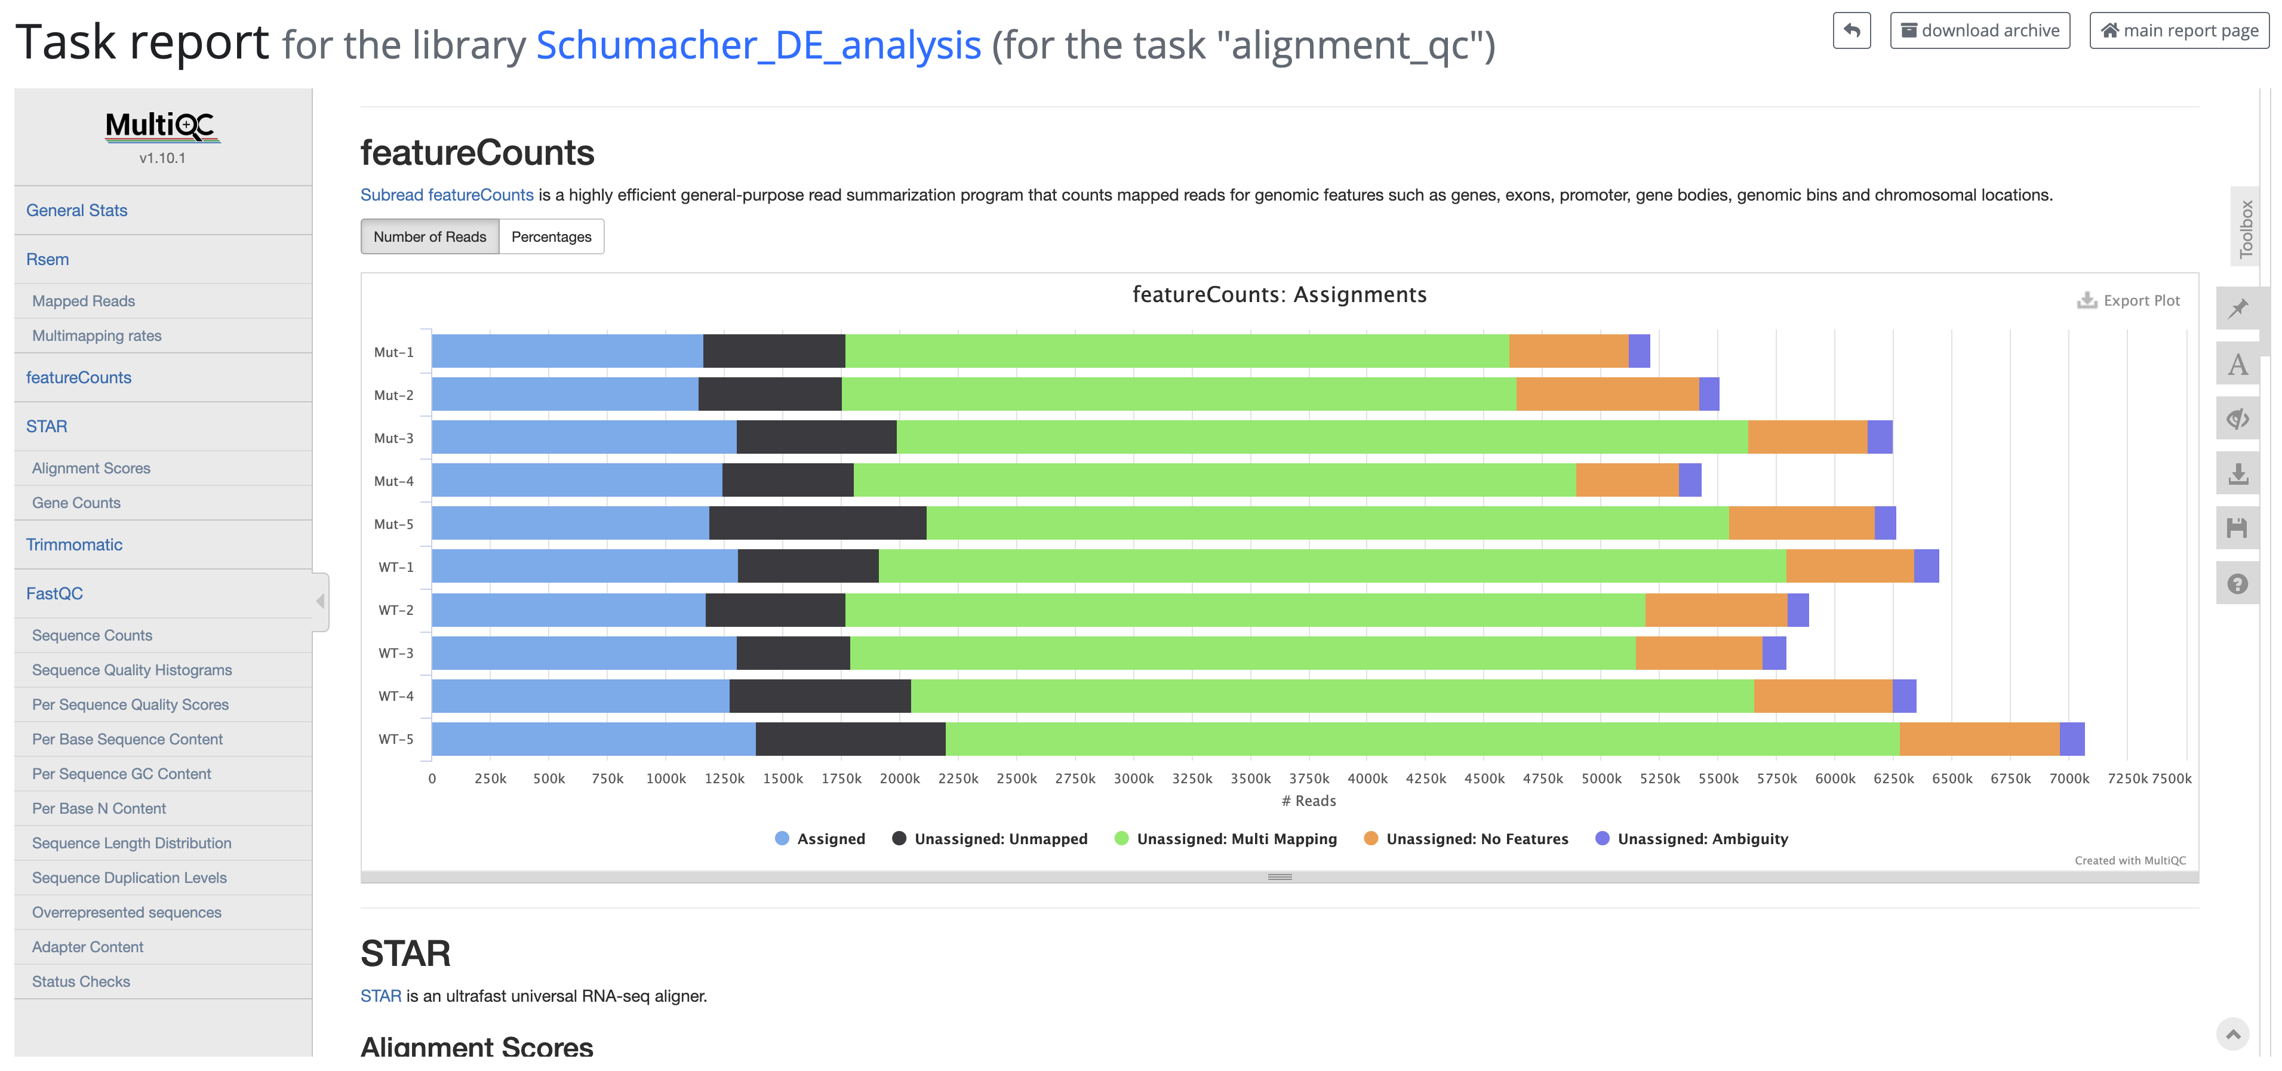
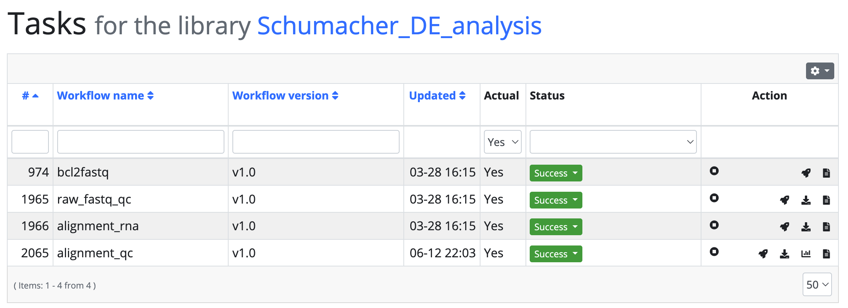

Slide 17
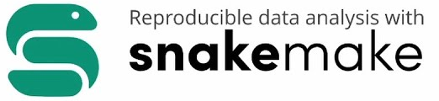
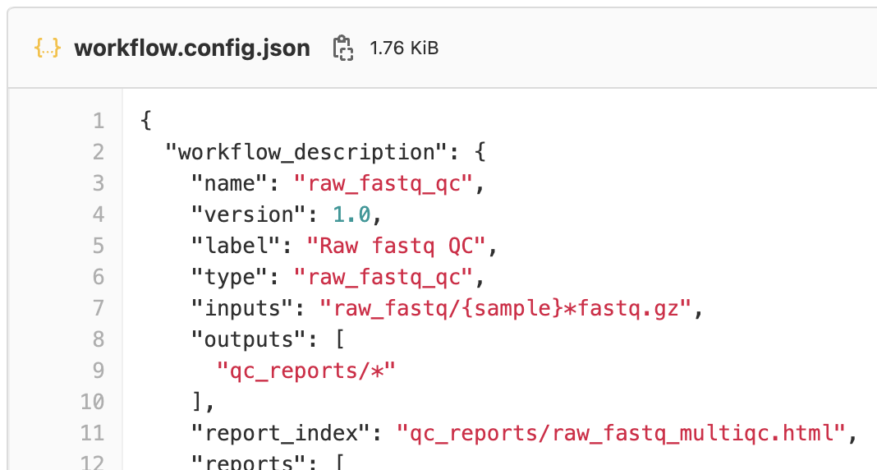
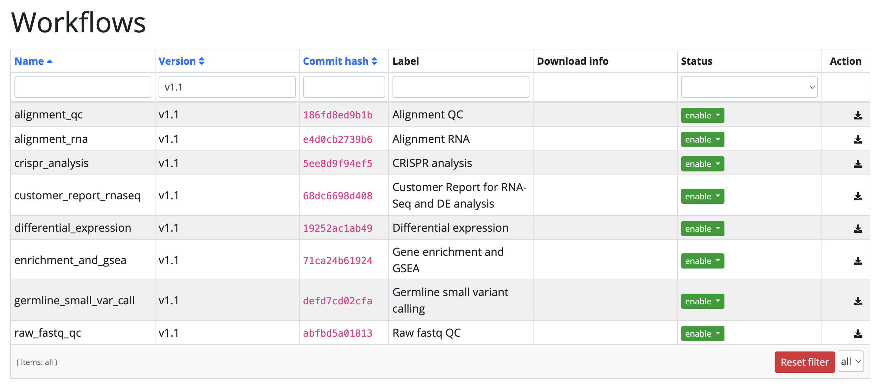
Generic workflow plug-in system

Slide 18
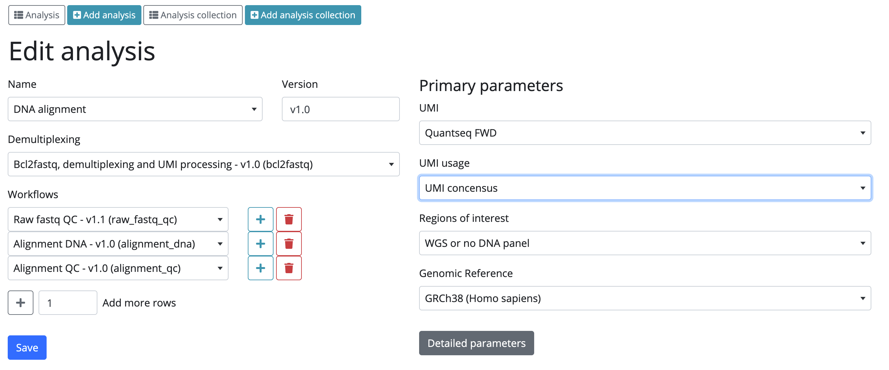
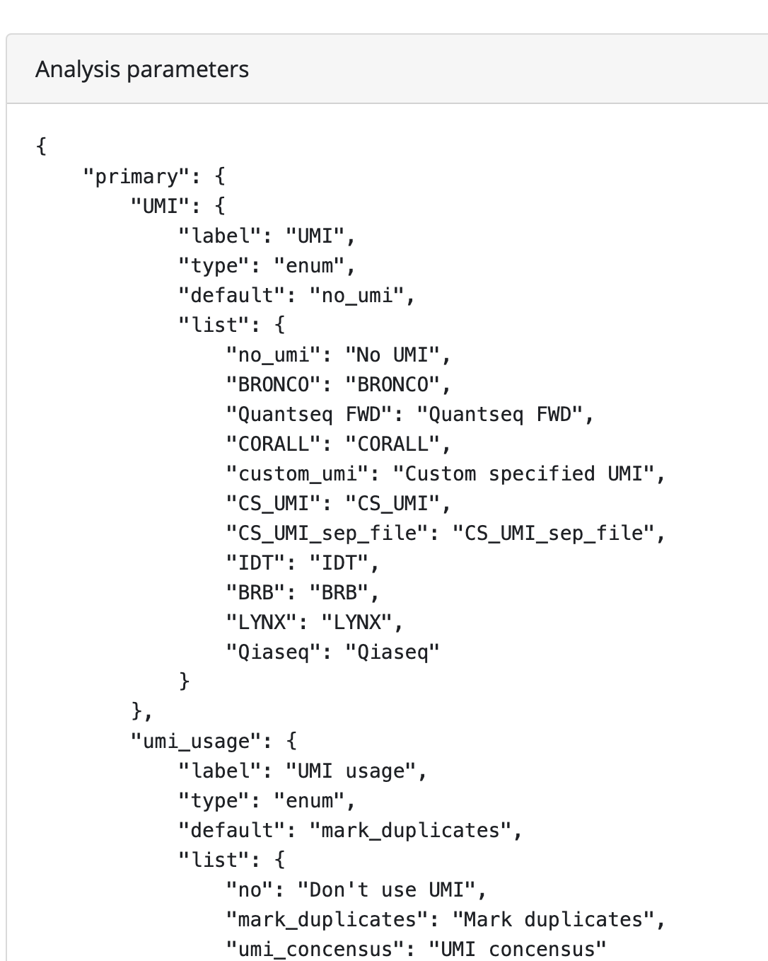

Slide 19
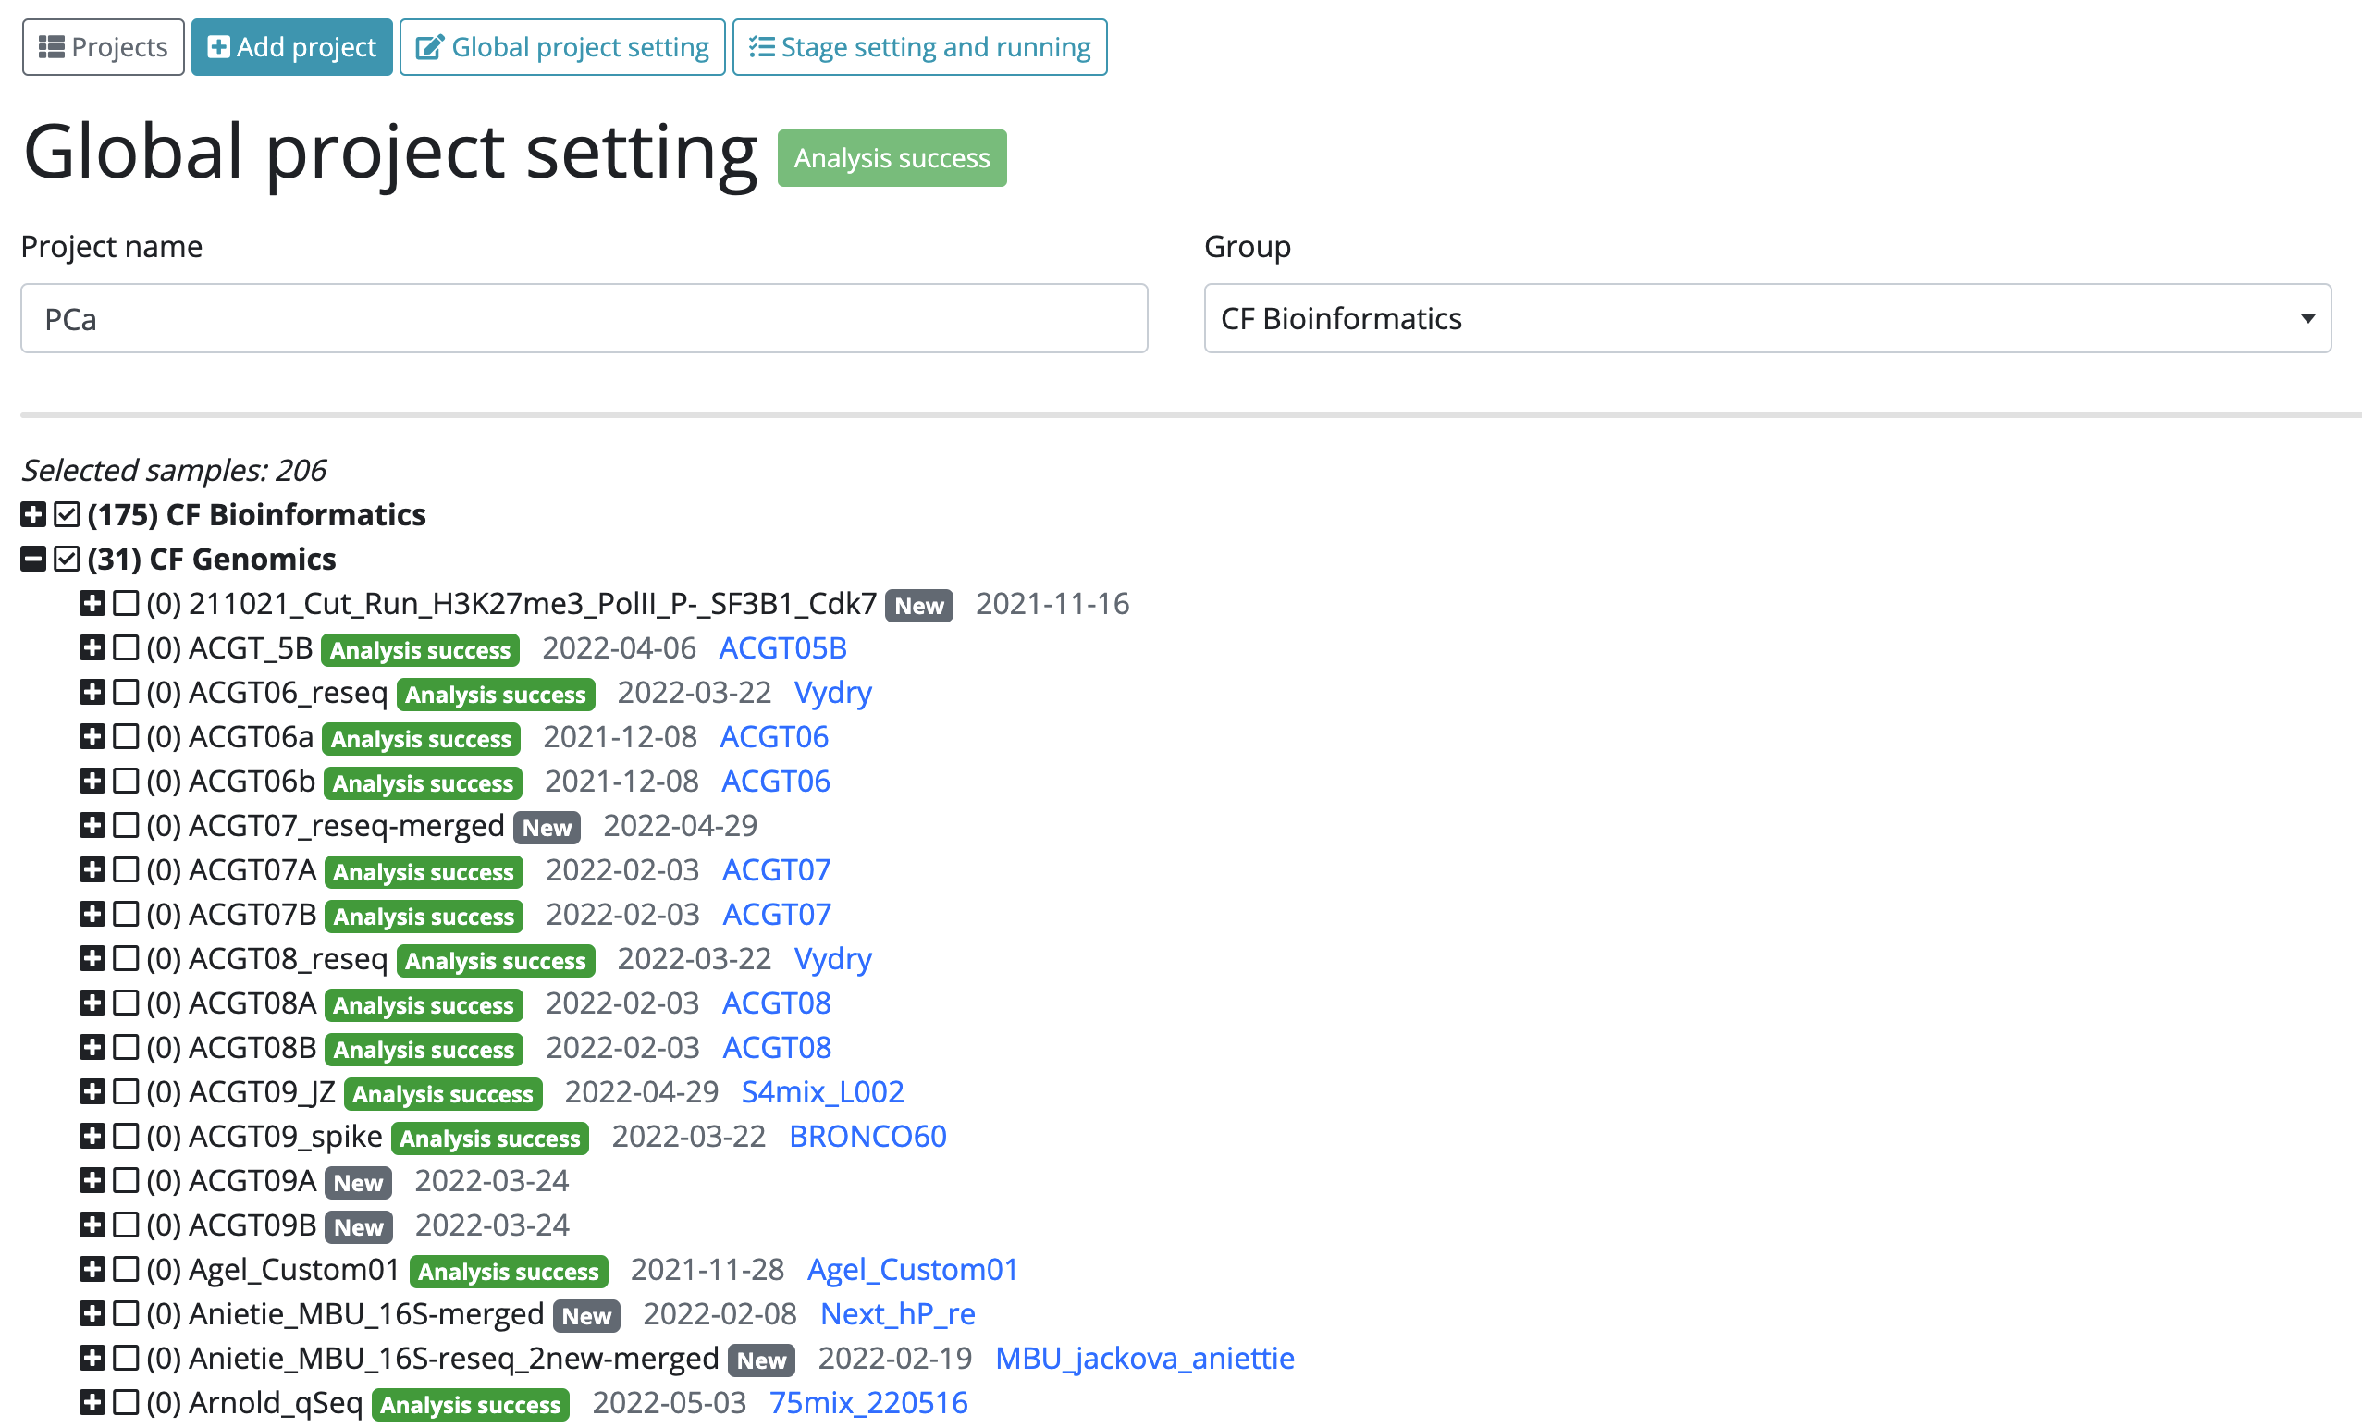

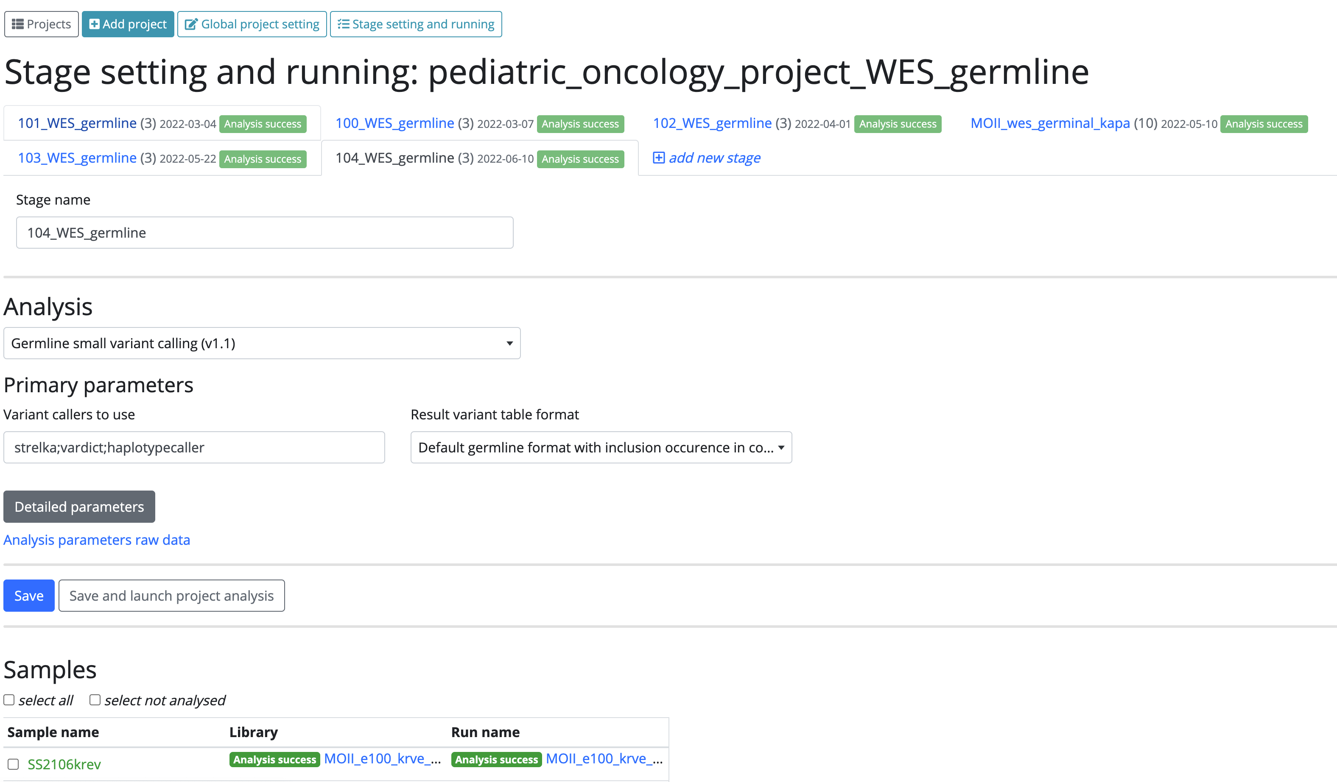




Projects feature and secure scalable architecture
SensitiveCloud
data
storage
HPC

Slide 20
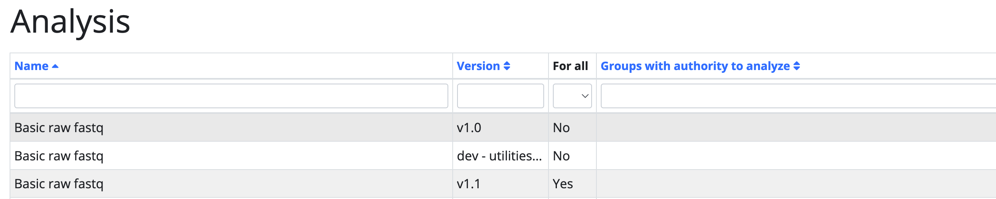
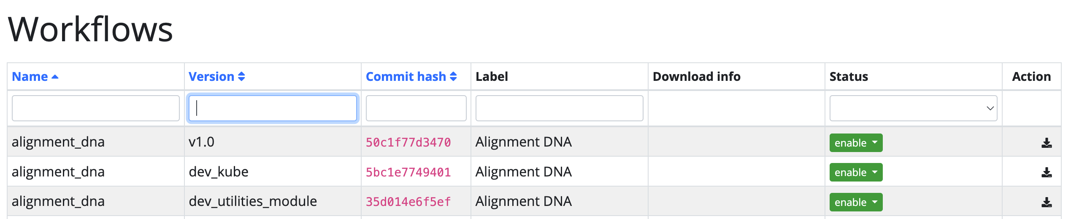
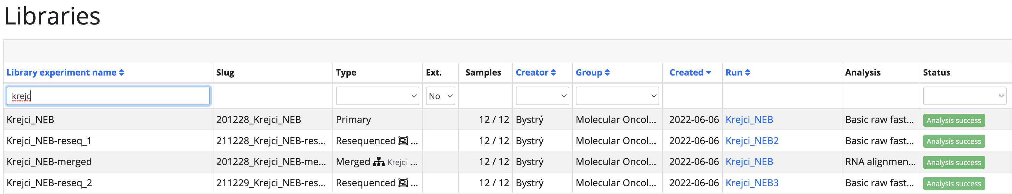
Other highlights
Workflow/analysis version control system
Re-sequencing support

Slide 21
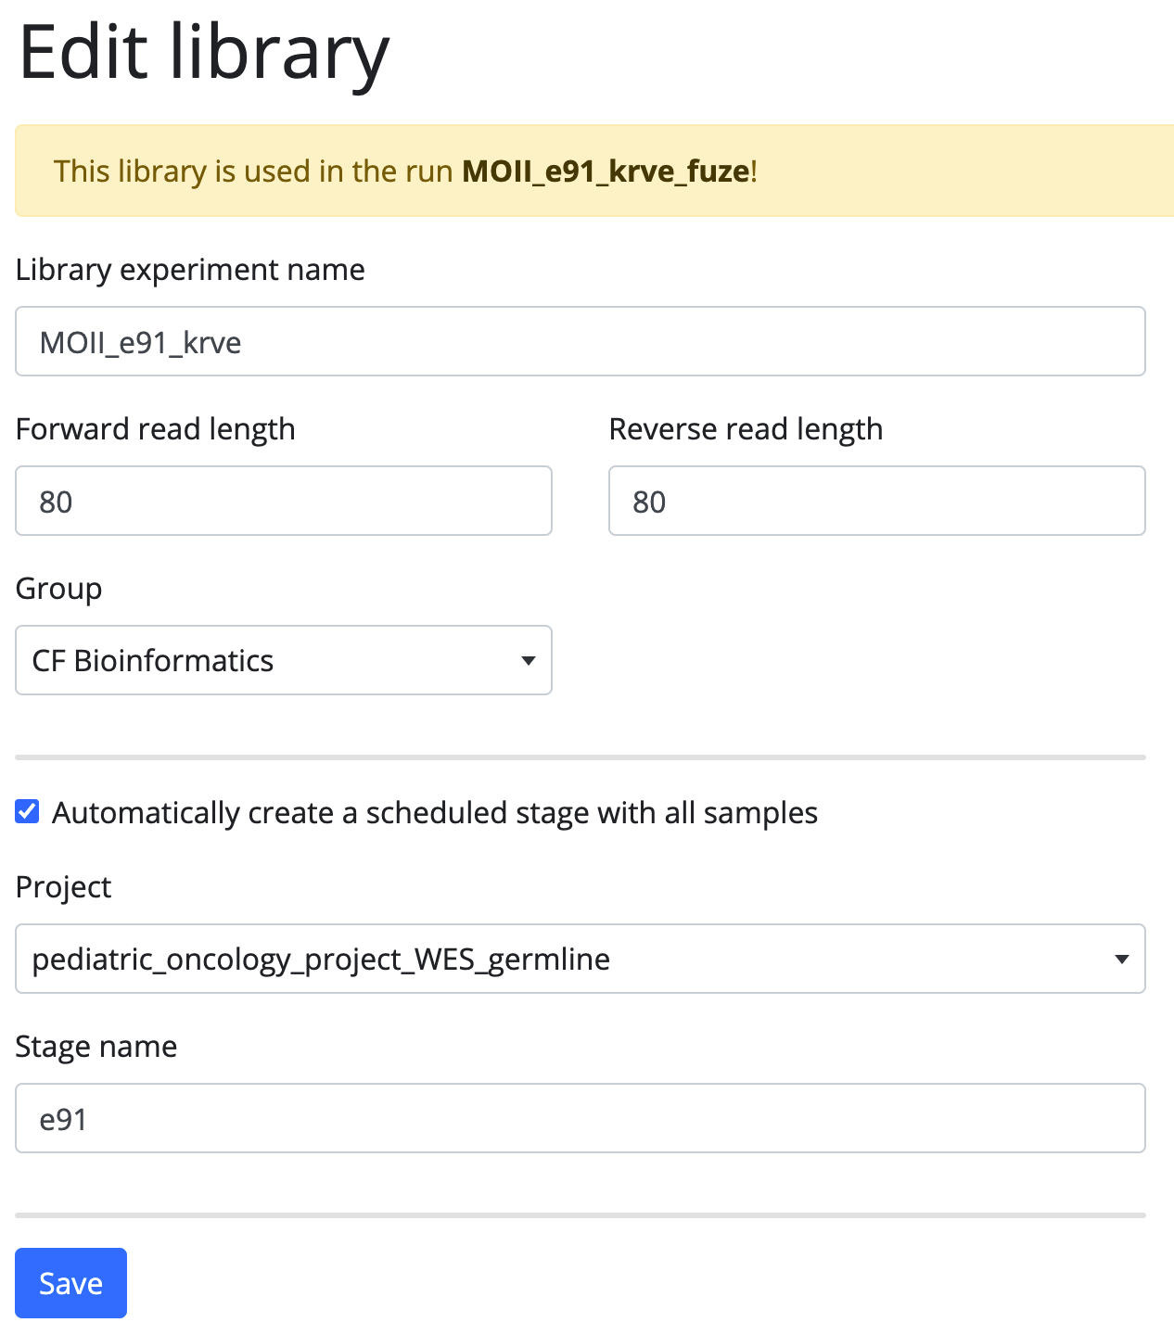
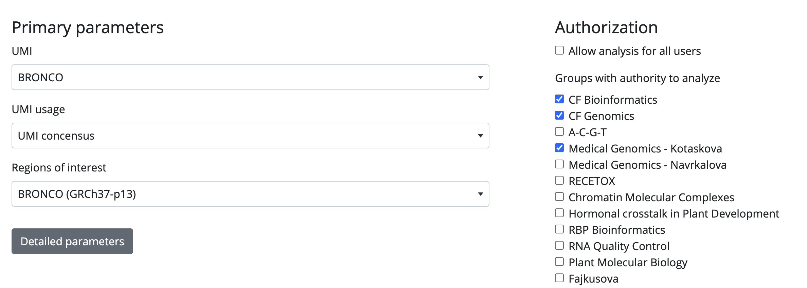
Other highlights
Personalized presets for analysis
Direct push of libraries to project

Slide 22
Availability
Not publicly available
Plan is a free use for academics
  final licensing scheme is still being negotiated
In case of an interest contact me please
vojtech.bystry@ceitec.muni.cz

Slide 23



Acknoledgments
Panagiotis Alexiou
Vaclav Hejret
Martin Demko
Katerina Juraskova
Nicolas Blavet
Jan Oppelt
Viktor Masicek
Nicolas Mokris
Tomas Kudelka
Boris Tichy
Terezie Kurucova
Filip Pardy
Karolina Trachtova
Petra Pokorna
Robin Jugas
Dagmar Al Tukmachi

Slide 24
CEITEC
@CEITEC_Brno
Thank you
for your attention
www.ceitec.eu

