Slide 1
Eliška Chalupová – RBP Bioinformatics
chalupovaeliska@email.cz
375973@mail.muni.cz
Deep Learning the binding patterns of RNA-binding proteins using ENNGene
Notes:
1

Slide 2
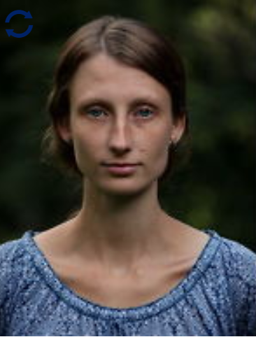
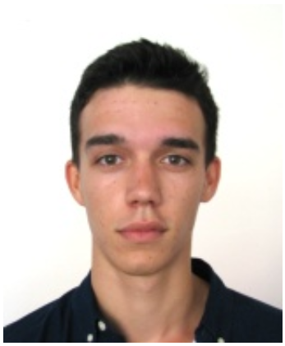
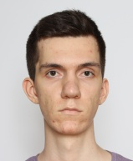


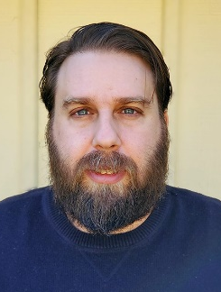
Authors
Eliška Chalupová
Ondřej Vaculík
Jakup Poláček
Filip Jozefov
Tomáš Majtner
Panagiotis Alexiou
Ondrej Vaculik
PhD Student
PhD Student
Mgr Student
Mgr Student
postDoc
Group Leader
Deep Learning the binding patterns of RNA-binding proteins using ENNGene
2
Notes:
2

Slide 3
Outline
Basic concepts & key terms
  Deep Neural Networks
    Convolutional Networks
RNA-binding proteins
  Previous methods
  Deep Learning approaches
  Our results
ENNGene
  Tool overview
Deep Learning the binding patterns of RNA-binding proteins using ENNGene
3
Notes:
Topic - RNA binding protein target site identification using Machine Learning algorithms
3

Slide 4
Basic concepts & key terms
Deep Learning the binding patterns of RNA-binding proteins using ENNGene
4
Notes:
4

Slide 5
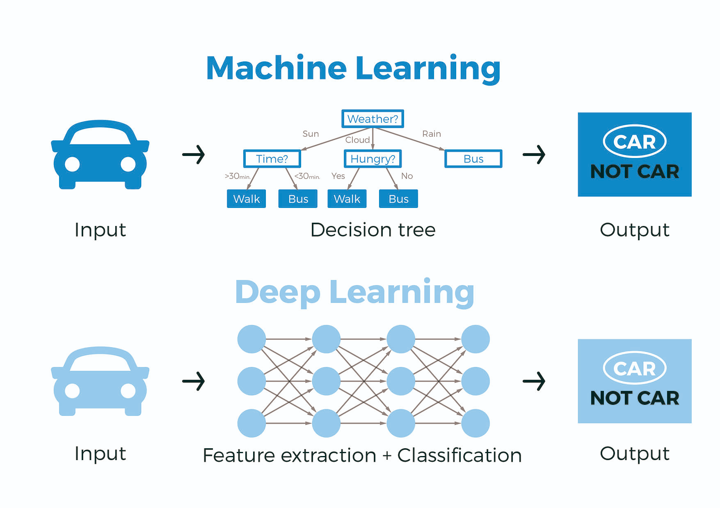
Deep Neural Networks
Deep Learning the binding patterns of RNA-binding proteins using ENNGene
5
Notes:
Deep learning is a subfield of machine learning that structures algorithms in layers to create an "artificial neural network” that can learn and make intelligent decisions on its own.
While basic machine learning models do become progressively better at whatever their function is, they still need some guidance. If an AI algorithm returns an inaccurate prediction, then an engineer has to step in and make adjustments. With a deep learning model, an algorithm can determine on its own if a prediction is accurate or not through its own neural network.
A deep learning model is able to learn through its own method of computing—a technique that makes it seem like it has its own brain.
5

Slide 6
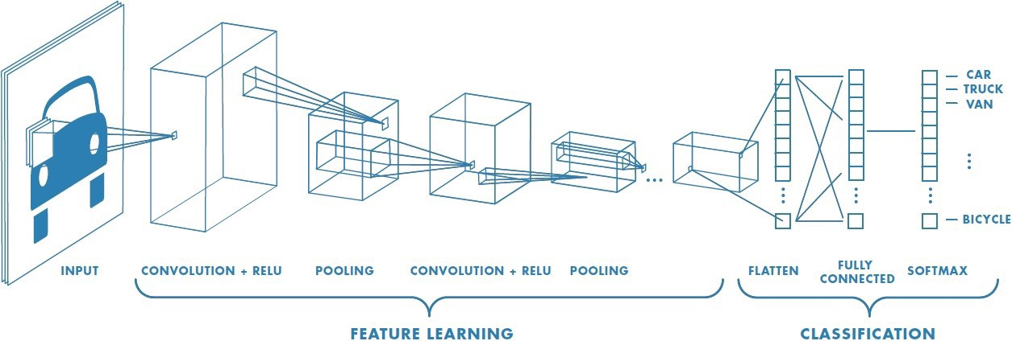
Convolutional Neural Networks
Deep Learning the binding patterns of RNA-binding proteins using ENNGene
6
Notes:
Just as each neuron responds to stimuli only in the restricted region of the visual field called the receptive field in the biological vision system, each neuron in a CNN processes data only in its receptive field as well. The layers are arranged in such a way so that they detect simpler patterns first (lines, curves, etc.) and more complex patterns (faces, objects, etc.) further along.
6

Slide 7
RNA-binding proteins
Deep Learning the binding patterns of RNA-binding proteins using ENNGene
7
Notes:
7

Slide 8
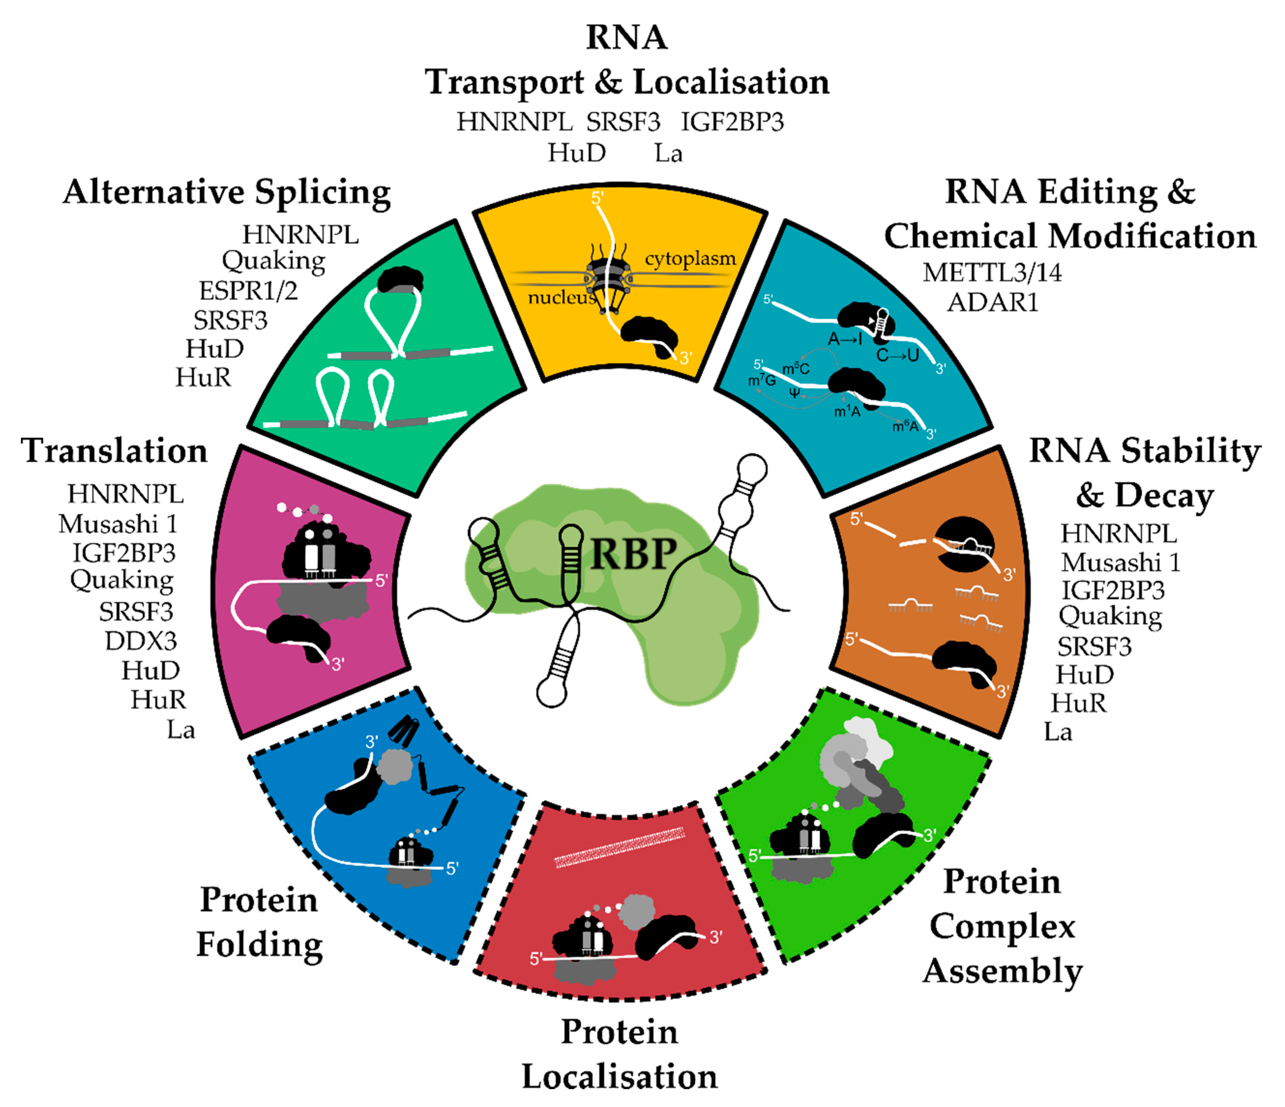
RNA-binding proteins
Various methods with diverse results
  In vitro (SELEX, RNAcompete, RNA Bind-n-Seq)
  In vivo (RIP-chip, RIP-seq, CLIP-seq)
Difficult to predict the binding events
  Diverse and often non-canonical forms of binding
  Binding sites split into two or more places
  Binding is not only sequence-specific
Source: Weiße et al., RNA-Binding Proteins as Regulators of Migration, Invasion and Metastasis in Oral Squamous Cell Carcinoma. 2020
Deep Learning the binding patterns of RNA-binding proteins using ENNGene
8
Notes:
8

Slide 9
Older ML Methods
Method | Year | Features | Model
RNAContext | 2010 | Seq + struct | Probabilistic
GraphProt | 2014 | Seq + struct | SVM
Oli | 2014 | Seq | SVM
iONMF | 2016 | Seq + struct + reg. type, clip combin. | Matrix factorization
RNAcommander | 2016 | Seq | Matrix factorization
RCK | 2016 | Seq + struct | Probabilistic
RPI-bind | 2017 | Seq + struct | SVM, NN, RF
Deep Learning the binding patterns of RNA-binding proteins using ENNGene
9
Notes:
9

Slide 10






Deep Learning Methods
2015
2016
2017
2018
2019
2020
DeepBind
Deepnet-rbp
iDeep
pysster
CRIP
DeepClip
DLPRB
DeepRiPe
DeepRKE
Deep Learning the binding patterns of RNA-binding proteins using ENNGene
10
Notes:
10

Slide 11
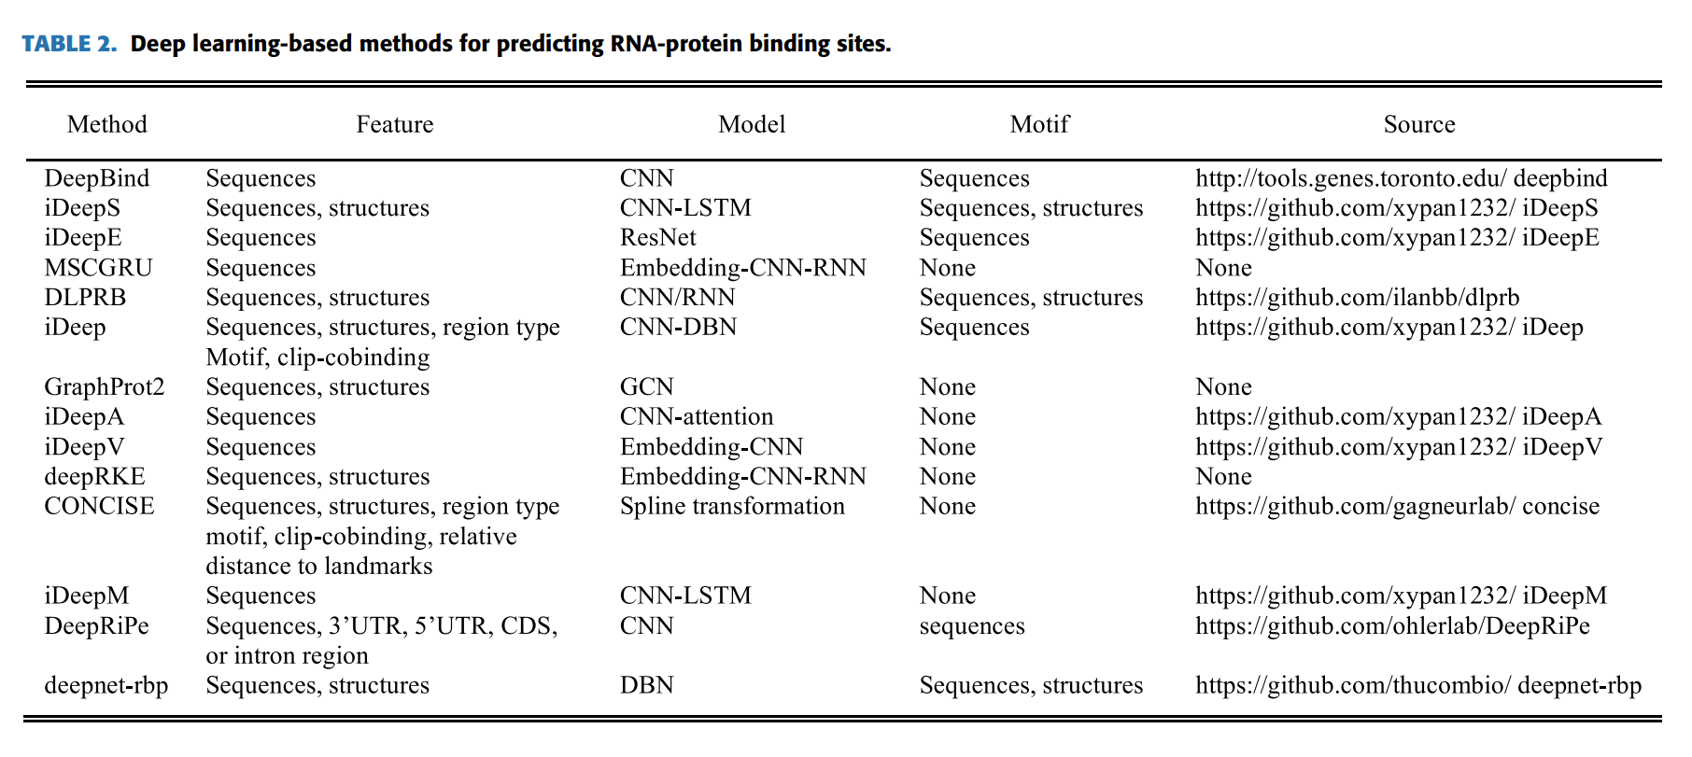
Deep Learning Methods
Yan & Zhu, 2020
Deep Learning the binding patterns of RNA-binding proteins using ENNGene
11
Notes:
11

Slide 12
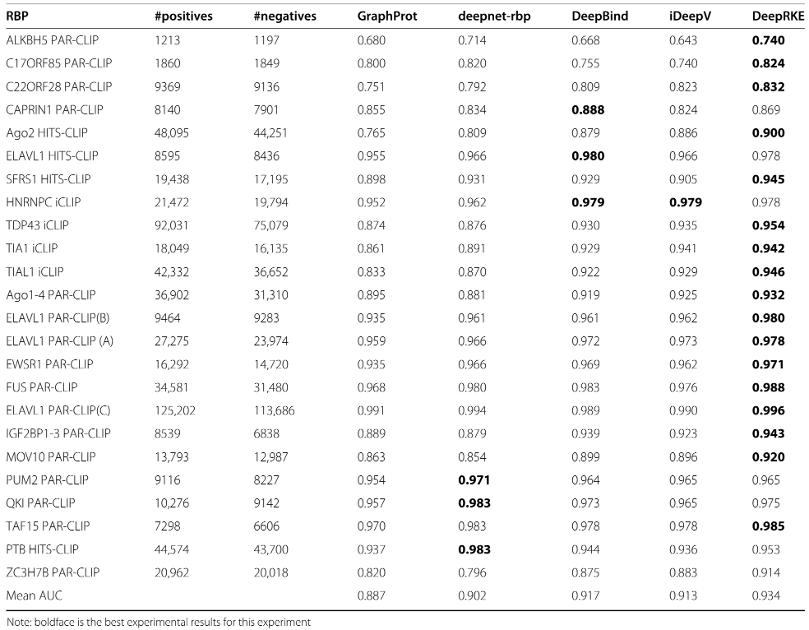
RBP24 Dataset
2014 2016 2016 2018 2020
Originally from GraphProt
Positive sites based on CLIP-seq experiments
Negative sites from other non-bound region from the same gene
Deep Learning the binding patterns of RNA-binding proteins using ENNGene
12
Notes:
12

Slide 13
Our results
Hypothesis
Binding specificity of each RBP can be best predicted by a tailored architecture.
Deep Learning the binding patterns of RNA-binding proteins using ENNGene
13
Notes:
13

Slide 14
Our results
Hypothesis
Binding specificity of each RBP can be best predicted by a tailored architecture.
Improved performance on 14/24 datasets
Average AUC ROC
GraphProt | deepnet-rbp | DeepBind | iDeepV | iDeepE | DeepRKE | ENNGene
0.887 | 0.903 | 0.918 | 0.913 | 0.931 | 0.934 | 0.947
Deep Learning the binding patterns of RNA-binding proteins using ENNGene
14
Notes:
14

Slide 15
Our observations
Predicted RNA secondary structure seemed redundant to sequence.
Evolutionary conservation improved performance in most cases.
Using GRU/LSTM did not improve upon CNN.
Designing an architecture per protein can improve performance and save time and resources.
Deep Learning the binding patterns of RNA-binding proteins using ENNGene
15
Notes:
15

Slide 16
ENNGene: Easy Neural Network model building tool for Genomics
Deep Learning the binding patterns of RNA-binding proteins using ENNGene
16
Notes:
16

Slide 17
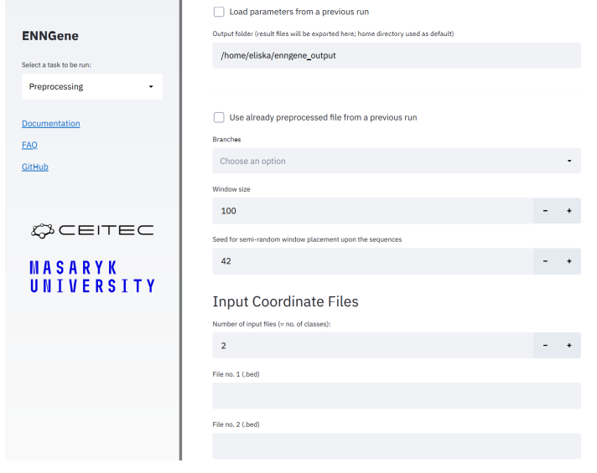
Overview
Deep Learning without programming
User friendly GUI
Custom CNN/RNN architecture
Three input types
  Sequence
  RNA secondary structure
  Evolutionary conservation
Any species, arbitrary number of classes
Full reproducibility of results
Deep Learning the binding patterns of RNA-binding proteins using ENNGene
17
Notes:
17

Slide 18
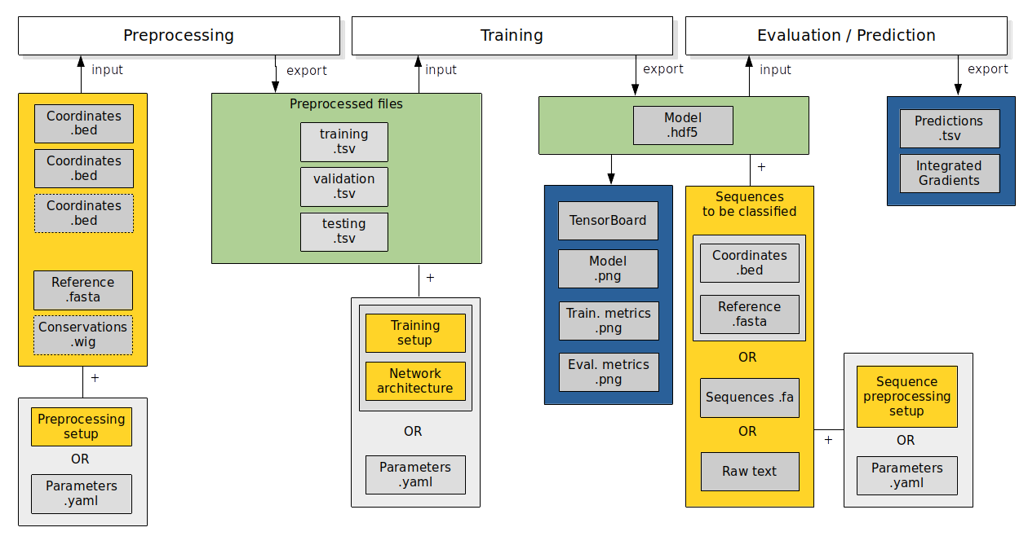
Dataflow
Deep Learning the binding patterns of RNA-binding proteins using ENNGene
18
Notes:
18

Slide 19
1 Preprocessing
2+ input files → classes
Up to 3 input types → model branches
Unify sequence length
Map to any species’ genome/transcriptome
Unify/reduce dataset size
Split datasets for training and evaluation
Preprocess!
Deep Learning the binding patterns of RNA-binding proteins using ENNGene
19
Notes:
19

Slide 20
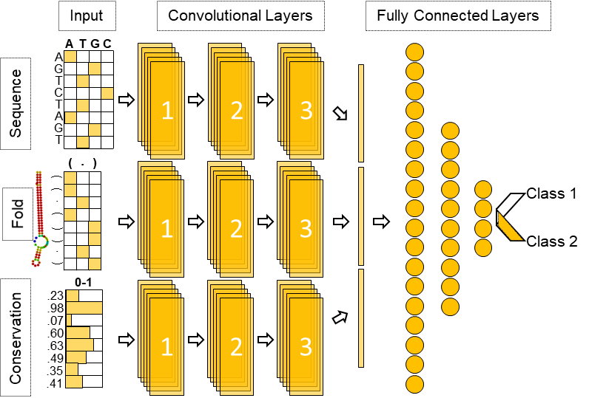
Network input types
User Input
ENNGene Process
Network Input
One-hot encode
Reference genome
.fasta
Map
Coordinates
.bed
+
Fold by ViennaRNA 2
One-hot encode
Coordinates
.bed
Coordinates
.bed
+
Conservation files (PhyloP)
.wig
Map
Deep Learning the binding patterns of RNA-binding proteins using ENNGene
20
Notes:
20

Slide 21
2 Training
Up to 3 branches
Set up training options
    Batch size, epochs, early stopping
    Optimizers
    Learning rate
Customize network architecture
Customize layer options
    Dropout, batch normalization
    Layer-specific options
Train!
Deep Learning the binding patterns of RNA-binding proteins using ENNGene
21
Notes:
21

Slide 22
Branches
Deep Learning the binding patterns of RNA-binding proteins using ENNGene
22
Notes:
22

Slide 23
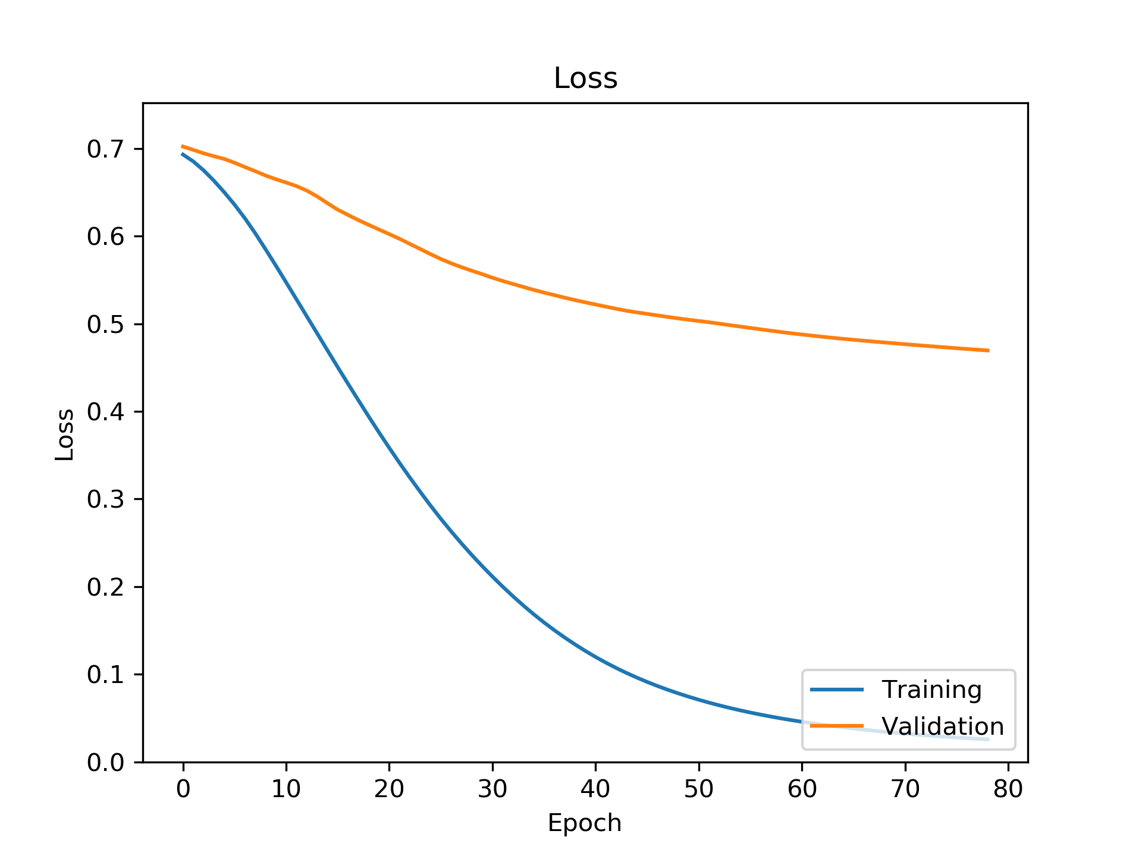
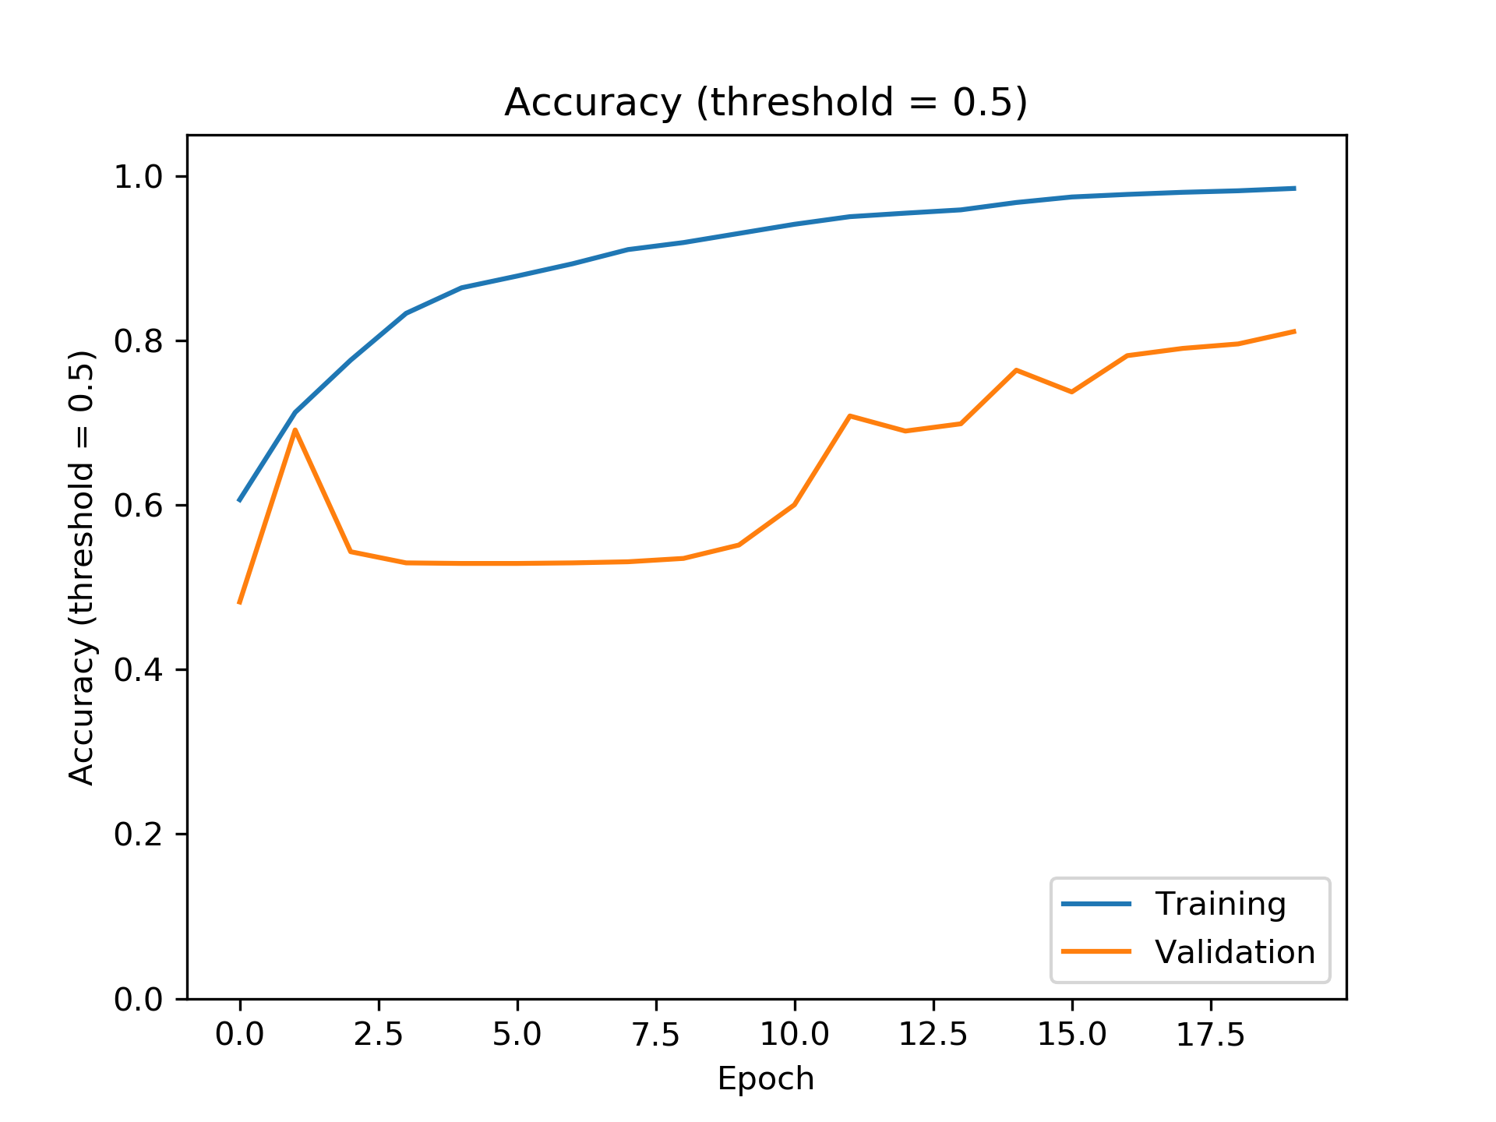
Metrics monitored during training
Loss (categorical crossentropy) Accuracy
Deep Learning the binding patterns of RNA-binding proteins using ENNGene
23
Notes:
23

Slide 24
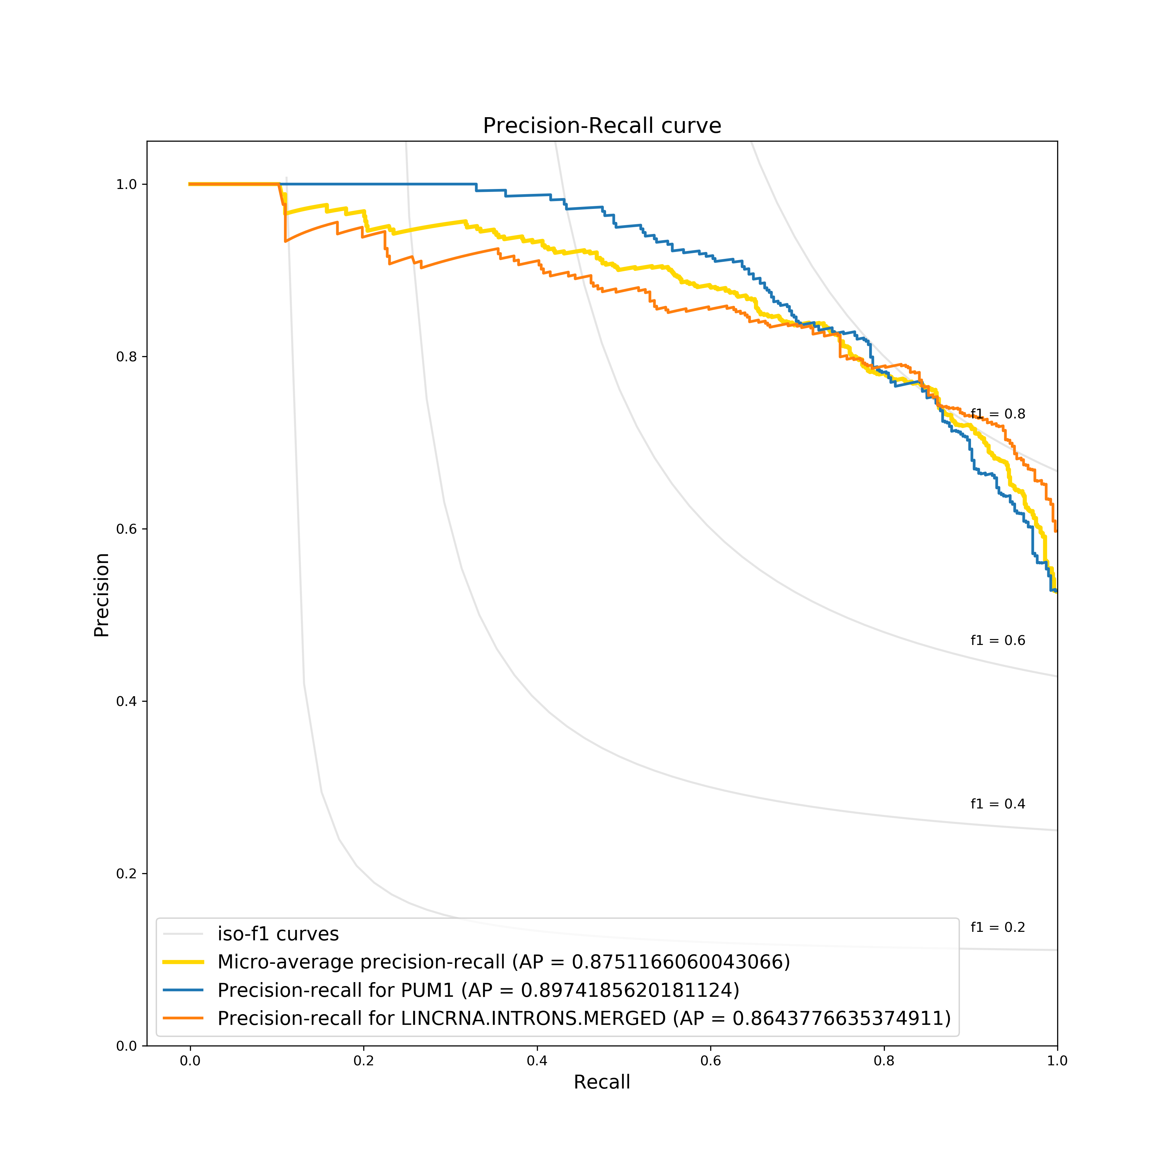
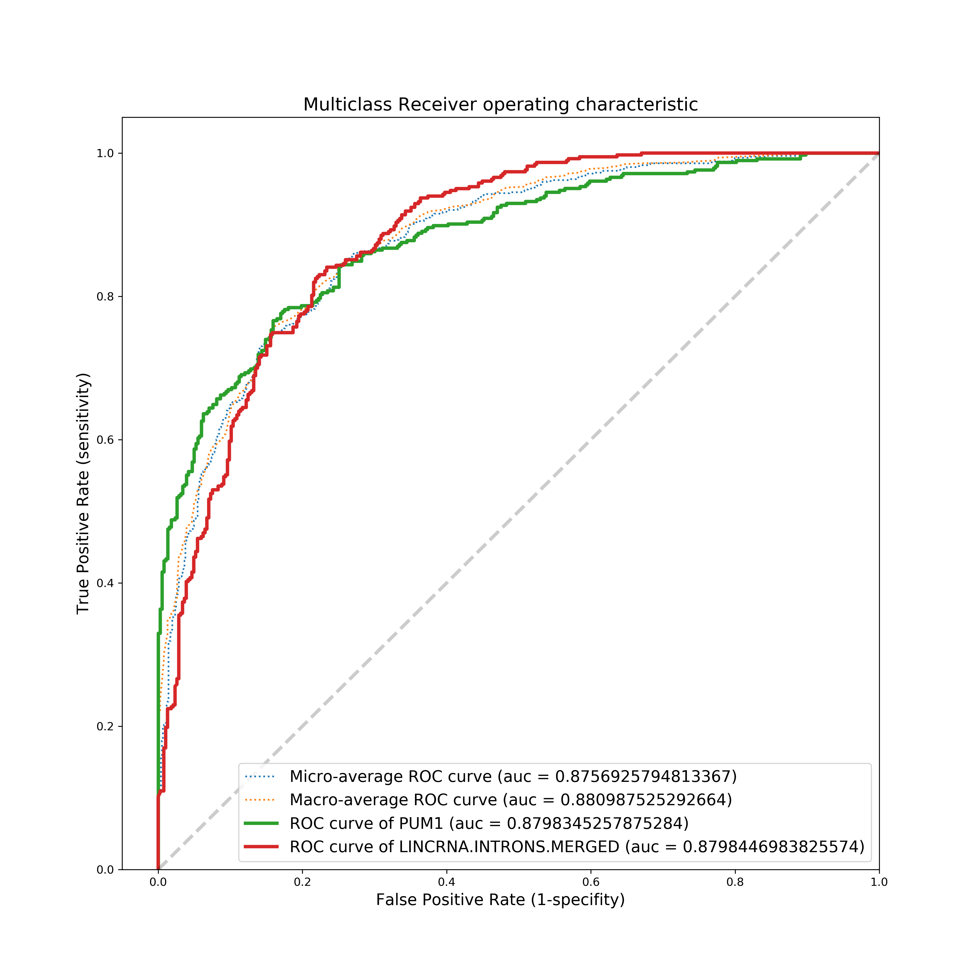
Evaluation metrics
Metrics evaluating model performance
    AUC (Receiver operating characteristic)
    Precision-Recall curve
Deep Learning the binding patterns of RNA-binding proteins using ENNGene
24
Notes:
24

Slide 25
TensorBoard
Visualize and compare metrics
Browse model architecture
Check model parameters’ distribution
Deep Learning the binding patterns of RNA-binding proteins using ENNGene
25
Notes:
25

Slide 26
3 Evaluation / Prediction
Apply trained model
  Evaluate on different dataset
  Classify novel sequences
Preprocess sequences
Predict!
Calculate Integrated Gradients
Deep Learning the binding patterns of RNA-binding proteins using ENNGene
26
Notes:
26

Slide 27
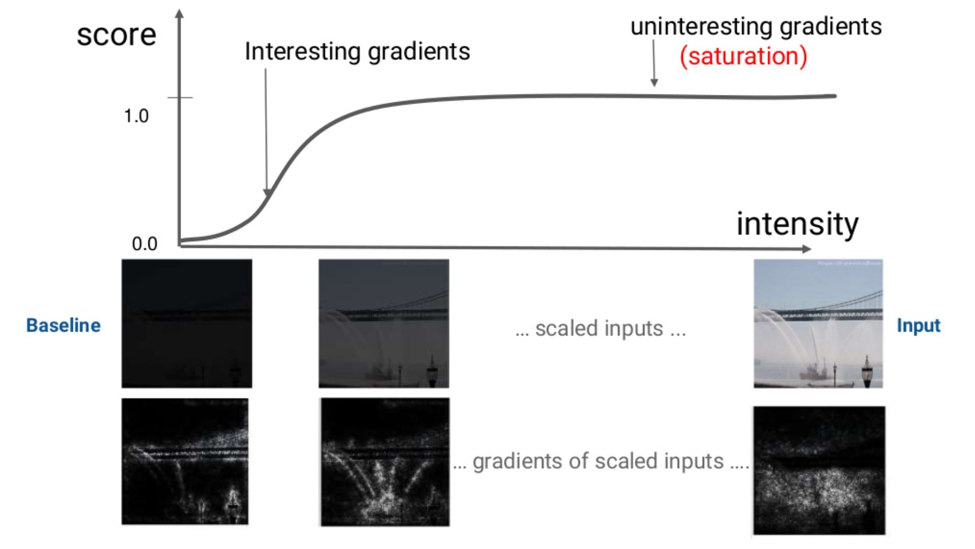
Integrated Gradients
Source: AI Explained: What are Integrated Gradients? (A. Taly, 2020)
Deep Learning the binding patterns of RNA-binding proteins using ENNGene
27
Notes:
- Explaining Predictions
- as opposed to the other/older methods, IG accounts for all postulated axioms so far (sensitivity/conservation of total relevance, implementation invariance)
- Works for differentiable models, needs access to gradients
- easy to implement
- backed by an axiomatic theory
27

Slide 28
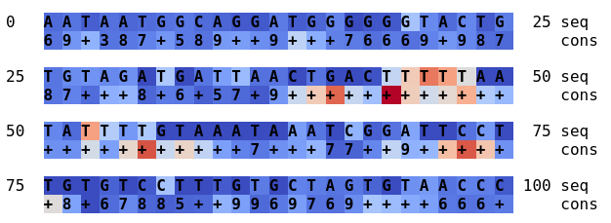
Integrated Gradients @ENNGene
Differentiating bases with high and low attribution
Available for all combinations of all three branches
Deep Learning the binding patterns of RNA-binding proteins using ENNGene
28
Notes:
28

Slide 29

CEITEC
@CEITEC_Brno
Contact @ Eliška Chalupová
chalupovaeliska@email.cz
375973@mail.muni.cz
github.com/ML-Bioinfo-CEITEC/ENNGene
www.sci.muni.cz
www.ceitec.eu
Notes:
29

