Slide 1

Bioinformatics tools
for Non-Invasive Prenatal Testing
Hana Dohnalová

Slide 2

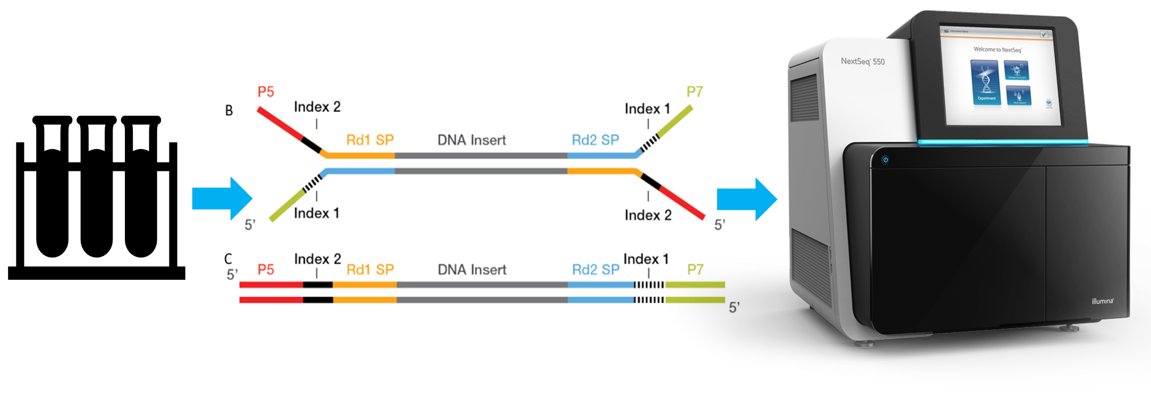
Non-Invasive Prenatal Testing
Prenatal screening method
NGS of circulating cell-free DNA from the plasma of pregnant women
Predicting fetal aneuploidy and sex of fetus
Illumina NextSeq 550

Slide 3
Fetal Fraction
Proportion of cell-free fetal DNA in cell-free DNA of maternal plasma

Slide 4
Methods
SeqFF
Male fetus
Female fetus
ComboFF
DEFRAG
FF
FF
FF
NGS data

Slide 5
Autosomal aberrations
Deviations from the normal number of chromosomes

Slide 6
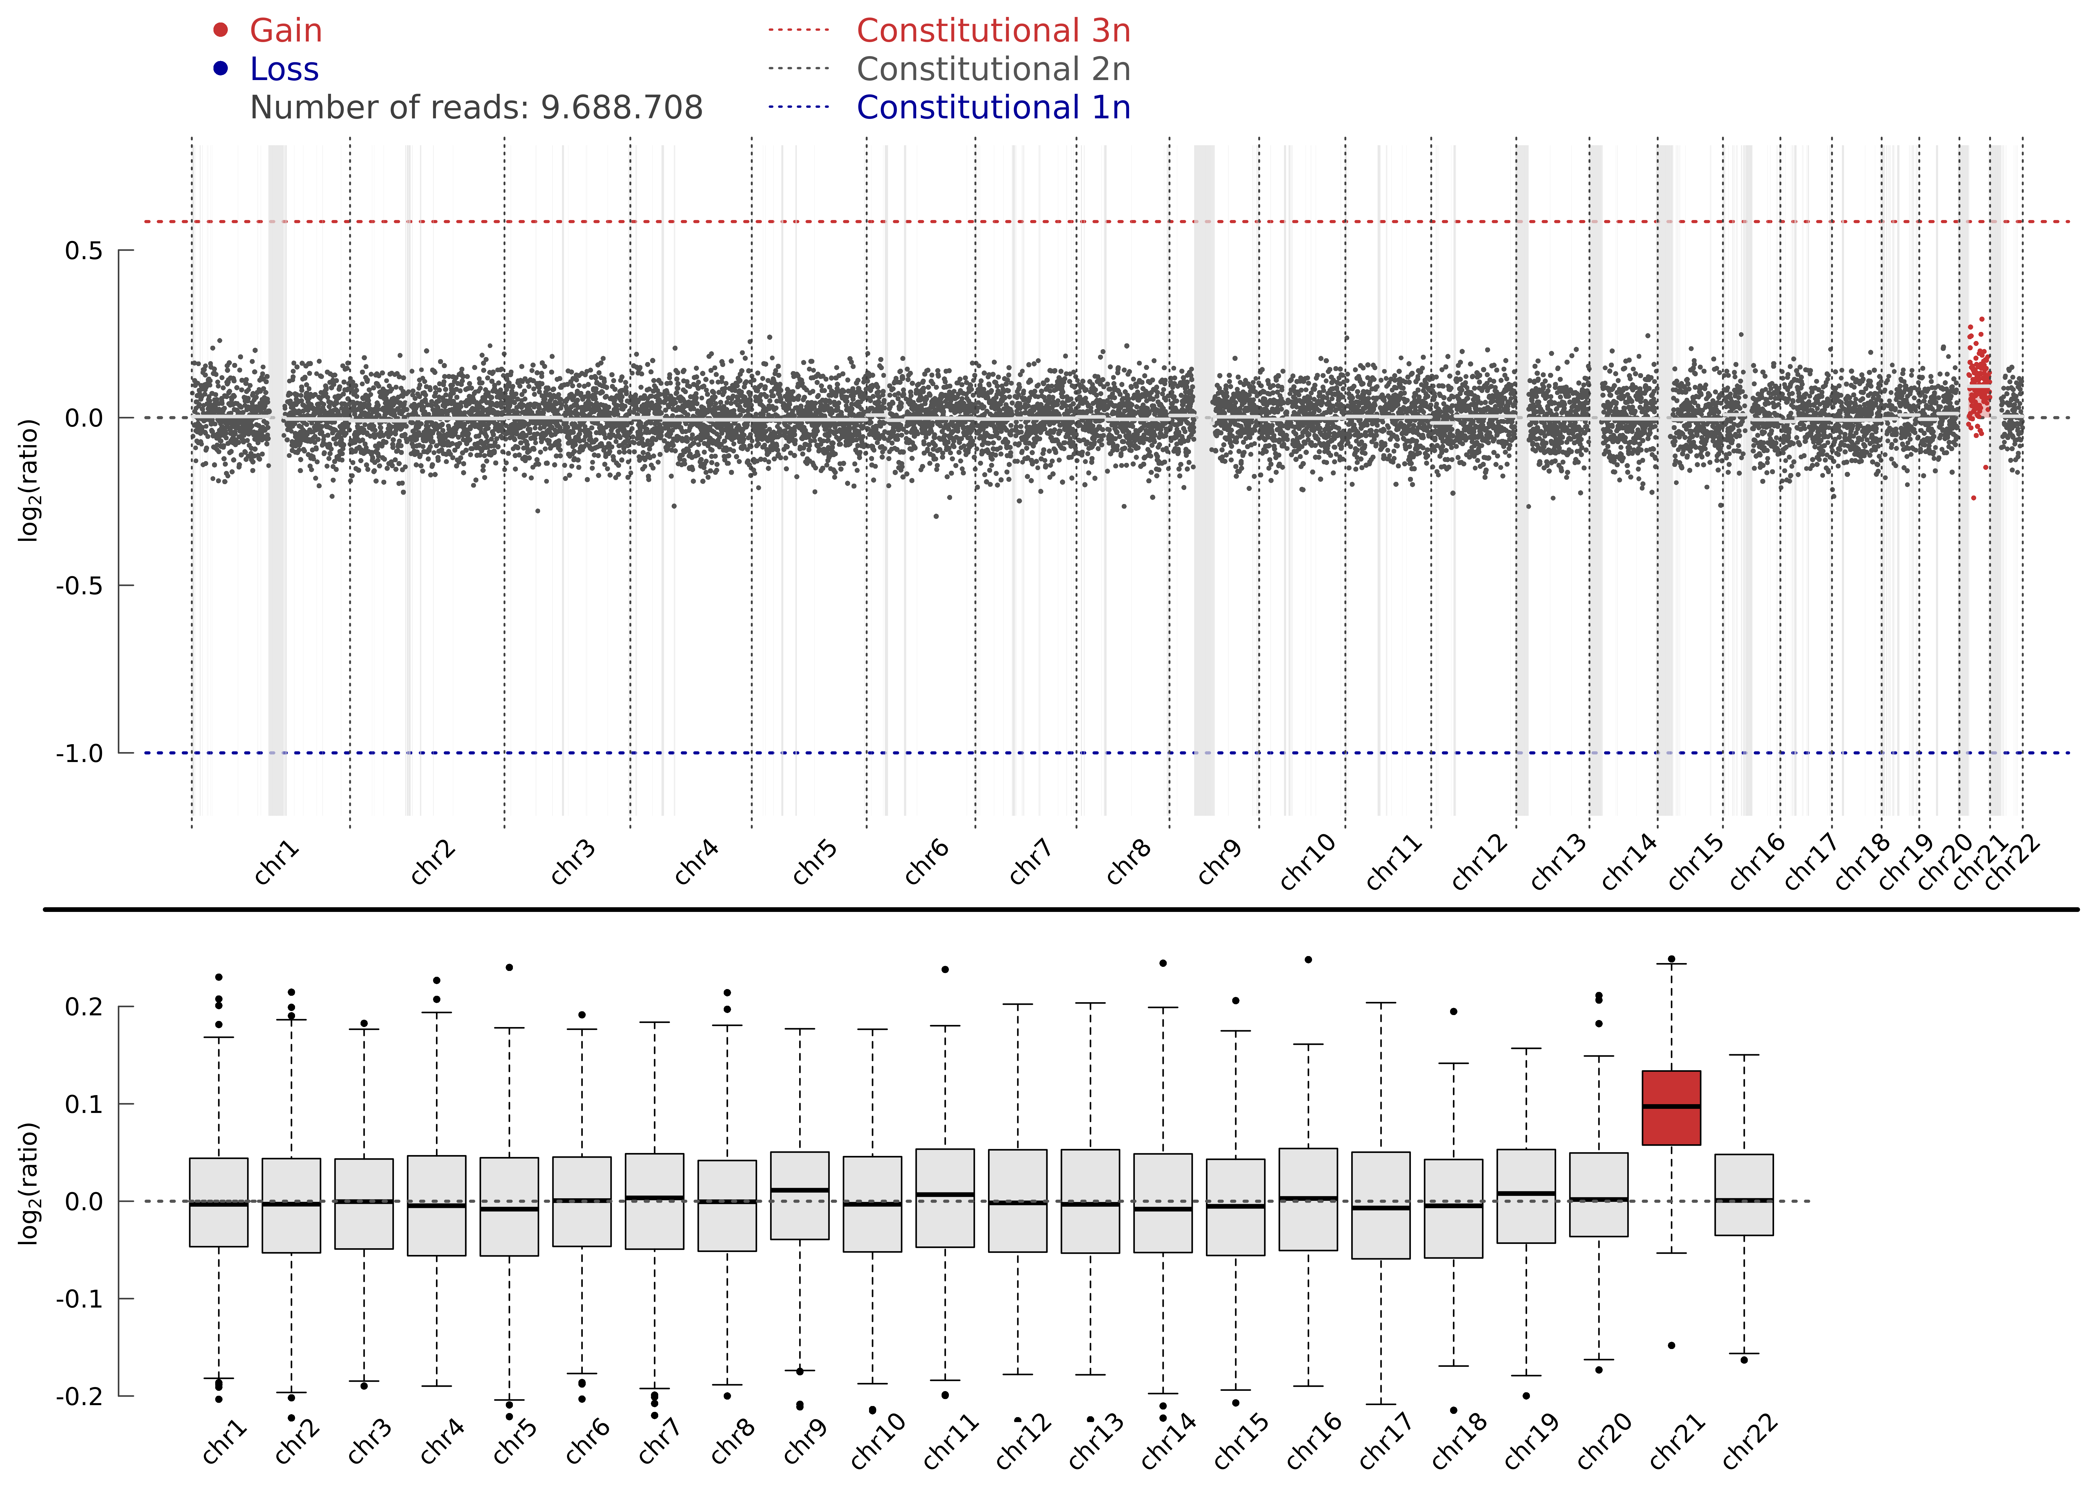
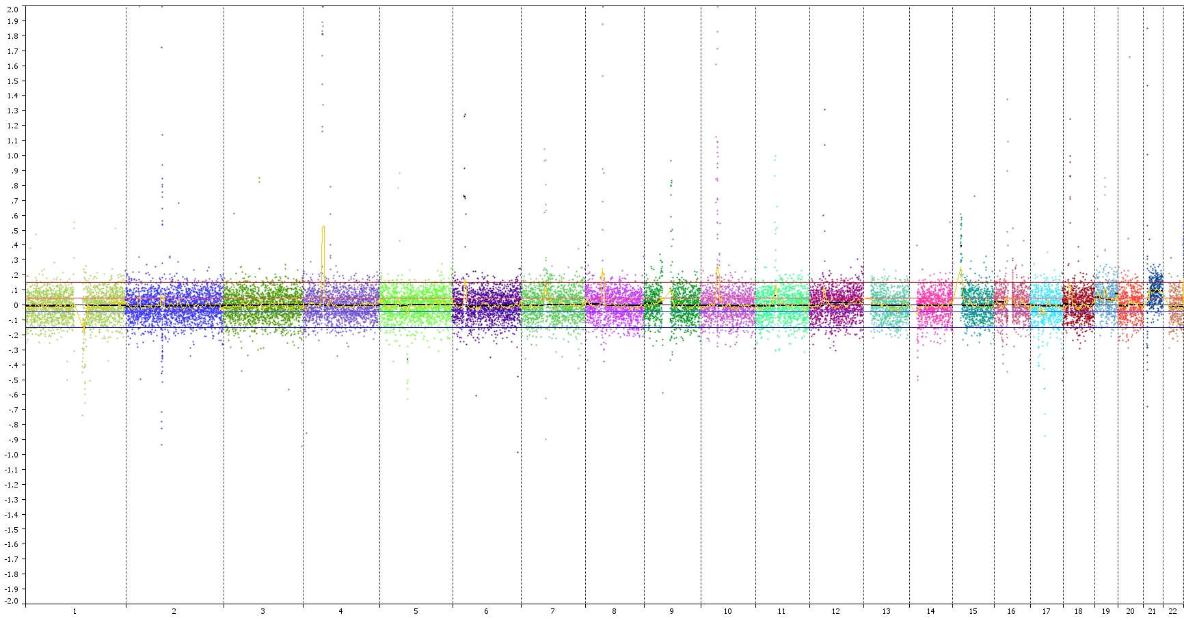
NGS data
WisecondorX
Nexus Copy Number
FF
Methods

Slide 7
Fetal sex prediction

Slide 8
Methods
number of reads on the chrY
DEFRAG
Proprietary algorithm
Nexus Copy Number

Slide 9
Results

Slide 11
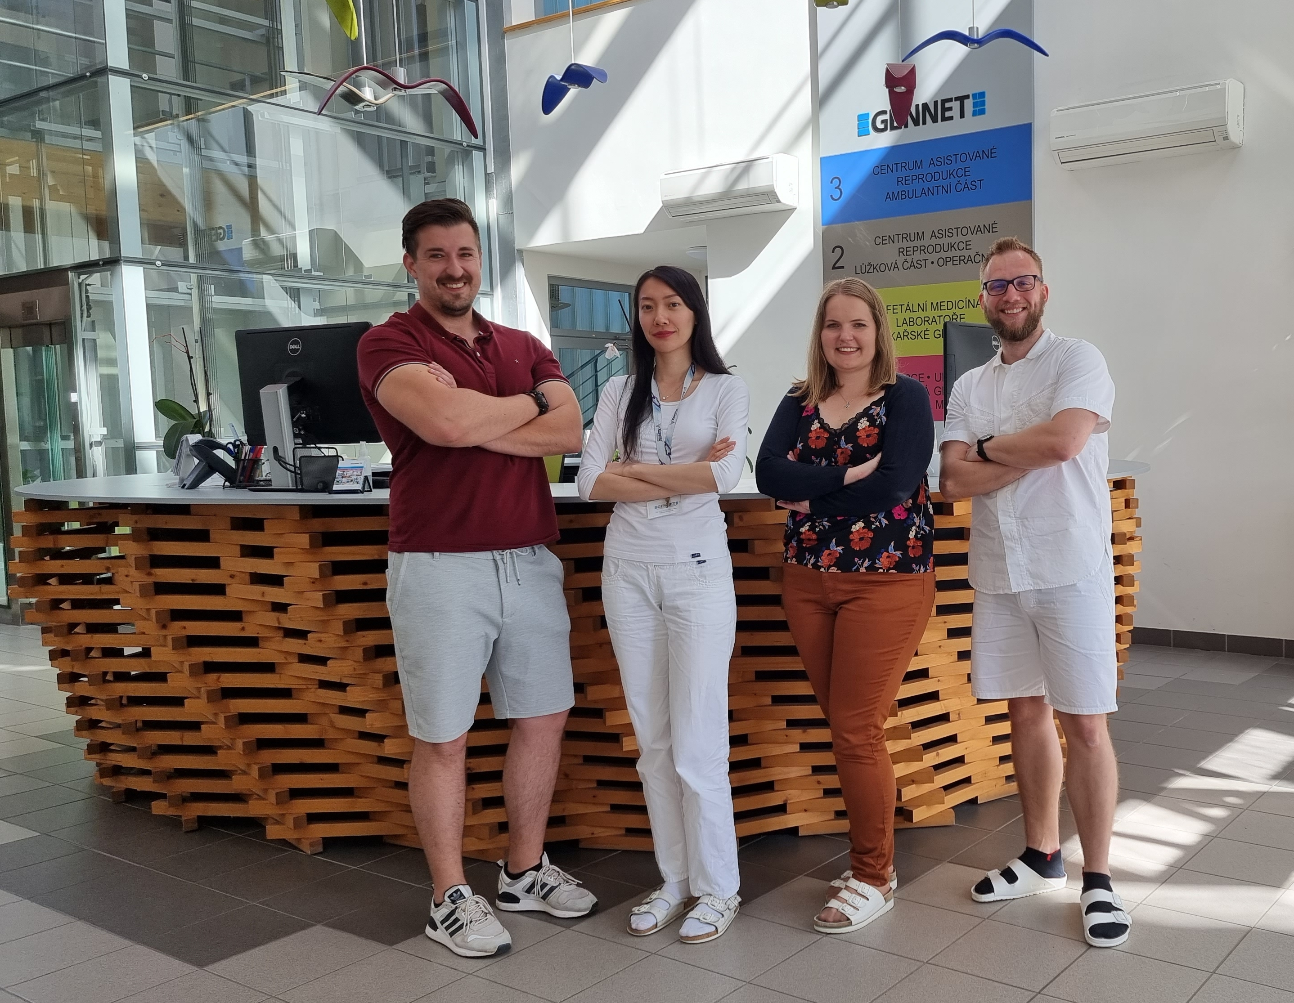
For more information P-07
Filip Zembol
Lenka Bitch Nguyen Thi Ngoc
Hana Dohnalová
Michael Němec
David Stejskal
Monika Koudová
Martina Bittóová

