Slide 1
Protein structure quality trends
Radka Svobodová, Vladimír Horský, Gabriela Bučeková, Jana Porubská, Viktoriia Doshchenko

Slide 2
General trends: Number of protein structures grows

Slide 3
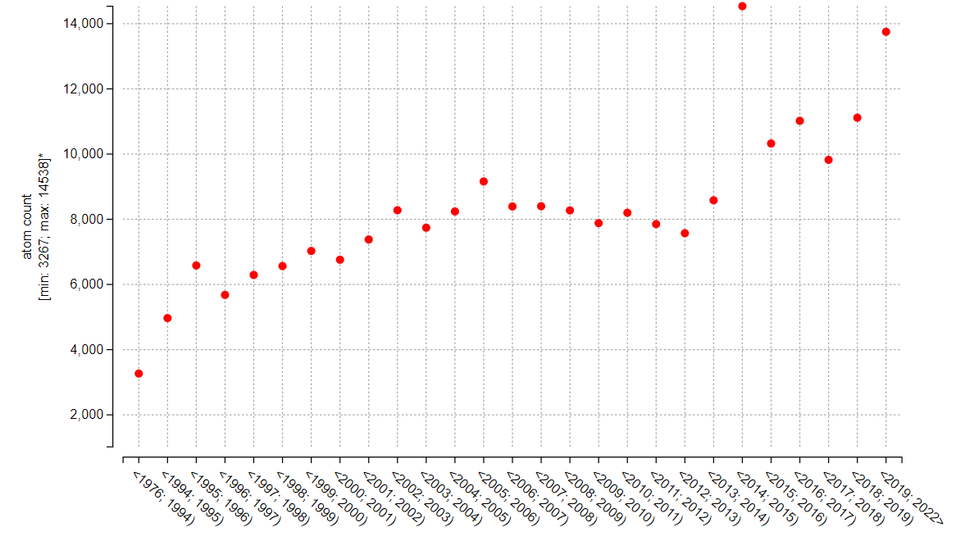
General trends: Size of protein structures grows

Slide 4
General trends: Resolution?

Slide 5
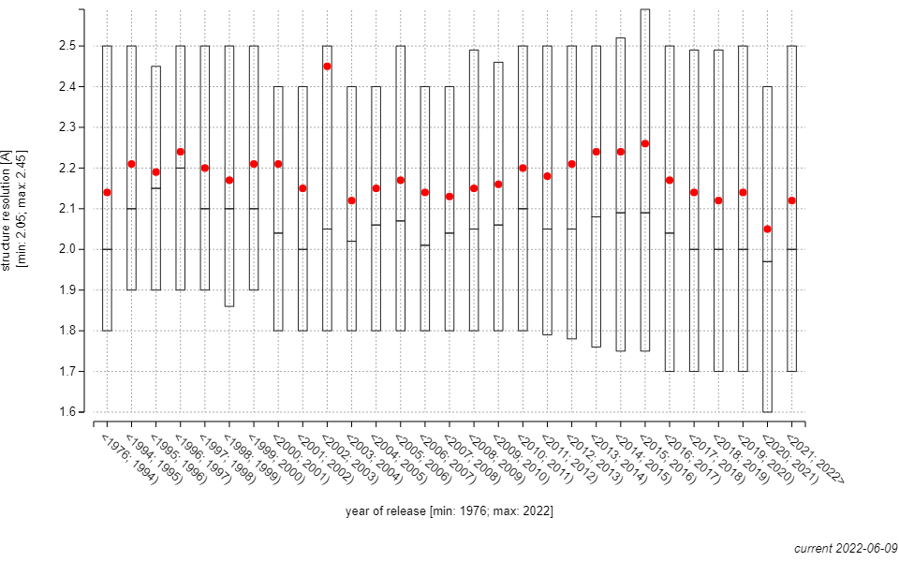
General trends: Resolution?
Vladimír Horský
Better
https://ncbr.muni.cz/ValTrendsDB

Slide 6
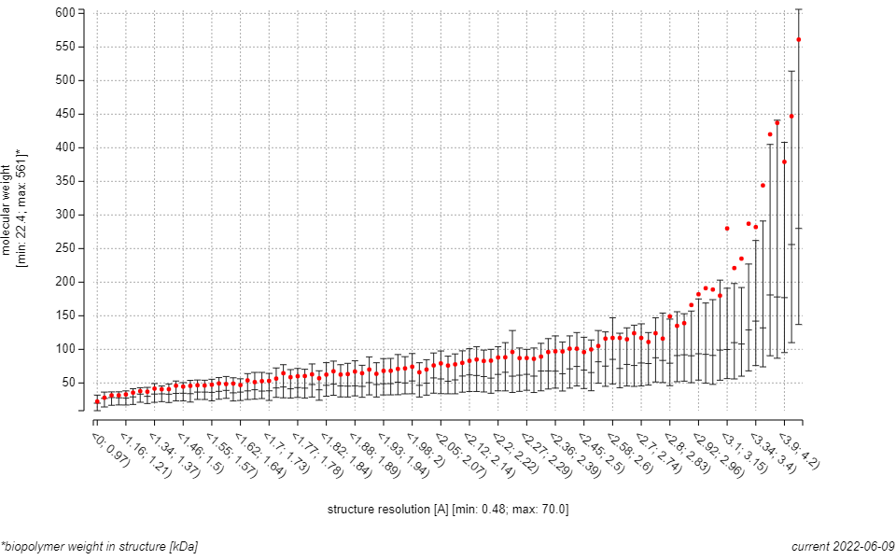
General trends: Resolution?
https://ncbr.muni.cz/ValTrendsDB

Slide 7
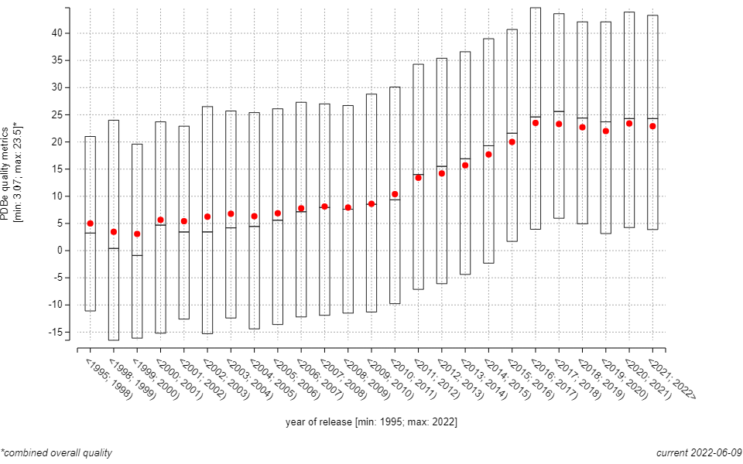
General trends: Combined PDB quality
Vladimír Horský
Better
Smart O.S., Horský V., Gore S., Svobodová R., Bendová V., Kleywegt G.J., Velankar S. (2018). Worldwide Protein Data Bank validation information: usage and trends. Acta Crystallographica D: Structural Biology, 74(3), 237-244.
https://ncbr.muni.cz/ValTrendsDB

Slide 8
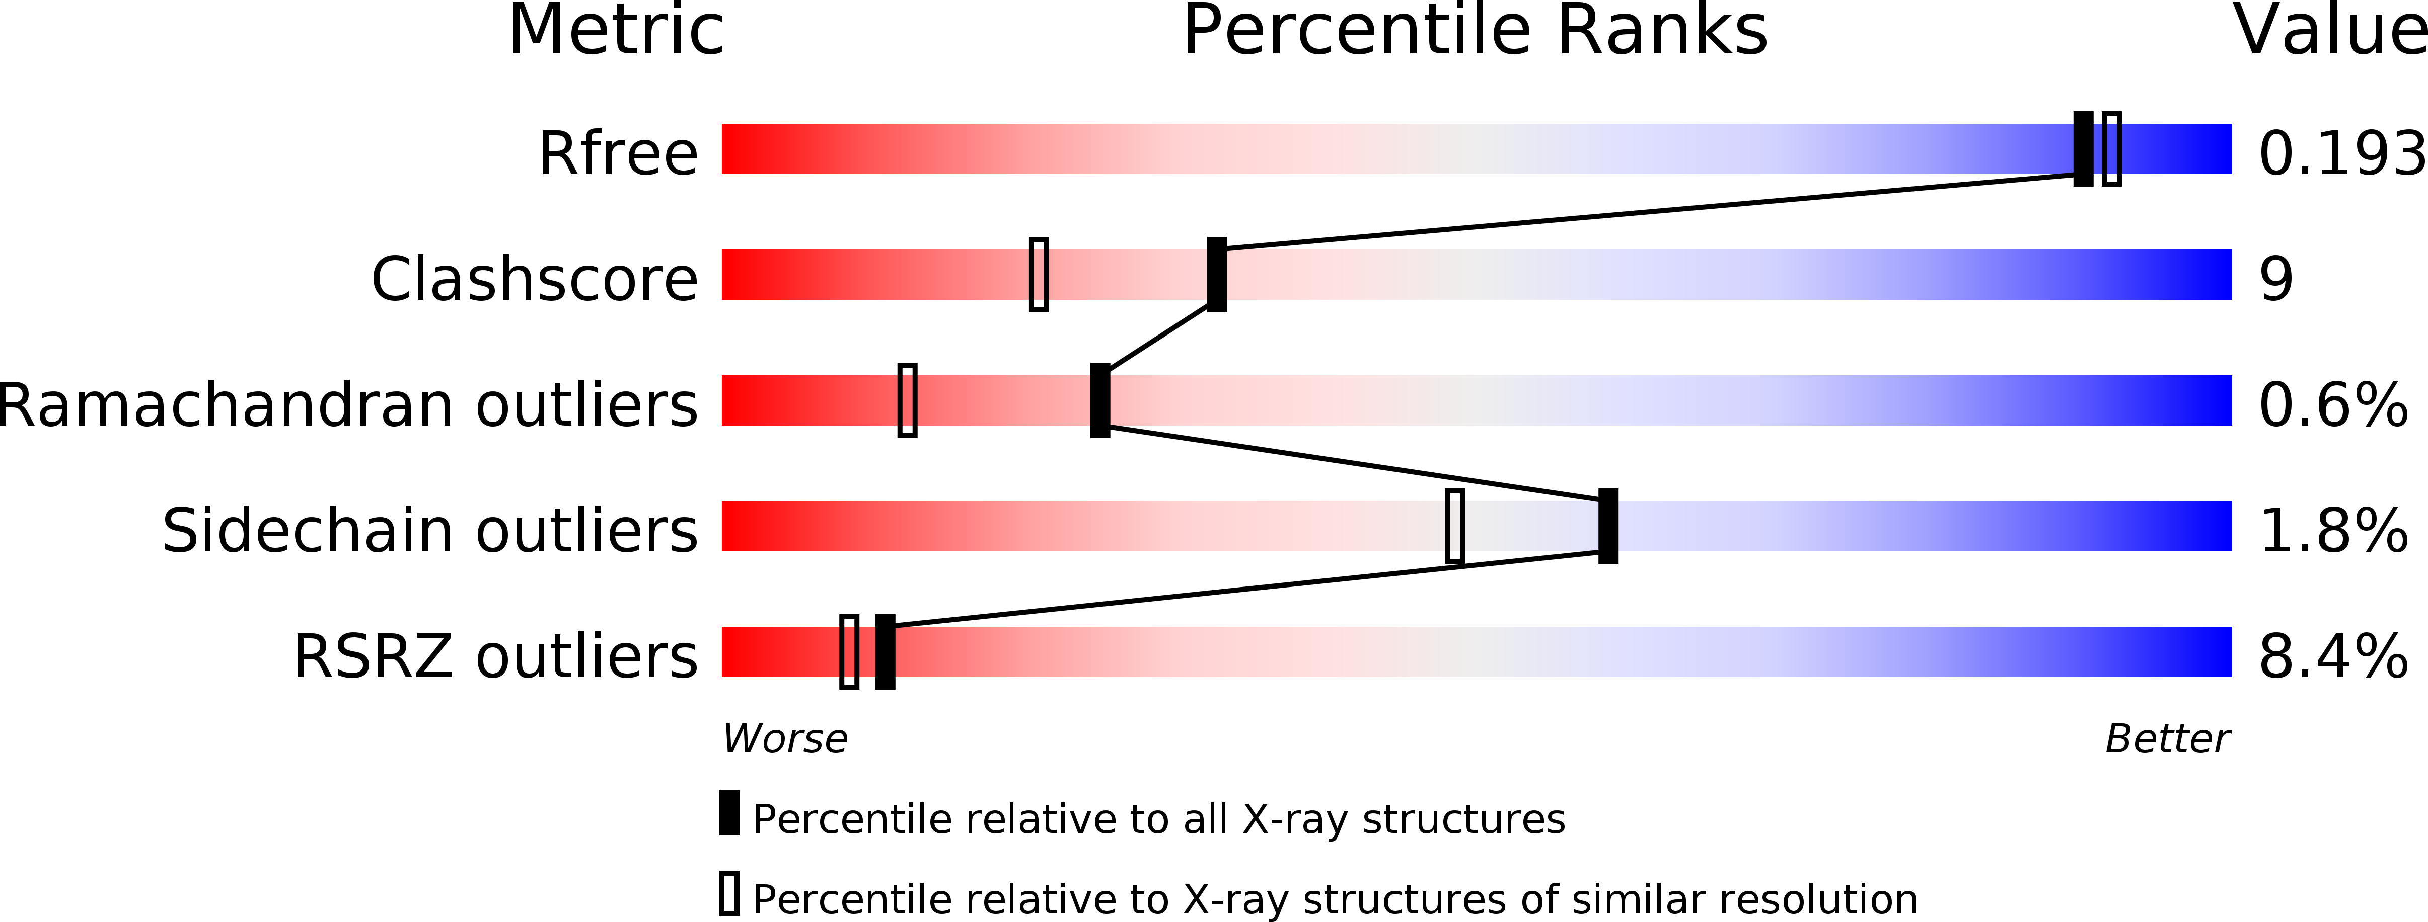
PDB: Main quality criteria
PDB ID 2de2
Notes:
RSRZ – Určuje normalizáciu miery zhody medzi časťou modelu rezidua a dátami v reálnom čase
R_{free} - Určuje podobnosť vypočítaného a experimentálne pozorovaného difrakčného obrazca (s použitím 90 % údajov).

Slide 9
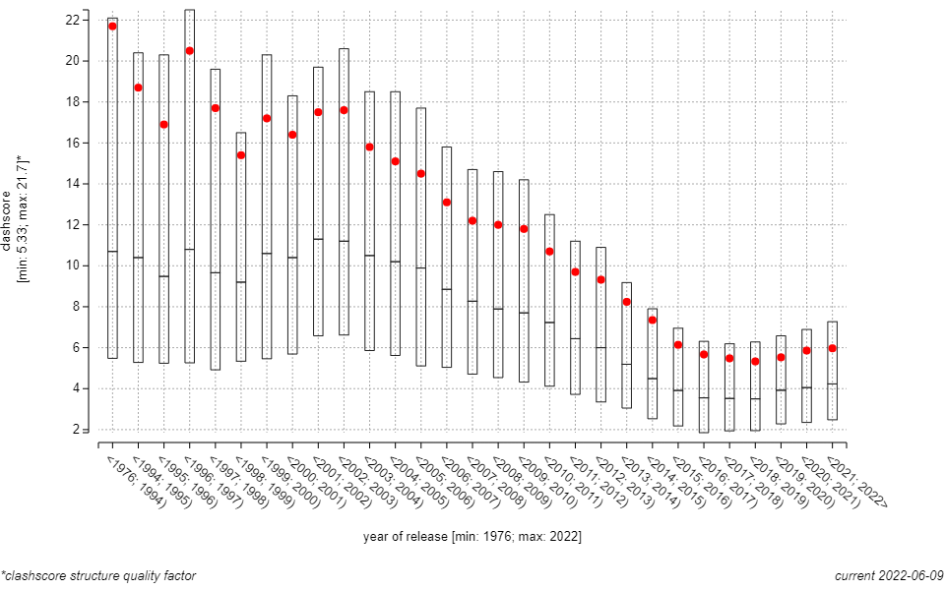
Protein quality: Clashscore
Better
https://ncbr.muni.cz/ValTrendsDB

Slide 10
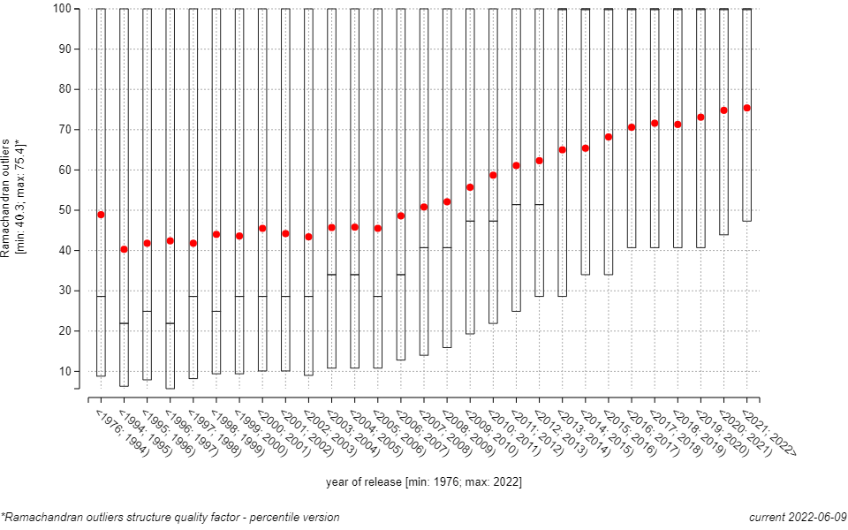
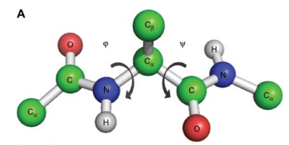
Protein quality: Ramachandran outliers
Better
https://ncbr.muni.cz/ValTrendsDB

Slide 11
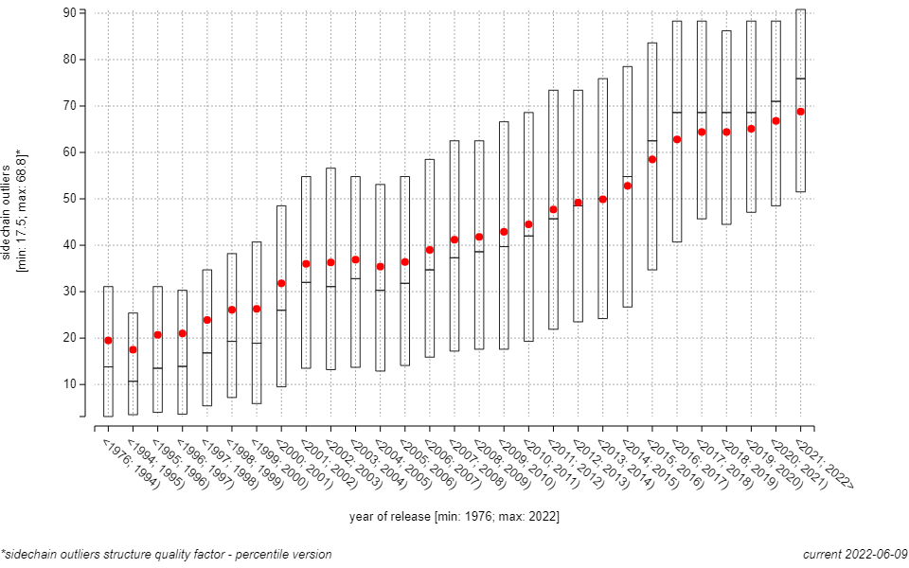
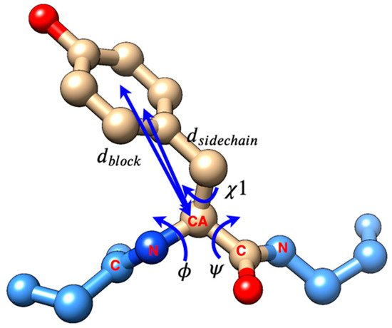
Protein quality: Sidechain outliers
Better
https://ncbr.muni.cz/ValTrendsDB

Slide 12
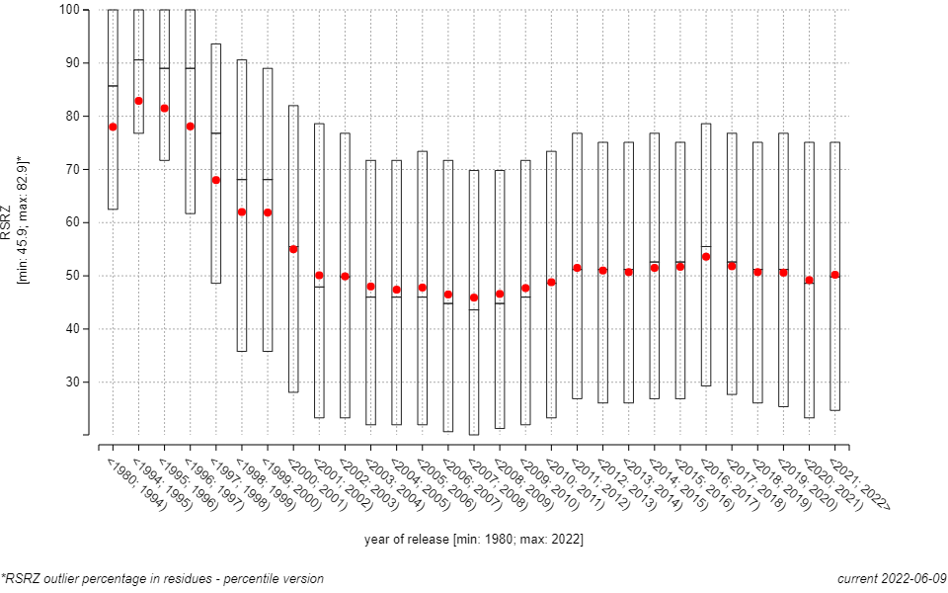
Protein quality: RSRZ outliers
Better
https://ncbr.muni.cz/ValTrendsDB
Notes:
RSRZ – Určuje normalizáciu miery zhody medzi časťou modelu rezidua a dátami v reálnom čase

Slide 13
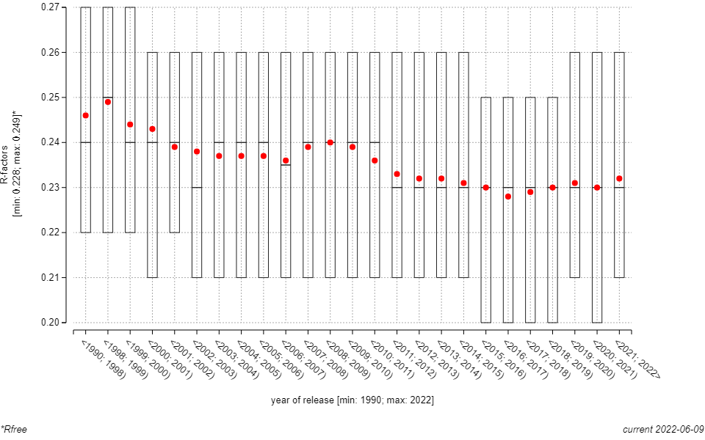
Protein quality: Rfree
Better
https://ncbr.muni.cz/ValTrendsDB
Notes:
R_{free} - Určuje podobnosť vypočítaného a experimentálne pozorovaného difrakčného obrazca (s použitím 90 % údajov).

Slide 14
Protein quality – ligands

Slide 15
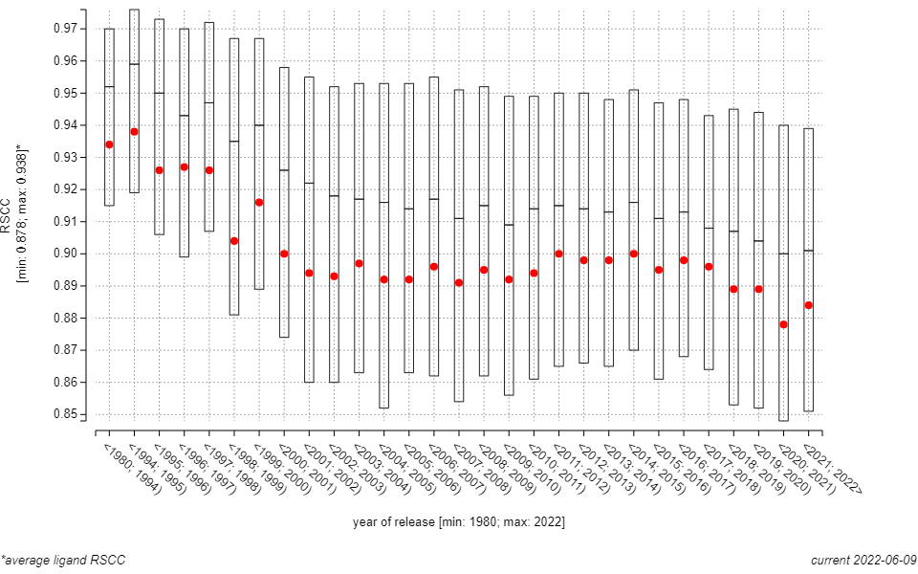
Protein quality - ligands: RSCC
Better
https://ncbr.muni.cz/ValTrendsDB
Notes:
RSCC – real space correlation coefficient

Slide 16
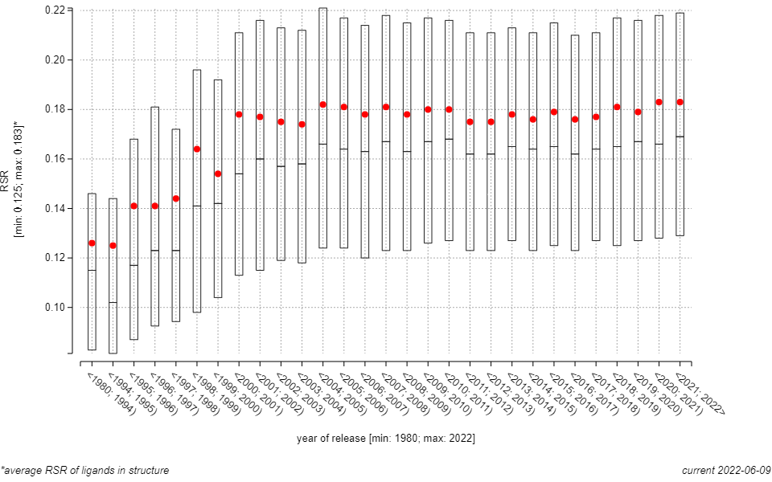
Protein quality - ligands: RSR
Better
https://ncbr.muni.cz/ValTrendsDB
Notes:
RSR Rozdíl mezi prostorem zabíraným modelem a reálným prostorem.

Slide 17
Protein quality – influence of journals

Slide 18
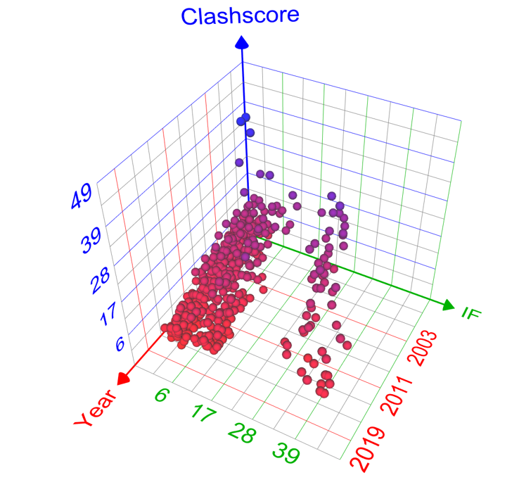
Validation trends - journals
Jana Porubská
33 journals with
> 1000 published structures

Slide 19
Validation trends - journals

Slide 20
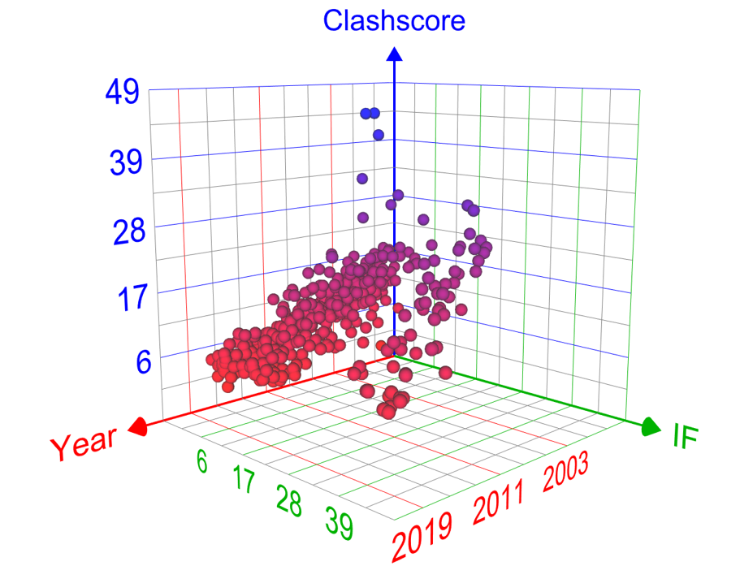
Validation trends - journals

Slide 21
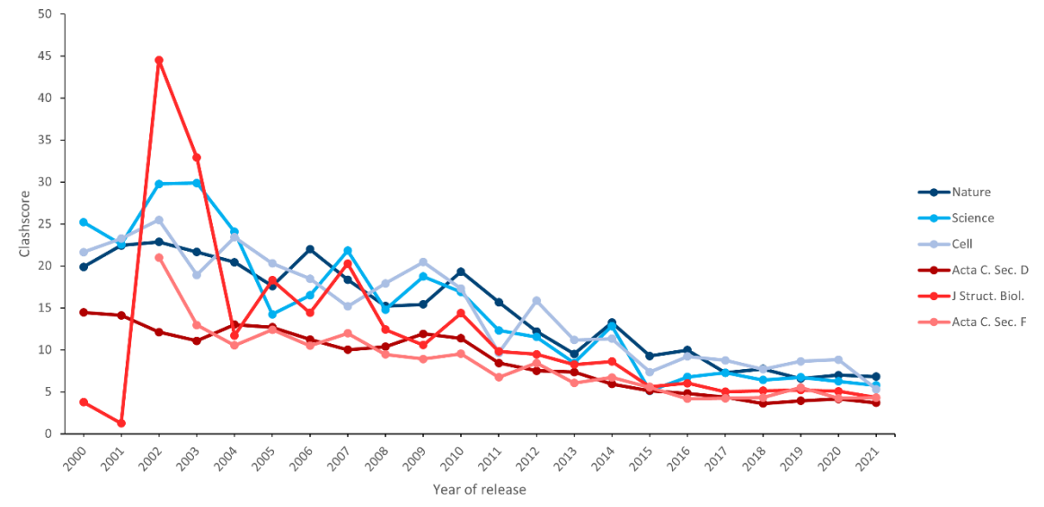
Clashscore – influence of source journals
Gabriela Bučeková

Slide 22
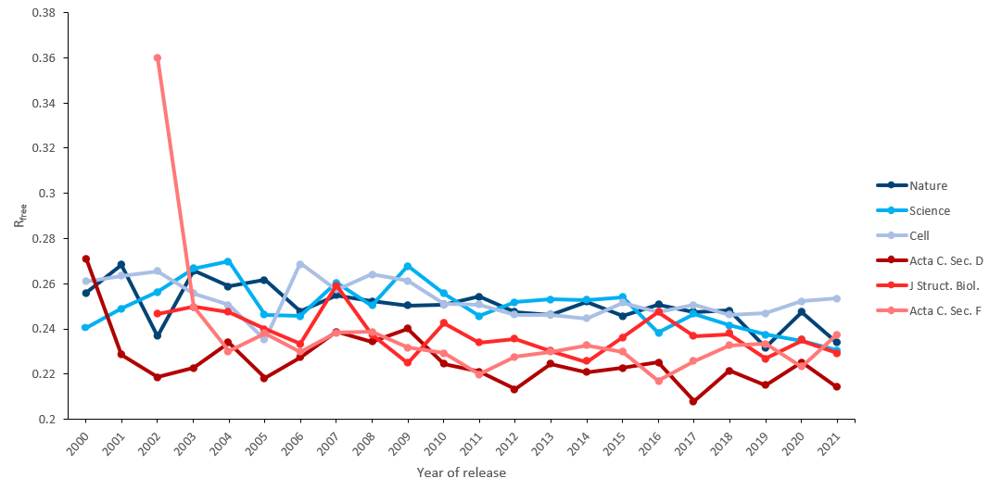
Rfree – influence of source journals

Slide 23
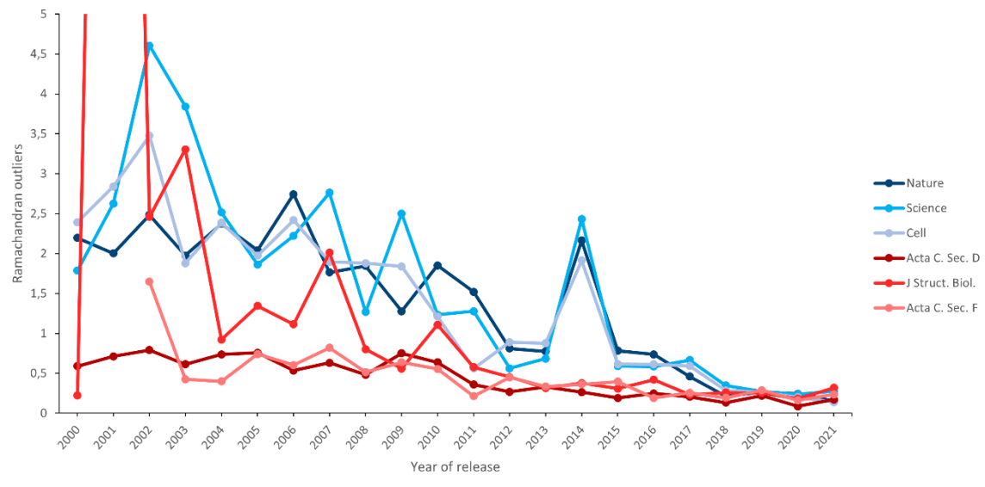
Ramachandran outliers – influence of source journals

Slide 24
Protein quality – uncovered topics Ring conformations

Slide 25
Cyclohexane – ring conformations

Slide 26
Cyclohexane – ring conformations in PDB
Gabriela Bučeková
Jana Porubská
Viktoriia Doshchenko

Slide 27
Cyclohexane – ring conformations in PDB
Untypical conformations:
Resolution < 2.5 Å: 41.2 %
AND Covered by density: 15.6 %
The rest of these conformations are errors
Similar problems with cyclopentans, benzenes and pyrans.
Aliaksei Charesneu

Slide 28
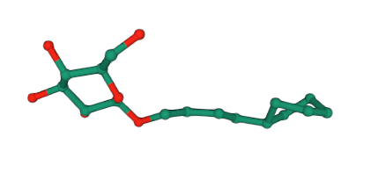
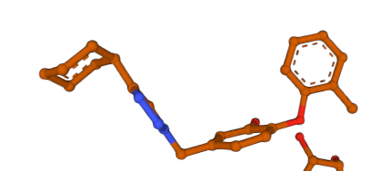
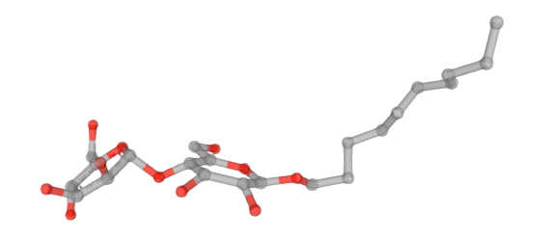
Untypical ring conformations
Examples of problematic rings
Deformed cyclohexane: 4iut, ligand CMV 302
Chair conformation of benzene: 5mtp, ligand 53K 302
Planar pyrans: 3abk, ligand DMU 526

Slide 29
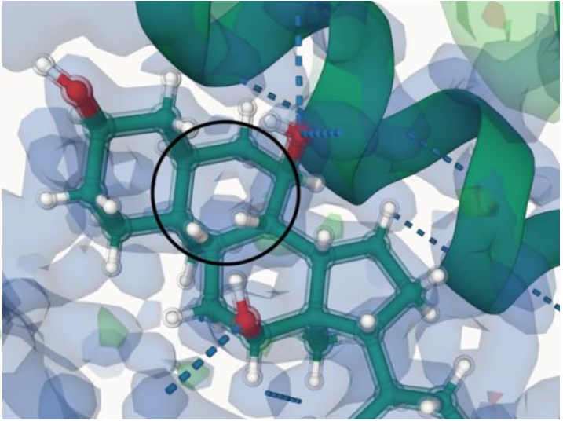
Untypical ring conformations
Examples of biologically relevant untypical ring conformations
Planar cyclopentanes: 5hdr, ligand H79 504
Half chair cyclohexan: 5pld, ligand CPS

Slide 30
Summary
Some quality trends are positive
Others are not improving
Ligands are more problematic
Great journals ~ worser structure quality
Some quality topics are not covered yet

Slide 31
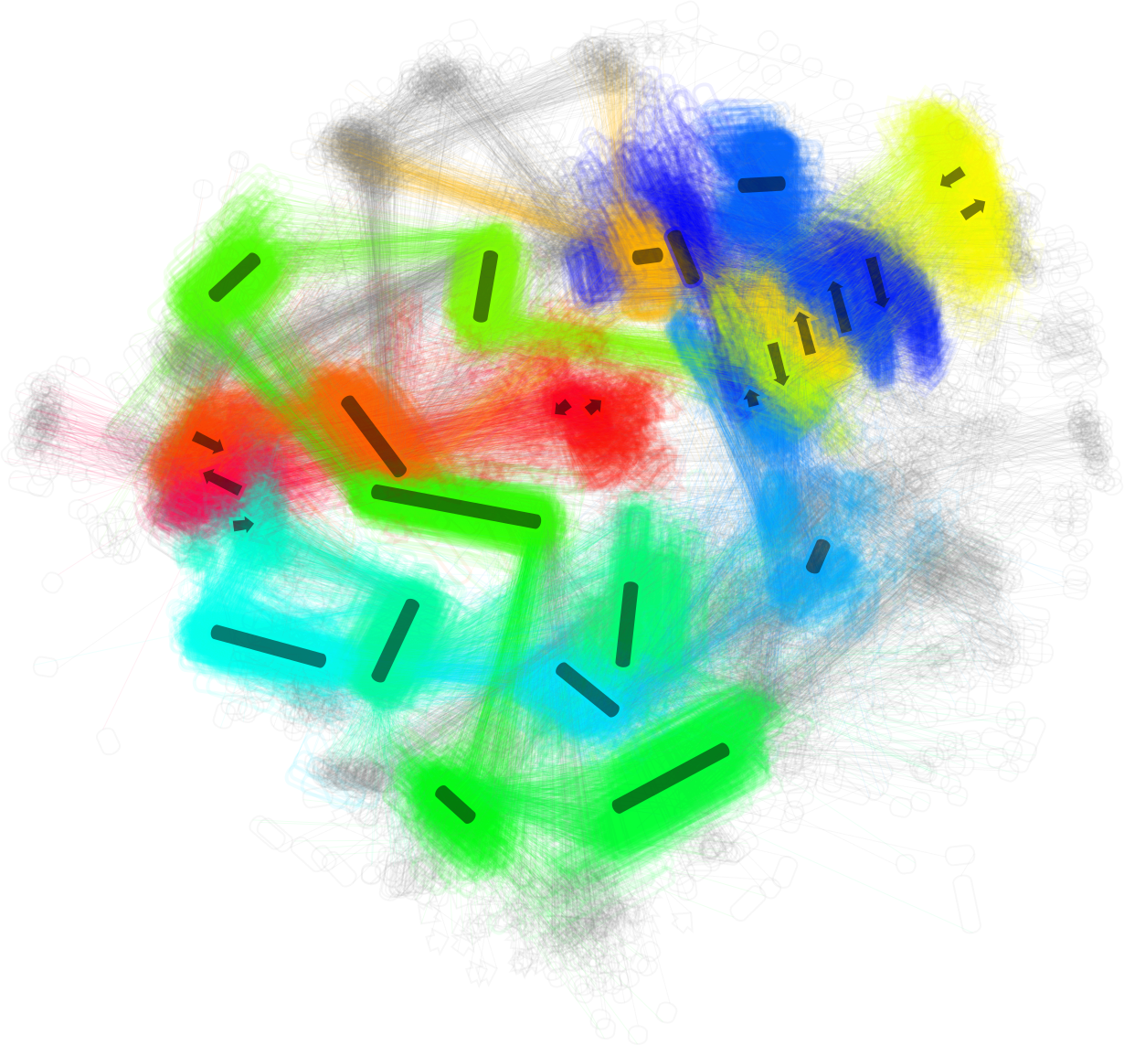
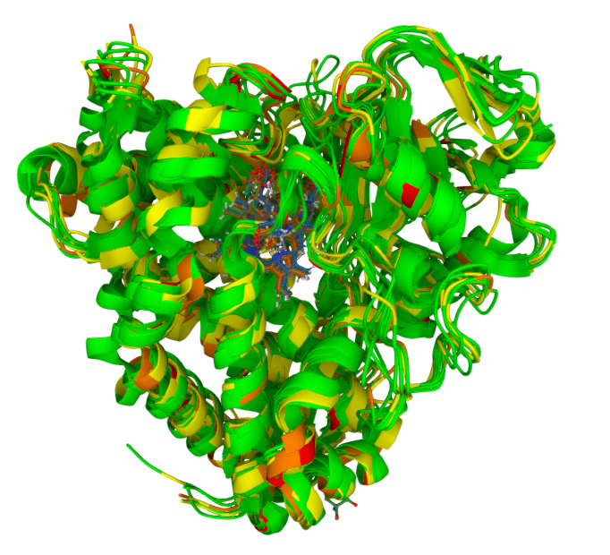
Ideas

Slide 32
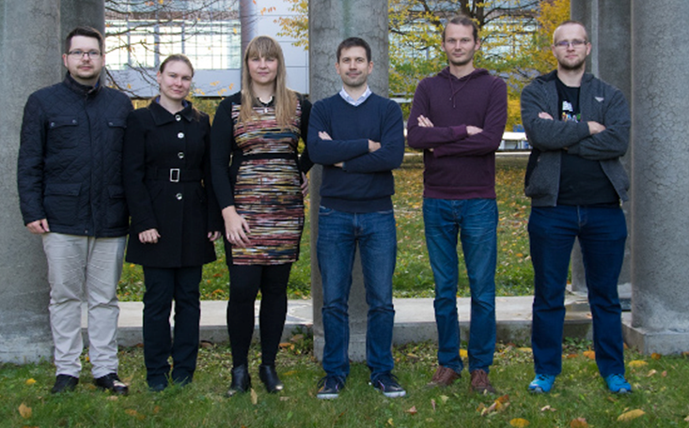
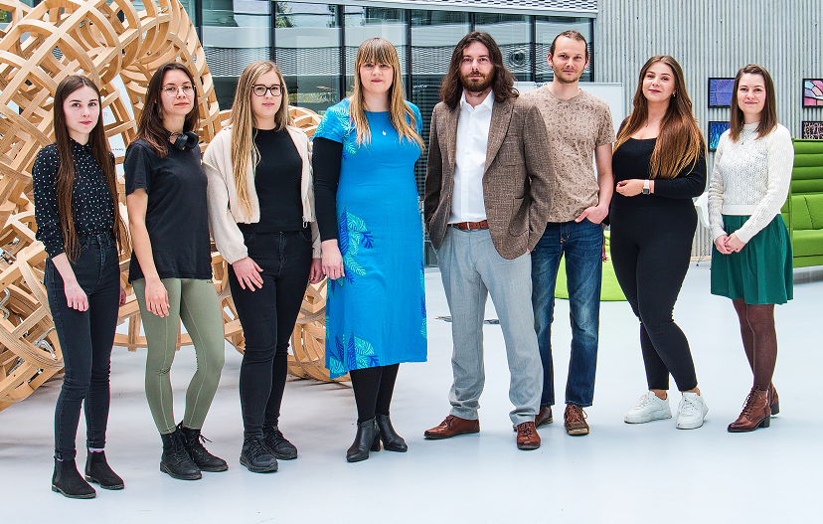
Acknowledgements
Thank you for your attention :-)))

