Slide 1


NarCoS
Integrating genomic surveillance of SARS-CoV-2 positive clinical samples in Slovak republic
Asoc. Prof. Tomáš SZEMES, PhD.
Comenius University Science Park

Slide 2
How is genomic survey organized in Slovakia?
Public health authority coordinates sample selection and retrieval from RT-PCR testing labs (24+3 active labs)
RNA is isolated from collection tubes in 96 well plate format
96 well plates are distributed to sequencing laboratories (6 current sequencing facilities)
Illumina COVID Seq kit used on Illumina different platforms
3 Regional public health authority PCR labs
24 rtPCR Labs
Public health authority isolates RNA and prepares 96 plates for sequencing
6 Illumina Seq labs
Bioinformatics, Variant call, metadata, reporting to DBs

Slide 3
Issues
Complex pre-NGS laboratory procedures (BSL2-3 lab, storage, RNA isolation, metadata gathering, )
Low experience in NGS and bioinformatics in new labs of Public health authority - HR limits
Weekly from 500 to 2000 samples (from alpha to omicron wave)
Low level of LIMS integration in state run laboratories
Lack of standardized evaluation
Need for speed (in reporting)
Contamination in isolation labs

Slide 4


NarCoS
Not what you think!
Národne COVID Sekvenovanie
Tool for managing genomics survey in Slovakia settings
Illumina based labs
Web based service with authenticated access
Different roles policy
Illumina sequencing run planning (all platforms)
Automated ID based metadata transfer
QC and filtering, Mapping, Variant calling,
Evaluation by experts
Batch upload

Slide 5
Automated run planning and data handling
96 well plate logic from RNA isolation step maintained
Automated import of data and metadata for sequenced samples
Integrated with national register of COVID-19 cases (IS COVID)
  Unique sample identifier
  Pairing with plate ID and plate position for automated
  Transfer of required metadata for
Individual and batch sample input possible
Instant generation and export of sample sheets for different Illumina systems
  Illumina MiniSeq, MiSeq, NextSeq 500/550, NextSeq 1000/2000

Slide 6
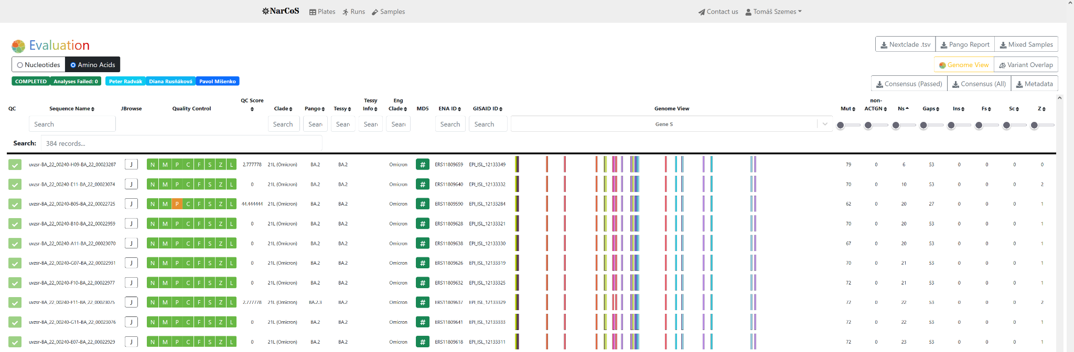
Evaluation module
Per sample visualisation
QC parameters
Individual reads can be viewed (contamination and recombinants)

Slide 7
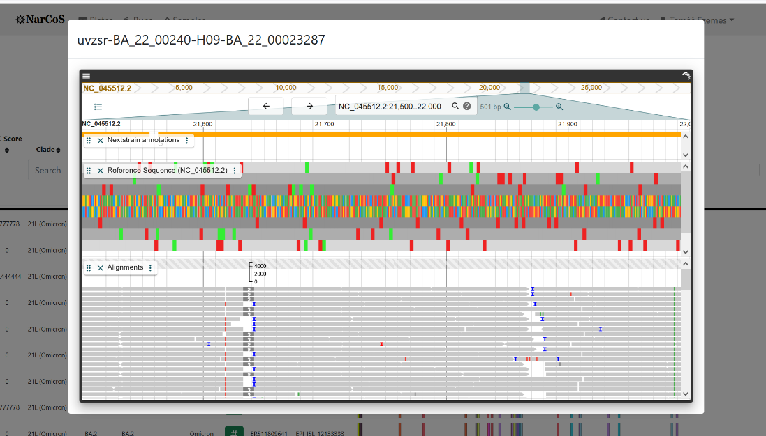
Jbrowse

Slide 8
Automated sample analysis
After run completion FASTQ are batch uploaded via FTP
Autoanalysis (sample id matching)
Uniquely tuned bioinformatics pipeline for mapping, mutation calling and variant calling
Integrated NextClade tool

Slide 9
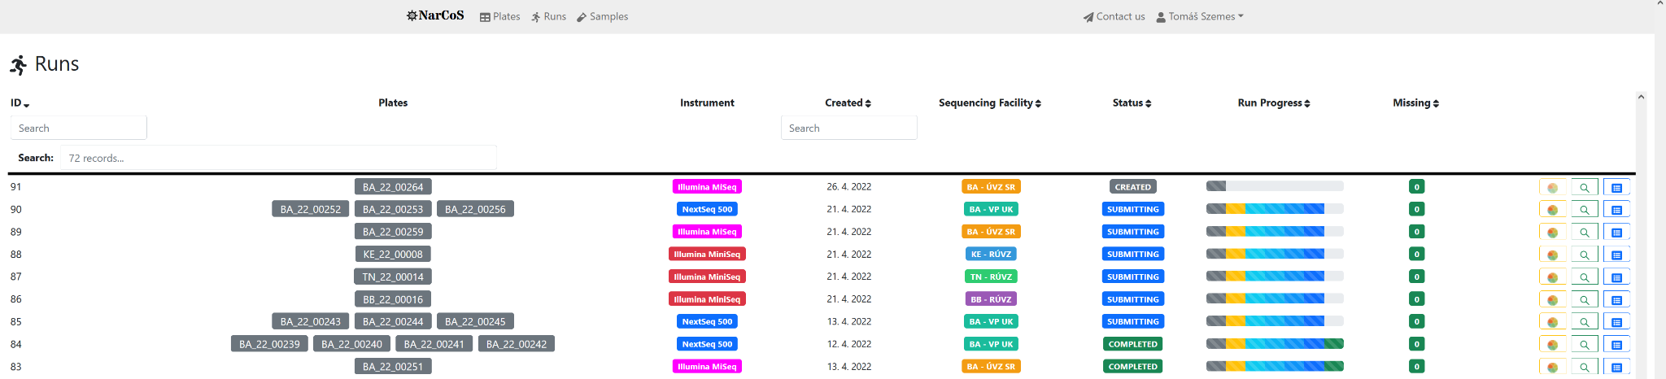
Batch submission to GISAID, ENA and Tessy
Evaluation module for individual sample validation and call approval
Batch upload to GISAID and ENA, than submission to Tessy
Simple process monitoring

Slide 10
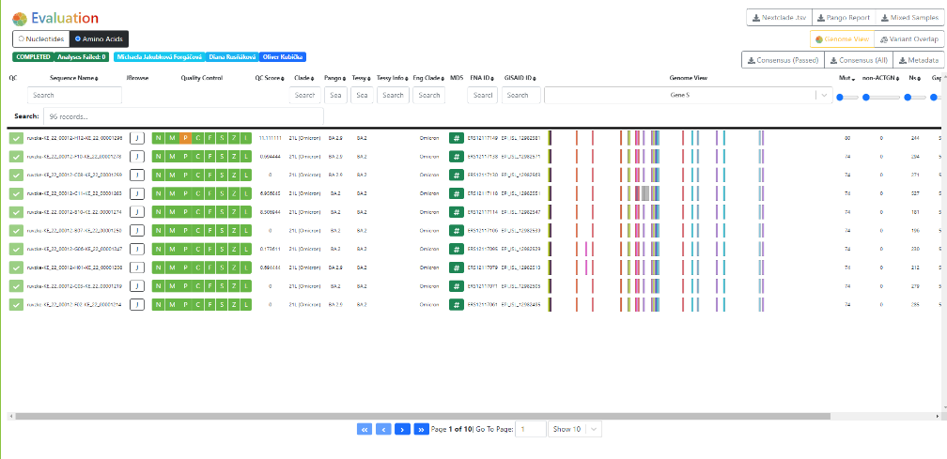

Slide 11
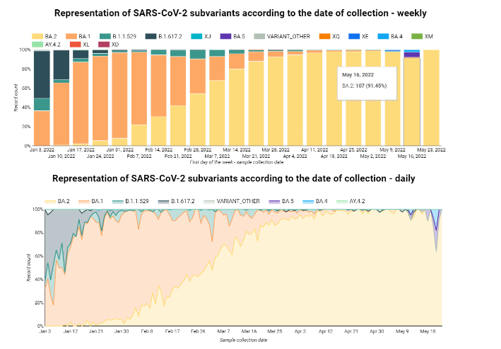
Google Data Studio analyses on aggregate results
Variants overview

Slide 12
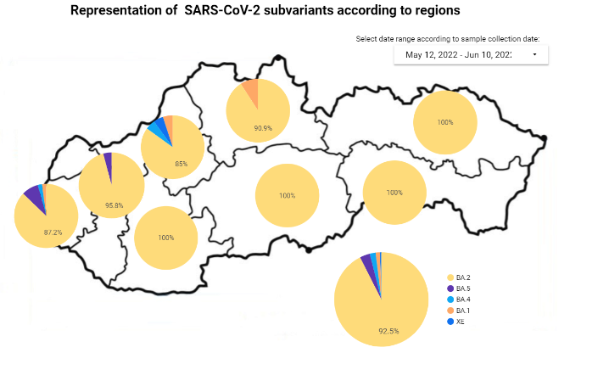
Regions view

Slide 13
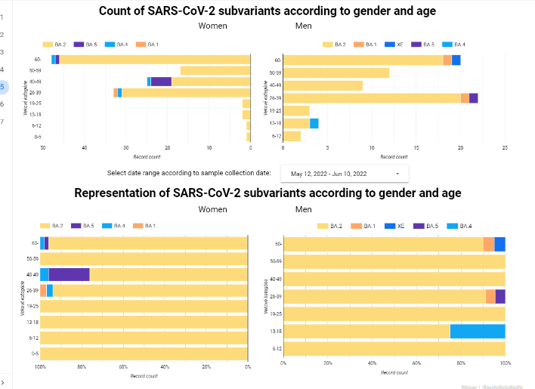

Slide 14
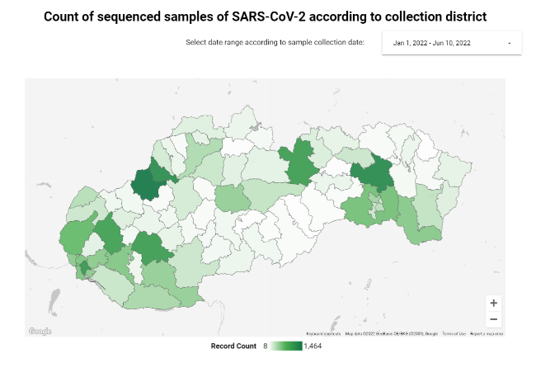

Slide 15
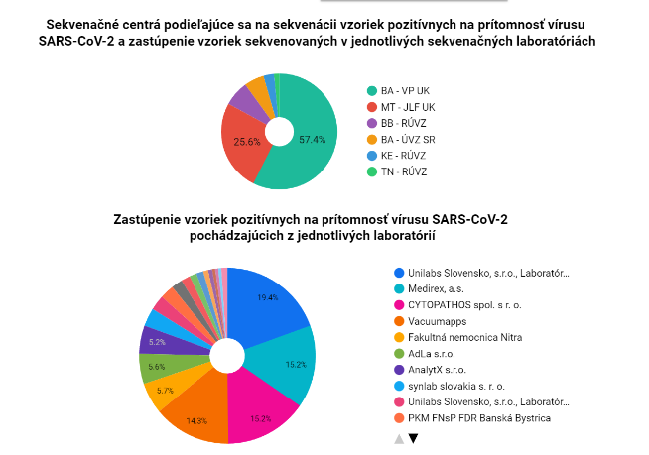

Slide 16
Effects
Effective scale up from 500 to 2000 samples per week
Sample results accuracy and robustness for case based epidemiology
Faster reporting to GISAID (from average 30 day below 12), ENA uploads, faster ECDC Tessy reporting
Real-time situation overview (Ministry of health)

Slide 17
Further development
Wastewater SARS-CoV-2 sequencing survey and visualization
Other pathogens (Illumina Respiratory Pathogen ID/AMR Enrichment Panel Kit)

Slide 18
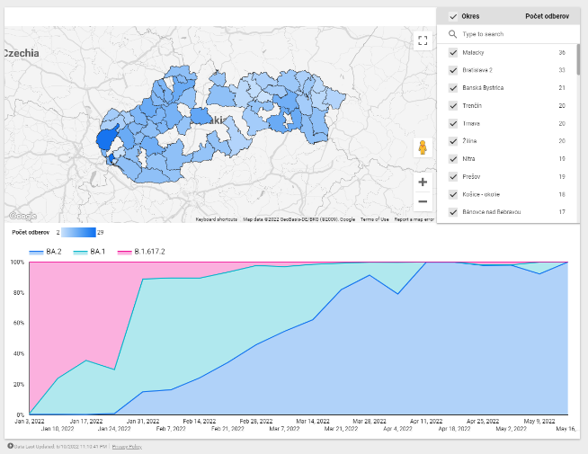

Slide 19

NATURE news
28 April 2022

Slide 20
VISION
Continuous monitoring of airline traffic by sample sequencing for respiratory infections
Global monitoring system like NarCoS

Slide 21
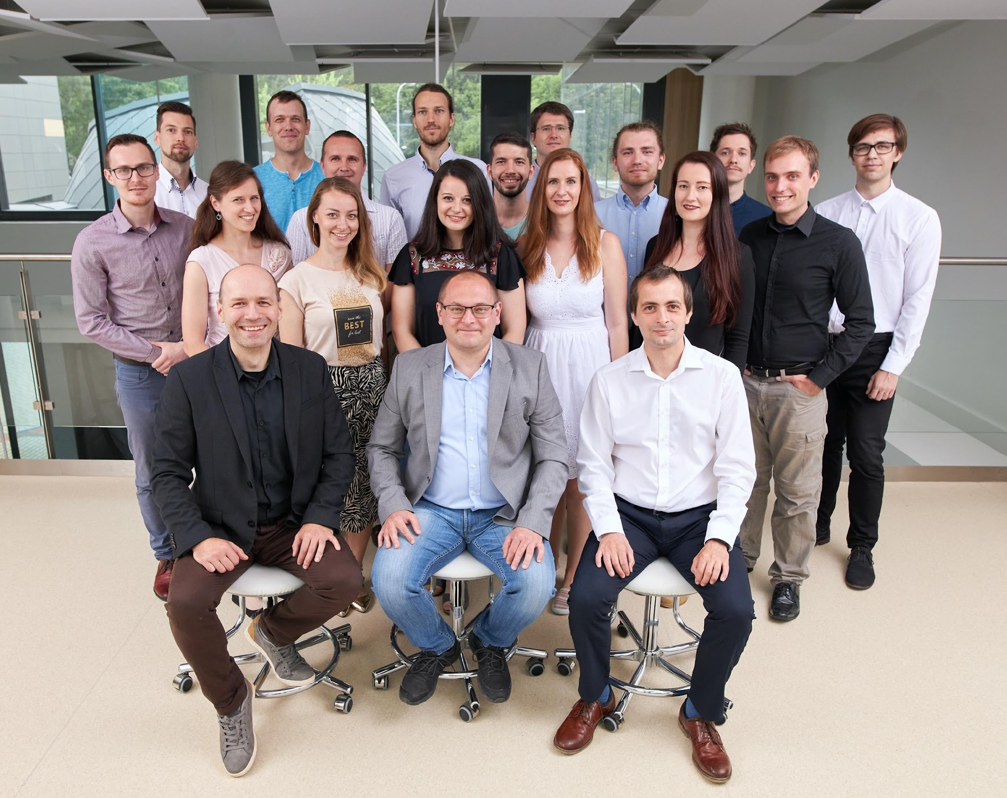
Poďakovanie
Comenius University Science Park
  Tatiana Sedláčková
  Diana Rusňáková
  Jaroslav Budiš
  Miroslav Böhmer
  Pavol Mišenko
  Jakub Styk
  Tomáš Sládeček
  Rastislav Hekel
  Michaela Gažiová
  Jozef Sitárčík
Public Health authority
  Anna Kaliňáková
  Lucia Ševčíková
  Terézia Vrábľová
  Edita Staroňová
  Elena Tichá
  Barbora Kotvasová
Slovak Center for Scientific and Tech Information
  Ján Turňa
  Anna Krivjanska

