Slide 1
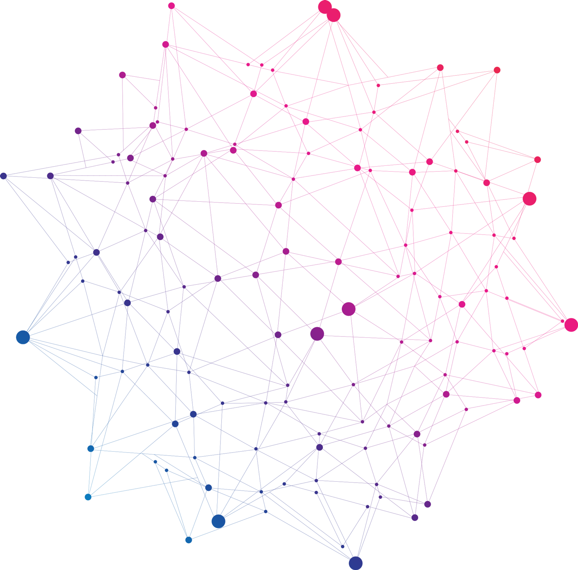
Feature
Interrelation
Profiling
Ivan Čmelo
Department of Informatics and Chemistry
UCT Prague
ENBIK 2022

Slide 2
Many cheminformatic models are based on presence of individual features
Natural product likeness (NPScore), Synthetic accessibility assessment (SAScore, SYBA), etc.

Slide 3
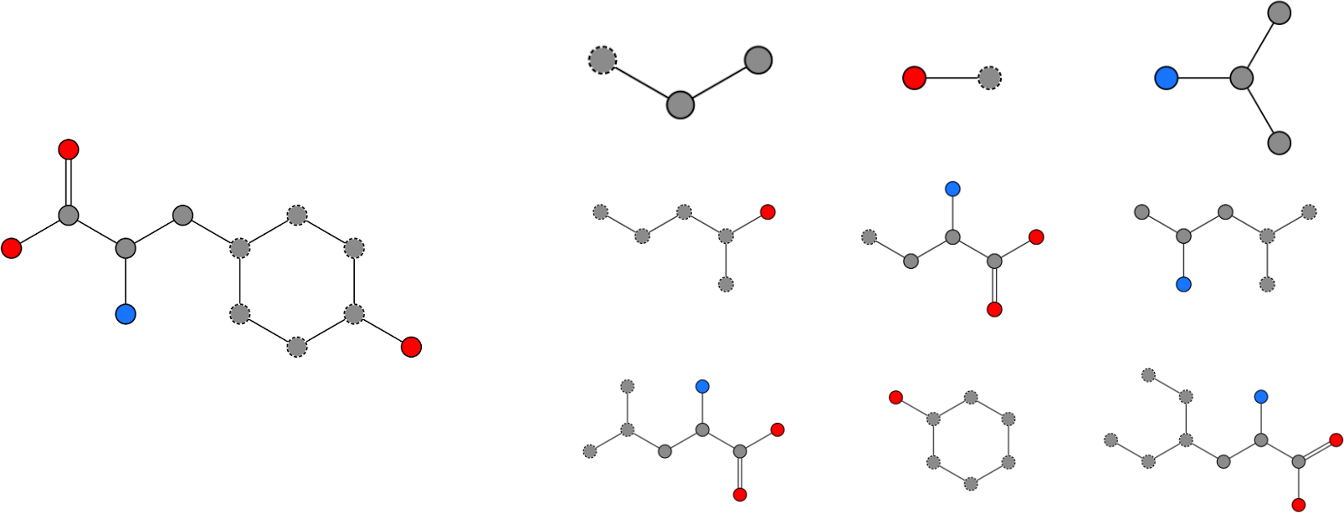
Many cheminformatic models are based on presence of individual features
Natural product likeness (NPScore), Synthetic accessibility assessment (SAScore, SYBA), etc.
Structural features
(example: extended connectivity substructures)
Structure
(example: tyrosine)

Slide 4
Many cheminformatic models are based on presence of individual features
Natural product likeness (NPScore), Synthetic accessibility assessment (SAScore, SYBA), etc.
Structural features
(example: extended connectivity substructures)
Scoring
Structure
(example: tyrosine)

Slide 5
Many cheminformatic models are based on presence of individual features
Natural product likeness (NPScore), Synthetic accessibility assessment (SAScore, SYBA), etc.
Structural features
(example: extended connectivity substructures)
Scoring
Structure
(example: tyrosine)
0.28
0.13
0.34
0.11
0.23
0.27
0.22
0.15
0.17

Slide 6
Many cheminformatic models are based on presence of individual features
Natural product likeness (NPScore), Synthetic accessibility assessment (SAScore, SYBA), etc.
Structural features
(example: extended connectivity substructures)
Scoring
Structure
(example: tyrosine)
0.28
0.13
0.34
0.11
0.23
0.27
0.22
0.15
0.17
? How about "good" features in "bad" combinations, and vice versa ?

Slide 7
Conceptual parallels for feature interrelations
Bioinformatics: quantifying gene co-inheritance
Medicine: quantifying disease co-morbidities
… among many others ...
Linguistics: quantifying text difficulty (Flor et. al.)
  prior: "text containing obscure words is harder to comprehend"
  proposed: "text containing strange word combinations is harder to comprehend"

Slide 8
Conceptual parallels for feature interrelations
Bioinformatics: quantifying gene co-inheritance
Medicine: quantifying disease co-morbidities
… among many others ...
Linguistics: quantifying text difficulty (Flor et. al.)
  prior: "text containing obscure words is harder to comprehend"
  proposed: "text containing strange word combinations is harder to comprehend"
For comparison, consider the sentences:
"Sheep slept quietly in the barn." vs. "Sheep slept furiously in the hospital."

Slide 9
Conceptual parallels for feature interrelations
Bioinformatics: quantifying gene co-inheritance
Medicine: quantifying disease co-morbidities
… among many others ...
Linguistics: quantifying text difficulty (Flor et. al.)
  prior: "text containing obscure words is harder to comprehend"
  proposed: "text containing strange word combinations is harder to comprehend"
For comparison, consider the sentences:
"Sheep slept quietly in the barn." vs. "Sheep slept furiously in the hospital."
🤔

Slide 10
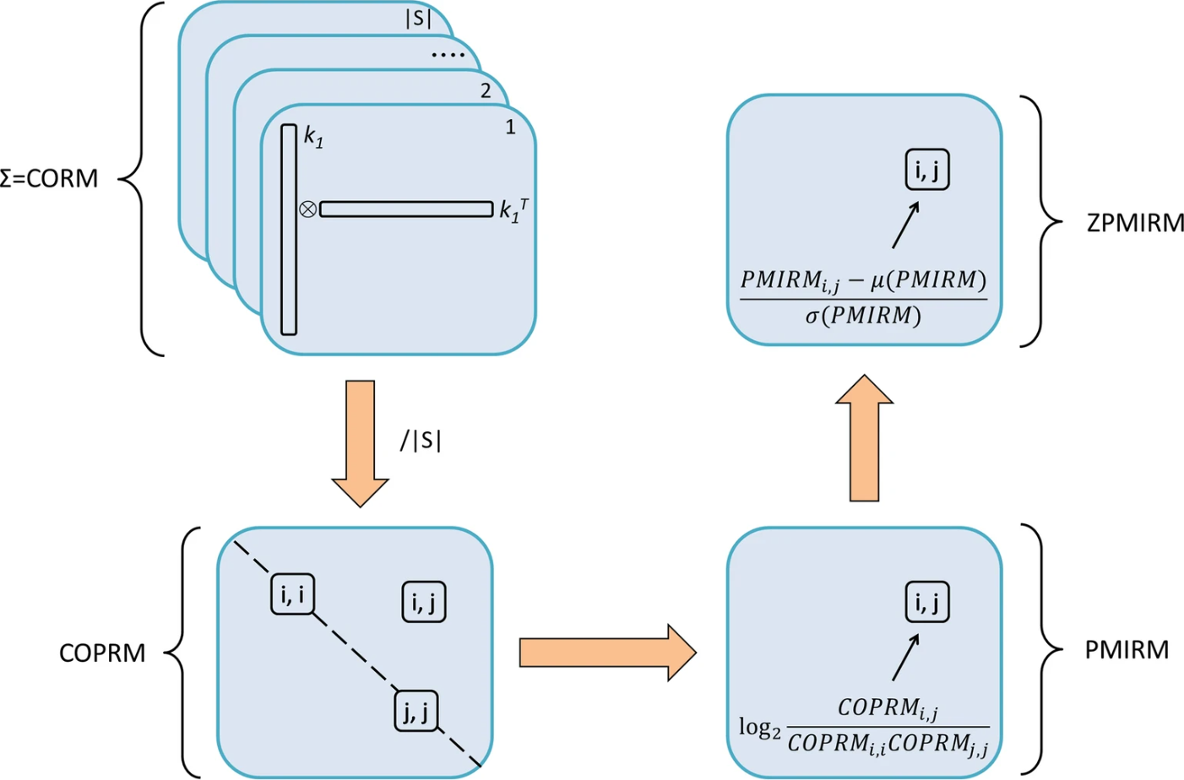
Pointwise mutual information (PMI):
Structural features
Feature co-occurences (CORM)
Co-occurrence probabilities (COPRM)
Pointwise mutual information values (PMIRM)
Optionally Z-Scored (ZPMIRM)

Slide 11
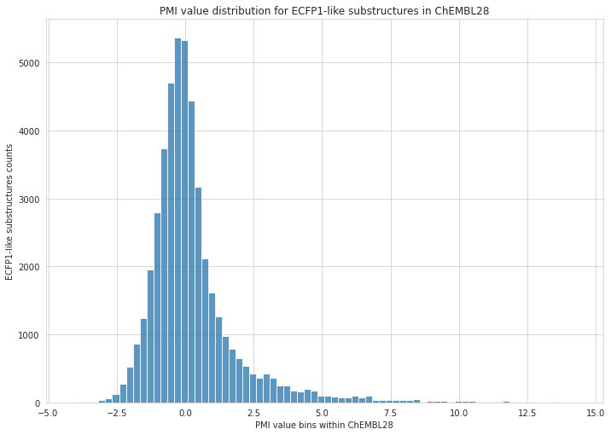


Slide 12
Relative feature tightness (RFT)
For a given vector of features, quantifies how well does the feature combination fit the reference interrelation profile (PMIRM)
Translate a molecule to its structural features
Look up the feature combinations in the reference interrelation profile (PMIRM)
Calculate the average of their PMI values
Molecule
Features
Feature combinations
PMIRM
reference
interrelation
profile
RFT value
Feature PMI values
mean for all combinations F_{i}, F_{j} in a feature set of F₁-F_{n}, against a reference PMIRM profile PMI_{ref}

Slide 13

Application on synthetic accessibility: ZRFT against ZINC PMI profile using ECFP4
ZINC
a database of commercially available molecules
Sterling T, Irwin JJ (2015) ZINC 15—ligand discovery for everyone. J Chem Inf Model 55(11)
Nonpher
a tool to produce synthetically less accessible molecules
Voršilák M, Svozil D (2017) Nonpher: computational method for design of hard-to-synthesize structures. J Cheminform 9:20
SAScore
a well-established estimator of synthetic accessibility
Ertl P, Schuffenhauer A (2009) Estimation of synthetic accessibility score of drug-like molecules based on molecular complexity and fragment contributions. J Cheminform 1:8
SYBA
a bayesian classifier for estimating synthetic accessibility
Voršilák, M., Kolář, M., Čmelo, I. et al. SYBA: Bayesian estimation of synthetic accessibility of organic compounds. J Cheminform 12:35
ZINC
structures
Nonpher structures
ZPMIRM profile
ZINC
ZRFT values
Nonpher
ZRFT values
… compare ZRFT values with SAScore, SYBA

Slide 14
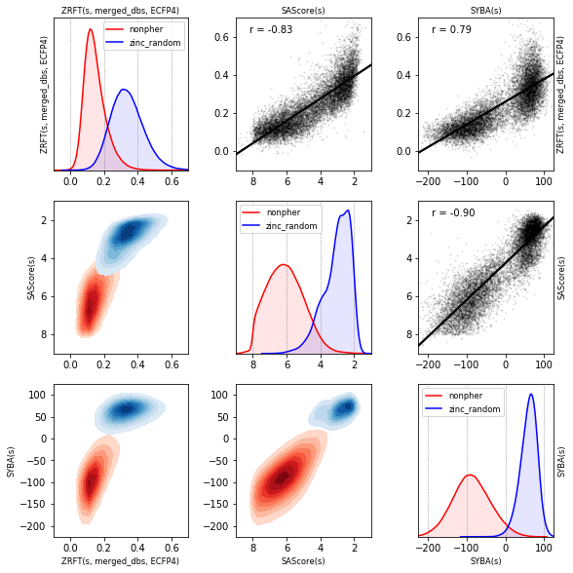
Application on synthetic accessibility: ZRFT against ZINC PMI profile using ECFP4
ZINC
structures
Nonpher structures
ZPMIRM profile
ZINC
ZRFT values
Nonpher
ZRFT values
… compare ZRFT values with SAScore, SYBA

Slide 15
Application on synthetic accessibility: ZRFT against ZINC PMI profile using ECFP4
There seems to be a strong correlation between ZRFT and the established methods
It is possible to gain information on synthetic accessibility based on bit interrelations in ECFP4 fingerprints alone
More information in the paper:
Čmelo, I., Voršilák, M. & Svozil, D. Profiling and analysis of chemical compounds using pointwise mutual information. J Cheminform 13, 3
Speculated improvements:
  Use fragments directly instead of ECFP4 bits
  (remove the factor of bit collisions)
  Use a reference interrelation profile
  (reduce inherent interrelations from fragment overlaps, etc.)

Slide 16
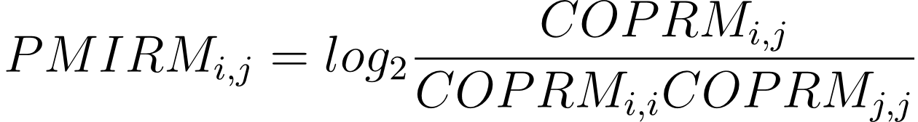
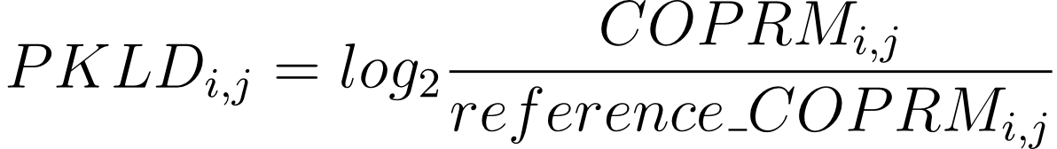
Pointwise Kullback–Leibler divergence (PKLD)
Structural features can be inherently linked by overlapping, etc.
Instead of marginal probabilities, another profile can be used
PKLD is a difference profile between a given pair of profiles
Observed co-occurrence probabilities
Vs.
Co-occurrence probabilities
presuming feature independence
Reference co-occurrence probabilities

Slide 17
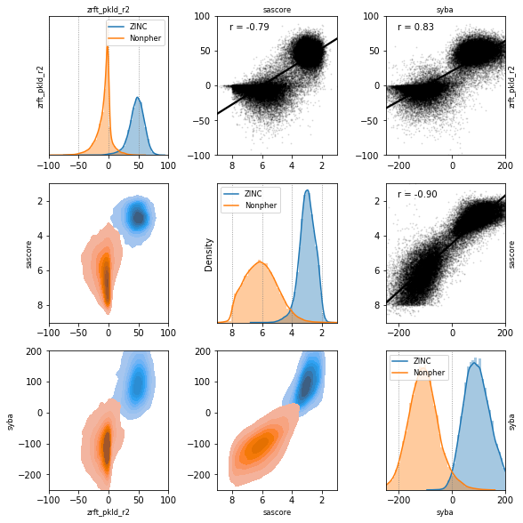
ZRFT against PKLD ZINC/Nonpher profile
There seems to be about the same correlation between ZRFT and the established methods as before
However, the separation between ZINC and Nonpher structures seems to be much improved

Slide 18
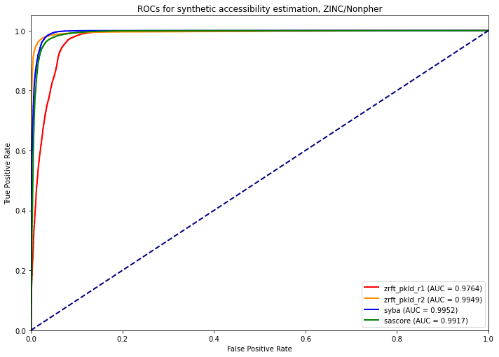
ZRFT against PKLD ZINC/Nonpher profile
There seems to be about the same correlation between ZRFT and the established methods as before
However, the separation between ZINC and Nonpher structures seems to be much improved
Fragment radius of 1 not sufficient; fragment radius of 2 seems optimal. Radii of 3+ yield very large, sparse profiles
According to ROC, the performance of ZRFT now seems comparable with the established synthetic accessibility estimation methods

Slide 19
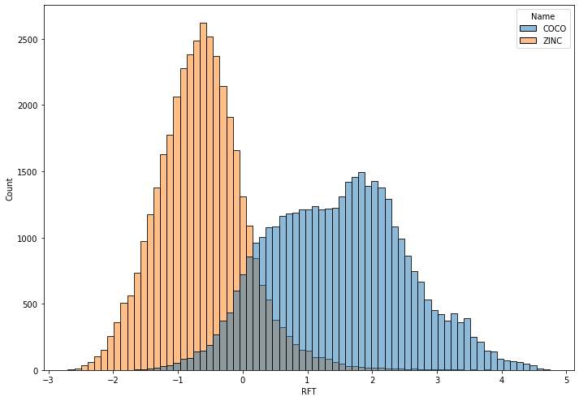
RFT also seems to work for natural product-likeness
COCONUT
database of natural products
Sorokina, M., Merseburger, P., Rajan, K. et al. COCONUT online: Collection of Open Natural Products database. J Cheminform 13, 2
Interrelation methodology now being adapted for natural product likeness estimation by Bc. Kateřina Lišková
COCONUT/ZINC PKLD profile, ECFP6, 2048 bits
Natural products seem to have quantitatively different ECFP bit interrelations from generic ZINC substances

Slide 20
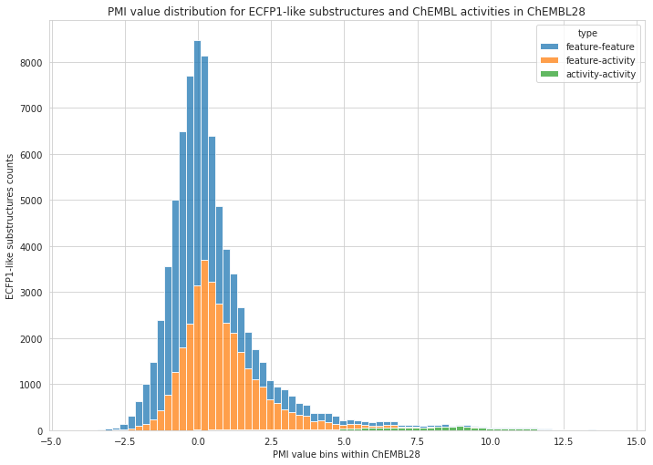
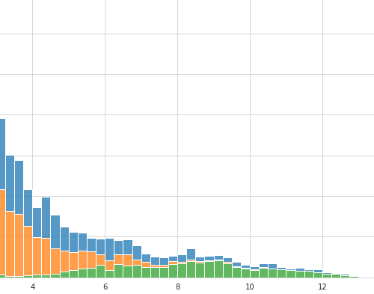
Hybrid feature interrelation profiles

Slide 21

Summary
All tested chemical datasets had structural feature interdependencies
These interdependencies differ between the tested datasets
Differences in these interdependencies were used to assess synthetic accessibility of chemical structures, as well as natural product likeness
(+) Can be made for arbitrary features, not just structural
(+) The features and their mutual relations can also be interpreted as a graph
(+) It is a generic measure, not a model!
(-) Many structures needed for meaningful profiles
(-) Profiles get very large
Implemented as an open-source Python library (https://github.com/cmeloi/fip3)

Slide 22



Thank you!
Prof. Daniel Svozil, Ph.D.
Ing. Milan Voršilák, Ph.D.
Mgr. Wim Dehaen
Bc. Kateřina Lišková
Supported by the Ministry of Education of the Czech Republic (RVO 68378050-KAV-NPUI and LM2018130), as well as Junior Internal Grant of the UCT Prague (2021, #2103)

