Slide 1
Circular fingerprint inversion: an algorithmic approach
Wim Dehaen
14.6.2022
ENBIK2022
Němčice

Slide 2
Overview
Chemical similarity and fingerprints
ECFP and the morgan algorithm
Inverting ECFP
Case study: reconstructing GDB-11
Conclusion

Slide 3
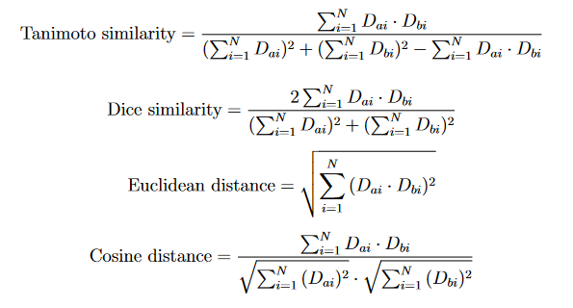
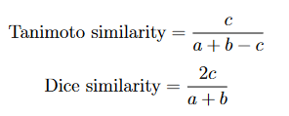
Chemical similarity and fingerprints
How to estimate chemical similarity quantitatively?
Similarity between fingerprints
Binary vectors or vectors of real values

Slide 4
Chemical similarity and fingerprints
What is a molecular fingerprint
A vector of desciptors that encode into a value (bool, int, float) some value derived from the chemical information present in the structure
Usually (very) lossy and not intended for round-trip interconversion
Many types:
Pharmacophore FP (2D and 3D), structural key, topological FP, activity FP, protein ligand interaction FP
Favorable properties (consistent size, compact)
Fast DB searching
Model building

Slide 5
ECFP and the morgan algorithm
Morgan algorithm:
Used to provide a canonical atom ordering for a connectivity table.
Assign initial invariants (usually valence)
Generate new invariants by summing the invariants of directly adjacent invariants
Repeat until amount of distinct invariants does not increase
Use size of invariants to determine canonical atom order

Slide 6
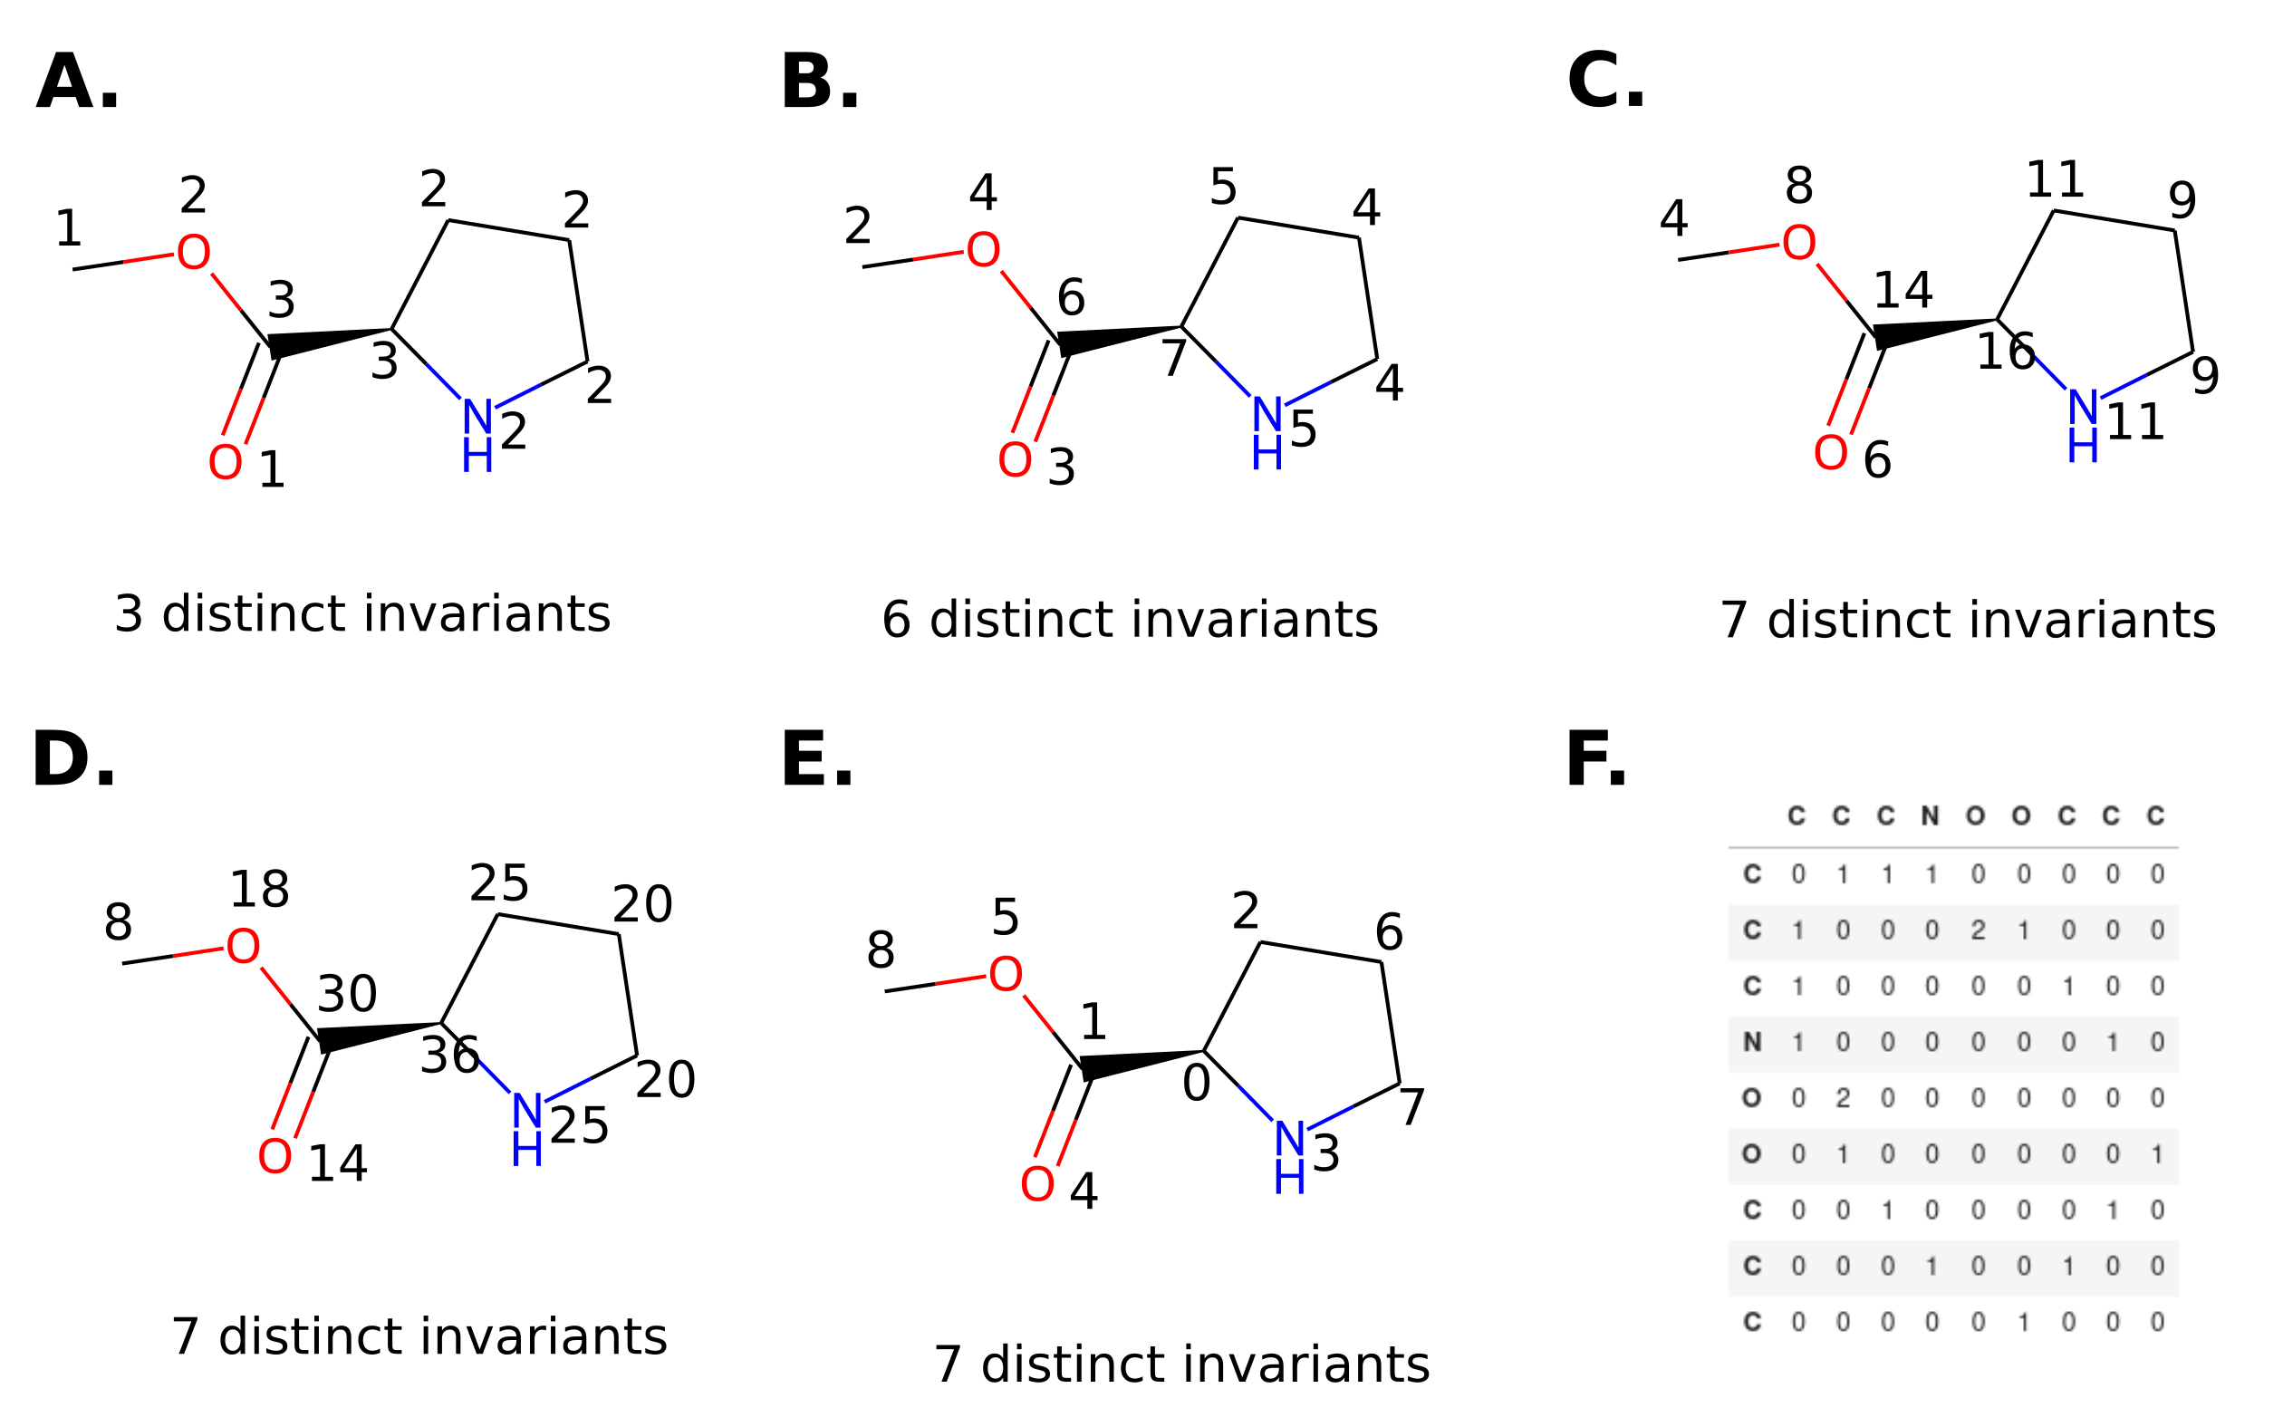
ECFP and the morgan algorithm
Morgan algorithm example:

Slide 7
ECFP and the morgan algorithm
Extended Connectivity Fingerprint (ECFP)
Fingerprint encoding the presence of substructures with a certain radius
Commonly used and highly performant in QSAR models
Also called Morgan fingerprint due to the overlap between the ECFP generating procedure and the Morgan algorithm

Slide 8
ECFP and the morgan algorithm
Extended Connectivity Fingerprint (ECFP) algorithm
Assign initial invariant to each atom, based on (a hash of) atom type, charge, valence, hydrogen count, ring status
Assign the next invariant by hashing with the directly surrounding invariants
Repeat a predetermined amount of times, which is called the radius and which corresponds to the topological radius of the corresponding fragment
The invariants are folded to a given length by a modulo operation, the result assigns an on bit at the given index

Slide 9
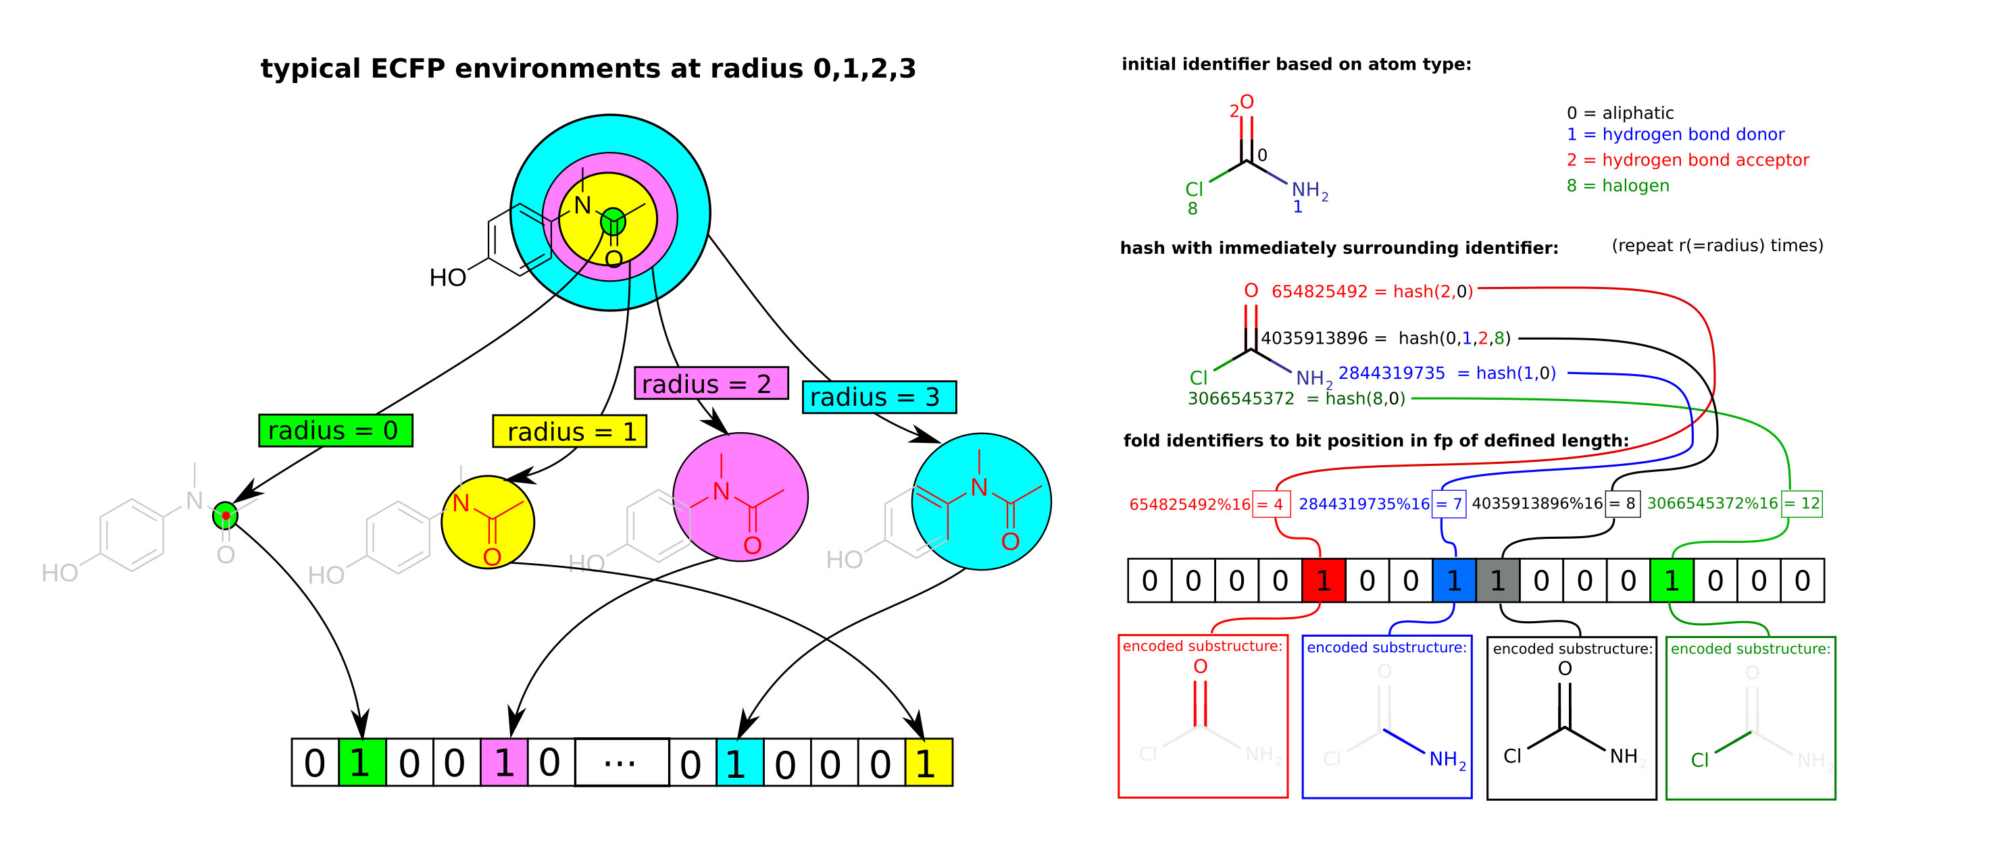
ECFP and the morgan algorithm
Extended Connectivity Fingerprint (ECFP) illustration

Slide 10
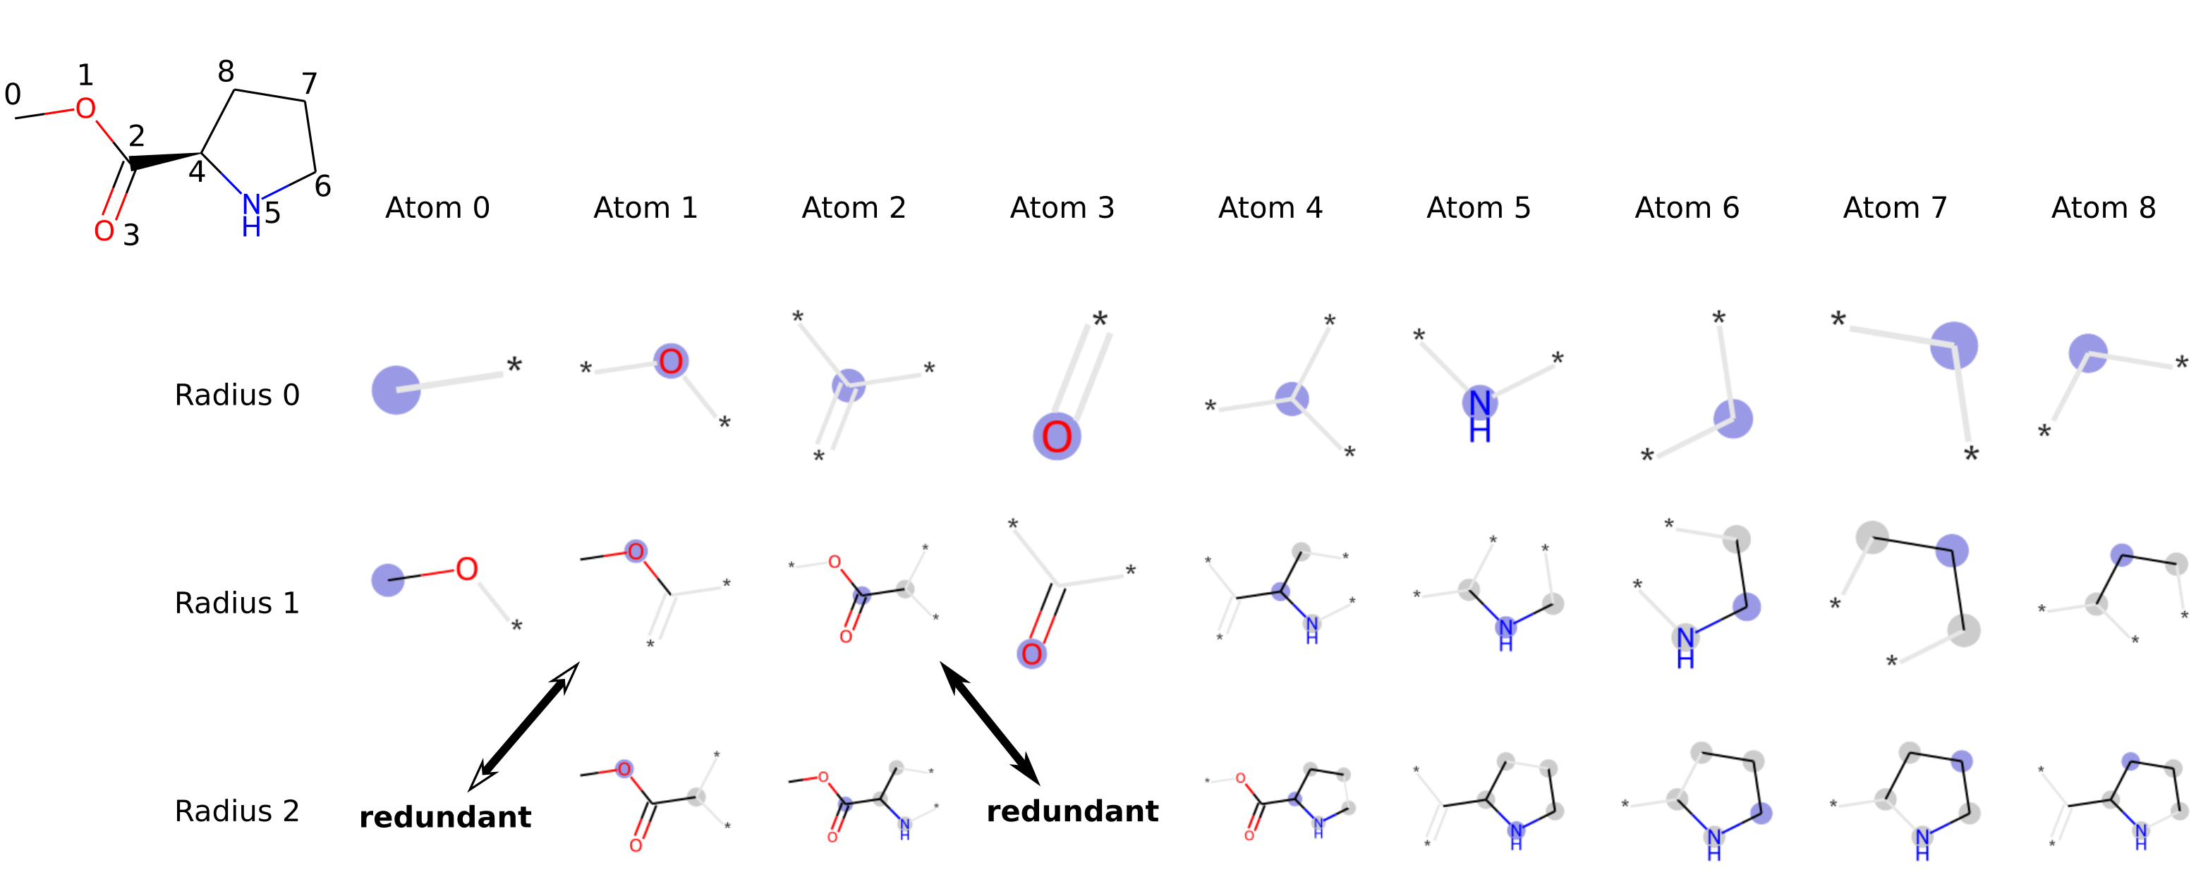
ECFP and the morgan algorithm
Extended Connectivity Fingerprint (ECFP) illustration

Slide 11
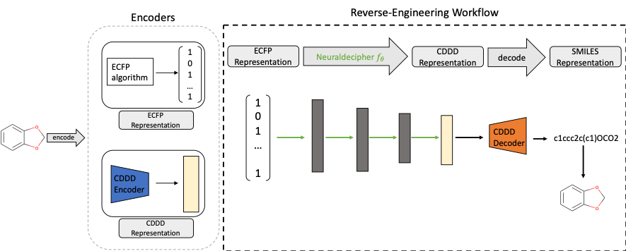
Inverting ECFP
Surprisingly, inverting (Some) ECFP is possible
Neural Decipher:
Feed forward neural network that converts ECFP to CDDD representation which is then decoded to smiles

Slide 12
Inverting ECFP
Limitations of Neural Decipher:
Black box
Huge training set (ChEMBL25)
Biased training set (ChEMBL25)
Intensive training
Limited reconstruction success (10-50%)
New model needed for every FP setting

Slide 13
Inverting ECFP
An algorithmic method could address some of these issues
Fully interpretable
More general
No training = No overfitting or bias
Run for whatever FP settings
However, for these advantages to be helpful the method needs to work

Slide 14
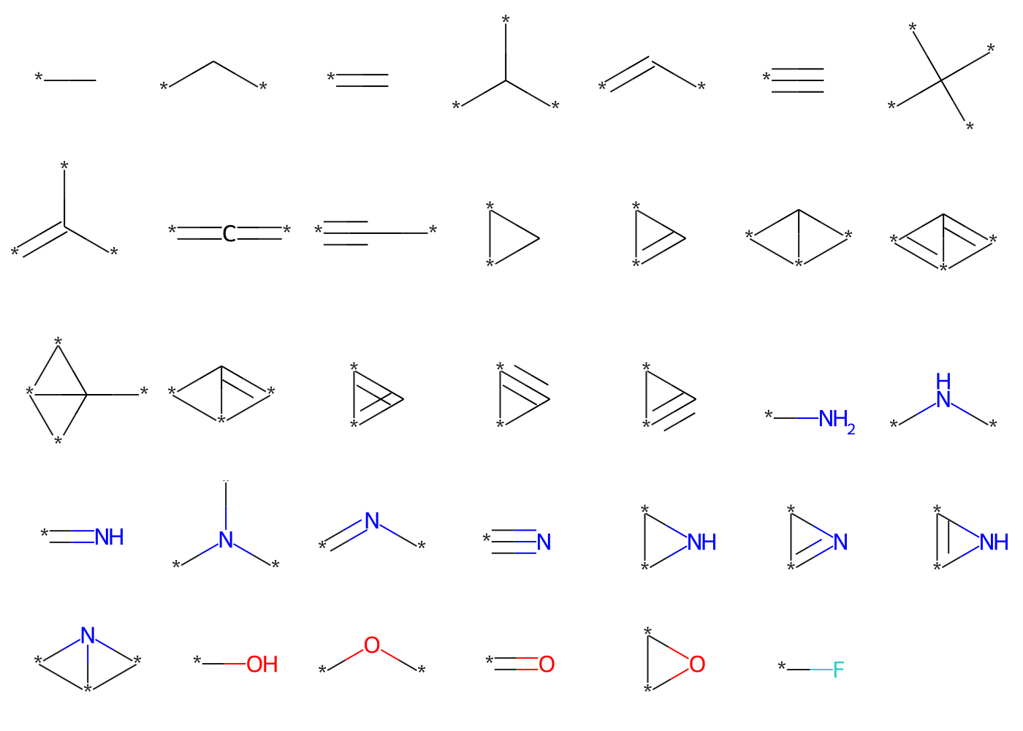
Inverting ECFP
Algorithmic approach: atom-per-atom search
There is a limited amount of radius 0 ECFP fragments. 34 for uncharged CNOF, shown below

Slide 15
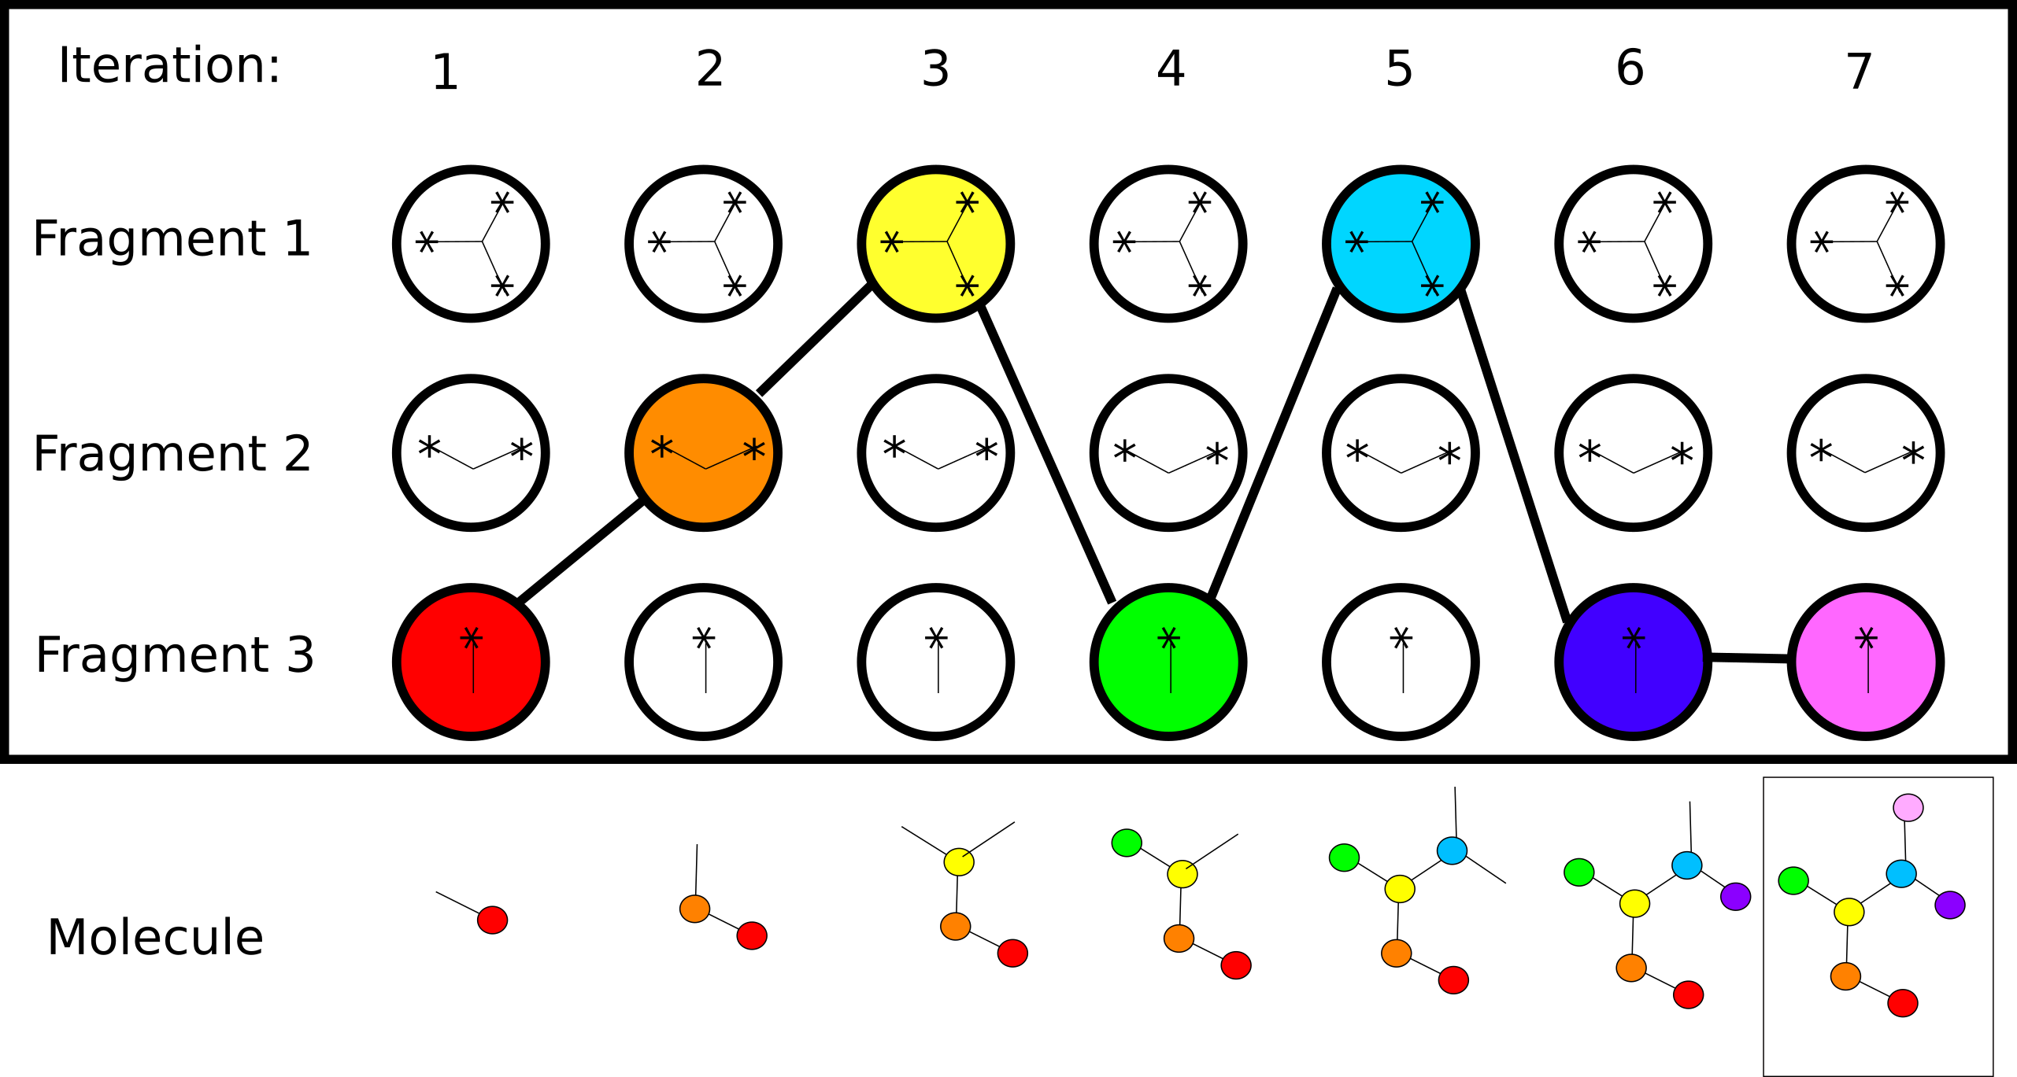
Inverting ECFP
Algorithmic approach: atom-per-atom search through atom connection tree:

Slide 16
Inverting ECFP
Algorithmic approach:
atom-per-atom search through atom connection tree
guided by total amount of matching on-bits and immediate backtracing when a non-matching on bits is found
Atom addition position determined by “pointer dummy”: dummy with longest lifespan and highest bond order
Ring closure operation needs to be added for non-acyclic molecules

Slide 17
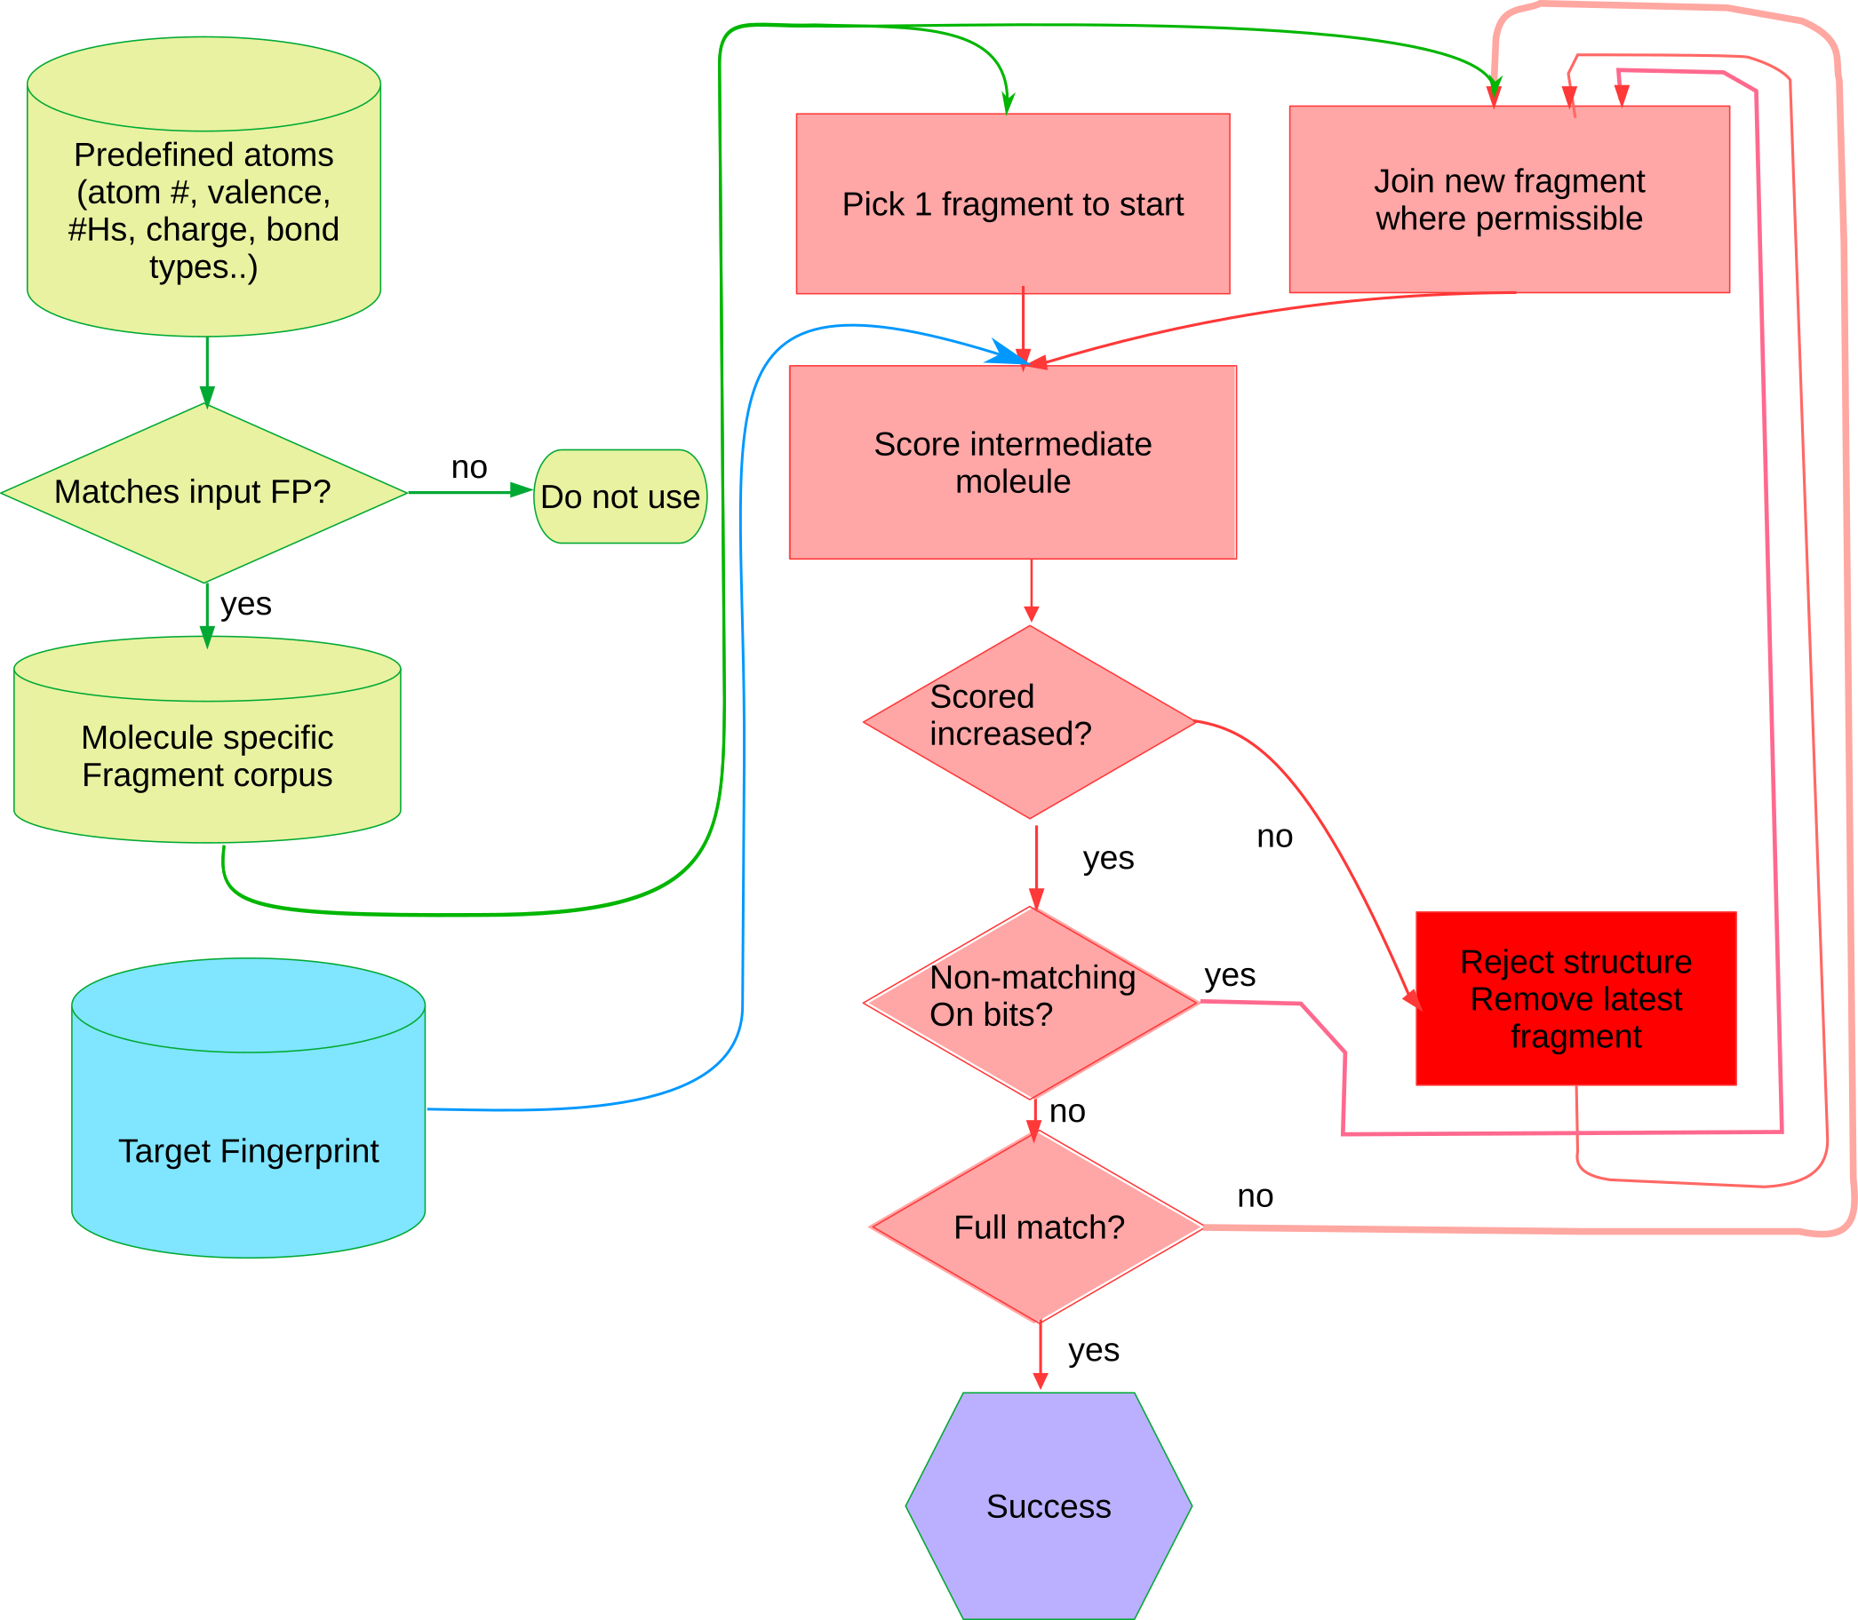
Inverting ECFP
Algorithmic approach: illustration

Slide 18
Inverting ECFP
Algorithmic approach: problem with cycles
The only ring info in a radius 0 invariant is a ring membership bool. Highlighted atoms equivalent
Solve by cyclic tether. [W] used in this implementation

Slide 19
Inverting ECFP
Algorithmic approach: Well behaved molecules:

Slide 20
Inverting ECFP
Algorithmic approach: Tough molecules:
High symmetry, repeating fragments

Slide 21
Inverting ECFP
Algorithmic approach: Expanding the corpus:
Many molecules also have S, P, halogens. These can be added to the corpus

Slide 22
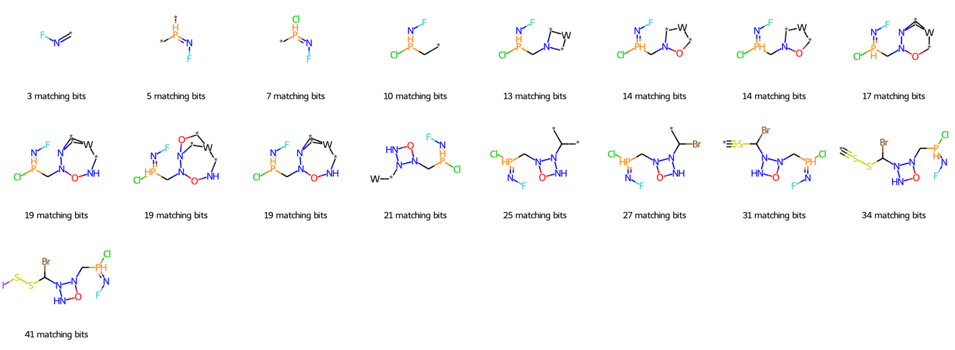
Inverting ECFP
Algorithmic approach: Nonsense molecules
Algo has only minimal chemical info (atom no and valence) so it can also reconstruct unrealistic molecules

Slide 23
Case study: reconstructing GDB-11
GDB
Complete enumeration of molecules specifying specific constraints
Max heavy atom count <= 11
Atom type CNOF
Feasibility filter (e.g. BH alkene)
Maximal chemical diversity, many exotic compounds and unknown fused ring systems
Reconstruction would prove general applicability of reconstruction approach to unseen diverse structures

Slide 24
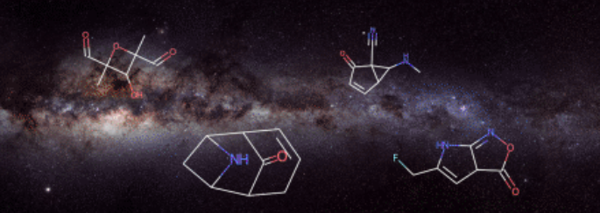
Case study: reconstructing GDB-11
GDB
A few random molecules

Slide 25
Case study: reconstructing GDB-11
GDB reconstruction results (random sample of 1000)
 | GDB9 | GDB8 | GDB9 | GDB10 | GDB11
reconstruction | 100% | 100% | 100% | 99.5% | 99.6%
speed (sec) 0.18 0.23 0.55 1.15 1.4 | 0.18 | 0.23 | 0.55 | 1.15 | 1.4

Slide 26
Conclusion
Many ECFP can be inverted
Not confidential
Inverse QSAR
Interesting theoretical implications (barely information loss)
Algorithmic method was developed
Simpler, more general and more interpretable than neural method
Prototype RDKit implentation available via github.com/dehaenw/ECFPInvert
TBD:
General benchmarking (vs CHEMBL and ZINC)
Algorithm implementation efficiency optimization beyond proof of concept
Other CFP like FCFP and custom CFPs

Slide 27
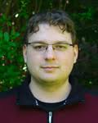
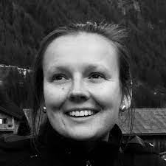
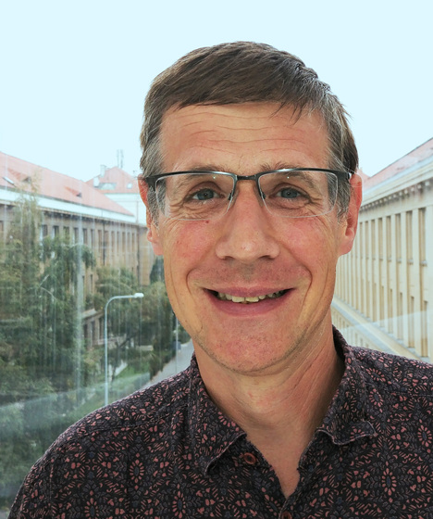
Final slide
Thanks to the following people:
I.Čmelo
A. Karlová
D. Svozil
This work was supported from the Ministry of Education of the Czech Republic (RVO 68378050-KAV-NPUI and LM2018130)

Slide 28
Appendix: Some inversion paths

Slide 29
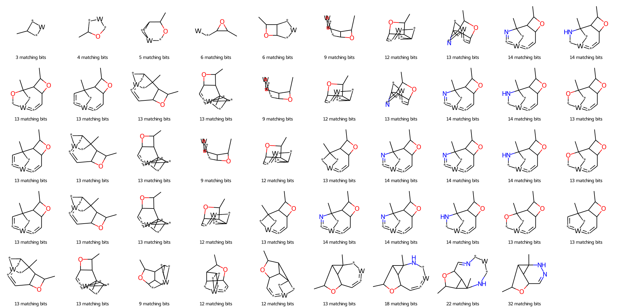
Appendix: Some inversion paths

Slide 30
Appendix: Some inversion paths

Slide 31
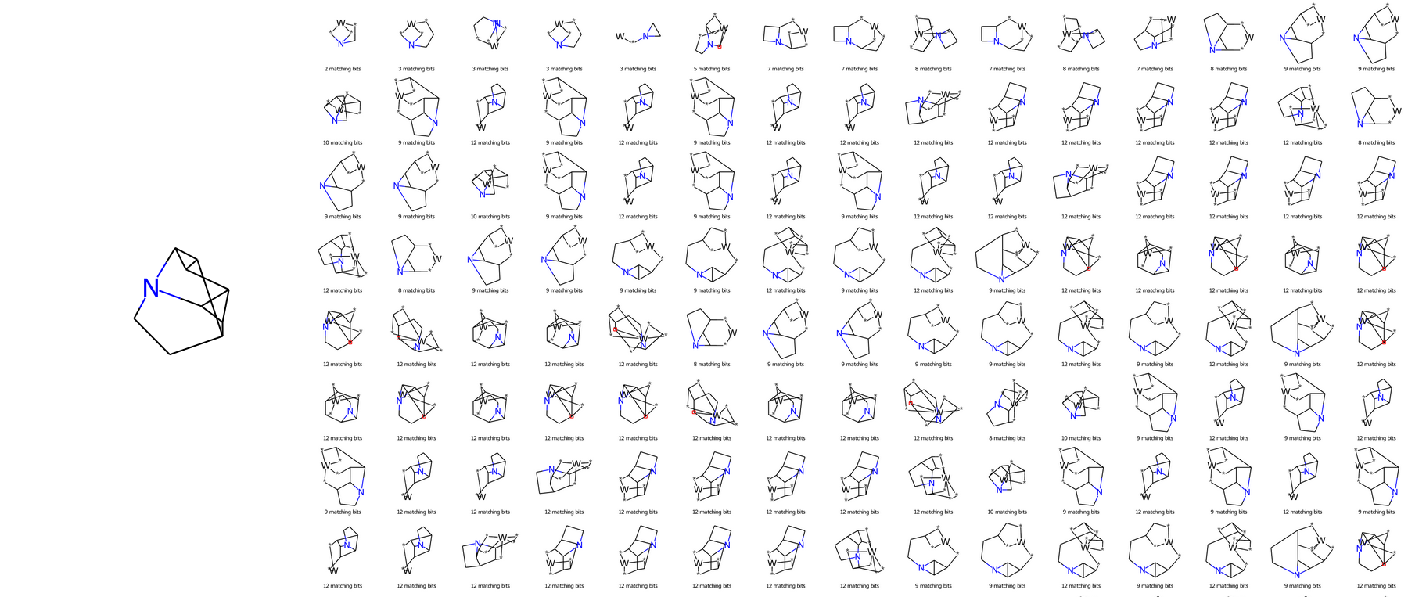
Appendix: GDB10 failure case

