Slide 1

Multiple instance learning: a new method for 3D QSAR modelling
Matveieva M., Zankov D., Nikonenko A., Madzhidov T. , Polishchuk P.
matveiem@vscht.cz
Université de Strasbourg
Kazan Federal University
UPOL

Slide 2
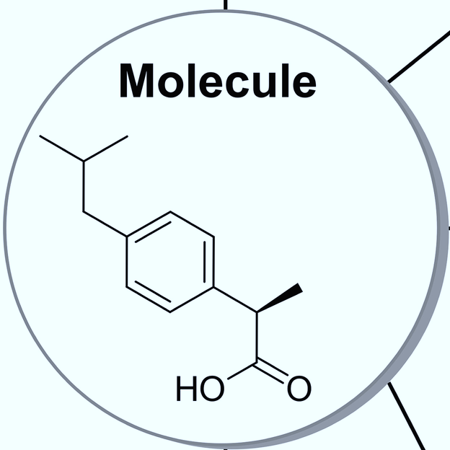
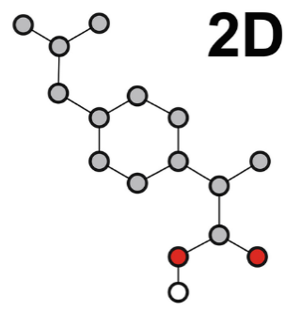


Molecule Representations
1D
2D
3D
4D
C₁₃O₂H₁₈

Slide 3
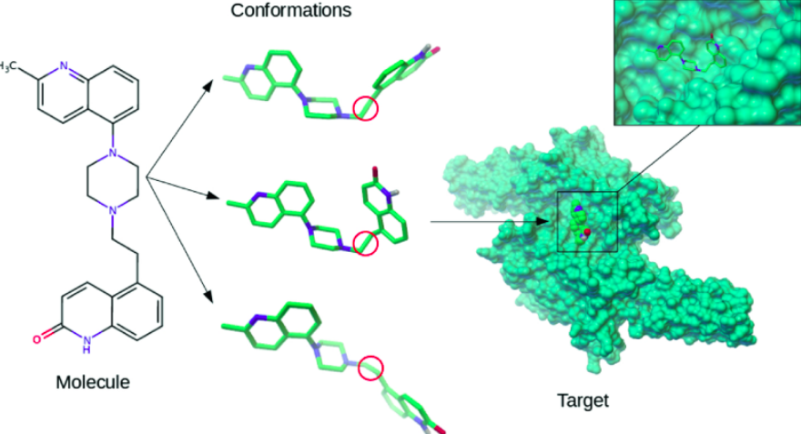
Binding: how to select bioactive conformation?

Slide 4
Current approaches…
Generate conformers →
generate alignment-independent descriptors →
weighting by some coefficients →
classical Machine learning
e.g. Boltzmann factor; however not reliable estimate…

Slide 5
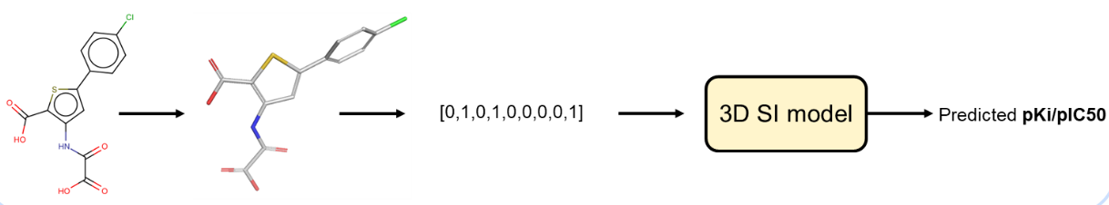

Single VS Multiple instance learning
Single-Instance QSAR
Multi-Instance QSAR

Slide 6
Aims
Benchmarking of Multiple Instance learning algorithms
Compraison MI algorithms against single Instance algorithms
Bioactive conformation identification using MI agorithms

Slide 7
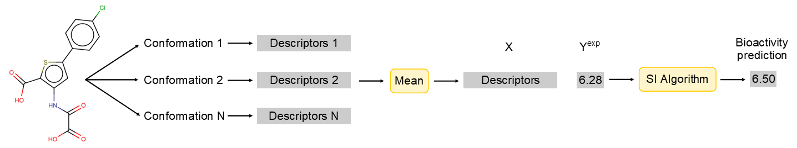

Multi-Instance Algorithms
Bag-Wrapper = Averaging conformation descriptors
Instance-Wrapper = Averaging conformation predictions

Slide 8
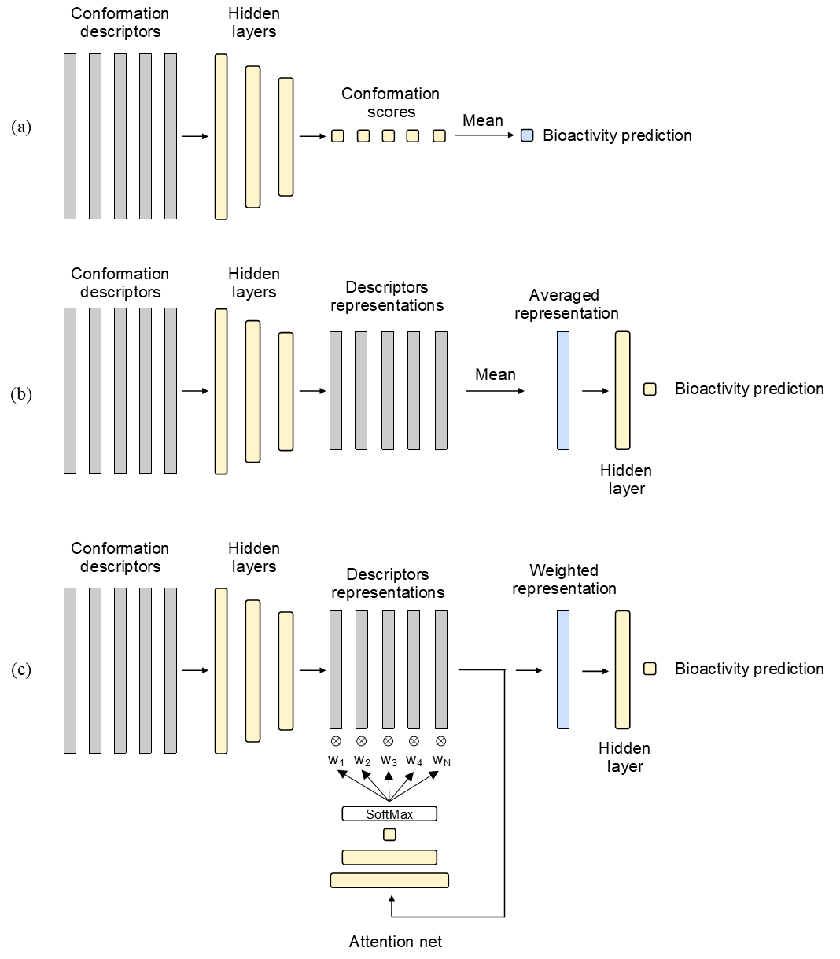
Multi-Instance Algorithms: Neural nets
Bag-Net = Averaging conformation embeddings
Instance-net = Averaging conformation scores

Slide 9
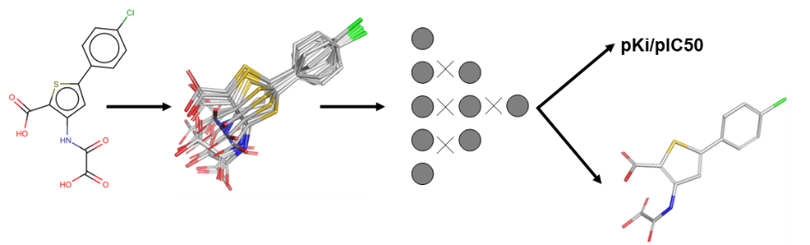
Bag-Attention Net = Weighted averaging of conformation embeddings
Bag-Attention Net = Weighted averaging conformation embeddings

Slide 10
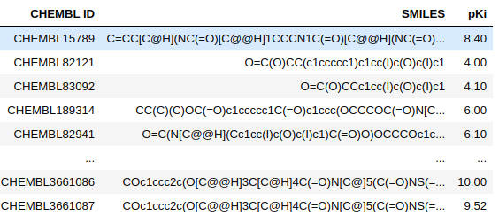
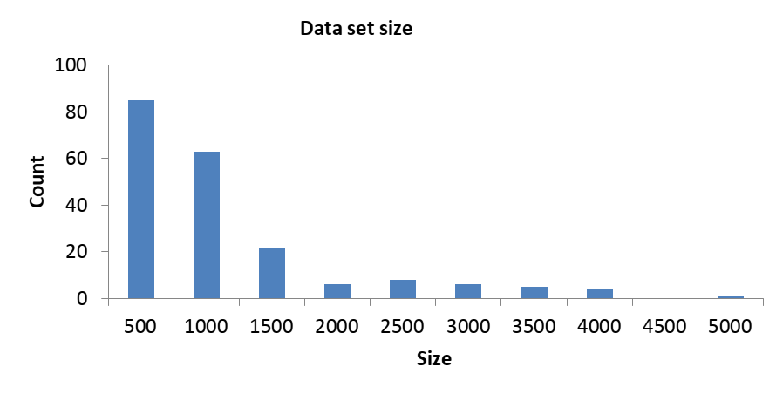
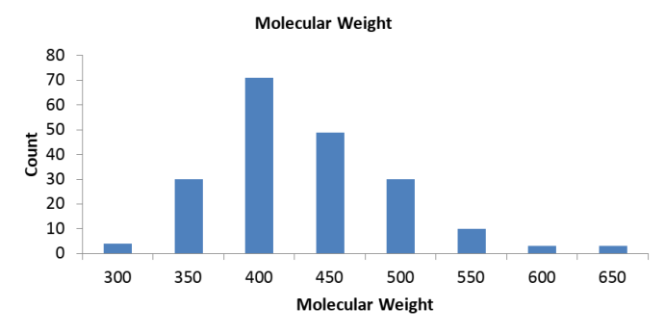
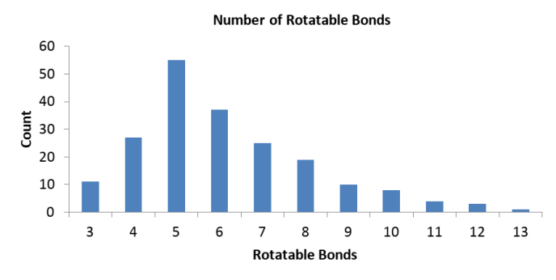
Datasets
We extracted 175 sets from the CHEMBL23 database

Slide 11
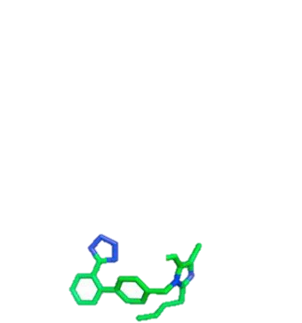
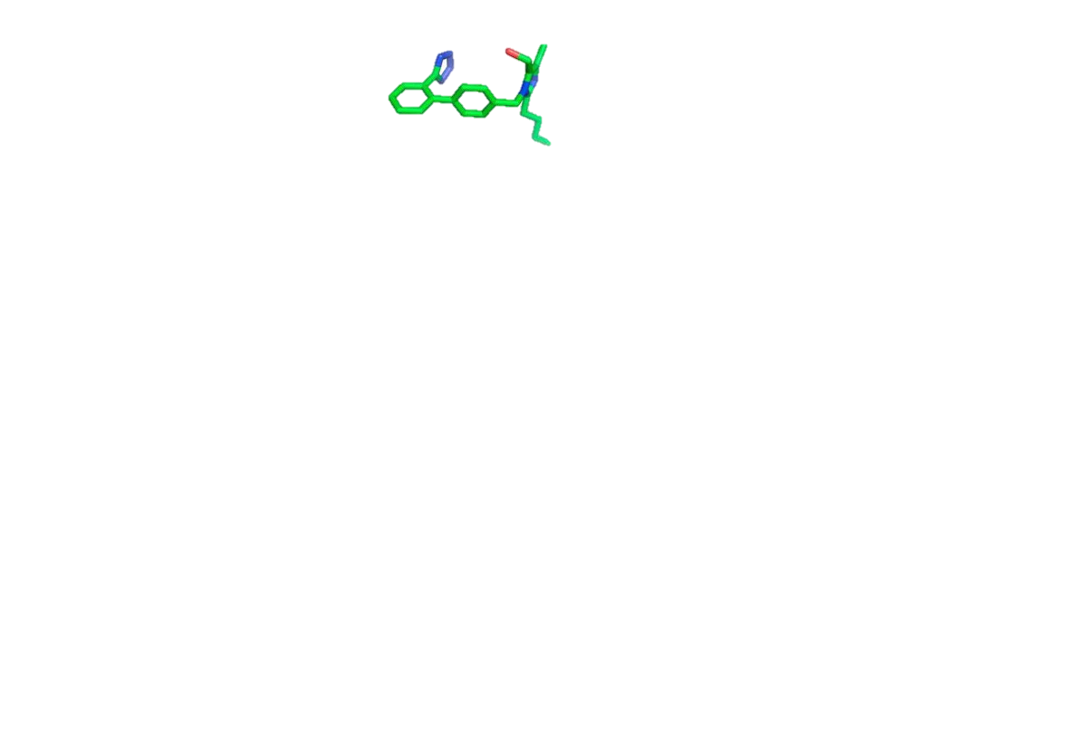
Conformation Generation
Generation of
100 conformations per molecule
RDKit
Calculation of
Pmapper* 3D descriptors
→
ΔE = 100 kcal/m
*Kutlushina, A., Khakimova, A., Madzhidov, T., & Polishchuk, P. (2018). Ligand-based pharmacophore modeling using novel 3D pharmacophore signatures. Molecules, 23(12), 3094.

Slide 12
Results

Slide 13
Nomenclature
Representation Level
(2D or 3D)
3D / MI / Instance-Wrapper
Learning Concept
(Single or Multi-Instance)
Learning Algorithm

Slide 14
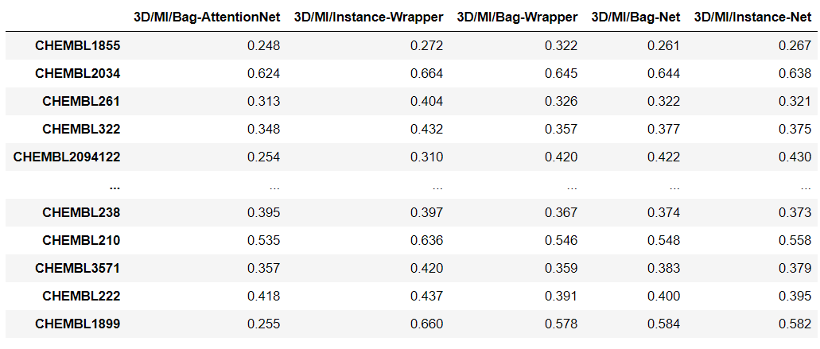
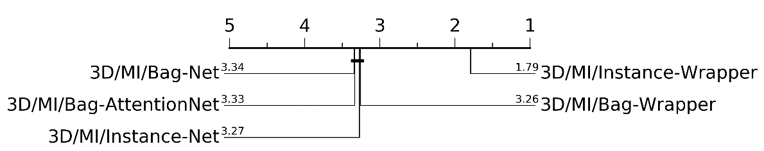
Benchmarking Multi-Instance Algorithms
R2 >=0,4 130 data sets
Groups of models that are not significantly different (at a confidence level of 0.05) are connected by the thick line

Slide 15
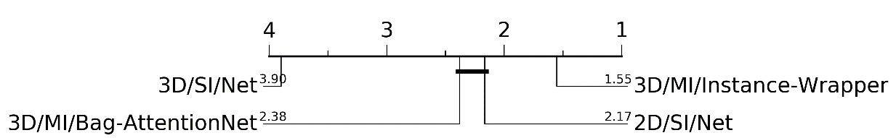
Comparison of 2D and 3D models
Model | Mean | Median
3D/MI/Instance-Wrapper | 0.530 ± 0.123 | 0.532
2D/SI/Net | 0.474 ± 0.189 | 0.503
ЗD/MI/Bag-Attention Net | 0.474 ± 0.157 | 0.476
3D/SI/Net | 0.027 ± 0.374 | 0.092
139 data sets

Slide 16
Identification of Bioactive Conformation

Slide 17
Identification of Bioactive Conformation

Slide 18
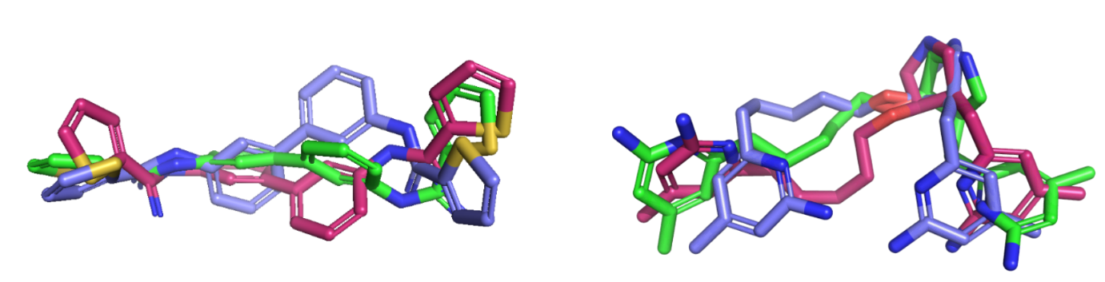
Example
PDB conformation
Lowest-energy conformation
Conformation predicted by 3D/MI/Bag-AttentionNet model
CHEMBL2820
Training set
Test set
Experimental pKi: 6.10
3D/SI/Net pKi: 6.48, RMSD = 2.42 Å
3D/MI/Bag-AttentionNet pKi: 6.31, RMSD = 1.70 Å
Experimental pKi: 7.42
3D/SI/Net pKi: 7.86, RMSD = 2.78Å
3D/MI/Bag-AttentionNet pKi: 7.41, RMSD = 1.55 Å

Slide 19

Conclusions
Multi-instance models outperform both single-instance 3D models and traditional QSAR models built on 2D descriptors in many cases
Multi-instance models is good alternative to 2D modeling if the latter fails
Multi-instance neural network with an attention mechanism can correctly identify a “bioactive” conformation close to the experimental structure of a ligand retrieved from PDB.
All algorithms and data sets are freely available at
https://github.com/cimm-kzn/3D-MIL-QSAR
ZANKOV, D., M. MATVEIEVA, A. NIKONENKO, R. NUGMANOV, I. BASKIN, A. VARNEK, P. POLISHCHUK a T. MADZHIDOV. Journal of Chemical Information and Modeling. 2021

Slide 20
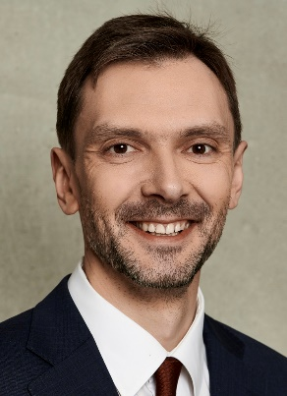
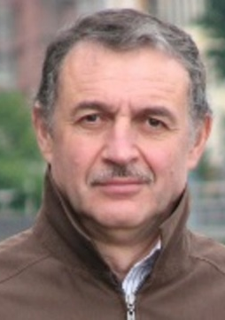







Acknowledgement
Pavel Polishchuk
Alexandre
Varnek
Ramil Nugmanov
Igor Baskin
Dmitriy Zankov
Timur Madzhidov

