Slide 1
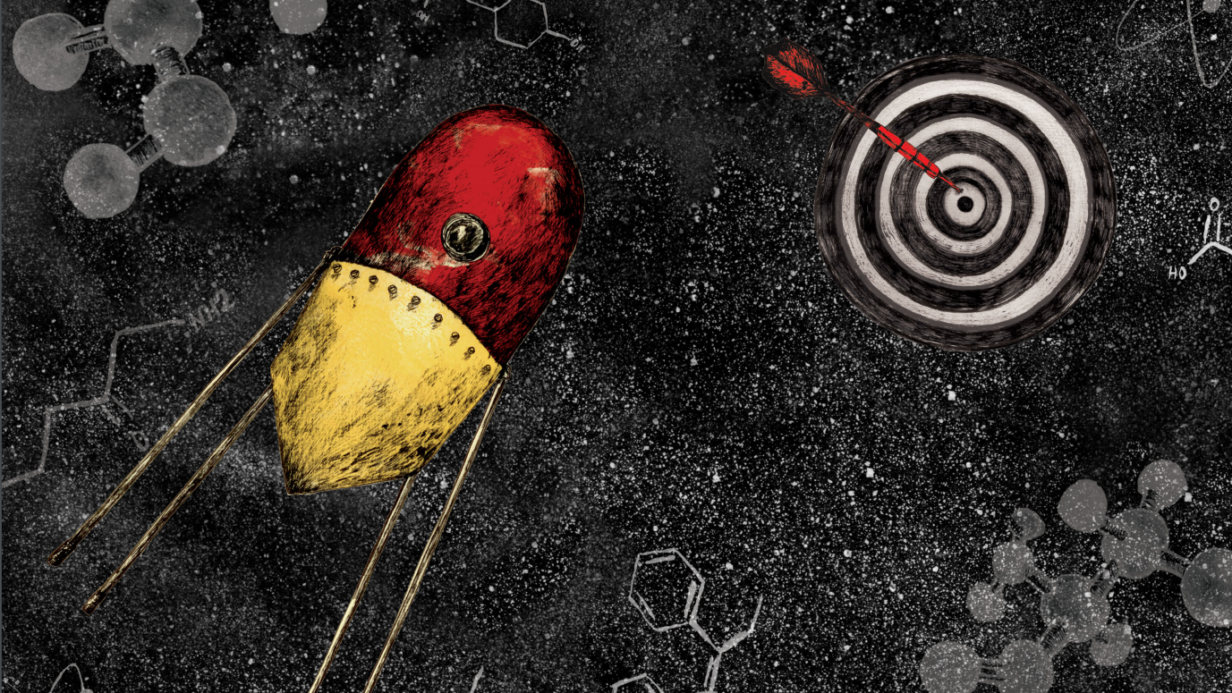
PROBES & DRUGS PORTAL IN 2022
a hub for the integration of high-quality bioactive compound sets
Ctibor Škuta CZ-OPENSCREEN: NATIONAL INFRASTRUCTURE FOR CHEMICAL BIOLOGY AT THE INSTITUTE OF MOLECULAR GENETICS OF THE CZECH ACADEMY OF SCIENCES (IMG CAS)
CZECH REPUBLIC

Slide 2
A BRIEF HISTORY OF THE PROBES & DRUGS PORTAL
Started as a CZ-OPENSCREEN in-house project that would simplify our bioactive library updates selection
High-quality bioactive compound sets scattered across databases, web-pages, publications, vendor sets
Our goal was to put all of the relevant sets together and provide a user-friendly interface with tools that would allow anyone to work with the set
P&D released in 2017 with ~30,000 compounds representing 29 sets
Skuta C, Popr M, Muller T, Jindrich J, Kahle M, Sedlak D, Svozil D, Bartunek P. (2017) Probes & Drugs Portal: an interactive, open data resource for chemical biology. Nature Methods 14(8), pp.759-760.

Slide 3
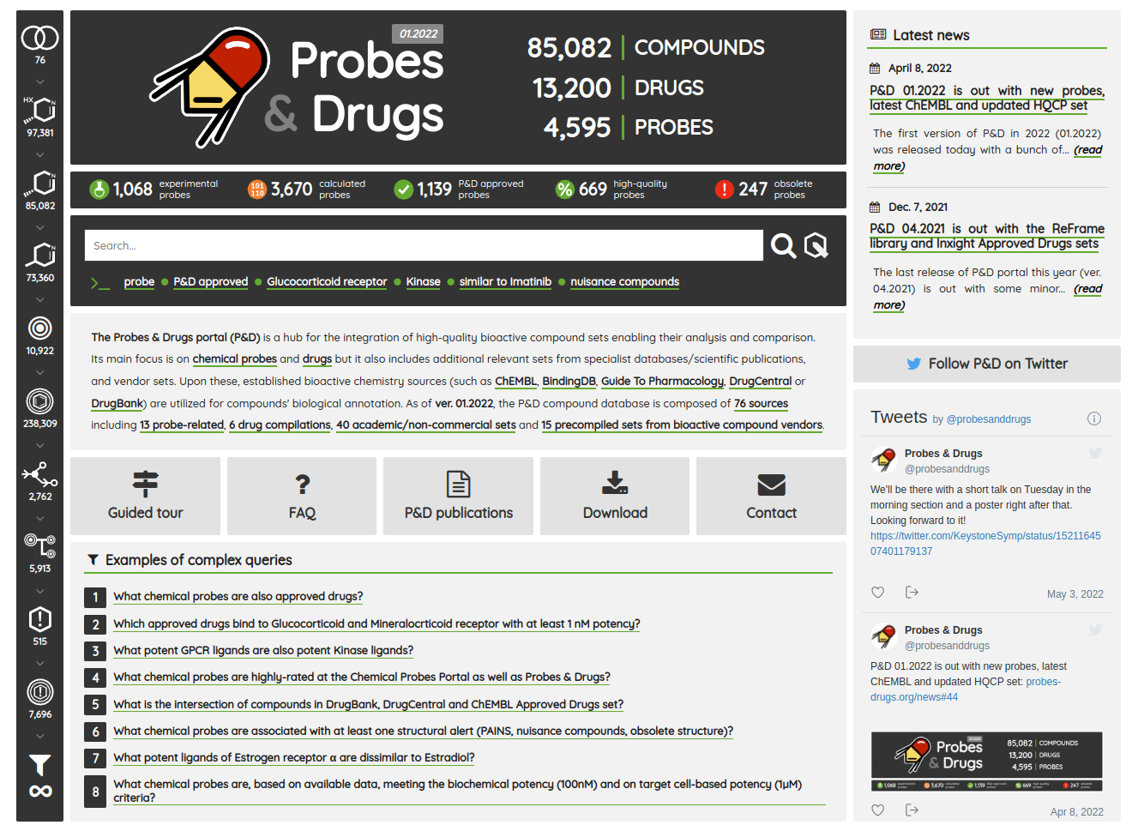
PROBES & DRUGS PORTAL IN 2022
P&D integrates 76 compound sources (>85k standardized compounds) including 13 probe-related, 6 drug compilations, 40 academic/non-commercial sets and 15 precompiled sets from bioactive compound vendors
P&D probe-likeness score
Score reflecting common probe criteria
Integrated probes scores from Chemical Probes Portal and Probe Miner
Live set of High-quality Chemical Probes (updated with each new P&D version)
The most comprehensive resource in the field of chemical probes

Slide 4
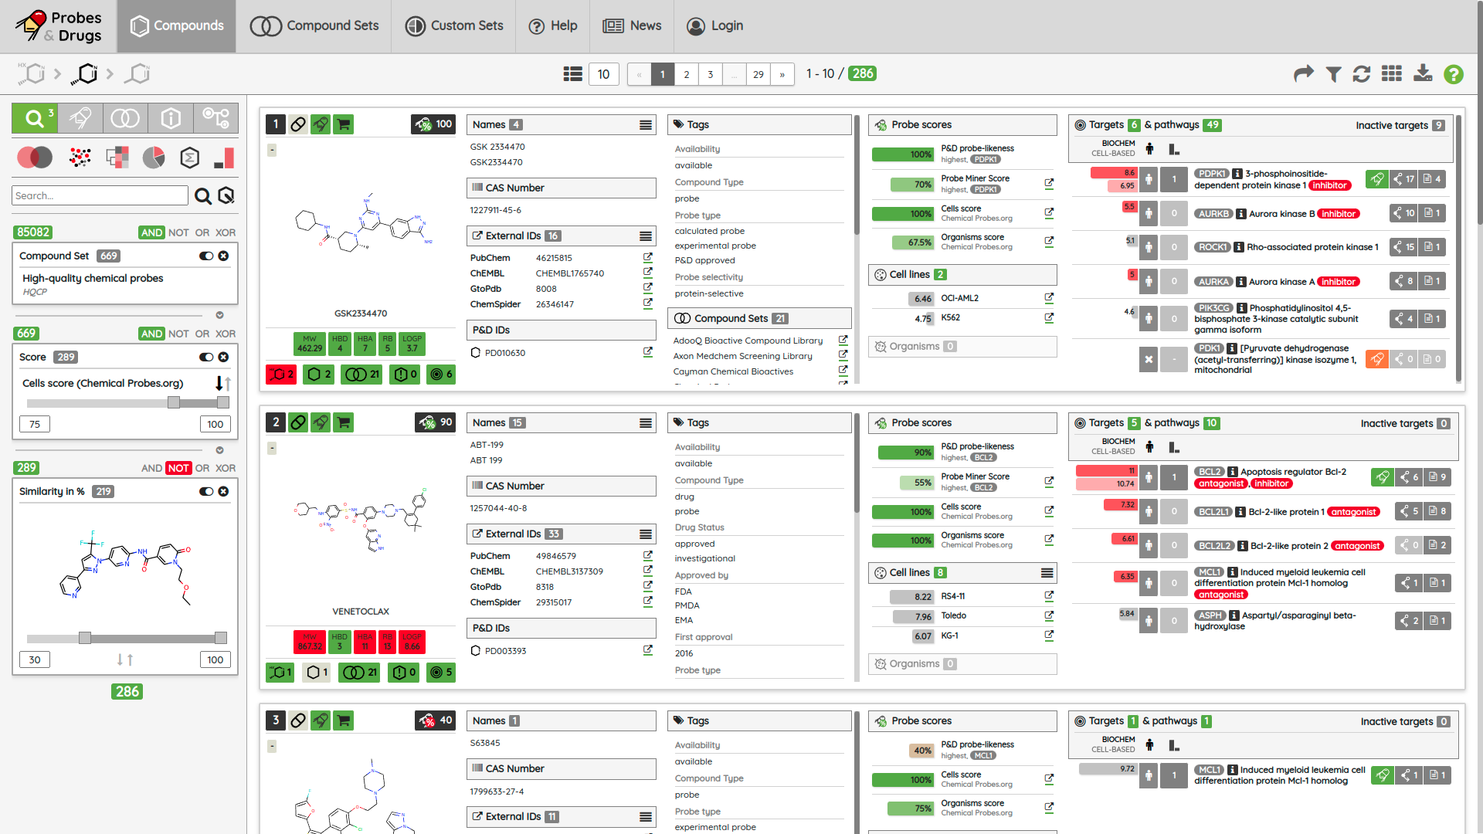
P&D WORKSPACE
COMPOUND
NAMES & IDs
TAGS & SETS
PROBE SCORES
TARGETS & PATHWAYS
TABS
VIS
SEARCH
CELL-LINES & ORGANISMS
FILTERS

Slide 5
EVERYTHING IS A FILTER!
COMPOUND SETS
TAGS/ATTRIBUTES
PROBE CRITERIA
PROBE SCORES
OR
AND
NOT
AND
TARGETS/PROBE TARGETS
TARGET CLASSES
BIOLOGICAL PATHWAYS
AND
XOR
OR
CELL-LINES
ORGANISMS
ORGANISM CLASSES
STRUCTURES/SCAFFOLDS
XOR
OR
NOT
NOT
BIOACTIVITY REFERENCES
PHYSICO-CHEMICAL PROPERTIES
MOA/MOA EFFECT
XOR
AND
XOR
EXTERNAL IDS/EXTERNAL DBS
STRUCTURAL ALERTS/ALERT FAMILIES
NOT

Slide 6
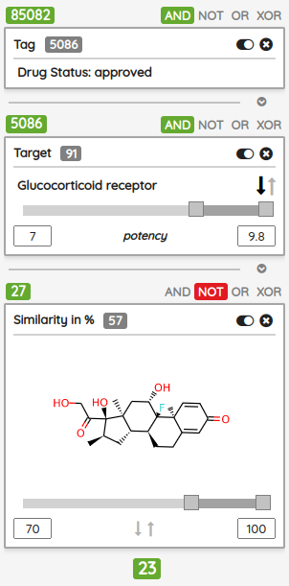
ALL COMPOUNDS
BOOLEAN OPERATORS
1
BRACKETS
DISABLE/REMOVE
2
ORDER BY
RANGE SLIDERS
TOP-DOWN FILTERING
3
RESULT OF THE QUERY

Slide 7
THANKS TO
Petr Bartůněk
Tomáš Müller
Martin Popr
Christopher Southan
and others…
https://www.probes-drugs.org
@probesanddrugs
support@probes-drugs.org
skutac@img.cas.cz

