Slide 1


P-34
NextDOM 2.0: Detector of Somatic Point Mutations in Leukemias Resistant to Therapy
Pavla Suchánková, Adéla Benešová, Pavla Pecherková, Jitka Koblihová, Václava Polívková, Kateřina Machová Poláková
Institute of Hematology and Blood Transfusion
Enbik 2022 pavla.suchankova@uhkt.cz

Slide 2
Introduction
Early and correct mutation detection is crucial in the treatment of chronic myeloid leukemia (CML) and Ph+ acute lymphoblastic leukemia (Ph+ ALL)
The frequency of the error occuring during deep amplicon sequencing by next generation sequencing (NGS) is dependent on:
  the nucleotide position in the DNA sequence
  the type of the nucleotide substitution (transition, transversion)
Machova Polakova, K., et al., Next-generation deep sequencing improves detection of BCR-ABL1 kinase domain mutations emerging under tyrosine kinase inhibitor treatment of chronic myeloid leukemia patients in chronic phase. J Cancer Res Clin Oncol, 2015. 141(5): 887-99.
Enbik 2022 pavla.suchankova@uhkt.cz

Slide 3

Introduction
Early and correct mutation detection is crucial in the treatment of chronic myeloid leukemia (CML) and Ph+ acute lymphoblastic leukemia (Ph+ ALL)
The frequency of the error occuring during deep amplicon sequencing by next generation sequencing (NGS) is dependent on:
  the nucleotide position in the DNA sequence
  the type of the nucleotide substitution (transition, transversion)
Blue: transition
Red: transversion
Machova Polakova, K., et al., Next-generation deep sequencing improves detection of BCR-ABL1 kinase domain mutations emerging under tyrosine kinase inhibitor treatment of chronic myeloid leukemia patients in chronic phase. J Cancer Res Clin Oncol, 2015. 141(5): 887-99.
Enbik 2022 pavla.suchankova@uhkt.cz

Slide 4
Introduction
Early and correct mutation detection is crucial in the treatment of chronic myeloid leukemia (CML) and Ph+ acute lymphoblastic leukemia (Ph+ ALL)
The frequency of the error occuring during deep amplicon sequencing by next generation sequencing (NGS) is dependent on:
  the nucleotide position in the DNA sequence
  the type of the nucleotide substitution (transition, transversion)
Main Task:
To calculate the individual thresholds, i.e. for each nucleotide position, for mutation detection above the error background through the entire kinase domain of BCR::ABL1 (NGS).
Machova Polakova, K., et al., Next-generation deep sequencing improves detection of BCR-ABL1 kinase domain mutations emerging under tyrosine kinase inhibitor treatment of chronic myeloid leukemia patients in chronic phase. J Cancer Res Clin Oncol, 2015. 141(5): 887-99.
Enbik 2022 pavla.suchankova@uhkt.cz

Slide 5
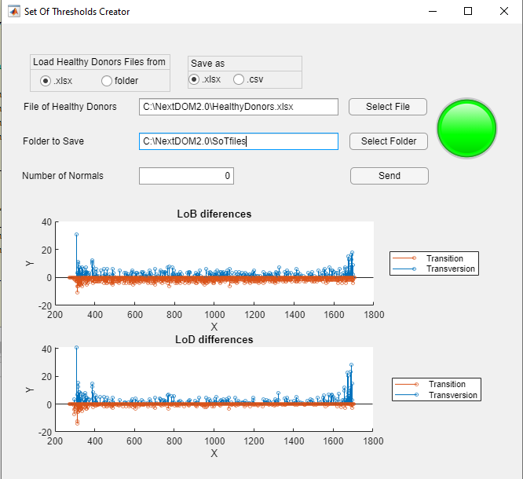

NextDOM Set of Thresholds Creator
Min. 20 healthy donors (mutation negative control)
Two calculation algorithms -> Comparing -> Selecting higher limit of quantification
$$\min_{j}\left(F_{j},R_{j}\right)≥1000$$
Data normalization
Type of nucleotide
A C T G
Each position
Transition
Transversion
Transition
Transversion
Poisson distribution
Poisson distribution
LoQs of specific nucleotide change
LoQs of each nucleotide position
Comparing and selecting the higher value from LoQ for all positions
Enbik 2022 pavla.suchankova@uhkt.cz

Slide 6
NextDOM 2.0
Load Part 1 mutation report files generated by NextGENe
Load Part 2 mutation report files generated by NextGENe
Samples reports
  Frequency of nucleotides at each position in the sequence
  List of variants with frequency higher than 0.5% at given position
Result report
  Mutations at statistically significant levels
  Highlighted clinically relevant variants
Data normalization
Evaluation using the Set of thresholds
LoD
LoQ
Detection of statistically significant mutations (p-value = 0.05)
Creating basic results files in *csv
Creating advance results file with conditional formating in excel
Enbik 2022 pavla.suchankova@uhkt.cz

Slide 7
Conclusion
This approach of analysing data from NGS enables to detect mutation at very low level and facilitates better disease management.
NextDOM Set of Thresholds Creator can be used as a universal threshold calculator and NextDOM 2.0 is modifiable for mutation detection in various amplicon sequencing data.
Machova Polakova, K., et al., Next-generation deep sequencing improves detection of BCR-ABL1 kinase domain mutations emerging under tyrosine kinase inhibitor treatment of chronic myeloid leukemia patients in chronic phase. J Cancer Res Clin Oncol, 2015. 141(5): 887-99.
Enbik 2022 pavla.suchankova@uhkt.cz

Slide 8
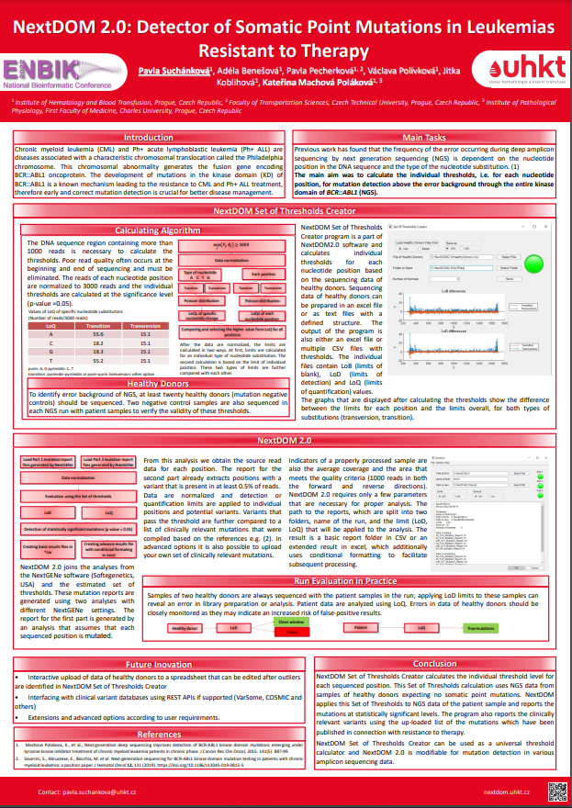
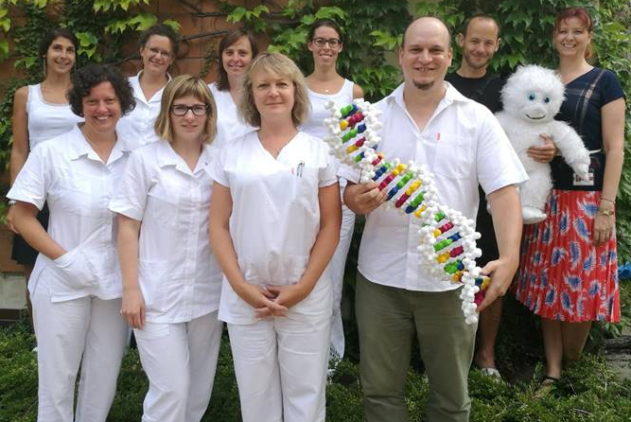
More details and questions will be answered at
Poster 34:
NextDOM 2.0: Detector of Somatic Point Mutations in Leukemias Resistant to Therapy
Enbik 2022 pavla.suchankova@uhkt.cz

