Slide 1





Milan Voršilák (Tomáš Müller)
ENBIK 14.06.2022

Slide 2
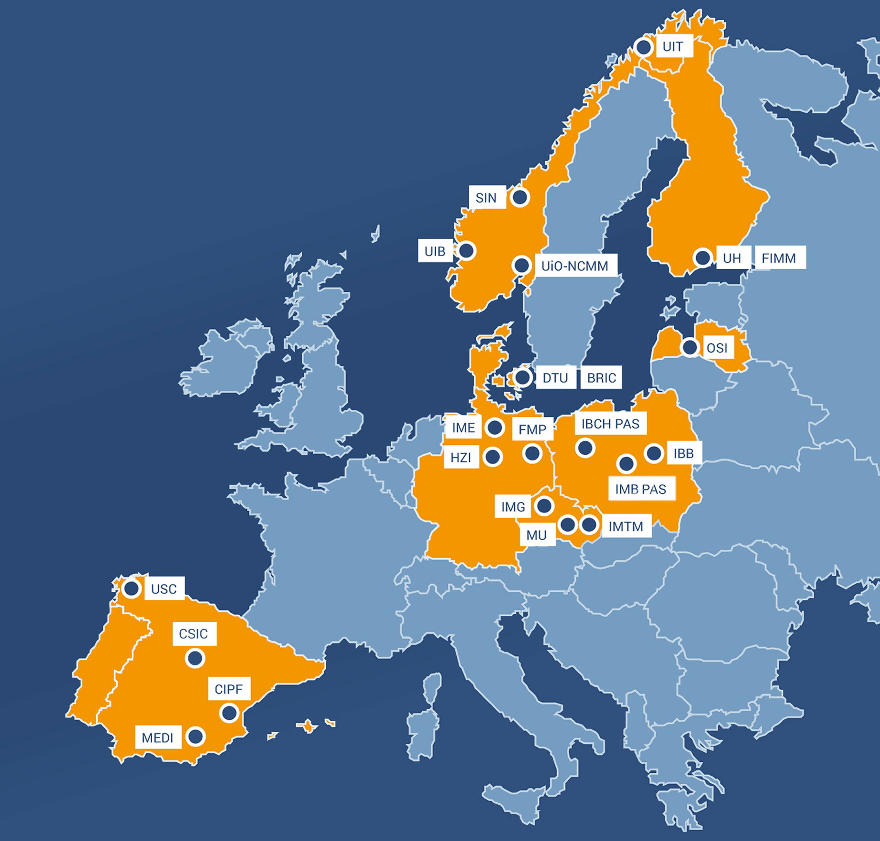
EU-OPENSCREEN integrates
high-capacity screening platforms
throughout Europe
Compound collection
Collaboratively develops novel
molecular tool compounds
23 Partner sites in 9 countries
IMG, MU and IMTM in Czechia

Slide 3

Generally
Central data hub for data generated within the EU-OPENSCREEN network
Developed in line with the FAIR principles ensuring Findability, Accessibility, Interoperability, and Reusability of the data
Data covered by CC BY 4.0
Export csv, xslx, json
Database dump

Slide 4






Technologically

Slide 5
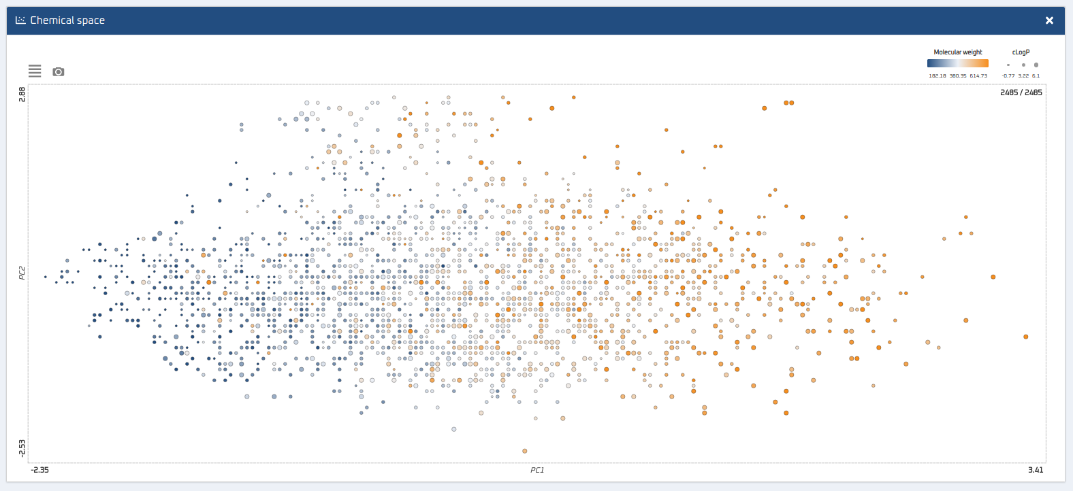
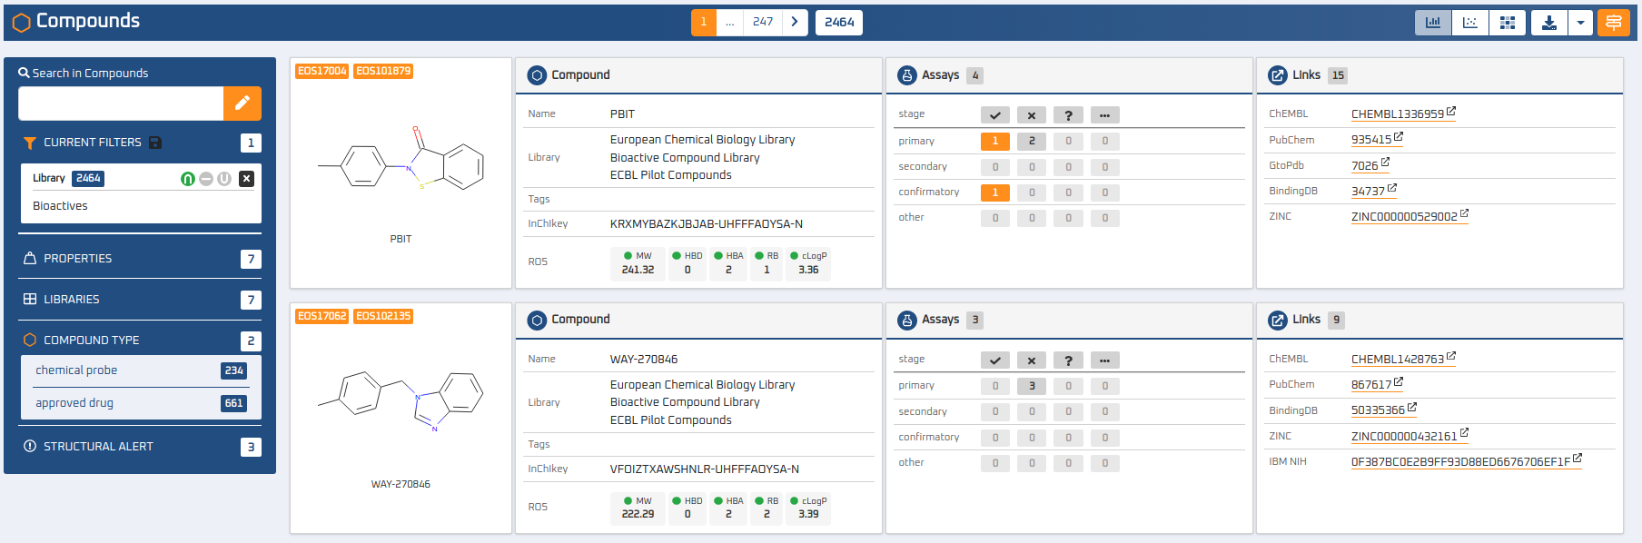
Compounds
102135 in diverse, bioactive, fragment and nuisance libraries

Slide 6
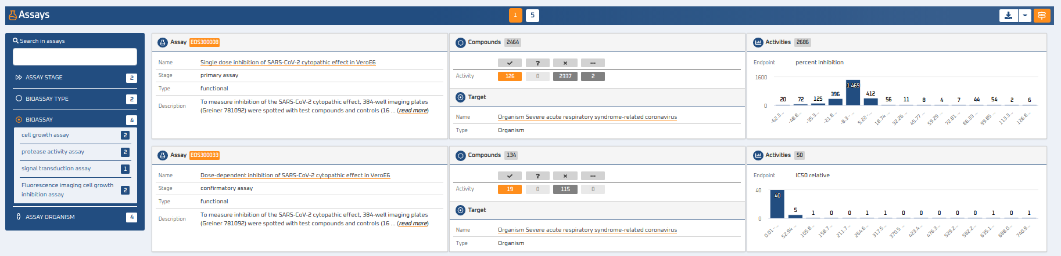
Assays
5 public and 18 private assays on 5 targets
Embargo up to 36 months
Described with established ontologies such as BioAssayOntology, NCBI Taxonomy, ...

Slide 7
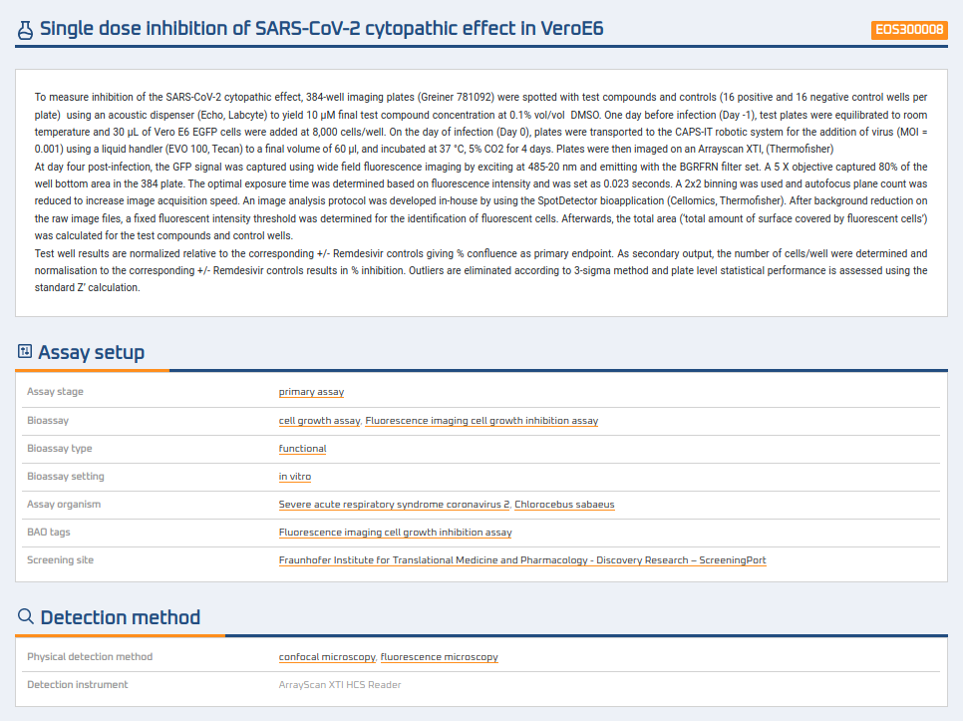
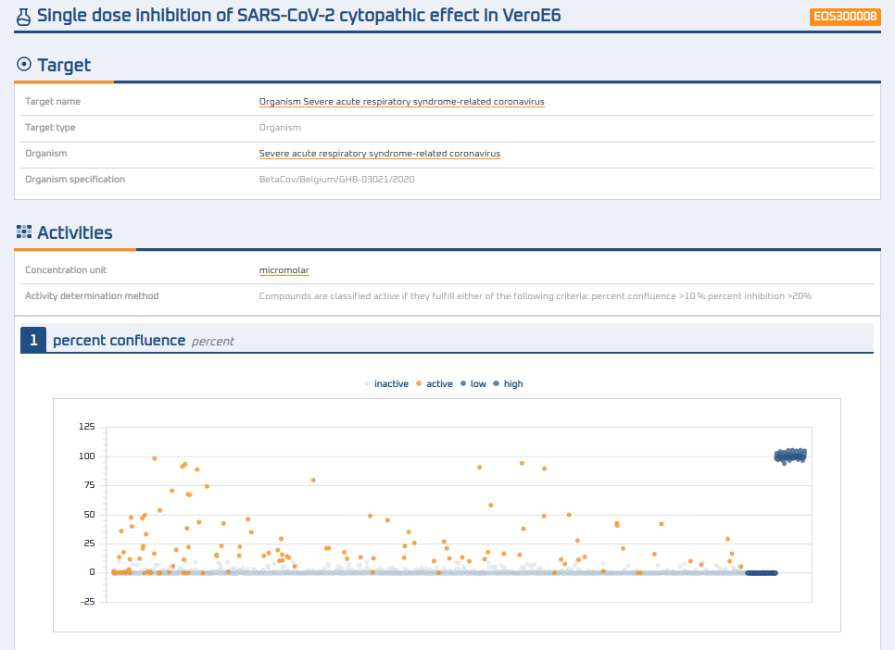
Assay detail

Slide 8
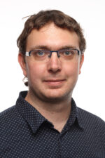


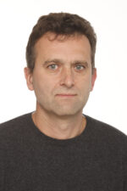

See you at poster 38
Milan Voršilák
Tomáš Müller
Ctibor Škuta
Petr Bartůněk

