Slide 1
Modelling of Ago2 Binding using CLASH
Panagiotis Alexiou
ENBIK 2022

Slide 2
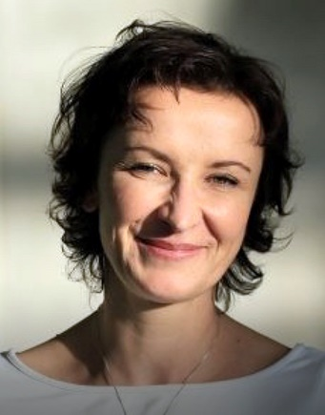
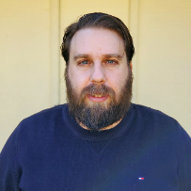
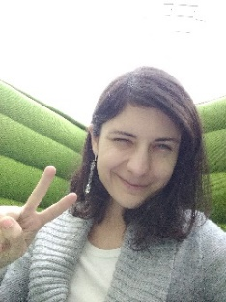
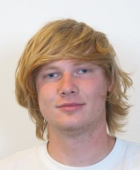
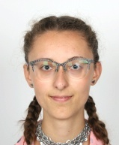
Modelling of Ago2 Binding using CLASH
Wet Lab experiments
Data Analysis Pipeline
Machine Learning Models
Stepanka Vanacova
Panagiotis Alexiou
Ilektra-Chara Giassa
Nandan
Mysore
Varadarajan
Eva Klimentova
Vaclav Hejret
panagiotis.alexiou@ceitec.muni.cz

Slide 3
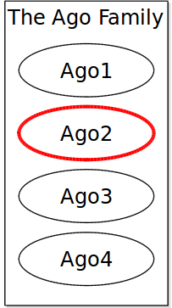
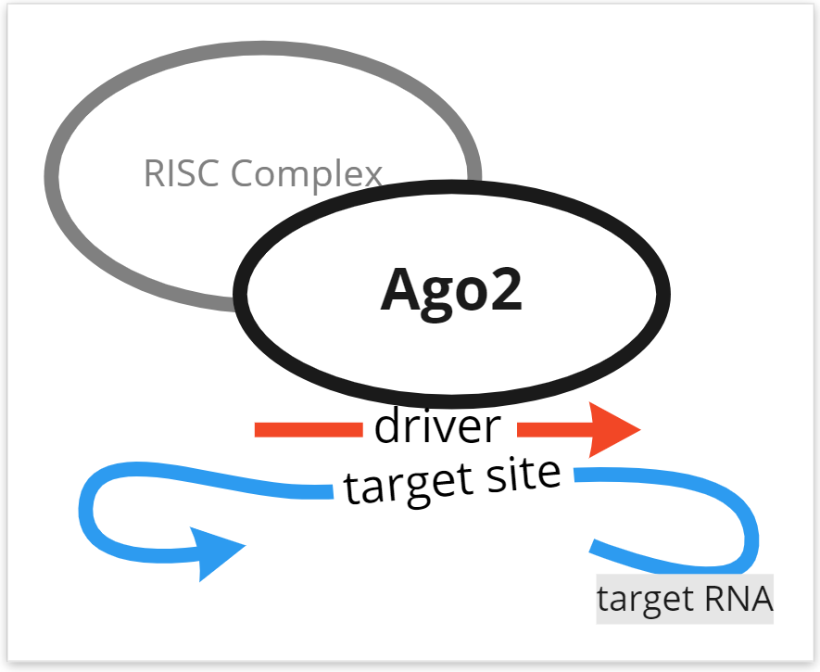

Slide 4
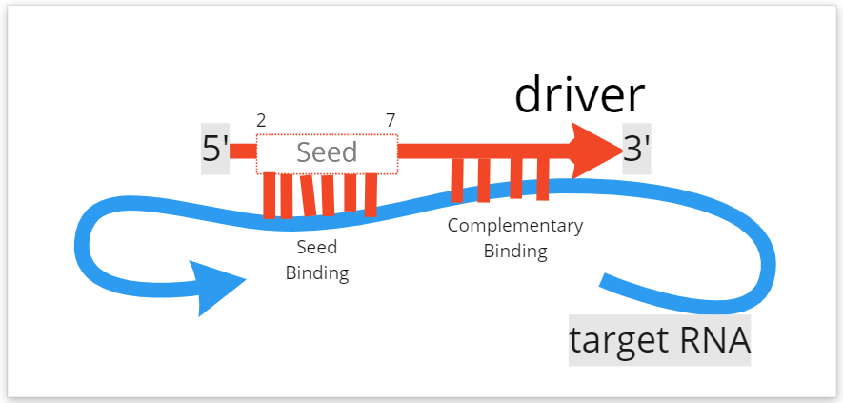
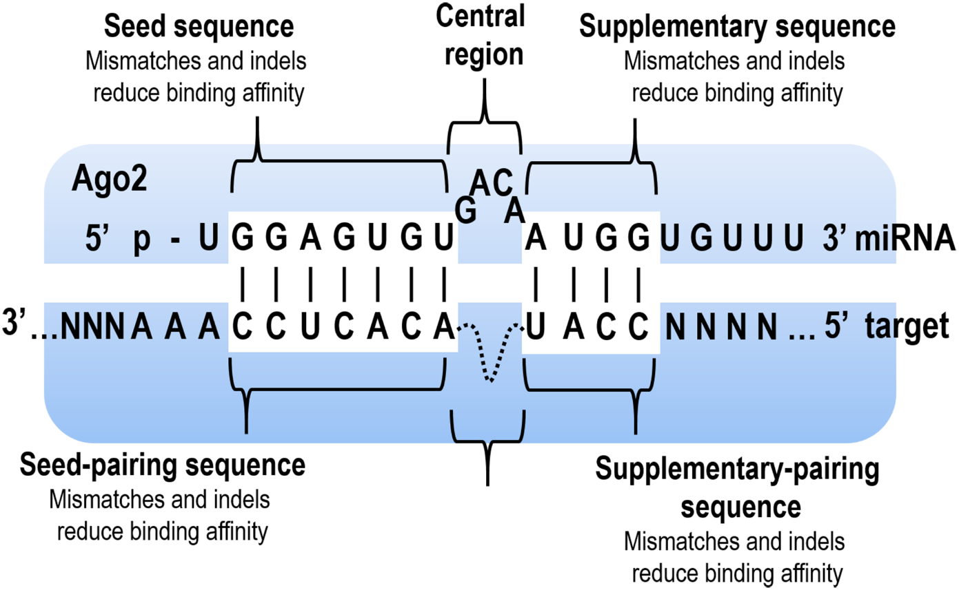
Seed Binding
+
More?

Slide 5
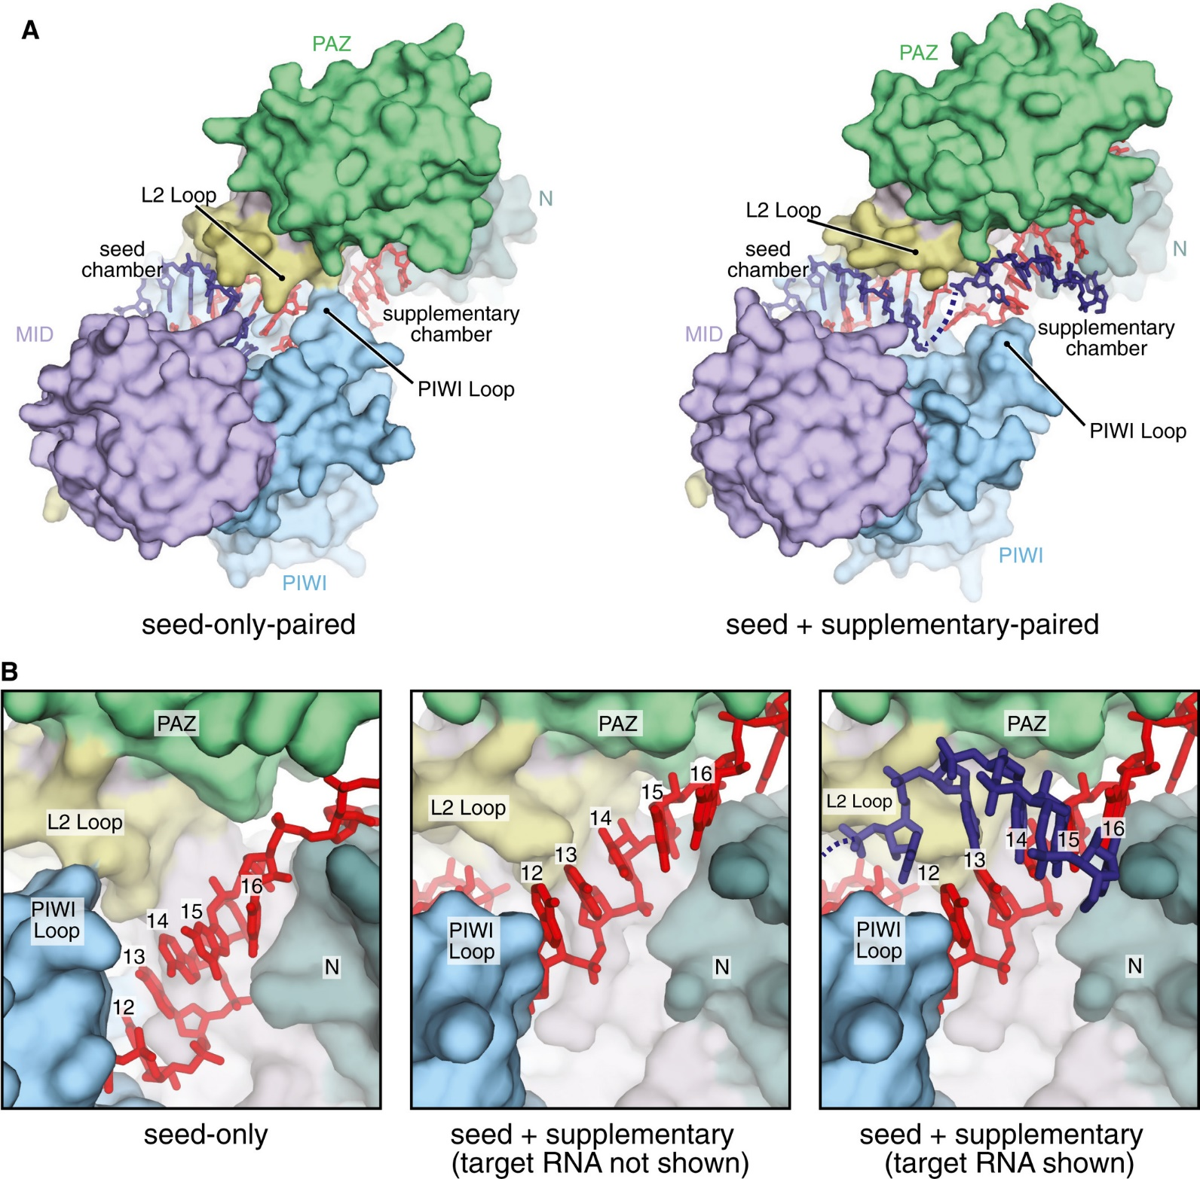
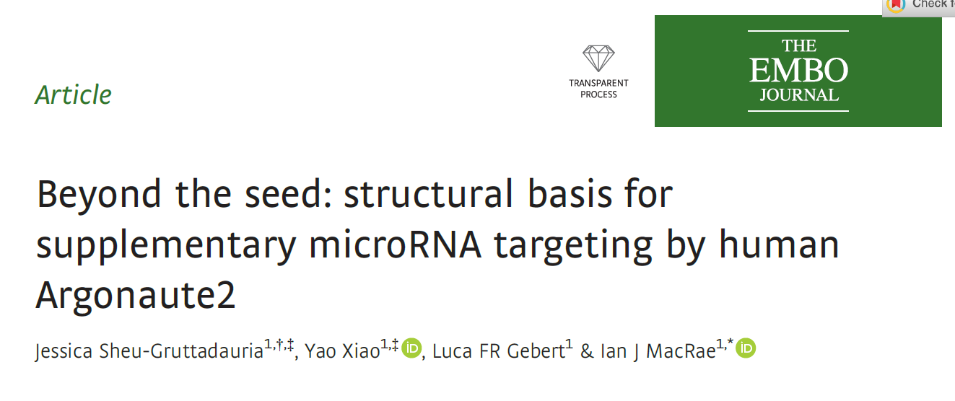
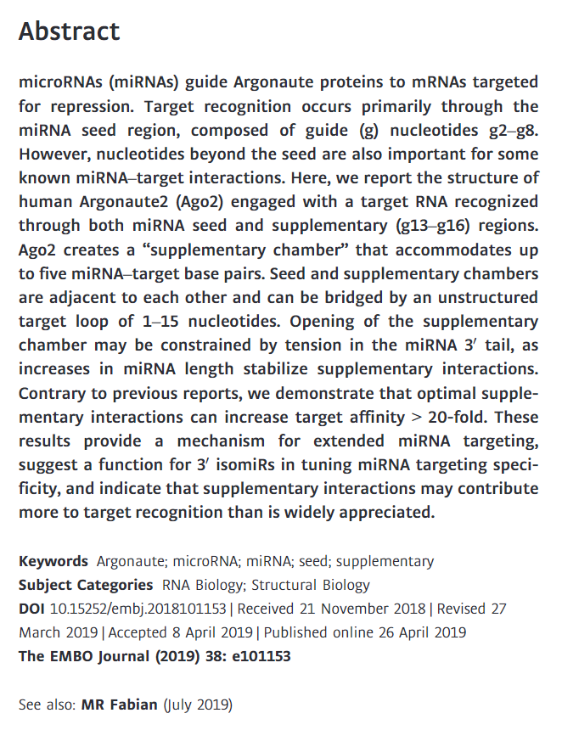

Slide 6
CLIP-Seq lacks the connection
UV crosslinking
Immunoprecipitation
High-throughput sequencing
UV

Slide 7
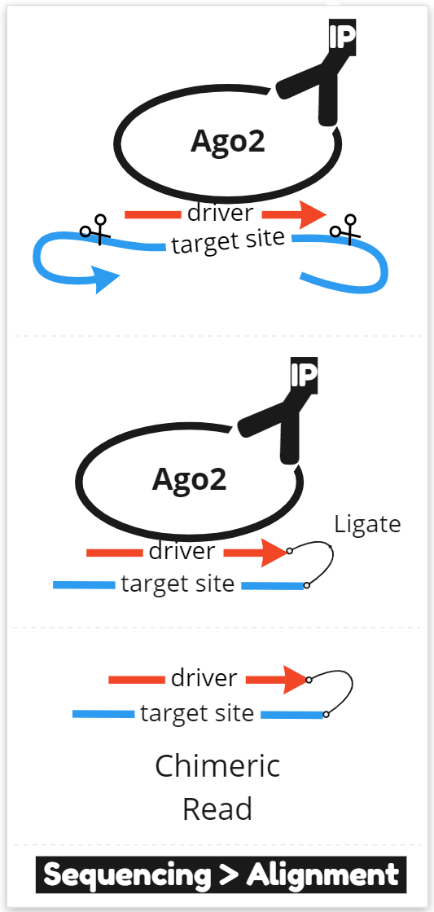
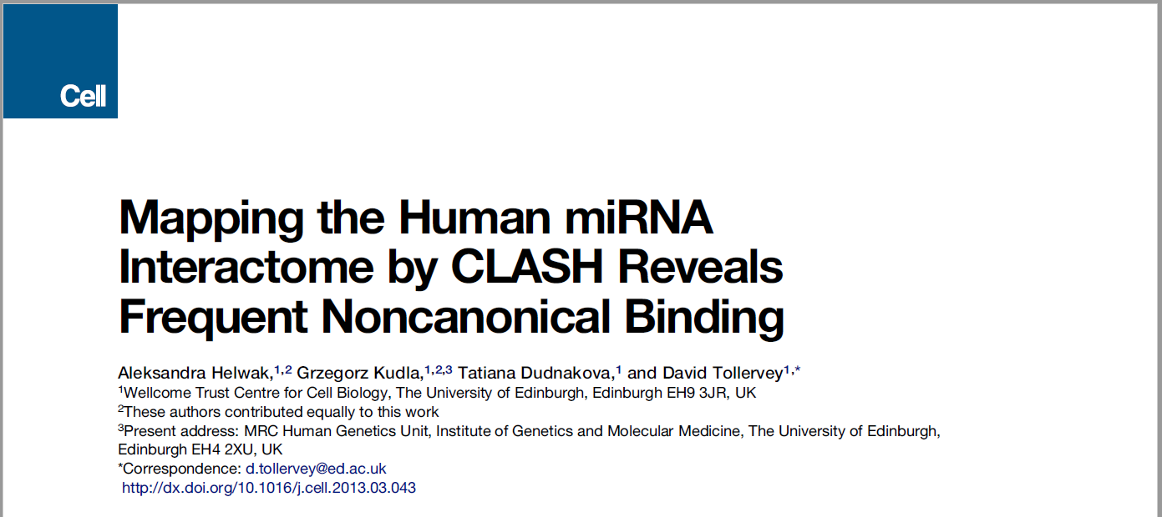
CLASH sequences Chimeric Reads

Slide 8
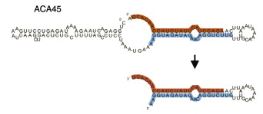
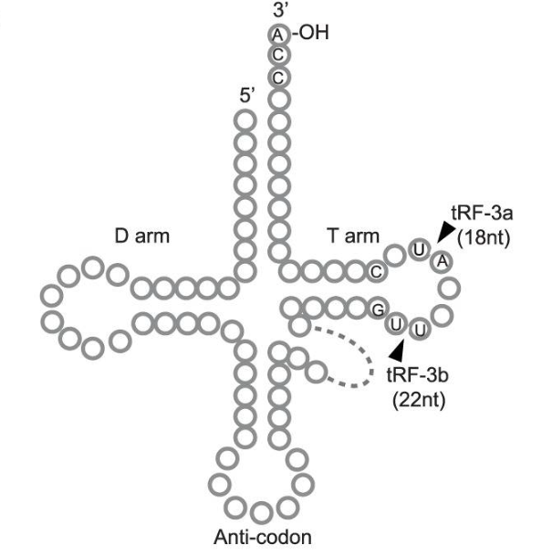
Who are the drivers?
miRNAs
tRNA fragments
snoRNAs
yRNAs ??
rRNAs ??
vRNAs ??

Slide 9
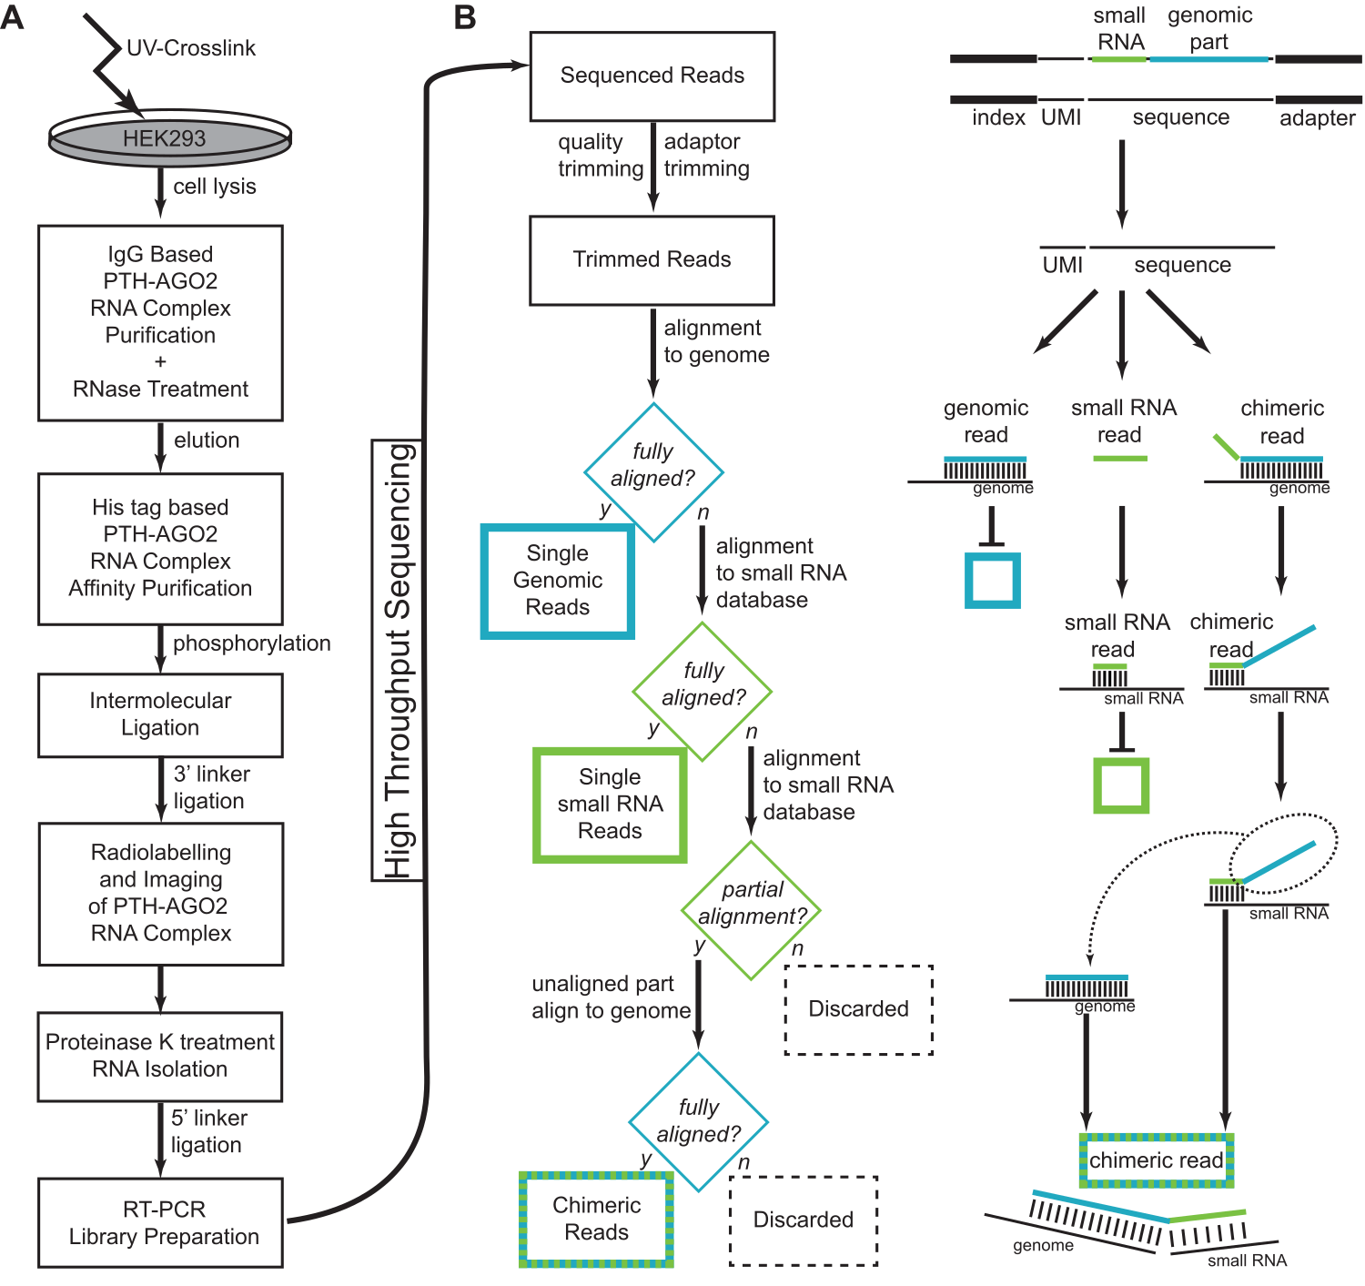
LAB
Performed first ever Ago2-CLASH experiment

Slide 10
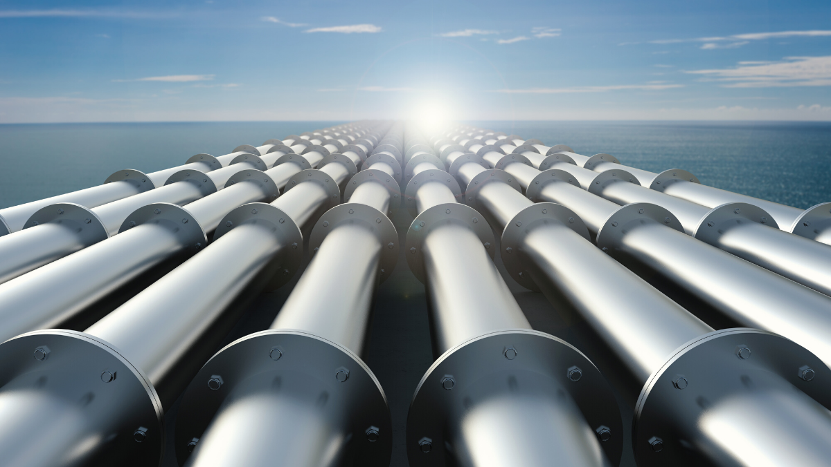
CLASH Analysis Pipeline

Slide 11
Driver, Target,
Chimera, Noise
Sequenced
Reads
Driver
Chimera
Target
Noise

Slide 12
Bioinformatics pipeline
MODULE 1
MODULE 2
What we need:
Bioinformatics approach for accurate chimeric read detection
Stand-alone and platform-independent pipeline
Modular and easy to use
Implemented with some workflow management system - Snakemake
Reproducibility is the top priority, all software tools installed via Conda
MODULE 3
MODULE 4
MODULE 5
MODULE 6

Slide 13
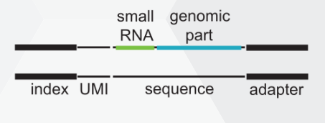
Bioinformatics pipeline
MODULE 1
MODULE 2
MODULES 1 & 2
MODULE 3
Sequenced
Reads
UMI Extraction
Adaptor Trimming
Quality Control
Discard < 16nt
MODULE 4
MODULE 5
MODULE 6

Slide 14
MODULE 3
Genomic Reference
Mask all potential Driver sequences
(miRNAs, tRNAs, snoRNAs etc)
Sequenced
Reads
Fully Aligned to Genome
TARGETS
SEPARATED

Slide 15
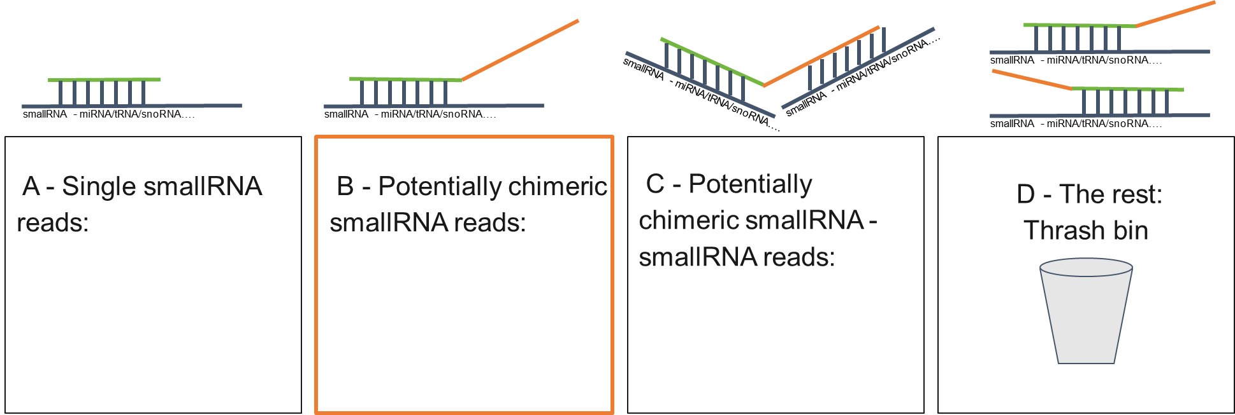
MODULES 4-6
Loose alignment to Small RNA References
Soft-clipped alignment to Genome
Disambiguation
A B

Slide 16
Results
all demultiplexed reads – 812M
all trimmed reads – 730M - 90%
single genomic targets – 194M - 24%
single smallRNA drivers – 119M - 14,7%
potential smallRNA chimeras – 25M - 3,1%
potential genomic targets – 16M - 2,1%
potential chimeric (unique alignment) – 8M - 1%
potential chimeric - deduplicate, filter, cluster
Low confidence:
30’104 - 0,004%
High confidence:
14’205 - 0.002%

Slide 17
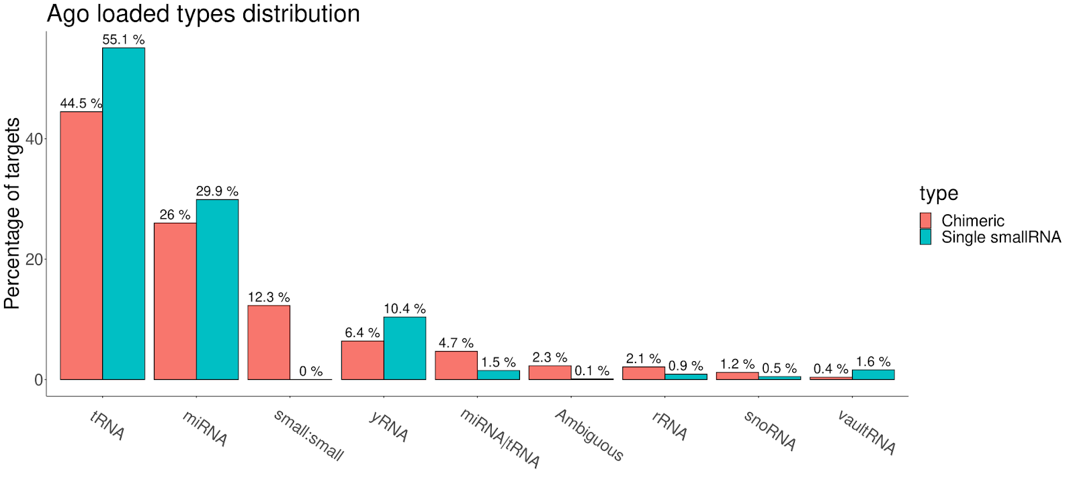
High confidence:
14,205 chimeric interactions
119M single small RNA reads

Slide 18
Can we learn how to predict binding sites?

Slide 19
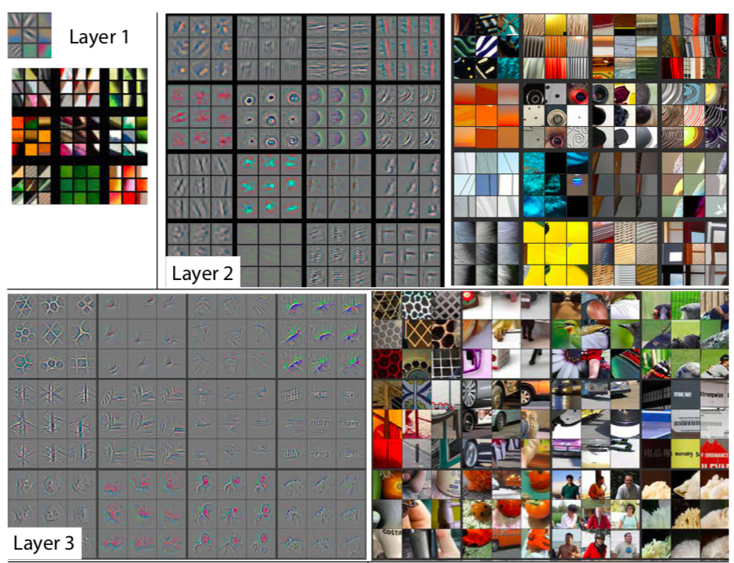
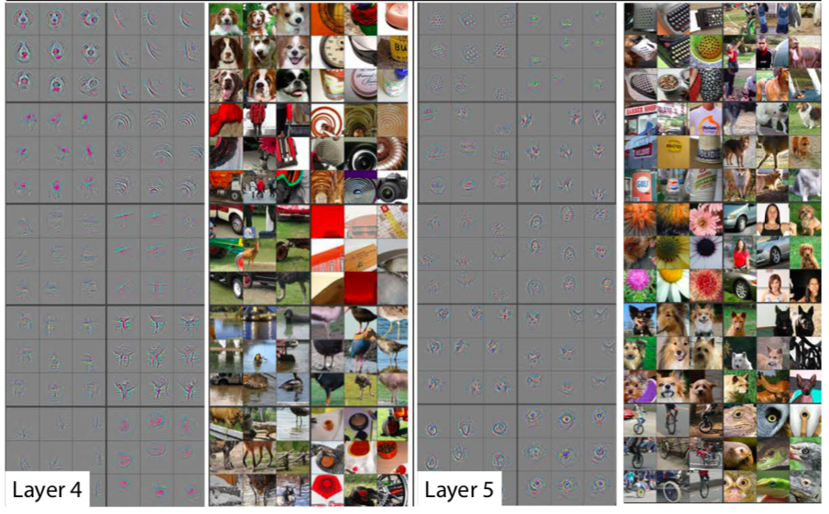
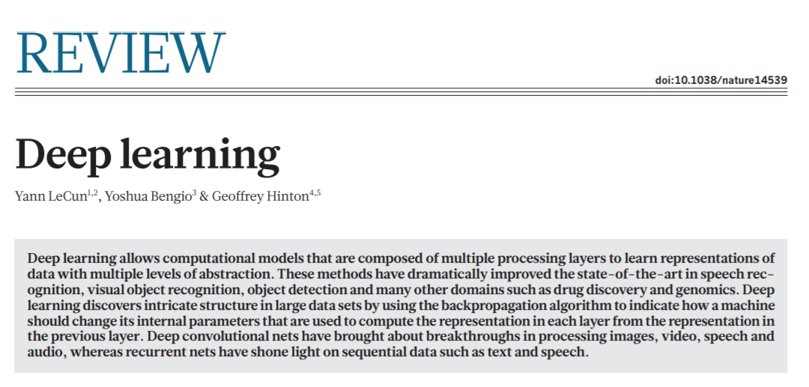
2015 – Deep Learning Revolution

Slide 20
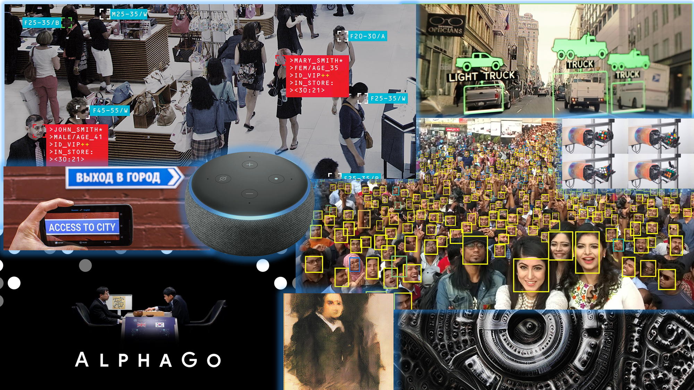
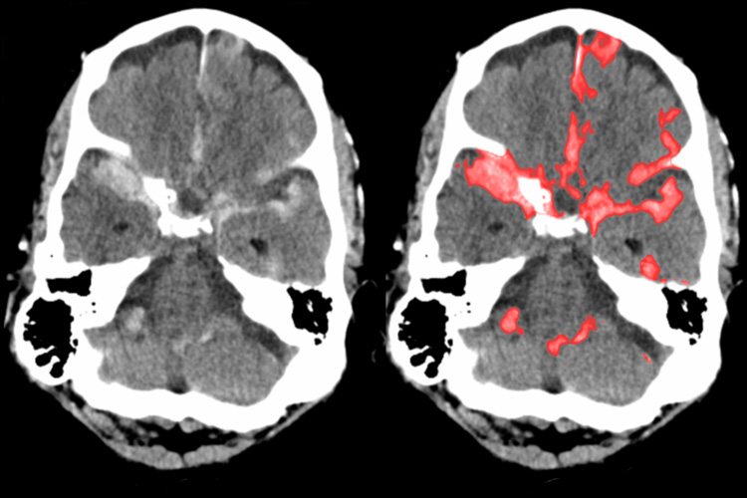
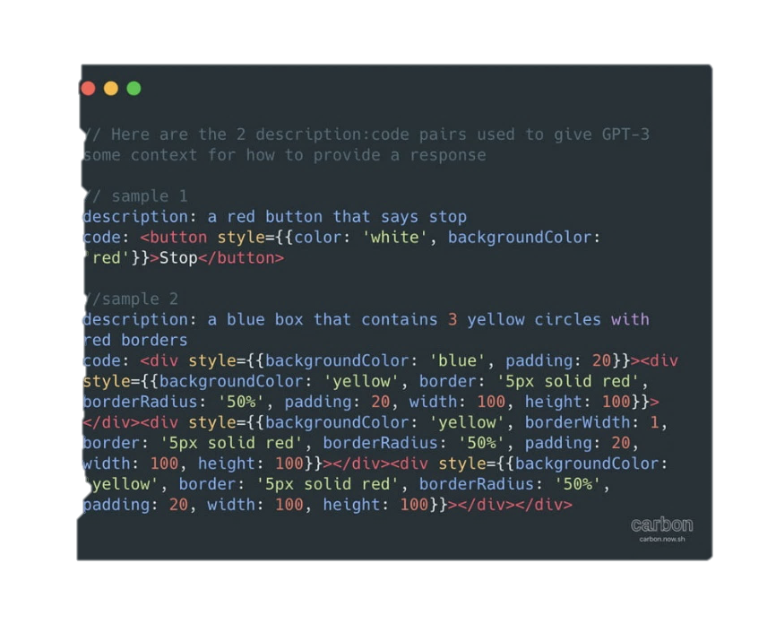
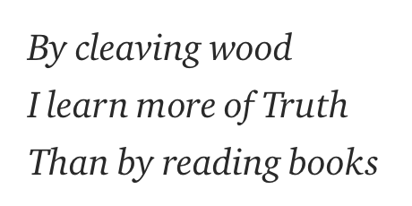

Slide 21
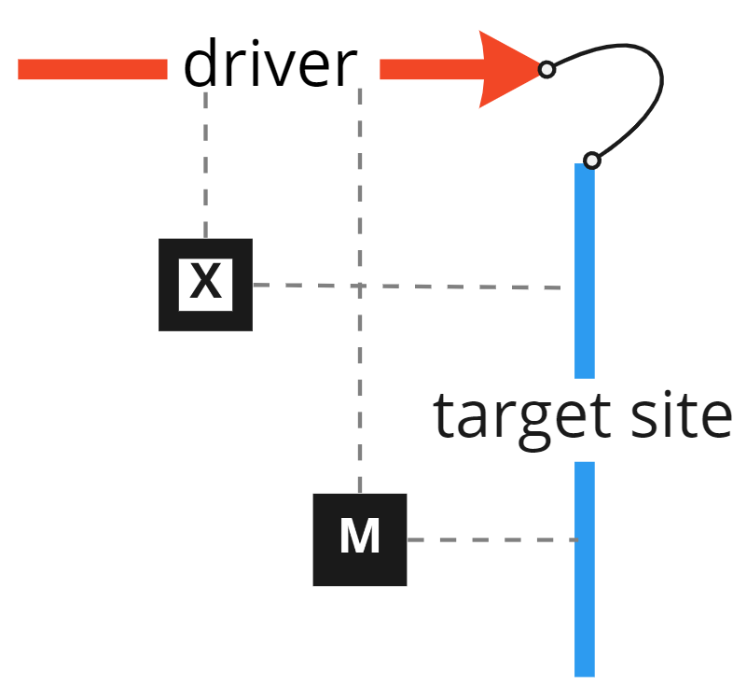
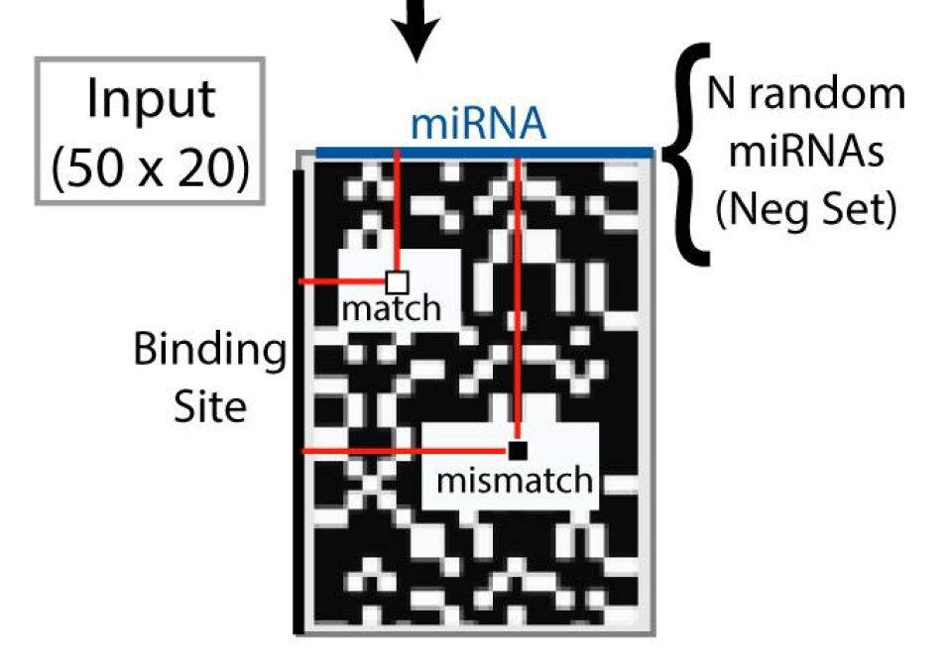
TACGTCAGTTCATGAAGCTA
(driver ~20nt)
AGTTCTAGTTCGTCCGTCAGTGTCAG
TTCATGAGCACCAGTCACGTTCGTCTA
(target ~50nt)

Slide 22
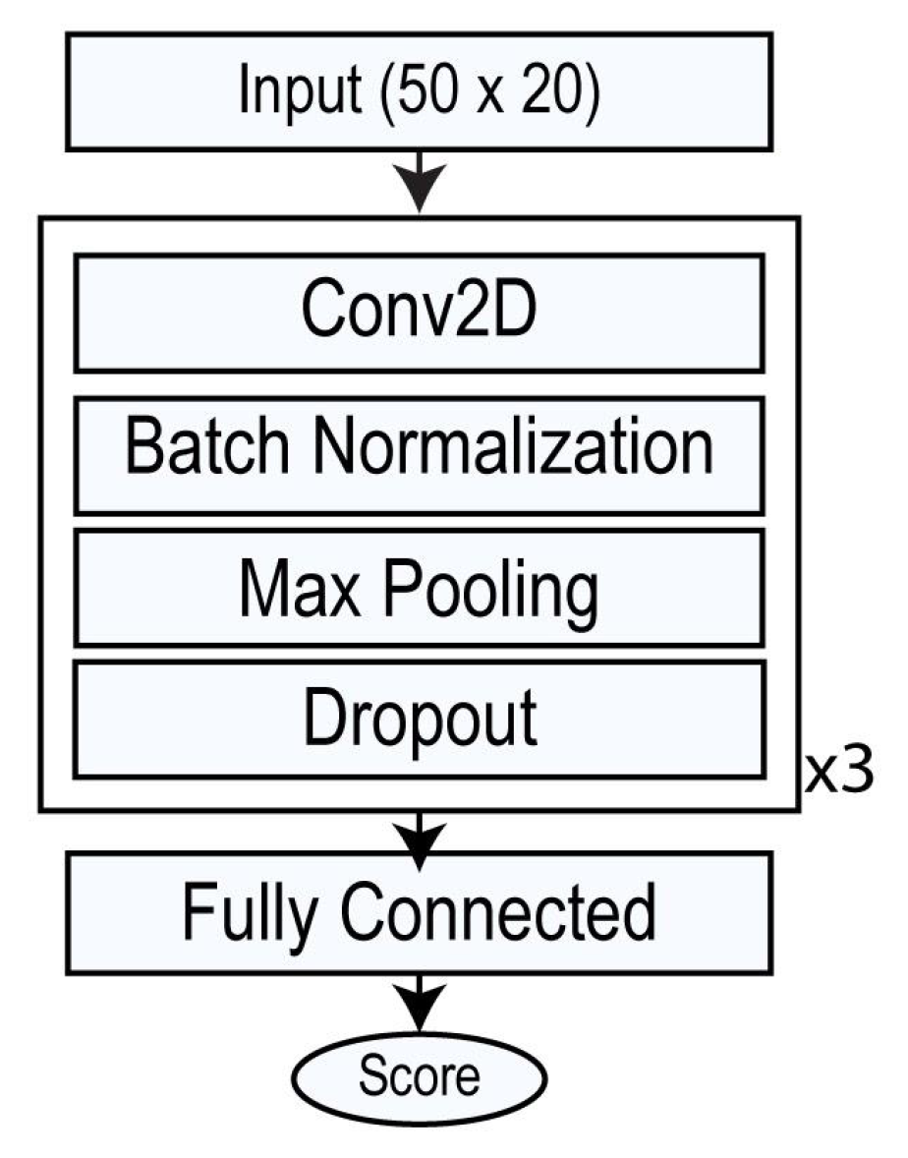
Repeat
6 times
(layer depth)
Hyperparameter Tuning
6 convolutional layers
kernel size 4
pool size 2
dropout rate 0.2
3 dense layers
learning rate 0.01
0
1
1:1 Balanced Dataset

Slide 23
Can we predict binding sites? -- miRNA

Slide 24
Can we predict binding sites? -- tRNA

Slide 25
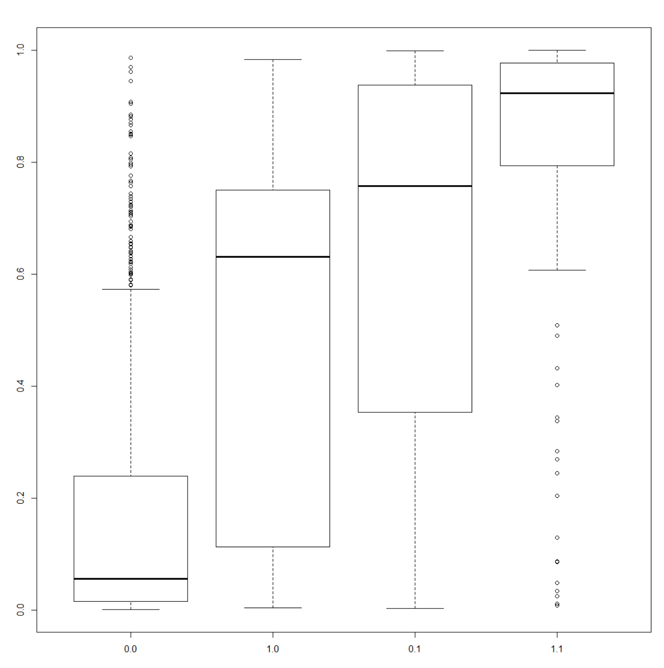
miRNA Ago2 CNN model
Our model has learned SOMETHING beyond seed
Negative Class
Positive Class
No Seed
Seed
No Seed
Seed

Slide 26
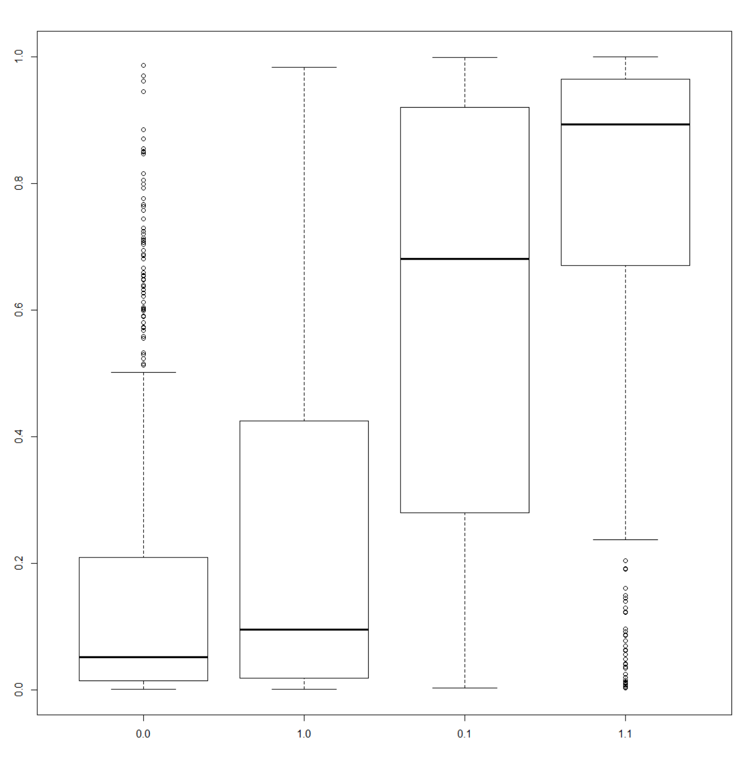
miRNA Ago2 CNN model
Our model has learned SOMETHING beyond seed
NOT Mismatches…
Negative Class
Positive Class
No Seed
Seed
No Seed
Seed
Negative Class
Positive Class
No Seed
Seed
No Seed
Seed

Slide 27
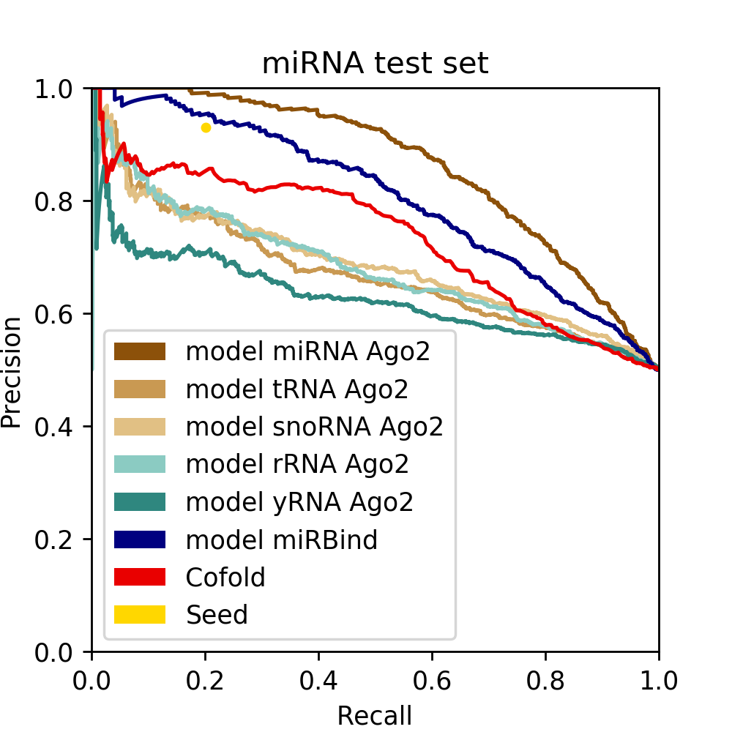
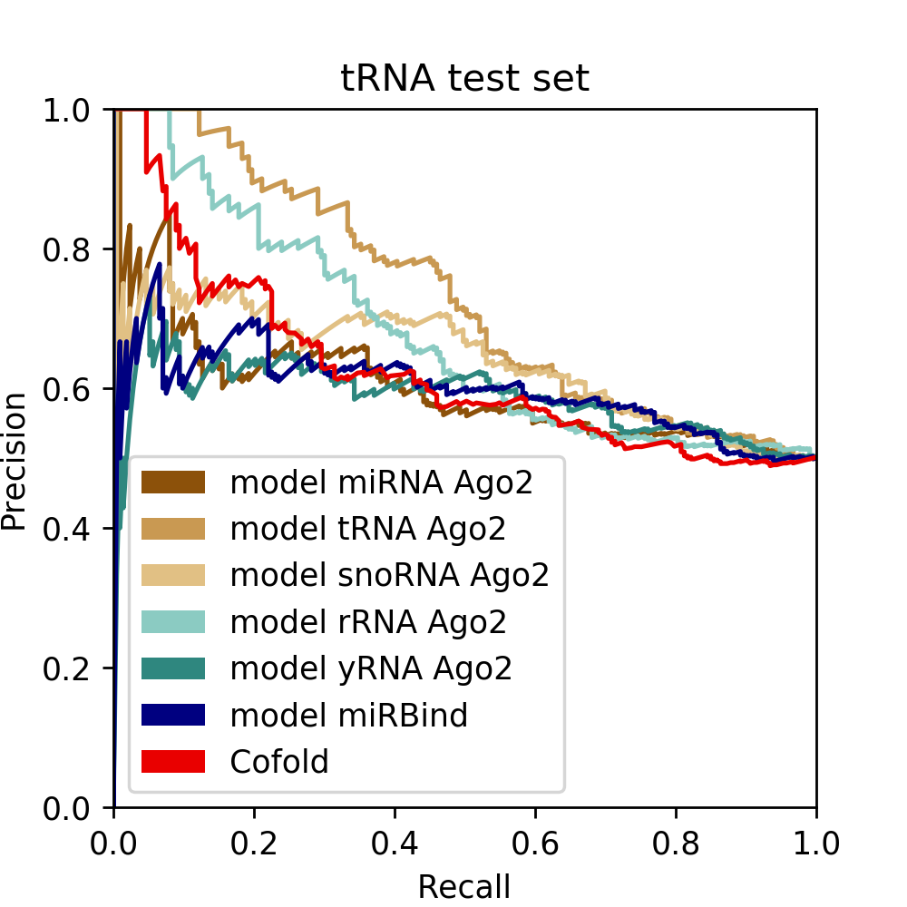
Our model has learned something DIFFERENT for miRNA and tRNA

Slide 28
Our model has learned something DIFFERENT for miRNA and tRNA

Slide 29
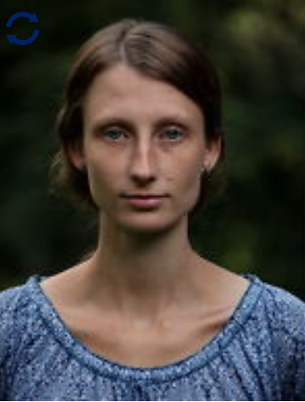
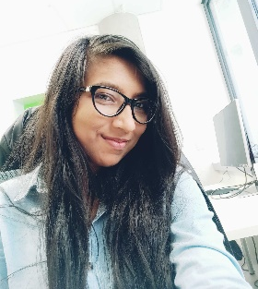
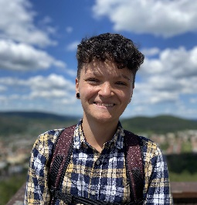
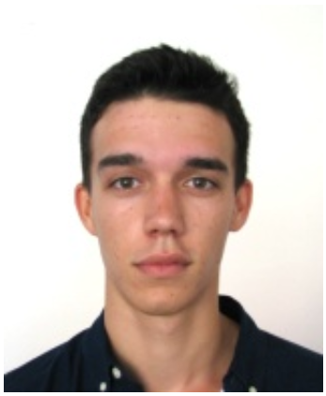
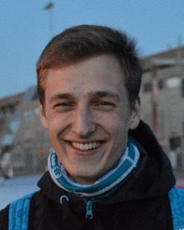
Thanks to Collaborators
Stepanka Vanacova Lab (CEITEC)
Nandan Mysore Varadarajan
Thank you for your Attention
panagiotis.alexiou@ceitec.muni.cz

