Slide 1
5 years of AlphaFoldology:
How to live in the world with model structure for every protein.
Karel Berka

Slide 2
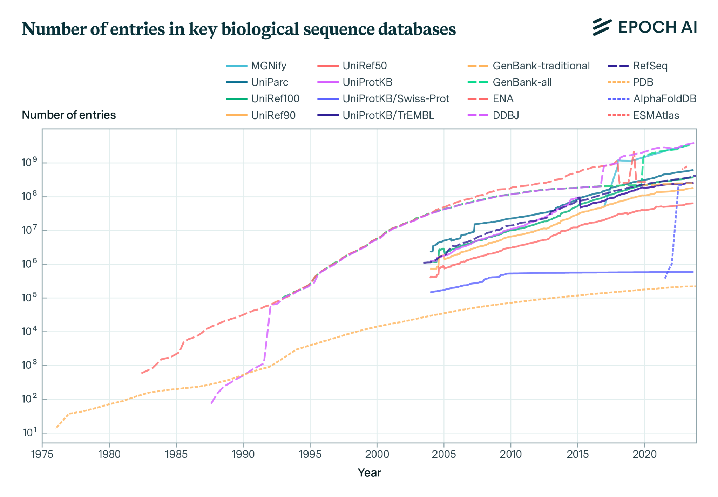
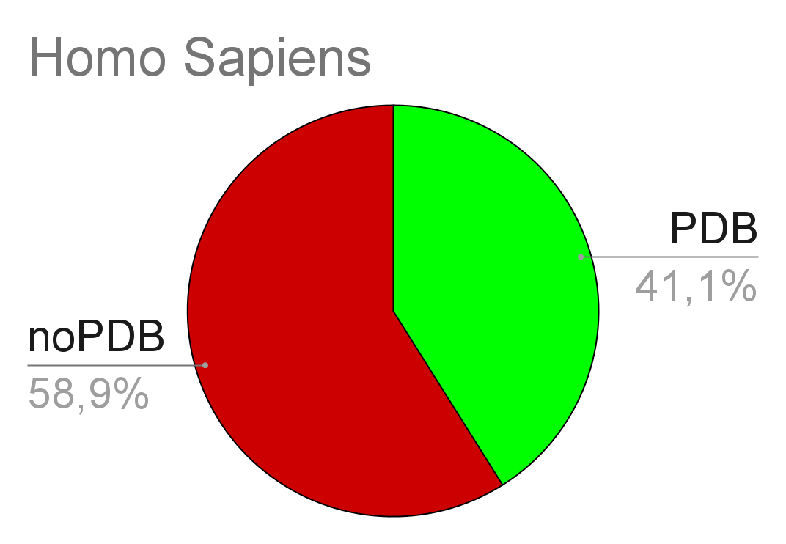
Solving 3D structures is still difficult...
MGNify metagenomics
UniprotKB
protein sequences
9,605
13,786
PDB
protein structures
Berka, Nov 2024
https://epochai.org/blog/biological-sequence-models-in-the-context-of-the-ai-directives
The gap between numbers of experimental structures and sequences is increasing over time
Notes:
Mgnify Uniprot PDB

Slide 3
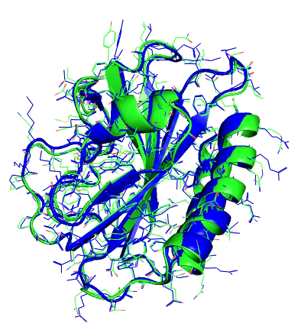
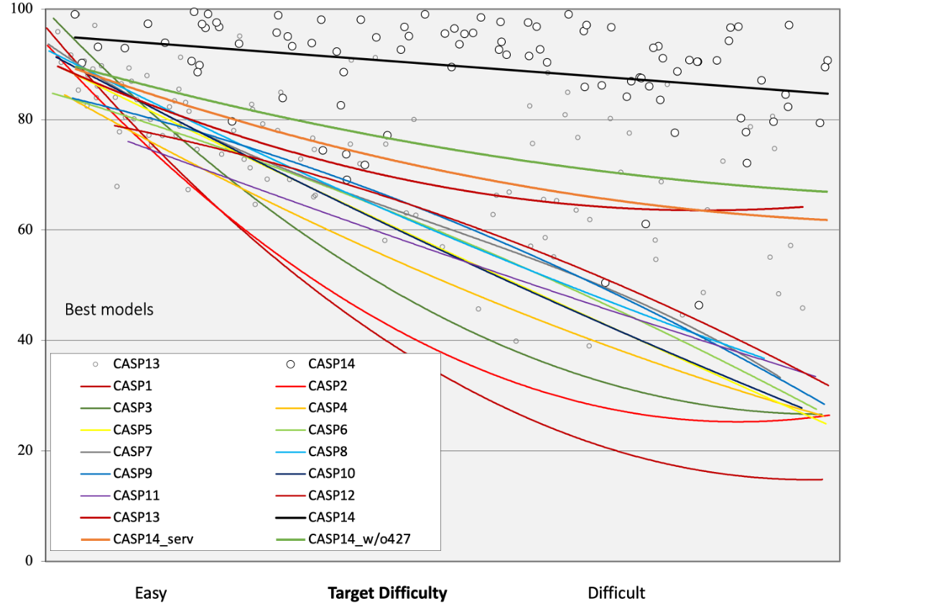
GDT_TS = 96.5
CASP14(2020) - AlphaFold2 wins
GDT_TS = 44.6
https://predictioncenter.org/casp14/doc/presentations/2020_11_30_CASP14_Introduction_Moult.pdf

Slide 4
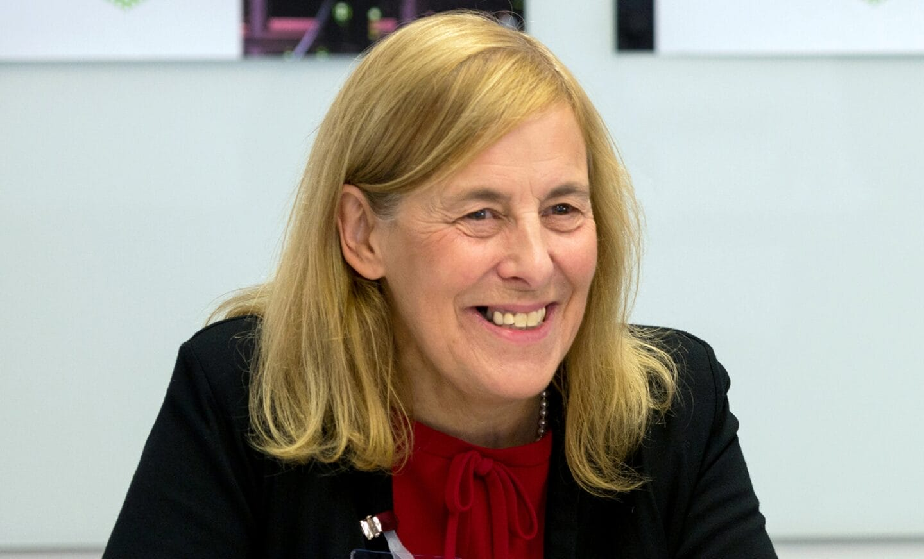
Motto:
AlphaFold(ology)
Alphafold 2 in 2020 has brought reliable protein models – BUT in July 2021 went open source
What comes next?
AlphaFoldology
“Disruptive scientific breakthroughs raise more questions than they answer. They open new research avenues and can inspire entirely new fields of study. Just as the Human Genome moment marked the beginning of a revolution in genomics, so too AlphaFold might usher in a new era in biology.”
Janet Thornton, director emeritus EMBL-EBI - 22 July 2021, Cambridge
Notes:
KB - under the hood, basic uses

Slide 5
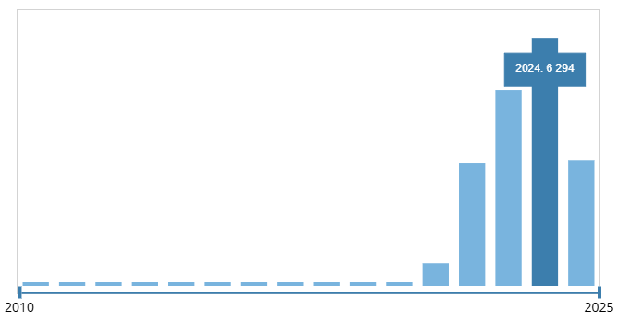
Alphafoldology
Alphafold led to enormous innovations in protein design
2018 2019
2020
2021
2022
2023
2024
2025
CASP13
Alphafold1
CASP14
AlphaFold 2 RoseTTAFold
AF2 code
AFDB
…
AFMultimer
AFConformer
ColabFold
AlphaFill
ProteinMPNN
…
AlphaMissense
ESMFold+Atlas
RoseTTAFoldNA
…
(all major DBs)
RoseTTAFoldAA
AlphaFold 3
Chai-1
Boltz-1
…
ChannelsDB 2.0
BioEmu
Boltz-1x
Boltz-2
…
Notes:
2018 - CASP13 2020 - AlphaFold 1 paper
2020 - CASP14
2021 - Alphafold 2 2021 - Human proteome
2021 - AlphaFoldDB
2022 - ColabFold
2022 - AlphaFold Multimer
2022 - ProteinMPNN
2022 - AlphaFill
2022 - AlphaFold conformers
2023 - AlphaMissense
2023 - ESMfold + ESMAtlas
2023 - RoseTTAFoldNA
2024 - cryoEM building
2024 - RoseTTAFoldAA
2024 - AlphaFold 3
2024 - Chai-1

Slide 6
WHERE?
Where to run?

Slide 7
"This will be one of the most important datasets since the mapping of the Human Genome."
Professor Ewan Birney
EMBL Deputy Director General and EMBL-EBI Director
https://www.alphafold.ebi.ac.uk/

Slide 8
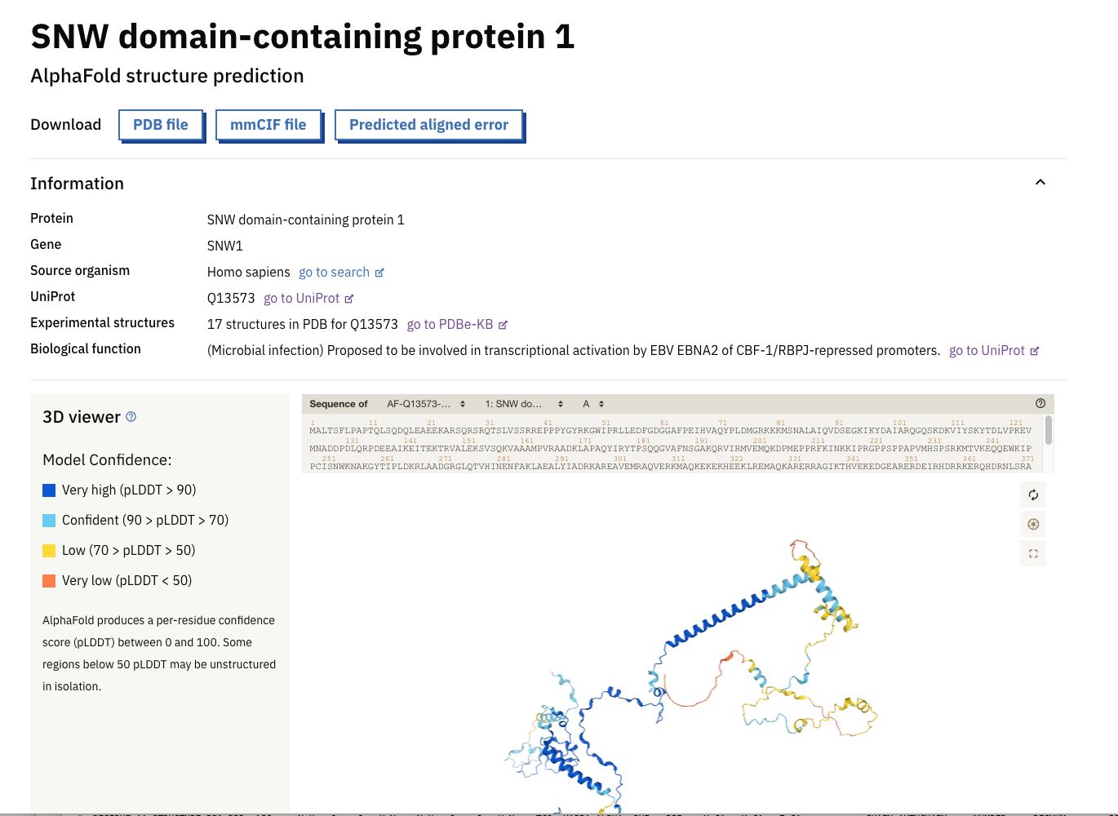
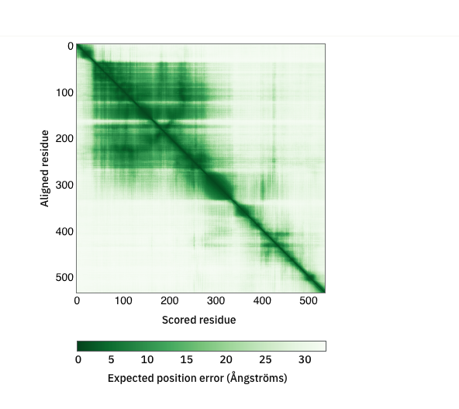
Quality metrics
pLLDT – model confidence in that AA
PAE – predicted confidence of contact

Slide 9
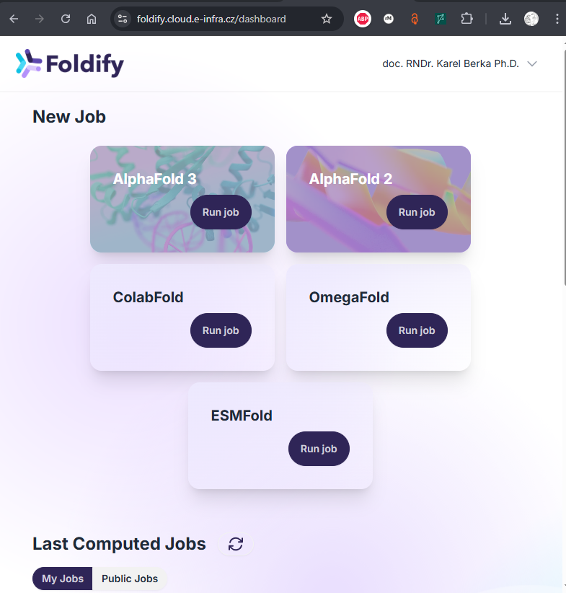
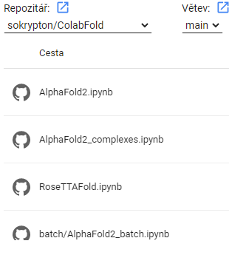
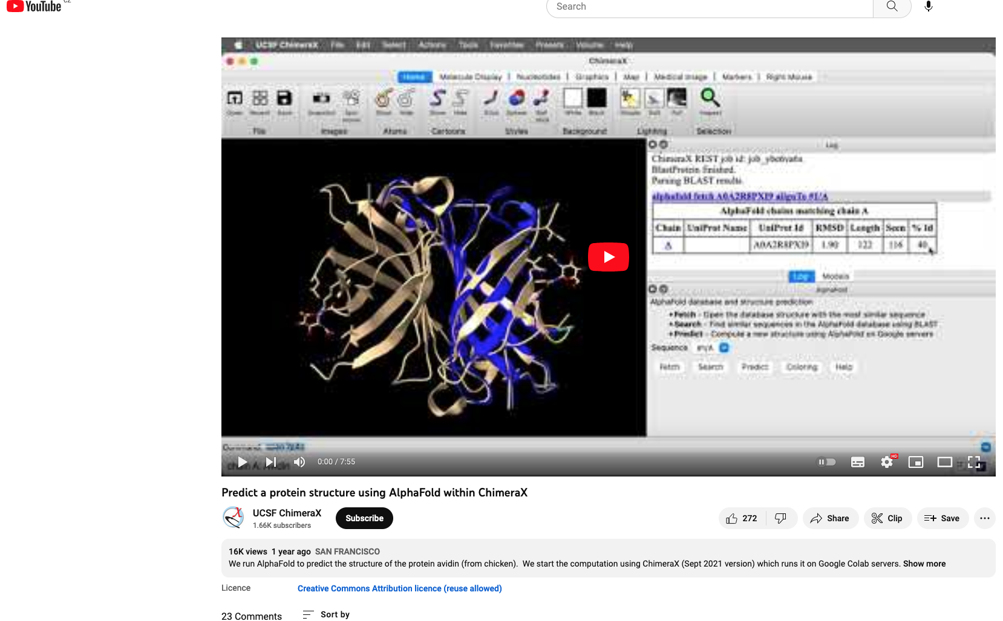
Where to run AF?
https://foldify.cloud.e-infra.cz
ColabFold in GoogleColab
ELIXIR CZ/MetaCentrum/Galaxy
Mirdita, M. et al. ColabFold: making protein folding accessible to all. Nat Methods 19, 679–682 (2022).
https://colab.research.google.com/github/sokrypton/ColabFold/
ChimeraX
Fetch
Search AFDB
Predict – Boltz

Slide 10
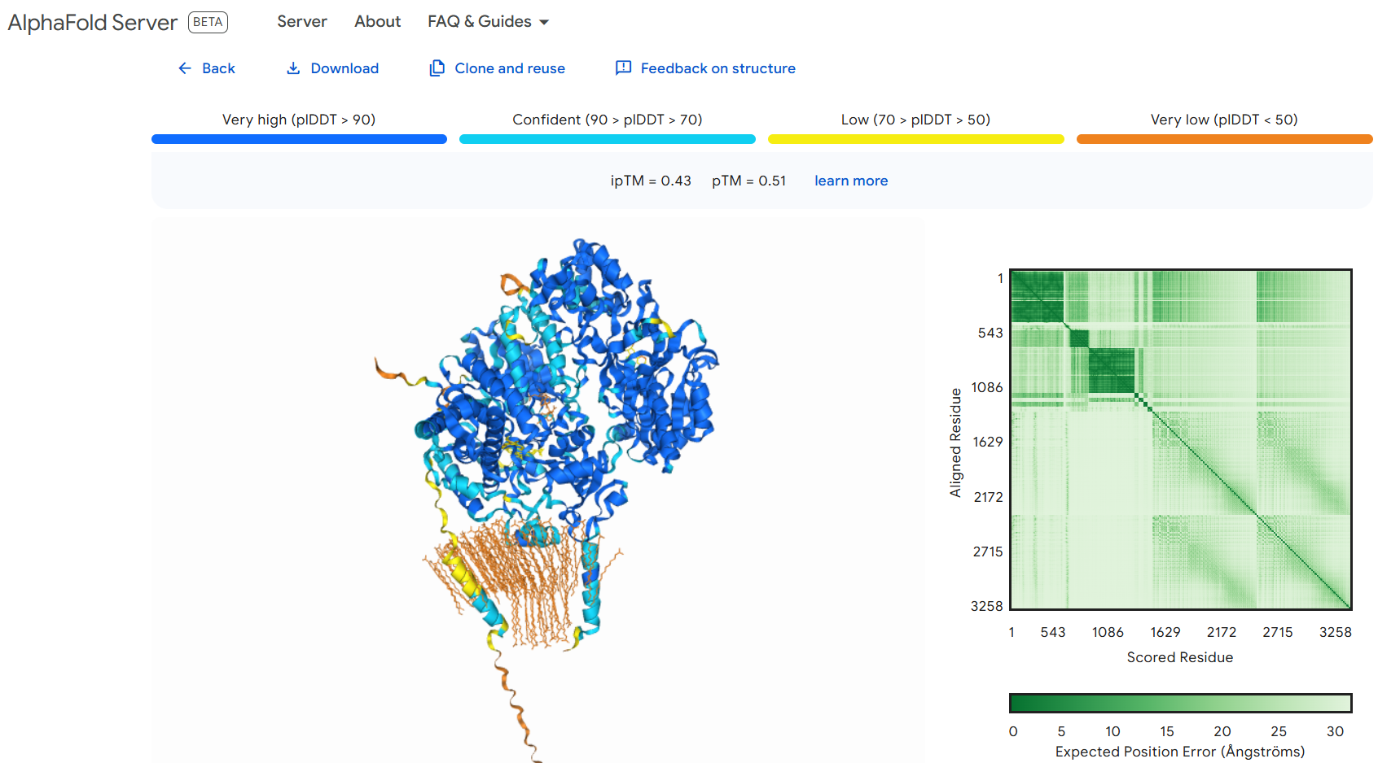
AlphaFold 3 - alphafoldserver.com
AF3 enables modelling of proteins, ligands (list of), nucleic acids, ions
20 jobs per day
CYP3A4+CYPOR+ +cofactors+FFAs
Abramson, J., Adler, J., Dunger, J. et al. Accurate structure prediction of biomolecular interactions with AlphaFold 3. Nature 630, 493–500 (2024). https://doi.org/10.1038/s41586-024-07487-w

Slide 11
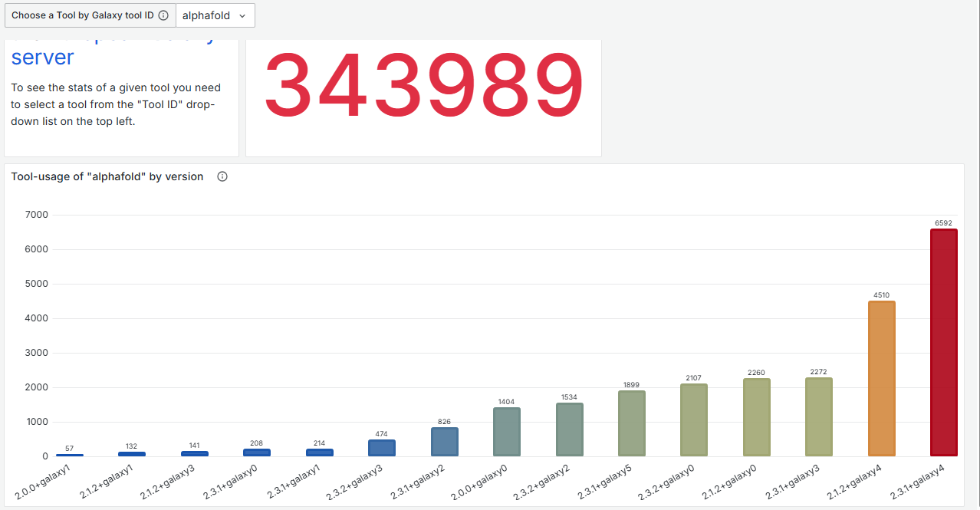
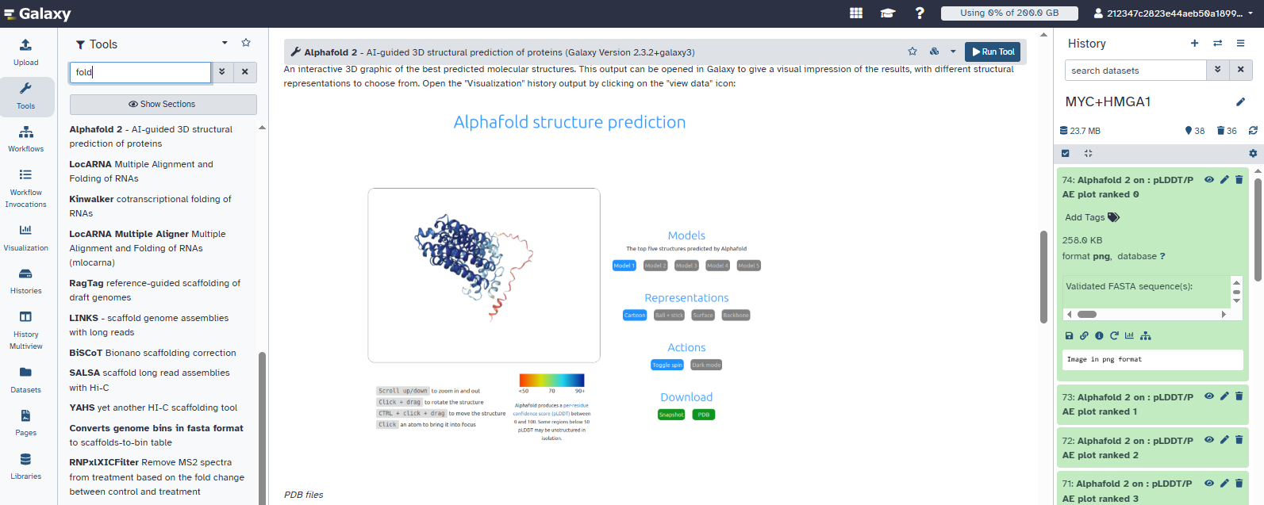
Galaxy implementation

Slide 12
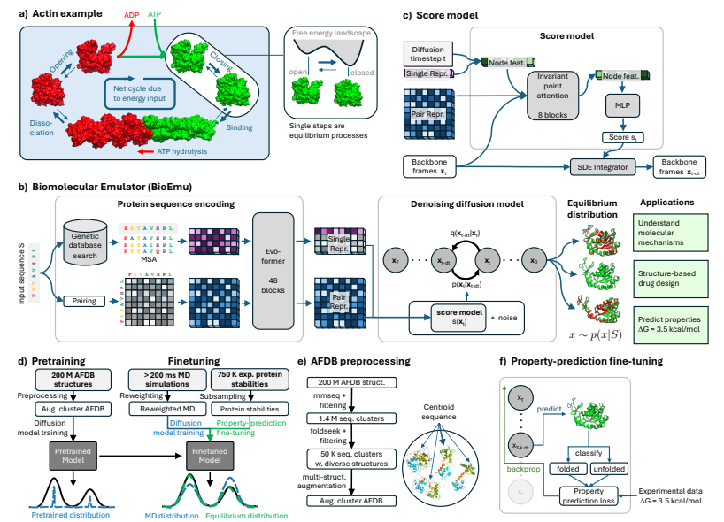
BioEmu-2 – conformational ensembles
Emulate molecular dynamics structural ensembles
PIN8_ARATH
Lewis S, et al: Scalable emulation of protein equilibrium ensembles with generative deep learning. bioRxiv 2024.12.05.626885
https://colab.research.google.com/github/sokrypton/ColabFold/blob/main/BioEmu.ipynb

Slide 13
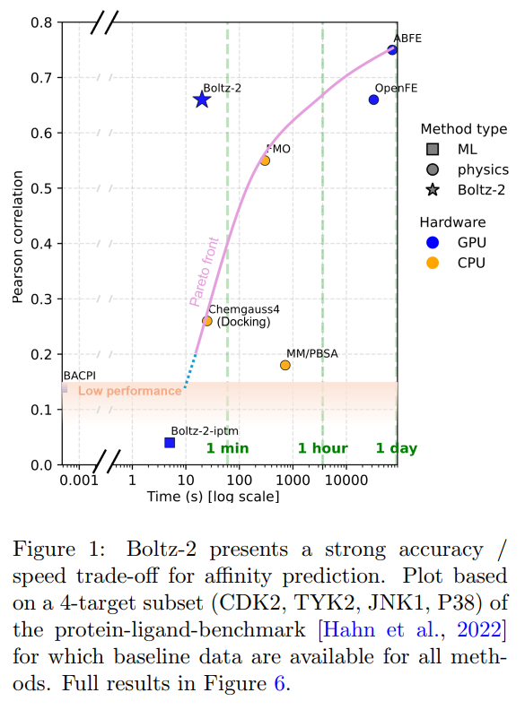
June 2025 - Boltz-2
added prediction
ligands poses
affinity
MD ensemble - better local dynamics
de novo generation
https://github.com/jwohlwend/boltz

Slide 14
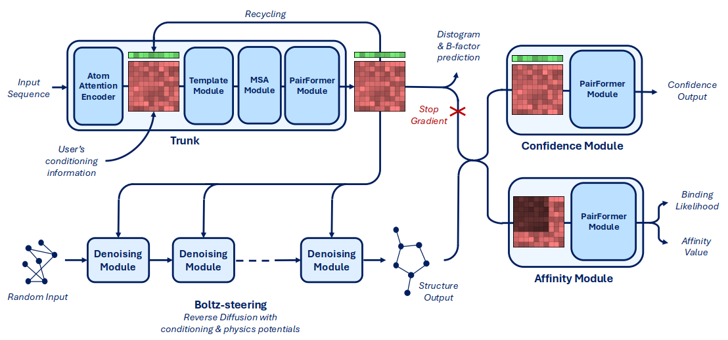
Boltz-2

Slide 15
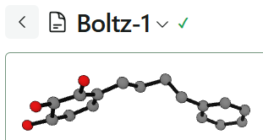
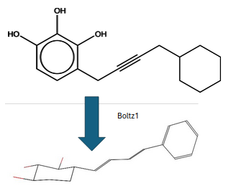
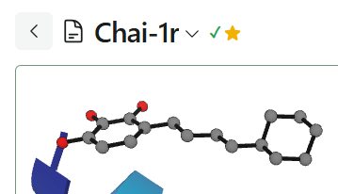
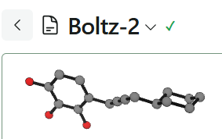
Wim’s ligand halucinations
https://github.com/dehaenw/LiH/tree/main

Slide 16
Alphafoldology Hacks

Slide 17
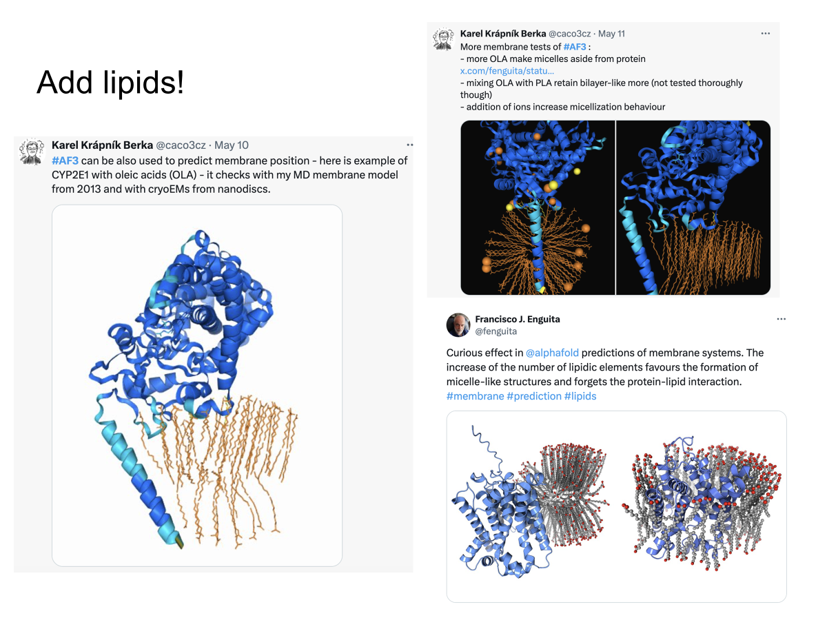

Slide 18
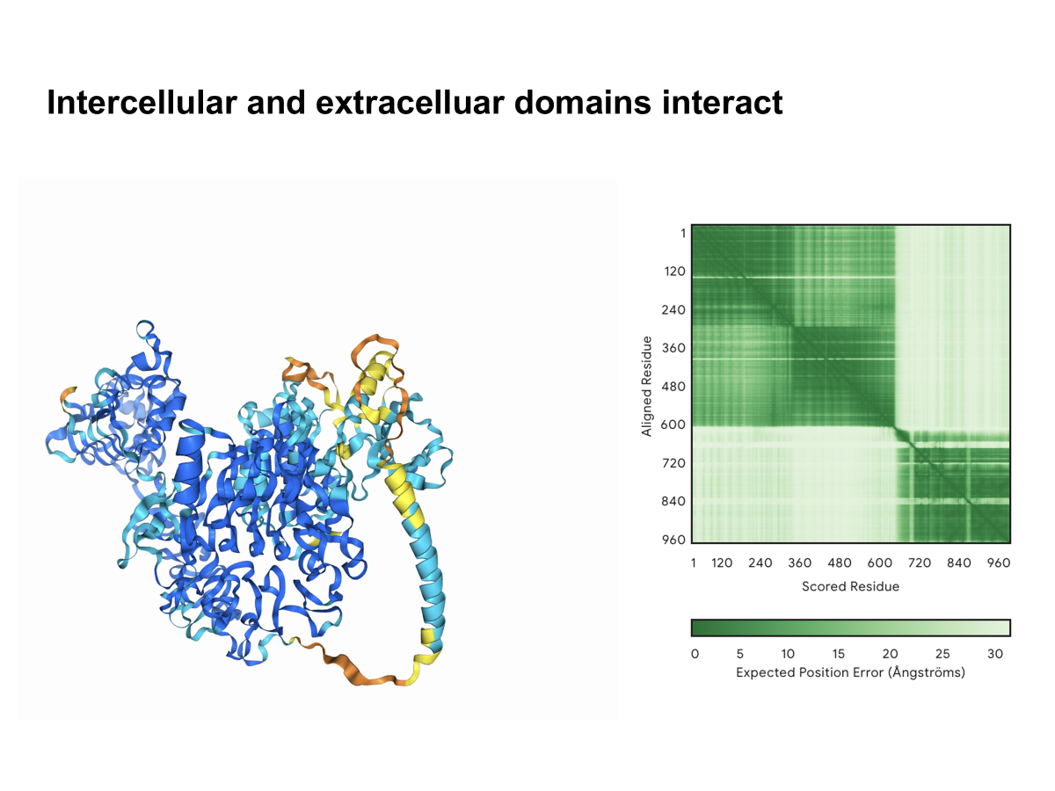
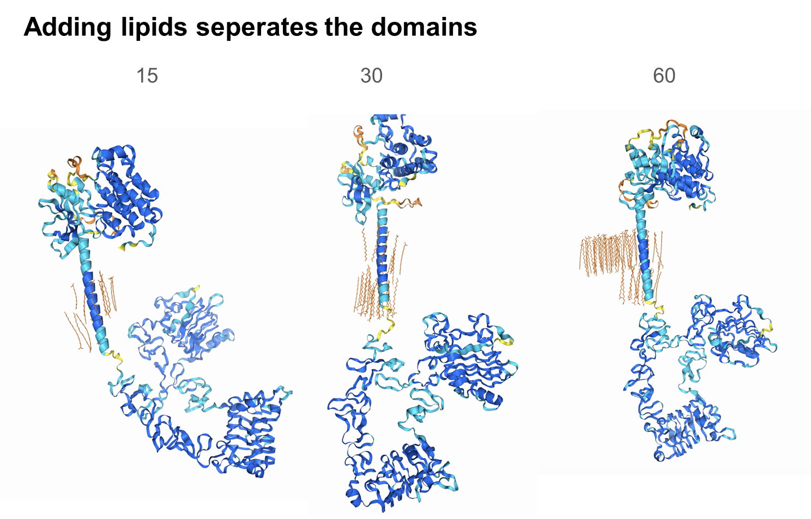
AF3 + lipids
Sergey Ovchinnikov - Boston Protein Design and Modeling Club - https://www.youtube.com/watch?v=qjFgthkKxcA

Slide 19
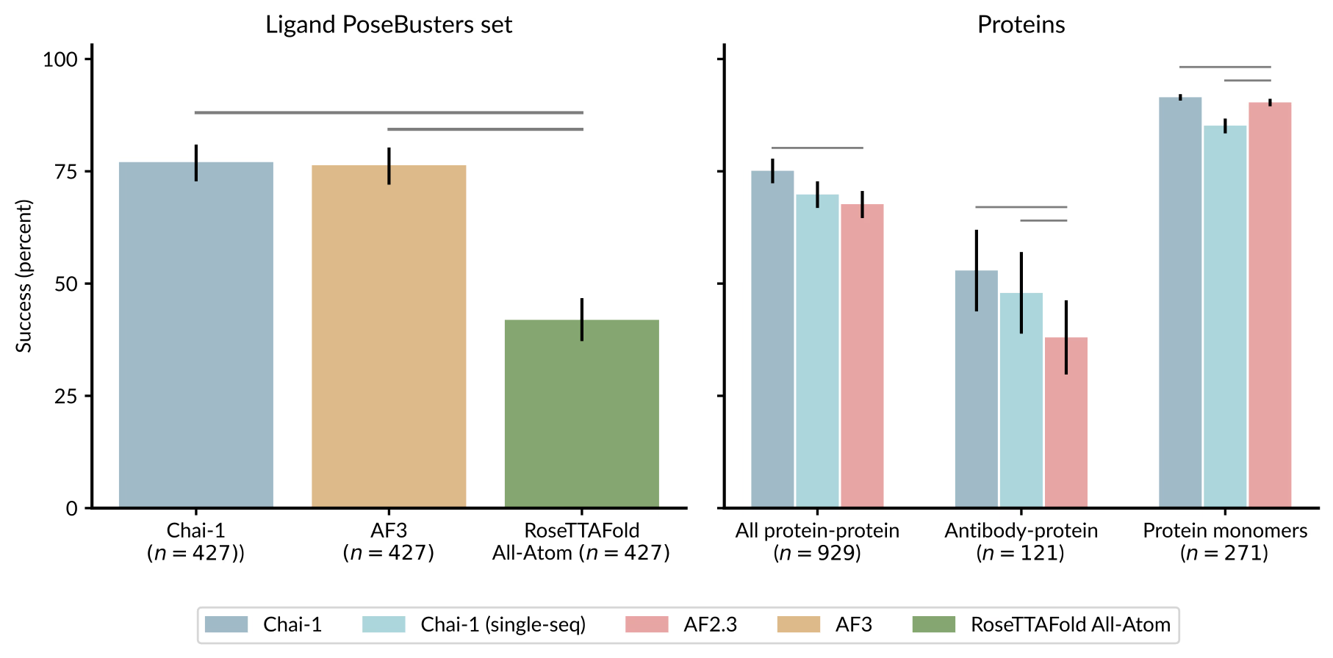
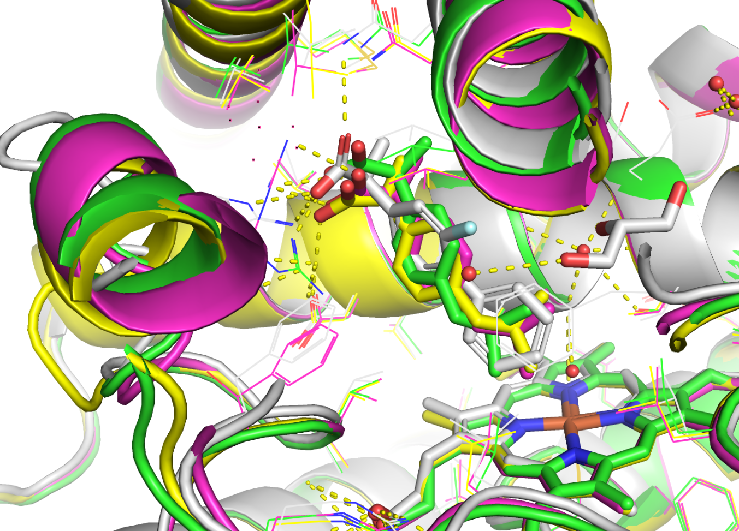
Chai-1 – cofolding “docking”
ibuprofen to CYP2C9 - copy flurbiprofen pose
Works the best if similar to the known structure
Chai Discovery, Jacques Boitreaud, Jack Dent, Matthew McPartlon, Joshua Meier, Vinicius Reis, Alex Rogozhnikov, Kevin Wu: Chai-1: Decoding the molecular interactions of life, bioRxiv 2024.10.10.615955; https://doi.org/10.1101/2024.10.10.615955

Slide 20
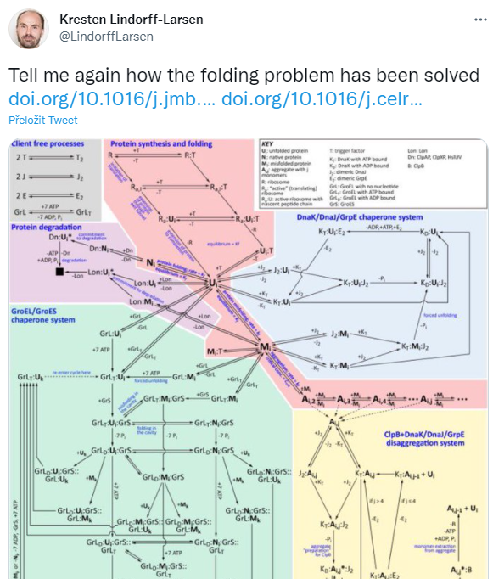
Summary
Alphafold2 made a huge leap in prediction accuracy enabling to use protein structural models due to quality predictor
Role of open science and publicly available data in PDB can not be overstated
CASP competition was a driver of the change
Alphafold is publicly available and can be run from many places including ELIXIR CZ
Alphafold has inspired many “Alphafoldology” tools and uses already and this space flourish with innovation
Openness helps to quick innovation cycle

Slide 21
Thank you for your attention
Questions, please?

Slide 22
BioLists
github.com/biolists
📖 Table of contents
Predictors
Tools and Extensions
Databases and Datasets
Webservers
Discontinued
abeebyekeen.com/biomodes-biomolecular-structure-prediction/
BioMoDes: A Repository of Tools for Biomolecular Modeling and Design
1. Biomolecular Structure Prediction Tools
2. Biomolecular Design Tools
3. Biomolecular Property Prediction and Analysis Tools
4. Protein Search, Alignment, & DB Management Tools
5. Small-molecule Design and Prediction Tools

Slide 23
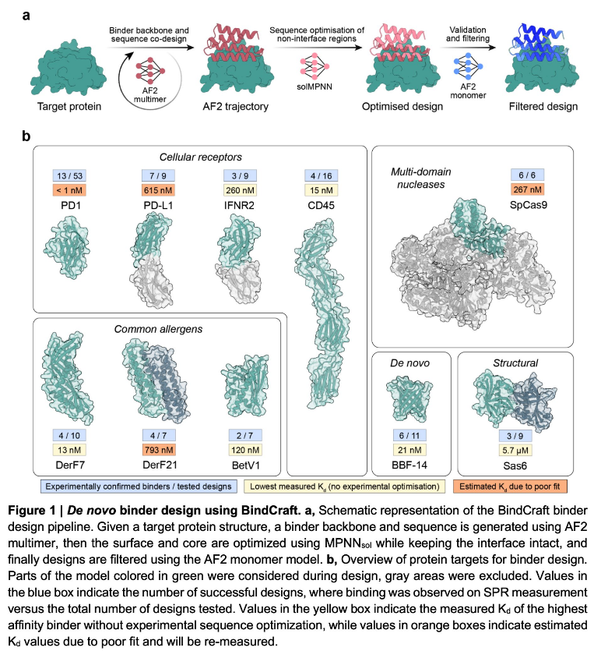
BindCraft
Protein–protein interactions (PPIs)
open-source and automated pipeline for de novo protein binder design with experimental success rates of 10-100%.
github.com/martinpacesa/BindCraft
Martin Pacesa, et al. BindCraft: one-shot design of functional protein binders. bioRxiv 2024.09.30.615802; doi:10.1101/2024.09.30.615802

Slide 24
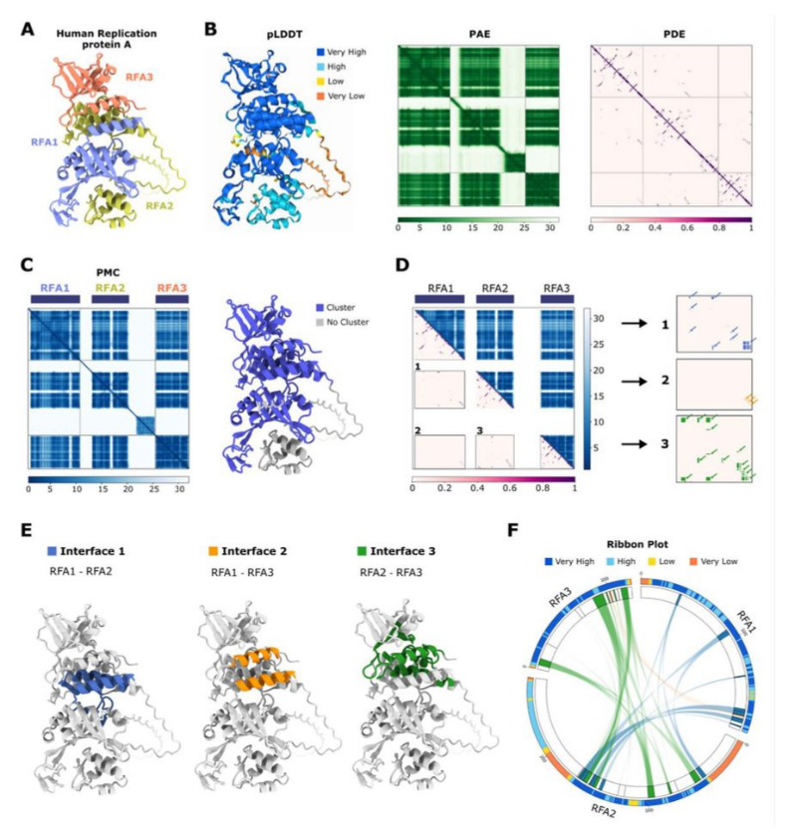
AlphaBridge: analysis of predicted macromolecular complexes
interactive platform where users can upload AlphaFold3 prediction files,
visualize the predicted 3D structures, and analyze contact interfaces through an integrated web viewer.
https://alpha-bridge.eu/
github.com/PDB-REDO/AlphaBridge
Álvarez-Salmoral D, et al. AlphaBridge: tools for the analysis of predicted macromolecular complexes. bioRxiv 2024.10.23.619601; doi: 10.1101/2024.10.23.619601

Slide 25
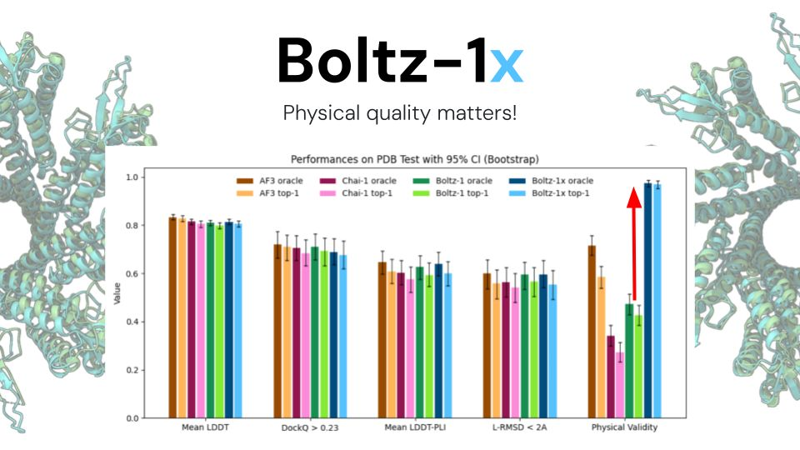
Boltz-1x
MIT licence
Fully open model
Updated 1st May 2025
https://github.com/jwohlwend/boltz
https://colab.research.google.com/github/sokrypton/ColabFold/blob/main/Boltz1.ipynb
Wohlwend J, et al. : Boltz-1 Democratizing Biomolecular Interaction Modeling. bioRxiv 2024.11.19.624167

Slide 26
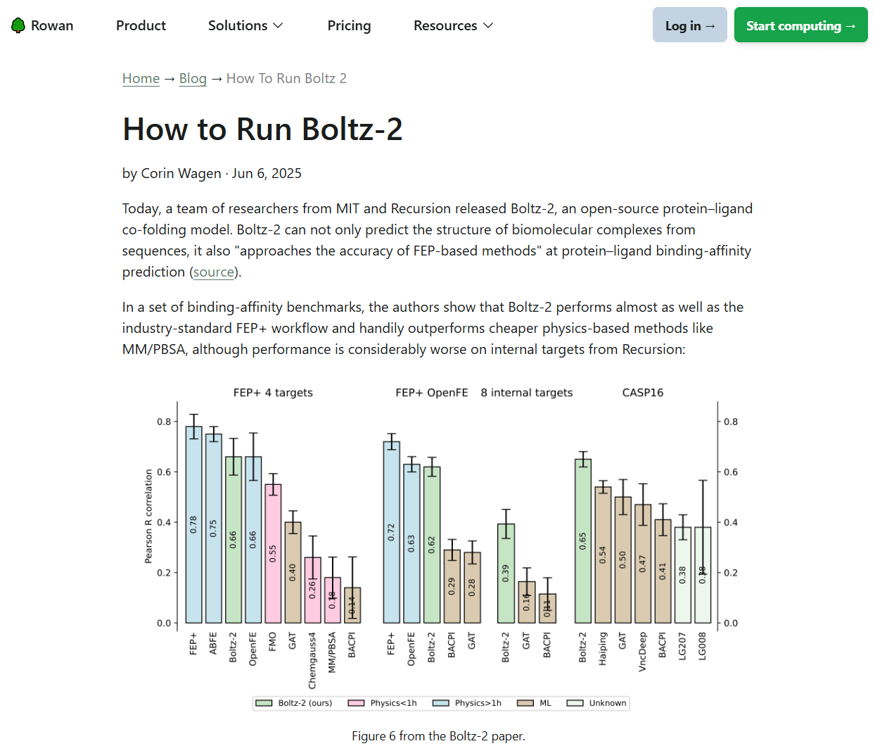
How to run Boltz-2 in Rowan
https://rowansci.com/blog/how-to-run-boltz-2

Slide 28
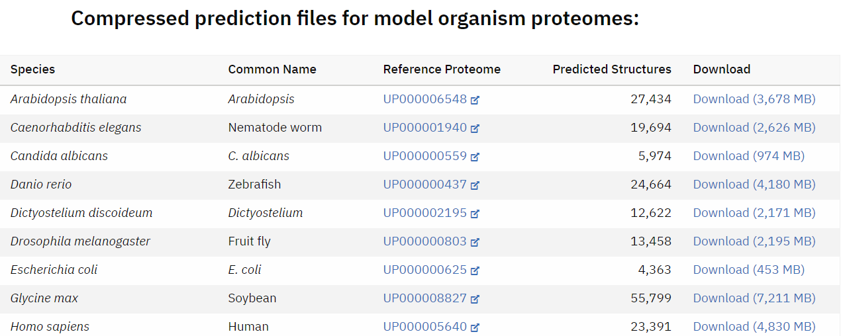
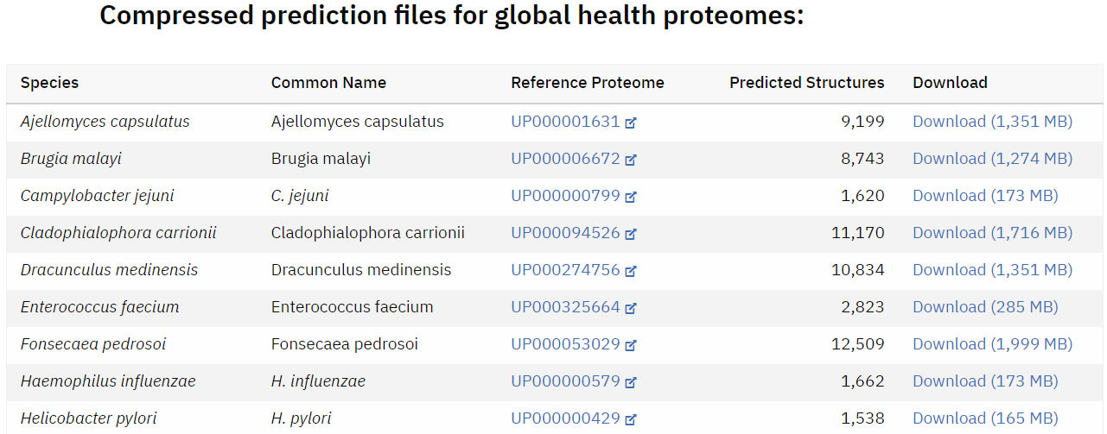
Complete structures of 48 model organism proteomes
AlphaFold DB currently provides predicted structures for the 48 organisms (including human), as well as the majority of Swiss-Prot. >200 M structures

Slide 29
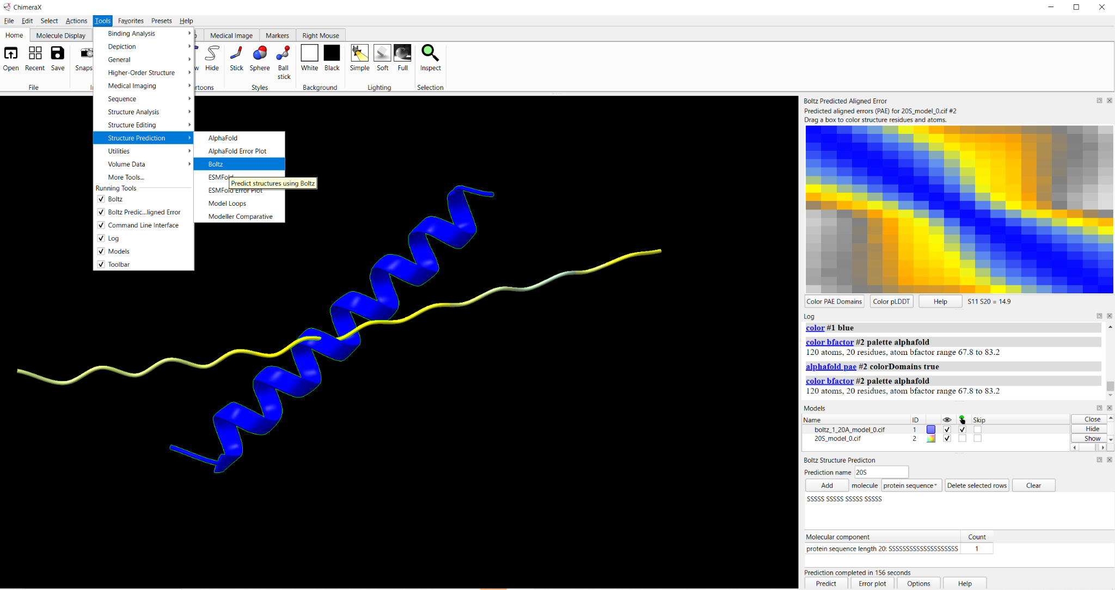
How to run models in ChimeraX
https://www.rbvi.ucsf.edu/chimerax/data/boltz-apr2025/boltz_help.html

Slide 30
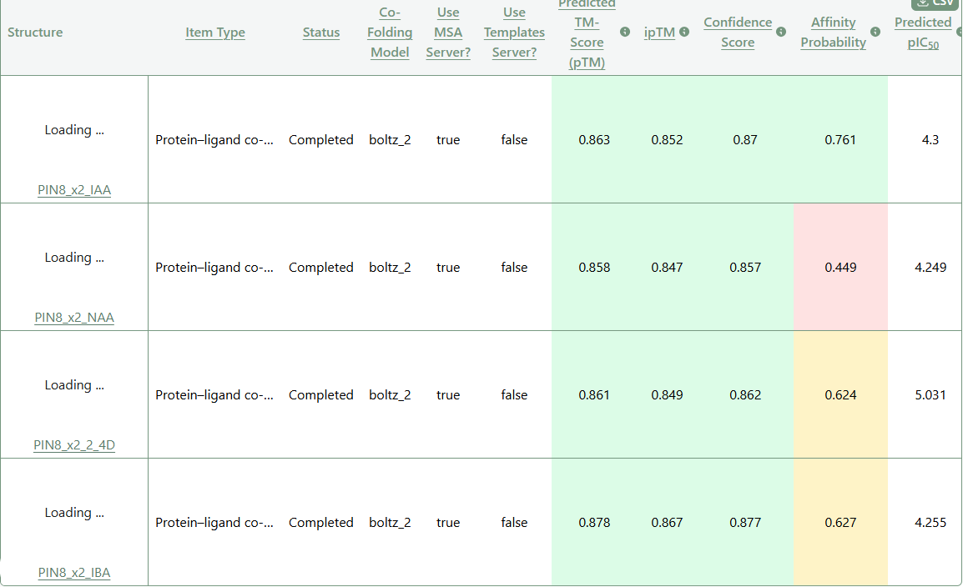
Boltz-2 predicted affinities
PIN8_ARATH

Slide 31
How?
AlphaFold - under the hood*
* briefly - there are excellent step-by-step resources: alphafold-decoded.com , alphafolding.ipynb, YouTube videos…

Slide 32
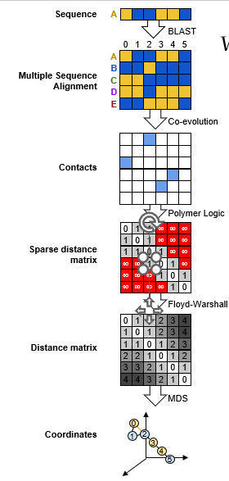
Alphafold 1 vz Alphafold 2
Alphafold 1
Alphafold 2
i) co-evolutionary analysis
to map residue co-variation in protein sequence to physical contact in protein structure, (ii) deep neural networks
to identify patterns in protein sequence and co-evolutionary couplings and convert into distance-wise contact maps.
(iii) make structure from these contacts
i) co-evolution stands (MSA)
ii) deep neural networks exchanged for transformer - Evoformer
contact maps exchanged for triangles
iii) structure module with MD optimization

Slide 33
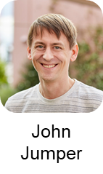
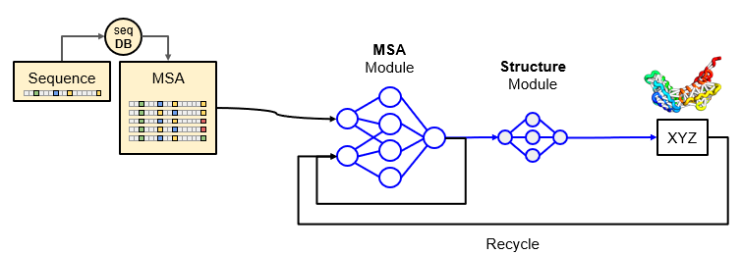
AF2 vz AF3
AF2
Jumper, J., Evans, R., Pritzel, A. et al. Highly accurate protein structure prediction with AlphaFold. Nature 596, 583–589 (2021). https://doi.org/10.1038/s41586-021-03819-2
AF3
Abramson, J., Adler, J., Dunger, J. et al. Accurate structure prediction of biomolecular interactions with AlphaFold 3. Nature 630, 493–500 (2024). https://doi.org/10.1038/s41586-024-07487-w

Slide 34
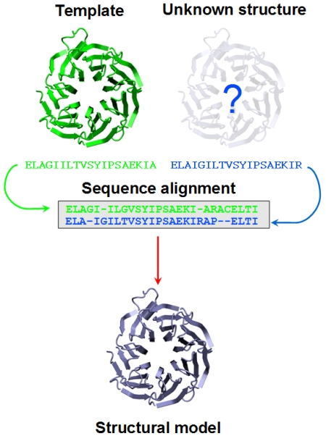
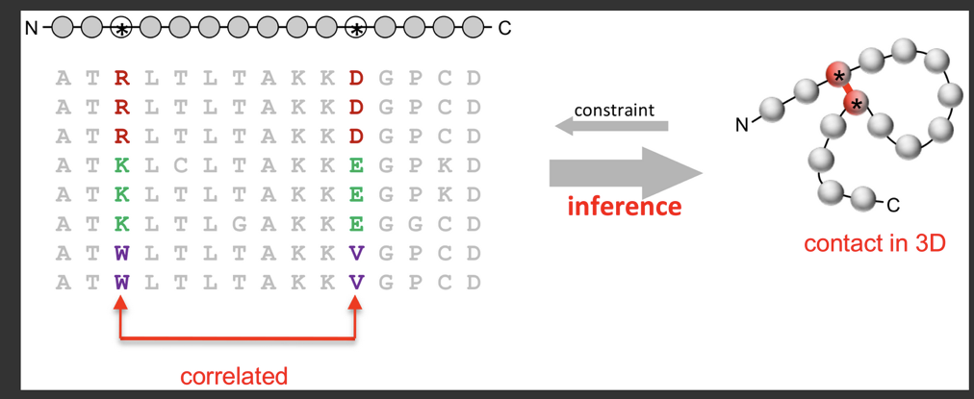
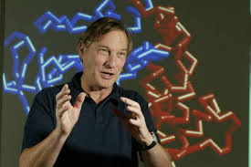
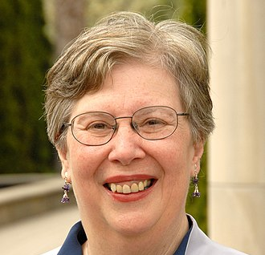
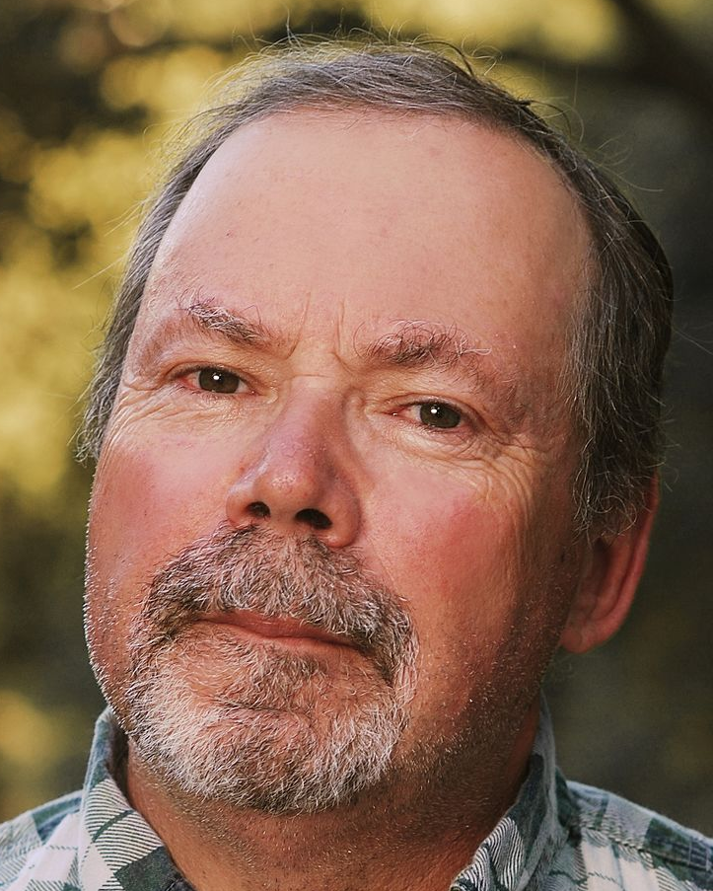
Principles of prediction from sequence
Template-based Covariance
NEED for VALIDATION
CASP - critical assessment of protein structure prediction
since 1994 biannually
compare with experimentally solved structures in PDB
JOHN MOULT
CO-FOUNDER AND CHAIR OF CASP, UNIVERSITY OF MARYLAND
https://www.unil.ch/pmf/en/home/menuinst/technologies/homology-modeling.html
HELEN BERMAN PHILIP BOURNE
former PDB directors

Slide 35
Why?
Proteins are workers and their structure means function

Slide 36
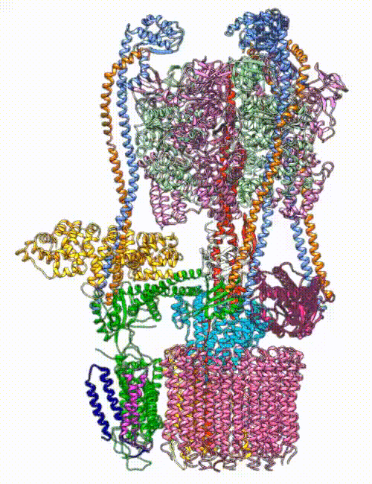
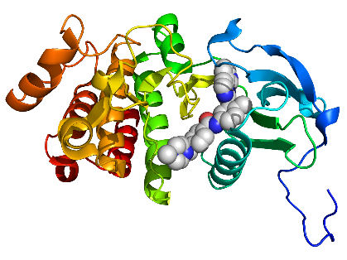
Why the fuzz? Knowing structure helps to understand the function
structural biology
= function understanding
biomolecular chemistry = e.g. drug design
imatinib + Abl kinase
PDBID: 2HYY
Soung-Hun Roh et al. Cryo-EM and MD infer water-mediated proton transport and autoinhibition mechanisms of Vo complex. Sci.Adv. 6 ,eabb9605 (2020). DOI:10.1126/sciadv.abb9605

Slide 37
What?
Protein structure prediction problem

Slide 38
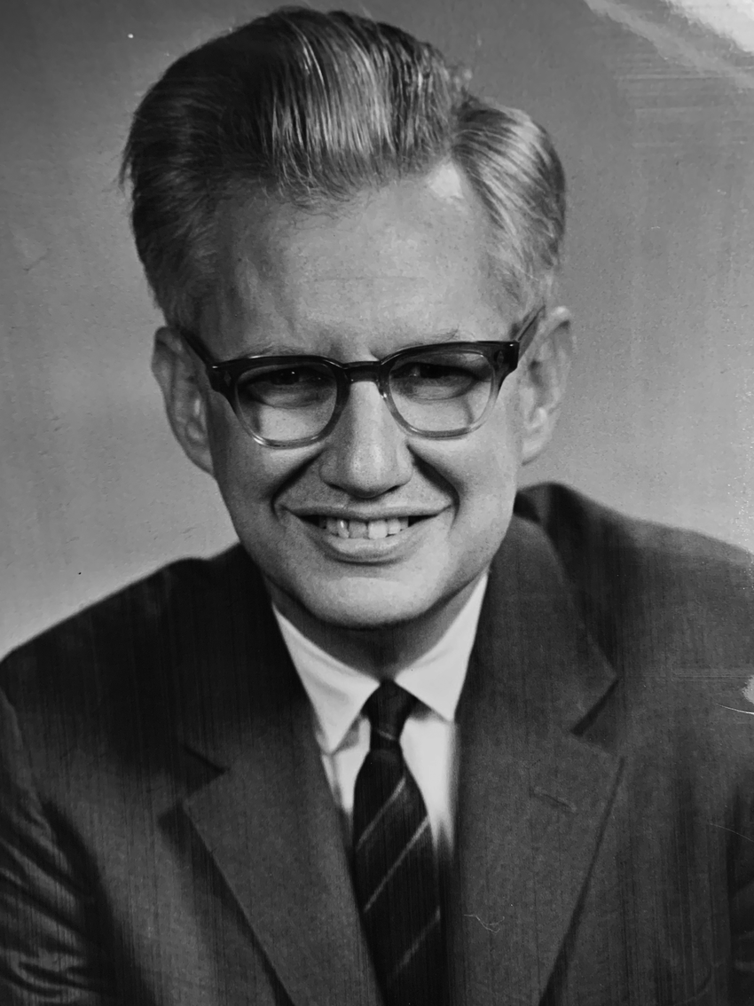
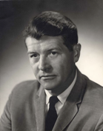
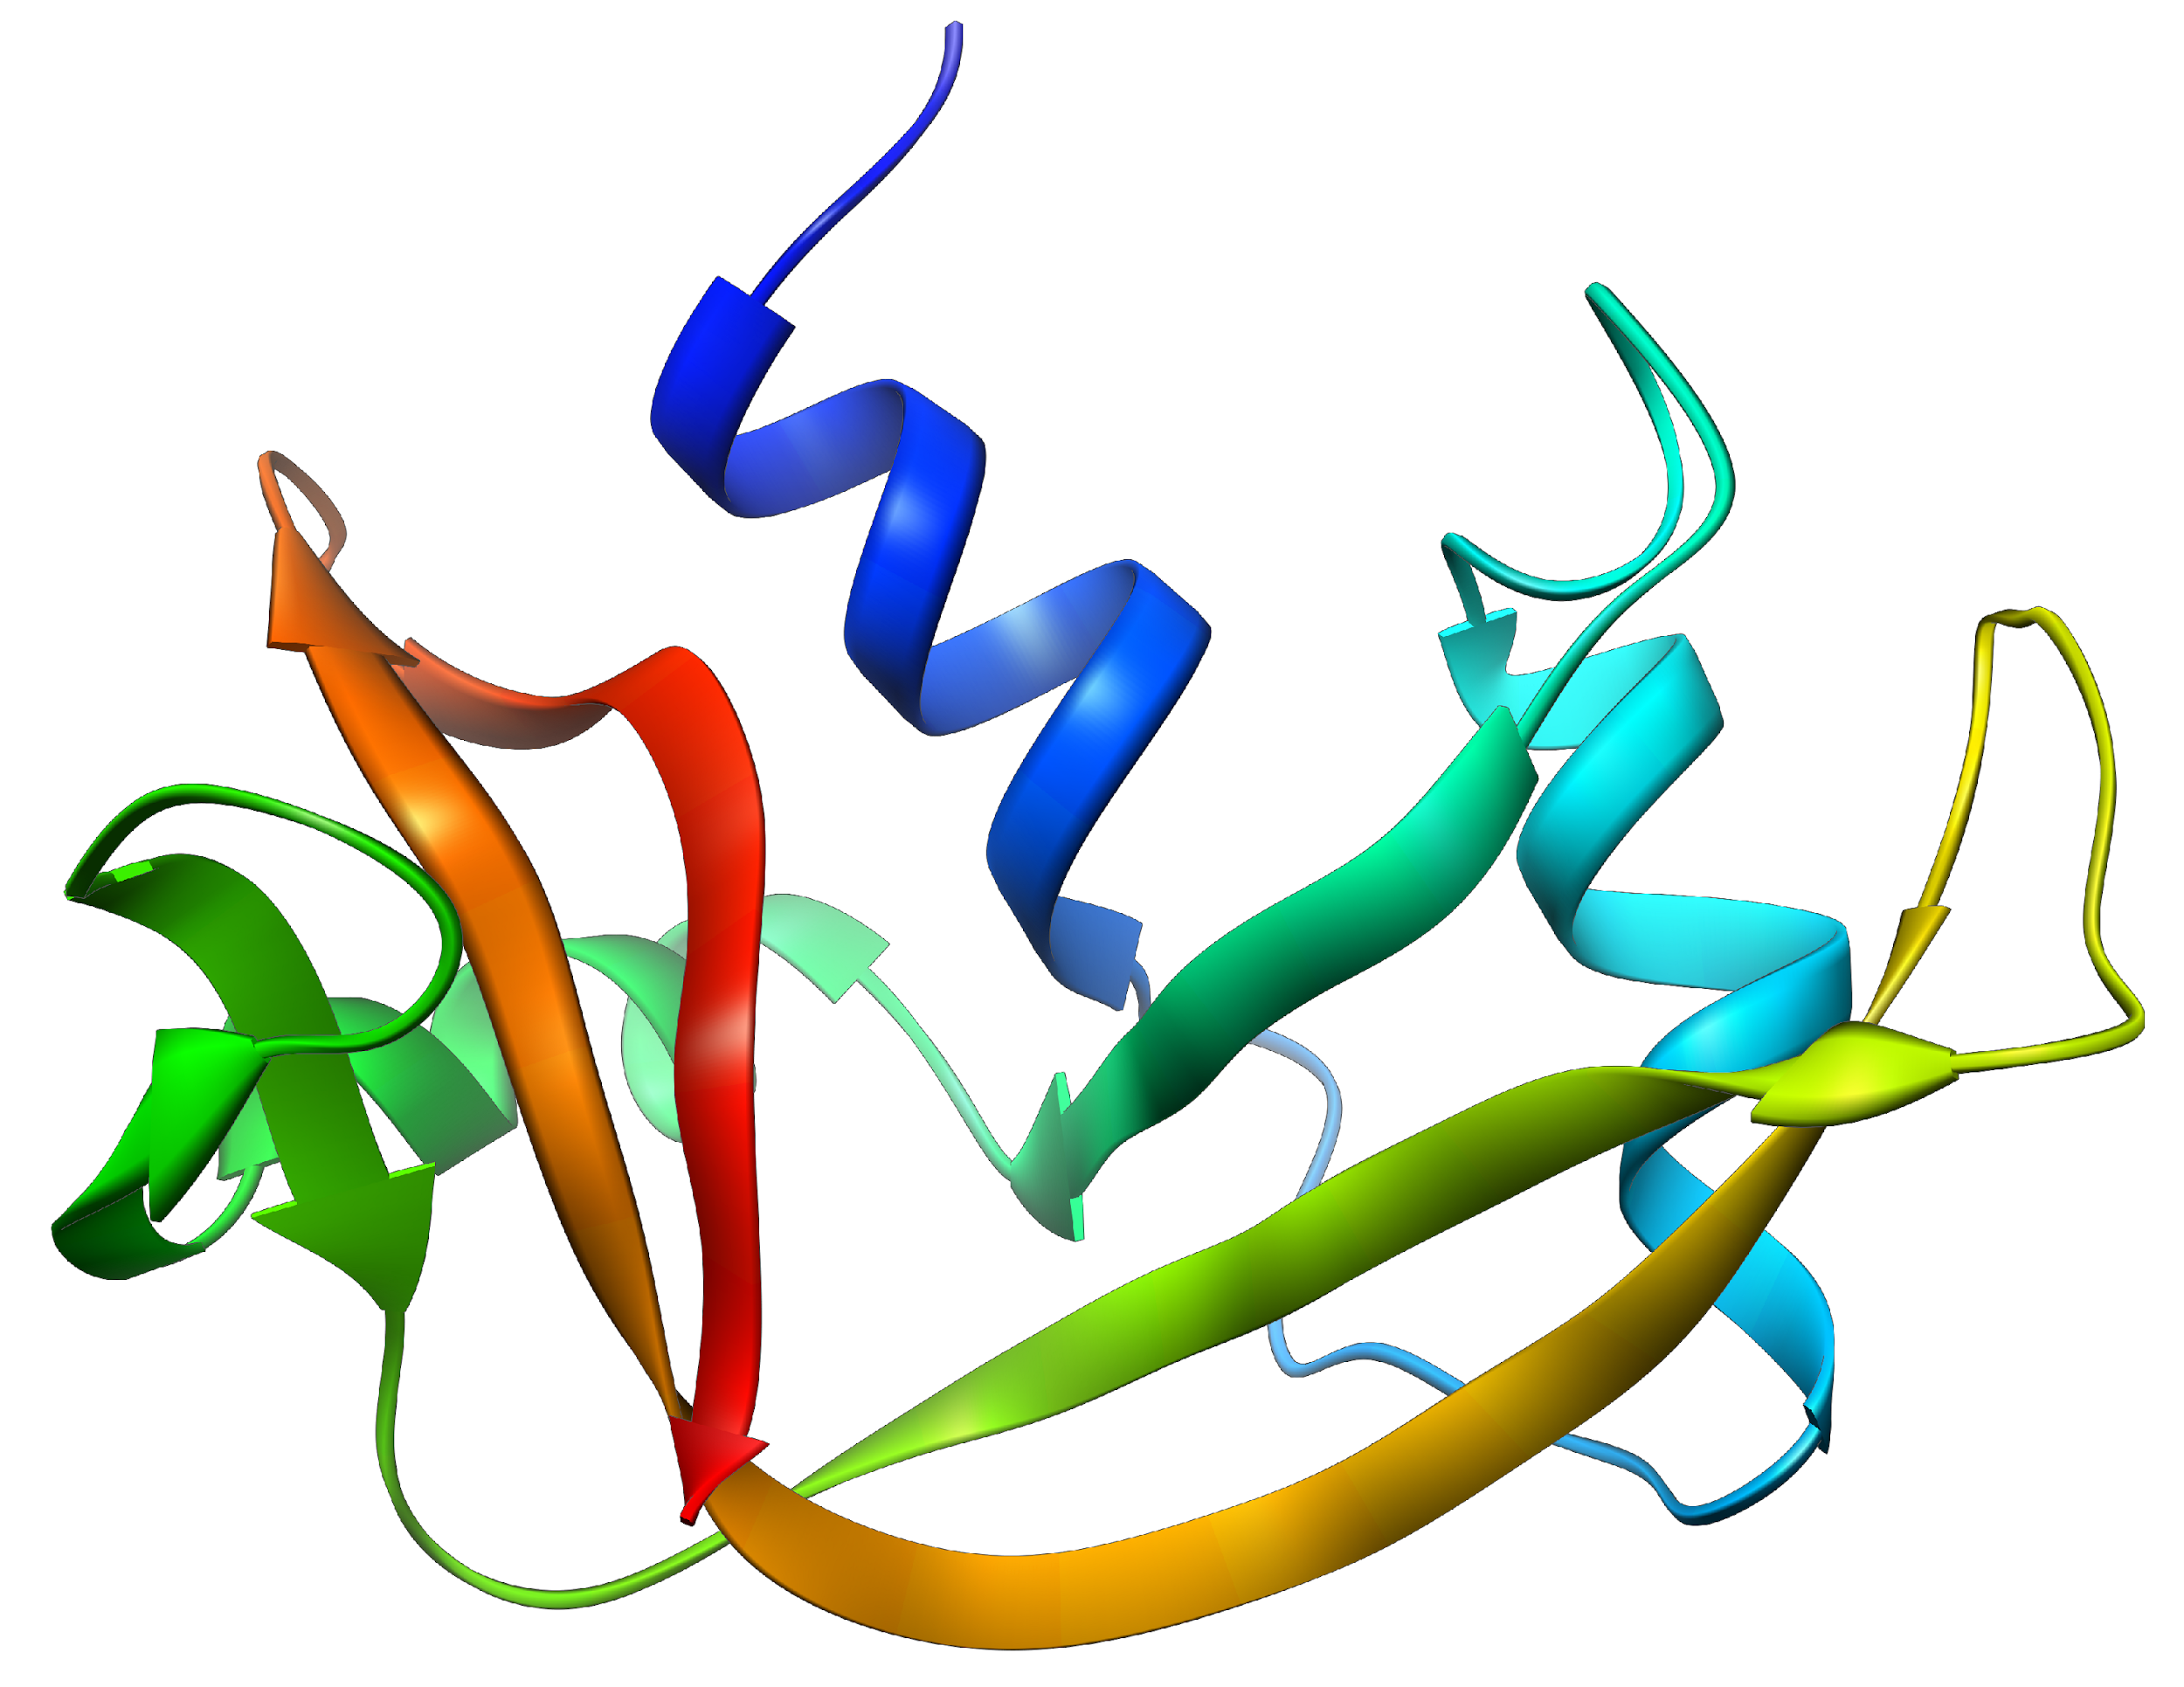
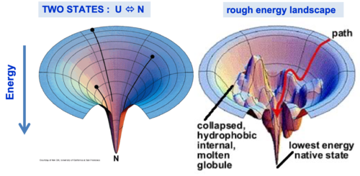
Sequence to predict 3D structure?
Levinthal paradox (1969)
100 residues = 99 peptide bonds = 198 angles φ,ψ if each in 3 stable angles, => 3¹⁹⁸ conformations.
Sequential sampling of all the possible conformations, => longer than the age of the universe
=> folding pathways
Anfinsen Nobel prize in Chemistry (1972)
for describing the relationship between sequence and structure
"The native conformation is determined by the totality of interatomic interactions and hence by the amino acid sequence, in a given environment.”
C. Levinthal
C.B. Anfinsen
but how to predict structure from sequence?
Ribonuclease A
wikipedia

Slide 39
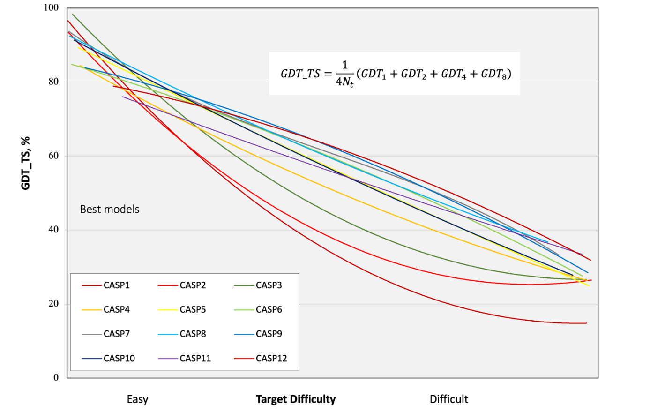
How to compare structures?
After precision growth CASP1(1994) -> CASP6(2006) protein prediction field was stuck
https://predictioncenter.org/casp14/doc/presentations/2020_11_30_CASP14_Introduction_Moult.pdf
GDT_TS = Global distance test - total score (max 100%)
The conventional GDT_TS total score in CASP is the average result of cutoffs at 1, 2, 4, and 8 Å falling within experimental position

Slide 40
CASP13(2018) - AlphaFold enters...
DEMIS HASSABIS
DEEPMIND, former Bullfrog Productions (Theme Park)
DeepMind: 1st company to ever attend CASP
! not open model (too expensive to use)
https://predictioncenter.org/casp14/doc/presentations/2020_11_30_CASP14_Introduction_Moult.pdf

Slide 42
May 2024:Return of the king - AlphaFold3
Model with ligands
Public server
Abramson, J., Adler, J., Dunger, J. et al. Accurate structure prediction of biomolecular interactions with AlphaFold 3. Nature 630, 493–500 (2024). https://doi.org/10.1038/s41586-024-07487-w

Slide 43
October 2024: Nobel prize in Chemistry
9.10.2024

Slide 44
AlphaFold 2
Input: sequence
extended by MSA (at least 30 sequences) + structural templates (UniRef30 PDB-trained self distillation)
Evoformer and Structure model (w Amber MD simulation)
plDDT - predicted local confidence prediction
https://www.nature.com/articles/s41586-021-03819-2
Notes:
Fig. 1: AlphaFold produces highly accurate structures.
a, The performance of AlphaFold on the CASP14 dataset (n = 87 protein domains) relative to the top-15 entries (out of 146 entries), group numbers correspond to the numbers assigned to entrants by CASP. Data are median and the 95% confidence interval of the median, estimated from 10,000 bootstrap samples. b, Our prediction of CASP14 target T1049 (PDB 6Y4F, blue) compared with the true (experimental) structure (green). Four residues in the C terminus of the crystal structure are B-factor outliers and are not depicted. c, CASP14 target T1056 (PDB 6YJ1). An example of a well-predicted zinc-binding site (AlphaFold has accurate side chains even though it does not explicitly predict the zinc ion). d, CASP target T1044 (PDB 6VR4)—a 2,180-residue single chain—was predicted with correct domain packing (the prediction was made after CASP using AlphaFold without intervention). e,
Model architecture. Arrows show the information flow among the various components described in this paper. Array shapes are shown in parentheses with s, number of sequences (Nseq in the main text); r, number of residues (Nres in the main text); c, number of channels.
https://www.nature.com/articles/s41586-021-03819-2/figures/1

Slide 45
EvoFormer
mixing MSA and pairs via updates
graph inference problem in 3D space
edges = residues in proximity
updates per each block (48 blocks) separately (AF1 updated all network at once)
using triangles (instead of just pairs from contact map)
https://www.nature.com/articles/s41586-021-03819-2

Slide 46
Structure model
prioritize backbone positions+orientations
residue gas - free floating rigid body rotations and translation
updates
IPA (invariant point attention) - neural activations only in rigid 3D
equivariant update using updated activations
later fix backbone geometry
avoid loop closure problem)
sidechain final refinement:
OpenMM with Amber 99sb forcefield
https://www.nature.com/articles/s41586-021-03819-2

Slide 47
AF3
diffusion module - enables to build ligands
- denoising towards structure
shortening MSA module -> speeding up calculations

Slide 48
What next?
Usage - AlphaFoldology

Slide 49
AF on monomers
and proteomes

Slide 50
AlphaFold and Intrinsically Disordered Proteins
Ruff KM, Pappu RV ,AlphaFold and Implications for Intrinsically Disordered Proteins,
J Mol Biol. 2021, https://doi.org/10.1016/j.jmb.2021.167208

Slide 51
AF on proteomes

Slide 52
How good are the predictions of human proteins?
9,605
13,786
pLDDT
quality metrics
measure of disorder
pLDDT - per-residue estimate of its confidence on a scale from 0 - 100
model’s predicted score on the lDDT-Cα metric (local superposition-free score for comparing protein structures and models using distance difference tests).
Tunyasuvunakool, K., Adler, J., Wu, Z. et al. Highly accurate protein structure prediction for the human proteome. Nature 596, 590–596 (2021). https://doi.org/10.1038/s41586-021-03828-1

Slide 53
Proteome secondary structures
General trends Secondary structure distribution seems to follow similar trend across analyzed proteomes.
Hutařová Vařeková I, Martinát D, Svobodová R, Berka K. Proteome secondary structures generated by AlphaFold. in preparation

Slide 54
ChannelsDB 2.0: protein tunnels and pores in AlphaFold era
channelsdb2.biodata.ceitec.cz
Major update of ChannelsDB database
Addition of Caver on top of MOLE
Addition of AlphaFold DB structures
Cognate ligands
Next: Pores
Špačková A, Vávra O, Raček T, Bazgier V, Sehnal D, Damborský J, Svobodová R, Bednář D, Berka K ChannelsDB 2.0: a comprehensive database of protein tunnels and pores in AlphaFold era, Nucleic Acids Research, 52(D1), D413–D418, 2024, https://doi.org/10.1093/nar/gkad1012

Slide 55
AFESM Clusters
Structures of ALL known proteins (821M) clustered together – ESMfold did not bring new folds over AlphaFoldDB TED analysis
Yeo J, et al. Metagenomic-scale analysis of the predicted protein structure universe. bioRxiv 2025.04.23.650224;
https://afesm.foldseek.com/

Slide 56
AF on conformers

Slide 57
Alphafold can predict dynamics
pLDDT shows flexibility
SLC1A5
6mp6 AlphaFold 6rvx Outward-Facing similar to OF Inward-Facing
lower pIDDT values show flexible regions

Slide 58
Alphafold can do point-mutations effects Fold-switching proteins
GA77
GA98
L45Y
GB98
GB77
GB98 models shows mix between 3α to α+β
own calculations

Slide 59
Alphafold can do conformational changes
manipulation with MSA allows selection of multiple conformers via mutation of contact points in MSA
LmrP transporter
default after mutation on interface
Mhp1
Notes:
https://www.biorxiv.org/content/10.1101/2022.03.11.484043v2
An initially generated MSA, via MMSeqs2, is input into Alphafold2 within ColabFold to generate five structural models. Residues for mutation are chosen, in this case the three residues in red mediating a contact point on the upper surface of the protein. These mutations are made across the entire MSA (ignoring gaps). This modified MSA is then input into ColabFold for generation of new models. With the contact point in red missing, Alphafold2 within ColabFold generates a new conformation based on the contacts shown in blue.

Slide 60
AlphaFold2 models of the active form of human typical protein kinase domains
Humans - 437 active kinases
PDB - 268 kinases (155 actives)
AFDB - 209 of the 437 (48%) catalytic human protein kinases have a fully active model in the EBI data set
pipeline to produce actives:
MSA for templates in active forms (including non human kinases)
multiple depths MSA (1-90 seqs) -> different models -> check active conformation -> combine models
http://dunbrack.fccc.edu/kincore/activemodels
Faezov B, Dunbrack RL: AlphaFold2 models of the active form of all 437 catalytically competent human protein kinase domains. bioRxiv 2023.07.21.550125; https://doi.org/10.1101/2023.07.21.550125

Slide 61
Conformation-biasing MSA AF
Prediction of mutation shifting protein conformational occupancy
https://github.com/alicetinglab/ConformationalBiasing/
Peter E. Cavanagh et al, Computational design of conformation-biasing mutations to alter protein functions
bioRxiv 2025.05.03.652001; doi: https://doi.org/10.1101/2025.05.03.652001

Slide 62
AF on mutations

Slide 63
AlphaMissense
AlphaFold is not enough sensitive to mutations, but structural context for mutations is important
AlphaMissense adds protein language modelling on variants
downloadable from Zenodo
available in AFDB
Jun Cheng et al. Accurate proteome-wide missense variant effect prediction with AlphaMissense.Science 381,eadg7492(2023).DOI:10.1126/science.adg7492

Slide 64
AlphaMissense
https://alphamissense.hegelab.org/
Tordai, H., Torres, O., Csepi, M. et al. Analysis of AlphaMissense data in different protein groups and structural context. Sci Data 11, 495 (2024). https://doi.org/10.1038/s41597-024-03327-8

Slide 65
AlphaMissense in channels and TM parts show high pathogenicity
cytochrome P450 family
GLUT transporters
pathogenicity trend:
most: cofactor environment
channels
transmembrane parts
least: proteins in general
Pravda, L., Berka, K., Svobodová Vařeková, R. et al. Anatomy of enzyme channels. BMC Bioinformatics 15, 379 (2014). https://doi.org/10.1186/s12859-014-0379-x
Špačková A, Kadášová N, Hutařová Vařeková I, Berka K: Pathogenicity Patterns in Cytochrome P450 Family
bioRxiv 2025.03.30.646180; doi: https://doi.org/10.1101/2025.03.30.646180
Kadášová N, Špačková A, Martinát D, Berka K: Understanding GLUT Proteins Pathogenicity: Integration of AlphaMissense, SIFT, and PolyPhen-2 Predictions, in preparation

Slide 66
AF on engineered proteins

Slide 67
Why protein design?
Listov, D., Goverde, C.A., Correia, B.E. et al. Opportunities and challenges in design and optimization of protein function. Nat Rev Mol Cell Biol 25, 639–653 (2024). https://doi.org/10.1038/s41580-024-00718-y
Notes:
De novo-designed proteins present a range of possibilities for the development of new molecules with biotechnological and therapeutic applications. Some popular areas of research are protein binders and antivirals (Protein Data Bank (PDB) entry: 3R2X), cancer therapies (PDB entry: 7JH5), protein-based therapies (PDB entry: 2B5I), protein switches (PDB entry: 6IWB), drug-delivery vehicles (PDB entry: 6VFI), vaccines (PDB entry: 3LHP) and biosensors (PDB entry: 7AYE).

Slide 68
Alphafold 2 requires MSA for start -> language models (pLM) - e.g. ESMfold
Zeming Lin et al. Evolutionary-scale prediction of atomic-level protein structure with a language model. Science 379, 1123-1130 (2023). DOI:10.1126/science.ade2574
Notes:
Orphan sequences

Slide 69
Reversed prediction - ProteinMPNN
find sequence to a given structural feature
-> applicability to almost any protein sequence design problem
DAVID BAKER
Institute for Protein Design
University of Washington
J. Dauparas …, Baker D, et al. Robust deep learning–based protein sequence design using ProteinMPNN. Science 378, 49-56(2022). DOI:10.1126/science.add2187
https://github.com/dauparas/ProteinMPNN

Slide 70
Chroma
Ingraham, J.B et al et al. Illuminating protein space with a programmable generative model. Nature 623, 1070–1078 (2023). https://doi.org/10.1038/s41586-023-06728-8 https://github.com/generatebio/chroma

Slide 71
RF diffusion 2
De novo enzyme design based on reaction intermediate structures
Ahern W, …, Baker D: Atom level enzyme active site scaffolding using RFdiffusion2. bioRxiv 2025.04.09.648075;

Slide 72
PINAL – natural language processing protein design
Dai F, et al. Toward De Novo Protein Design from Natural Language. bioRxiv 2024.08.01.606258
http://www.denovo-pinal.com/

Slide 73
AF on ligands

Slide 74
Alphafold can be filled with ligands and cofactors
https://alphafill.eu/
Hekkelman, M.L., de Vries, I., Joosten, R.P. et al. AlphaFill: enriching AlphaFold models with ligands and cofactors. Nat Methods 20, 205–213 (2023). https://doi.org/10.1038/s41592-022-01685-y
Notes:
a, Ablation results on two target sets: the CASP14 set of domains (n = 87 protein domains) and the PDB test set of chains with template coverage of ≤30% at 30% identity (n = 2,261 protein chains). Domains are scored with GDT and chains are scored with lDDT-Cα. The ablations are reported as a difference compared with the average of the three baseline seeds. Means (points) and 95% bootstrap percentile intervals (error bars) are computed using bootstrap estimates of 10,000 samples. b, Domain GDT trajectory over 4 recycling iterations and 48 Evoformer blocks on CASP14 targets LmrP (T1024) and Orf8 (T1064) where D1 and D2 refer to the individual domains as defined by the CASP assessment. Both T1024 domains obtain the correct structure early in the network, whereas the structure of T1064 changes multiple times and requires nearly the full depth of the network to reach the final structure. Note, 48 Evoformer blocks comprise one recycling iteration.

Slide 75
AlphaFold models good enough for drug design?
AlphaFold2 predicts holo protein in 70% => it can be used for drug designing
pLDDT values in a single 3D model could be used to infer local conformational changes linked to ligand binding transitions.
locally AlphaFold2 can be there - but it needs validation (as always)
T1064
Notes:
Tady se ukazuje, ze pro klasicke dokovani moc vhodny AlphaFold neni

Slide 76
AlphaFold docking antibiotics example
benchmarking docking by metabolic activity of 12 essential proteins
auROC = 0.48 (Vina on AF2)
rescoring -> auROC 0.63
auROC = 0.46 (Vina on experimental structures)
both bad (auROC random is 0.5)
Felix Wong et al. Molecular Systems Biology 18: e11081 | 2022

Slide 77
RoseTTAFold All-Atom
building protein around ligand
Rohith Krishna et al. Generalized biomolecular modeling and design with RoseTTAFold All-Atom. Science 384,eadl2528(2024). DOI:10.1126/science.adl2528

Slide 78
Chai-1 - open version of AF3
CYP3A4 +POPC
lab.chaidiscovery.com, github.com/chaidiscovery/chai-lab
Chai Discovery, Jacques Boitreaud, Jack Dent, Matthew McPartlon, Joshua Meier, Vinicius Reis, Alex Rogozhnikov, Kevin Wu: Chai-1: Decoding the molecular interactions of life, bioRxiv 2024.10.10.615955; https://doi.org/10.1101/2024.10.10.615955

Slide 79
Are structural biologists and bioinformaticians on the job market?
Alphafold does not tell much about folding process
Alphafold can not do point mutations - design of functions
Alphafold is not usable for drug design
Alphafold can not do conformational changes or dynamics
Alphafold can not do multiprotein complexes – interactions
Alphafold can not do effects of post-translational protein modifications
Alphafold can not do ligand effects
Alphafold is not good with orphan sequences
or is it?
Notes:
přidat

Slide 81
Extra slides

Slide 82
LigandMPNN
deep learning-based protein sequence design method that explicitly models all non-protein components of biomolecular systems
bioRxiv preprint https://doi.org/10.1101/2023.12.22.573103 https://github.com/dauparas/LigandMPNN

Slide 83
AlphaFold2 structures template ligand discovery
prospective screen
different binding site conformation
bioRxiv preprint doi: https://doi.org/10.1101/2023.12.20.572662

Slide 84
Alphafold can describe folding process to some level Was Anfinsen right?
Notes:
a, Ablation results on two target sets: the CASP14 set of domains (n = 87 protein domains) and the PDB test set of chains with template coverage of ≤30% at 30% identity (n = 2,261 protein chains). Domains are scored with GDT and chains are scored with lDDT-Cα. The ablations are reported as a difference compared with the average of the three baseline seeds. Means (points) and 95% bootstrap percentile intervals (error bars) are computed using bootstrap estimates of 10,000 samples. b, Domain GDT trajectory over 4 recycling iterations and 48 Evoformer blocks on CASP14 targets LmrP (T1024) and Orf8 (T1064) where D1 and D2 refer to the individual domains as defined by the CASP assessment. Both T1024 domains obtain the correct structure early in the network, whereas the structure of T1064 changes multiple times and requires nearly the full depth of the network to reach the final structure. Note, 48 Evoformer blocks comprise one recycling iteration.

Slide 89
Architectural details AF2
Notes:
Fig. 3: Architectural details.
a, Evoformer block. Arrows show the information flow. The shape of the arrays is shown in parentheses. b, The pair representation interpreted as directed edges in a graph. c, Triangle multiplicative update and triangle self-attention. The circles represent residues. Entries in the pair representation are illustrated as directed edges and in each diagram, the edge being updated is ij. d, Structure module including Invariant point attention (IPA) module. The single representation is a copy of the first row of the MSA representation. e, Residue gas: a representation of each residue as one free-floating rigid body for the backbone (blue triangles) and χ angles for the side chains (green circles). The corresponding atomic structure is shown below. f, Frame aligned point error (FAPE). Green, predicted structure; grey, true structure; (Rk, tk), frames; xi, atom positions.

Slide 90
MSA - multiple sequence alignment
using standard tools - jackhmmer, HHBlits
sequence DBs:
UniRef90
UniClust30 = for sequence self-distilation
metagenomicsDBs - to fully cover classes underepresented in UniRef90
Big Fantastic database (BFD) = 66M protein families from 2.2G protein sequences
clustered MGnify
needed at least 30 sequences per MSA otherwise quality deteriorated>
https://www.nature.com/articles/s41586-021-03819-2

Slide 91
Training
PDB database + PDB70 clusters
training db:
40% identity clusters, crop to 258 residues, batches by 128 per Tensor processing unit (TPU)
enhance accuracy by noisy student self-distillation
predict 350000 structures from UniRef30 using trained network
filter to high confidence subset
then train again from scratch with mixture of PDB and UniRef30
=> effective use of unlabelled sequence data
randomly mask or mutate individual residues from MSA using BERT (bidirectional encoder representations from Transformers => to predict masked elements within MSA
https://www.nature.com/articles/s41586-021-03819-2

Slide 92
Interpreting the neural network
depth of neural network - it is usually quick, but for challenging targets it can be quite deep
https://www.nature.com/articles/s41586-021-03819-2
Notes:
a, Ablation results on two target sets: the CASP14 set of domains (n = 87 protein domains) and the PDB test set of chains with template coverage of ≤30% at 30% identity (n = 2,261 protein chains). Domains are scored with GDT and chains are scored with lDDT-Cα. The ablations are reported as a difference compared with the average of the three baseline seeds. Means (points) and 95% bootstrap percentile intervals (error bars) are computed using bootstrap estimates of 10,000 samples. b, Domain GDT trajectory over 4 recycling iterations and 48 Evoformer blocks on CASP14 targets LmrP (T1024) and Orf8 (T1064) where D1 and D2 refer to the individual domains as defined by the CASP assessment. Both T1024 domains obtain the correct structure early in the network, whereas the structure of T1064 changes multiple times and requires nearly the full depth of the network to reach the final structure. Note, 48 Evoformer blocks comprise one recycling iteration.

Slide 93
Sergey Ovchinnikov -

Slide 94
Effect of cross-chain contacts.
prediction is worse for heterotropic contacts (large complexes where 3D structure is dictated by other chains in complex)
homotropics yields high-accuracy even when chains are intertwinned
PDB 6SKO
Notes:
a, Backbone accuracy (lDDT-Cα) for the redundancy-reduced set of the PDB after our training data cut-off, restricting to proteins in which at most 25% of the long-range contacts are between different heteromer chains. We further consider two groups of proteins based on template coverage at 30% sequence identity: covering more than 60% of the chain (n = 6,743 protein chains) and covering less than 30% of the chain (n = 1,596 protein chains). MSA depth is computed by counting the number of non-gap residues for each position in the MSA (using the Neff weighting scheme; see Methods for details) and taking the median across residues. The curves are obtained through Gaussian kernel average smoothing (window size is 0.2 units in log10(Neff)); the shaded area is the 95% confidence interval estimated using bootstrap of 10,000 samples. b, An intertwined homotrimer (PDB 6SK0) is correctly predicted without input stoichiometry and only a weak template (blue is predicted and green is experimental).

Slide 96
AlphaFold in Google Colab
Github enabled JupyterNotebooks running in Google Colab environment
limitation in size (timing)
start also from Chimera
Mirdita M, Ovchinnikov S, Steinegger M. ColabFold - Making protein folding accessible to all. bioRxiv, 2021 https://doi.org/10.1101/2021.08.15.456425
https://colab.research.google.com/github/sokrypton/ColabFold/

Slide 97
Alphafold 2 on ELIXIR CZ
Alphafold “needs” TPU to run -> not many people have it on their PC
Alphafold has been installed on Elixir CZ hardware
Alphafold (Multimer) in the newest version 2.2.0 is accessible through Metacentrum
speed is dependent on size of predicted protein (complex)
https://wiki.metacentrum.cz/wiki/AlphaFold
Notes:
workflow to run Alphafold - https://console.latch.bio/workflows

Slide 98
AlphaFold and Intrinsically Disordered Proteins
Notes:
Pridat DisProt

Slide 99
AlphaFold within ChimeraX
Fetch
Search AFDB
Predict

Slide 100
AlphaFold on Latch
https://console.latch.bio/workflows

Slide 101
But one still needs to be careful…
putative human cytochrome P450 2C7
Structure can be only as good as its sequence
A0A087X1C5 CP2D7_HUMAN
A0A1B0GTQ1 A0A1B0GTQ1_HUMAN

Slide 102
AlphaFold in UseGalaxy.eu
e.g. dimer Nucleocapsid protein from SARS-CoV-2
trick - dimerization fake as long disordered poly-N chain
https://usegalaxy.eu/tool_runner?tool_id=toolshed.g2.bx.psu.edu%2Frepos%2Fgalaxy-australia%2Falphafold2%2Falphafold%2F2.1.2%2Bgalaxy0

Slide 103
MrParse: Finding homologues in the PDB and the EBI AlphaFold database for Molecular Replacement and more
Adam J. Simpkin, Jens M. H. Thomas, Ronan M. Keegan, Daniel J. Rigden
doi: https://doi.org/10.1101/2021.09.02.458604

Slide 104
How accurate are the models?

Slide 105
Alphafold is just a start...
use Alphafold ideas for development of their own 3D structure predictions
RoseTTAfold
ESMfold
OpenFold
Chroma
prediction of designed proteins
...
as of 31.1.2024
as of 30.3.2022

Slide 106
Alphafold can do multiprotein complexes – interactions
https://twitter.com/RolandDunbrack/status/1502818748868317188
Notes:
a, Ablation results on two target sets: the CASP14 set of domains (n = 87 protein domains) and the PDB test set of chains with template coverage of ≤30% at 30% identity (n = 2,261 protein chains). Domains are scored with GDT and chains are scored with lDDT-Cα. The ablations are reported as a difference compared with the average of the three baseline seeds. Means (points) and 95% bootstrap percentile intervals (error bars) are computed using bootstrap estimates of 10,000 samples. b, Domain GDT trajectory over 4 recycling iterations and 48 Evoformer blocks on CASP14 targets LmrP (T1024) and Orf8 (T1064) where D1 and D2 refer to the individual domains as defined by the CASP assessment. Both T1024 domains obtain the correct structure early in the network, whereas the structure of T1064 changes multiple times and requires nearly the full depth of the network to reach the final structure. Note, 48 Evoformer blocks comprise one recycling iteration.

Slide 107
Alphafold can do multiprotein complexes – interactions
Notes:
a, Ablation results on two target sets: the CASP14 set of domains (n = 87 protein domains) and the PDB test set of chains with template coverage of ≤30% at 30% identity (n = 2,261 protein chains). Domains are scored with GDT and chains are scored with lDDT-Cα. The ablations are reported as a difference compared with the average of the three baseline seeds. Means (points) and 95% bootstrap percentile intervals (error bars) are computed using bootstrap estimates of 10,000 samples. b, Domain GDT trajectory over 4 recycling iterations and 48 Evoformer blocks on CASP14 targets LmrP (T1024) and Orf8 (T1064) where D1 and D2 refer to the individual domains as defined by the CASP assessment. Both T1024 domains obtain the correct structure early in the network, whereas the structure of T1064 changes multiple times and requires nearly the full depth of the network to reach the final structure. Note, 48 Evoformer blocks comprise one recycling iteration.

Slide 108
Alphafold can not do effects of post-translational protein modifications (by itself)
Notes:
a, Ablation results on two target sets: the CASP14 set of domains (n = 87 protein domains) and the PDB test set of chains with template coverage of ≤30% at 30% identity (n = 2,261 protein chains). Domains are scored with GDT and chains are scored with lDDT-Cα. The ablations are reported as a difference compared with the average of the three baseline seeds. Means (points) and 95% bootstrap percentile intervals (error bars) are computed using bootstrap estimates of 10,000 samples. b, Domain GDT trajectory over 4 recycling iterations and 48 Evoformer blocks on CASP14 targets LmrP (T1024) and Orf8 (T1064) where D1 and D2 refer to the individual domains as defined by the CASP assessment. Both T1024 domains obtain the correct structure early in the network, whereas the structure of T1064 changes multiple times and requires nearly the full depth of the network to reach the final structure. Note, 48 Evoformer blocks comprise one recycling iteration.

Slide 109
MutAmore
generate all SNPs of protein
using ESMfold/OpenFold
https://www.youtube.com/watch?v=1XgiFXg-Xrs&list=PL0QUUE_zWBuJ6Y5NWtDoY93FUweUUGVuf
https://www.biorxiv.org/content/10.1101/2023.09.15.557870v1 https://github.com/kWeissenow/MutAmore

Slide 112
Accurate prediction of protein structures and interactions using a three-track neural network
https://www.science.org/doi/full/10.1126/science.abj8754

Slide 113
Geometric deep learning of RNA structure
https://www.science.org/doi/10.1126/science.abe5650

Slide 114
RoseTTAfold2 from Pymol

Slide 115
AlphaFold decoded
https://www.alphafold-decoded.com/
https://www.youtube.com/watch?v=7dS3nyEcOyE&list=PLJ0WcPQS7xJVJr6ceIPFSkAGAgrkmw1c9

Slide 116
Not used files

Slide 117
Side chain predictions– orf8 covid19
GDT_TS= 87
so how does it works?

Slide 118
(almost) Complete human genome
Notes:
a, Ablation results on two target sets: the CASP14 set of domains (n = 87 protein domains) and the PDB test set of chains with template coverage of ≤30% at 30% identity (n = 2,261 protein chains). Domains are scored with GDT and chains are scored with lDDT-Cα. The ablations are reported as a difference compared with the average of the three baseline seeds. Means (points) and 95% bootstrap percentile intervals (error bars) are computed using bootstrap estimates of 10,000 samples. b, Domain GDT trajectory over 4 recycling iterations and 48 Evoformer blocks on CASP14 targets LmrP (T1024) and Orf8 (T1064) where D1 and D2 refer to the individual domains as defined by the CASP assessment. Both T1024 domains obtain the correct structure early in the network, whereas the structure of T1064 changes multiple times and requires nearly the full depth of the network to reach the final structure. Note, 48 Evoformer blocks comprise one recycling iteration.

Slide 119
So what is a protein?
elements of cells that actually do things
responsible for almost everything
composed of amino acids
produced from RNA by ribosomes
folding leads to a 3D structure
humans have around 20 000 different proteins
wikipedia

Slide 120
Structure prediction = simulation of protein folding
Levinthal’s paradox - protein of 100 aa has 10⁷⁰ available conformations -> it would take 10⁵² years at the speed of 10⁻¹¹ s to sample one conformation to assume it native shape

Slide 121
We have been stuck on this one problem – how do proteins fold up – for nearly 50 years. To see DeepMind produce a solution for this, having worked personally on this problem for so long and after so many stops and starts, wondering if we’d ever get there, is a very special moment.
PROFESSOR JOHN MOULT
CO-FOUNDER AND CHAIR OF CASP, UNIVERSITY OF MARYLAND

Slide 122
How to move the prediction field forward?
transparent competition
provide an “environment” for communication and exchange of experience
develop metrics for careful examination of predicted structures
CASP – critical assessment of protein structure prediction
once in two years since 1994
compare with experimentally solved structures

Slide 123
How does good/bad prediction looked like?
GDT_TS = 44.6
GDT_TS = 96.5

Slide 124
How much does the tertiary structure tell?
50% of archaeal, 45% of bacterial, and 20% of eukaryotic proteomes form homomers
coiled-coil regions as major enablers of quaternary structure evolution in Eukaryotes
disease mutations are enriched at interfaces
https://www.biorxiv.org/content/10.1101/2023.06.09.544317v1

Slide 125
https://www.ebi.ac.uk/training/events/alphamissense-predictions-human-genetic-variation-research/

