Slide 1
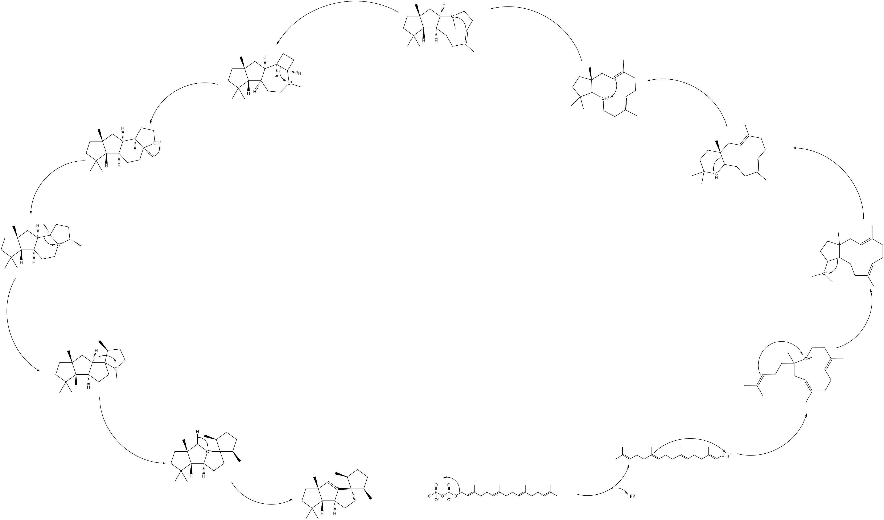
Mechanisms and reactions of terpene synthases - database
Martin Engst
Notes:
Hello, my name is Martin Engst a first year PhD student at the laboratory of plant specialized metabolites at IOCB. The project of MARTS Database started as my master thesis and is near its lets say first phase conclusion. So I will tell you a story of how I am supporting the research an

Slide 2
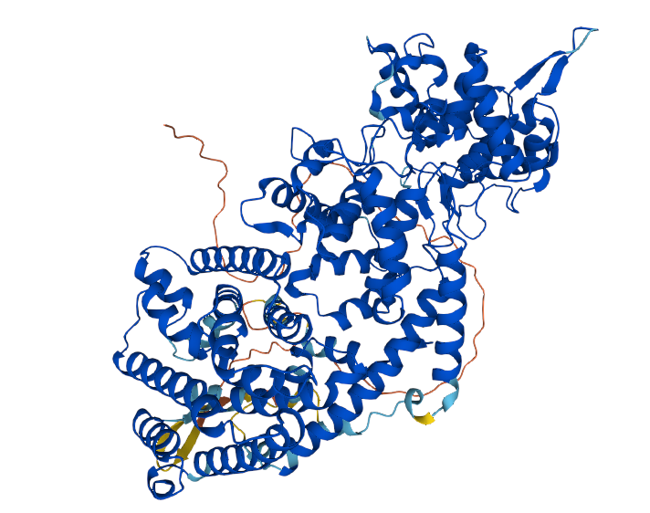
What am I doing?
Worry not good scientists your data is in good hands
The story
Tell me you secrets!
Me supproting research
Enzyme function prediction
All enzymes at once – unfeasible – choose a single enzyme family
Terpene synthases (TPS)
Notes:
This work – support of science through data curation and presentation – data for what? -> enzymed function prediction -> single family

Slide 3
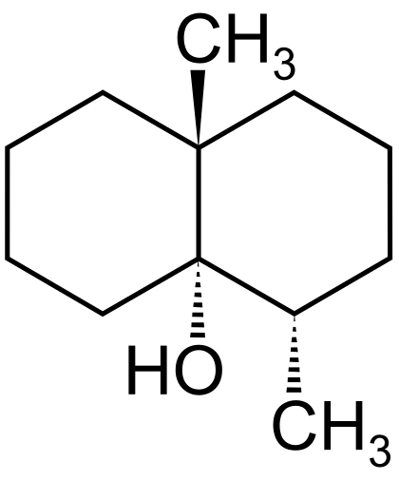
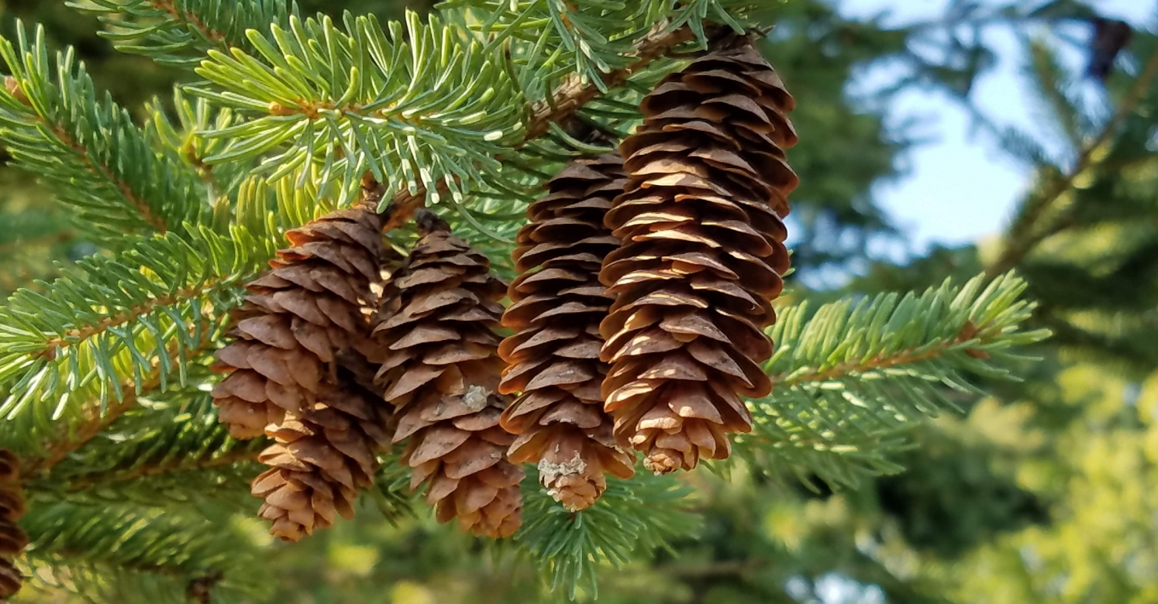
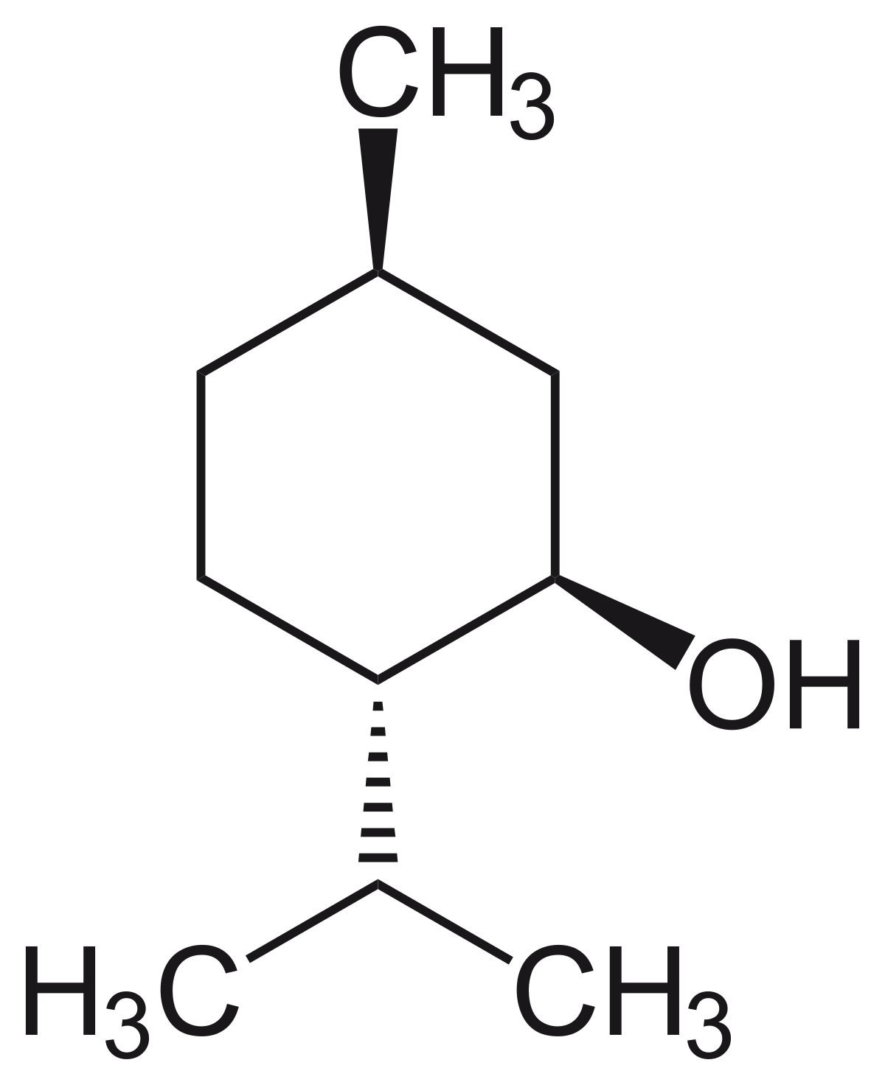
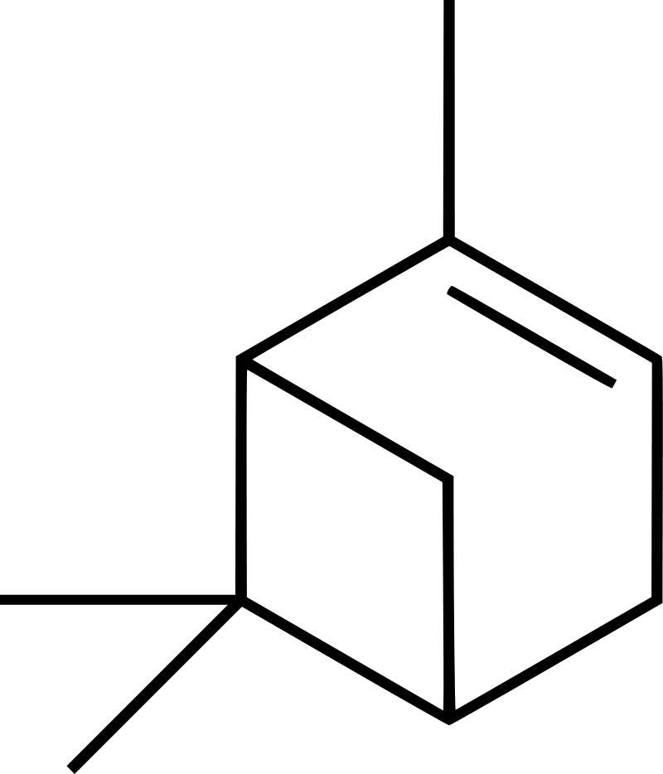
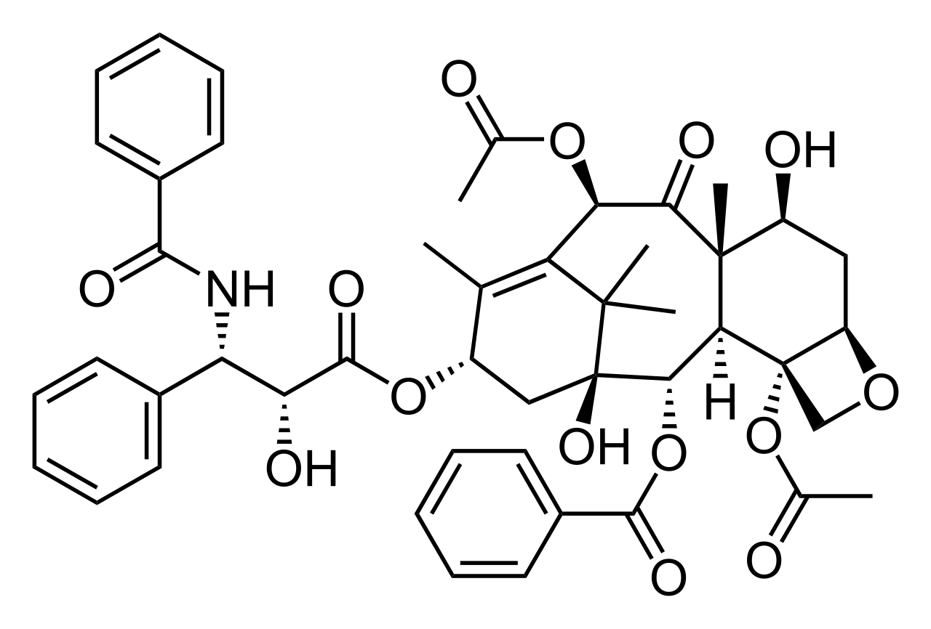
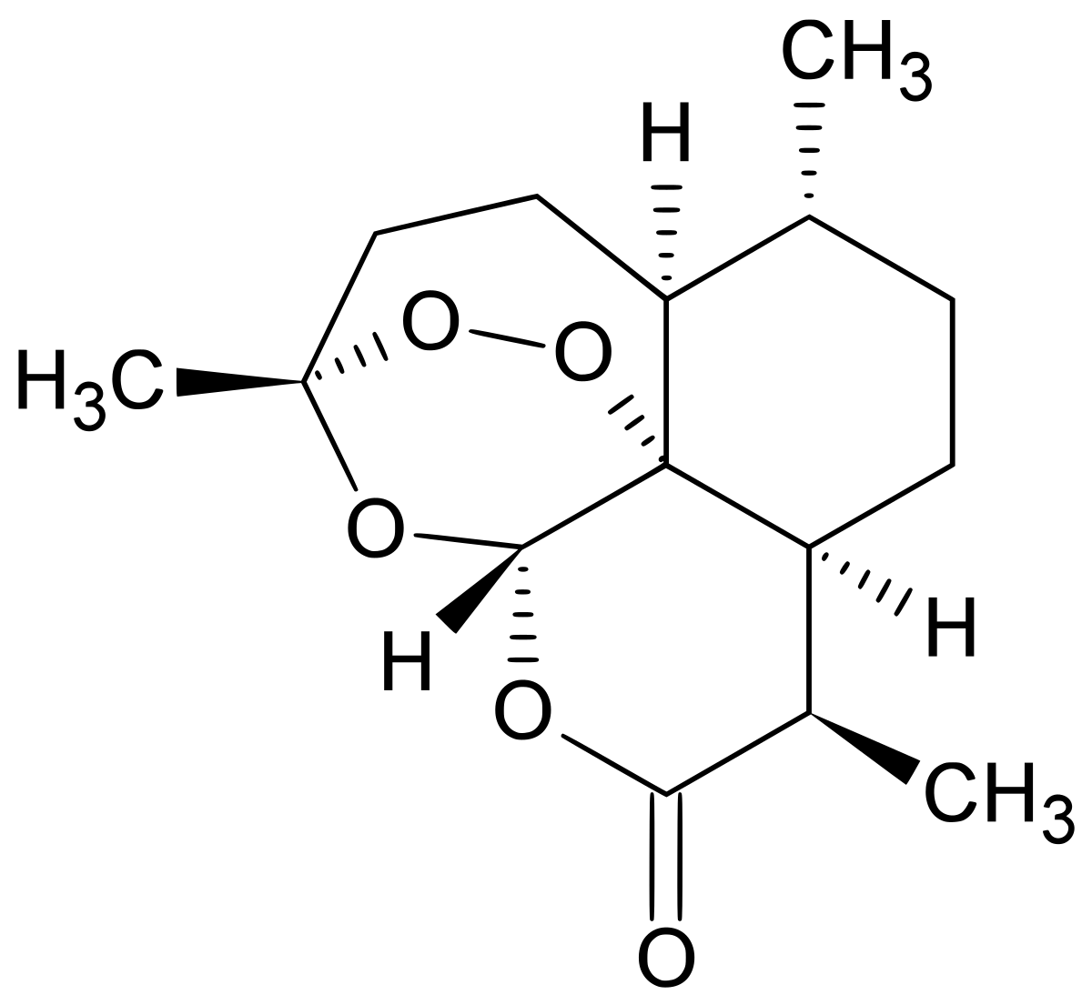
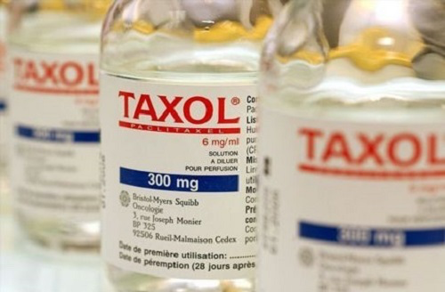
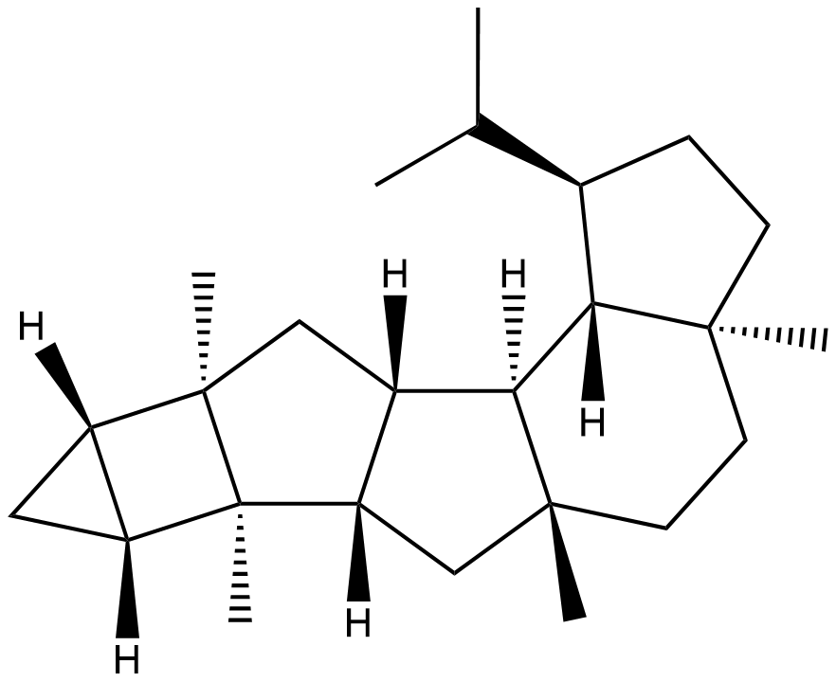
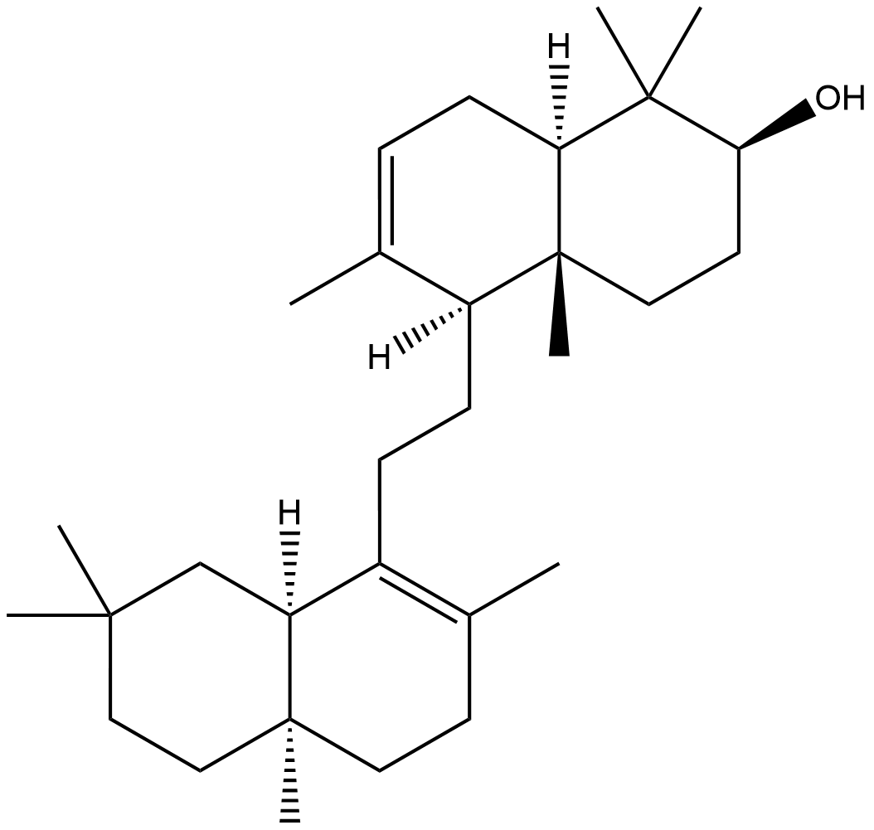
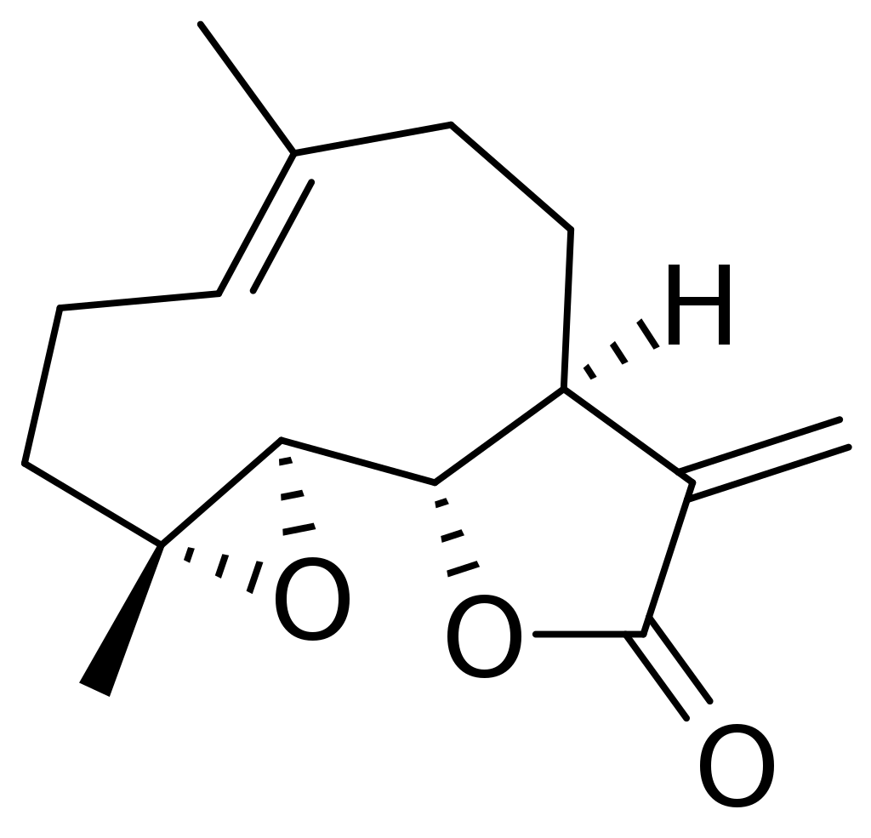
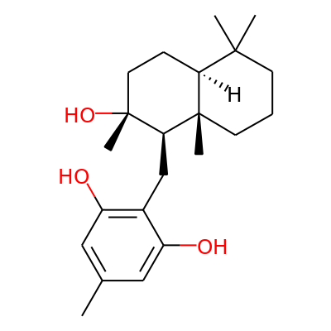
What are terpene synthases?
Terpenoids
Largest class of natural products
Notes:
What are terpene synthases -> terpenoid synthesis -> Terpenoids -> all around us -> medicine -> diverse

Slide 4
Terpene synthases (TPS)
Terpenoids
Terpenes
Compounds made from terpenes by special tailoring enzymes
Terpenes – carbon backbones of terpenoids
Notes:
Terpenoids vs terpenes

Slide 5
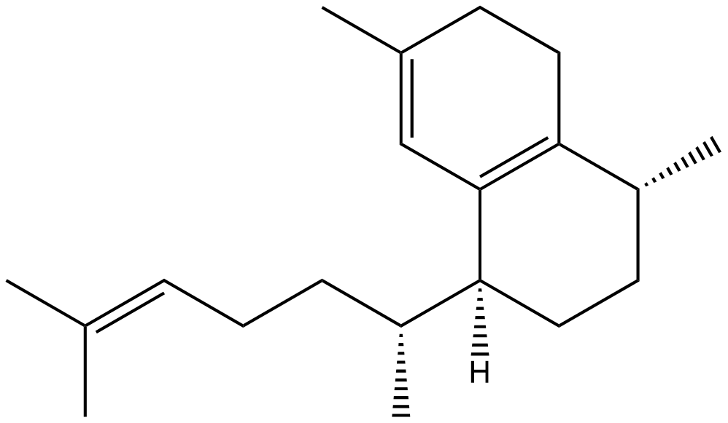
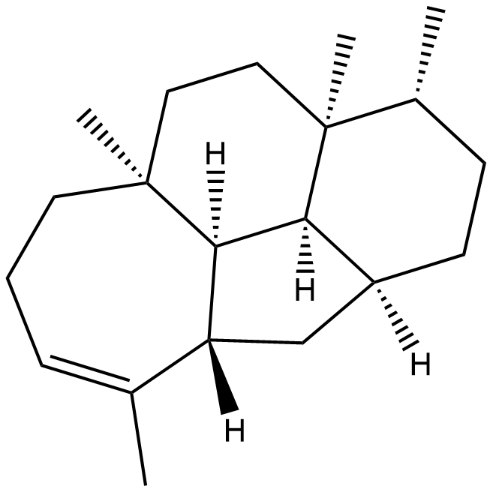
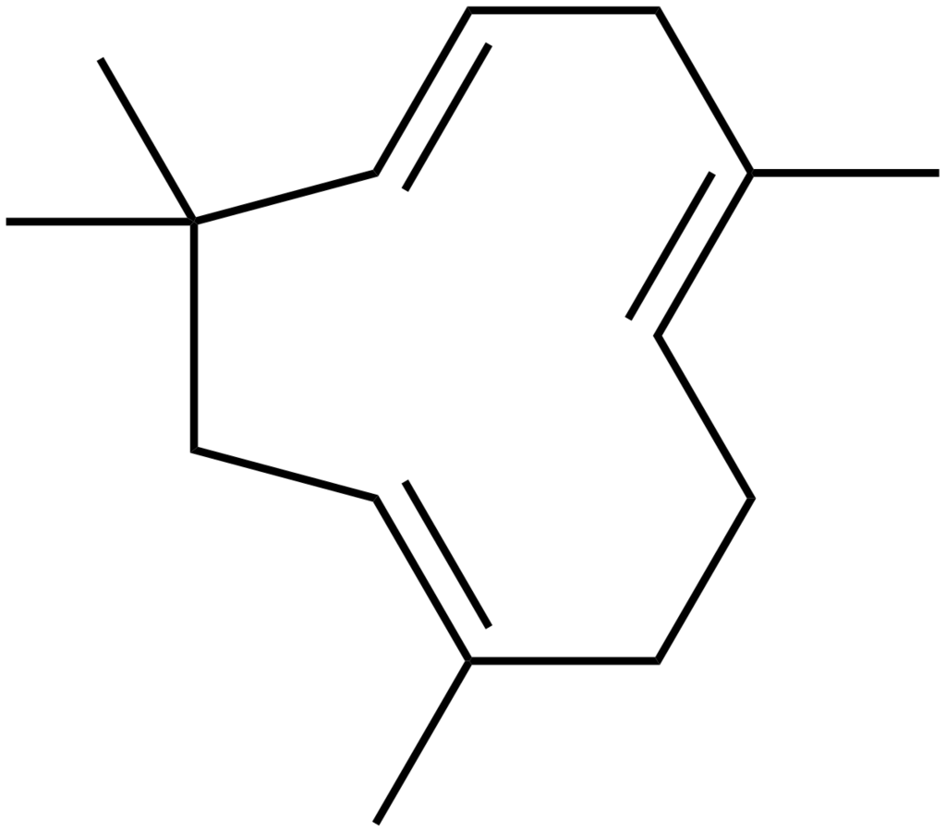
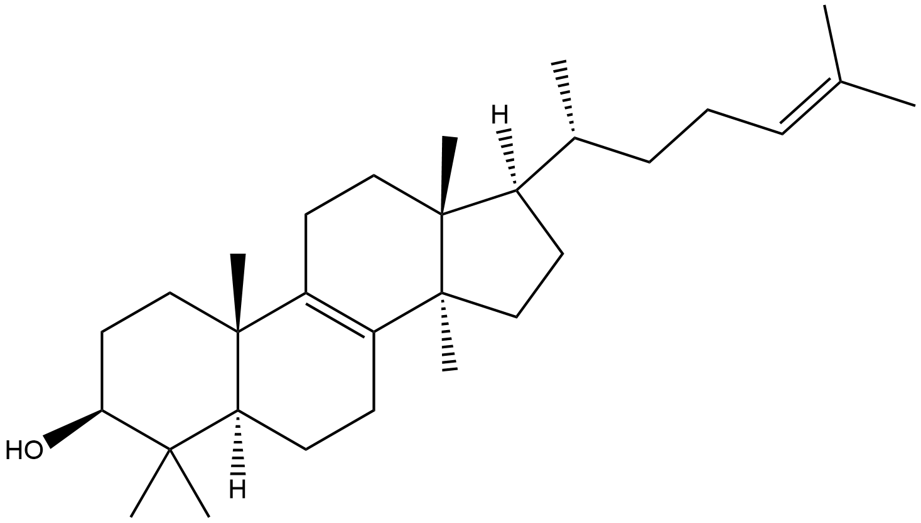
Terpenes
Notes:
Terpenes still very diverse

Slide 6
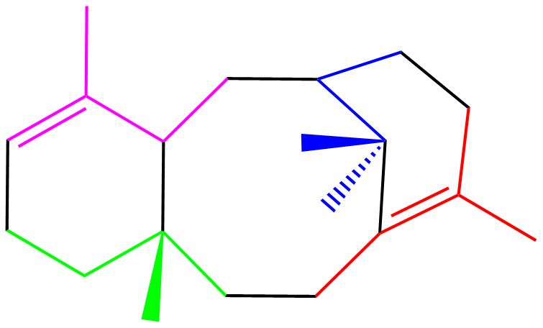
Terpene substrates
mono-
sesqui-
di-
sester-
tri-
Terpene types
Isoprene units
Notes:
Created from simple precursors of varing lengths -> complex mechanisms

Slide 7
Terpene synthase reaction
Notes:
Terpene synthases know about 10 different steps by which they turn a simple precursor into a compound that is often quite complex, with many cycles.

Slide 8
Why terpene synthases?
Tell me you secrets!
Enzyme function prediction
Terpenes are interesitng
The reactions are complex yet organized – reaction mechanisms
Defined set of substrates
Machine learning requires data – where to find data?
Notes:
TPS -> interesting, the mechanistic complexity offers a way to understand -> look at mechanism -> stepwise transformation

Slide 9
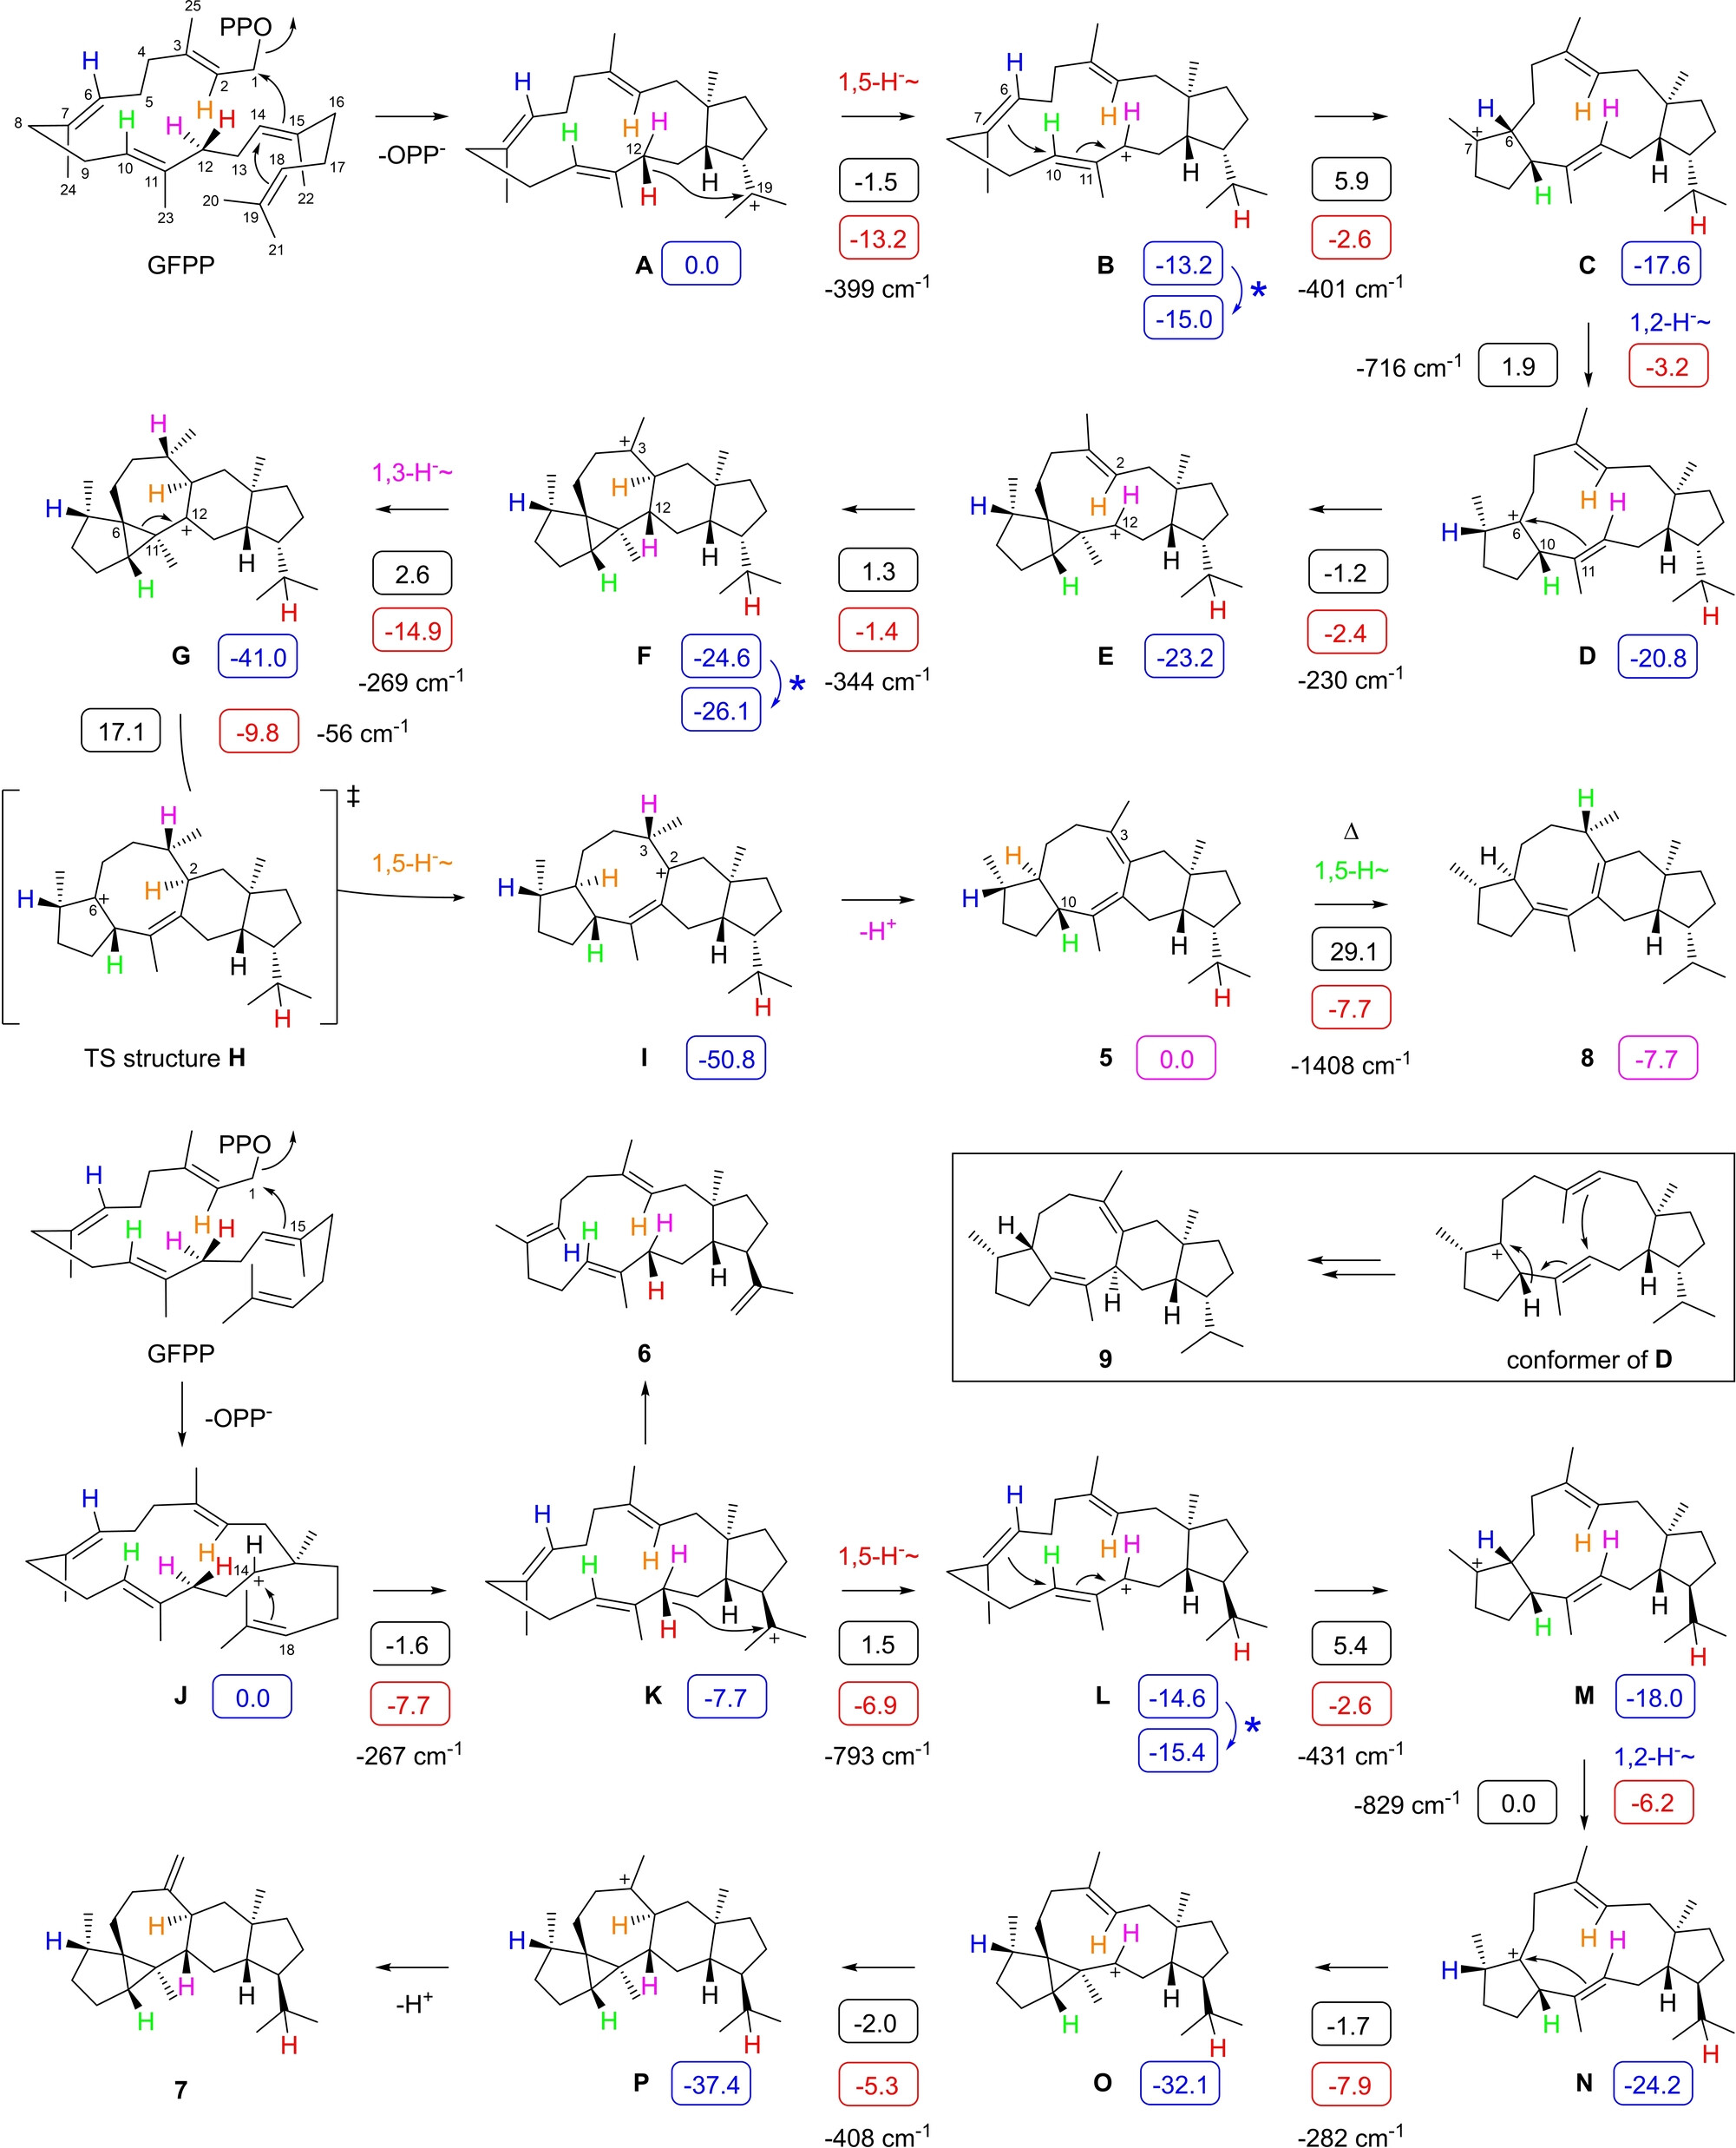
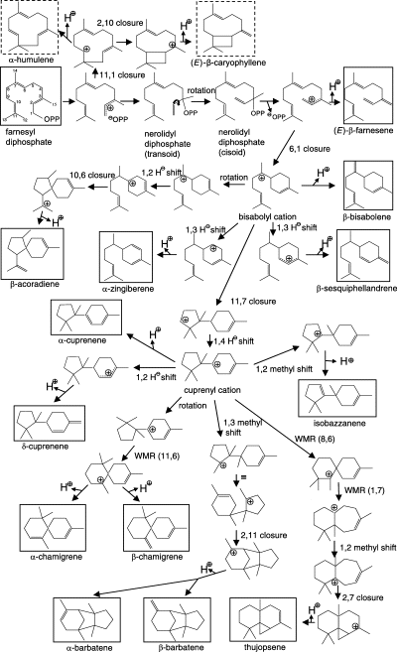
Dataset construction
Previously – no unified source for terpene synthases
Dataset!
Hundreds of papers
Reactions and mechanism
Notes:
So a dataset was constructed from manual curation of papers

Slide 10
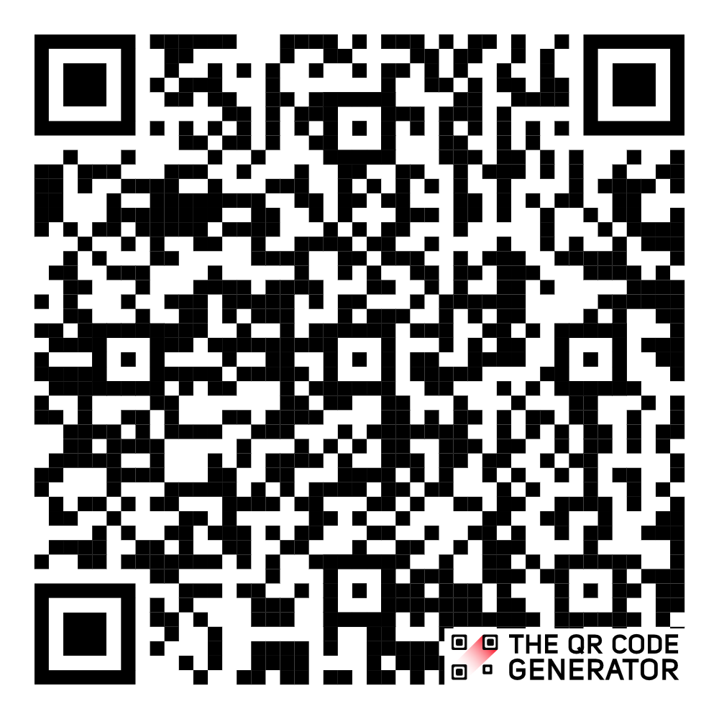
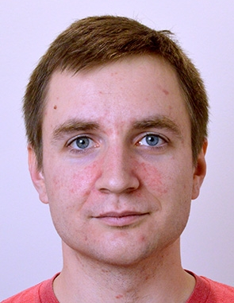
How was the dataset used
Are you a terpene synthase?
Novel terpene synthase discovery
https://www.biorxiv.org/content/10.1101/2024.01.29.577750v4
Onwards to the next tasks
What do you do? Could you help me create others like you?
Also used in other labs – how to share the data?
Notes:
Used already for novel TPS Discovery and is currently used in next tasks even in other labs -> so it needs to be shareable -> you could share it just as a datafile or you could make a framework for it and upgrade the dataset to a true database -> better than a csv in some repostiory

Slide 11
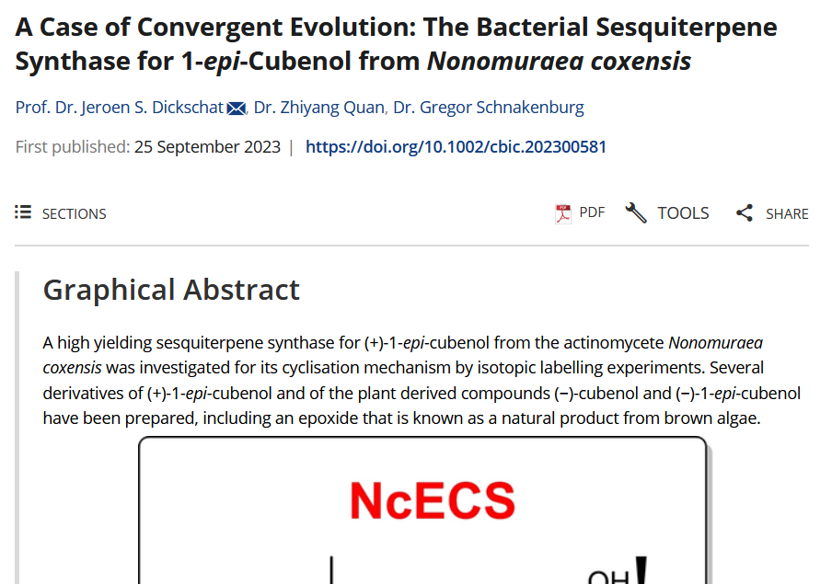
How to build a database
Transform data
Notes:
Which is what we did -> dtaset turned to SQL database, model constructed to save all the data and more

Slide 12
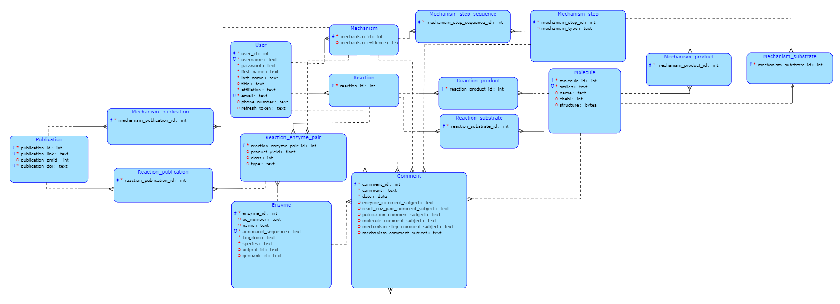
How to build a database
Host it somewhere
Behold a database!
MySQL
Now make the database accessible?
Notes:
And so a mysql database to hold the dataset was built, but a database should be presentable.

Slide 13
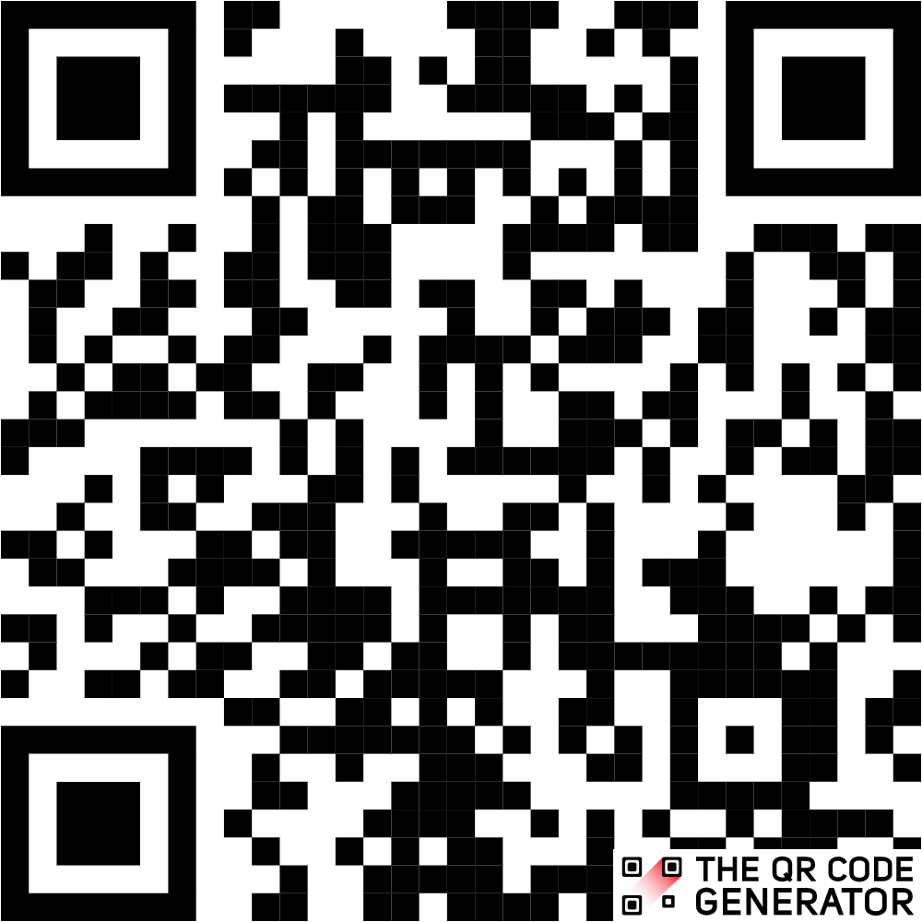
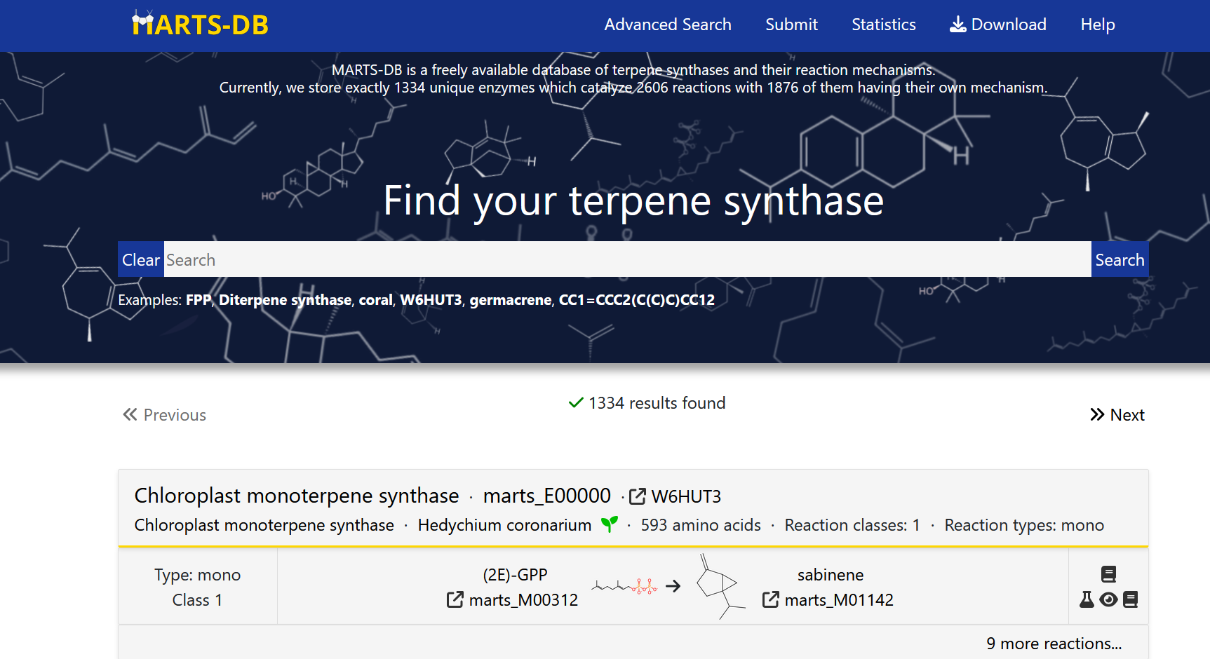
How to present a database
marts-db.org
Buy a domain
Notes:
And so MARTS-DB was born – exists on marts-db.org -> user friendly, holds the entrée dataset

Slide 14
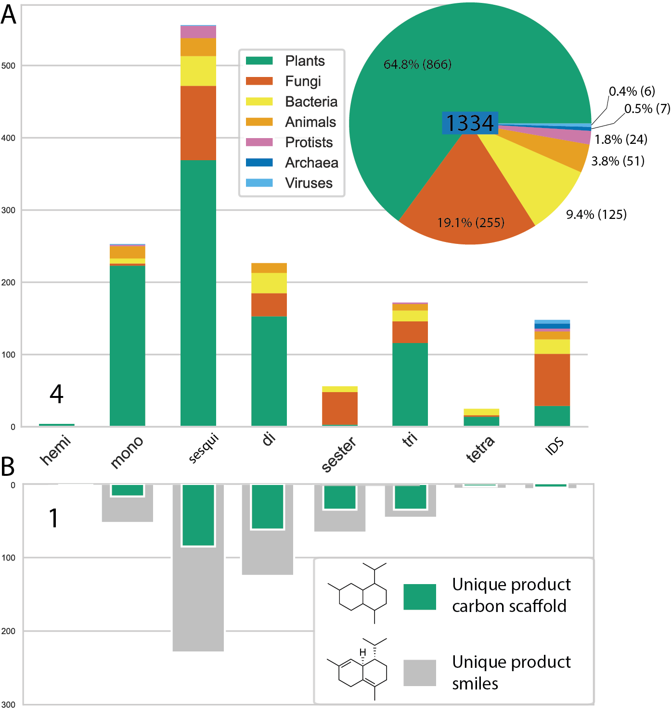
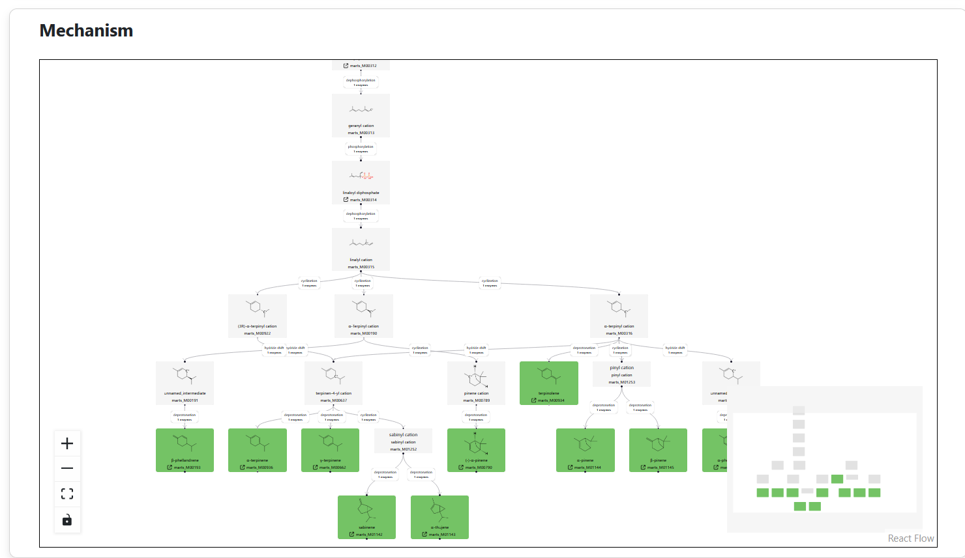
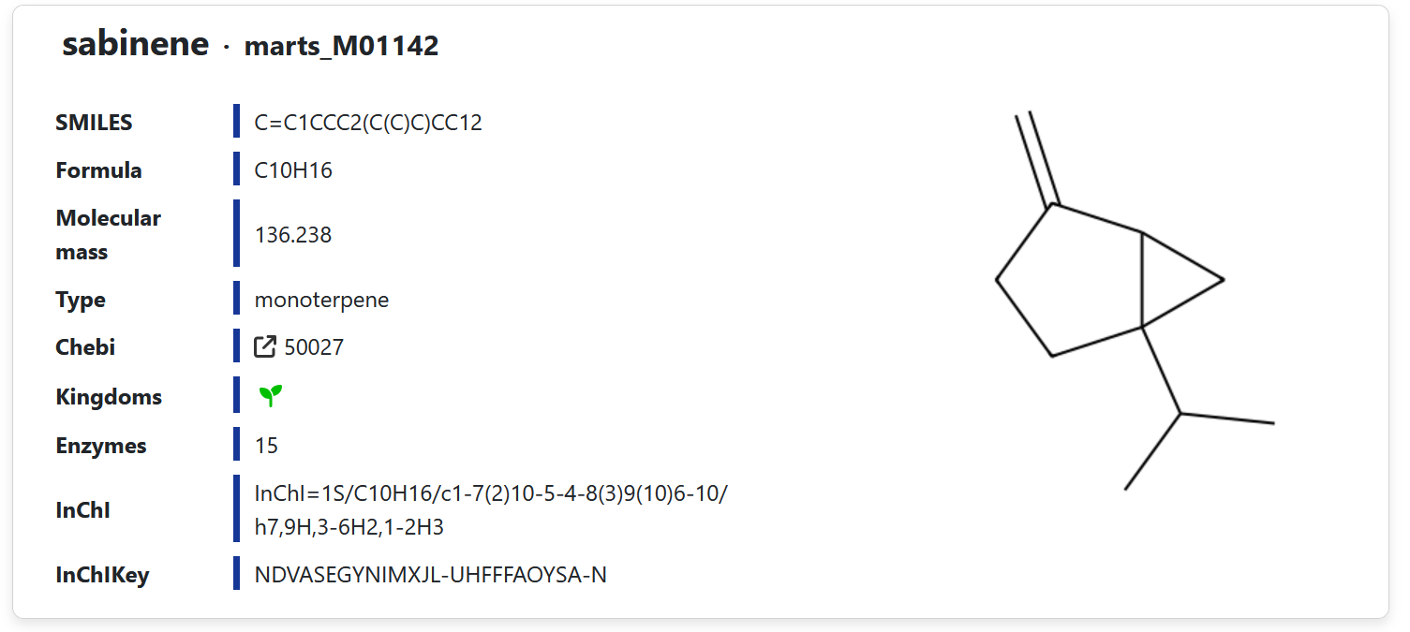
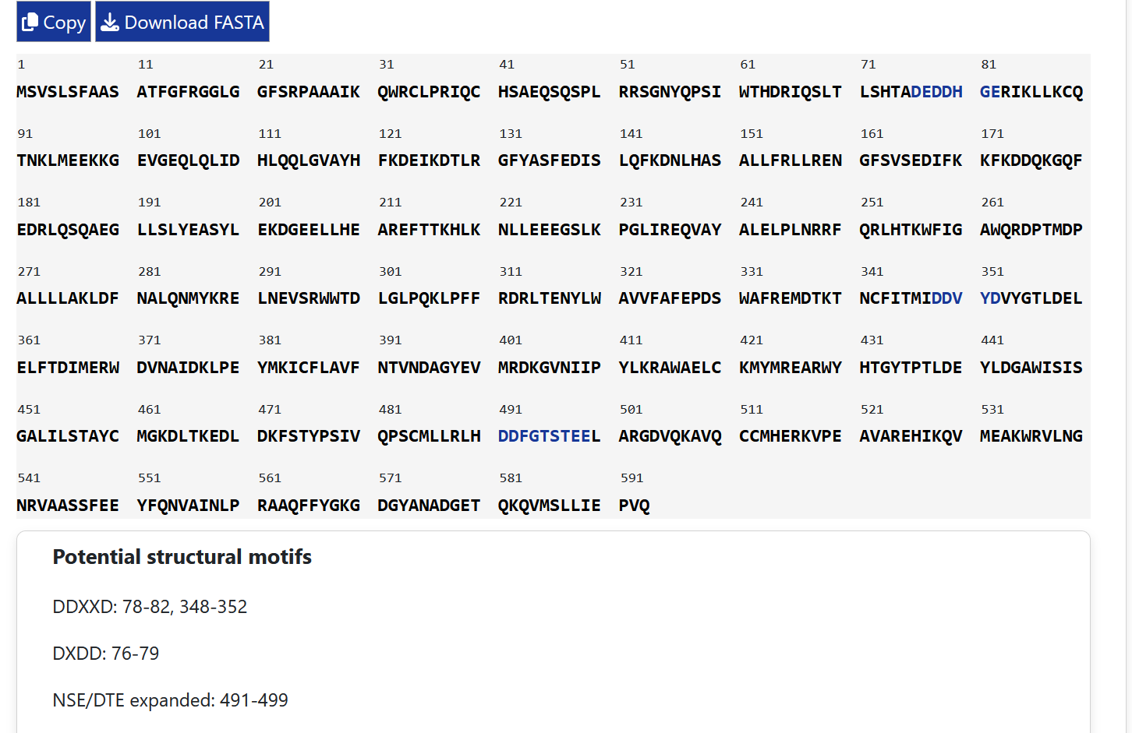
- A web for TPS lovers
Browse and download over 1300 terpene synthases from all domains of life
Notes:
More than 1300 enzymes -> Can be freely browsed and downloaded in standard formats (csv, fasta, cytoscape json) -> user friendly and clear (at least I tried)

Slide 15
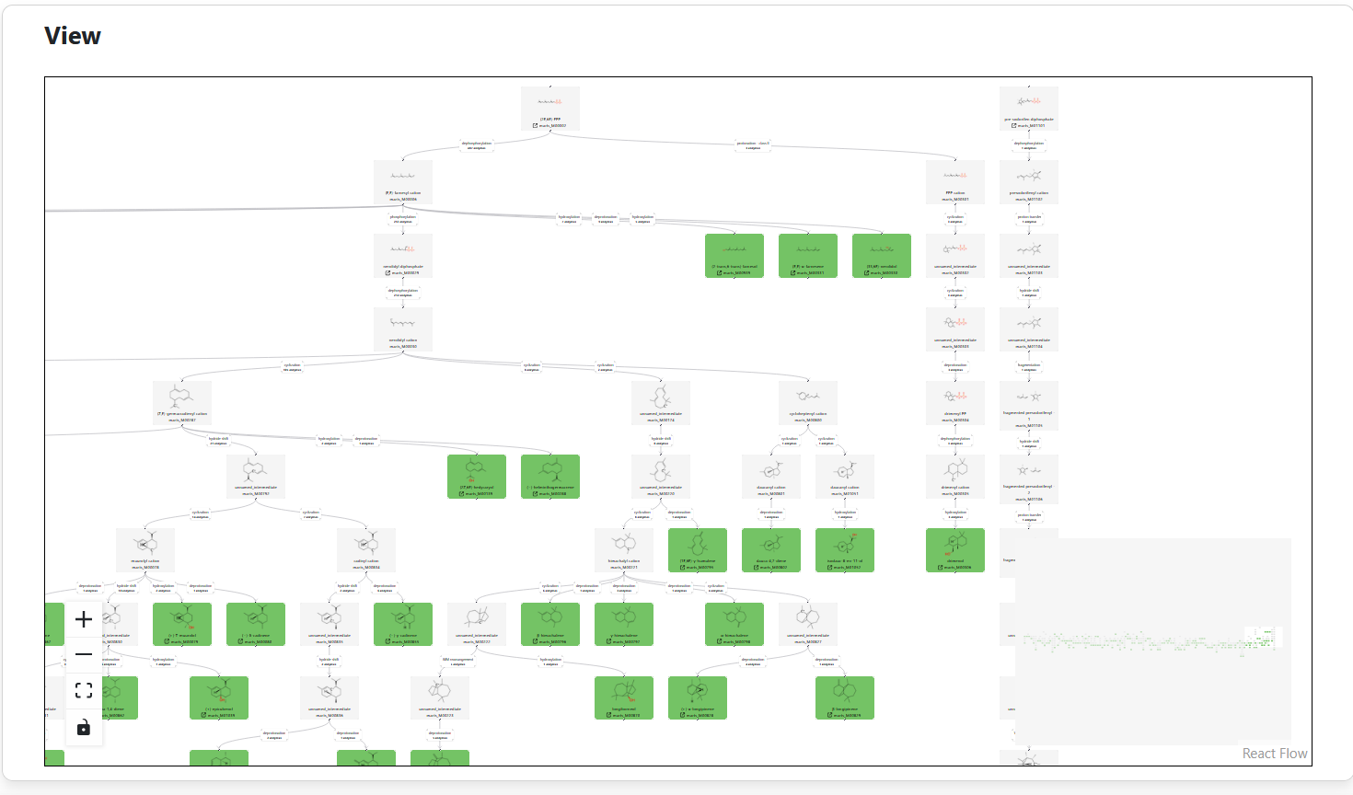
- A web for TPS lovers
Explore reaction mechnisms across the known terpenome
Search trees by kingdoms, enzymes….
Notes:
Mechanisms browsed as networks -> very cool and unique -> important

Slide 16
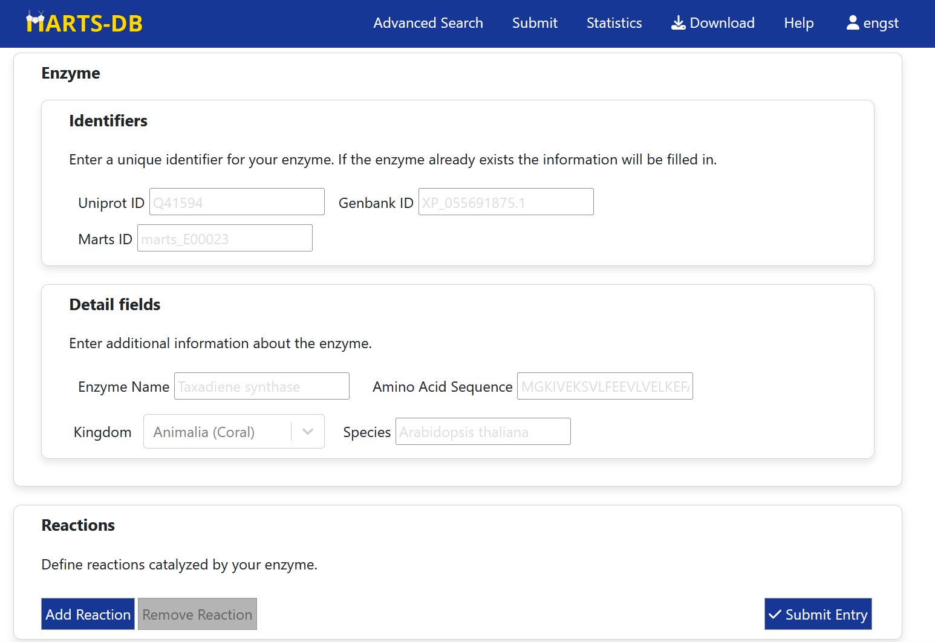
- A web for TPS reasearchers
Submission of new data from the community
Data is checked before release
Every change marked in changelog to ensure consistency of data
Notes:
As a unified terpene web server MARTS-DB allows users to contribute their data -> data checked -> changelog to ensure consistency

Slide 17
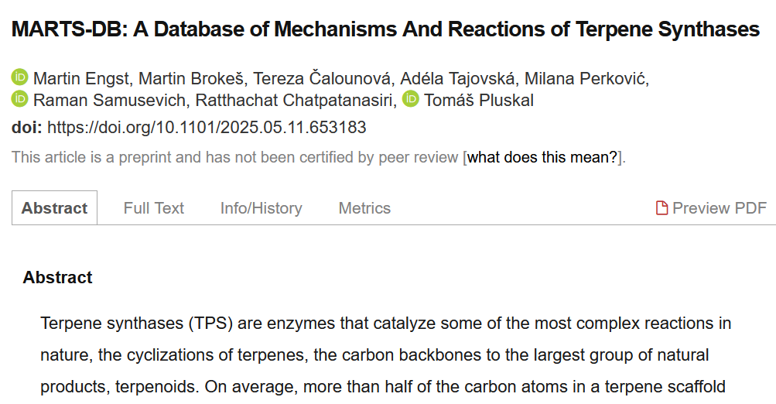
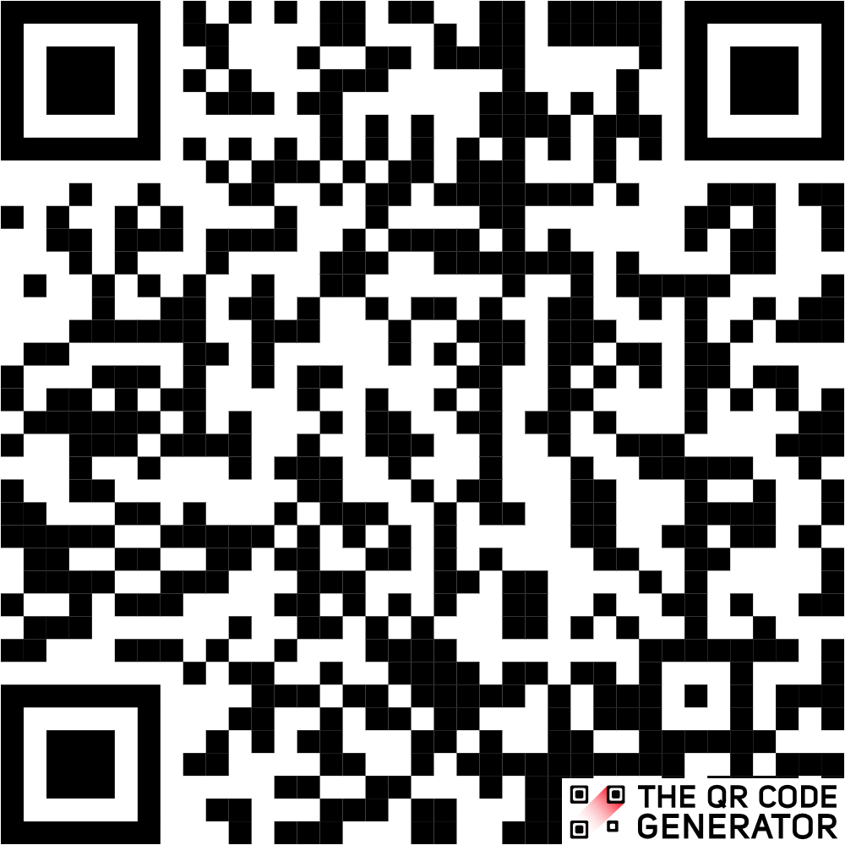
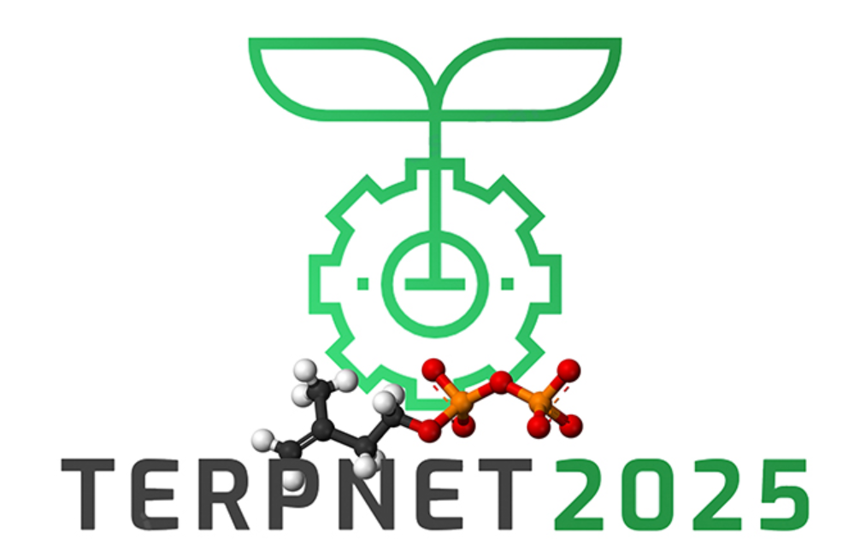
The future of
Publishing in the current form
Presentation to public
Here we are
Notes:
The developement is nearing the end of its most intensive first phase -> will push for publishing and is being preented at conferences

Slide 18
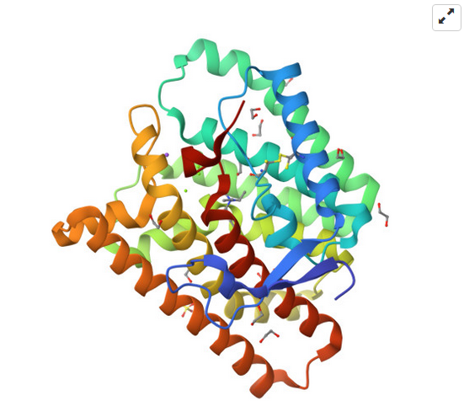
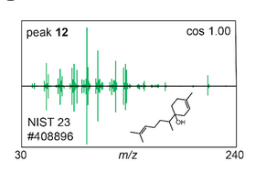
The future of
Continuous expansion of the dataset
Expansion to a terpene study platform
Structural information
Mass spectrometry information
Notes:
Stilll the dataset will be exapnded with the help of community and new features will be developer like strcutral module of perhaps a spectroscopy module

Slide 19
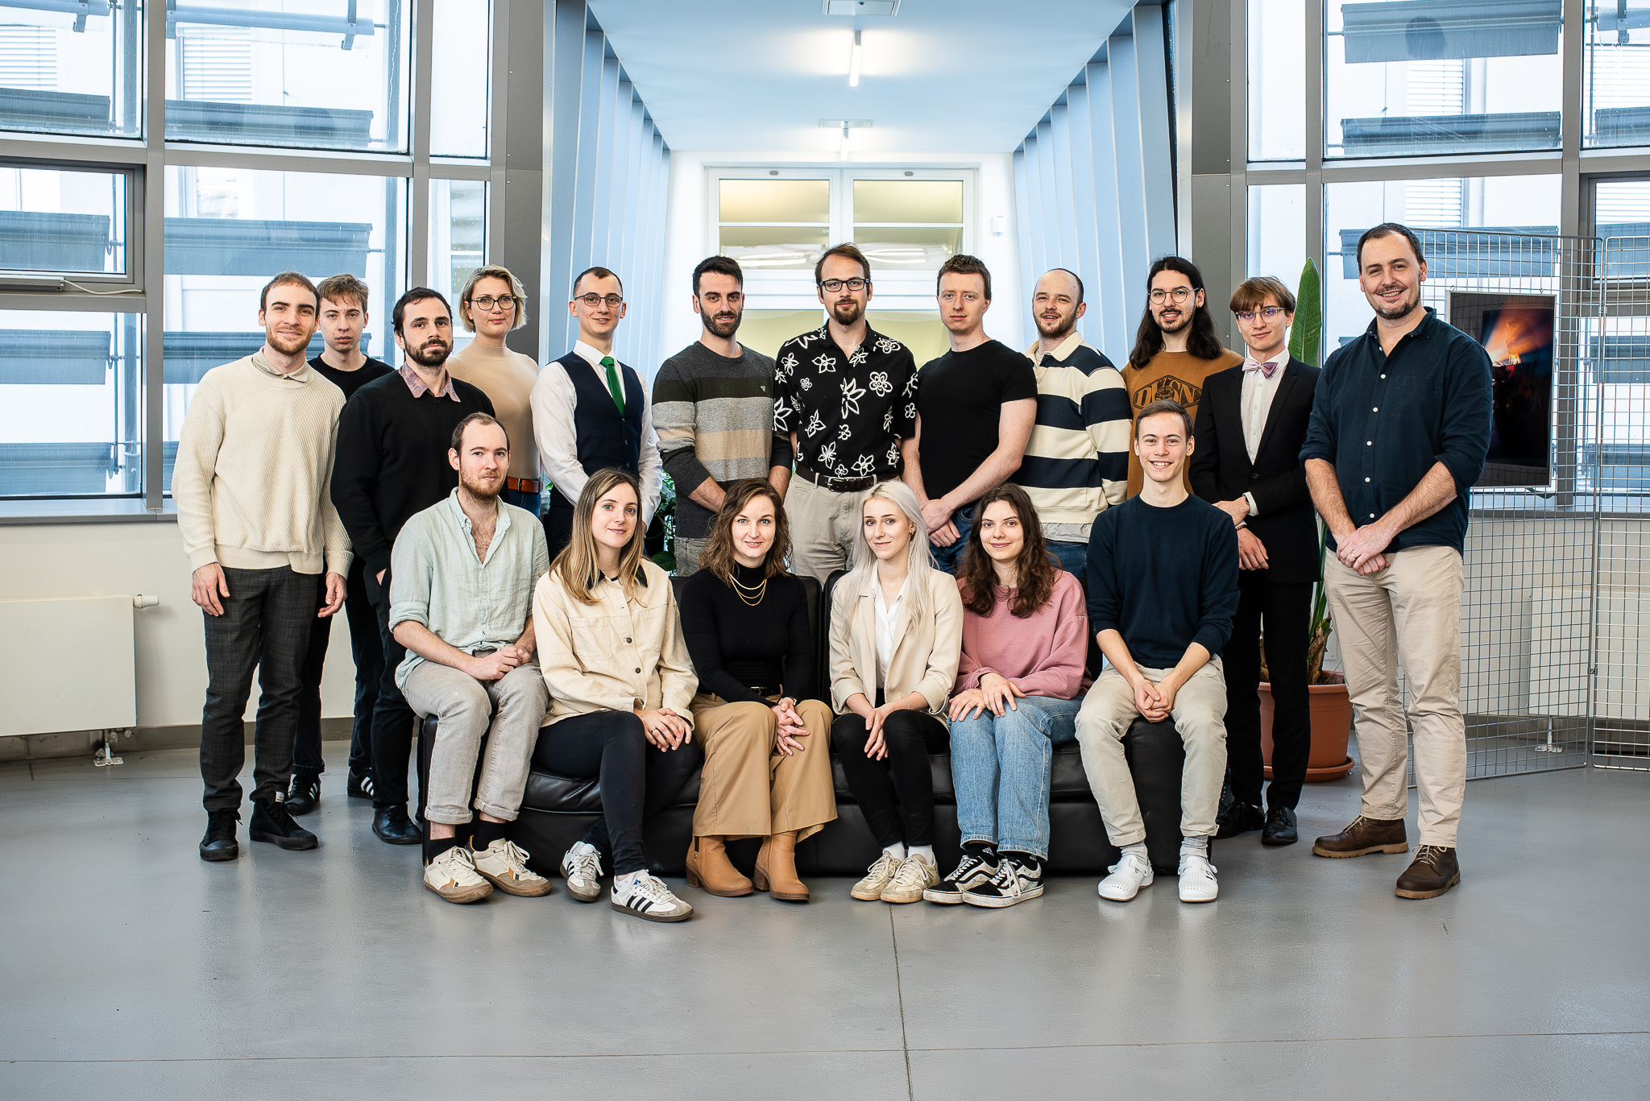
Acknowledgement
Laboratory of Biochemistry of Plant Specialized Metabolites
Martin Brokeš
work on MARTS-DB
Tereza Čalounová, Adéla Tajovská, Milana Perković, Samusevich, Ratthachat Chatpatanasiri – work of the TPS dataset
Tomáš Pluskal
supervisor
Notes:
Thanks and acknowledgements

