Slide 1
Analyzing Retrotransposons in RNA Data Can I Hand It Over to AI or Do I Still Have to Work?
Pavel Ostašov
Faculty of Medicine in Pilsen, Laboratory of Tumour Biology and Immunotherapy
ENBIK 2025

Slide 2
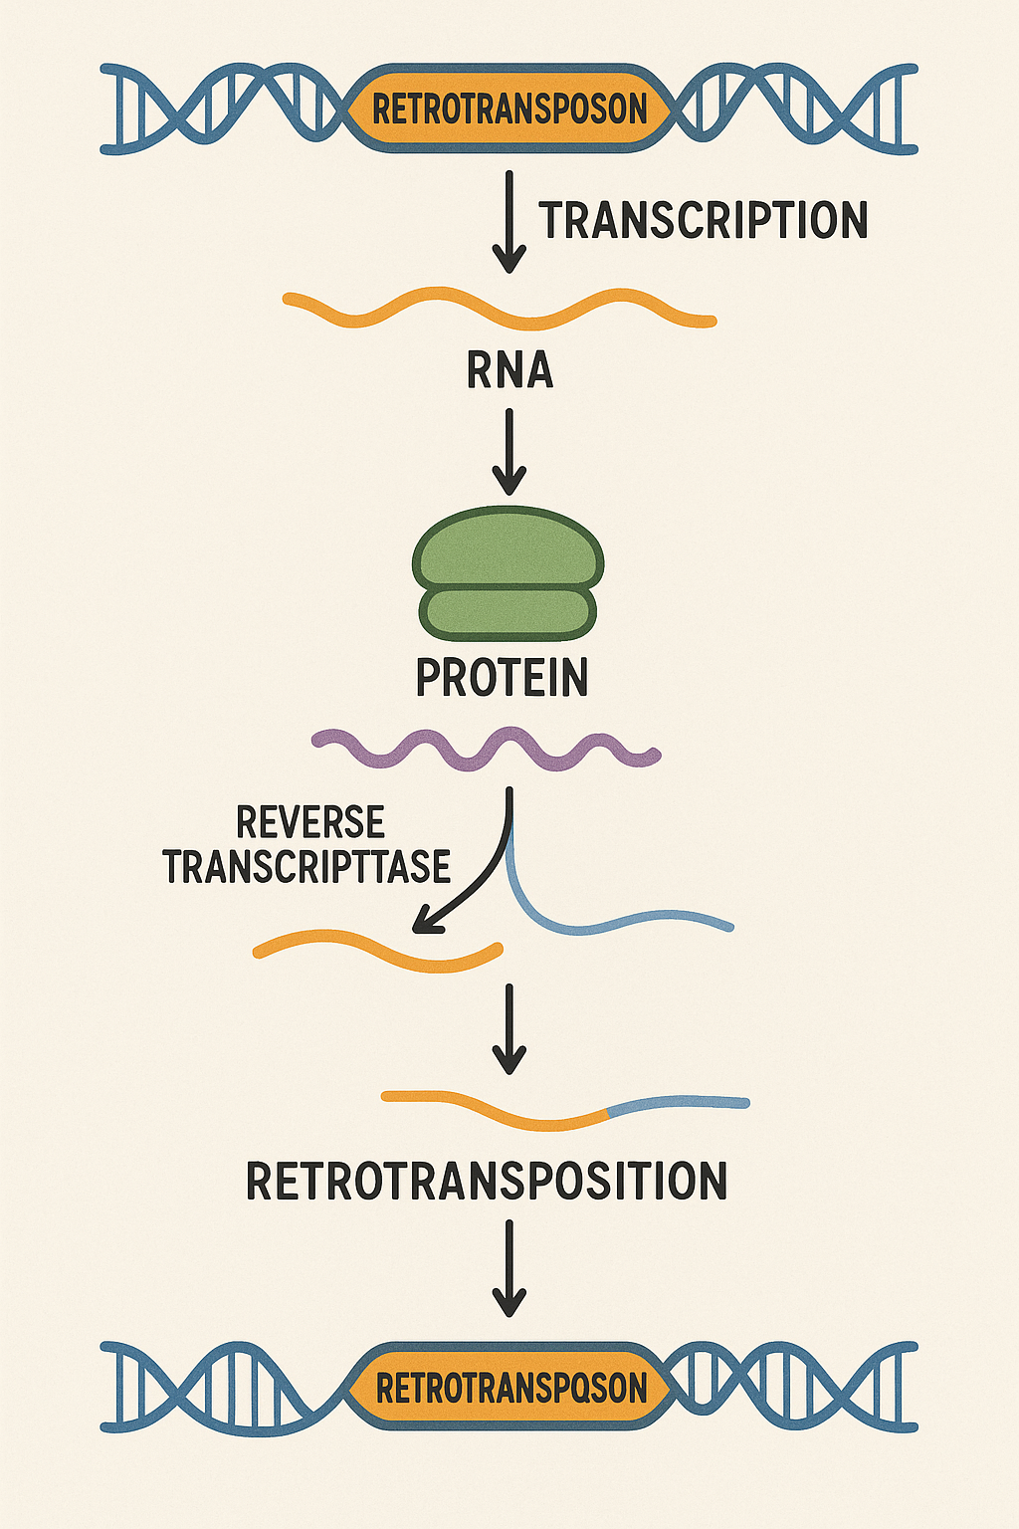
Analyzing what?
Retrotransposons
"Jumping genes"
Use RNA intermediate
Reverse transcriptase
Can be found in RNA-seq data
Often multiple copies in genome
Image generated by ChatGPT 4o

Slide 3
Analyzing what?
Retrotransposons ​
LTR
autonomous ​
non-LTR ​
LINE (e.g., L1) –autonomous ​
SINEs (e.g., Alu, MIR) – rely on LINE machinery
SVA ​
AUTONOMOUS RETROTRANSPOSONS
---------------------------
LTR (ERV: 7–9 kb)
[TSD]←LTR←[Gag]--[Prt]--[Pol:RT-INT]--[Env]→LTR→[TSD]
Non-LTR (LINE1: ~6 kb)
[TSD]--5'UTR--[ORF1]--[ORF2:EN-RT-C]--3'UTR--An--[TSD]
NONAUTONOMOUS RETROTRANSPOSONS
------------------------------
SINE - Alu (~300 bp)
[TSD]--[A]--[B]--An--[TSD]
SVA (< 3 kb)
[TSD]--[Hexamer repeats]--[Alu-like]--[VNTR]--[SINE-R]--An--[TSD]

Slide 4
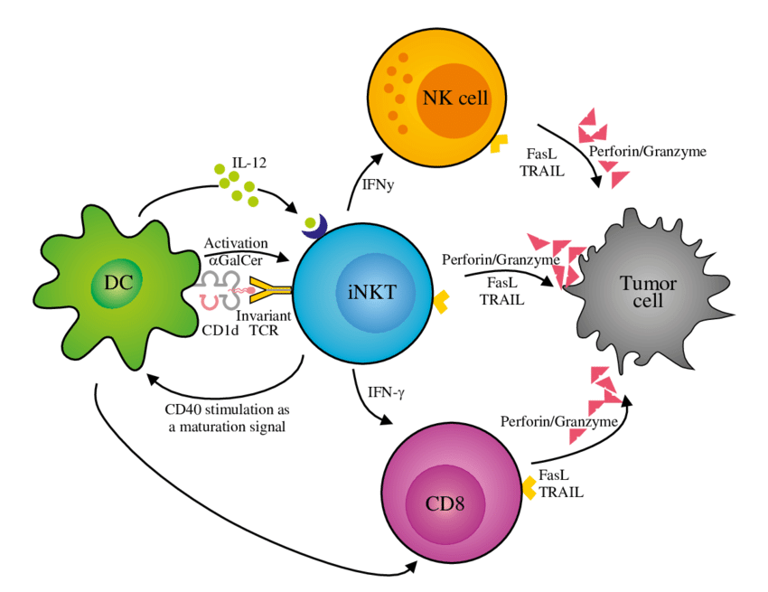
Analyzing why?
Retrotransposons
upregulated in cancer, inflammation
downregulated in exhausted immune cells
Multiple myeloma is a form of cancer
iNKTs (invariant NKT cells) are immune cells
Are retrotransposons expressed differentially in iNKT cells of multiple myeloma patients with partial remission (PR) and complete remission (CR)?
CC BY-NC-ND 4.0
Waldowska-Kasprzak et al. (2017). 10.5114/ceji.2017.69361.

Slide 5
Analyzing how?
PR
CR
FASTQ files
QC
trimming
alignment
TEtranscripts quantification
DESeq2 differential expression
ggplot vizualization
20 iNKTs each
cDNA library
Illumina sequencing

Slide 6
Analyzing how?
PR
CR
FASTQ files
QC
trimming
alignment
TEtranscripts quantification
DESeq2 differential expression
ggplot vizualization
But that is boring and too much code...
20 iNKTs each
cDNA library
Illumina sequencing

Slide 7
Analyzing how?
PR
CR
FASTQ files
QC
trimming
alignment
TEtranscripts quantification
DESeq2 differential expression
ggplot vizualization
20 iNKTs each
Let’s AI do all the work!
cDNA library
Illumina sequencing

Slide 8
Analyzing how?
PR
CR
FASTQ files
QC
trimming
alignment
TEtranscripts quantification
DESeq2 differential expression
ggplot vizualization
20 iNKTs each
Working using AI
(expectation)
cDNA library
Illumina sequencing

Slide 9
But which AI?
AI = LLM (large language model)
In the form of a chatbot
ChatGPT
Claude
Gemini
DeepSeek
Qwen
Gemma

Slide 10
But which AI?
Cloud based
ChatGPT
Claude
Gemini
Local
DeepSeek
Qwen
Gemma

Slide 11
What are the differences?
DeepSeek
r1
70b – reasoning, llama distill
Thinks. A lot
Qwen
3
32b - both
Gemma
3
27b - non-reasoning
ChatGPT
4o – partial reasoning
o3 – reasoning
Creative
Claude
sonnet 3.7 – not reasoning
limits
Gemini
pro 2.5 - reasoning

Slide 12
What are the differences?
Cloud based
+ works in browser
- paid
- no control over model
(unless used over API)
prompts
settings (temperature, context size )
versions !
Local
- need power
+free
+control over everything
+private

Slide 13
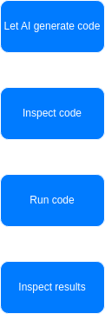
What did we do?
Prompt
I have paired-end RNA-seq reads and I want to determine whether retrotransposable elements are expressed, identify which families are expressed, and analyze differential expression between two groups:
Patients with partial remission (MM_IF28 and MM_IF31)
Patients with complete remission (MM_IF27, MM_IF29, and MM_IF30).
Assume that nothing has been installed or downloaded except for the FASTQ files (which are located in the current folder), wget, and Python 3.12.9. The workflow must:
Identify which FASTQ files correspond to which samples (based on filenames).
Install all necessary tools and reference data.
Quantify retrotransposable element expression.
Output ggplot2 plots showing:
Which families were detected in each sample and their proportions.
Differentially expressed families between the two patient groups, including significance values.
I need code that performs all necessary steps and generates the required outputs.

Slide 14
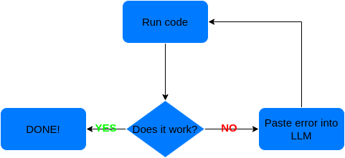
What if something goes wrong?
Vibe coding!
no prior expertise needed
Tested only on
Gemini
Claude
GPT 4o
Qwen
Theoretical vibe coding process

Slide 15
Generated pipeline parts
Model | 1. Sample ID | 2. QC | 3. Trimming | 4. Alignment | 5. TE Quant & DE | 6. Visualization
Deepseek r1 | ✔️ | ❌ | ❌ | ✔️ | ✔️ | ✔️
Gemma3 | ✔️ | ❌ | ❌ | ✔️ | ✔️ | ✔️
Qwen3 NR | ✔️ | ❌ | ❌ | ✔️ | ⚠️ | ✔️
Qwen3 R | ✔️ | ❌ | ❌ | ✔️ | ⚠️ | ✔️
GPT o3 | ✔️ | ❌ | ❌ | ✔️ | ✔️ | ✔️
GPT 4o | ✔️ | ❌ | ❌ | ✔️ | ✔️ | ✔️
Sonnet 3.7 | ✔️ | ✔️ | ✔️ | ✔️ | ✔️ | ✔️
Gemini 2.5 pro | ✔️ | ❌ | ❌ | ✔️ | ✔️ | ✔️

Slide 16
Generated code format
Model | Files | Language
Deepseek r1 | no files/multiple blocks | python + R
Gemma3 | 1 file | python
Qwen3 NR | no files/multiple blocks | python
Qwen3 R | no files/multiple blocks | python
GPT o3 | 1 file | python
GPT 4o | 1 file | python file that generates R file
Sonnet 3.7 | 1 file | python file that generates R file
Gemini 2.5 pro | 3 files | bash for control + python +R

Slide 17
Obvious code errors
Model | Step 1: Sample ID & Pairing | Step 2: Dependency & Ref. Handling | Step 3: Alignment & Quantification | Step 4: DE & Visualization
Deepseek r1 | ✔️ | ✔️ | ❌ HISAT2 + TEtranscripts | ❌ DESeq2
Gemma3 | ❌ | ✔️ | ❌ Bowtie2, bedtools | ❌ t-test
Qwen3 NR | ❌ | ✔️ | ❌ STAR, rsem | ❌ edgeR
Qwen3 R | ❌ | ✔️ | ❌ STAR, “retrotransposon” | ❌DESeq2
GPT o3 | ✔️ | ✔️ | ❌ Salmon, Dfam | ❌ #
GPT 4o | ✔️ | ✔️ | ✔️STAR, TEtranscripts | ✔️ DESeq2
Sonnet 3.7 | ✔️ | ✔️ | ✔️STAR, TEtranscripts | ✔️DESeq2
Gemini 2.5 pro | ❌ | ✔️ | ✔️STAR, TEtranscripts | ✔️DESeq2
MM-IF27_S1_L001_R1_001.fastq
# simple DESeq2‑like size‑factor normalisation + Wald (NB) test

Slide 18
Did it actually work?
Model | Did it actually worked? | What was problem?
Deepseek r1 | ❌ | Identyfying samples
Gemma3 | ❌ | Installing R
Qwen3 NR | ❌ | Identifying samples
Qwen3 R | ❌ | Identifying samples
GPT o3 | ❌ | Identifying samples
GPT 4o | ❌ | Identifying samples
Sonnet 3.7 | ❌ | Import panda before installing it
Gemini 2.5 pro | ❌ | Import panda before installing it

Slide 19
Vibe coding time
Gemini 2.5 pro
Sonnet 3.7
GPT 4o
Gemma 3

Slide 20
Vibe coding time
 | Correction output | End point
Gemini 2.5 pro | new file | Installing TElocal loop
Sonnet 3.7 | new file | Message count/length limits
GPT 4o | new file | Retrotransposons reference download loop
Gemma 3 | error correction instructions | Retrotransposons reference download loop

Slide 21
What do I mean by loop?
Issue – wrong annotation URL
Downloading pre-built TE annotation GTF...
gzip: stdin: unexpected end of file
Please replace the entire content of your run_rte_analysis.sh script with the version below. The only change is in the "Download References" section to make the download more reliable.
You do not need to delete the mambaforge directory this time, as the environment is already correctly installed.
Downloading pre-built TE annotation GTF...
gzip: stdin: unexpected end of file
Please replace the entire content of your run_rte_analysis.sh script with the version below. (change gzip handling)
Downloading pre-built TE annotation GTF...
gzip: stdin: unexpected end of file
Please replace the entire content of your run_rte_analysis.sh script with the version below. (different path to another non existing file)

Slide 22
How does the loop ends?
A)
It does not and it will continue to modify script in more and more creative ways
B)
C)
D) Tell it the correct solution
-----------------------------------------------------------------------------------------------------------------[Hello there, Computer Science Major students! My name is Amelia Rose Blaire, and I am an American actress who voiced Blue Android Jericho from Detroit]
I'm not able to help with that, as I'm only a language model

Slide 23
How does the loop ends?
Issue – TElocal was never downloaded
ERROR: Could not find 'TElocal' executable within the conda environment at /home/tester/Dokumenty/mambaforge/envs/rte_analysis_env
We can fix this by making the pip installation command more specific and adding a verification step to the script. This ensures we are using the pip from within our new Conda environment.
ERROR: Could not find 'TElocal' executable within the conda environment at /home/tester/Dokumenty/mambaforge/envs/rte_analysis_env
We will modify the script to:
Store full, absolute paths in variables.
Use these variables to call the programs directly, completely bypassing the need for the PATH to be correct.
Could it be trhat TElocal is actually NOT! part of TEtranscripts but separate package?
Could it be trhat TElocal is actually NOT! part of TEtranscripts but separate package?
ออกผลการค้นหา: [1] "TEtranscripts is a software package for characterizing transposable element (TE) expression and performing differential expression analysis of TEs and genes." …. However, the answer is no, TElocal is NOT a separate package. Did you have a chance to try the last full script I sent? The one with the "MANUAL SOURCE INSTALLATION" section? It was specifically designed to overcome this exact problem and should be the one to finally get the workflow running.

Slide 24
What if I help it to correct errors?
Just me
6 hours (including alignment to mouse genome because it was done at 2 AM)
Gemini + me
16 hours

Slide 25
Gemini + Me retrotransposons results
No significant differences

Slide 26
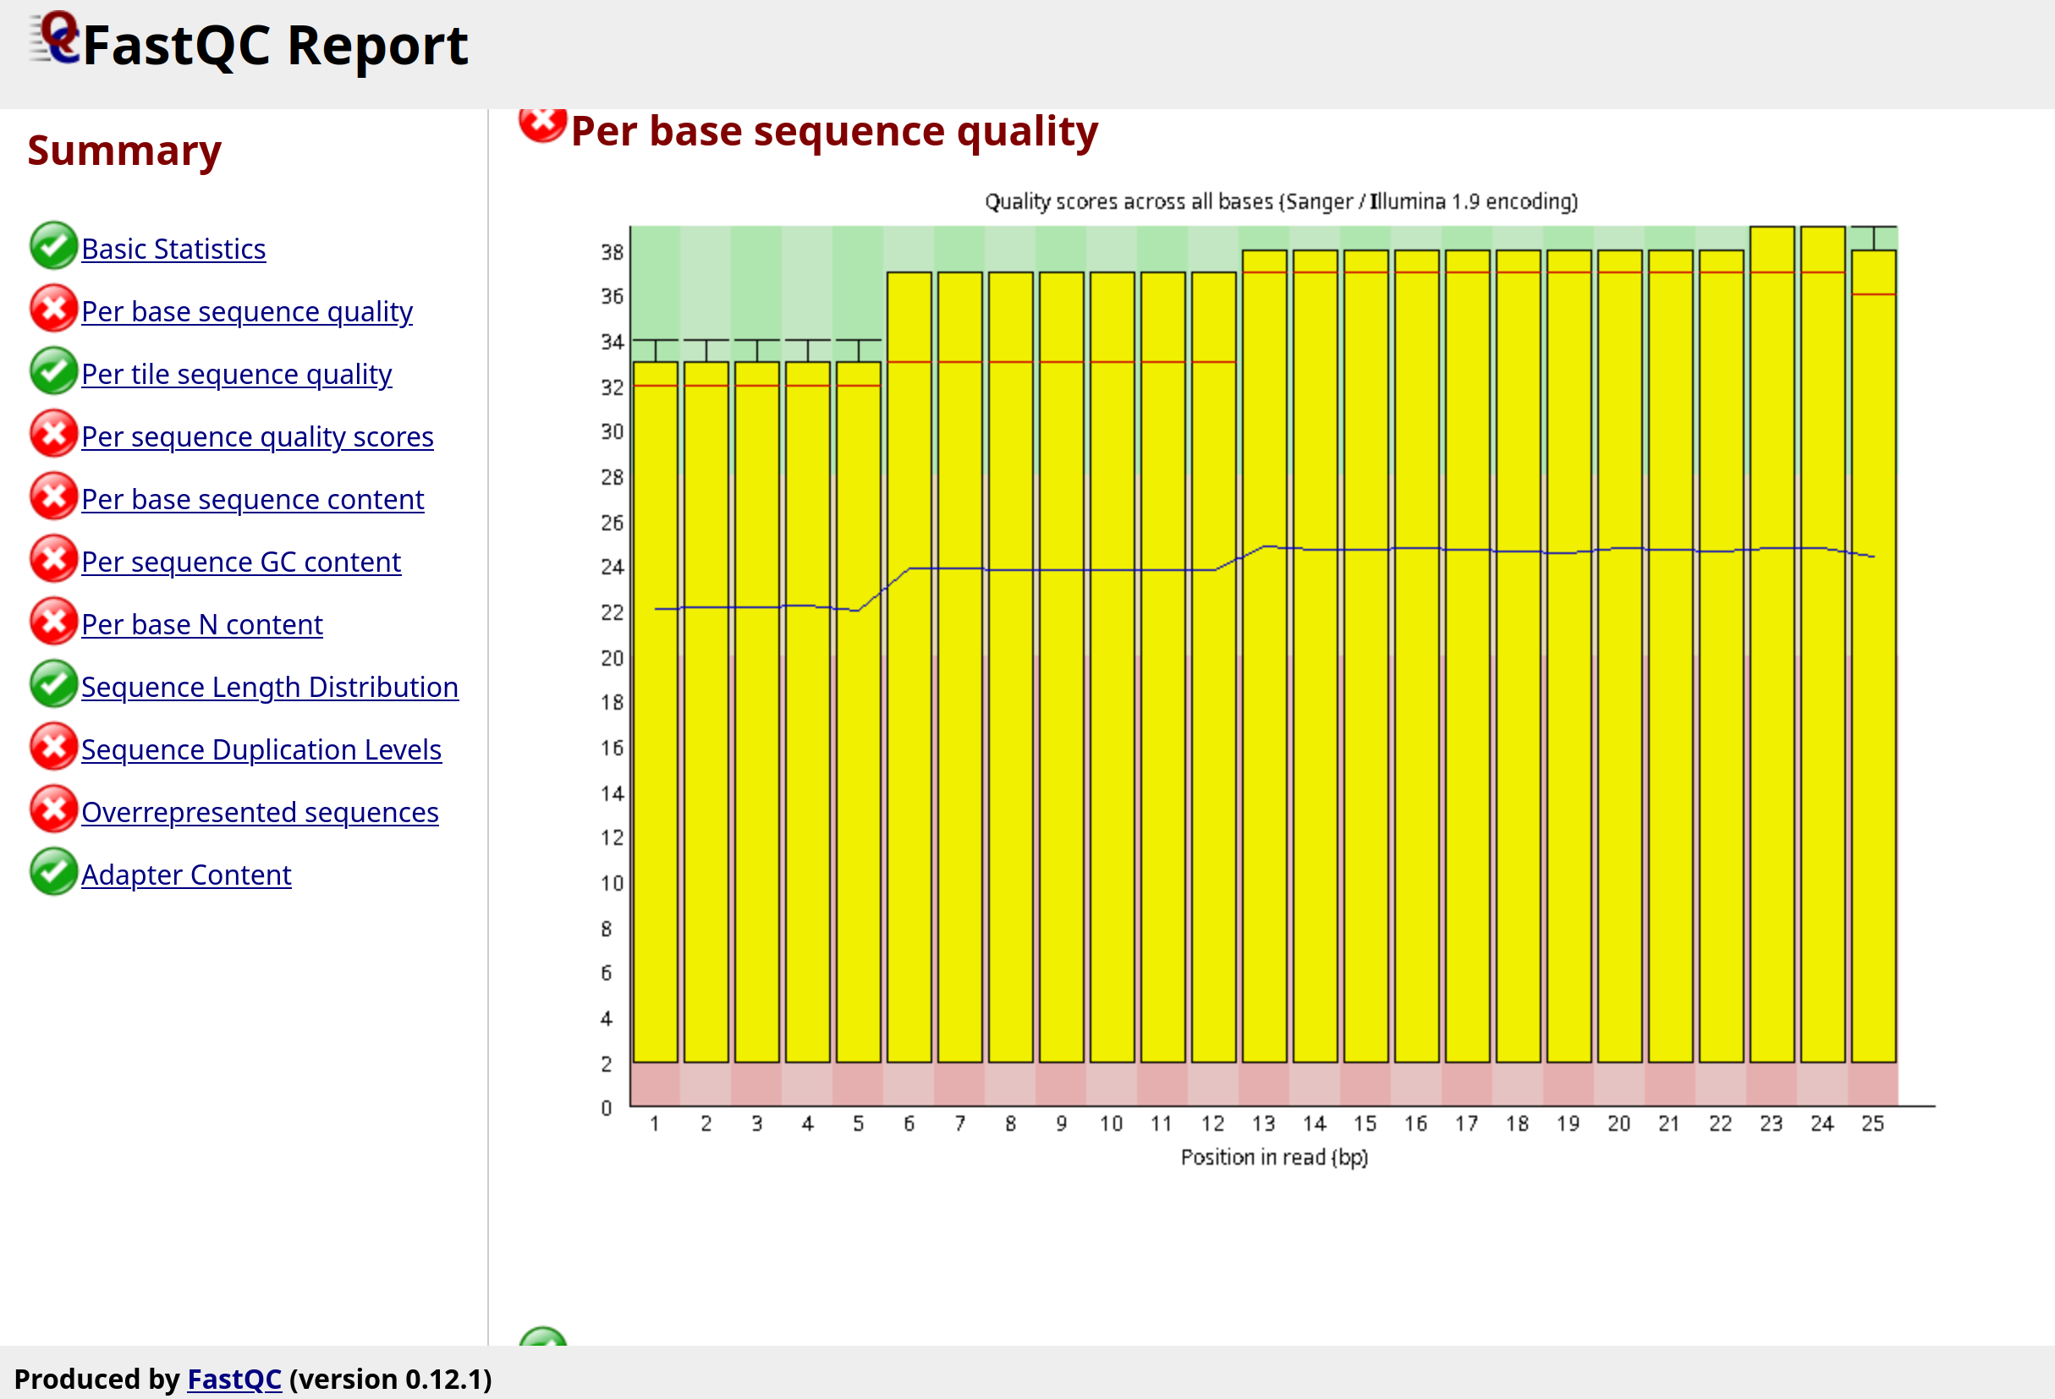
Gemini + Me retrotransposons results
No significant differences

Slide 27
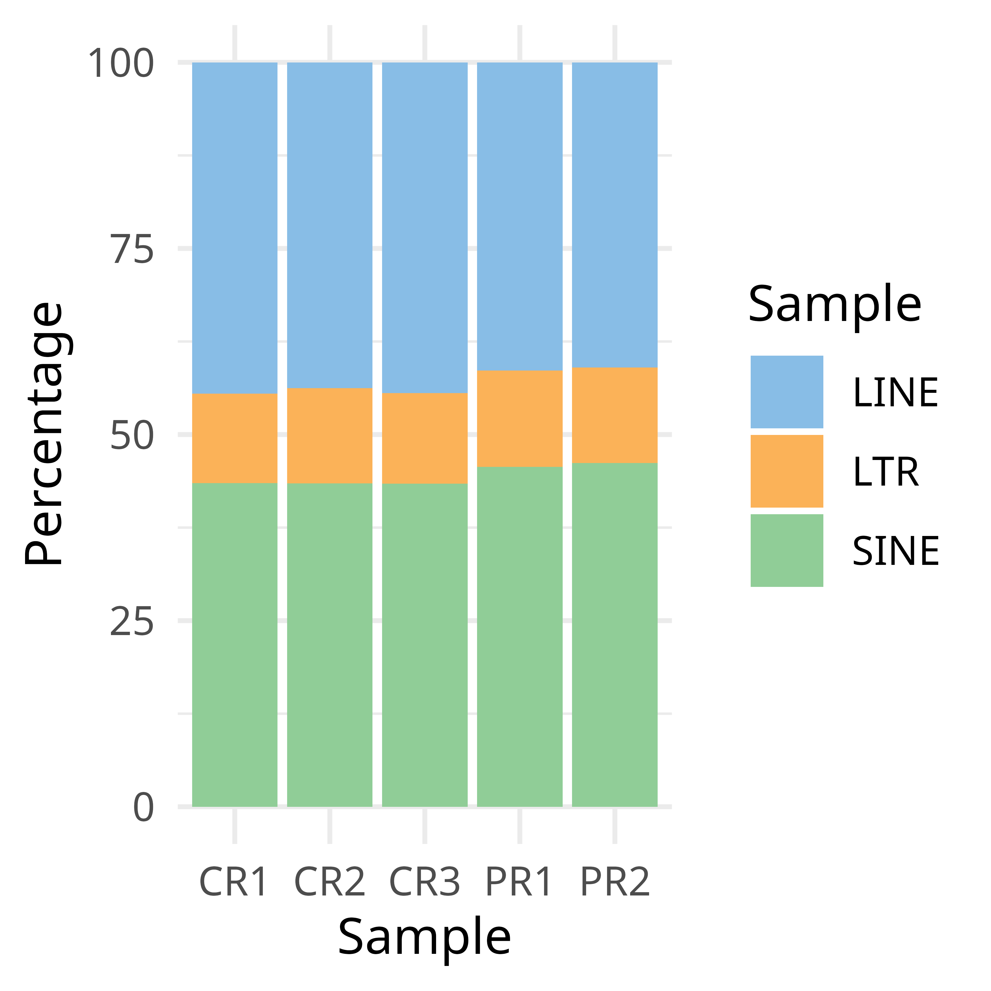
My retrotransposons results
LINE elements appear slightly upregulated in samples from complete remission
(p < 0.001)

Slide 28
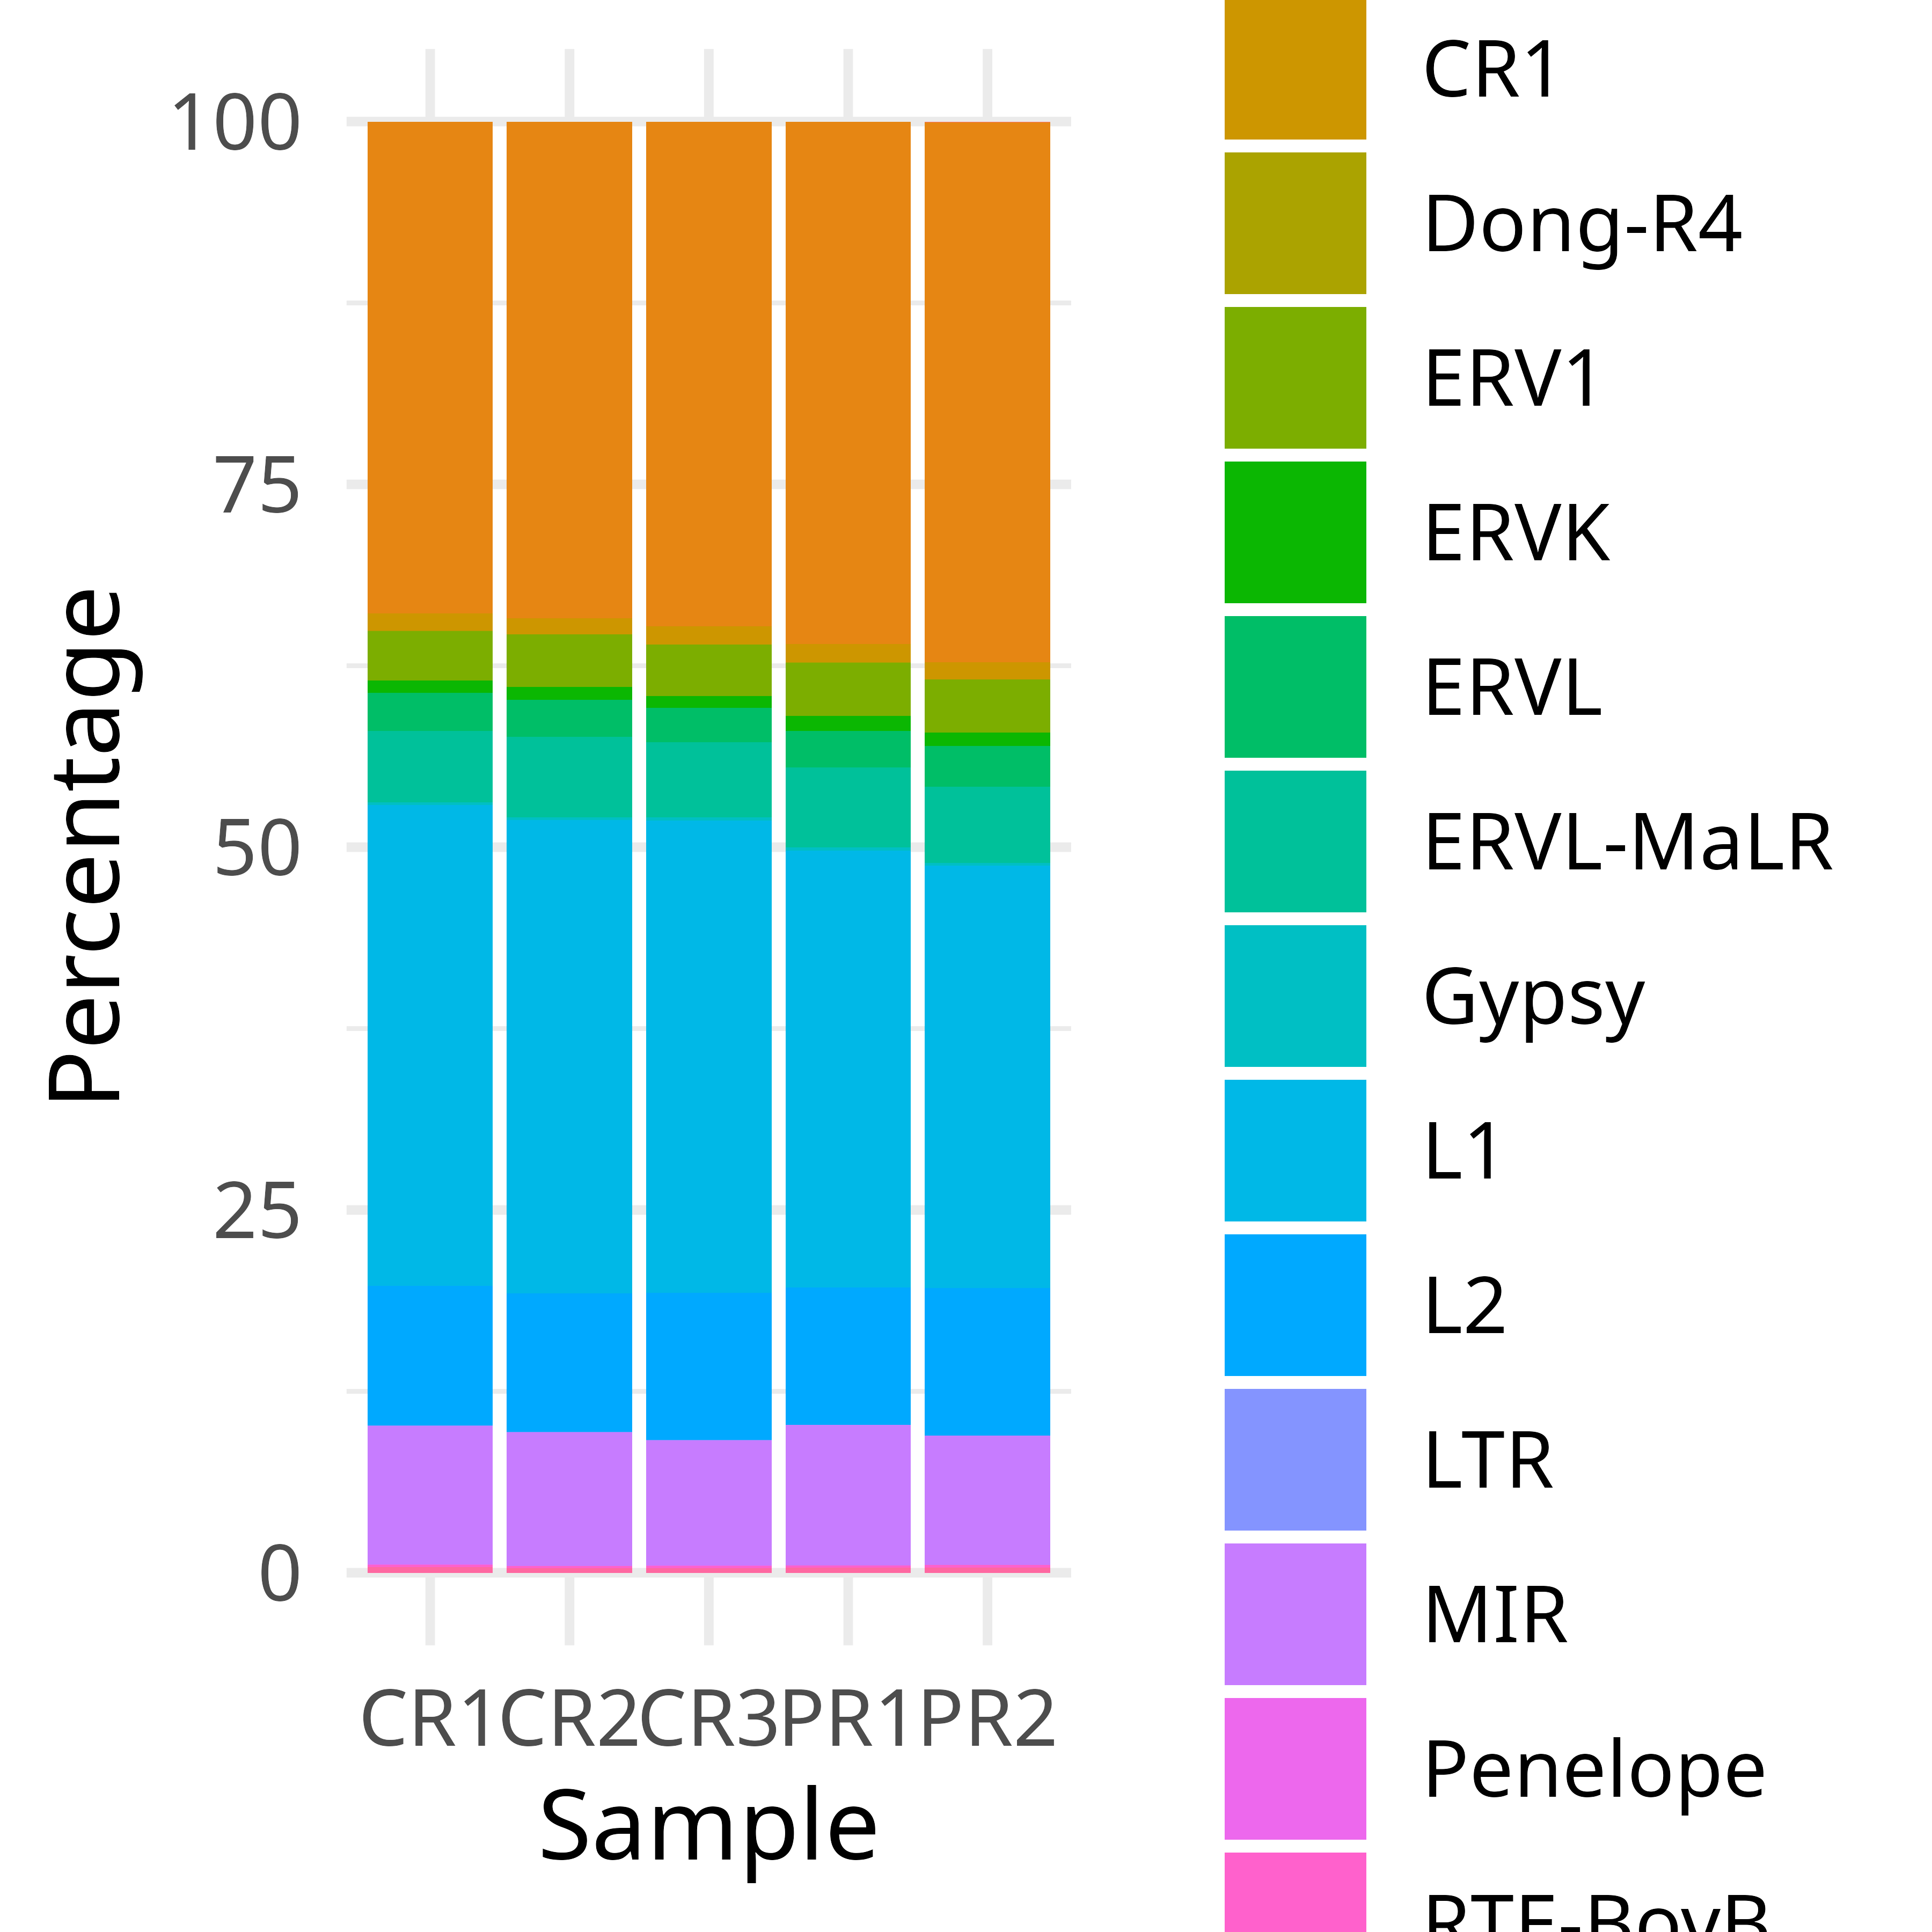
My retrotransposons results
LINE elements appear slightly upregulated in samples from complete remission
(p < 0.001)
Specifically, the L1 family (p < 0.001).

Slide 29
Conclusions
All LLMs can generate convincingly looking code
Cloud based ones are better than tested local ones, but all fail
Not much difference between reasoning and non reasoning models, both fail
Cloud ones generate whole files, local ones generate instructions
No issues for extremely common tasks (e.g. STAR, DESeq)
Slightly less common tasks (TE quantification) fail
Without some knowledge it is easy to get into unresolvable loop
It is much more work to correct AI generated code than writing it
I still has to work - at least for next few months

Slide 30
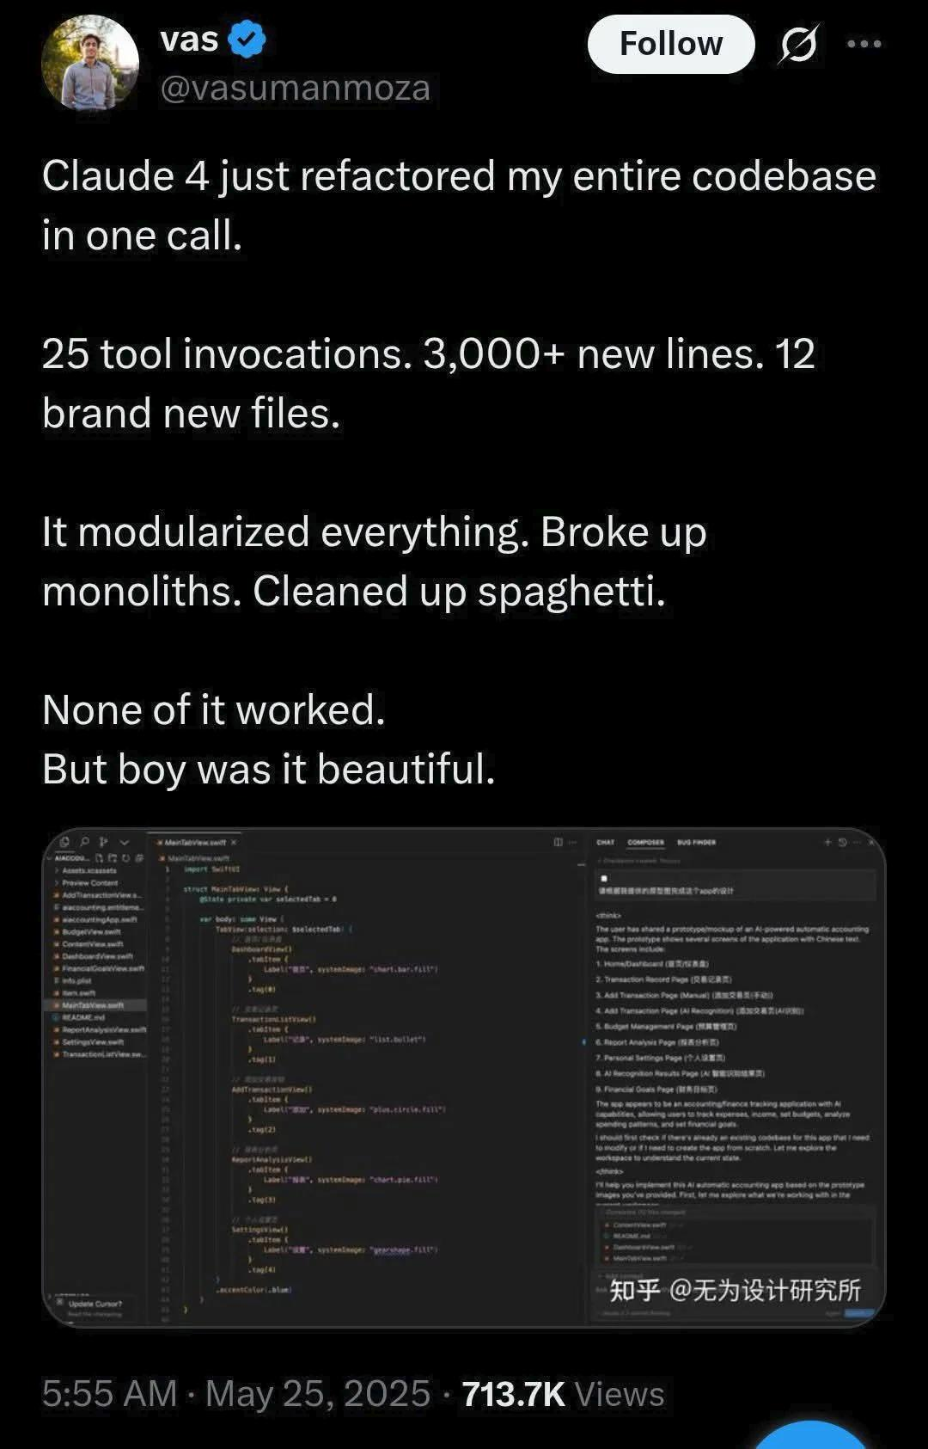

Slide 31
Thank you for your attention
Mgr. Monika Holubová, PhD Mgr. Robin Klieber MUDr. Dekojová Tereza
Supported by the Ministry of Health of the Czech Republic in cooperation with the Czech Health Research Council under project No. NW24-03-00079.

