Slide 1
QSPRpred, Spock and DrugEx: Developing an Open Source Ecosystem for Cheminformatics
Martin Šícho (Martin.Sicho@vscht.cz) – ENBIK 2025 – 2025-09-06

Slide 2
Cheminformatics Workflows are Complex
Generative Model
Generated Library
Virtual Screening Library
Data Source
Machine Learning
Structure Processing
Exploratory Analysis
QSAR Model
Structure Processing
Tautomers/Protomers
Conformer Generation
Pharmacophore Model
Results Analysis and Processing
Molecular Docking
Tautomers/Protomers
Conformer Generation
Results Analysis and Processing

Slide 3
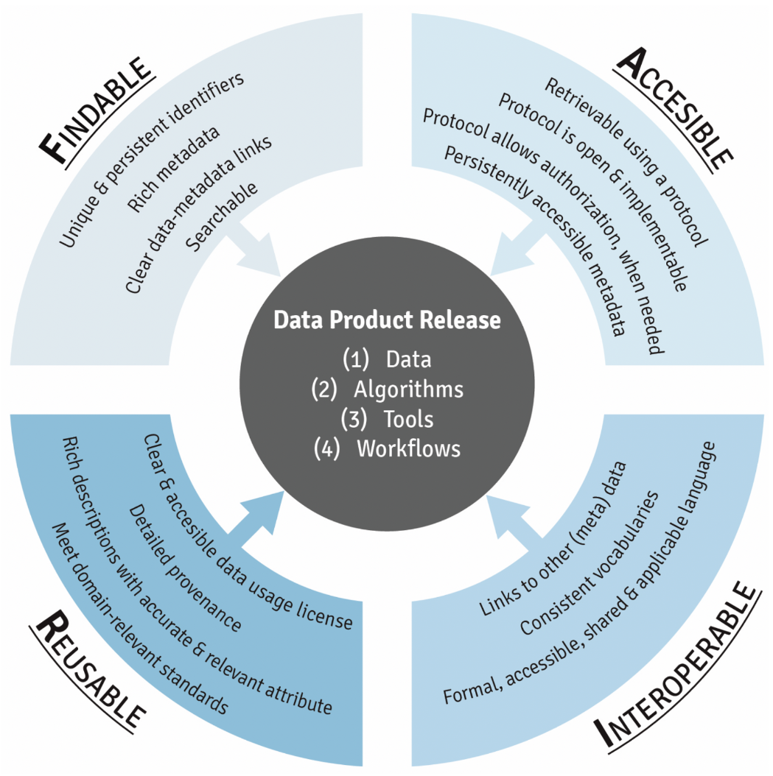
Problems with Scientific Software and Data
Common problems: data management and software development practices
poorly documented
poorly structured (i.e. lack of encapsulation, no installable package)
improperly tested (i.e. small errors often lead to big problems for the users)
→ not reusable and interoperable
Practical complications
steep learning curve for newcomers (i.e. students)
low adoption of novel innovative methods
reinventing the wheel
communication issues
Barker, M., Chue Hong, N.P., Katz, D.S. et al. Introducing the FAIR Principles for research software. Sci Data 9, 622 (2022). https://doi.org/10.1038/s41597-022-01710-x

Slide 4
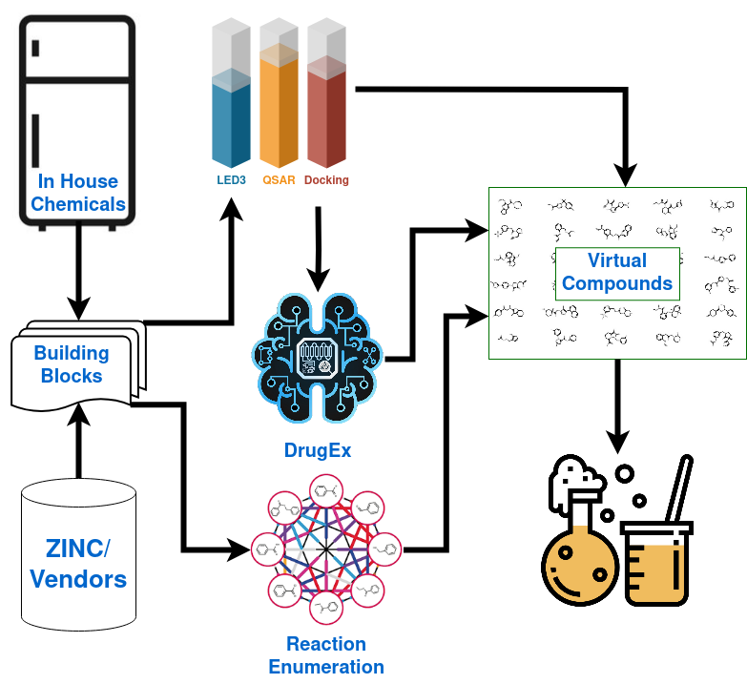
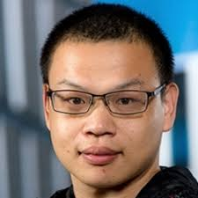
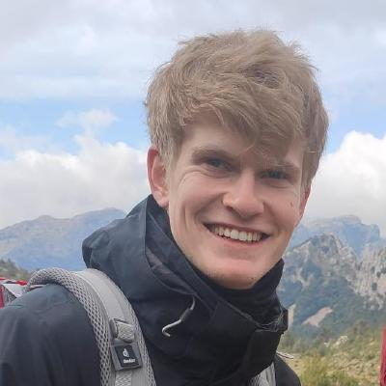
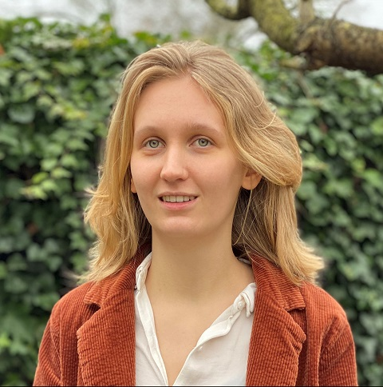
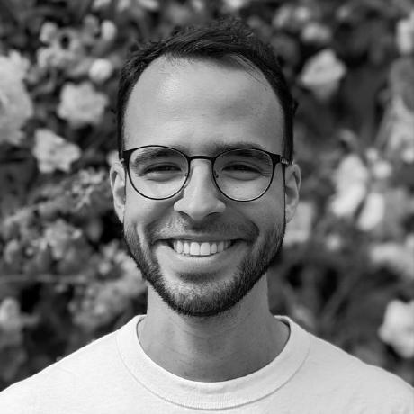
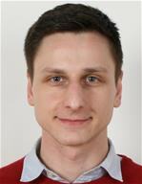
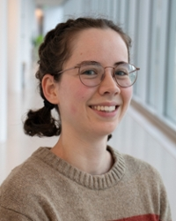
Postdoc Mission: Practical De Novo Drug Design
DrugEx (Molecular Generation)¹
https://github.com/CDDLeiden/DrugEx
LED3Score (SA Scoring)²
https://github.com/AlanHassen/led3_score
QSPRPred (QSPR Modelling)³
https://github.com/CDDLeiden/QSPRPred
Spock (Molecular Docking/SBDD)⁴
https://github.com/CDDLeiden/spock
GenUI (GUI)
https://github.com/martin-sicho/genui
1. Šícho M, Luukkonen S, van den Maagdenberg HW, Schoenmaker L, Béquignon OJM, van Westen GJP. DrugEx: Deep Learning Models and Tools for Exploration of Drug-Like Chemical Space. J Chem Inf Model. 2023 Jun 26;63(12):3629-3636. doi: 10.1021/acs.jcim.3c00434. Epub 2023 Jun 5. PMID: 37272707; PMCID: PMC10306259.
2. Hassen, A.K., Šícho, M., van Aalst, Y.J. et al. Generate what you can make: achieving in-house synthesizability with readily available resources in de novo drug design. J Cheminform 17, 41 (2025). https://doi.org/10.1186/s13321-024-00910-4
3. van den Maagdenberg, H.W., Šícho, M., Araripe, D.A. et al. QSPRpred: a Flexible Open-Source Quantitative Structure-Property Relationship Modelling Tool. J Cheminform 16, 128 (2024). https://doi.org/10.1186/s13321-024-00908-y
4. In preparation
Notes:
LED3 = Leiden Early Drug Discovery & Development

Slide 5
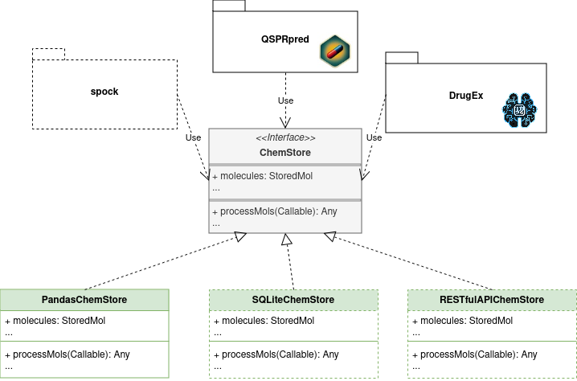
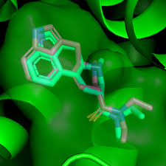
Open Source Software Stack for Cheminformatics
https://github.com/CDDLeiden/
Findable
unique and persistent identifiers
rich metadata
searchable
Accessible
retrievable using a protocol (i.e. JSON for metadata)
metadata is persistent and always readable
Interoperable
modular encapsulated code with documented APIs
Reusable
installable packages
integrated pipelines
automatic and transparent testing

Slide 6
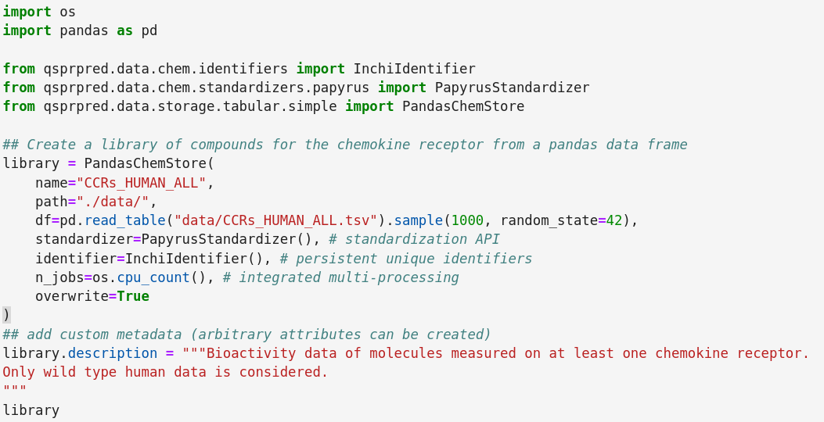
Data Storages

Slide 7
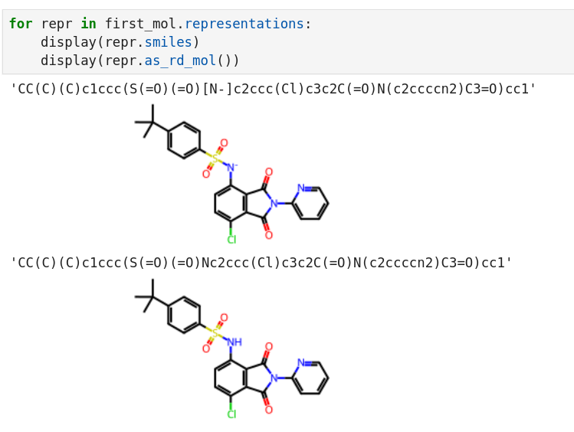
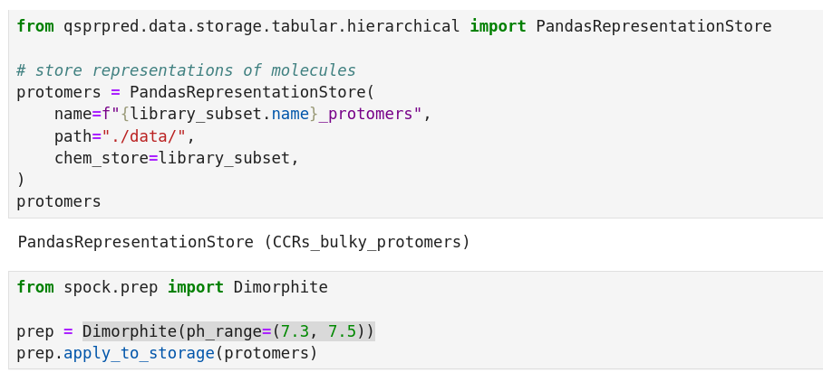
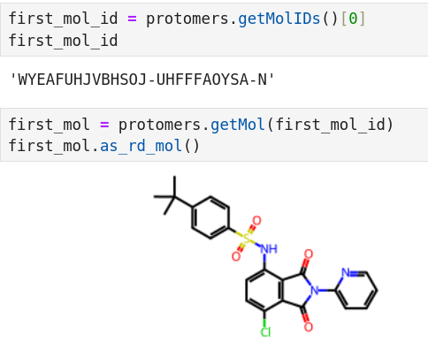
Molecule Repesentations

Slide 8
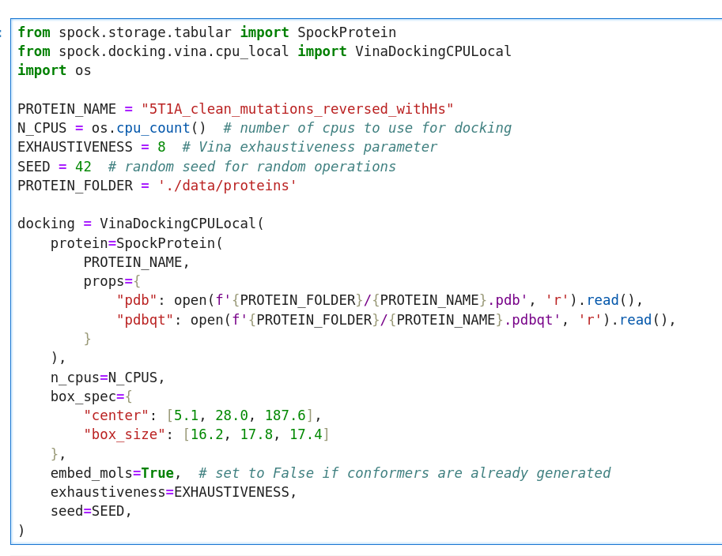
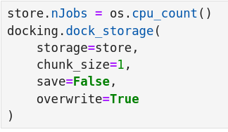
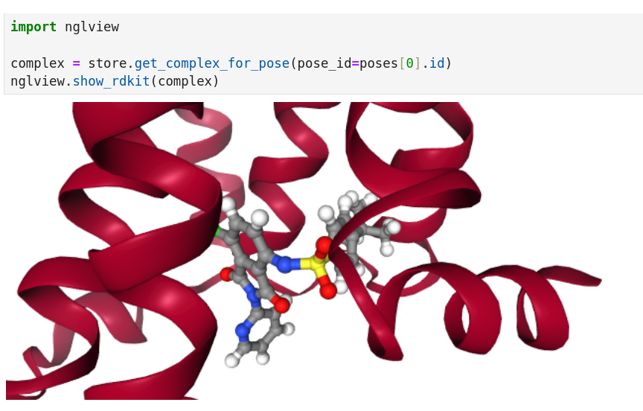
Docking with Spock

Slide 9
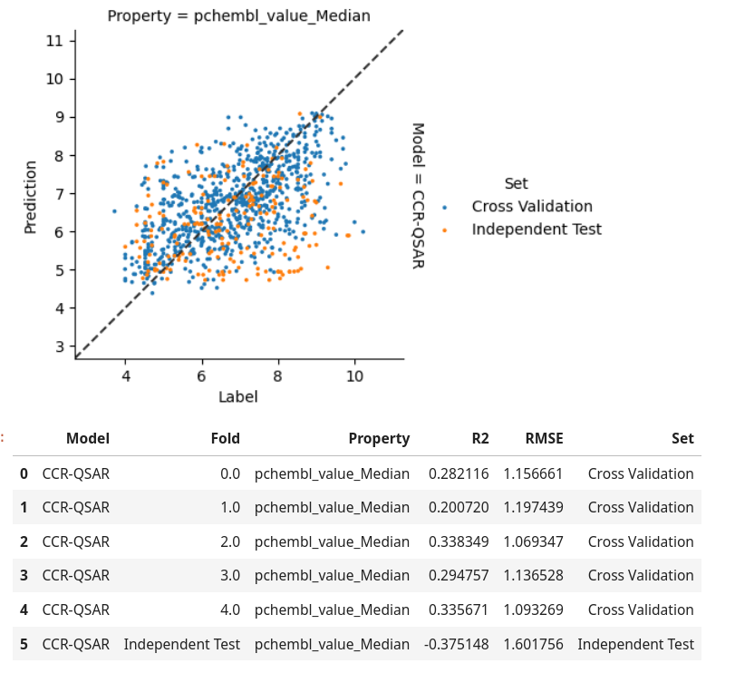
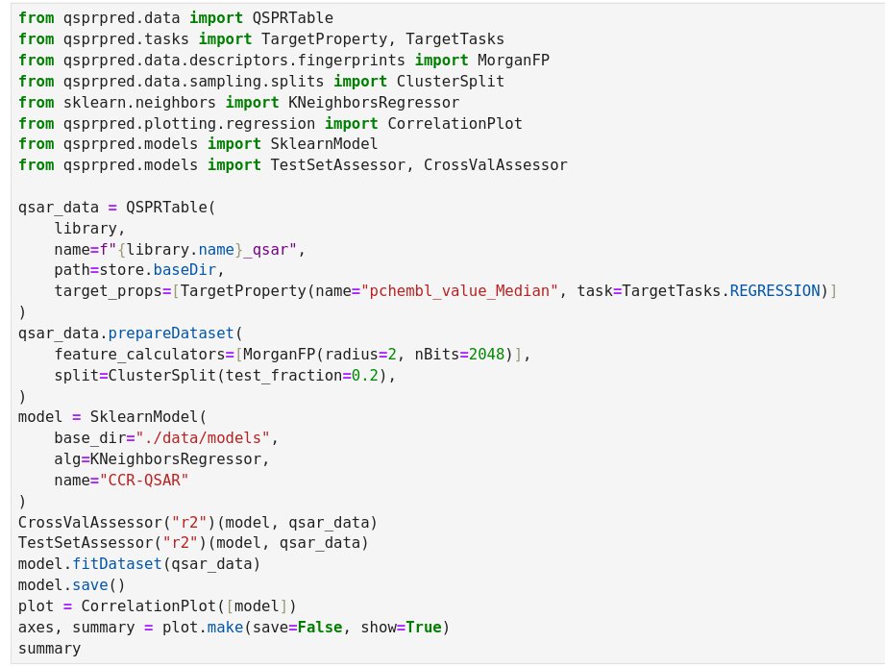
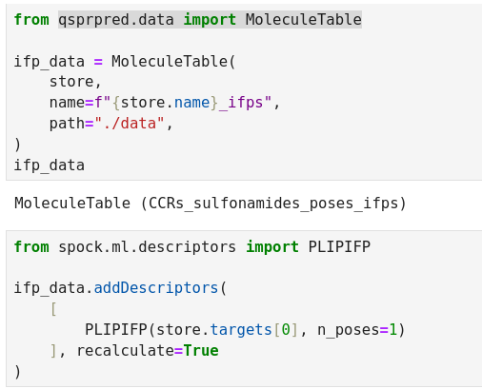
QSAR Modelling

Slide 10
Conclusions
It takes effort and time to balance good data management and software development practices, but the benefits may be worth it:
Communication (everyone uses the same tool stack).
It is easy to pick up old work or someone else’s work.
Centralizing code prevents reinventing the wheel.
New users learn faster.
Lessons learned
Research output does not have to suffer when software development responsibilities are shared.
Regular software development meetings are essential to set priorities and divide responsibilities.
Insisting on documentation and tutorials pays off.
Hard at first, but pays off later.
Future Directions
Looking for partners to help with development and add new methods.
demo notebook

Slide 11
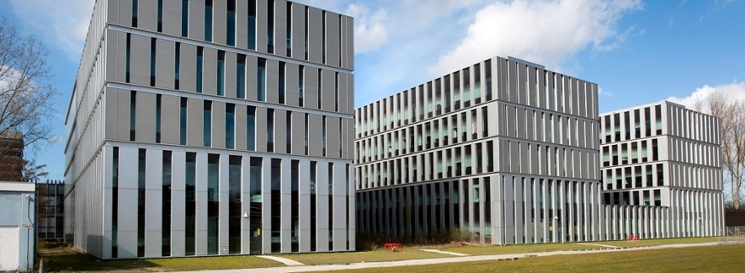
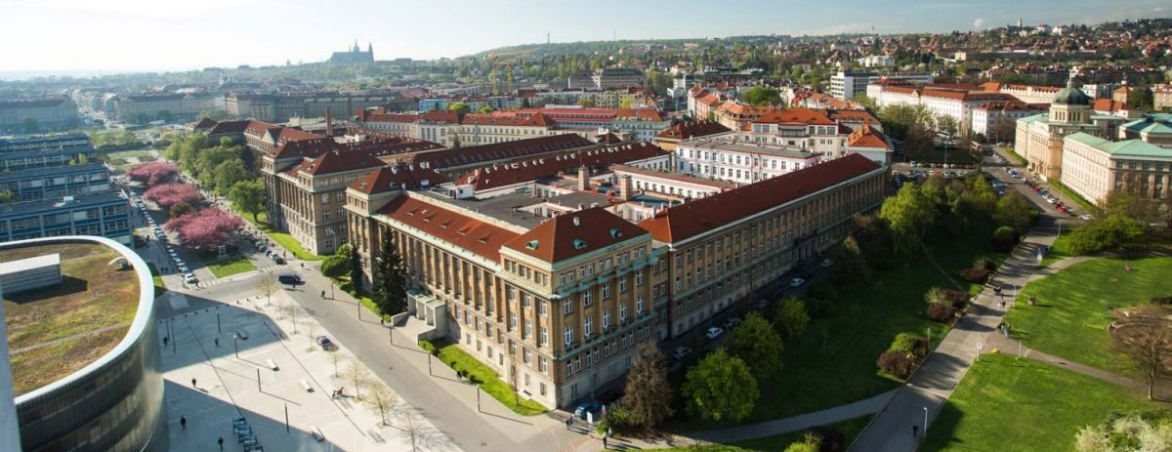
Acknowledgments
LACDR Colleagues
Supervisors & Consultants:
Gerard van Westen
Willem Jespers
Anthe Janssen
Laura Heitman
Postdocs
Sohvi Luukkonen
LACDR Students
PhD Students
Helle van den Maagdenberg
Olivier Béquignon
Alan Kai Hassen
Andrius Bernatavicius
Yorick van Aalst
Remco van den Broek
Master Students
Chara Spyropoulou
Sem Egbers
VŠCHT DICH
Daniel Svozil
Wim Dehaen
Valeria Fil
Petr Palivec
Jozef Fulop
Asia Ceklarz
GitHub

Slide 12
Thank you.

